Slide 1
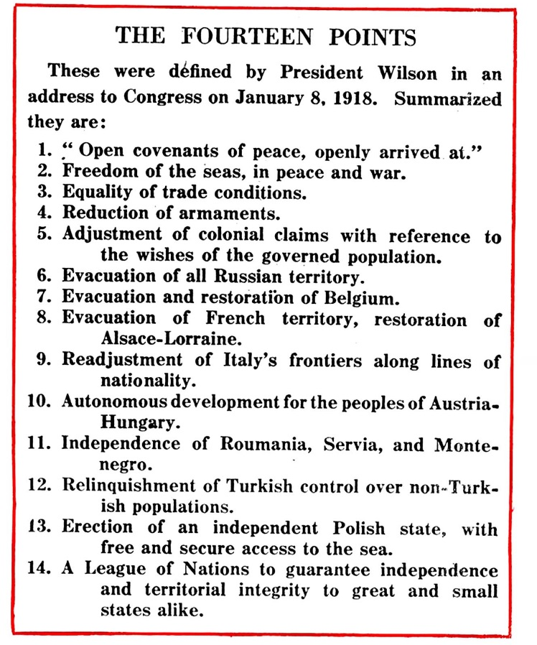

Slide 2
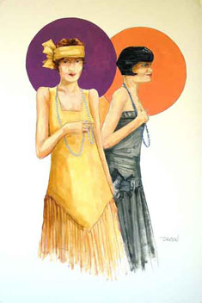
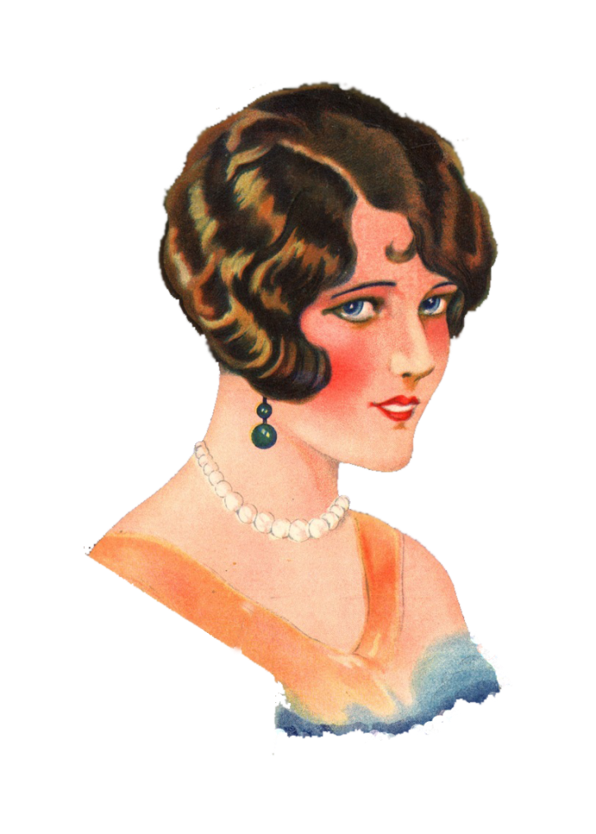
The
1920’s

Slide 3
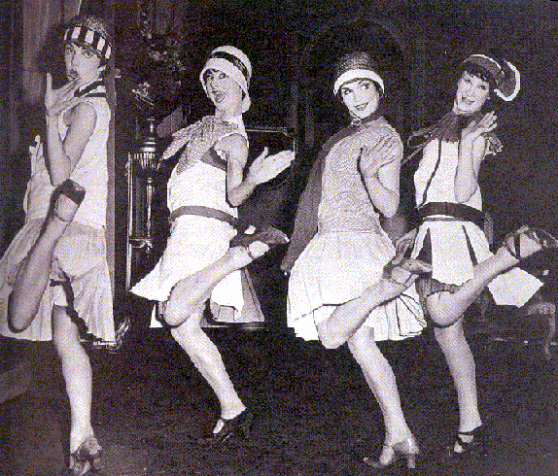
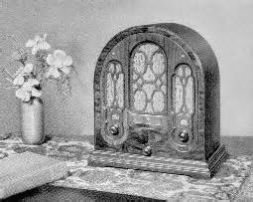
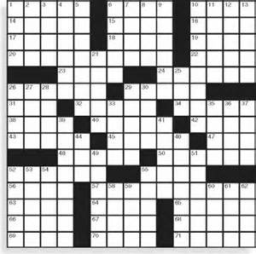
FADS
What is a fad?
Fad: a large portion of the population becomes interested in a new item or style that only lasts for a limited amount of time.
Trend: a growing movement towards a certain style or idea. A trend is more long term than a fad.

Slide 4
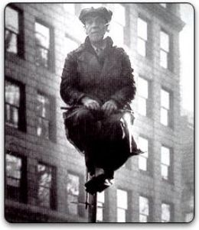
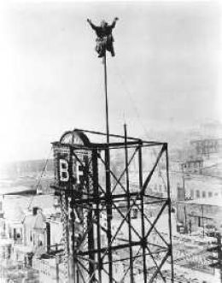
FLAG POLE SITTING
Flag pole sitting was used as a marketing ploy.
Alvin Shipwreck Kelly held the record for sitting 23 days, 7 hours with food and drink lifted to him in a bucket.

Slide 5
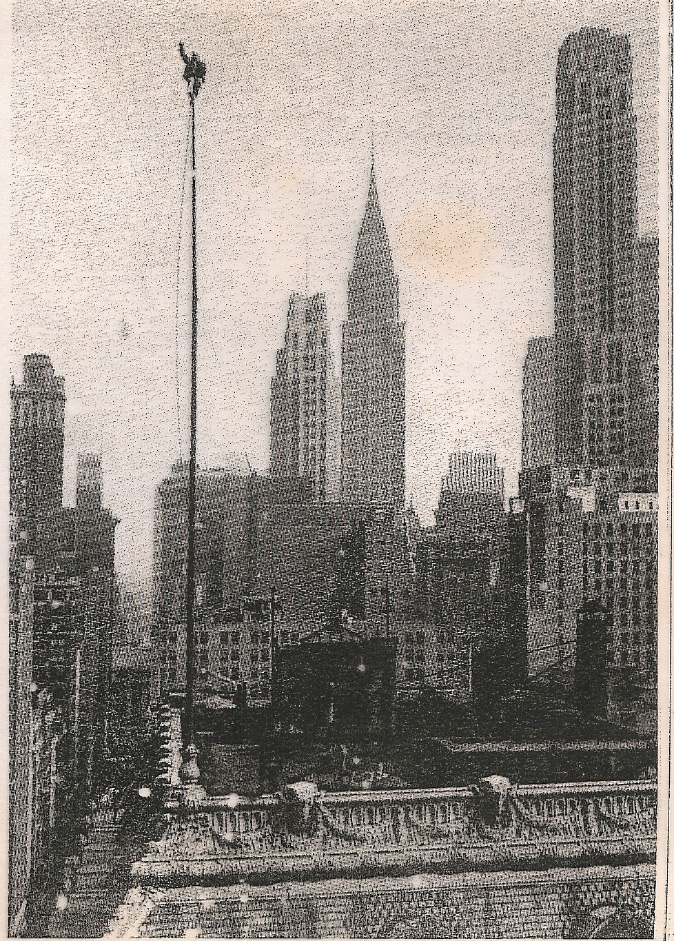

Slide 6
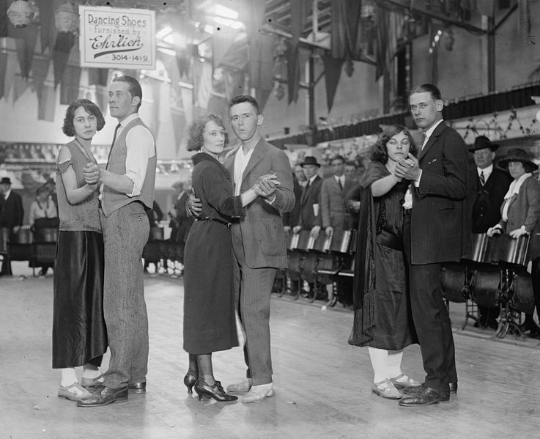
MARATHON DANCING
Marathon Dancing was popular in the 1920’s and 1930’s.
The record was 5,148 hours and 28 minutes.
You danced until you dropped.

Slide 8
GOLDFISH SWALLOWING
How many live goldfish can you swallow?
Popular game for college students.

Slide 9
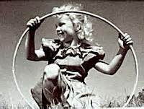
Fads Through the Decades
1950’s:
hula hoop, phone booth stuffing, poodle skirts, saddle shoes, bowling shirts, greased hair, leather jackets, white t-shirt.
1960’/70’s:
Bell bottoms, long hair, peace sign, tye dye, big collars, mini-skirts, lava lamps, sideburns.
1980’s:
Parachute pants, feathered hair, neon, rubix cube, Madonna look, Michael Jackson look, 50’s comeback, hairspray, lots of make up, cinched jeans…

Slide 10
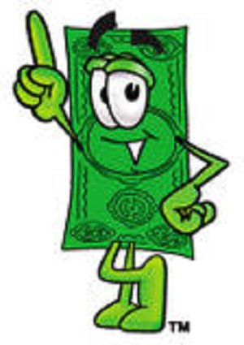
CONSUMERISM
America was experiencing an economic boom during the 1920’s.
Wages were rising, people had more money to spend, and there were more things to buy.
A consumer economy depends on a large number of people buying a large number of products.
Production quotas are based on the amount being bought by the public.
During the 1920's production could not meet demand. Factories had problems switching from war goods to consumer goods.

Slide 11
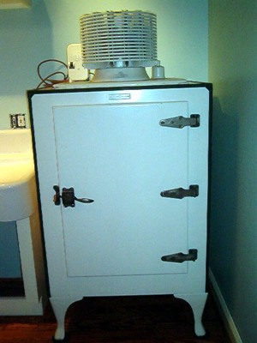
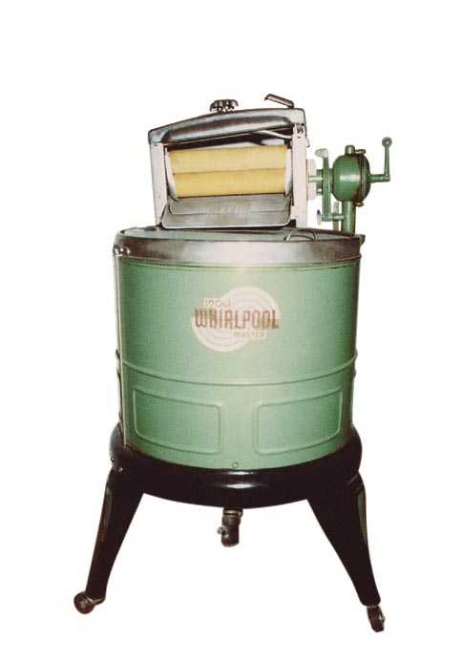
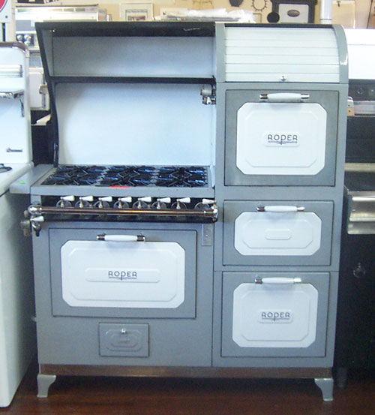
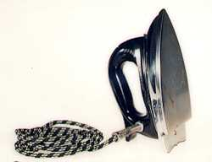
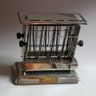
New Technology

Slide 12
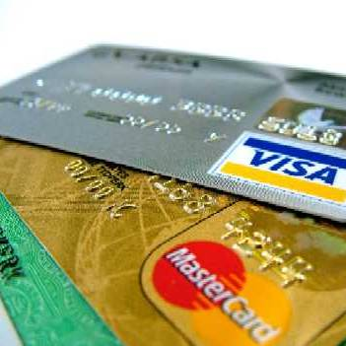
Credit Cards
Consumers could pay for a product with a metal plated card and a certain amount of credit.
Installment Plan: the consumer makes partial payments at select intervals over a period of time.
Debt: owing more than you can pay back.

Slide 13
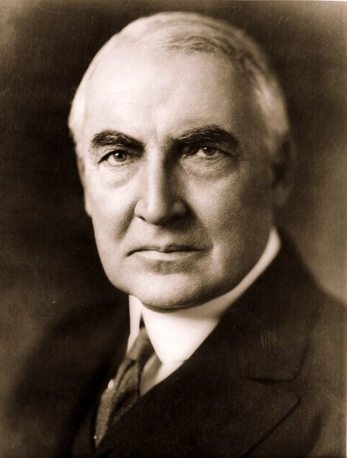
Politics in the 1920’s
Laissez-Faire: the policy of the government staying out of business.
Warren G. Harding
Calvin Coolidge

Slide 14
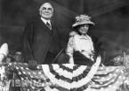
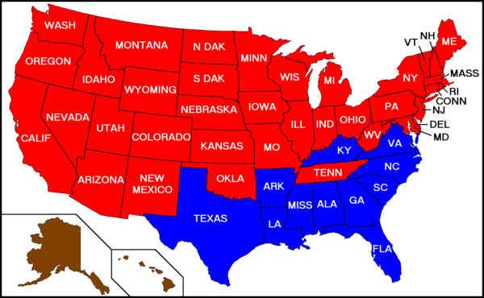
Harding: Election of 1920
Harding was the Republican candidate from Ohio who promised little interference from the government in the country’s affairs.
He promised “normalcy” after the war. Harding won a landslide victory in the election.
The 1920 election was the first election in which women had the right to vote.

Slide 15
Ohio Gang
Warren G. Harding once said:
“This is a terrible job. I have no trouble with my enemies. But my friends… they’re the ones who keep me walking the floors at night.”
When Harding became president he brought with him to Washington many of his friends and political advisors from Ohio.
He saw many of these men as loyal friends and advisors who would strengthen his administration.

Slide 16
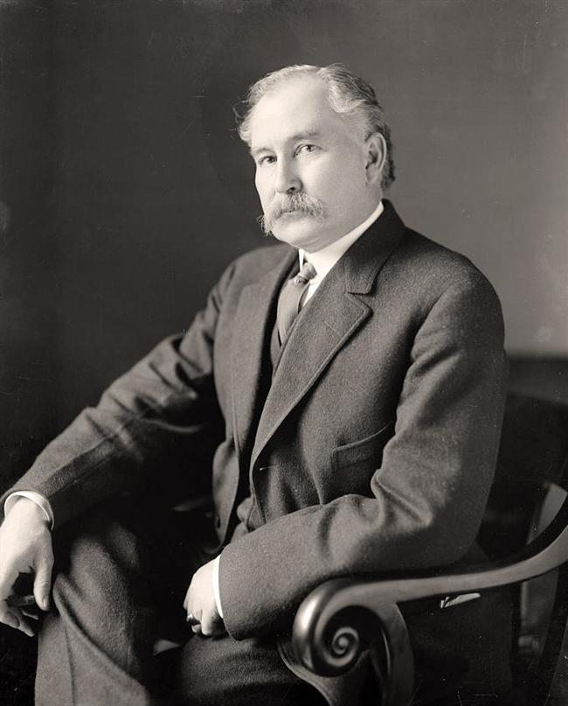
Death of Harding
In 1923 Harding’s health began to fail. In August he collapsed and died from a cerebral hemorrhage.
The reports of scandals will appear after his death.
Several senators became suspicious of the luxurious lifestyle led by the Secretary of the Interior, Albert Fall.
Fall convinced the Secretary of the Navy to transfer oil rich land in Teapot Dome, Wyoming to the Department of the Interior.
Albert Fall

Slide 17
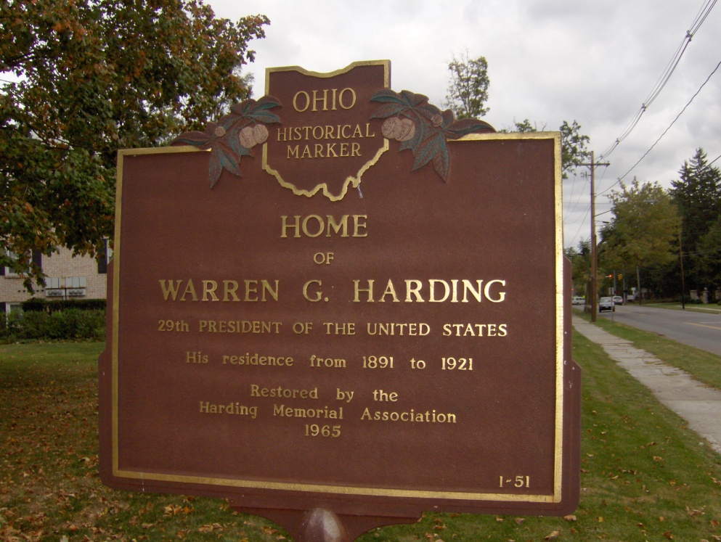
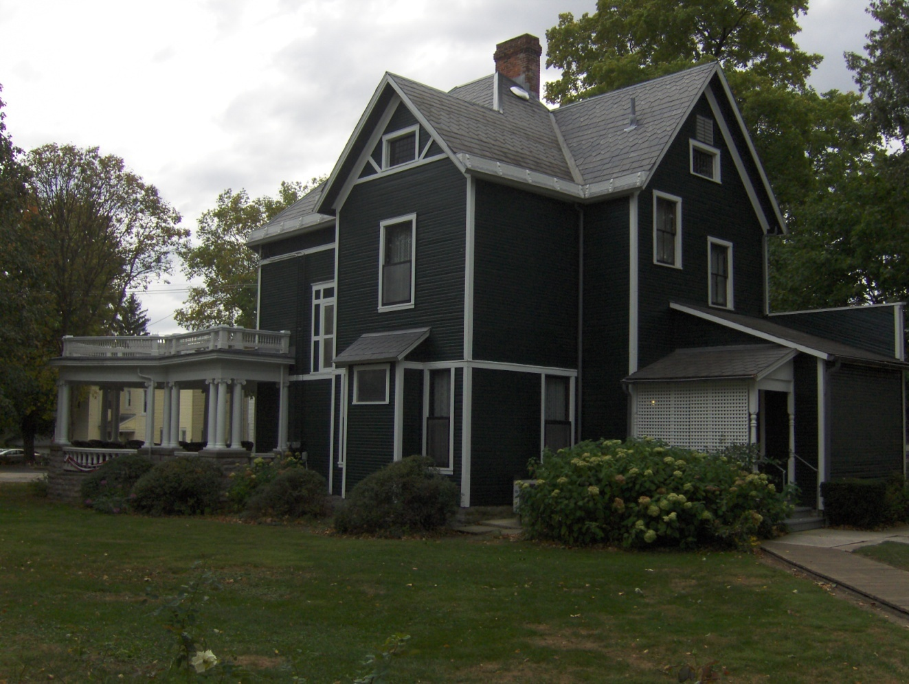
Harding: Ohio President

Slide 18
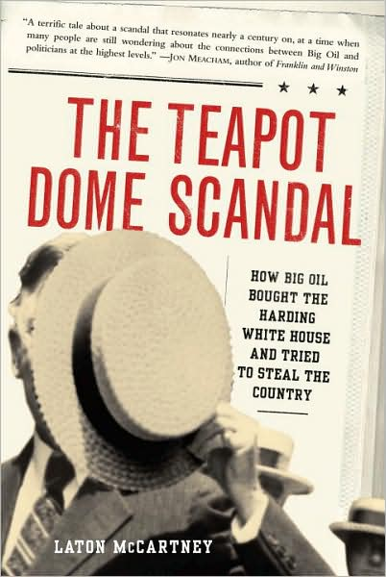
Teapot Dome Scandal
The land had been reserved for the navy. Fall leased it out to private business interests.
This agreement allowed Fall to make $200,000 in government bonds and $185,000 in cash.
When Fall was caught he was linked to Harding’s administration which would gain a bad reputation because of the scandal. Fall will later go to jail for his role in the scandal.
There was no evidence that the president had any involvement in the scandals.

Slide 19
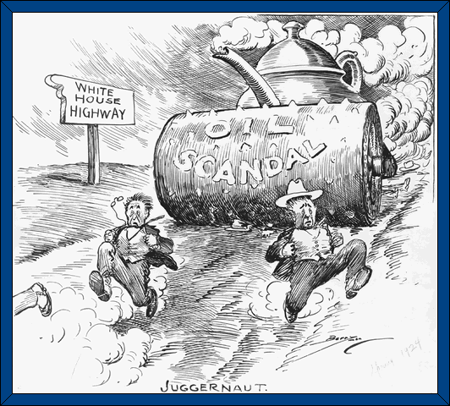

Slide 20
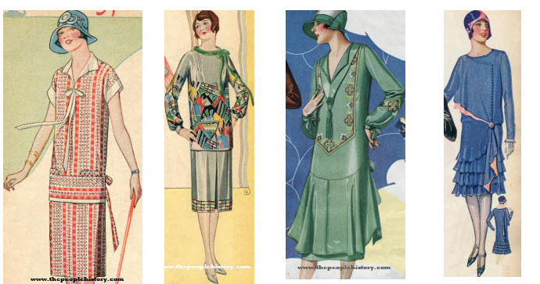
WOMEN
In the 1920’s women will go through a transformation from what was considered the “Victorian Woman” to the “Modern Woman”.
Clothing styles will change, hair length, and expectations.

Slide 21
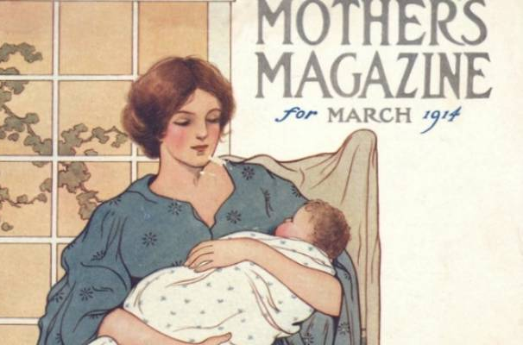
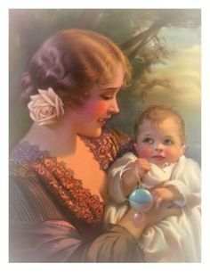
MOTHERHOOD REDEFINED
After World War I, behaviorists such as John B. Watson, challenged the assumption that women had an instinctive capacity for motherhood.
Women began to see their relationships with their husbands as more than just for the purpose of procreation.

Slide 22
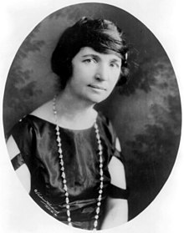
MARGARET SANGER
In the early 20th century, at a time when matters surrounding family planning or women’s healthcare were not spoken in public, Margaret Sanger founded the birth control movement and became an outspoken and life-long advocate for women’s reproductive rights.
In her later life, Sanger spearheaded the effort that resulted in the modern birth control pill by 1960.

Slide 23
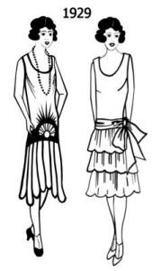
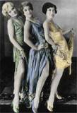
Flappers
Flappers challenged the ideas of the Victorian woman.
Short Skirts
Short Hair
Long Bead
Rebellious
Drink and Smoke in Public

Slide 24
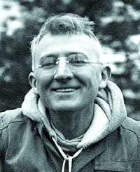
DALE CARNEGIE
Dale Carnegie was an American writer and lecturer, and the developer of famous courses in self-improvement, salesmanship, corporate training, public speaking, and interpersonal skills.

Slide 25
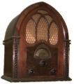
The Radio
The 1920’s saw the birth of one of the most influential forms of communication of the century.
In November 1920 the first radio broadcast was made. By the end of the decade more than one million families in America had radios.
The radio will create a common identity and culture amongst Americans.

Slide 26
The Hindenburg
Some of radio’s greatest moments occurred as a reporter
commented live at an event where something unexpected
happened.
On May 6, 1937 in Lakehurst, New Jersey a huge German Zepplin, the graf Hindenburg was scheduled to land.
The ship was supposed to represent the greatness of the
German Reich and it leader Adolf Hitler.
The early part of the recording was Herb Morrison giving
background information about the airship.

Slide 27
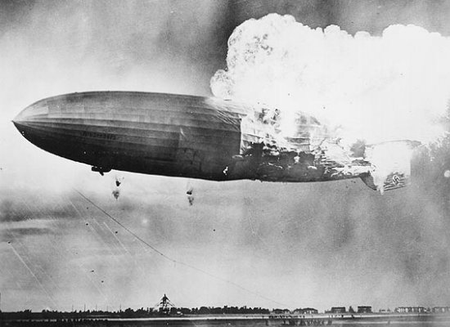
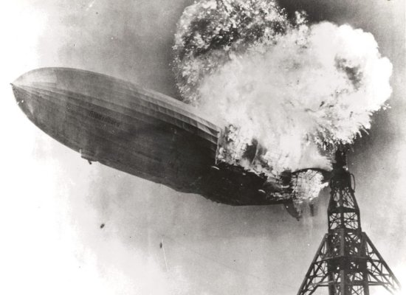
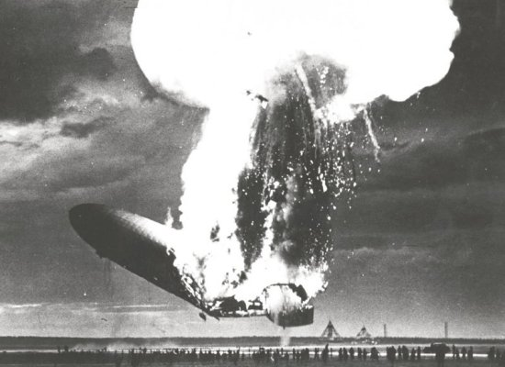
At 7:25, a few witnesses saw the fabric ahead of the upper fin flutter as if gas were leaking. Witnesses also reported seeing blue discharges—possibly static electricity—moments before the fire on top and in the back of the ship near the point where the flames first appeared.

Slide 28
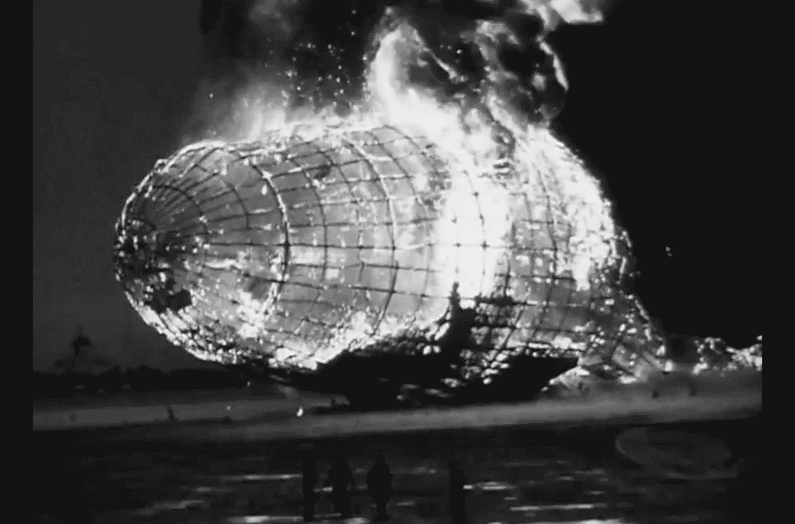
Of the 97 people on board, 35 people died. There was one additional fatality on the ground.

Slide 29
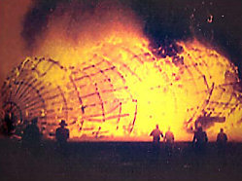
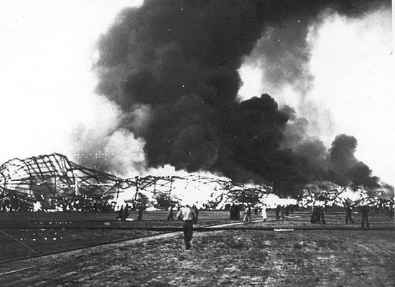

Slide 32
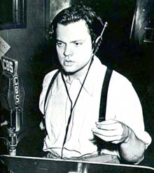
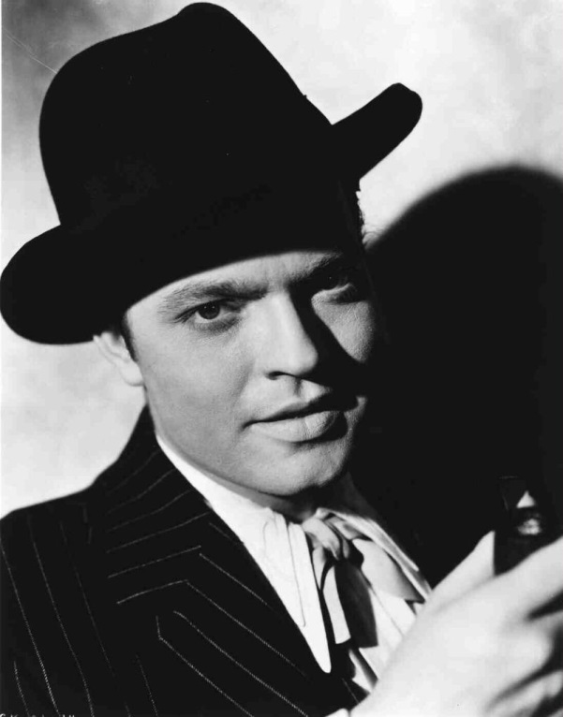
War of the Worlds
On Halloween 1938, Orson Welles produced a play called Invasion from Mars.
Welles played a frightened and horrified news reporter who was describing the landing of spaceship full of Martians who were going on a killing spree.
People who tuned in to the program after it was in progress were caught off guard.
Welles was so convincing in his descriptions that many people believed that it was an actual report.

Slide 33
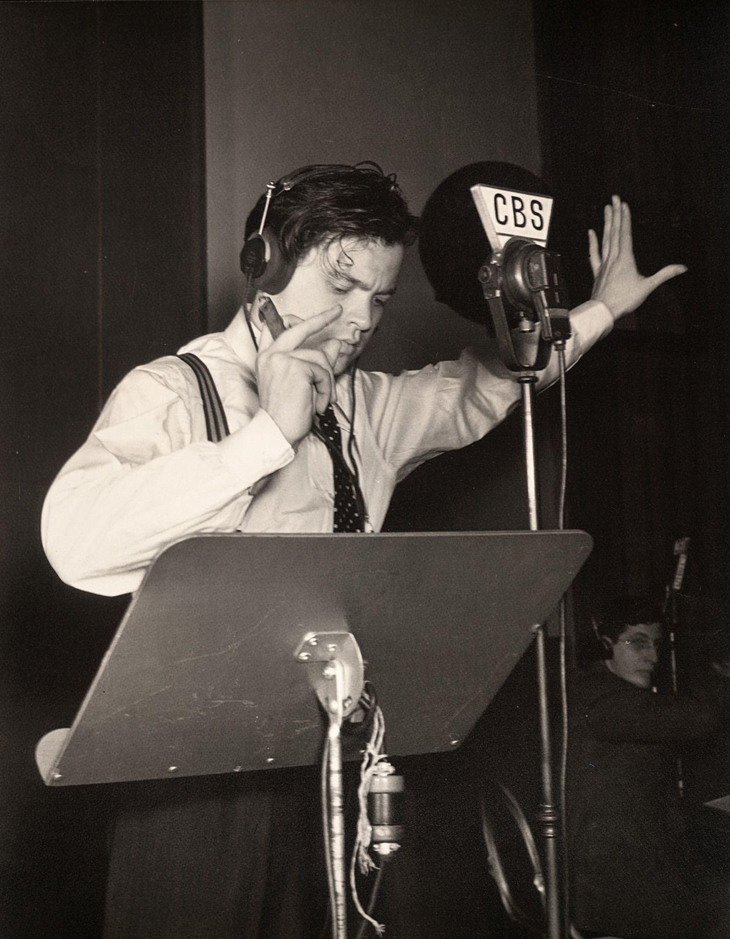
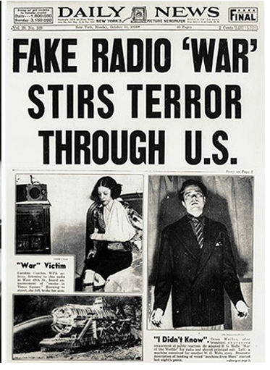

Slide 34
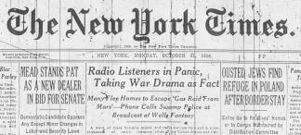
War of the Worlds
There were no disclaimers before the program aired explaining that it was just a play.
As the news was broadcast thousands of rational adults began to panic.
People ran out of their homes screaming in terror.
Although Welles was reprimanded for his role in the event he was propelled to instant fame.

Slide 35
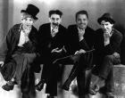
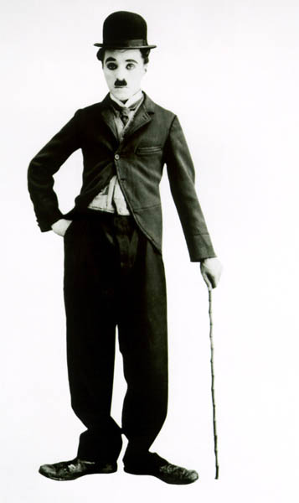
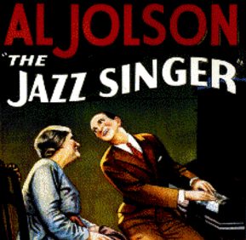
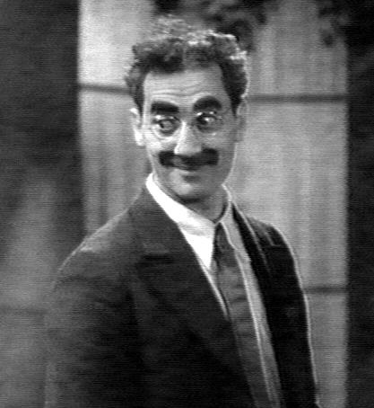
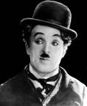
The Movies
Movie theaters became a popular form of entertainment in the 20’s.
The movies were silent. Script was added to follow along with the story line.
In the 1930’s “talkies” were popular.

Slide 36
THE JAZZ SINGER
The first full feature “talkie” was The Jazz Singer with Al Jolson.
The use of performing in black face was still common in this era.

Slide 37
COMICS
In 1924, Ethel Hayes started a single panel, daily comic strip called Flapper Fanny Says that was published in multiple different newspapers from its launch.
Flapper Fanny came to be one of the most influential comics in the 20s through her feminine wit.
Another large comic strip icon that started is Popeye the Sailor Man.
Popeye was created by E.C. Segar for his comic strip Thimble Theatre.

Slide 38
STEREOTYPES IN FILM
Women will be portrayed overwhelmingly as wives and mothers.
Few films included African American characters.
Most black characters were portrayed as servants, farmhands, or entertainers.

Slide 39
Heroes
Of the 1920’s

Slide 40
Charles Lindbergh
Charles Lindbergh was drawn to aviation’s biggest prize: $25,000, offered by a New York hotel owner for the first successful flight from New York to Paris.
With backing from some businessmen from St. Louis and $2,000 of his own money Lindbergh ordered a plane to built to his specifications.
He named the plane the Spirit of St. Louis. It took him 33 1/2 hours to fly the first non-stop flight from New York to Paris.
He became and instant national hero.

Slide 41
SPORTS
In the 1920’s sports became and obsession.
A combination of more money, more leisure time, and the freedom of the road led to more time to enjoy sports.

Slide 42
Babe Ruth
60 Homeruns in one season.
He became a hero when baseball was struggling to overcome a huge scandal.
The Black Sox Scandal
He became a national hero and
was used by several companies for
advertising.
He could pitch, hit, and run.

Slide 43
Red Grange
Red Grange was a player for the University of Illinois.
In one game he scored four touchdowns in five minutes and rushed 263 yards.
He became an instant hero.

Slide 44
Gertrude Ederle
In the summer of 1926, young woman dominated the sports headlines.
Ederle became the first woman to swim the English Channel.
She beat the record of the fastest man by two hours.
She had 29 different national and world titles.

Slide 45
Lost Generation
The "Lost Generation" was the generation that came of age during World War I. The term was popularized by Ernest Hemingway who used it as one of two contrasting epigraphs for his novel, The Sun Also Rises.
In that volume Hemingway credits the phrase to Gertrude Stein, who was then his mentor and patron.
She picked up the phrase from someone describing the men who fought in WWI.

Slide 46
LIFE MAGAZINE
Life Magazine was first published in 1936.
It had the largest readership than any magazine other than Reader’s Digest.
It devoted attention to economics and politics during the Depression.

Slide 47
Jazz

Slide 48
The Jazz Age
Jazz music grew out of the African American music of the South. It combines blues and ragtime with a process of improvisation.
The artists are able to make up the music as they play rather than relying on printed scores.
In the 1920’s Jazz became a nationwide craze. A survey suggests that two-thirds of all radio time was spent playing Jazz.

Slide 49
Harlem Renaissance
One of the hottest places to listen to Jazz was Harlem. This is where many young Jazz musicians could make their mark. Greats like Louis Armstrong and Duke Ellington became legends.
By a count at one time Harlem had 500 Jazz Clubs. The Cotton Club was one of the most famous of these Jazz Clubs.

Slide 50
LANGSTON HUGHES
Langston Hughes was an American poet, social activist, novelist, playwright, and columnist from Joplin, Missouri. He moved to New York City as a young man, where he made his career.
He was one of the earliest innovators of the then-new literary art form called jazz poetry.
Leader of Harlem Renaissance.

Slide 51
A Dream Deferred By: Langston Hughes
What happens to a dream deferred?
Does it dry up like a raisin in the sun? Or fester like a sore-- And then run? Does it stink like rotten meat? Or crust and sugar over-- like a syrupy sweet?
Maybe it just sags like a heavy load.
Or does it explode?

Slide 52
Marcus Garvey
Some African Americans, frustrated by continued violence and discrimination, dreamed of a new homeland where they could live in peace.
The leader of the activist movement to make this a reality was Marcus Garvey.
Garvey was a Jamaican immigrant who argued that white America would never treat African Americans equally.
He urged African Americans to look within their own culture for dignity and pride.

Slide 53
Back to Africa
In 1919 four million people paid dues to his society. Garvey set up the Black Star Line Steamship to provide transportation to African Americans back to Africa.
The trip was never realized, Garvey went bankrupt, he was soon convicted of defrauding his followers and he was deported.
Garvey’s ideas remained an inspiration to later “black pride” movements of the 1960’s.

Slide 54
Black Nationalism
The repatriation of African-American slaves to Liberia or Sierra Leone was a common black nationalist theme in the 19th century.
Marcus Garvey's Universal Negro Improvement Association of the 1910s and 1920s was the most powerful black nationalist movement to date, claiming millions of members.

Slide 55
Chicago Race Riot: Red Summer
On July 27, 1919, an African-American teenager drowned in Lake Michigan after violating the unofficial segregation of Chicago’s beaches and being stoned by a group of white youths.
His death, and the police’s refusal to arrest the white man whom eyewitnesses identified as causing it, sparked a week of rioting between gangs of black and white Chicagoans, concentrated on the South Side neighborhood surrounding the stockyards.

Slide 56
Ku Klux Klan
The Klan was brought back to life in 1915 by William J. Simmons, a minister and soldier.
Several changes occurred from the Klan of the late 1800’s to the Klan of the 1920’s.
Membership
During the late 1800’s Klan membership and initiation was very secretive.
In the 1920’s people were openly recruited for membership in the Klan. Simmons and two others traveled the country selling $10.00 memberships.

Slide 57
Ku Klux Klan
The old Klan was limited to the South, the new Klan gained strength in small Midwest towns.
The early Klan geared all of its attention towards suppressing the vote of African Americans with violence and intimidation.
The Klan of the 1920’s broadened its attacks to include Jews, Roman Catholics, immigrants, African Americans, and anyone else who did not conform to their standards.

Slide 58
Klan Declines
Klansmen were responsible for floggings, lynchings, branding, and tar and feathering. Many victims of the Klan were African American veteran soldiers from World War I.
The influence of the Klan began to decline in 1925 when the imperial wizard of the Klan in Indiana was convicted of murder.
Most Klansmen believed that they were invincible from the law because most juries would not convict a white male in a crime against an African American.

Slide 59
Birth of a Nation
The film The Birth of a Nation was released, mythologizing and glorifying the first Klan.
This helped recruitment into the Klan in the 1920’s.

Slide 61
African American Migration
Why people migrated:
To escape Jim Crow and the segregated South.
To find jobs in the Northern cities.
To find decent housing.
Results:
More competition for jobs in the North.
More competition for housing in the North.
The growth of the NAACP and other Civil Rights groups.
Less competition for jobs in the South.

Slide 62
Effects of African American Migration
The Great Migration of African-Americans created the first large, urban black communities in the North.
It is conservatively estimated that 400,000 left the South during the two-year period of 1916-1918 to take advantage of a labor shortage created in the wake of the First World War

Slide 63
Scottsboro Boys
The Scottsboro Boys were nine black teenage boys accused of rape in Alabama in 1931.
The landmark set of legal cases from this incident dealt with racism and the right to a fair trial.
The case included a frame-up, an all-white jury, rushed trials, an attempted lynching, an angry mob, and is an example of an overall miscarriage of justice.

Slide 64
The Red Scare
Red Scare was an intense fear of communism and other extreme ideas. The fear included the idea that there was a threat to takeover the government of the United States.
The color red has come to symbolize the idea of communism.
People were quick to take action against anything or anyone who they thought was Anti-American.
People called for Communists in the country to be jailed or driven out of the country.

Slide 66
Communism
A theory of government in which wealth and property are owned in common and production and labor is shared equally among the people.
Lenin made Communism the official ideology of the Soviet Union.

Slide 67
J. Edgar Hoover
Hoover was an American law enforcement administrator and the first Director of the Federal Bureau of Investigation(FBI) of the United States.
He was appointed as the director of the Bureau of Investigation – the FBI's predecessor – in 1924 and was instrumental in founding the FBI in 1935, where he remained director for over 37 years until his death in 1972 at the age of 77.

Slide 68
The Lavender Scare
Cross Dressing
In 1993 a book came out called: The Secret Life of J. Edgar Hoover.
In the book, Summers alleged the Mafia had blackmail material on Hoover, which made Hoover reluctant to pursue organized crime aggressively.
During the Lavender Scare, Cohn and McCarthy further enhanced anti-Communist fervor by suggesting that Communists overseas had convinced several closeted homosexuals within the U.S. government to leak important government information in exchange for the assurance that their sexual identity would remain a secret.

Slide 70
Palmer Raids
The Secretary of Labor ruled that membership in a radical group or organization such as the Communist Party was grounds for deportation.
In November 1919, the Justice Department along with local police would raid the places where they believed alleged radical groups were meeting.
Thousands were arrested, beaten, and forced to confess. The raids violated civil rights because no warrants were used, there was little evidence, and people were denied lawyers.

Slide 71
Sacco and Vanzetti
In May 1920, a shoe factory in Braintree, Massachusetts was robbed and two payroll workers were attacked and killed by two men.
Two Italian immigrants, Nicola Sacco and Bartolomeo Vanzetti were arrested while they protested a friend who died while in police custody.
There was no evidence to link them to the murders.

Slide 72
Sacco and Vanzetti Verdict
Despite the lack of evidence they were convicted of murder and sentenced to death.
Publicity in the newspapers resulted in a movement to have their charges appealed.
The efforts failed and in 1927, Sacco and Vanzetti were executed.

Slide 73
Emergency Quota Act of 1924
The Immigration Act of 1924 limited the number of immigrants allowed entry into the United States through a national origins quota.
The quota provided immigration visas to two percent of the total number of people of each nationality in the United States as of the 1890 national census.

Slide 74
Popular Front Alliances
The Great Depression brought Communism into the light because they were harsh critics of capitalism.
The Popular Front Alliances were coalitions of anti-fascists groups on the left who were mostly Communist.
The driving force behind these groups was Stalin and the Soviet Union.
Stalin hoped that Roosevelt would be an ally against Nazi Germany.

Slide 75
Lincoln Brigade: Spanish Civil War
A group of around 3,000 Americans formed the Lincoln Brigade and traveled to Spain to fight fascism during the Spanish Civil War in the 1930’s.
The American Communist Party was instrumental in forming the Lincoln Brigade and directed many of its activities.

Slide 76
Socialism
The Socialist Party of America said the economic crisis during the Great Depression was evidence of the failure of capitalism.
Led by Norman Thomas.
It attempted to mobilize support from the rural poor.
Hostility towards Communism was high in many levels of the government.

Slide 77
Retreat to Idealism
Idealism in foreign policy holds that a state should make its internal political philosophy the goal of its foreign policy.
For example, an idealist might believe that ending poverty at home should be coupled with tackling poverty abroad. U.S. President Woodrow Wilson was an early advocate of idealism.

Slide 78
WELFARE CAPITALISM
Some employers adopted paternalistic techniques to help their workers that became known as welfare capitalism.
For Example: Henry Ford shortened the work week, raised wages, and instituted paid vacations.
Welfare Capitalism could only survive as long as industry prospered.

Slide 79
American Plan
This was a harsh campaign of union busting.
The American Plan deemed unions to be "un-American, and the resulting anti-union efforts of employers decreased union membership and efficacy until the 1930s.
During World War I, U.S. Steel took a strong anti-union stance in its Chicago mills, calling union organizers "German propagandists."
U.S. Steel also required that steelworkers sign a "Pledge of Patriotism," promising not to strike.

Slide 80
ASIAN AMERICANS
In the West and Southwest there were a large number of Asian immigrants.
In the wake of the Chinese Exclusion Act, Japanese immigrants began filling the unskilled positions left by the Chinese.
Issei: Japanese immigrants, many came over through Hawaii
Nisei: the children of Japanese born immigrants.

Slide 81
1924 Election
Calvin Coolidge succeeded Harding after his unexpected death in 1923.
A short time after he became president he had to prepare for the next election.
Coolidge easily won the election. The American public was happy with Coolidge and his government policies.

Slide 82
Farm Crisis
During WWI they were producing enough food to feed the American people, U.S. Troops, and struggling European nations who were affected by the war.
When the war was over the farmers were still producing war time amounts of food and were left with too much.
The problem was addressed to the U.S. Government but no action was taken to solve the situation.
During the Depression thousands were going hungry in the city while at the same time farmers had more food than they could sell. Many consumers could not afford to buy much food.

Slide 83
Farmers Lose Their Farms
In some cases farmers had no choice but to shoot and bury their livestock and to let their crops rot in the fields.
Farmers could not pay their debts and had their farms repossessed by the bank.

Slide 84
Fundamentalism
Before the teaching of evolution became an issue many Americans were uneasy with social changes. Challenges to traditional beliefs came from many directions.
1. Science and technology
2. War and widespread economic problems.
3. Scholars discussing the possibility of inaccuracies and
contradictions in the Bible.

Slide 85
RELIGION
The issue of religion will highlight the differences between urban and rural views.
Americans will become divided over whether or not evolution should be taught in public schools.
Biblical Creation
vs.
Evolution

Slide 86
Scopes Trial
The Scopes Trial challenged the state’s right to ban the teaching of evolution.
In 1925, Tennessee passed the Butler Act.
John Scopes, a biology teacher, ignored the law and continued to teach evolution.

Slide 87
The Butler Act
An American legal case that tested the Butler Act which made it unlawful "to teach any theory that denies the story of the Divine Creation of man as taught in the Bible, and to teach instead that man has descended from a lower order of animals" in any Tennessee state-funded school and university.

Slide 88
Darrow vs. Bryan
Scopes Lawyer was Clarence Darrow, one of the most famous lawyers in his day.
The state’s lawyer was William Jennings Bryan who was known as a defender of the faith.

Slide 89
The Trial
The Scopes Trial was the first trial to be broadcast on the radio.
Darrow knew the guilt of Scopes was never the issue, it was whether the state had the right to tell him what to teach.
Scopes was found guilty and fined $100.
The judge in the case had a sign behind is head that read:
“READ YOUR BIBLE”

Slide 90
PROHIBITION

Slide 91
The Noble Experiment
On the eve of Prohibition , Americans prepared to greet the future as a dry nation. Saloons were open for the final hours.
People held mock funeral services to mourn the end of alcohol.
The Noble Experiment was meant to reduce drinking and the problems associated with it.
Many believed that Prohibition would help the poor and increase productivity in the workplace.

Slide 92
Women for Prohibition

Slide 93
The 18th Amendment
Prohibition outlawed the manufacture, transport, and sale of alcohol. The 18th Amendment did nothing to prevent people from buying or drinking alcohol.
When the U.S. entered WWI, Prohibition took on a new attitude a patriotic act. People linked alcohol with the enemy because many of the breweries had German names.

Slide 95
Volstead Act
Volstead Act: legislation that was passed to help with the enforcement of Prohibition. There were several exceptions to the law including the use of alcohol for medicinal and religious purposes.

Slide 96
Bathtub Gin and Homemade Liquor
It was easy to get liquor despite the laws. One way was to make it yourself.
People could buy machines for distilling liquor at the hardware store and take out books at the library on how to brew beer.
Beer was brewed in the bathtub, coffee maker, and anywhere and everywhere.

Slide 98
Speakeasies
A speakeasy was an establishment which illegally sold alcoholic beverages during Prohibition.
It was a private club. Secret knocks and passwords were used to gain entry and to prove one was not an officer of the law.

Slide 99
Bootleggers and Moonshiners
The people who did not want to make their own alcohol could go to bootleggers and moonshiners.
Bootlegging: illegal making, selling, and transporting of alcohol. Often times the illegal substance was transported in fashionable high legged boots.
Moonshine: liquor made by the light of the moon or in secret.

Slide 101
Rum Runners
Rum-running is the business of smuggling or transporting of alcoholic beverages or any other illegal drinks; illegally, usually to circumvent taxation or prohibition.
The term usually applies to transport of goods over water, over land it is commonly referred to as bootlegging.

Slide 102
The Feds Busting Up Barrels

Slide 103
Organized Crime
In several cities large crime rings were organized to control the distribution of alcohol. Violence became the answer to the problem of competition.
Illegal bootleggers often times expanded their business to include gambling, prostitution, and racketeering.
Racketeering: forcing local businesses to pay protection money

Slide 104
Elliot Ness
Elliot Ness is the main investigator who is credited with taking down Capone.
He was originally a Cleveland Police Detective.

Slide 106
Al Capone
Al Capone was a ruthless crime boss who was referred to by his enemies as "Scarface" a name he despised.
He had a talent for avoiding jail time. He used the $60 million he made a year to pay off police, judges, and juries.
In 1931, Capone was finally imprisoned on a charge of tax evasion. He paid off the jury, however a new jury was seated just hours before the trial began.

Slide 107
Capone Goes to Prison
Capone will serve his time in Alcatraz.
Eventually his days of boozing and dealing with prostitutes will catch up with him.
He died from the effects of syphilis.

Slide 110
21st Amendment

Slide 111
End of Prohibition
After 14 years Prohibition came to an end. It created more crime, violence, and public drunkenness than before it was enacted.
President Franklin Roosevelt promised in his 1932 campaign that he would put an end to Prohibition if he was elected.
He made good on his promise when the 21st Amendment was added to the Constitution in 1933 to repeal the 18th Amendment.

Slide 112
Calvin Coolidge
Coolidge was a calm, quiet man who was honest and conservative. He became known as a man of few words. Silent Cal.
Coolidge would become one of the most popular presidents in American history.
The economy was booming and the country was at peace.
“The Business of America is Business.”

Slide 113
TAXES
Revenue Act of 1924
Just before the Republican Convention began, Coolidge signed into law the Revenue Act of 1924, which reduced the top marginal tax rate from 58% to 46%, as well as personal income tax rates across the board, increased the estate tax and bolstered it with a new gift tax.

Slide 114
ASSOCIATIONALISM
Herbert Hoover was elected in 1928. He promised a new effort to solve the nation’s economic problems.
Associationalism is a concept that envisioned the creation of national organizations of businessmen in particular industries.
Hoover believed they could study and stabilize their industries and promote efficiency.

