Slide 1
HUMAN
RELATIONSHIPS

Slide 2
Learning Outcomes:
Discuss the extent to which biological, cognitive, and sociocultural factors influence human relationships.
Evaluate psychological research relevant to the study of human relationships.
Distinguish between altruism and pro-social behavior.
Contrast two theories explaining altruism in humans.
Explain cross-cultural differences in pro-social behavior with reference to research studies.
Examine factors that influence bystanderism.

Slide 3
Social
Responsibility

Slide 4
Social responsibility is an ethical ideology or theory that an entity, be it an organization or individual, has an obligation to act to benefit society at large.
This responsibility can be passive, by avoiding engaging in socially harmful acts, or active, by performing activities that directly advance social goals.

Slide 5
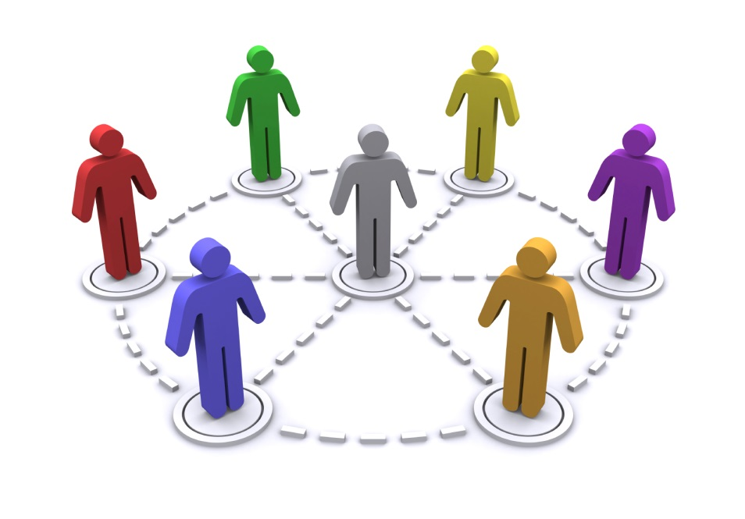
Pro-social behavior: Every behavior that benefits others or society (such as preventing aggression, refraining from driving after drinking)
Helping Behavior: is behavior that intentionally helps or benefits another person. The goal is the make a difference.

Slide 6
Altruism: unselfish regard for the welfare of others.
*Social Psychologists began to study the behavior of individuals in certain situations concerning altruism after a particularly violent crime that occurred in March of 1964.
The supposed lack of reaction of numerous neighbors watching the scene prompted research into diffusion of responsibility and the bystander effect.

Slide 7
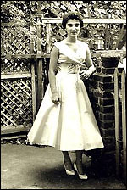
For more than half an hour thirty-eight respectable, law-abiding citizens in Queens watched a killer stalk and stab a woman in three separate attacks in Kew Gardens.

Slide 8
Empathy-altruism model (Batson et al., 1981) - we experience either
-personal distress - anxiety or fear which motivates us to help egoistically to relieve our fear or anxiety
-empathetic concern - sympathy or compassion which motivates us to help where the goal is relieving the person's suffering (not your own fear or anxiety)

Slide 9
Bibb Latane & John Darley carried out a series of famous lab experiments to find out what situations make people less likely to be ALTRUISTIC.
Their experiments showed that there is a tendency towards BYSTANDER APATHY - this means that people will ignore an emergency when they believe someone else will deal with it instead.
The larger the group, the more likely the people in it will display Bystander Apathy - this is called DIFFUSION OF RESPONSIBILITY.

Slide 10
In a 1973 experiment, recruited participants had to walk from one building to another, where they would give a lecture. In some scenarios, these students were told that they were in a hurry or that they had a few minutes to spare.
The experimenters positioned a moaning man along the students’ path. The amount of students who helped along their way was highest in the low hurry situations (63%) and lowest in high hurry (10%).

Slide 11
Further studies reveal that the explanation for bystander apathy may have less to do with human callousness and more to do with a tendency to take social cues from those around us.
In a 1969 experiment by Darley and Daniel Batson, subjects were placed in a room to fill out questionnaires.

Slide 12
The room slowly filled with smoke. There were three conditions: one in which the subject was alone, one in which three naïve subjects were in the room, and one in which one naïve subject was placed with two confederates who noticed and ignored the smoke.
The alone subjects calmly reported the smoke 75% of the time. In the confederate and naïve bystander conditions, only 10% and 38% of subjects reported the smoke, respectively. In some of the confederate instances, the smoke grew so thick that the subject look concerned, got up, and checked the vent.
However, upon seeing the how calm the confederates remained, they went back to their forms.

Slide 13
BYSTANDER EFFECT

Slide 14
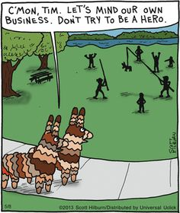
Social psychologists, John Darley and Bibb Latané started this line of research, showing that larger numbers of bystanders decrease the likelihood that someone will step forward and help a victim.
The reasons include the fact that onlookers see that others are not helping either, that onlookers believe others will know better how to help, and that onlookers feel uncertain about helping while others are watching.

Slide 15
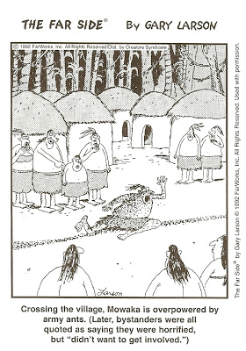
There are many reasons why bystanders in groups fail to act in emergency situations, but social psychologists have focused most of their attention on two major factors.
According to a basic principle of social influence, bystanders monitor the reactions of other people in an emergency situation to see if others think that it is necessary to intervene.

Slide 16
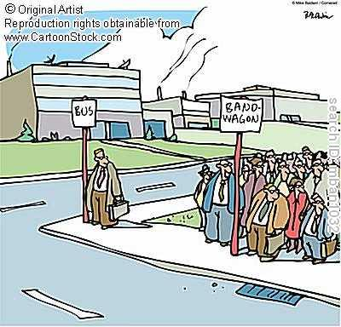
Pluralistic Ignorance or Social Proof
Since everyone is doing exactly the same thing (nothing), they all conclude from the inaction of others that help is not needed.
Diffusion of Responsibility
This occurs when observers all assume that someone else is going to intervene and so each individual feels less responsible and refrains from doing anything.

Slide 17
Social Exchange Theory: Our social behavior is an exchange process. The aim is to maximize benefits and minimize costs.
Reciprocity Norm: The expectation that we should return help and not harm those who have helped us.
Social–Responsibility Norm: Largely learned, it is a norm that tells us to help others when they need us even though they may not repay us.

Slide 18
WHAT WOULD YOU
DO?
A woman was broken down on the side of the highway with 5 children.
Two high school age students were beating up a grade schools student.
A baby was locked in a hot car.
A person passed out on the sidewalk in front of you.
A group of kids were beating up a homeless person.

Slide 19
The false consensus effect is the tendency for people to project their way of thinking onto other people. In other words, they assume that everyone else thinks the same way they do.

Slide 20
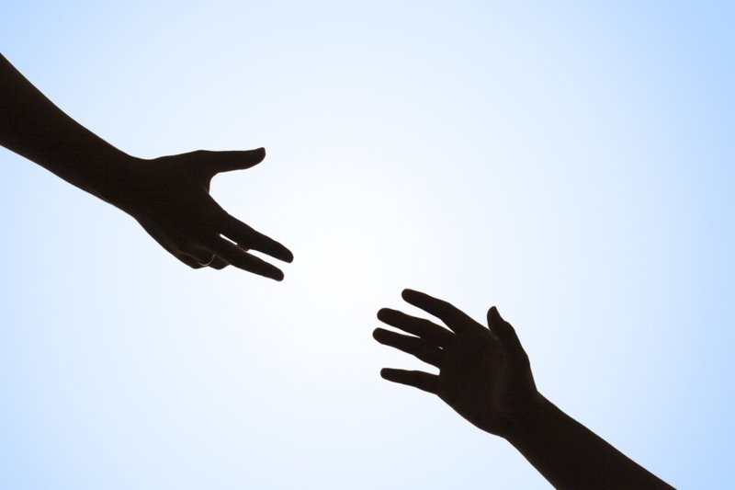
the victim appears to need and deserve help.
the victim is in some way similar to ourselves.
we have just observed someone else being helpful.
we are not in a hurry.
we are in a small town or rural area.
we are feeling guilty.
we are focused on others and not preoccupied.
we are in a good mood.
The last result, that happy people are helpful, was the most consistent finding in all of psychology.

Slide 21
other bystanders are more qualified to help, such as doctors or police officers, and that their intervention would be unneeded.
People may also experience evaluation apprehension and fear losing face in front of the other bystanders.
They may also be afraid of being superseded by a superior helper
offering unwanted assistance,
facing the legal consequences of offering inferior
danger of assistance.

