Slide 1
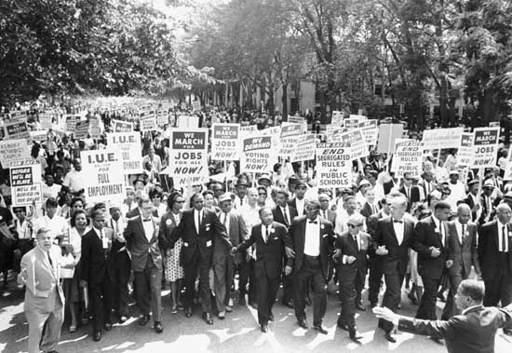
The Civil Rights Movement

Slide 2
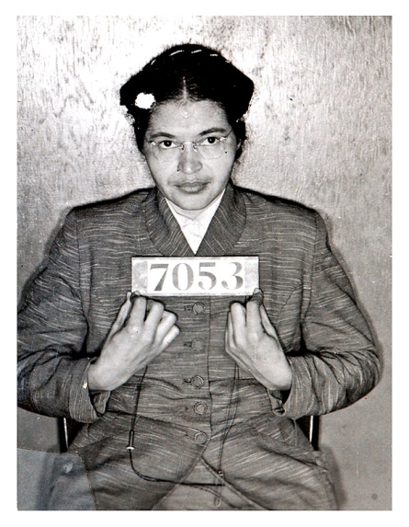
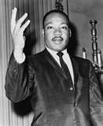
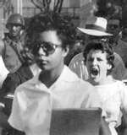
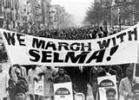
The Civil Rights Movement
The struggle against racial injustice began in the years after World War II. The Supreme Court declared the segregation of schools unconstitutional in the 1950’s.
African Americans searched for more ways to overcome discrimination.

Slide 3
Sources of the Mass Movement
1. Black Urbanization: African Americans moved from the rural areas to the cities.
2. Religious Faith: faith that all people were equal
before God.
3. Constitutional Rights: Belief in Constitution and the hope given from cases like Brown vs. the Board
4. Media Coverage: Viewers who were shocked at what they saw became a part of the movement.

Slide 4
Second Class Citizens
African Americans living in the South were in the 1950’s referred to as “colored” or “Negro”.
It was common for a white southerner to call even a grown adult “girl” or “boy”. Some names used were worse than that.
African Americans in the South were expected to know their place. If they were out of line the consequences could be deadly.
Southern blacks were constantly reminded of their second class status.
Most aspects of life were separated from white society. The facilities for African Americans was usually of inferior quality.

Slide 5
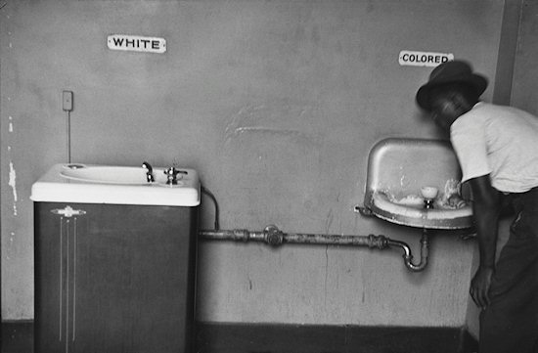
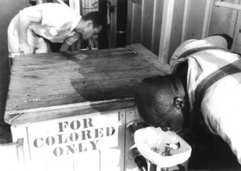
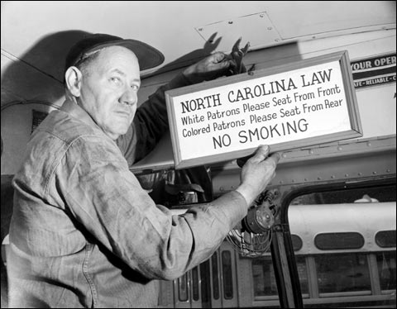
Jim Crow
1. They had to attend separate schools.
2. Water fountains were labeled “For Coloreds Only”.
3. Restaurants had separates seating areas and blacks
had to enter from the back door.
4. At concerts and movies black and white teenagers were seated in separate sections.
5. Blacks were expected to ride in the back of the bus.
When the bus filled up they were expected to give up their seats to oncoming whites.
6. In the workplace African Americans had lower status and lower paying jobs.
7. If they were charged with a crime they would be faced with an all white jury.
8. If sick they would have to find a “colored” emergency
room.
9. When they died they were buried in a “colored”
cemetery.

Slide 6
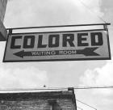
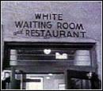
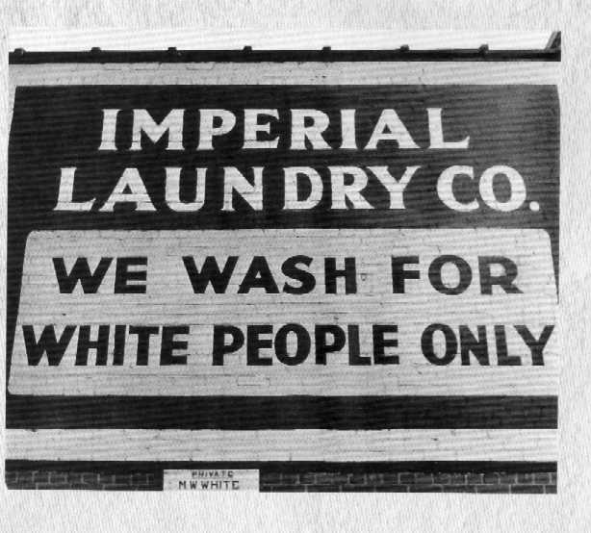
Nurses- No person or corporation shall require any white nurse to work in a ward or room, or hospitals where Negro men are placed.
Buses- All passenger stations in the state operated by any motor transportation company shall have separate waiting rooms and division of the cars.
Restaurants- It is unlawful to serve food where white and colored people are served in the same room. There must be a solid partition of seven feet or higher.
Billiard Rooms- It shall be unlawful for white and colored people to play together in a game of pool.
Toilet Facilities- Every employer of white and Negro males must provide separate toilet facilities.
Education- The schools for white children and the schools for Negro children shall be conducted separately.

Slide 7
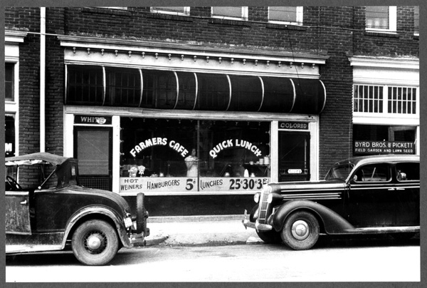

Slide 8
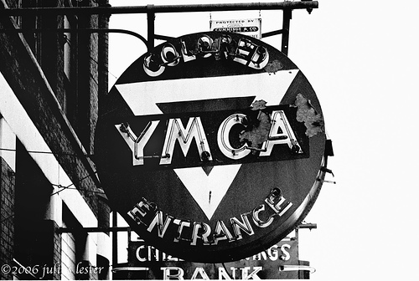
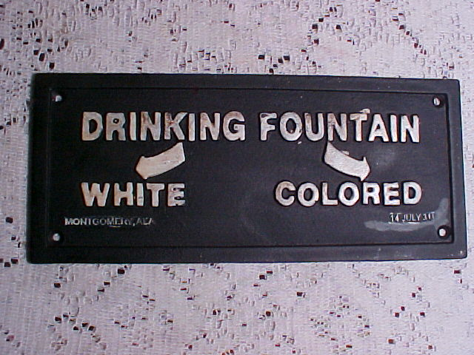
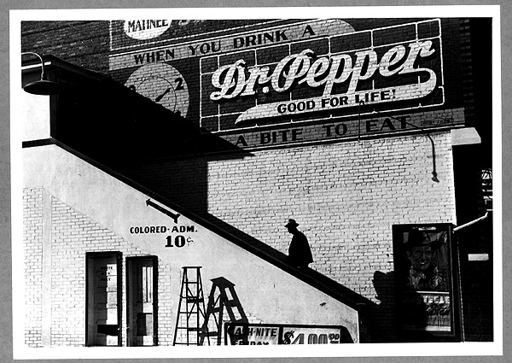
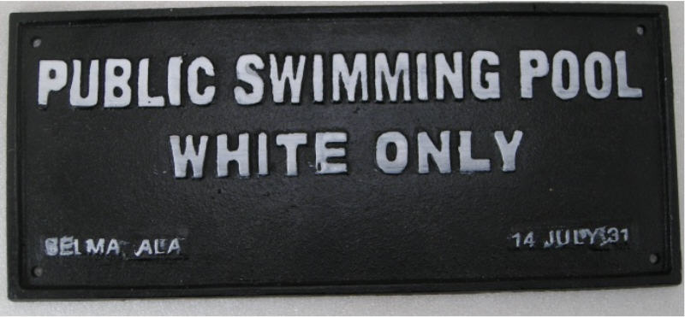

Slide 9
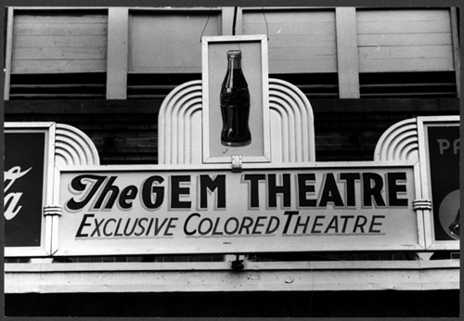
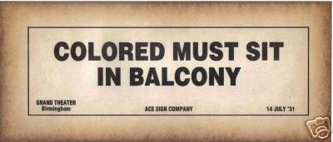
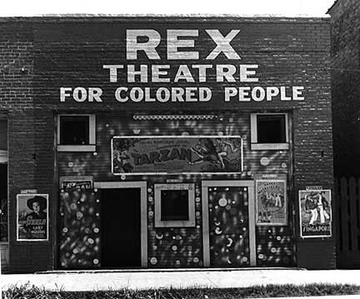

Slide 10
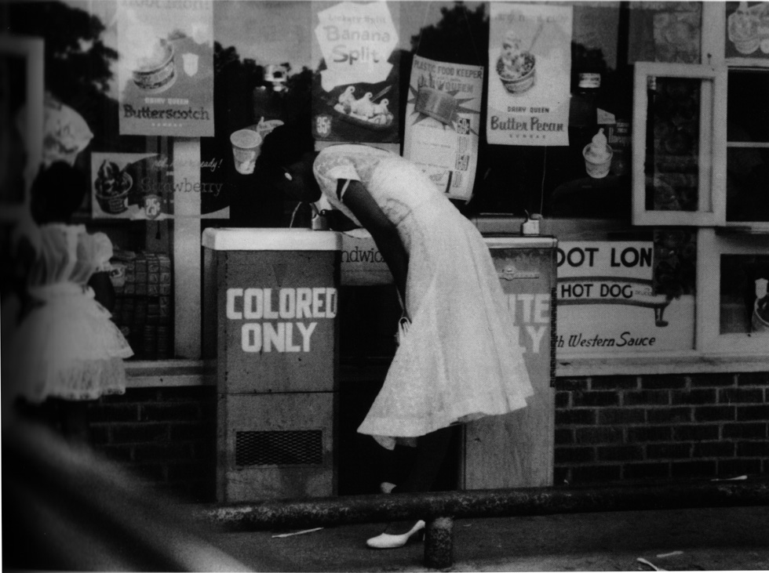
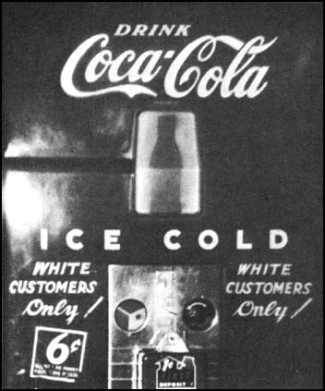
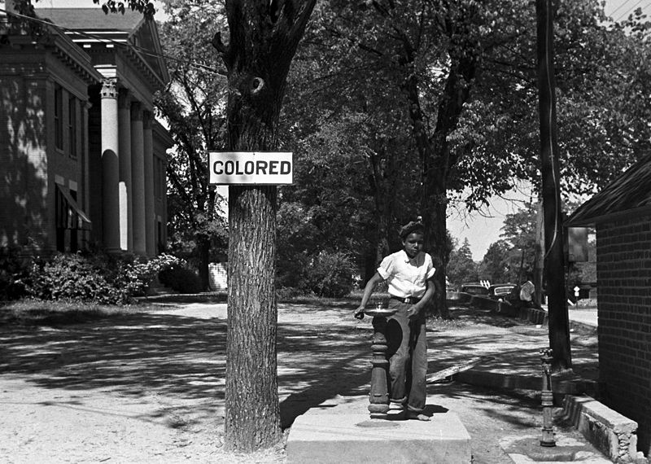
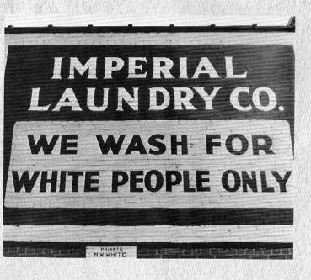

Slide 11
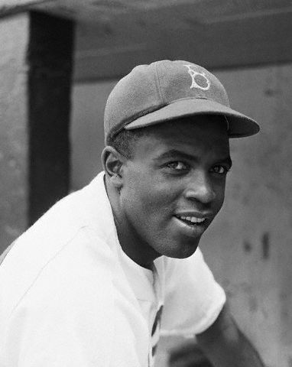
Jackie Robinson
Jackie Robinson joined the Brooklyn Dodgers on April 15, 1947.
He was the first African American to play in the National League.
The owner of the Dodgers had scouted Robinson from UCLA where he was a star athlete.

Slide 12
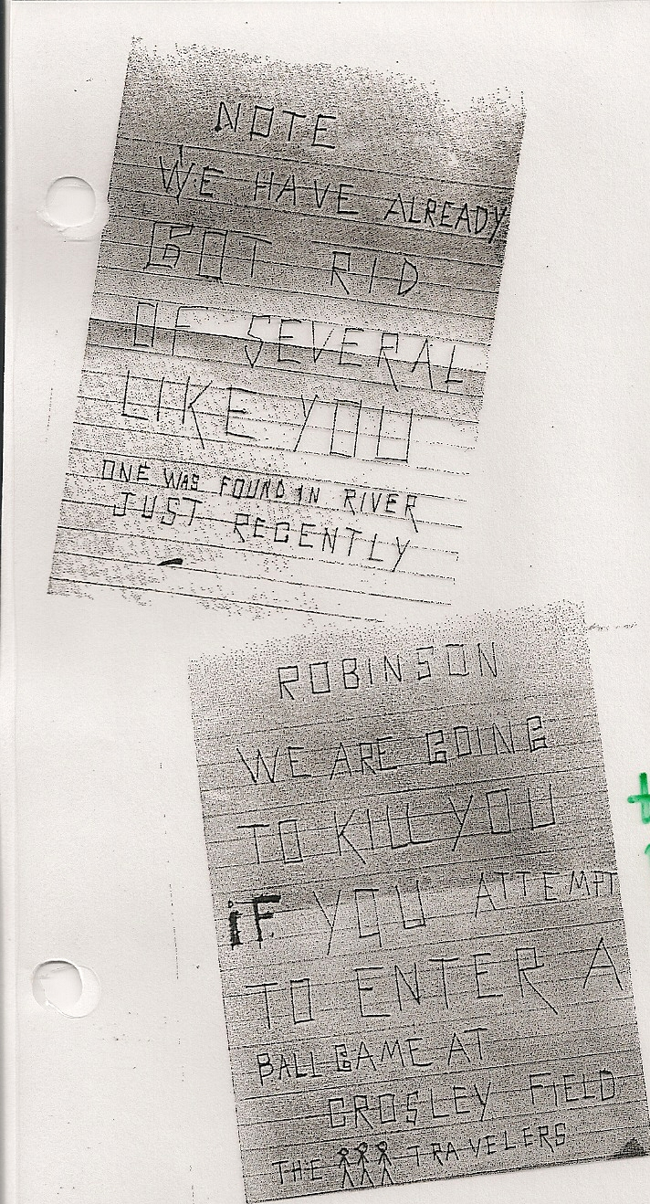
Robinson was speedy and skillful on the diamond and proud and graceful under the pressure of bigotry.
He won over the his teammates, the local fans, and eventually most of the nation.
His courage in the words of the Dodgers owner “jump started the movement for black civil rights in the United States”.

Slide 13
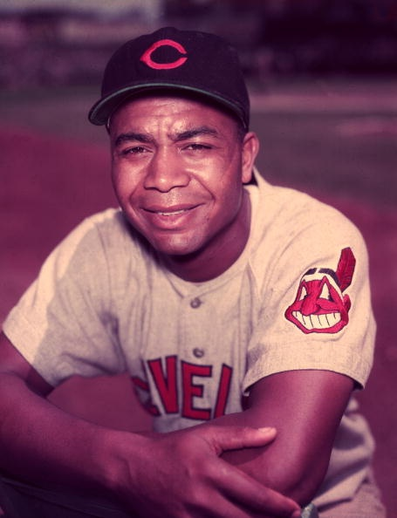
Larry Doby

Slide 14
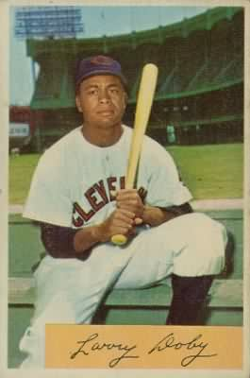
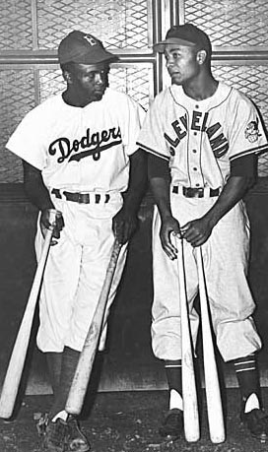
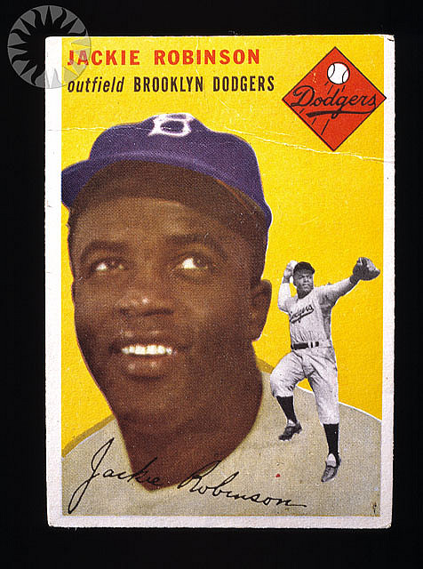

Slide 15
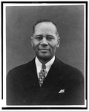
Charles Houston
Charles Hamilton Houston (was an African American lawyer, Dean of Howard University Law School and NAACP Litigation Director who played a significant role in dismantling the Jim Crow laws and trained future Supreme Court justice Thurgood Marshall.

Slide 16
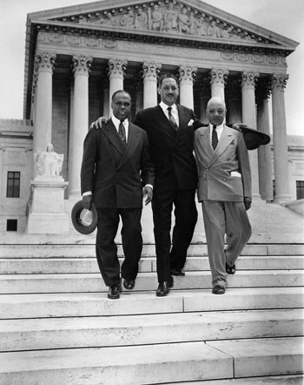
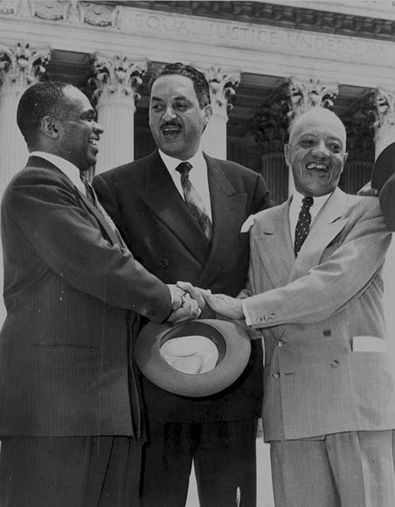
Thurgood Marshall
he was a lawyer who was best remembered for his high success rate in arguing before the Supreme Court and for the victory in Brown v. Board of Education.
In total, Marshall won 29 out of the 32 cases he argued before the Supreme Court.

Slide 17
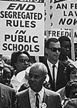
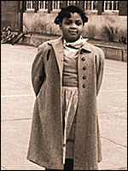
Brown v. the Board
In 1954 the Supreme Court outlawed segregation in public schools in a landmark case known as Brown vs. the Board of Education.
Linda Brown attended an all black elementary school that was located across town. She lived close to an all white school that was in walking distance.
The Supreme Court agreed that most black schools were of worse quality than the white schools. Plessy vs.Ferguson was overturned.

Slide 18
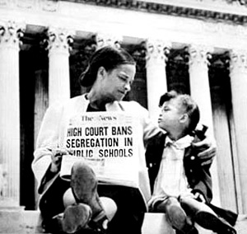

Slide 19
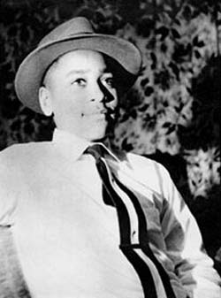
Emmett Till
During the summer of 1955 a young boy named Emmett Till traveled down South to visit relatives. Till was from Chicago and did not understand the unspoken rules of the South.

Slide 20
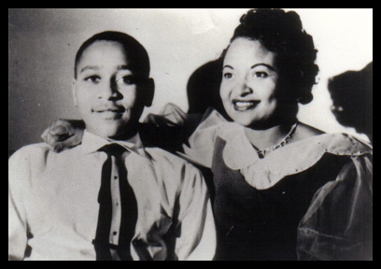
Emmett Till
He heard some teenagers talking outside of a country store. Emmett soon began to brag about his white girlfriend in Chicago.
Dating across racial lines was unheard of in Mississippi.
The teenagers doubting his story pointed to a white woman inside the store and dared him to go talk to her.

Slide 21
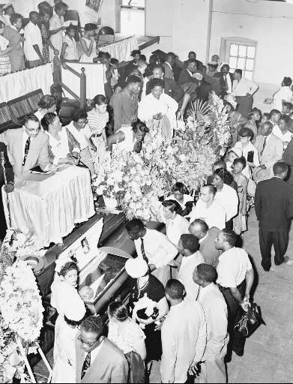
After viewing the body, she also insisted on leaving the casket open for the funeral and allowing people to take photographs because she wanted people to see how badly Till's body had been disfigured

Slide 22
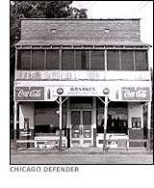
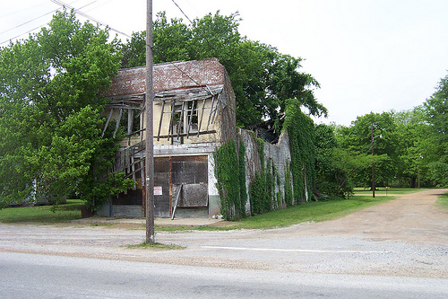
Accounts say Till whistled at Bryant; others say he grabbed her hand and asked her for a date; still others say that he said "Bye, baby" as he left the store.

Slide 23
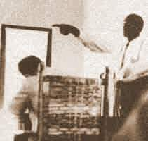
Mose Wright
Stood up and court and testified against two white men.

Slide 24
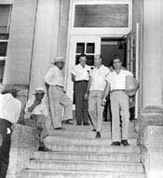
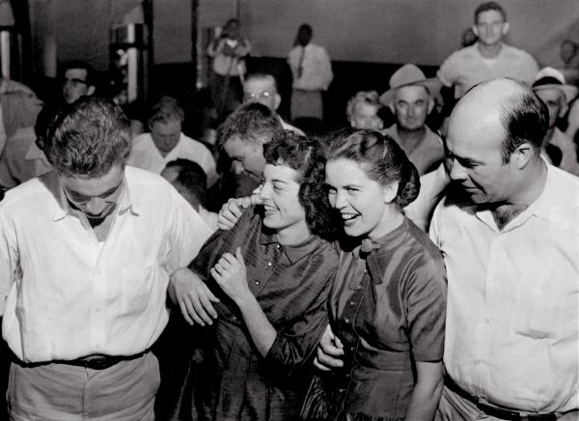
The Verdict
On September 23 the all-male, all-white jury acquitted both defendants. Deliberations took merely 67 minutes; one juror said, "If we hadn't stopped to drink pop, it wouldn't have taken us too long.“
The hasty acquittal outraged people throughout the United States and Europe and energized the nascent Civil Rights Movement.

Slide 25
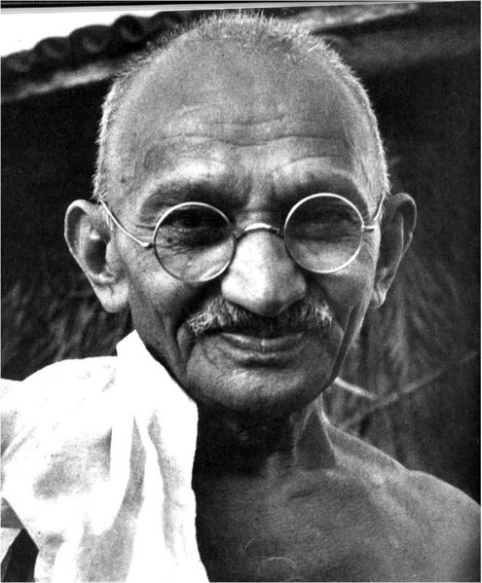
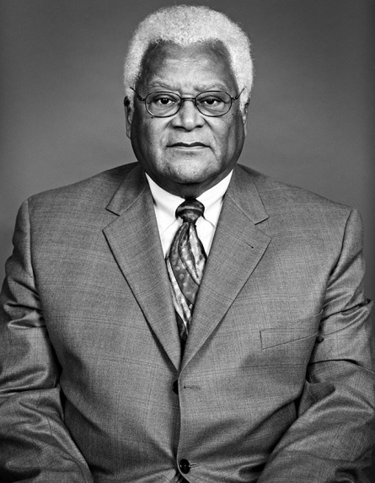
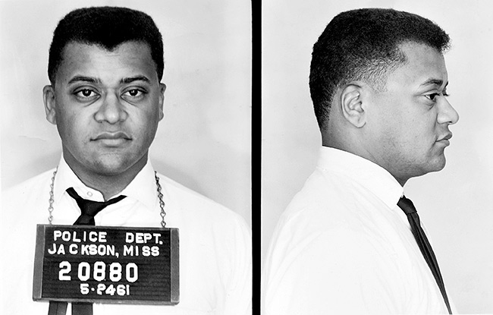
Civil Disobedience
Refusal to obey a law on the grounds that it is immoral or unjust in itself, or furthers injustice. Disobedience within a framework of obedience to law.
Appeals to the majority’s sense of justice, in order to get them to reconsider and change public policy.
Goal: to put the issue on the public’s agenda, to call attention to an unjust law. Disobedience must be open and public.
James Lawson travelled to India in the early 1950’s to study Gandhi.

Slide 26
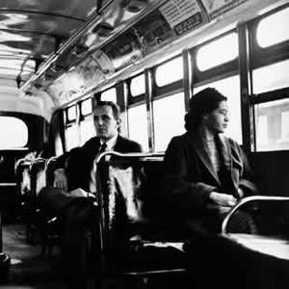
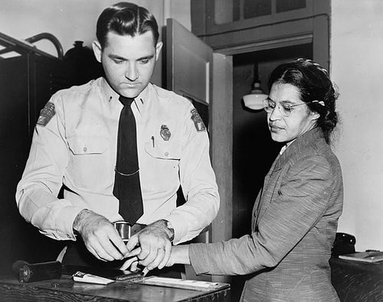
Montgomery Bus Boycott
On December 1, 1955 a woman named Rosa Parks chose to defy a law that stated black passengers had to give up their seat on the bus if there were no seats left for white passengers.
Parks was tired and refused to get up out of her seat. The police were called and she was taken away to the city jail.
The result of this action was that 50,000 blacks were ready to unite in protest against the unfair law.

Slide 27
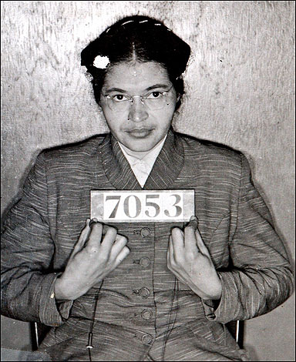
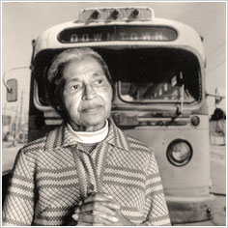
A group of black women organized a boycott of the city buses.
Thousands of newsletters were circulated urging blacks to stay off of the buses.
Most of the passengers that rode the buses were black so the boycott could seriously hurt business if it were a success.

Slide 28
Introduction of Dr. Martin Luther King Jr.
The Montgomery Bus Boycott took place in 1955 and the young Dr. King was propelled into the spotlight after he was asked to lead the boycott.
Dr. King was charismatic and possessed a talent for the spoken word that few are able to achieve. He was able to, through his words, convince African Americans that there could and would be change through peaceful protest.

Slide 29
Martin Luther King Jr.
Martin Luther King Jr. was born on January 15, 1929 in Atlanta, Georgia.
His was a minister by profession. He was ordained before he graduated, at the age of 19, from Morehouse College. He went on to Boston University where he earned his doctorate in theology in 1955.
Dr. King’s efforts to achieve racial equality brought him acclaim throughout the country. His greatest award was the Nobel Peace Prize which he received in 1964.

Slide 30
The Montgomery Bus Boycott took place in 1955 and the young Dr. King was propelled into the spotlight after he was asked to lead the boycott.
Dr. King was charismatic and possessed a talent for the spoken word that few are able to achieve.

Slide 31
White Citizens Council
While the boycott was taking place Montgomery’s whites
joined the White Citizens Council.
White Citizens Council: these councils were formed
throughout the South to oppose integration.
*In 1956 the courts declared that segregation on buses
was unconstitutional. It was one of the first major
victories of the Civil Rights Movement.

Slide 32
The Little Rock Nine

Slide 33
Little Rock
Despite the Brown vs. the Board decision many Southern schools kept blacks out.
*In 1957 Little Rock, Arkansas planned to begin the integration of the schools. During the first year 9 black students were scheduled to attend an all white school.
*The governor opposed the plan and sent the National Guard to the school and had it surrounded.
Orval Faubus

Slide 34
Eisenhower hesitated to react to the situation. Eventually federal troops had to be sent to maintain order while the law was being carried out.

Slide 35
Elizabeth Eckford is depicted in this photograph taken by Will Counts in 1957. It is one of the top 100 photographs of the 20th century, according to the Associated Press.

Slide 38
Day after day the students had to escorted to school by
the troops and protected from angry whites.
*The governor ordered the public schools closed in 1958
in order to prevent integration. The Supreme Court
ruled that “evasive schemes” to avoid integration were
illegal.
*The schools were reopened in 1959.

Slide 39
Lunch Counter in the Smithsonian

Slide 40
Lunch Counter Sit ins
On February 1, 1960 four black students from North Carolina Agricultural and Technical College went to downtown Greensboro to protest.
Their goal was to go into Woolworth’s and sit down at the whites only lunch counter and order coffee.
The waitress told them that coloreds were not served there. They remained seated until the store closed.

Slide 41
The Protest Grows
The next day there were 23 students there to protest and the day after that there were 64. The number involved in the silent protest grew.
Police would come to arrest the non-violent protesters. Crowds would often gather to shout at the students, they poured ketchup over their heads, and even put out cigarettes on their backs.

Slide 43
Freedom Rides
In 1961 groups of protesters known as the freedom riders began to board buses and ride across the South.
The riders were trying to gain attention to the policy of segregation on interstate trains and buses.
The riders were often in danger of angry mobs who would drag them from the buses and beat them.

Slide 44
News of the violence gained national attention and demands for the end of interstate segregation were made.

Slide 45
In September of 1961 the Interstate Commerce Commission outlawed segregation in interstate travel.
The next year the Supreme Court outlawed segregation in all public travel accommodations.

Slide 46
Ruby Bridges
In 1960, at the age of 6, Ruby Bridges became the first black elementary school child to attend a white school.
Due to White opposition of integration, Ruby needed to be escorted to school by federal marshals.
After Ruby entered the school, many of the teachers refused to teach and many of the White students went home.
Ruby went to school everyday.

Slide 47
The March on Washington

Slide 48
March on Washington
August, 1963, buses and trains began to bring thousands of marchers across the country to Washington D.C. To support the passage of the Civil Rights Act.
There were about 250,000 people crowed onto the mall in Washington D.C. 190,000 African Americans and 60,000 White Americans.
The people chanted “Pass the bill. Pass the bill.”

Slide 49
“I Have a Dream”
Many people in the media predicted that violence would break out at the large gathering but it remained a peaceful event.
*The day filled with songs and speeches ended with speech from Martin Luther King Jr. that has become a familiar part of our history.
*M.L.K. put aside a prepared speech and spoke from his heart:

Slide 51
“I Have A Dream”
“I have a dream today!
From every mountainside, let freedom ring.
And when we allow freedom to ring, when we let it ring
from every village, from every hamlet,
from every state and every city,
we will be able to speed up the day when all God’s children,
black men and white men,
Jews and Gentiles,
Protestants and Catholics,
will be able to join hands and sing in the word
of the old Negro spiritual:
Free at last! Free at last!
Thank God Almighty, we are free at last.”

Slide 52
The Civil Rights Act of 1964
The death of Jim Crow began with the passing of the Civil Rights Act of 1964 yet there was a far way to go to reach an end to discrimination.

Slide 53
Violence in Mississippi
Medgar Evers was a veteran of World War II who upon returning home from war expected gain his full rights as an American citizen.
He fought in Normandy on D-Day and risked his life to help save Democracy in the world.
Evers became the head of the NAACP in Mississippi and devoted himself to the Civil Rights Movement.
He investigated lynching, like Emmett Till’s and helped blacks register to vote.

Slide 54
University of Mississippi
*One of Ever’s projects was to help with the integration of the University of Mississippi. It was an all white school that had been proud of its traditions.
*In the fall of 1963 the federal court ordered that air force veteran, James Meredith be admitted to the school.
*The school became a war zone. The governor tried to stop Meredith from attending and Kennedy had to send federal marshals to protect him.

Slide 55
Evers Murdered
One year later when Evers was pulling into to his driveway late at night bullets rang out from a car speeding by.
Evers was killed and his accused murderer got off.

Slide 56
Birmingham
Birmingham was being called “Bombingham” because between 1957 and 1963 there were twenty cases of bombings against African Americans.
*The governor of Alabama was a fierce segregationalist. George Wallace was quoted as saying:
“I say segregation now, segregation tomorrow, segregation forever.”
*Martin Luther King Jr. decided to launch a non-violent protest in Birmingham in the form of sit-ins, boycotts, and protest marches.

Slide 57
The police chief Eugene “Bull” Connor responded by arresting the demonstrators.
*Bull Connor’s officers used brutal force to stop the protests. They used electric cattle prods, fire hoses, batons, and police dogs.
*Around the world people saw small children blasted with fire hoses and chased with police dogs.

Slide 65
Letter from a Birmingham Jail
Reverend King was arrested along with many others. In jail he wrote a long letter to some clergymen who said he should end the demonstrations.
The protests worked. Stores began to desegregate and hire more black employees. Kennedy went on television to comment on the success in Birmingham.

Slide 66
Voting Rights
In 1964 fewer than 15% of the blacks living in the South were able to vote despite the passing of the 15th Amendment in 1870.
*Officials had many ways to keep the ballot out of the hands of blacks.
*They would close their offices when blacks tried to register. They gave impossible literacy tests and even have blacks fired from their jobs after they registered.

Slide 67
Freedom Summer
Included about 1,000 students, many of them whites from elite colleges in North
Two main elements: 1. Voter Registration 2. Freedom Schools

Slide 68
Mississippi Burning
Three civil rights workers, Andrew Goodman, Michael Schwerner, and James Chaney who were a part of this project turned up missing. Their bodies were later found.
*During Freedom Summer 37 black churches were burned or bombed.

Slide 70
SELMA

Slide 71
The Selma March
The struggle for voting rights reached its height in Selma, Alabama. Very few blacks had been allowed to vote despite the efforts of Freedom Summer.
*Anyone who protested their exclusion from voting was arrested.
*In 1965 a march was planned from Selma to the state capital Montgomery to protest the denial of voting rights.
*Marchers were stopped on the edge of town by troopers who fired tear gas and beat them with clubs.

Slide 72
Voting Rights Act of 1965
The situation during the 1960's became very volatile when African Americans were intimidated at the polls and could not assert their voting rights.
The number of African American voters in the South increased dramatically after this legislation was passed.
It is also known as the Civil Rights Act of 1965

Slide 73
SCLC
The Southern Christian Leadership Conference (SCLC) is an American civil rights organization.
SCLC was closely associated with its first president, Dr. Martin Luther King, Jr. The SCLC had a large role in the American Civil Rights Movement.

Slide 74
SNCC
The Student Nonviolent Coordinating Committee (SNCC) was one of the principal organizations of the American Civil Rights Movement in the 1960s.
It emerged from a series of student meetings.
SNCC grew into a large organization with many supporters in the North who helped raise funds to support SNCC's work in the South.

Slide 75
CORE
The Congress of Racial Equality or CORE is a U.S. civil rights organization that originally played a pivotal role for African-Americans in the Civil Rights Movement.
Membership in CORE is still stated to be open to "anyone who believes that 'all people are created equal' and is willing to work towards the ultimate goal of true equality throughout the world."
James Farmer

Slide 76
NATION OF ISLAM
Elijah Muhammad was the leader of the mostly Black political and religious group The Nation Of Islam.
His teachings, often perceived as racist, preached complete separation from Whites in society.

Slide 77
Malcolm X
One of the most controversial figures of the Civil Rights Movement was Malcolm X.
He was a minister of the Black Muslims, a religious group that called for the separation of the races.
Malcolm X explained that white society would never see African Americans as equals and that white society could not be trusted.

Slide 78
Black Separatism
He urged blacks to reject the white world. Blacks could improve their lives by creating a separate all black society.

Slide 79
Martin Luther King and Malcolm X had very different views. Malcolm X ridiculed M.L.K.’s idea of peaceful protest and urged blacks to fight back against whites.

Slide 80
Malcolm X
Malcolm X gathered wide spread admiration from African American’s and wide spread fear from Whites.

Slide 81
Assassination
Malcolm’s view became so radical he was expelled from the Black Muslims by leader Elijah Muhammad.
In 1964 he began to modify his views, and consider the possibility of interracial harmony.
He did not live long enough to develop his new views. He was murdered in New York City by three men. Two of the men were Black Muslims

Slide 82
Muhammad Ali
Muhammad Ali is one of the most recognizable men on earth.
In the 1960 Olympics he burst on the scene when he won a gold medal in the games held in Rome, Italy.
Ali brought unprecedented speed and grace to his sport. His charm and wit changed what the public expected a champion to be.
His accomplishments in the ring were the stuff of legends. In two fights with Sonny Liston he proclaimed himself:
“The Greatest”

Slide 83
There has always been more to Muhammad Ali than what was seen in the rink. Ali’s life and career played out on the front page as on the sports page.
His embrace of the Nation of Islam gave him his name Muhammad Ali. His birth name was Cassius Clay which he considered his slave name.

Slide 84
He proved over and over that he was. In three epic fights with Joe Frazier and a stunning victory over George Foreman in Zaire. The “rumble in the jungle”.
He dethroned Leon Spinks to become the heavyweight champion for an unprecedented third time.

Slide 85
He refused to be inducted into the U.S. Army citing religious reasons and he would not help the U.S. government to oppress other people in the world.
His case went all the way to the U.S. Supreme Court.

Slide 86
BLACK POWER MOVEMENT
Black Power is a political slogan and a name for various associated ideologies.
Black Power" expresses a range of political goals, from defense against racial oppression, to the establishment of separate social institutions and a self-sufficient economy (separatism).

Slide 87
BLACK POWER
Tommie Smith and John Carlos give the Black Power salute at the 1968 Summer Olympics.
The two men were suspended by the United States team and banned from Olympic village.
The action is considered a milestone of The Civil Rights Movement.

Slide 88
The Black Panthers
The Black Panther Party was an African American civil-rights and self-defense organization, founded in 1966

Slide 89
The Black Panthers
U.S. African American Militant group.
Founded in 1966 in Oakland.
Political Party.
Led by Huey P. Newton and Bobby Seale.
Urged African Americans to arm themselves.

Slide 90
WATTS RIOTS
The term Watts Riots of 1965 refers to a large-scale riot which lasted 6 days in the Watts neighborhood of Los Angeles, California, in August 1965.
By the time the riot subsided, 34 people had been killed, 2,032 injured, and 3,952 arrested

Slide 92
Investigating the Riots
The riot is viewed by some as a reaction to the supposed record of police brutality by the LAPD and other racial injustices allegedly suffered by black Americans in Los Angeles, including job and housing discrimination.
The media attention focused on the riots in cities like Watts rather than the condition that people were living in, in the ghettos.
President Johnson appointed a commission to study the riots.

Slide 93
White Backlash: as a result of black separatism, the black power movement, and urban violence a group of white Americans began to oppose the demands of black Americans.

Slide 94
Affirmative Action: this policy required businesses and schools that received federal funds to recruit minorities such as blacks and women.

Slide 95
Bakke v California
The case claimed that the special consideration given to women and African Americans infringed upon the rights of non-minorities.
Allan Bakke who applied to University of California was turned down twice by the school. He sued for reverse discrimination.

Slide 97
Reverse Discrimination: Whites claimed that these policies created reverse discrimination.
*The policy at the school was that 16 of every 100 class spaces was reserved for minorities.
*The judges came up with six separate responses. In the end the court ruled that the school could consider race as part of admission but could not set quotas.

Slide 98
1968
Despite the development of the idea of black separatism and the black power movement, Martin Luther King continued to preach racial harmony and non-violence.
Over time Dr. King grew more outspoken. He became convinced that poverty was a major roadblock to racial equality.

Slide 100
The Poor People’s March
Organized by Martin Luther King, Jr. and the Southern Christian Leadership Conference, the Poor People's Campaign addressed the issues of economic justice and housing for the poor in the United States.
He began to organize a “Poor People’s March on Washington”.

Slide 101
Memphis
Before the march he went to Memphis, Tennessee to support a strike of the city’s garbage collectors.

Slide 103
Dr. King’s Last Speech
“Like anybody, I would like to live a long life, but I’m not concerned with that now. God’s allowed me to go up to the mountain. And I’ve have looked over, and I have seen the promised land.”

Slide 104
The next night while standing on the balcony of a motel, King was shot and killed by white assassin James Earl Ray. He was just 39 years old.

Slide 107
James Earl Ray

Slide 108
Indianapolis
Riots broke out across the United States as people heard the news that Martin Luther King had been killed. 46 people lost their lives as a result.
Indianapolis was the only major city where there was no rioting.

Slide 112
Coretta Scott King
Long active in the fight for civil and human rights, Coretta Scott King has become an international icon for her efforts to promote nonviolent social change.
After the assassination of her husband she continued to work for equal rights for minorities, women, and the poor.
In 1986 she prevailed in her crusade to make Martin Luther King Day a national holiday.

