Slide 1
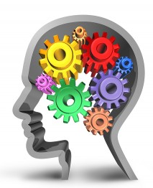
Cognitive perspective

Slide 2
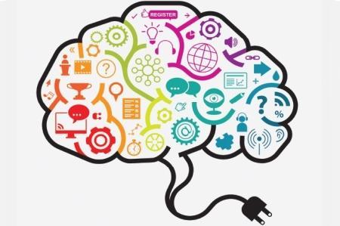
COGNITIVE PERSPECTIVE
The cognitive level of analysis (CLA) is based on how mental processes such as perception, attention, language, memory and thinking in the brain processes information.
It concerns the way we take in information from the outside world, how we make sense of that information and what use we make of it.

Slide 3
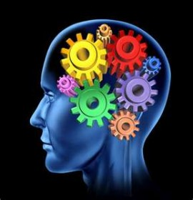
#20 Outline principles that define the cognitive level of analysis.
Mental processes can be studied scientifically.
Mental representations guide behavior.
Cognitive processes do not function in isolation.
Biases in cognitive processes can be systematic and predictable.

Slide 4
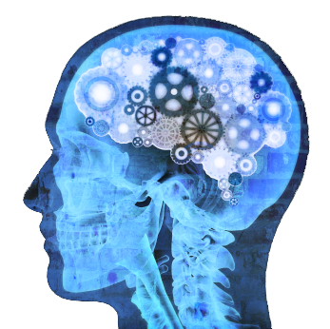
Purpose of the principles
These principles are the main ideas that have driven focused research on specific areas of behavior and cognition.
They also allow us to understand how behavior can be influenced by cognitive processes
Define cognition
Refers to a process that is based on one's mental representations of the world, such as images, words and concepts
People likewise have different experiences and therefore each individual will have different mental representations of the world

Slide 5
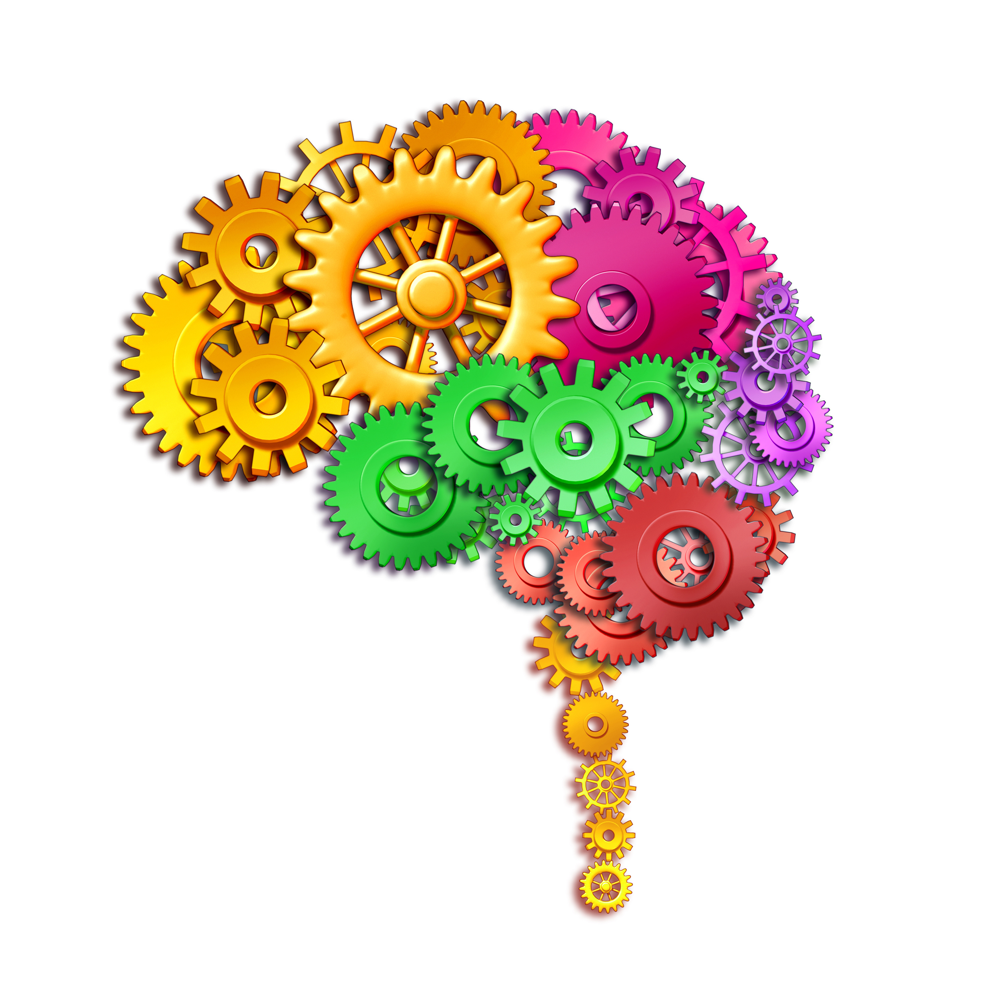
5 steps in the development of the cognitive psychology
Introspectionism
Psychoanalysis
Behaviorism
Cognitive Psychology
Behavioral Economics

Slide 6
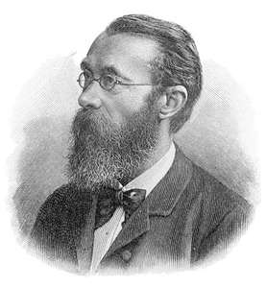
Introspectionism
Introspection is often used in everyday language to refer to the process of looking inward, but the term also applies to a more formalized process that was once used as an experimental technique.
The experimental use of introspection is similar to what you might do when you analyze your own thoughts and feelings but in a much more structured and rigorous way.
The term introspection is also used to describe a research technique that was first developed by psychologist Wilhelm Wundt.
Psychology should study the mind. The mind is rational and can therefore be studied by means of introspection.

Slide 7
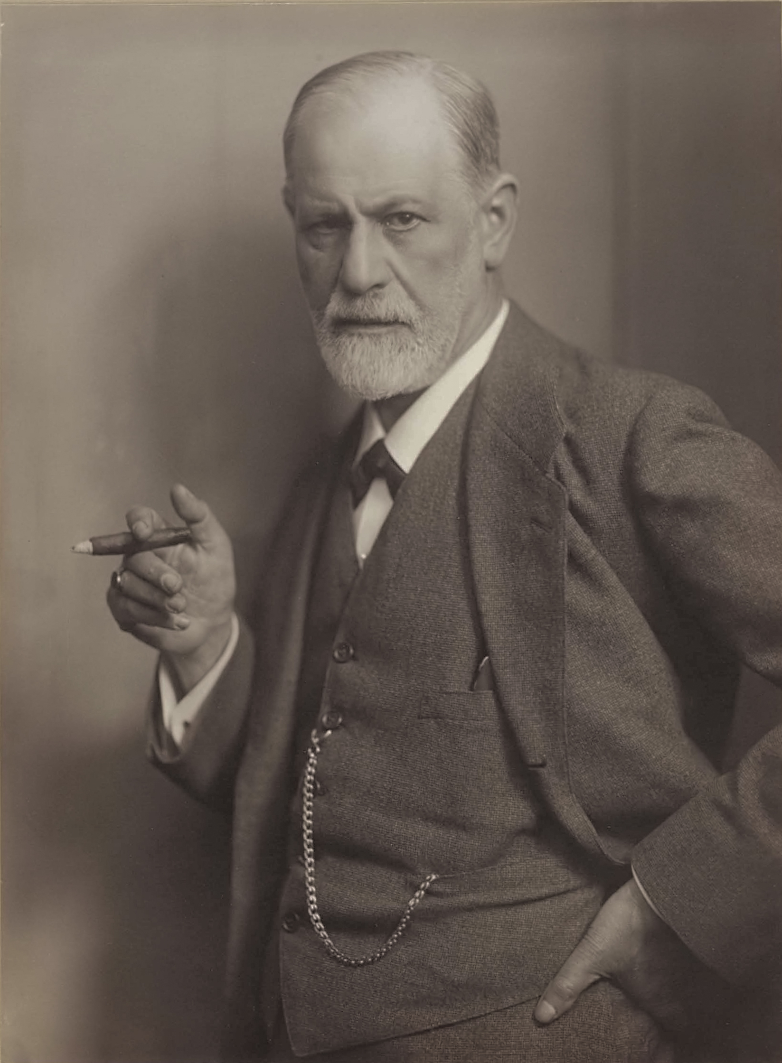
Psychoanalysis
Psychoanalysis was founded by Sigmund Freud (1856-1939). Freud believed that people could be cured by making conscious their unconscious thoughts and motivations, thus gaining insight.
The aim of psychoanalysis therapy is to release repressed emotions and experiences, i.e., make the unconscious conscious. It is only having a cathartic (i.e., healing) experience can the person be helped and "cured.
The mind is mostly irrational and should be studied by dream interpretation.

Slide 8
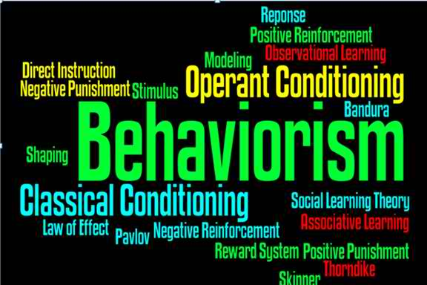
Behaviorism
Behaviorism refers to a psychological approach which emphasizes scientific and objective methods of investigation. The approach is only concerned with observable stimulus-response behaviors, and states all behaviors are learned through interaction with the environment.
The behaviorist movement began in 1913 when John Watson wrote an article entitled 'Psychology as the behaviorist views it,'
Behaviorism is primarily concerned with observable behavior, as opposed to internal events like thinking and emotion.

Slide 9
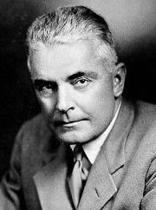
John Watson
“Give me a dozen healthy infants, well-formed, and my own specified world to bring them up in and I'll guarantee to take any one at random and train him to become any type of specialist I might select – doctor, lawyer, artist, merchant-chief and, yes, even beggar-man and thief, regardless of his talents, penchants, tendencies, abilities, vocations, and race of his ancestors.”

Slide 10
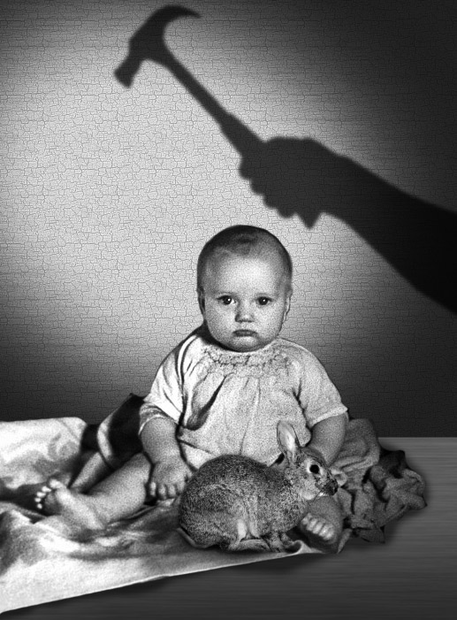
Watson argued that behavior is governed primarily by the environment.
Watson wanted to demonstrate that he could condition emotions such as fear.
His experiment with Little Albert is still controversial because he did not extinguish the behavior he conditioned.

Slide 11
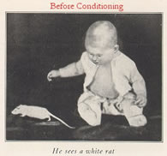
Little Albert Experiment
One of the most controversial experiments in psychology was performed by Watson and Rayner. It has become immortalized in introductory psychology textbooks as the Little Albert experiment.
The goal of the experiment was to show how principles of classical conditioning could be applied to condition fear of a white rat into "Little Albert", an 11 month old boy.

Slide 12
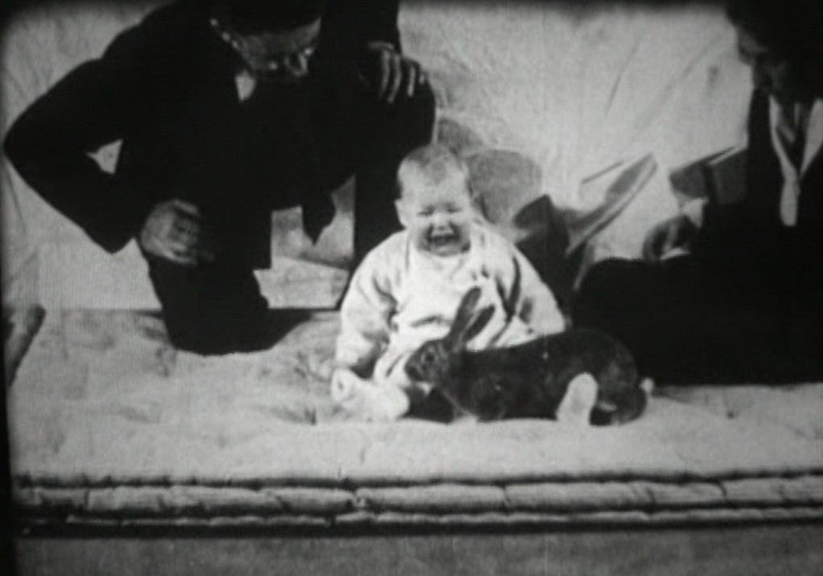
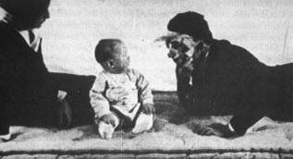
The Little Albert experiment was an experiment showing empirical evidence of classical conditioning in humans.
This study was also an example of stimulus generalization.
The study was done at Johns Hopkins University

Slide 13
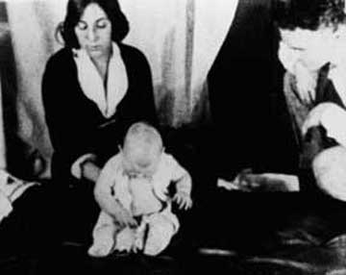
The Experiment
Little Albert was given a
battery of baseline
emotional tests.
The infant was exposed,
briefly and for the first time,
to a white rat, a rabbit, a dog, a monkey, masks with and without hair, cotton wool, burning newspapers, etc.
The experiment began by placing Albert on a mattress on a table in the middle of a room. A white laboratory rat was placed near Albert and he was allowed to play with it.

Slide 14
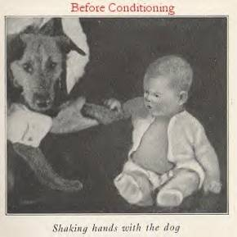

Slide 15
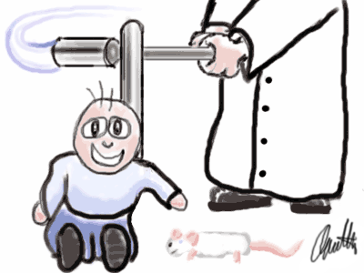
In later trials, Watson and Rayner made a loud sound behind Albert's back by striking a suspended steel bar with a hammer when the baby touched the rat.
Not surprisingly in these occasions, Little Albert cried and showed fear as he heard the noise. After several such pairings of the two stimuli, Albert was again presented with only the rat.
He now showed fear.

Slide 16
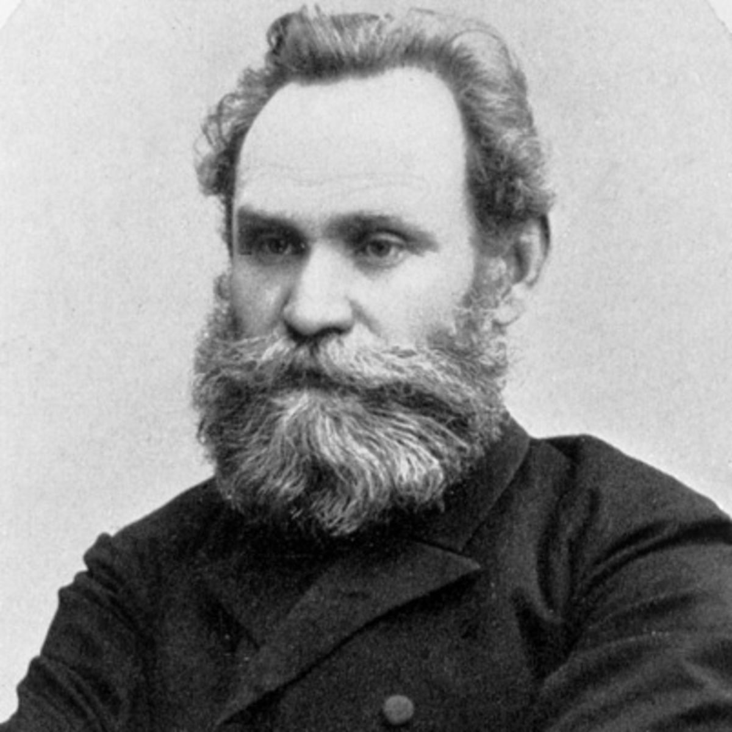
Classical (Pavlovian) Conditioning
Ivan Pavlov
Russian physiologist
Studying the role of saliva in digestion
Discovered the “conditions” that produce this kind of learning.

Slide 17
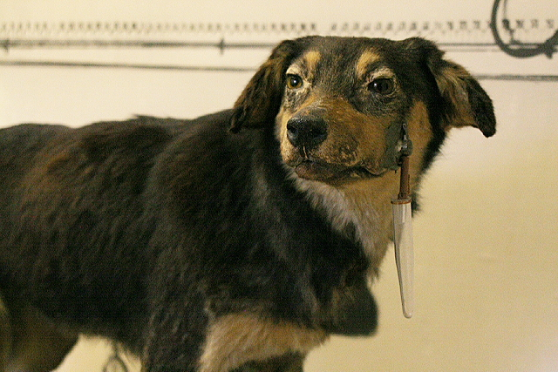
Pavlov’s Dogs
One of Pavlov’s Dogs with surgically implanted saliva collection tube.

Slide 18
Unconditioned stimulus (UCS)
A stimulus that evokes an unconditioned response without previous conditioning.
In Pavlov’s experiments the UCS was meat powder.

Slide 19
Unconditioned Response (UCR)
An unlearned reaction to an unconditioned stimulus that occurs without previous conditioning.
In Pavlov’s experiment this was the dog salivating at the sight of the meat powder.

Slide 20
Conditioned Stimulus (CS)
A previously neutral stimulus that has, through conditioning, acquired the capacity to evoke a conditioned response.
In Pavlov’s experiment, the CS was the presentation of a tone, without the meat powder.

Slide 21
Conditioned Response (CR)
A learned reaction to a conditioned stimulus that occurs because of previous conditioning.
In Pavlov’s experiment, this was the dog salivating at the sound of the tone without seeing the meat powder.

Slide 22
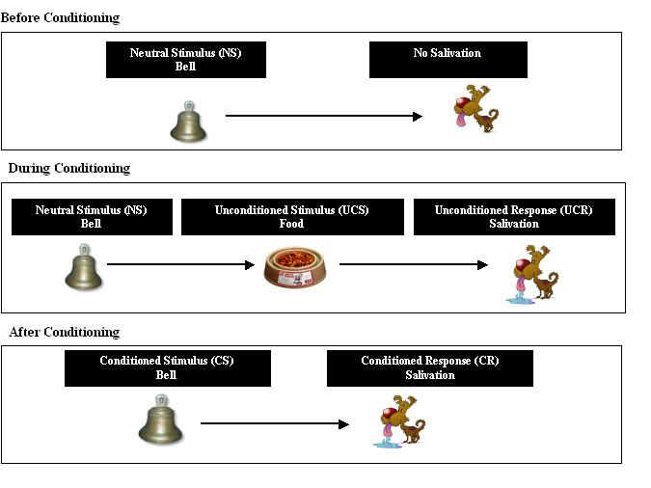

Slide 23
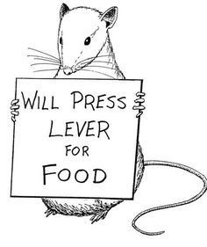
OPERANT CONDITIONING
Organisms often associate their own actions consequences.
In operant conditioning, behavior is strengthened if followed by a reinforcer or diminished if followed by a punisher.
Both Classical and Operant Conditioning involve acquisition, extinction, spontaneous recovery, generalization, and discrimination.

Slide 24
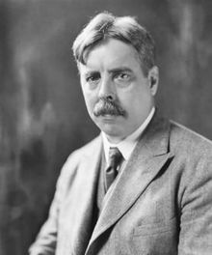
Thorndike’s Law of Effect
Thorndike’s principle that behaviors followed by favorable consequences become more likely and behaviors followed by unfavorable consequences become less likely.
Using Thorndike’s law of effect as a starting point, B.F. Skinner will develop a behavioral technology.

Slide 25
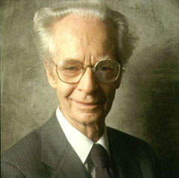
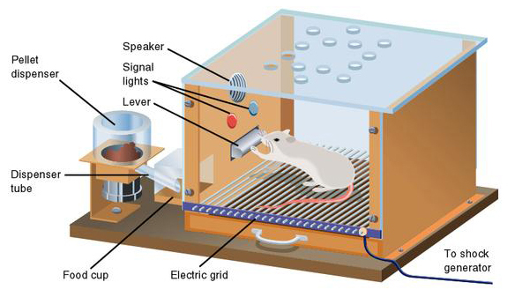
B.F. Skinner

Slide 26
Skinner’s Learning Theory
Skinner believed that there are five main obstacles in learning:
1. People have a fear of failure
2. There is a lack of directions
3. There is also a lack of clarity in the direction
4. Positive reinforcement is not used enough
5. The task is not broken down into small enough steps

Slide 27
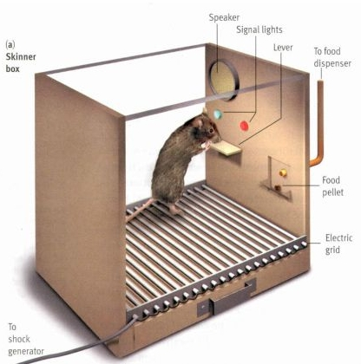
Skinner Box
Inside the box, the rat presses the bar for a food reward.
Outside, a measuring device records the animal’s accumulated responses.

Slide 28
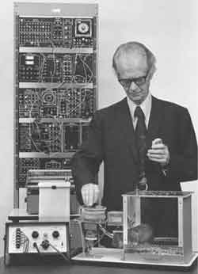
Operant Chamber
Operant Chamber: a chamber containing a bar or key that an animal can manipulate to obtain food or water.
The chamber includes a device to record the animal’s rate of bar pressing.

Slide 29
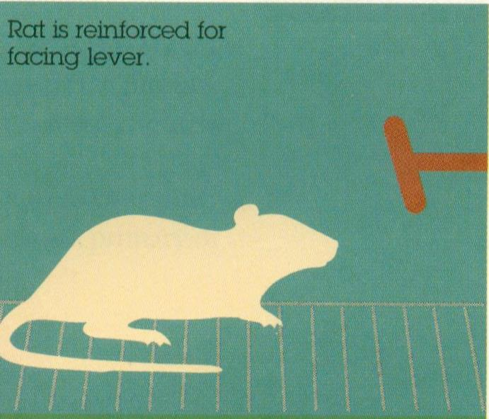
Shaping Procedure
The rat is placed in a lit box in a dark room.
When the rat faces the lever a food pellet is released.
Whenever the rat faces or approaches the lever the food pellet is released.

Slide 30
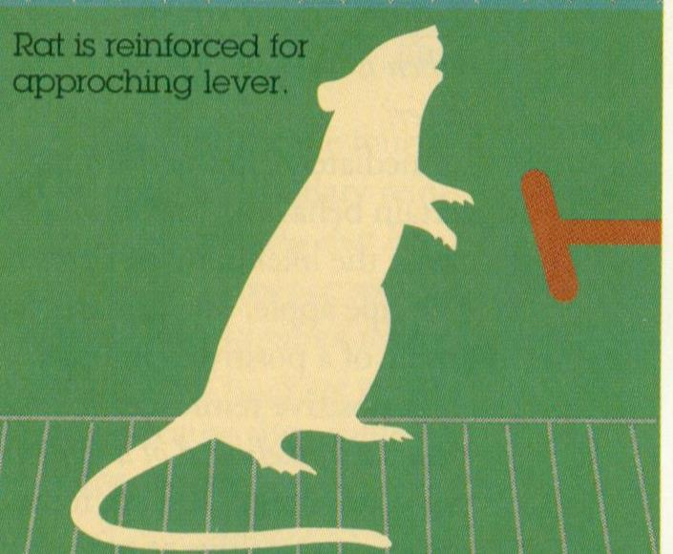
Shaping Procedure
The next step would be to only release the pellet when the rat approaches the lever.
When the rat shows interest in the lever by sniffing it or touching it, it will receive a pellet.

Slide 31
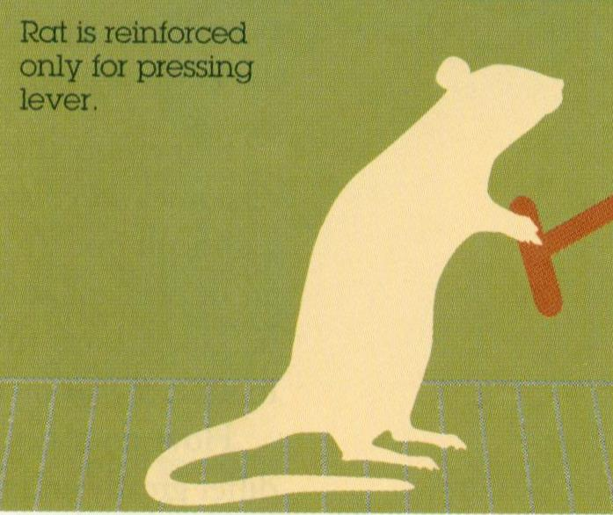
Shaping Procedure
When the rat puts his paw on the lever a pellet is released.
This final step is continued until the rat puts enough pressure on the lever to release a pellet himself.

Slide 32
Types of Reinforcement
Reinforcement: any event that strengthens a behavior.
Positive Reinforcement: increasing behavior using positive stimuli such as food.
Negative Reinforcement: increasing behaviors by stopping or reducing negative stimuli.
EXAMPLES
If you call your parents from college and ask for money and they give it to you, you will likely call again.
Putting on your seatbelt makes the annoying bell stop in the car.

Slide 33
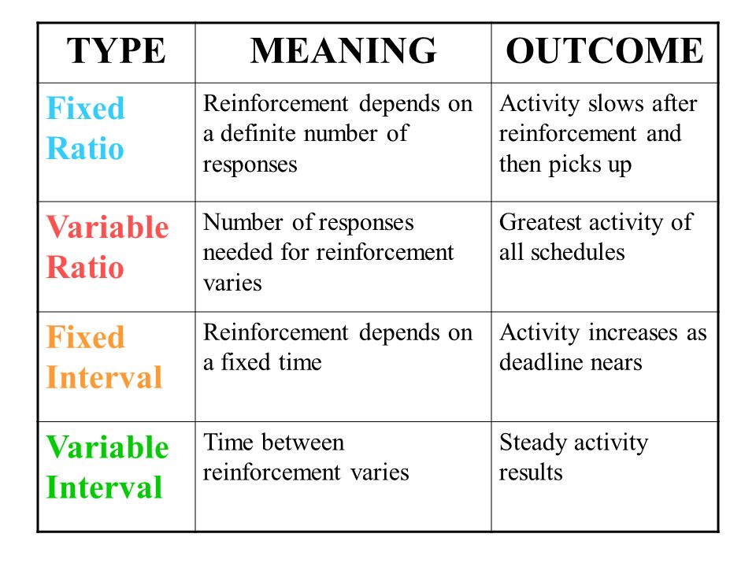

Slide 34
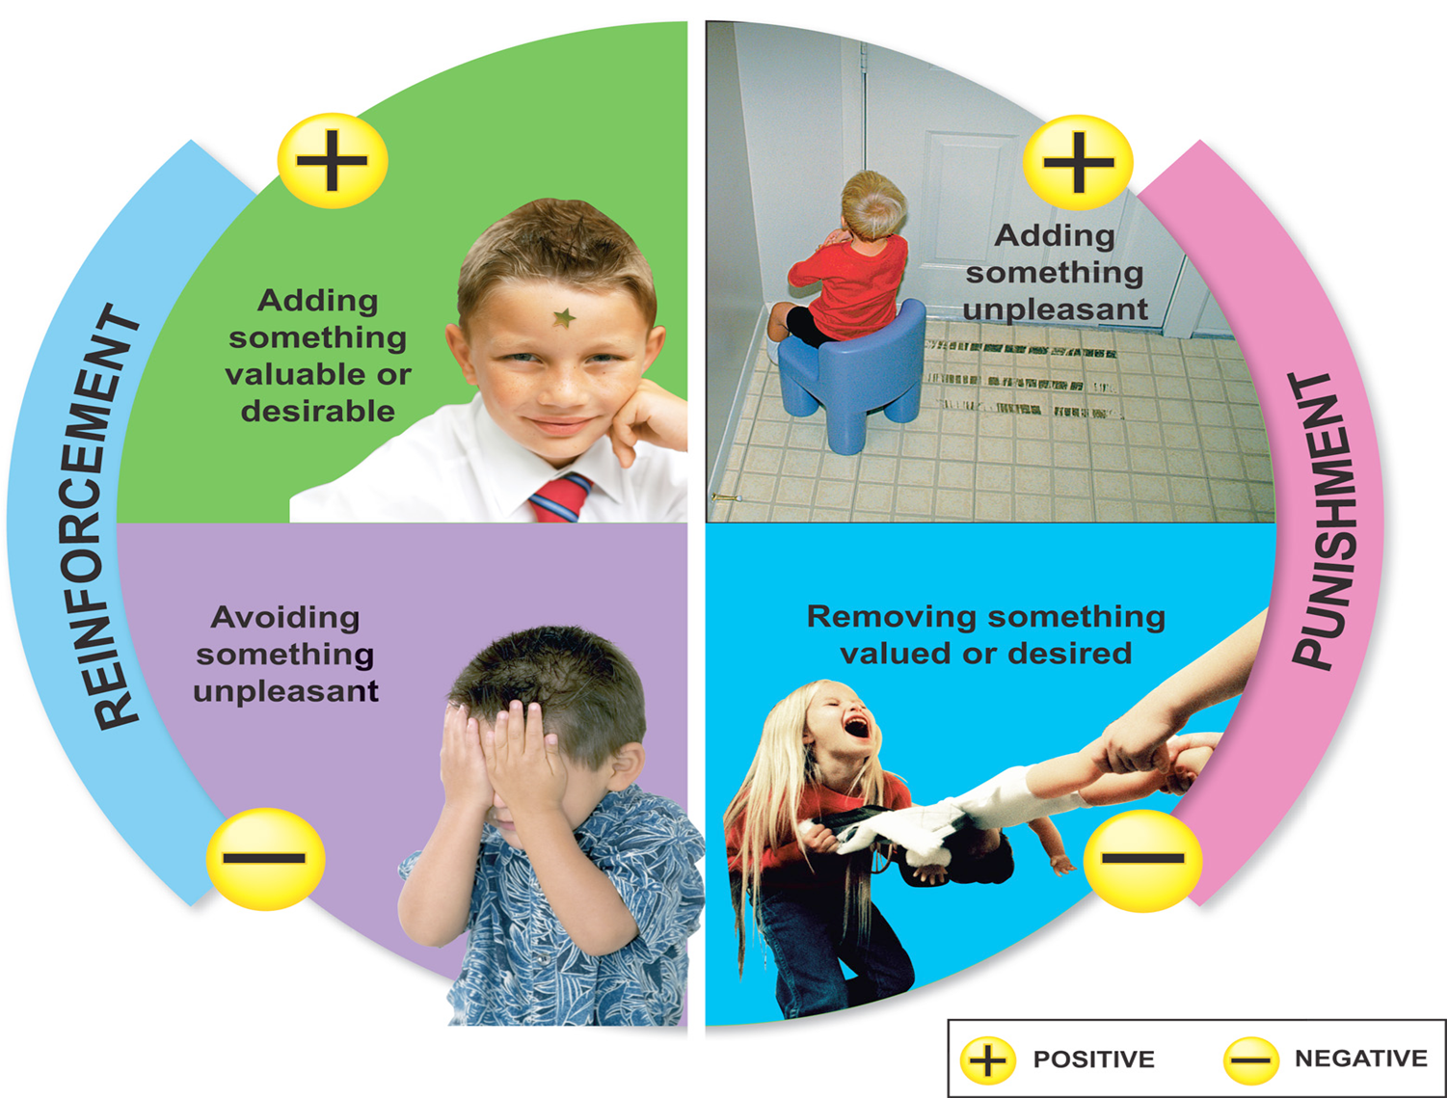
Punishment
Punishment is a consequence that decreases the likelihood of a behavior occurring again.
Examples:
Heavy fines for misbehavior in sports.
Sitting in I.S.S. after several tardies to school.
Losing eligibility to play sports after poor grades.

Slide 35
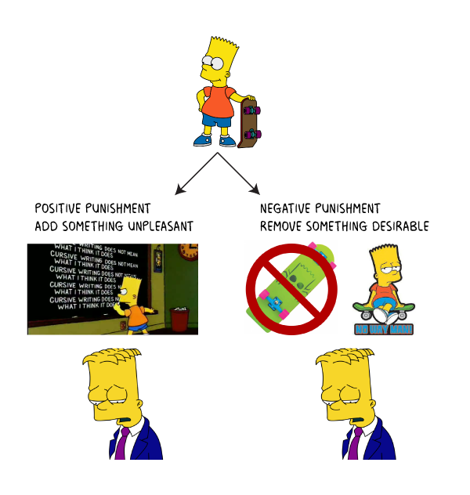
Punishment cont…
Even though punishment suppresses unwanted behavior it does not guide one toward the desirable behavior.
Parents of delinquent youth often lack the awareness of how to reinforce the desirable behavior.
Psychologists favor positive/negative reinforcement over punishment in child-rearing.

Slide 36
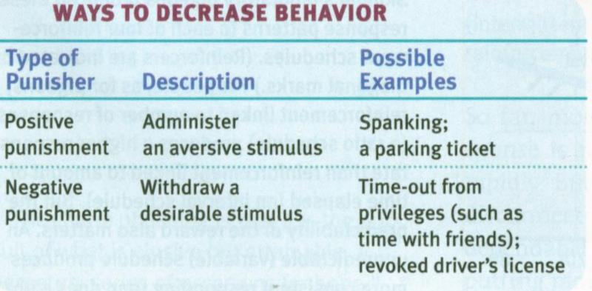
Ways to Decrease Behavior

Slide 37
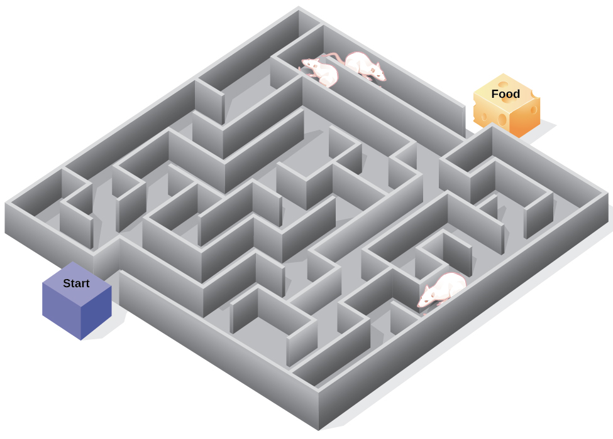
Cognition and Operant Conditioning
Evidence of cognitive processes has come from studying rats in mazes.
Rats exploring a maze with no obvious reward will wander at their leisure.
The rats will develop a cognitive map of the maze.
When a reward is present the rat can get through the maze very quickly.

Slide 38
Cognitive Psychology
Human beings are information processors and that mental representations guide behavior
Psychologists see the mind as a complex machine – where they believe that it is useful to model mental processes using an information-processing approach whereby:
Information is examined from the outside world is received and encoded
Storage and representation of this information to ourselves
Ways in which this information is manipulated and used by the individual
And how we output information back into the world to be received by others.
Psychology can be studied using models.
We can make predictions based on models by making predictions and fitting them into the best model.
The overarching model for cognitive psychology is the computer metaphor.

Slide 39
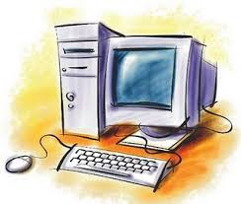
Many cognitive psychologists have used the computer analogy, where they have conceived the human mind as being similar to a computer, in that both can be seen as information processors, to attempt to understand how the brain manages these mental processes (information processing).
The brain in this instance is seen as the hardware and the mind, thoughts and mental representations/images as the software.

Slide 40
They have addressed how the mind selects and codes incoming information and represents knowledge to itself while processing it and combining it with previously stored information (organization), and then how inferences are made based upon this information and therefore how these cognitions affect behavior.
(OR) Both people and computers store information and retrieve it when applicable to current tasks.
People, like computers acquire information from the environment (input).
Both transform information, produce new information and then both return the information back to the environment in the form of behavior (output).

Slide 41
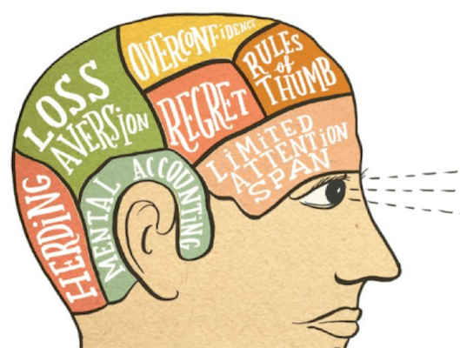
Behavioral economics
People make mistakes in their judgments, and these mistakes are not just random deviations from the norm.
Sometimes biases are systematic and predictable.
Irrational decisions are an important part of human behavior.
Irrationality in judgment and decision making should be accounted for in the models of cognitive functioning.

Slide 42
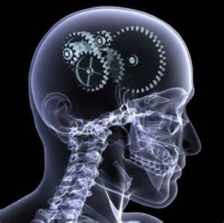
MEMORY

Slide 43
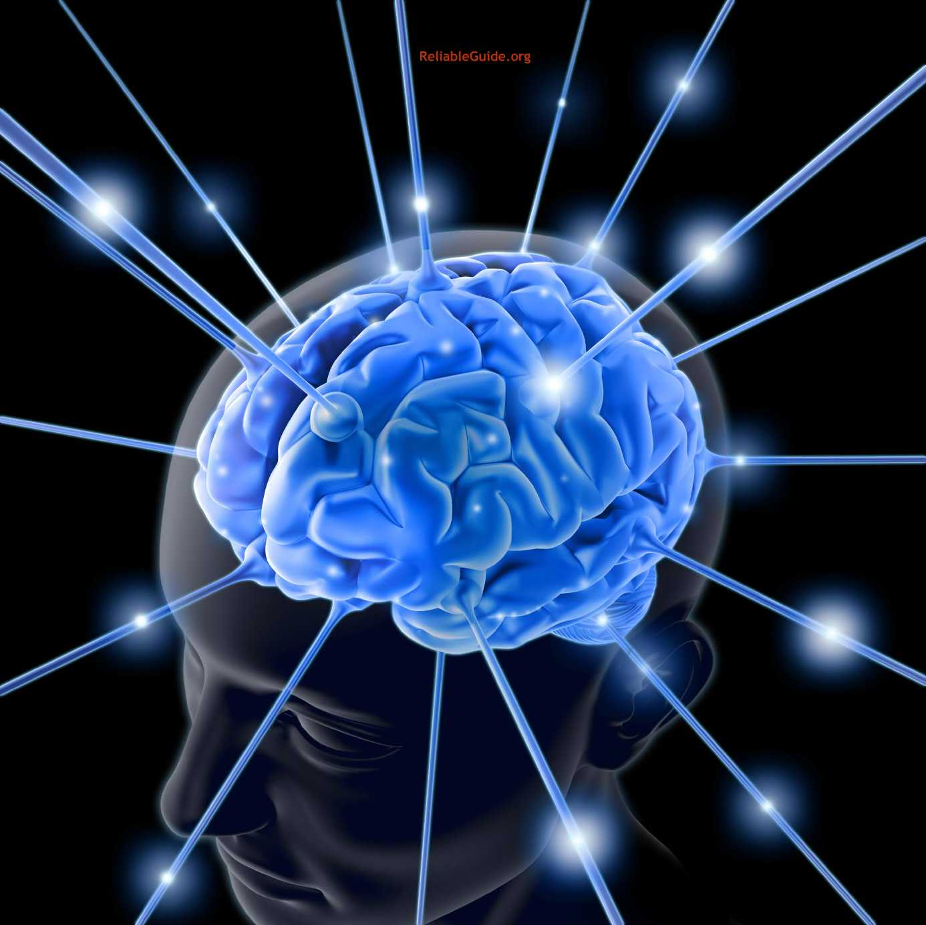
MEMORY
In psychology, memory is an organism's ability to store, retain, and subsequently retrieve information.
Traditional studies of memory began in the realms of philosophy, including techniques of artificially enhancing the memory.

Slide 44
Processes
There are several ways to classify memories, based on duration, nature and retrieval of information.
From a information processing perspective there are three main stages in the formation and retrieval of memory:

Slide 45
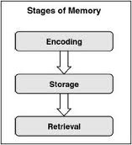
Encoding or registration (receiving, processing and combining of received information)
Visual Encoding- images
Acoustic Encoding- sounds
Semantic Encoding- meaning
Storage (creation of a permanent record of the encoded information)
Retrieval or recall (calling back the stored information in response to some cue for use in a process or activity)

Slide 46
attention
The condition that has to be met for information to transfer from sensory memory to short term memory is attention.
If a unit of memory is attended to, it does not decay, but moves to the next memory store.
If it does not catch our attention it fades away.

Slide 47
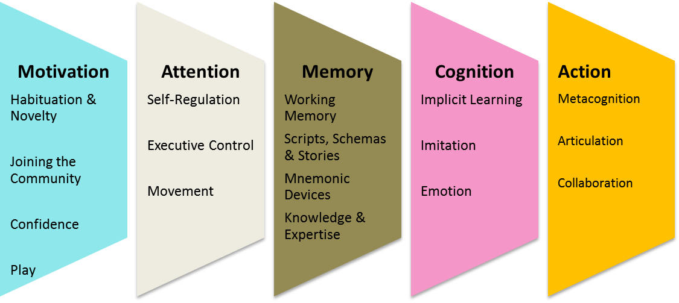

Slide 48
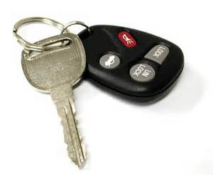
Automatic Process
Time: during the day you unintentionally note the sequence of the days events. Later when you realize you lost something you go back through the sequence to retrace your steps.
Space: you may encode the place where something appears when you try to retrieve it later. When you struggle to recall the information you visualize its location.
Frequency: you keep track of how often things happen such as noticing that this is the third time you may have seen someone today.

Slide 49
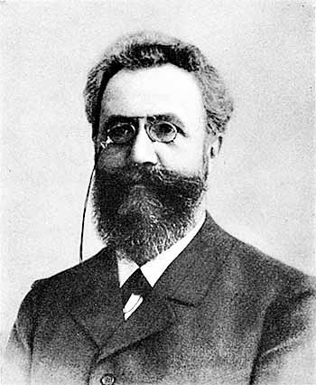
Effortful Processing
We can enhance our memory through rehearsal and repetition. This was shown by the German researcher Ebbinhaus. This method often produces durable and accessible memories.
Ebbinhaus used verbal material that was not familiar by forming a list of non-sense syllables. He was have the subjects read the list 8 times out loud and then try to recall the items.

Slide 50
JIH, BAZ, FUB, YOX, SUJ, XIR, DAX, LEQ, VUM, PID, KEL, WAV, TUV, ZOF, GEK, HIW

Slide 51
Results
Ebbinhaus would try to recall them the day after. He could recall a few but were they entirely forgotten?
It took fewer repetitions on the second day to recall the list. This began the simple beginning principle that “the amount remembered depends on the amount of time spent learning”.
Three times three study at Kent State.
JIH, BAZ, FUB, YOX, SUJ, XIR, DAX, LEQ, VUM, PID, KEL, WAV, TUV, ZOF, GEK, HIW

Slide 52
Iconic and echoic memory
Iconic Memory: Iconic memory is the visual sensory memory register pertaining to the visual domain and a fast-decaying store of visual information. It is a component of the visual memory system which also includes visual short-term memory and long-term memory.
Echoic Memory: Echoic memory is the sensory memory register specific to auditory information. The sensory memory for sounds that people have just perceived is the form of echoic memory. Unlike visual memory, in which our eyes can scan the stimuli over and over, the auditory stimuli cannot be scanned over and over.

Slide 53
3 Stage Model
Atkinson-Shiffrin Model
#21
Each of these components is characterized by a specific duration, capacity, and conditions.

Slide 54
Classification
A basic and generally accepted classification of memory is based on the duration of memory retention, and identifies three distinct types of memory:
sensory memory
short term memory
long term memory

Slide 55
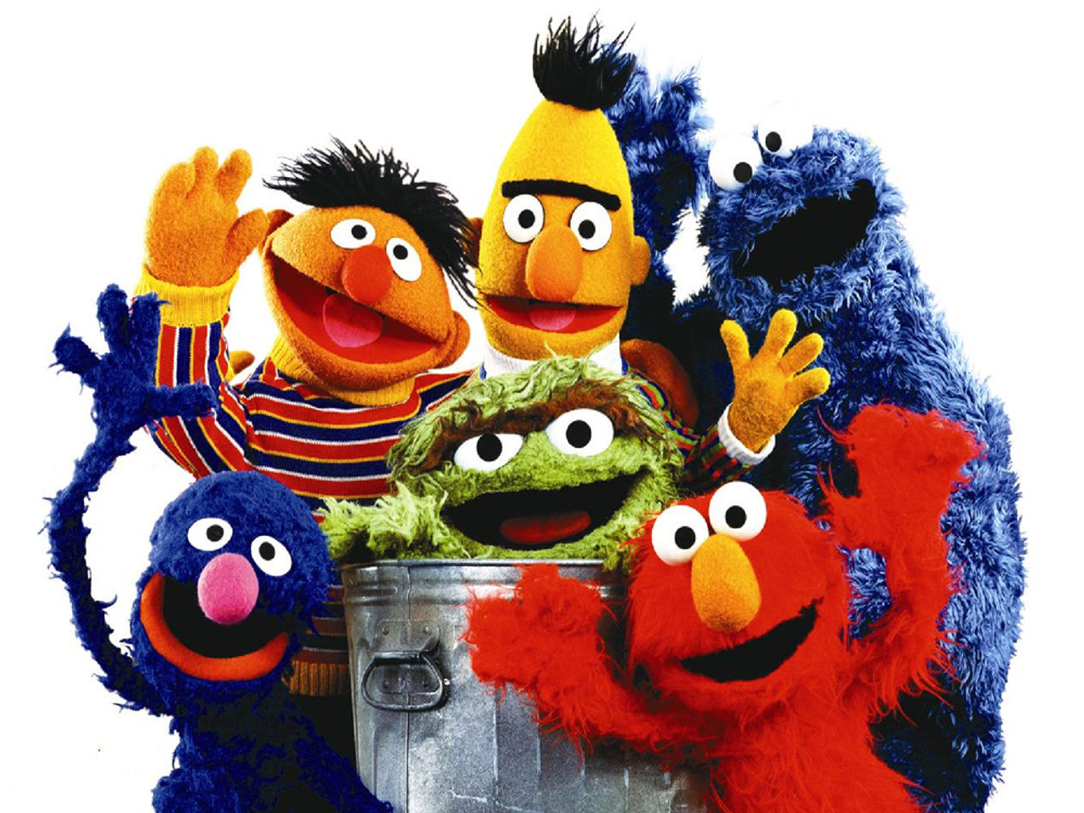
Sensory
Sensory memory corresponds approximately to the initial 200 - 500 milliseconds after an item is perceived.
The ability to look at an item, and remember what it looked like with just a second of observation, or memorization, is an example of sensory memory.
The first experiments exploring this form of sensory memory were conducted by George Sperling. This type of memory decays very quickly.
Notes:
I flash this image up for them for just a second and then ask who was in the picture.

Slide 56
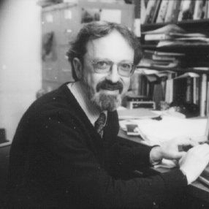
George Sperling
Sperling, through several experiments, was able to prove his hypothesis that human beings store a perfect image of the visual world for a brief moment, before it is discarded from memory.
Sperling performed an experiment using a matrix with three rows of four letters. Participants of the study were asked to look at the letters, for a brief period of time, and then recall them immediately afterwards

Slide 57
P B Q H
C Z L A
R K F T
Notes:
This slide is only up for a short time and then I have them try to write it down. I then show the slide again.

Slide 58
P B Q H
C Z L A
R K F T

Slide 59
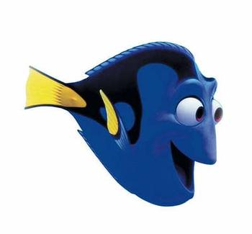
SHORT TERM MEMORY
Short-term memory allows one to recall something from 20-30 seconds without rehearsal.

Slide 60
George Sperling
G 7 Y 5
B R 3
K 4 M 6
If you present people with randomly scattered letters and numbers, and ask people to recall the letters (or numbers), which is a partial report task, people perform very poorly.
This is because the category “number” vs. the category “letter” is semantic in nature. The fact that people have a difficult time recalling that information suggests that SM is veridical and sensory (i.e., no meaning).
G 7 Y 5
B R 3
K 4 M 6
Notes:
I only allow the grid to been shown for a short period of time.

Slide 61
Free Recall
The technique, called "free recall" showed that participants were able to, on average, recall 4-5 letters of the 9 they were given.
This however, was already generally accepted in the psychological community, but Sperling believed that all 9 letters were stored in the viewer's memory for a short period of time, but the memory failed so rapidly that only 4 or 5 could be recalled.

Slide 62
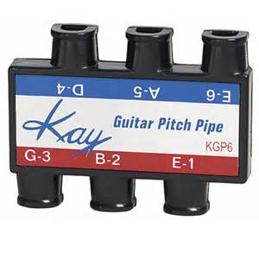
Cued Recall
Sperling proved this with his experiment of cued recall. This trial was similar to free recall, however, instead if allowing participants to recall ANY of the letters, it would allow them to view the same matrix for the same amount of time, and then hear a pitch corresponding to a different row in the matrix.
The viewer was to recall the letters in that corresponding row. On average, viewers were able to recall more during cued recall trials than free recall. Sperling built upon this experiment to then determine the amount of time before information was discarded from a person's memory

Slide 63
ACTIVITY

Slide 64
The Next In-Line Effect
When people form a circle and have to remember what the people before them said, their poorest memories are of the person who was right before them.
When we are the next in line we tend to focus on our own performance and fail to process the information from the person before us.
research indicates that this next-in-line memory deficit reflects a failure at encoding, rather than retrieval.
Notes:
Before this slide I have the students do an activity where they stand in a circle and have to go around and say each person’s name and birthday. Each new person has to say all of the one’s before them. By the time we get half way around the circle the next in-line effect becomes clear.

Slide 65
Modern estimates of the capacity of short-term memory are typically on the order of 4-5 items, and we know that memory capacity can be increased through a process called chunking.
For example, if presented with the string:
FBIPHDTWAIBM
people are able to remember only a few items. However, if the same information is presented in the following way:
FBI PHD TWA IBM
people can remember a great deal more letters.
This is because they are able to chunk the information into meaningful groups of letters.
CHUNKING

Slide 66
ELEPHANT
FALCON
TIGER
FLAMINGO
CAT
CANDLESTICK
DONKEY
LLAMA
TURTLE
ROOSTER
LION
EAGLE
MEMORIZE THE FOLLOWING LIST:

Slide 67
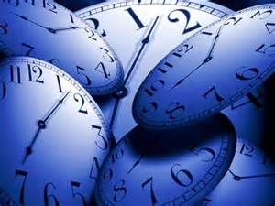
Why We Remember What We Remember
Short Term Memory There are typically six reasons why information is stored in our short term memory.
1. primacy effect - information that occurs first is typically remembered better than information occurring later. When given a list of words or numbers, the first word or number is usually remembered due to rehearsing this more than other information.
2. recency effect - often the last bit of information is remembered better because not as much time has passed; time which results in forgetting.

Slide 68
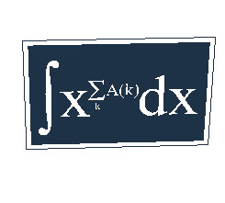
3. distinctiveness - if something stands out from information around it, it is often remembered better. Any distinctive information is easier to remember than that which is similar, usual, or mundane.
4. frequency effect - rehearsal, as stated in the first example, results in better memory. Remember trying to memorize a formula for your math class. The more you went over it, the better you knew it.

Slide 69
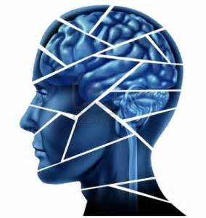
5. associations - when we associate or attach information to other information it becomes easier to remember. Many of us use this strategy in our professions and everyday life in the form of acronyms.
6. reconstruction - sometimes we actually fill in the blanks in our memory. In other words, when trying to get a complete picture in our minds, we will make up the missing parts, often without any realization that this is occurring.

Slide 70
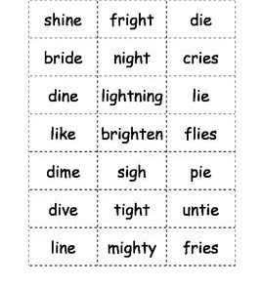
Glanzer and cunitz
Glanzer and Cunitz are famous for their studies on serial position effect.
These studies are support for the idea that STM and LTM are separate memory stores.
Serial position effect is the tendency to recall the first and last items on the list better than the middle.
Participants memorize a list of words followed by a free recall task.

Slide 71
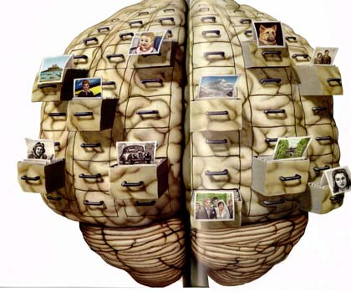
LONG TERM
MEMORY

Slide 72
Long Term
The storage in sensory memory and short-term memory generally have a strictly limited capacity and duration, which means that information is available for a certain period of time, but is not retained indefinitely.
By contrast, long-term memory can store much larger quantities of information for potentially unlimited duration (sometimes a whole life span).
For example, given a random seven-digit number, we may remember it for only a few seconds before forgetting, suggesting it was stored in our short-term memory.

Slide 73
On the other hand, we can remember telephone numbers for many years through repetition; this information is said to be stored in long-term memory.
One of the primary functions of sleep is improving consolidation of information, as it can be shown that memory depends on getting sufficient sleep between training and test, and that the hippocampus replays activity from the current day while sleeping.

Slide 74
Why do we remember some things better than others?
In March 2007 German researchers found they could use odors to re-activate new memories in the brains of people while they slept and the volunteers remembered better later.
Emotion can have a powerful impact on memory. Numerous studies have shown that the most vivid autobiographical memories tend to be of emotional events, which are likely to be recalled more often and with more clarity and detail than neutral events.

Slide 75
Flashbulb Memory
The Day Bambi’s Mom was Shot

Slide 76
Flashbulb memories typically are remarkably vivid and seemingly permanent memories.
These memories are typically of highly emotional and personal events in one's life.
Flashbulb memories can also be of personal circumstances during an event that did not affect one personally, such as a leader's assassination or a devastating airline crash.

Slide 77
FLASHBULB MEMORY
Flashbulb Memories is a special kind of emotional memory, which refers to vivid and detailed (photographic-like) memories of highly emotional events that appear to be recorded in the brain as though with the help of a ‘camera’s flash.’
Brown & Kulik (1977) also argued that the special biological memory mechanism of FBM is triggered when an individual usually encounters significant, often unexpected and emotional events or experiences (that has had exceeded levels of surprise and emotion) therefore creating a FBM of the immediate experiences surrounding the highly emotional (happy) experience or traumatic event.

Slide 78
FBM theory also have unique features distinguishing/that differ them from other memories in that they are more vivid, detailed, accurate, long-lasting, consistent and easily to remember.
This is in contrast to normal memories, which most researchers are believed to be selective, unreliable and malleable (easily changed or distorted).

Slide 79
Method:
Interviewed 80 Americans
40 African Americans
40 Caucasian Americans
Had to answer questions about 10 events
9 of these events were mostly on assassinations or attempted assassinations of well-known American personalities
The last event was self-selected of personal events that included self-shock
They were asked how much they rehearsed these events (overtly or covertly)
Overly: rehearsal by discussing with other people
Covertly: private rehearsing or ruminating

Slide 80
Results
They found that J.F. Kennedy's assassination in 1963 led to the most flashbulb memories of all participants (90% of participants recalled this in context and with vivid detail)
African Americans recalled more FBM's of civil right leaders; e.g. the assassination of Martin Luther King more than the Caucasians recalled it (as a FBM)
For the tenth event (which was self-selected) most participants recalled shocking events like the death of a parent.

Slide 81
Some theorists have suggested that a certain flashbulb mechanism is responsible for capturing such events and storing them in memory for an indefinite period of time, yet others suggest that these memories are not encoded any differently than others.
What makes flashbulb memories different, they argue, is that they are much more often rehearsed. Personal reactions to such events are usually brought up in conversation often, and so they are remembered more often.

Slide 82
Memorization
Memorization is a method of learning that allows an individual to recall information verbatim. Rote learning is the method most often used.
The spacing effect shows that an individual is more likely to remember a list of items when rehearsal is spaced over an extended period of time.
In contrast to this is cramming which is intensive memorization in a short period of time.
Also relevant is the Zeigarnik Effect which states that people remember uncompleted or interrupted tasks better than completed ones.

Slide 83
Retrieval of Memory
Recall: a measure of memory in which the person must retrieve information learned earlier.
Recognition: a measure of memory in which the person need only to identify previously learned items.
Relearning: a memory measure that assesses the amount of time saved when learning material for a second time.

Slide 84
Memory Tasks
Paired associate learning - when one learns to associate one specific word with another. For example when given a word such as "safe" one must learn to say another specific word, such as green. This is stimulus and response.

Slide 85
How to build a memory palace
Choose a place you can easily visualize as the blueprint for your palace.
Walk through your palace to define a route.
Identify specific locations in the palace to store your information.
Practice visualizing your finished palace by physically drawing it.
Place important information in small chunks around the palace.
Use simple images to symbolize complicated phrases or numbers.
Spend at least 15 minutes exploring your palace every day. T

Slide 86
Mnemonic Devices
Mnemonic systems (or strategies) are conscious strategies and techniques that people use to remember information better than simply rehearsing the information. Thus, these strategies can be considered types of elaborative rehearsal, where a person is actively trying to remember and encode some information.
Probably the oldest known mnemonic is the method of loci, where a person associates things that need to be remembered with specific locations that are familiar.

Slide 87
A Web of Associations
The process of retrieving a memory follows the principle that because memories are stored by a web of associations, each piece of information is interconnected with others.
When you encode into memory a target piece of information you associate it with other information.
Priming: to retrieve a specific piece of information, you must first need to activate one of the strands that leads to it.

Slide 88
Was I here before?
Context Effect: putting yourself back into the context of what you were doing can prime your memory retrieval.
Déjà vu: French for “already seen”. Being in the context of one we’ve been in before can trigger the experience of déjà vu.
The familiar context activates memories that make you believe you have seen or done this before.

Slide 89
Mood Congruent Memory
Emotion can cue a memory. The emotion can prime us to remember associated events.
State-dependent memory: what we remember in what state we will recall when we are in that state again.
Sad= Sad
Happy= Happy
Drunk= Drunk
When people are depressed or drunk they do not properly encode information so it is more difficult to recall. It would be more likely to be recalled when they are in that state again.

Slide 90
FORGETTING
There are three general ways in which our memory fails us.
Encoding Failure
Storage Decay
Retrieval Failure

Slide 91
Three Sins of Forgetting:
Absent Mindedness: inattention to details produces failure to encode.
Transience: storage decay over time, unused information decays.
Blocking: inaccessibility, we can almost remember the name but it is “one the tip of our tongue”. It cannot be retrieved.

Slide 92
Three Sins of Distortion:
Misattribution: confusing the source of information.
Suggestibility: lingering affects of misinformation, false memory.
Bias: belief-colored recollections

Slide 93
Amnesia
Amnesia is a condition in which memory is disturbed. In simple terms it is the loss of memory.
Organic causes include damage to the brain, through trauma or disease, or use of certain (generally sedative) drugs.
Functional causes are psychological factors, such as defense mechanisms.

Slide 94
Two Types:
In anterograde amnesia, new events contained in the immediate memory are not transferred to the permanent as long-term memory.
Retrograde amnesia is the distinct inability to recall some memory or memories of the past, beyond ordinary forgetfulness.

Slide 95
Post-traumatic amnesia is generally due to a head injury (e.g. a fall, a knock on the head). Traumatic amnesia is often transient, but may be permanent of either anterograde, retrograde, or mixed type.
Mild trauma, such as a car accident that results in no more than mild whiplash, might cause the occupant of a car to have no memory of the moments just before the accident due to a brief interruption in the short/long-term memory transfer mechanism.

Slide 96
Dissociative Amnesia results from a psychological cause as opposed to direct damage to the brain caused by head injury, physical trauma or disease, which is known as organic amnesia.
Repressed memory refers to the inability to recall information, usually about stressful or traumatic events in persons' lives, such as a violent attack or rape.
The memory is stored in long term memory, but access to it is impaired because of psychological defense mechanisms. Persons retain the capacity to learn new information and there may be some later partial or complete recovery of memory.

Slide 97
Dissociative Fugue is also known as fugue state. It is caused by psychological trauma and is usually temporary, unresolved and therefore may return.
Some define it as "one or more episodes of amnesia in which the inability to recall some or all of one's past and either the loss of one's identity or the formation of a new identity occur with sudden, unexpected, purposeful travel away from home." While popular in fiction, it is extremely rare.

Slide 98
Other Types of Amnesia
Source amnesia is a memory disorder in which someone can recall certain information, but they do not know where or how they obtained the information.
Memory distrust syndrome is a term invented by the psychologist Gisli Gudjonsson to describe a situation where someone is unable to trust their own memory.

Slide 99
Blackout phenomenon can be caused by excessive short-term alcohol consumption, with the amnesia being of the anterograde type.
Korsakoff's syndrome can result from long-term alcoholism or malnutrition. It is caused by brain damage due to a Vitamin B1 deficiency and will be progressive if alcohol intake and nutrition pattern are not modified.

Slide 100
Drug-induced amnesia is intentionally caused by injection of an amnesiac drug to help a patient forget surgery or medical procedures, particularly those which are not performed under full anesthesia, or which are likely to be particularly traumatic.
Memories of the short time frame in which the procedure was performed are permanently lost or at least substantially reduced, but once the drug wears off, memory is no longer affected.

Slide 101
Organization of LTM
Explicit or Declarative memory
Information for facts
Information we are conscious of
Implicit or Procedural (non-declarative) memory
Information about how to perform tasks.
Unconscious information that influences behavior.

Slide 102
Illusion of Truth
The illusion-of-truth effect states that a person is more likely to believe a familiar statement than an unfamiliar one.
In a 1977 experiment participants were asked to read 60 plausible statements every two weeks and to rate them based on their validity.
A few of those statements (some of them true, others false) were presented more than once in different sessions.
Results showed that participants were more likely to rate as true statements the ones they had previously heard (even if they didn't consciously remember having heard them), regardless of the actual validity of the statement.
Hasher, Goldstein,
And Toppino
Illusion-of-truth effect occurs even without explicit knowledge, it is a direct result of implicit memory

Slide 103
#21
Evaluate two models or theories of one cognitive process with reference to research studies.

Slide 104
Atkinson-Shiffrin Model
The Atkinson-Shiffrin classics three-stage model of memory suggests that we:
register fleeting sensory memories.
processed into on-screen short term memories and
a small fraction of those are encoded into long term memory.
The multi-store model (also known as Atkinson-Shiffrin memory model) was first recognised in 1968 by Atkinson and Shiffrin

Slide 105
Multi-Store Model
Proposed by Atkinson & Shiffrin (1968)
The multi-store model (MSM) consists of three memory stores:
Sensory memory (SM)
Short-term memory (STM)
Long term memory (LTM)

Slide 106
Criticisms of AS Model
The multi-store model has been criticized for being too simplistic.
For instance, long-term memory is believed to be actually made up of multiple subcomponents, such as episodic and procedural memory.
It also proposes that rehearsal is the only mechanism by which information eventually reaches long-term storage, but evidence shows us capable of remembering things without rehearsal.

Slide 107
Clive Wearing
Wearing still has ability to talk, read, write, and sight-read music (procedural knowledge)
He could not transfer information from STM and LTM.
His memory lasted 7-30 seconds, and he was unable to form new memories.
Conclusion:
STM & LTM are separate stores
STM has limited duration

Slide 108
Working Memory Model
In 1974 Baddeley and Hitch proposed a working memory model which replaced the concept of general short term memory with specific, active components.
In this model, working memory consists of three basic stores:
1. the central executive,
2. the phonological loop
3. and the visuo-spatial sketchpad.

Slide 109
Working Memory
Working memory is often believed to be a subsystem of short term memory that uses information from short term memory and even from long term memory to accomplish a goal.
That is, working memory actively maintains current information in short term memory.

Slide 111
Central Executive
The central executive is the “boss” that governs all of the activity of the subordinate, systems. It divides up the processing responsibilities of different systems.
The central executive essentially acts as attention. It channels information to the three component processes: the phonological loop, the visuo-spatial sketchpad, and the episodic buffer.

Slide 112
Phonological Loop
The phonological loop stores auditory information by silently rehearsing sounds or words in a continuous loop; the articulatory process (the "inner voice")
The phonological loop has a very limited capacity, which is demonstrated by the fact that it is easier to remember a list of short words (e.g. dog, wish, love) than a list of long words (e.g. association, systematic, confabulate) because short words fit better in the loop.

Slide 113
Central Executive and Phonological Loop
Once it has received the info from the Phonological Buffer, it may decide to rehearse it by sending it back to the Phonological Buffer.
The loop from Central Executive to Phonological Buffer and back allows for repeated rehearsal.

Slide 114
Visuo-Spatial
The visuo-spatial sketchpad stores visual and spatial information.
It is engaged when performing spatial tasks (such as judging distances) or visual ones (such as counting the windows on a house or imagining images).

Slide 115
Visuo/Spatial Scratchpad
We are also able to store visual and spatial patterns.
The Central Executive can store and retrieve information using the Visuo/Spatial Scratchpad, just as it does with the Phonological Buffer.

Slide 116
Shallis &
Warrington
STUDY
KF was in a motorcycle accident which impaired his memory
Findings: He could transfer information from STM to LTM
He suffered problems with STM of different types of information
digit span was severely impaired
visual and auditory information (e.g. telephone ring) was unaffected
Conclusion: Findings suggest that:
STM & LTM are separate
STM is not There may be more than one STM store --> it is possible to suffer impairment of verbal information without affecting auditory information
equired for LTM

Slide 117
Aim: To investigate encoding in the short term memory store
Methods: Participants were given lists of words that were:
acoustically similar (e.g. cat, mat...)
acoustically different (e.g. pen, cow...)
semantically similar (e.g. boat, ship...)
semantically different (e.g. book, tree...)
Their recall of the words was tested.
Results:
In STM, better recall of acoustically different than acoustically similar words
more errors with similarly sounding words than distinctly sounding words
Slightly better recall of semantically different words than semantically similar words’
Baddeley
1966

Slide 118
Aim:
To investigate encoding in LTM
Method:
Participants were given the same lists of words in the previous experiment for STM Their recall of the words was tested
Results:
In LTM, no difference in recall of acoustically different and acoustically similar words Much better recall of semantically different words than semantically similar words

Slide 119
Conclusion:
In LTM, there is semantic encoding because recall is affected by meaning of words
Evaluation:
Strengths
strict control over variables
able to determine a cause-effect relationship between
Weaknesses Lacks ecological validity
Task is unrealistic; does not reflect daily activity
participants would do

Slide 120
Alzheimer’s
Alzheimer’s Disease is a serious and progressive degenerative brain disease, which leads to the loss of neurons and often leading to dementia.
The onset of symptoms is gradual but its progression is irreversible.
AD impairs the creation of new memories but procedural memory (how to die a bike or play a musical instrument) is largely unaffected.
Episodic memory (memory of events and personal experiences) is the most severely affected. Episodic memory problems are the earliest symptoms of AD
AD also causes a steady decline in the semantic memory – general knowledge about the world, concepts and language.

Slide 121
STROOP
The effect is named after John Ridley Stroop who first published the effect in English in 1935.
The effect had previously been published in 1929, but only in German.
The original paper has been one of the most cited papers in the history of experimental psychology, leading to over 700 replications.

Slide 122
Active Memory
To understand the mental process involved try this experiment. Look at the following letters on the screen:
tree
If you are like most people it is difficult for you not to quickly read the word "tree."
Most humans are so proficient at reading printed words that they cannot easily ignore them. In fact it takes considerable attentional effort to ignore them. This tendency to quickly read a word is used in the Stroop Task

Slide 123
Automatic Processing versus Effortful Processing
Current research on the Stroop effect emphasizes the interference that automatic processing of words has on the more mentally "effortful" task of just naming the colors. when given two conflicting signals -- has tentatively been located in a part of the brain called the anterior cingulate.
This is a region that lies between the right and left halves of the frontal portion of the brain.

Slide 124
What is a Schema?
#22
Explain Schema Theory and how it influences memory.
In psychology a schema is an organized pattern of thought about a certain subject.
It is a mental structure that we create.
It is a cognitive representation of our views on a certain subject.
A cognitive schema can be defined as networks of knowledge, beliefs, and expectations about particular aspects of the world.
What we already know will influence the outcome of our information processing.

Slide 125
What Schema do you have for the following:
A fireman
A ballet dancer
A politician
A college student
A male
A female

Slide 126
Biological Sex Identity
Sex means biological maleness/femaleness
Genetic sex denotes chromosomes (xy & xx)
Anatomical sex denotes the physical sex features
Gender therefore becomes the psycho-social meaning attached to the biological maleness & femaleness

Slide 127
What is gender identity?
Gender identity is the individual’s subjective sense of belonging to the male or female category or indeed neither of the two.
Gender may determine self concept and self esteem.
Gender may determine the talents that are cultivated/encouraged (boys vs girls knowledge & skills).
Biologically sex differences may also determine traits.

Slide 128
Gender Roles
Gender roles are our expectations
about the way men and women behave.
30 years ago:
Men were expected to initiate dates, drive the car, pick up the check.
Women were expected to decorate the home, raise the children, and cook and clean.
Do gender roles reflect what is biologically natural for men and women or do cultures construct them?

Slide 129
FREE TO BE YOU AND ME
An ABC special, also created by Marlo Thomas, using poetry, songs, and sketches followed two years later in March 1974.
The basic concept was to encourage post-1960s gender neutrality, saluting values such as individuality, tolerance, and comfort with one's identity. A major thematic message is that anyone—whether a boy or a girl—can achieve anything.

Slide 130
Pink vs. Blue
Gender differences surface early in children’s play. Boys typically play in large groups with activity focus and little intimate discussion. Girls usually play in smaller groups with one friend.
Girls are less competitive in their play than boys and initiate social relationships.

Slide 131
Child Rearing
Gender Identity: our sense of being male or female.
Gender-typed: some boys exhibit more masculine traits and some girls exhibit more feminine traits.
Social Learning Theory
This theory assumes that children learn gender-linked behaviors by observing and imitating and by being rewarded or punished.
“Big boys don’t cry.” Or “You are a good mommy to your dolls.”

Slide 132
Social learning theory
Almost from birth children are treated in gender specific ways (e.g birth day cards & dress)
Parents & society reinforce gender specific behaviors & attitudes.
Boys and girls imitate males & females respectively

Slide 133
Would you let your son have a dollhouse? Would you allow your daughter to join the wrestling team?

Slide 134
William Wants a Doll
When I Grow UP
It’s Alright to Cry

Slide 135
Gender Schema Theory
This theory combines social learning theory with cognition. Gender becomes a lens through which you view your experiences.
Age 1- Children discriminate between male and female voices.
Age 2- Children organize their language according to gender he/she
Age 3/4- Children seek out their own gender for play.
Age 5/6- Stereotypes about boys/girls peak.

Slide 136
Gender Schema Theory
Links cognitive development with social learning theory in the sense that schemas are socialized cognitive networks of sex & gender roles
People with high gender schemas are more prone to stereotypic perception & behavior.
High schemas facilitate the creation of cognitive gender stereotypes & gender values.

Slide 137
Identity constructed theory
This theory emphasises the individual’s sense of commitment to a gender category.
A person may feel they belong to the gender that matches with their assigned biological sex.
A person may feel they belong to the gender that is the opposite of their assigned biological sex.
The gender category may conflict with social norms (McManus 1999) - may lead to gender dysphoria.

Slide 138
Gender Dysphoria
Gender dysphoria (formerly gender identity disorder) is defined by strong, persistent feelings of identification with the opposite gender and discomfort with one's own assigned sex that results in significant distress or impairment.
People with gender dysphoria desire to live as members of the opposite sex and often dress and use mannerisms associated with the other gender. When sex identity is in conflict with gender identity (biological vs psycho-social identity)
Sex identity is given & genetic while gender identity & roles are culturally constructed.
Gender dysphoria is not the same as gender nonconformity, which refers to behaviors not matching the gender norms or stereotypes of the gender assigned at birth.
Gender dysphoria is also not the same being gay/lesbian.

Slide 139
Schemas and encoding
Bransford and Johnson carried out an experiment involving the effect of context on comprehension and memory of text passages.
They used independent measures with five groups of participants.
Participants listened to a recorded passage about popping of balloons and sound. They were then asked to recall the passage as accurately as possible and if they could not remember it exact to put the main ideas.
There were five conditions.

Slide 140
Bransford and Johnson
The five conditions were as follows:
No context, the participants just heard the passage.
No context, the participants heard the passage twice.
Context before: prior to hearing the passage participants were provided with a context picture and given 30 seconds to study it.
Context after: the same picture was shown, but after the participants heard the passage.
Partial Context: a context picture was shown before the passage was read but the objects were rearranged.

Slide 141
results
There were 14 ideas in the passage.
No context (1) 3.6 units remembered.
No context (2) 3.8 units remembered.
Context before 8.0 units remembered.
Context after 3.6 units remembered.
Partial context 4.0 units remembered.
Context before made a difference. Schema theory would suggest that having a mental representation prior to the passage helps with memory. The ideas were more effectively encoded because they were linked to the schema.

Slide 142
Schema and Retrieval
Anderson and Pichert demonstrated that schemas not only influence encoding but also influence retrieval.
Student participants were gathered and told they were in a study concerning how people think about and remember stories.
Each participant was assigned as either the homebuyer or the burglar.
They are asked to read a passage that has a number of points that would be of interest to a burglar or a real estate agent.

Slide 143
Method
Assign burglar and real estate agent roles.
Read passage for 2 minutes.
12 minute filler task involving vocabulary.
Reproduce story as much as possible on blank paper.
Another 5 minute filler task
Take on the other perspective and recall story or keep the same perspective and recall the story again.

Slide 144
results
First group: burglars recalled more burglar info and homebuyers recalled more homebuyer info.
Second group: people who changed perspective recalled more info that was important the second perspective and unimportant to the first.
Third group: people who did not change perspectives 2.9% less of the non-important information.
Conclusion: Schemas organize knowledge in our memory. New information we receive is actively perceived through the lens of the existing schemas.

Slide 145
exercise
Assess the internal validity. What are the confounding variables?
Assess the external validity. Can this be generalized to a wider population?
Assess the construct validity. What are the IV and DV?
IV: Change in perspective DV: Recall of elements specific to a schema
Can this be replicated?

Slide 146
How accurate is our memory?
The question has arose about how accurate our memory is and can it be distorted?
There are a number of ways in which bias and memory confabulation can occur and affect reliability of memory.
Memory Confabulation: is a memory error defined as the production of fabricated, distorted, or misinterpreted memories about oneself or the world, without the conscious intention to deceive.

Slide 147
Types of Schemas
Social Schemas: mental representations about various groups of people, for example a stereotype.
Scripts: schemas about sequences of events, for example going to a restaurant or making coffee.
Self-Schemas: mental representations about ourselves.

Slide 148
Darley and Gross
In the Darley and Gross study, participants were led to believe that a child (girl), came from a high socio-economic status. (SES)
The other group of participants were told that the child came from a low socio-economic status.
Both groups watched the child take an academic test. They were then required to judge the academic performance of the girl in the video.

Slide 149
Results:
The participants who believed the girl was from a higher socio-economic class believed that she would have a stronger academic performance than those who believed she came from a lower socio-economic class.
This shows that pre-stored schemas about what it means to be rich versus what it means to be poor were used as a lens in which to view the performance of the student.

Slide 150
Bower, Black, and Turner
The aim of this study was to see if in recalling text, subjects will use the underlying script to fill in gaps of actions not explicitly mentioned in the text.
Participants could be given two paragraphs of information. The two paragraphs open and close the same way.
After reading both paragraphs and being asked to recall the information, participants were prone to insert gap fillers.

Slide 151
Self-Schema
Aaron Beck’s Theory of Depression
According to cognitive behavioral theory, depressed people think differently than non-depressed people, and it is this difference in thinking that causes them to become depressed. For example, depressed people tend to view themselves, their environment, and the future in a negative, pessimistic light.
Aaron’s theory suggest that there is a negative schema that a person develops about themselves, and their thinking pattern is the driving force behind depression.

Slide 152
Bottom up and top down processing:
Bottom Up Processing: information processing occurs when the cognitive process is data driven; perception is not biased by prior knowledge or expectations.
Top Down Processing: this occurs when your prior knowledge or expectations (schemas) act as a lens or a filter for the information that you receive and process.

Slide 155
Rat man of bugelski & alampay
Participants in this study saw an ambiguous picture after being exposed to a series of drawings of either animals (condition 1) or faces (condition 2).
1st Condition: participants were more likely to interpret the ambiguous stimulus as a rat.
2nd Condition: participants were more likely to see a man wearing glasses.
After viewing a series of drawings they had an implicit expectation which influenced their perception of reality.

Slide 156
schematic Processing
The Rat Man is an example of top down processing.
It appears that top down processing could be a bad thing because it may lead to bias.
It is actually viewed as necessary because it is impossible to perceive data without background information.
Schematic processing can lead to stereotypes but it is necessary for day to day processing of information in an efficient manner.
Using schematic processing we see patterns in what could otherwise be unstructured stimuli. (pattern recognition)

Slide 157
Thinking and Decision making
#23
Explain how thinking and decision making are related.
It is a response, a reaction of memory. If you have no memory, you would not be able to think.
Memory stored in brain as knowledge is the result of all past experience.
That experience gives knowledge which is stored up in the brain. From knowledge there is memory & from that memory thought.

Slide 158
Decision Making
Chocolate or strawberry? Life or death?
We make some choices quickly and automatically, relying on mental shortcuts our brains have developed over the years to guide us in the best course of action.
Other decisions are agonizing, and deliberation drags on inefficiently.
Some factors that can limit the ability to make good decisions include missing or incomplete information, urgent deadlines, and limited physical or emotional resources.

Slide 159
Decision Making
When making a decision, we form opinions and choose actions via mental processes which are influenced by biases, reason, emotions, and memories.
The simple act of deciding supports the notion that we have free will.
We weigh the benefits and costs of our choice, and then we cope with the consequences.

Slide 160
Normative Models
Normative models: describe the way thinking should be, they assume unlimited time and resources, examples include- formal logic, theory of probability and utility theory.
One example of a normative model is formal logic.
Developed by Aristotle, the building block is a deductive syllogism: a combination of two premises and a conclusion.
Example:
All men are mortal.
All Greeks are men.
All Greeks are mortal.

Slide 161
Theory of probability
Another example of normative economic model is the theory of probability.
The normative thing to do in economics is look at the success or failure frequencies in the past and then make a projected analysis to make the decision.
Utility Theory: is the normative model for decisions involving uncertainty and trade offs between alternatives.
The decision maker has to determine the expected utility (or how much each choice will help) for each option and then choose what maximizes this utility.
Utility theory

Slide 162
Descriptive Models
Descriptive models: describe thinking as it occurs in real life.
Normative decision theories are unrealistic when making decisions in real life.
The do not account for:
Limited computational capacity.
The influence of emotion.
Justifying the choice to others.
One’s own belief system.

Slide 163
Theory of Reasoned Action
The Theory of Reasoned Action aims to explain the relationships between attitudes and behaviors when making choices.
The theory was proposed by Martin Fishbein
It is based on the idea that a person’s choice of behavior is based on expected outcomes of the behavior. (Behavioral intention)
There are two factors that determine behavioral intention:
Attitudes
Subjective norms

Slide 164
Theory of planned Behavior
Attitude describes a person’s individual perception of the behavior (positive or negative)
Subjective norm describes the social pressure regarding the behavior. Is it socially acceptable.
The theory was extended to include the Theory of Planned Behavior.
This theory added a third factor which is perceived behavioral control.
Perceived behavioral control is when attitude is positive and subjective norms do not prevent you from performing the behavior, however you do not think you are able to carry out the action.

Slide 165
Adaptive decision maker framework
Emotion may influence or thinking and decision making.
The consequences from previous decisions create a memory of the emotions that are attributed to that decision.
Payne, Bettman, Johnson
People possess a toolbox of strategies that may be used in thinking and decision making tasks.
People will draw from this toolbox in order to have options or alternatives when making a decision.

Slide 166
Strategies
Weighted Additive Strategy (WADD): in this for every alternative you multiply the value of every attribute by its importance and then calculate the weighted sum. You then choose the alternative with the largest weighted sum.
Lexicographic Strategy (LEX): Choose the most important attribute and the option that has the best value for that attribute.
Sacrificing Strategy (SAT): Determine a specific cut off point for each attribute. Choose the first option and then compare the value of that attribute to the cut off point.
Elimination by Aspects (EBA): Choose the most important attribute and eliminate all the options that do not meet that attribute.

Slide 167
Strategies like WADD and SAT are considered alternative based.
Strategies like LEX and EBA are attribute based.
According to the Adaptive Decision Maker Framework, strategy selection is guided by 4 goals:
1. Maximizing decision accuracy.
2. Minimizing Cognitive effort.
3. Minimizing the experience of negative emotion.
4. Maximizing ease of justification.

Slide 168
Unreliability of memory
#25
To what extent is memory reliable? What is reconstructive memory?
Depending on what schema a person is using to remember information could depend on how reliable their information is in their memory.
The fact that retrieval depends on schemas is one dimension of unreliability of memory.
Memory can also be distorted.
Active process: memory is active in processing information not just passive for retrieval.
Reconstructive Memory: n which the act of remembering is influenced by various other cognitive processes including perception, imagination, semantic memory and beliefs, amongst others

Slide 169
Reconstructing Memory
Misinformation effect
Loftus and Palmer (1974):
People watched a video of a car accident
Asked: ‘How fast were the cars going when they ____ each other?’

Slide 170
Loftus and palmer
Aim: To test their hypothesis that the language used in eyewitness testimony can alter memory.
Procedure: Forty-five American students formed an opportunity sample. This was a laboratory experiment with five conditions, only one of which was experienced by each participant (an independent measures experimental design).
After watching the film participants were asked to describe what had happened as if they were eyewitnesses. They were then asked specific questions, including the question “About how fast were the cars going when they (smashed / collided / bumped / hit / contacted) each other?”

Slide 171
Findings: The estimated speed was affected by the verb used. The verb implied information about the speed, which systematically affected the participants’ memory of the accident.
Participants who were asked the “smashed” question thought the cars were going faster than those who were asked the “hit” question. The participants in the “smashed” condition reported the highest speed estimate (40.8 mph), followed by “collided” (39.3 mph), “bumped” (38.1 mph), “hit” (34 mph), and “contacted” (31.8 mph) in descending order.

Slide 172
Conclusion
Response-bias factors: The misleading information provided may have simply influenced the answer a person gave (a 'response-bias') but didn't actually lead to a false memory of the event. For example, the different speed estimates occur because the critical word (e.g. 'smash' or 'hit') influences or biases a person's response.
The memory representation is altered: The critical verb changes a person's perception of the accident - some critical words would lead someone to have a perception of the accident being more serious. This perception is then stored in a person's memory of the event.
In real life situations, post event information might take aggressive forms such as providing misleading information.
This could happen in police interrogations or eyewitness testimony in the courtroom.

Slide 173
Loftus, palmer, burns
Aim: to see how verbal information supplied after an event influences a witness’s visual memory.
195 participants were shown 30 slides showing the progressive stages of a car/pedestrian accident.
½ of the participants saw a car approach a stop sign and ½ of the participants saw a car approach a yield sign.
After seeing the slides show below the car turns right and hits a pedestrian in a crosswalk.

Slide 174
2-by-2 experiment
After viewing the slides the participants answered a 20 question document.
“Did another car pass the red Datsun while it was stopped at the stop sign?”
“Did another car pass the red Datsun while it was stopped at the yield sign?”
Half of the subjects received consistent post-event information and the other half the information was inconsistent with their visual memories.
After a filler activity the subjects had to pick a slide they had actually seen from a pair of slides.
Participants with misleading information picked the correct slide 41% of the time.
Participants with the correct information picked the correct slide 75% of the time.
Signs in the slides: | STOP | YIELD
STOP | Group 1: Consistent Information | Group 2: Inconsistent Information
YIELD | Group 3: Inconsistent Information | Group 4: Consistent Information

Slide 175
McClosky and ZaraGoza
In order to dispute the Loftus and Palmer study they set up a similar scenario in which their aim was to show response bias.
Subjects were presented with 79 color slides where they saw a maintenance man enter and office, repair a chair, find and steal $20 and a calculator.
There were three different tools that were used to fix the chair depending on the sequence. Hammer, Wrench, Screwdriver.
½ the participants read a narrative that described what they saw as a tool.
½ the participants read a narrative that said wrench or screwdriver.

Slide 176
Results
The critical difference in their experiment was how the forced-choice recognition test was designed.
Participants were given a misleading choice and actual object.
In other conditions they were given the misleading choice and a third choice.
The third choice was not present in the slides or the narrative.
Their conclusion was that misleading information had no effect on the original memory.

Slide 177
Why do We use heuristics?
They save energy.
We don’t have to analyze every aspect of a situation every time we have to make a choice.
They are typically based on experience which means they have been used before.

Slide 178
Heuristics
Heuristics are simple, efficient rules which people often use to form judgments and make decisions.
They are mental shortcuts that usually involve focusing on one aspect of a complex problem and ignoring others.[
These rules work well under most circumstances, but they can lead to systematic deviations from logic, probability or rational choice theory.
The resulting errors are called "cognitive biases“.
In the early 1970s, psychologists Amos Tversky and Daniel Kahneman demonstrated three heuristics that underlie a wide range of intuitive judgments.

Slide 179
Two Independent Systems
System 1: Thinking is fast, instinctive, emotional, automatic and relatively unconscious. (intuition)
System 2: Thinking is slower, more analytical, logical, rule-based and conscious.
We use system 1 in the majority of common situations.
We use system 2 when the situation is uncommon or complex.
Our thinking works sequentially. First we use system 1 which is fast and automatic, then we go to system 2 if more thought and reasoning is required.

Slide 180
ACTIVITY

Slide 181
Intuitive thinking
There have been numerous attempts to identify common heuristics and cognitive biases.
There is no universally accepted classification of heuristics or the underlying causes.
Factors to focus on:
There is a tendency to focus on a limited amount of information.
There is a tendency to seek out information that confirms pre-existing beliefs.
There is a tendency to avoid the mental stress of holding inconsistent cognitions. (cognitive dissonance)

Slide 182
Selective attention
Sensory memory has a high capacity but a very limited duration.
In order for STM to be transferred into LTM it has to be attended to.
Selective attention is when we single out a piece of information from all that is presented as something that needs remembered.
Selective attention is mediated by our existing preconceptions and expectations.
While traveling from sensory to short term memory the information is seen through a lens of schemas.

Slide 183
Change blindness
Change blindness is a failure to detect that an object has moved or disappeared and is the opposite of change detection. The phenomenon of change blindness can be demonstrated even when the change in question is large.
For example, observers often fail to notice major differences introduced into an image while it flickers off and on again.

Slide 184
Change blindness has become a highly researched topic and some have argued that it may have important practical implications in areas such as eyewitness testimony and distractions while driving.
Older drivers make more incorrect decisions than younger drivers when faced with a change in the scene at an intersection.
This can be attributed to the fact that older individuals notice change at a slower rate compared to younger individuals

Slide 185
Change blindness blindness
Change blindness blindness is defined as a misplaced confidence in one's ability to correctly identify visual changes. People are fairly confident in their ability to detect a change, but most people exhibit poor performance on a change blindness task.
Factors affecting
Perceived Success – A higher perception of success from previous experience inflates the individual's confidence for success in future experiences.
Search Time – A longer time spent looking for the visual change creates the impression of poor performance on the task. In other words, a shorter time in identifying a visual change creates the impression of good performance and thus the individual will be overconfident in this ability.

Slide 186
Spotlight effect
The spotlight effect is a social phenomenon that is defined as an overestimation of the ability of others to notice us.
A seemingly obvious change such as another individual changing a sweater during a memory task is rarely noticed.
However, the individuals switching the sweater tend to overestimate the ability of the test writers to notice the change in sweaters.
In the spotlight effect, this poor performance is a result of the overestimation of others' ability to notice us whereas in change blindness it is the overestimation of others' ability to notice the sweater change.
In other words, it is the distinction between noticing differences on a person and noticing differences between any images.

Slide 187
Asymmetric dominance decoy
Huber, Payne, Puto studied decisions involving an asymmetrically dominated decoy.
If you have two choices and you are basing your decision on two important factors the decoy is one that sways your opinion even though it does not rank well in the two factors.
If the example is two items. One cost more than the other. The other one is a lot more money but better quality.
The third choice serves as a decoy to sway your opinion.
This strategy is used in marketing and advertising.

Slide 188
An option is asymmetrically dominated when it is inferior in all respects to one option; but, in comparison to the other option, it is inferior in some respects and superior in others.
In other words, in terms of specific attributes determining preferences, it is completely dominated by (i.e., inferior to) one option and only partially dominated by the other.

Slide 189
The asymmetrical dominance decoy works because people selectively attend to one of the attributes.
They may also like the ability to justify their choice and the decoy may give the person one more reason to select they choice they have made.

Slide 190
Confirmation bias
Another common source of heuristics is the tendency to seek out information that confirms pre-existing beliefs.
Wason’s Four Card Problem.
You have four cards.
Each card has a number on one side and a letter on the other.
If the card has a vowel on one side it has an even number on the other.
You need to decide which card to turn over in order to decide if this is true.

Slide 191
If you turn over the first card and there is an even number it supports the rule. If there is not it refutes the rule.
If you turn over the second card and there is an even number it tells you nothing about the rule.
Turning over the third card could support the rule but it cannot refute it.
The fourth card if turned over and is a consonant it tells you nothing if it is a vowel it refutes the rule.
In their findings: People are more likely to choose items that support their belief than refute it.

Slide 192
Congruence Bias
Congruence bias is a type of cognitive bias similar to confirmation bias. Congruence bias occurs due to people's overreliance on directly testing a given hypothesis as well as neglecting indirect testing.
The classic example of subjects' congruence bias was discovered by Peter Wason.
Here, the experimenter gave subjects the number sequence "2, 4, 6", telling the subjects that this sequence followed a particular rule and instructing subjects to find the rule underlying the sequence logic.
Subjects provided their own number sequences as tests to see if they could ascertain the rule dictating which numbers could be included in the sequence and which could not.
2,4,6,8

Slide 193
Most subjects respond to the task by quickly deciding that the underlying rule is "numbers ascending by 2", and provide as tests only sequences concordant with this rule, such as "3, 5, 7," or even "pi plus 2, plus 4, plus 6".
Each of these sequences follows the underlying rule the experimenter is thinking of, though "numbers ascending by 2" is not the actual criterion being used. However, because subjects succeed at repeatedly testing the same singular principle, they naively believe their chosen hypothesis is correct.

Slide 194
When a subject offers up to the experimenter the hypothesis "numbers ascending by 2" only to be told he is wrong, much confusion usually ensues.
At this point, many subjects attempt to change the wording of the rule without changing its meaning, and even those who switch to indirect testing have trouble letting go of the "+ 2" convention, producing potential rules as idiosyncratic as "the first two numbers in the sequence are random, and the third number is the second number plus two".
Many subjects never realize that the actual rule the experimenter was using was simply just to list ascending numbers, because of the subjects' inability to consider indirect tests of their hypotheses.

Slide 195
Illusory correlations
In psychology, illusory correlation is the phenomenon of perceiving a relationship between variables (typically people, events, or behaviors) even when no such relationship exists.
A false association may be formed because rare or novel occurrences are more salient and therefore tend to capture one's attention. This phenomenon is one way stereotypes form and endure.
Hamilton & Rose (1980) found that stereotypes can lead people to expect certain groups and traits to fit together, and then to overestimate the frequency with which these correlations actually occur.

Slide 196
David Hamilton and Robert Gifford (1976) conducted a series of experiments that demonstrated how stereotypic beliefs regarding minorities could derive from illusory correlation processes.
To test their hypothesis, Hamilton and Gifford had research participants read a series of sentences describing either desirable or undesirable behaviors, which were attributed to either Group A or Group B.
Abstract groups were used so that no previously established stereotypes would influence results. Most of the sentences were associated with Group A, and the remaining few were associated with Group B.
The following table summarizes the information given.
Behaviors | Group A (Majority) | Group B (Minority) | Total
Desirable | 18 (69%) | 9 (69%) | 27
Undesirable | 8 (30%) | 4 (30%) | 12
Total | 26 | 13 | 39

Slide 197
Each group had the same proportions of positive and negative behaviors, so there was no real association between behaviors and group membership.
Results of the study show that positive, desirable behaviors were not seen as distinctive so people were accurate in their associations.
On the other hand, when distinctive, undesirable behaviors were represented in the sentences, the participants overestimated how much the minority group exhibited the behaviors.

Slide 198
Rorschach test
The Rorschach test is a psychological test in which subjects' perceptions of inkblots are recorded and then analyzed using psychological interpretation, complex algorithms, or both.
Some psychologists use this test to examine a person's personality characteristics and emotional functioning. It has been employed to detect underlying thought disorder, especially in cases where patients are reluctant to describe their thinking processes openly.
The test is named after its creator, Swiss psychologist Hermann Rorschach. In the 1960s, the Rorschach was the most widely used projective test.

Slide 199
rorschach
Card IV “human or animal-contorted, monstrous, or threatening.
Examples: Horrid beast, giant with shrunken arms.
Failing to recognize the “horrid beast” in card 5 a sign of homosexuality.
Chapman and Chapman did a study involving practicing psychodiagnosticians who were using the Rorschach test in their practice.
They concentrated specifically on diagnosing male homosexuality.
Prior research revealed that some Rorschach signs were statistically associated with male homosexuality and some that are not.
Two that were found to be clinically valid were Card IV and Card V
Card V “animalized human or humanized animal”.
Examples: Pigeon wearing mittens, woman dressed as a bat.

Slide 200
When participants were asked to recollect their clinical experience and name the Rorschach signs that they found most diagnostic of homosexuality, they failed to mention cards 4 and 5 and instead mentioned the more feminine card 3.
When asked to rate the cards with their similarity to homosexuality they rated the invalid cards high and the valid cards low.
Chapman and Chapman also studied how naïve observers would rate the cards.
After seeing the cards the participants readily named the invalid cards.
Card 3: clinicians stated that seeing a woman’s bra in card 3 was a sign of homosexuality.

Slide 201
Responses:
Practicing clinicians also were given the list of symptoms and asked which characteristics would probably appear in the drawings of patients expressing a particular symptom. Here are some of their responses:
A drawing of a person with broad shoulders or a muscular build indicates a man who is worried about his masculinity, or has had problems with sexual impotence.
A drawing of a person with unusual eyes indicates a man who is suspicious of others, or is worried that others are saying bad things about him.
A drawing of a person with feminine or childlike features indicates a man who wants to be fed and taken care of by others, or is worried about his masculinity, or has had problems with sexual impotence, or is worried that others are saying bad things about him.

Slide 202
Results
As you may have noticed, most of the associations are consistent with what one might expect based on a verbal link between the drawing characteristic and the symptom.
For instance, there is a verbal link between drawing a muscular body and being worried about one's masculinity: clinicians may have a preconception that a man who is worried about his masculinity will tend to draw a masculine-looking person.
Chapman and Chapman (1967) predicted that the students, who would make the same associative links as the clinicians, would develop illusory correlations that were similar to the clinicians' responses.
And this is exactly what was found.
Thus, they concluded that many clinicians may have ignored the negative research findings because they had developed illusory correlations based on their clinical experiences.

Slide 203
Theory of cognitive dissonance
Cognitive Dissonance – the feeling of discomfort when simultaneously holding two or more conflicting cognitions: ideas, beliefs, values or emotional reactions. In a state of dissonance, people may sometimes feel “disequilibrium”: frustration, hunger, dread, guilt, anger, embarrassment, anxiety, etc. Festinger, L. (1957)
This theory was demonstrated by Leon Festinger
Cognitive Dissonance is mental stress caused by the inconsistency between:
Two (or more) contradictory beliefs or ideas.
One’s actions and one’s beliefs
New information and existing beliefs

Slide 204
festinger
Festinger’s (1957) cognitive dissonance theory suggests that we have an inner drive to hold all our attitudes and beliefs in harmony and we make efforts to avoid disharmony (or dissonance).
Cognitive dissonance refers to any situation which involves conflicting attitudes, beliefs or behaviors. This conflict in turn produces a feeling of discomfort which results in an alteration in one of the held attitudes, beliefs or behaviors to reduce the discomfort and restore balance.

Slide 205
Theory of cognitive dissonance
People are driven by a desire to reduce dissonance.
One of the best ways to test cognitive dissonance is to observe people who believe very strongly in something but new evidence runs contrary to their beliefs.
Belief disconfirmation paradigm happens when an individual is presented with information which conflicts with their beliefs. If the individual is unable to change their beliefs the conflict experienced could result in a rejection or denial of the conflicting information.
A person unable to resolve the conflict will seek others sharing a similar belief to restore agreement of thoughts.

Slide 206
Induced-compliance paradigm – The induced-compliance paradigm is when a person internalizes an attitude that they were encouraged to express because they had no other justification.
Free Choice Paradigm – When making a difficult decision, there are things about the choice we don’t make that we find appealing and these features are dissonant with choosing something else. By choosing X, you are dissonant about the things you like about Y.
Effort Justification Paradigm – Dissonance occurs whenever individuals voluntarily engage in an unpleasant activity to achieve a desired goal. One way of reducing dissonance is by the individual exaggerating how desirable the goal is.

Slide 207
Freedman and fraser
Foot in the Door Technique: smaller request followed by a larger one.
In the first experiment, they tested four conditions: 1. Performance - They asked a small request which was done, and later a bigger request. 2. Agree-Only They asked a small request but didn't have them do it, and later a bigger request 3. They familiarized the subject to the requester (no small request) and later a bigger request. 4. One-contact They were only asked the big request.

Slide 208
Emotion and cognition
#27
What influence does emotion have on cognitive processes?
Emotion is something that moves someone in response to an external stimulus.
Two implications that are reflected in psychological theories:
Emotional response is caused by a stimulus
Emotional response results in behavior.

Slide 209
Theories of emotion
Charles Darwin wrote a book called the Expression of the Emotions in Man and Animals in which he claimed that emotions had evolutionary meaning.
One example is that when we become afraid our palms sweat and this makes our hands have a better grip on the bark of a tree.
If there are evolutionary reasons for emotion it should be found across cultures.
Darwin gives the example of blushing. Blushing is found across all cultures.
In societies where large parts of the body are exposed, blushing occurs on large areas of the skin. In Western society, blushing is limited to the neck and face.

Slide 210
James-lange theory of emotion
Proposed independently by psychologist William James and physiologist Carl Lange, the James-Lange theory of emotion suggests that emotions occur as a result of physiological reactions to events.
In other words, this theory proposes that people have a physiological response to environmental stimuli and that their interpretation of that physical response then results in an emotional experience.
According to this theory, witnessing an external stimulus leads to a physiological response. Your emotional reaction depends on upon how you interpret those physical reactions.

Slide 211
example

Slide 212
Criticisms
The Cannon-Bard theory of emotion, proposed in the 1920s by Walter Cannon and Philip Bard, directly challenges the James-Lange theory. Cannon and Bard's theory instead suggests that our physiological reactions, such as crying and trembling, are caused by our emotions.
While modern researchers largely discount the James-Lange theory, there are some instances where physiological responses do lead to experiencing emotions.
Developing a panic disorder and specific phobias are two examples.
For example, a person may experience a physiological reaction such as becoming ill in public, which then leads to an emotional response such as feeling anxious.
If an association is formed between the situation and the emotional state, the individual might begin avoiding anything that might then trigger that particular emotion.

Slide 213
Schachter and singer
Schachter and Singer felt that physical arousal played a primary in emotions. However, they suggested that this arousal was the same for a wide variety of emotions, so physical arousal alone could not be responsible for emotional responses.
The two-factor theory of emotion focuses on the interaction between physical arousal and how we cognitively label that arousal. In other words, simply feeling arousal is not enough; we also must identify the arousal in order to feel the emotion.

Slide 214
Two stage processing

Slide 215
So, imagine you are alone in a dark parking lot walking toward your car. A strange man suddenly emerges from a nearby row of trees and rapidly approaches. The sequence that follows, according to the two-factor theory, would be much like this:
1. I see a strange man walking toward me. 2. My heart is racing and I am trembling. 3. My rapid heart rate and trembling are caused by fear. 4. I am frightened!
The process begins with the stimulus (the strange man), which is followed by the physical arousal (rapid heartbeat and trembling).
Added to this is the cognitive label (associating the physical reactions to fear), which is immediately followed by the conscious experience of the emotion (fear).

Slide 216
Schachter/singer study
In a 1962 experiment, Schachter and Singer put their theory to the test.
A group of 184 male participants was injected with epinephrine, a hormone that produces arousal including increased heartbeat, trembling, and rapid breathing.
All of the participants were told that they were being injected with a new drug to test their eyesight.
However, one group of participants was informed the possible side-effects that the injection might cause while the other group of participants was not.

Slide 217
Method
Participants were then placed in a room with another participant who was actually a confederate in the experiment.
The confederate either acted in one of two ways: euphoric or angry.
Participants who had not been informed about the effects of the injection were more likely to feel either happier or angrier than those who had been informed.
Those who were in a room with the euphoric confederate were more likely to interpret the side effects of the drug as happiness, while those exposed to the angry confederate were more likely to interpret their feelings as anger.

Slide 218
Results
Schacter and Singer had hypothesized that if people experienced an emotion for which they had no explanation, they would then label these feelings using their feelings at the moment.
The results of the experiment suggested that participants who had no explanation for their feelings were more likely to be susceptible to the emotional influences of the confederate.

Slide 219
Criticisms
While Schachter and Singer's research spawned a great deal of further research, their theory has also been subject to criticism. Other researchers have only partially supported the findings of the original study and have at times shown contradictory results.
In replications by Marshall and Zimbardo, the researchers found that participants were no more likely to act euphoric when exposed to a euphoric confederate than when they were exposed to a neutral confederate.
In another study by Maslach, hypnotic suggestion was used to induce arousal rather than injecting epinepherine. The results suggested that unexplained physical arousal was more likely to generate negative emotions no matter which type of confederate condition they were exposed to.
Other criticisms of the two-factor theory:
Sometimes emotions are experienced before we think about them.
Other researchers have supported James-Lange's initial suggestion that there are actual physiological differences between emotions.

Slide 220
Joseph ledoux
Fast Pathway: leads from perceiving the stimulus (sensory input) to thalamus and then amygdala, producing and emotional response.
Slow Pathway: leads from stimulus, to the thalamus, then to primary sensory cortex, association cortex, hippocampus, amygdala, and the response.
The idea is the brain simultaneously produces quick, direct emotional reaction and triggers a more sophisticated process of cognitive interpretation.

Slide 222
Why do we remember some things better than others?
In March 2007 German researchers found they could use odors to re-activate new memories in the brains of people while they slept and the volunteers remembered better later.
Emotion can have a powerful impact on memory. Numerous studies have shown that the most vivid autobiographical memories tend to be of emotional events, which are likely to be recalled more often and with more clarity and detail than neutral events.

Slide 223
Flashbulb Memory
The Day Bambi’s Mom was Shot

Slide 224
Flashbulb memories typically are remarkably vivid and seemingly permanent memories.
These memories are typically of highly emotional and personal events in one's life.
Flashbulb memories can also be of personal circumstances during an event that did not affect one personally, such as a leader's assassination or a devastating airline crash.

Slide 225
FLASHBULB MEMORY
Flashbulb Memories is a special kind of emotional memory, which refers to vivid and detailed (photographic-like) memories of highly emotional events that appear to be recorded in the brain as though with the help of a ‘camera’s flash.’
Brown & Kulik (1977) also argued that the special biological memory mechanism of FBM is triggered when an individual usually encounters significant, often unexpected and emotional events or experiences (that has had exceeded levels of surprise and emotion) therefore creating a FBM of the immediate experiences surrounding the highly emotional (happy) experience or traumatic event.

Slide 226
FBM theory also have unique features distinguishing/that differ them from other memories in that they are more vivid, detailed, accurate, long-lasting, consistent and easily to remember.
This is in contrast to normal memories, which most researchers are believed to be selective, unreliable and malleable (easily changed or distorted).

Slide 227
Method:
Interviewed 80 Americans
40 African Americans
40 Caucasian Americans
Had to answer questions about 10 events
9 of these events were mostly on assassinations or attempted assassinations of well-known American personalities
The last event was self-selected of personal events that included self-shock
They were asked how much they rehearsed these events (overtly or covertly)
Overly: rehearsal by discussing with other people
Covertly: private rehearsing or ruminating

Slide 228
Results
They found that J.F. Kennedy's assassination in 1963 led to the most flashbulb memories of all participants (90% of participants recalled this in context and with vivid detail)
African Americans recalled more FBM's of civil right leaders; e.g. the assassination of Martin Luther King more than the Caucasians recalled it (as a FBM)
For the tenth event (which was self-selected) most participants recalled shocking events like the death of a parent.

Slide 229
Some theorists have suggested that a certain flashbulb mechanism is responsible for capturing such events and storing them in memory for an indefinite period of time, yet others suggest that these memories are not encoded any differently than others.
What makes flashbulb memories different, they argue, is that they are much more often rehearsed. Personal reactions to such events are usually brought up in conversation often, and so they are remembered more often.

Slide 230
neisser
Three groups of informants—two in California, one in Atlanta—recalled their experiences of the 1989 Loma Prieta earthquake shortly after the event and again 1 1/2 years later.
The aim was to determine if people closer to the earthquake would remember with more detail.
The Californians' recalls of their own earthquake experiences were virtually perfect.
Even their recalls of hearing the news of an earthquake-related event were very good: much higher than Atlantan recalls of hearing about the quake itself.
Atlantans who had relatives in the affected area remembered significantly more than those who did not.
These data show that personal involvement in the quake led to greatly improved recall, but do not show why.

Slide 231
Sharot
Sharot conducted a study of personal recollections of the terrorist attacks in New York City on 9/11.
Three years after the attacks, 24 participants were asked to retrieve memories of that day as well as personally selected control events from that year.
Researchers took into account the geographical location of the participant during the attacks.
Each participant was placed in an MRI scanner and asked to retrieve 60 memories related to word cues.
The words indicated were of an event that occurred on 9/11 and during the summer months preceding the attacks.

Slide 232
results
Downtown participants showed selective activation of the amygdala as they recalled events from 9/11 but not when recalling controlled events.
83% of the downtown participants showed this reaction.
40% of the Midtown participants showed selective activation of the amygdala.
There was no difference for the summer control memory groups.
Selective activation correlated with proximity to the World Trade Center.
Sharot concluded that close personal experience was important in engaging the neural mechanism that is underlying in flashbulb memory.

Slide 233
Talarico and rubin
The aim of the study was to see the properties of flashbulb memories and their influence of emotion on the person.
Also, the aim was to see whether or not flashbulb memories are more consistent over time than everyday memories.
The day after the attacks on the Trade Center (9/11) students at Duke were called on and were tested on memories of hearing about the terrorist attack the previous morning.
To do this they used open-ended questionnaires to test them. One group of 18 participants, 4 male 14 female, was tested again 7 days later. The next group of 18, 6 male 12 female, was tested again after 42 days and the last group of 18, 4 male 14 female, was tested 224 days later.

Slide 234
results
They found that, just like several other studies, the recall consistency of these “flashbulb” memories was no different than that of everyday memories.
They concluded that Flashbulb memories are not immune to forgetting, and they aren’t any more accurate than other memories either. They fade just as quickly as other memories and have no mechanism to keep them preserved in our brains. The real only difference is the confidence in which they are answering the question. The people reporting these flashbulb are 100% sure their memories are correct.

