Slide 1
Conformity
and
Obedience

Slide 2
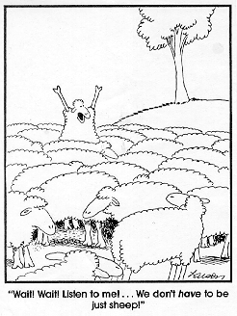
Conformity
A change in behavior or belief as a result of real or imagined social norms.
Refers to both acting as if you accept the group, and actually accepting the group attitudes.

Slide 3
Why do we conform?
We look to the group for information!
Factors that predict conformity:
Cohesiveness: wanting to fit with the group
  Refers to group status and unanimity
Norms for behavior
  Normative Influence: We want to be liked
  Informational Influence: We want to do the right thing, which is what others are doing.

Slide 4
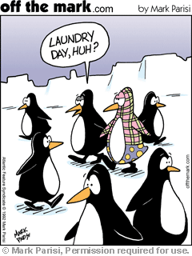
Groups Encourage
conformity
  Behave according to group expectations
  Adjust attitudes in accordance with the group
  Conformity can be good
  Is too much conformity bad?

Slide 5
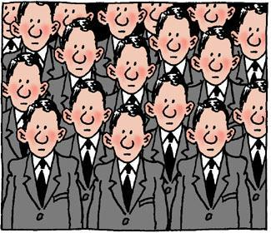
Social Influences on Individuals
Social norms
  Unwritten laws for behaving in social situations
  But, there are many rules and “laws” that are informal and unwritten. These rules are usually part of the closest group that you belong to, for example, your group of friends. Following these informal rules, called social norms
Notes:
Many laws and rules in a society or in a group are formally written down and must be legally followed. For example, in the US, you cannot go out and beat up someone.
But, there are many rules and “laws” that are informal and unwritten. These rules are usually part of the closest group that you belong to, for example, your group of friends. Following these informal rules, called social norms, is not a matter of legality; rather, is a matter of how you are expected to act and think in certain situations. That is, social norms are a set of guidelines that groups use to persuade members of the group in ways that they should think and act.
Sherif had participants sit, individually in a room and watch a beam of light projected on to a screen. All participants experienced the autokinetic effect, that is, the light appeared to move though it was static. The individual estimates of how far the light moved were highly variable. Sherif then placed the participants into groups of three to try to come up with group estimates of how far the light had moved (while watching it again). Finally, he re-tested the individuals without the aid of their groups. What happened, was that, after the group-testing was completed, participants’ estimates of the distance that the light had moved were very close to the estimates that the group had made together. Thus, the group participation had created a frame of reference that the individuals used in making their own judgments later.
Group polarization occurs when the initial decision or position of a group becomes more extreme over time and over more discussion. For example, if a group decided on a risky decision, later on, the final decision will be even riskier. Or, if the initial position is conservative, the final position and decision will be even more conservative.
For example, a group that is racially prejudiced will become more prejudiced after discussion of the topic. The reason for this seems to be constant reinforcement of the position of the group through repeated discussion.
Groupthink is the desire to avoid dissent from the group’s position so as to maintain a consensus of the group. Generally, groupthink occurs when a very important decision is made in a stressful situation and when the stakes are potentially very high. An example of this is the Iraq war. There was little to no dissent in the Bush administration (that we are aware of), the situation was stressful (for US citizens, not the administration) and the stakes were potentially high (for oil companies). This desire by a few to go to war caused everyone in the administration to conform to the group consensus.

Slide 6
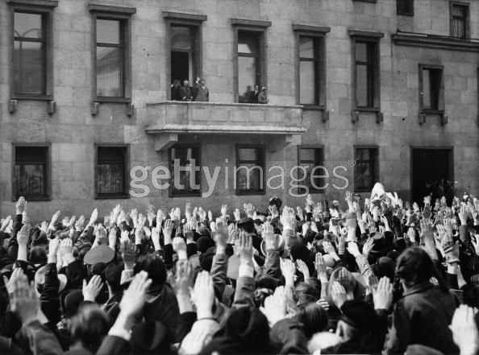
Group Polarization
Group polarization occurs when the initial decision or position of a group becomes more extreme over time and over more discussion.
Example:

Slide 7
GROUPTHINK CAN BECOME DANGEROUS:
Deindividuation: loss of self-awareness and self restraint occurring in group situations that foster arousal and anonymity.

Slide 8
Groupthink
Not all conformity is good though
Countless examples where conformity is disastrous
  The Holocaust
  Watergate Scandal
  Space Shuttle Challenger

Slide 9
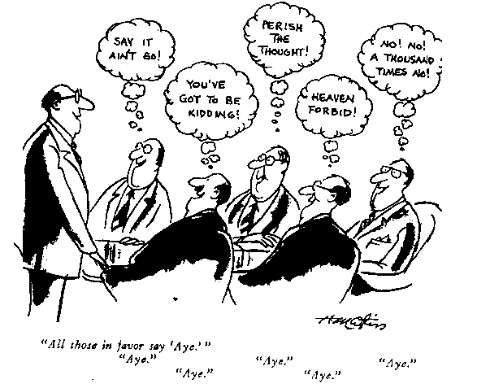
Groupthink
Groupthink is the desire to avoid dissent from the group’s position so as to maintain a consensus of the group.
Generally, groupthink occurs when a very important decision is made in a stressful situation and when the stakes are potentially very high.

Slide 10
Groupthink, continued…
Irving Janis coined the term groupthink
When concurrence seeking overrides realistic appraisal
Factors that lead to groupthink
  Self-censorship
  Illusion of unanimity
  Direct pressure on dissenters
  Illusion of invulnerability
  Illusion of morality
  Stereotype and dismiss competitors

Slide 11
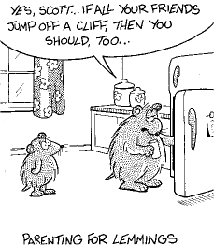
Acting Like Lemmings

Slide 12
Behavior is Contagious
One person laughs, yawns, or coughs and others in the group will do the same.
A cluster of people gaze upwards, passersby do likewise.
Bartenders and musicians “seed” their tip bar to look as if others have given.

Slide 13

Chameleon Effect
Chartrand and Bargh
We naturally copy the behavior of others.
People mimic out of empathy and to fit into the group.
Copycat Behavior: when people copy the behavior of others.
What causes suicide clusters?

Slide 14
In Group and Out Group
Ingroup: “us” people whom share a common identity.
People tend to hold positive attitudes towards members of their own groups, a phenomenon known as ingroup bias.
Outgroup: “them” those who are perceived as different or apart from one’s ingroup.
an outgroup is a social group towards which an individual feels contempt, opposition, or a desire to compete

Slide 15
Examples of Ingroup/Outgroup
Most students think that their school is better than the other schools in town.
Most graduating classes believe their class was the best.
High school students form cliques- such as jocks, goths, gangs, geeks, preps, and other groups.

Slide 16
Why People Join Cults
People are put in physically or emotionally distressing situations;
Their problems are reduced to one simple explanation, which is repeatedly emphasized;
They receive unconditional love, acceptance, and attention from a charismatic leader;
They get a new identity based on the group;
They are subject to entrapment (isolation from friends, relatives, and the mainstream culture) and their access to information is severely controlled.

Slide 17
Pratkanis and Aronson (1992): How to become a cult leader
Create your own social reality. Cut off external sources of information. Mail should be censored. Isolate cult headquarters from the rest of the world
Establish an ingroup of followers and an outgroup of the unredeemed.
  Jones called doubters “the enemy”
  Suicide would lead to salvation for the chosen people

Slide 18
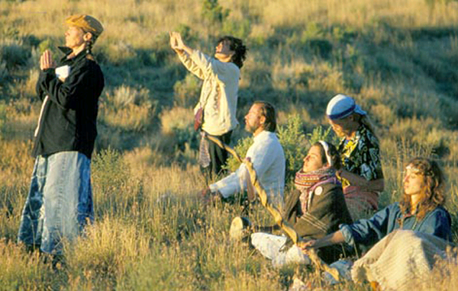
Cult Leader Tips
Generate commitment through dissonance reduction. Insure obedience by establishing a spiral of escalating commitment
  Foot in the door technique: the tendency for people who first complied with a small request to comply later with a larger request.

Slide 19
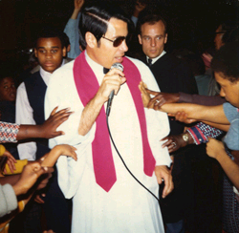
Cognitive Dissonance
  Cognitive dissonance and justification of actions.
  Cognitive Dissonance Theory: we act to reduce the discomfort (dissonance) we feel when our thoughts (cognitive) are inconsistent.
  Ex: attitudes and actions clash.

Slide 20
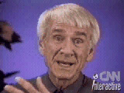
Credibility
Establish the cult leader’s credibility and attractiveness
Send members out to proselytize the unredeemed
  Brings in new members
  Members are constantly engaged in self-persuasion (dissonance reduction once again)
Distract members from undesirable thoughts
  Chanting, letter writing

Slide 21
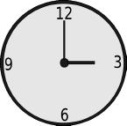
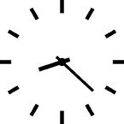
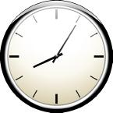
Time Control
Mind control cults keep their members so busy with meetings and activities that they become too busy and too tired to think about their involvement.
Time control also helps the cult keep their members immersed in the manufactured cult environment.
And time control helps keep cult members away from friends and family.

Slide 22
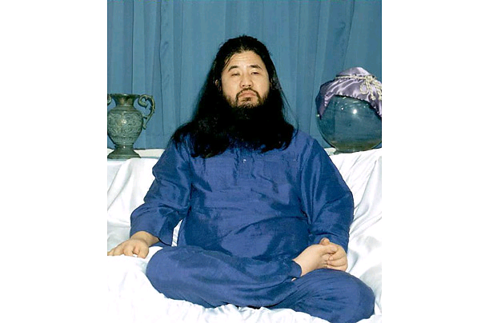
Cult Leader Tips
Maintain the notion of a promised land and a vision of a better world.
Provides a powerful incentive to keep working.
Maintains hope by providing a sense of purpose and freedom.

Slide 23
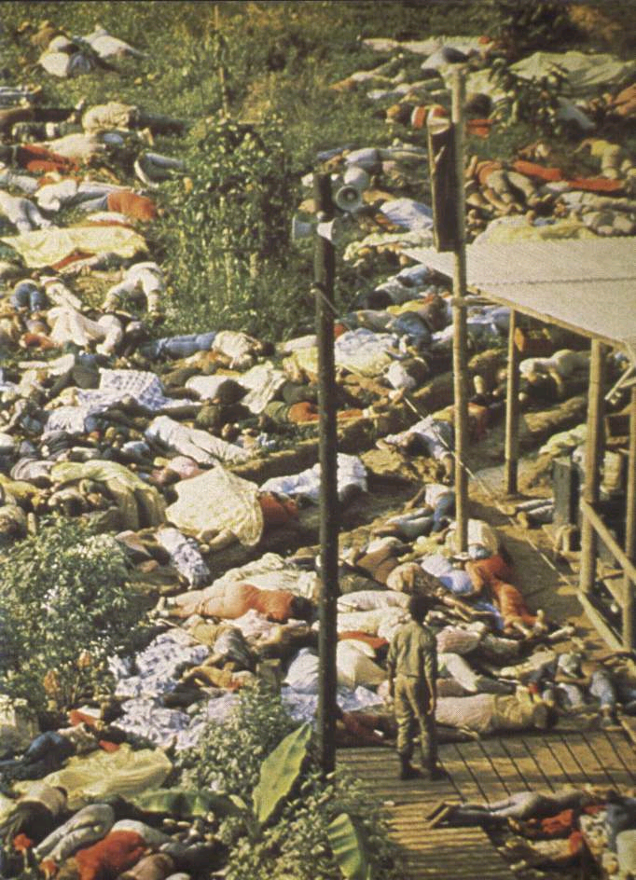
How People Leave:
There are at least three ways people leave a cult:
by one's own decision,
through expulsion
through intervention (Exit counseling, deprogramming).
Or commit mass suicide.

Slide 24
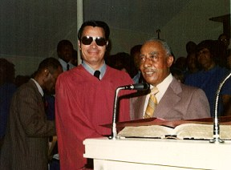
Jim Jones and The People’s Temple
Over 900 followers perished – for most it was a voluntary suicide
Jones used (perhaps unwittingly) a number of powerful social psychological phenomenon to his advantage

Slide 25
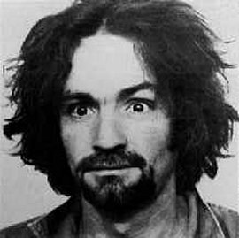
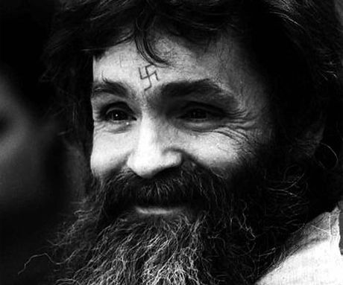
The Manson Family
Manson interpreted the lyrics “helter skelter” as the beginnings of a race war, and began building a small army of his own fascist brainwash brigade.

Slide 26

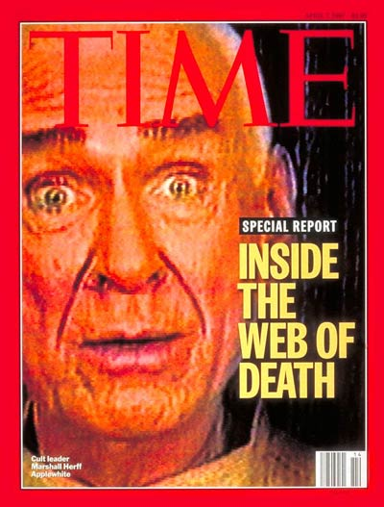
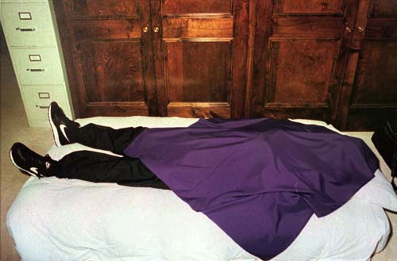
Heaven’s Gate
Heaven's Gate members believed that the planet Earth was about to be recycled (wiped clean, renewed, refurbished and rejuvenated), and that the only chance to survive was to leave it immediately.
While the group was formally against suicide, they defined "suicide" in their own context to mean "to turn against the Next Level when it is being offered", and believed that their "human" bodies were only vessels meant to help them on their journey.

Slide 27

Branch Davidians
The Branch Davidians (also known as "The Branch") are a Protestant sect that originated in 1955 from a schism in the Davidian Seventh Day Adventists ("Davidians"), a reform movement that began within the Seventh-day Adventist Church ("Adventists") around 1930.

Slide 28
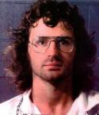
David Koresh
There is an ongoing controversy concerning whether or not David Koresh and his followers truly represented the reform movement that had been in existence for over 60 years at the time of the siege, and whether or not they had a right to use the name and property of the church.
Though his followers numbered around 140 at the time of the siege, only about 20 of them and their children were associated with the church before he drew them away to follow his unique teachings and practices. A much greater number of the loosely organized church rejected his claims.

Slide 29
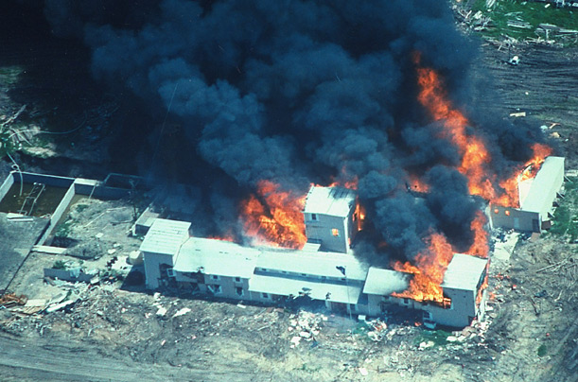
Waco, Texas

Slide 30
Social Facilitation
Social facilitation is simply the concept that people often perform better in the presence of others than alone (Cook, 2001).
However, when discussing social facilitation, it is important to understand that the term has been used to summarize both the positive and negative aspects of groups.
. Social facilitation effects refer to both social facilitation (better performance) and social impairment (worse performance)

Slide 31
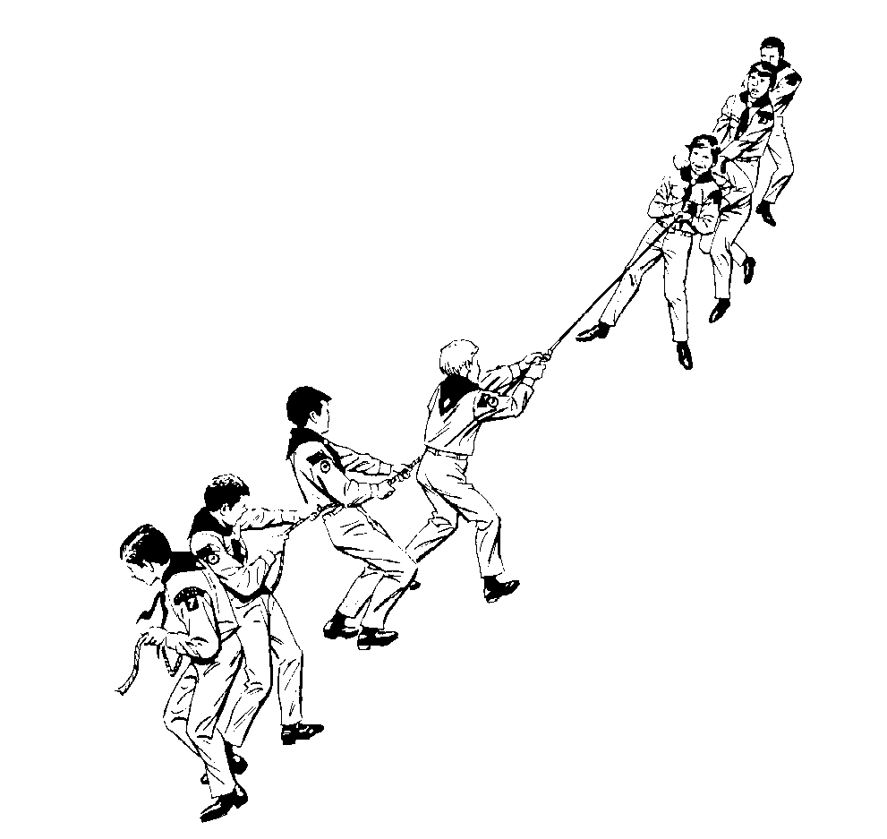
Social Influences on Individuals
Do we act the same around other people?
Social facilitation
  Enhanced performance when we are in front of others.
Social Loafing
  Less effort by individuals as a group compared to alone
  Ringelmann’s “Tug of War Study”
Notes:
The mere presence of other people can affect an individual’s behavior. That is, people do not even have to be involved with another individual for his/her behavior to be influenced.
Triplett (1898) and the Hand Crank: He had people perform simple tasks such as turning the hand crank on a fishing wheel. Surprisingly, people were faster and more accurate at these tasks when other people were present compared to when the task was performed alone.
Zajonc proposed that social facilitation was due to an increased arousal when people were present than absent. Indeed, there is some physiological evidence for this. This increased arousal leads to increased and better oerformance on these simple tasks.
Social Loafing is sort of the opposite of social facilitation. This is where a person will put forth less effort on a task when they are performing the same task simultaneously with other people compared to when they are performing the task alone.
Ringelmann and the Tug of War: Measured the force exerted by a single person pulling a rope and then when 8 people pulled the rope. Presumably, each person should work together and the total force of the rope should be the summation of each person’s individual effort. However, this was not so. In reality, the force exerted on the rope was about half as the predicted. Thus, in the presence of others doing the same task, each person did less.
Individual identifiably is whether, in a group, an individuals effort is able to be determined. If so, then they are more likely to experience social facilitation than social loafing.
Individual responsibility is where an individual is responsible for a distinct and separate part of a task. If so, then they are more likely to experience social facilitation than social loafing.

Slide 32
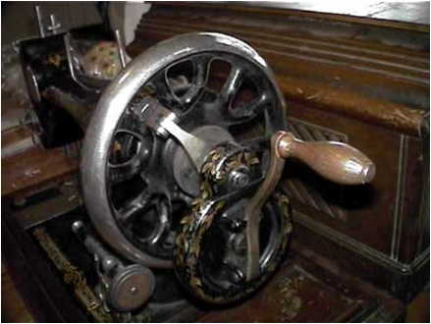
Hand Crank Study
Do we act the same around other people?
  Social facilitation
  Enhanced performance when
  we are in front of others
  “Hand Crank Study”

Slide 33
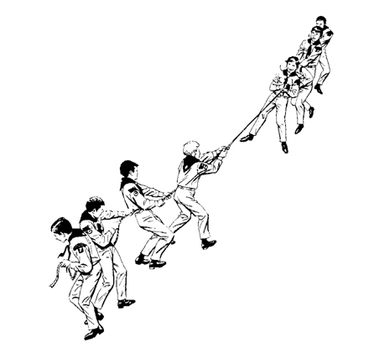
Tug of War Study
  Social Loafing
A 19th-century study by Maximilien Ringelmann discovered that the more people there are in a tug-of-war team, the less effort each contributes.
Every individual is inclined to slack off a little because others will take up the strain. The phenomenon is now known as “social loafing.”

Slide 34
Responses to Social Influence
Compliance: purely motivated by desire to gain reward or avoid punishment (Power)
Identification: adopt a behavior to be like those we find attractive. A greater level of belief adoption than in compliance (Attractiveness)
Internalization: becomes part of our belief system. Intrinsically driven by the desire to be correct. Most enduring (Credibility)
Asch study is an example of compliance

Slide 35
Conformity and Solomon Asch
Definition: change in a person’s behavior or opinions as a result of real or imagined pressure from a person or group of people
Asch: completed two studies that demonstrate how easily conformity occurs.

Slide 36
Asch Experiment
6 people in the experiment (actually, 5 confederates)
Which line matches the test line?

Slide 37
Asch: Other Variables
Size of group: as group size increases to 3 others, conformity increases. After that, little change
Presence of one dissenter decreases conformity immensely
The more wrong the majority was, the less influence.
The greater the privacy, the less conformity

Slide 38
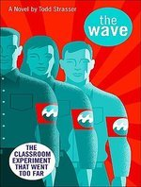
THE WAVE
The setting of the book is Gordon High School in 1969. The plot of the book revolves around a history teacher (Mr. Ben Ross), his high school students, and an experiment he conducts in an attempt to teach them about how it may have been living in Nazi Germany.
Unsatisfied with his own inability to answer his students' earnest questions of how and why, Mr Ross initiates the experiment in hopes that it answers the question of why the Germans allowed Adolf Hitler and the genocidal Nazi Party to rise to power, acting in a manner inconsistent with their own pre-existing moral values.

Slide 39
What is Social Influence?
Conformity - changing one’s behavior in response to real or imagined pressure from others
Compliance - responding favorably to an explicit request by another person
Obedience - social influence in which the less powerful person in an unequal power relationship submits to the demands of the more powerful person

Slide 40
Sources of Authority (Power)
Source
Definition
Coercive
Ability to punish or remove positive consequences.
Reward
Ability to provide positive or remove negative consequences
Expert
Person has expertise (knowledge) not widely available
Legitimate
Believe person has influence because of role.
Referent
People identify with or want to be like authority figure

Slide 41
Compliance
Compliance- getting people to say yes to a request
Principles underlying compliance
  friendship/liking- “she seems genuine and nice”
  commitment/consistency- “I’m committed to the cause”
  scarcity- “only one left”
  reciprocity- “she helped me so I should return favor”
  consenus - “everyone else is doing it”
  authority- “he seems legitimate”
Notes:
11
10
4

Slide 42
Compliance Techniques
Tactics based on liking
  ingratiation- enhance self or flatter target
  personal appeals - appeal to feelings of loyalty, friendship
Tactics based on commitment/consistency
  foot-in-the-door- small request followed by larger one
  lowballing- changing the deal midstream
Notes:
11
10
4

Slide 43
Compliance Techniques 2
Tactics based on reciprocity
  door-in-the-face- large request followed by smaller one
  “that’s not all”- sweeten the deal midstream
Tactics based on scarcity
  playing hard to get- suggesting item is scarce (valuable)
  deadline technique- limited time to buy

Slide 44
Compliance Techniques 3
Rational Persuasion
  Elaboration-Likelihood Model
Tactics based on mood
  Negative mood
    negative state relief hypothesis - The idea that people engage in certain actions, such as agreeing to a request, in order to relieve negative feelings and to feel better about themselves
  good mood- prime happy thoughts (AIM model)
    Inspirational appeals
Notes:
11
10
4

Slide 45
Resisting Obedience
Ways to resist obedience
  take responsibility for any harm produced
  realize total submission is inappropriate
  question authority’s motives
  increase awareness of the power of the situation
Notes:
12
11
4

Slide 46
Obedience is most direct form of social influence
Persons readily obey commands, even those from a relatively powerless source of authority
Many factors influence obedience
  diffusion of responsibility
  perceived authority
  gradual escalation of commands
  rapid pace of situation
Several strategies can be used to reduce obedience

Slide 47
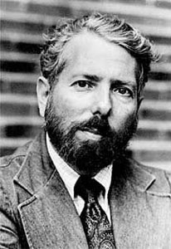
Milgram Experiment

Slide 48
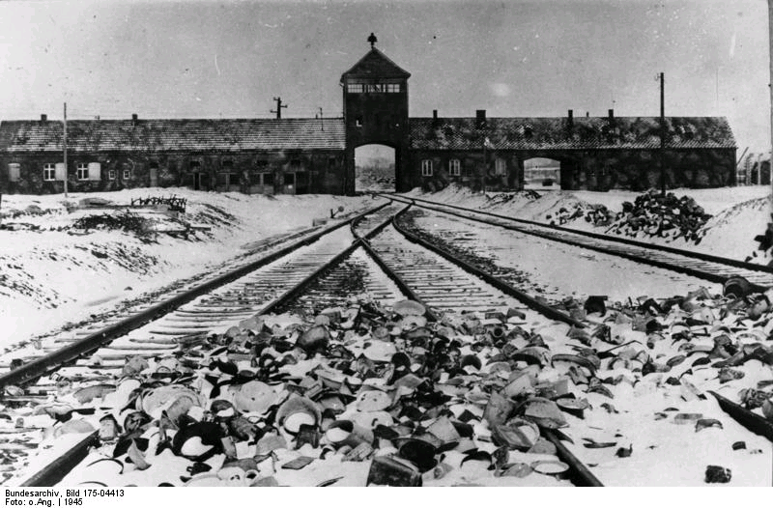
Why did Germans comply with Hitler’s plans for the Holocaust?

Slide 49
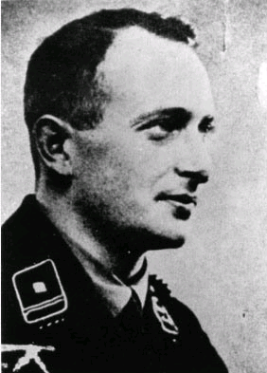
Adolf Eichmann
Adolf Eichmann was captured for war crimes in 1960.
The trial began in 1961.
During the whole trial, Eichmann insisted that he was only "following orders"

Slide 50
Applications of Conformity Research
Obedience to Authority: Stanley Milgram
Key ideas
  Power of the situation- authority figure pressing you on.
  Tendency of observers to commit the fundamental attribution error
  Fundamental Attribution Error: is a theory describing cognitive tendency to predominantly over-value dispositional, or personality-based, explanations. People predominantly presume that the actions of others are indicative of the "kind" of person they are, rather than the kind of situations that compels their behavior.
  Self-serving bias: is a cognitive bias which tends to enhance the ego and self confidence of an individual.

Slide 51
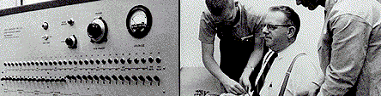
Stanley Milgram’s “Obedience Study”
  Subjects were “teachers” in a “memory study”
  “Learner” was in another room
  “Teacher” shocked “learner” for mistakes
  How long would the “teacher” give the shocks?
Notes:
Obedience is, loosely defined, as the situation where a person behaves or thinks in accordance with the desires and orders of a superior, even when they do not think that what they are doing is justified or OK. That is, people comply with the request of superiors and are persuaded by the arguments made by people in authority. (The Iraq war is a good example.)
An example of obedience is the behavior of the Nazi concentration camp workers during WWII. In this case
It was not actually a memory experiment, but was actually an experiment on obedience.
The “learner” was not actually a participant, but was a paid actor.
The “teachers” were told that they were to teach the learner a series of words to learn and that the learner would repeat the words. Anytime that the “learner” was incorrect” they should give him a shock and then increase the voltage.
The device that was used to deliver the shocks is shown here. It had a range of voltage from 15-450 volts with different labels under some of the voltages; from “Slight Shock” to Danger: Severe Shock” to the ominous “XXX”.
The “learner” was not shocked, but acted out different levels of pain to each shock.
The researcher made sure that the “teacher”: increased the shock severity after each mistake.
At the 300-Volt level the “learner” pounded the wall and stopped responding to all questions. At this point, the researcher told the “teacher” that ‘no-answer’ was an incorrect answer and to increase the voltage to 315-Volts and shock again. If the teacher complied, the “learner” continued to pound the wall again, but made no verbal response.
If the “teachers” did not want to continue, The researcher said: “Please go on.” “The experiment requires that you continue.” It is absolutely essential that you continue.” You have no other choice, you must go on.”

Slide 52
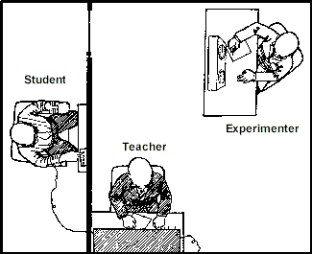
Milgram Experiment
Shock labels:
15 - slight shock
75 - moderate
150 - strong
225 - very strong
300 - intense
345 - severe
375 - Danger: severe shock
435 - XXX
450 - XXX

Slide 53
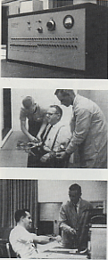
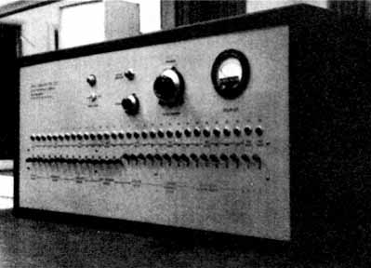
Milgram Experiment
Experiment involved “teaching through negative reinforcement”

Slide 54
Why did so many obey?
experimenter said he was responsible (diffusion)
commands were gradual in nature
participants had little time for reflection
experimenter was perceived as an authority figure
  People believed he had the power to influence/control their behavior

Slide 55
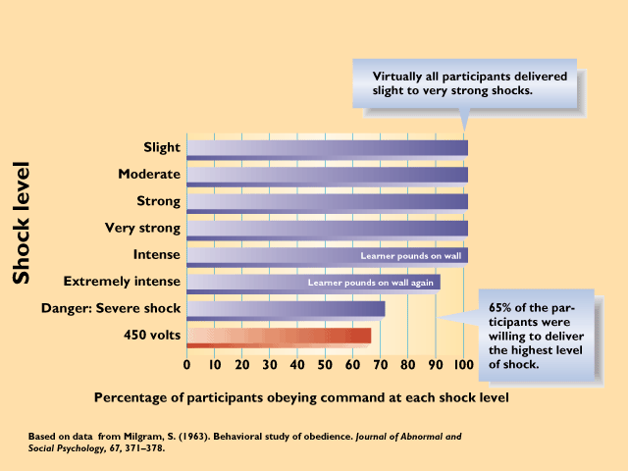
Obedience
Obedience- change behavior in response to direct orders from authority (most direct form)
Milgram’s Obedience Study
  Participants told to deliver increasing levels of shock to a “learner” each time he made an error on a simple learning task
Why did so many people obey? What was wrong with them?
Notes:
12
11
4

Slide 56
Social Influences on Individuals
Milgram (1963) Results:
  Majority of subjects gave the lethal shock!
Notes:
What is even more interesting is that, in a later experiment, Milgram found that 37.5% of participants would still give lethal shocks even when the learner was in the same room and could personally see the man struggling and in pain.
What is even more amazing, is that 30% would hold the man’s hand against a metal plate so that he would still be shocked when he tried to move his hand.

Slide 57
Social Influences on Individuals
What is even more interesting is that, in a later experiment, Milgram found that 37.5% of participants would still give lethal shocks even when the learner was in the same room and could personally see the man struggling and in pain.
What is even more amazing, is that 30% would hold the man’s hand against a metal plate so that he would still be shocked when he tried to move his hand.
Notes:
What is even more interesting is that, in a later experiment, Milgram found that 37.5% of participants would still give lethal shocks even when the learner was in the same room and could personally see the man struggling and in pain.
What is even more amazing, is that 30% would hold the man’s hand against a metal plate so that he would still be shocked when he tried to move his hand.

Slide 58
What reduces compliance?
  Two experimenters disagree about continuing
  Two “fellow participants” refuse to continue
  Experimenter was in different room than participant
  Participant has to physically hold victim’s hand to shock plate.

Slide 59
What did not reduce compliance?
  Victim claiming he had a heart condition
  The experiment was done for a market
  research company
  The victim extracting an explicit demand to stop on demand

Slide 60
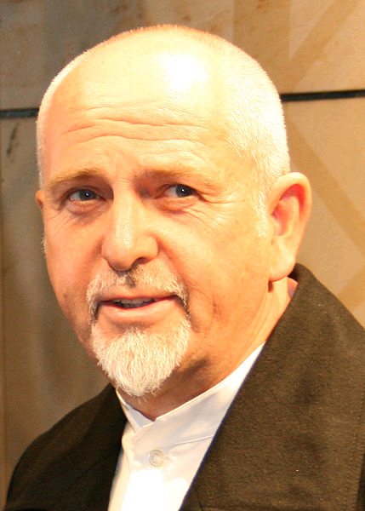
We Do What We're Told
n 1986, musician Peter Gabriel wrote a song called We do what we're told (Milgram's 37), referring to the number of fully obedient participants in Milgram's Experiment 18: A Peer Administers Shocks.
In this one, 37 out of 40 participants administered the full range of shocks up to 450 volts, the highest obedience rate Milgram found in his whole series.

Slide 61
Social Influences on Individuals
Impact of Milgram’s results?
  People follow authority
  Explains actions of Nazis
  guards and Abu Ghraib MPs
  Example of the FAE
    Underestimate situational factors on behavior
    Overestimate dispositional factors on behavior
Ethical considerations of Milgram study?
  Participants had negative self-perceptions
  Should deception be used?
Notes:
In Milgram’s experiments, the authority figure was the researcher, who prodded the participants to keep shocking the man. These studies seem to explain some of the behavior of Nazi death camp soldiers that killed people, that is, they were following orders. (This defense did not work at Nuremburg!)
What is interesting is that Milgram’s results represent the fundamental attribution error. Remember, this is where people underestimate the effectiveness of situational factors and overestimate the effect of dispositional factors, in the control of human behavior. In this case, the situational factors was the authority figure and the orders given and the dispositional factors was the person’s desire not to harm people.
Many people have questioned whether Milgram should have done his study in this way.
Although the participants were very stressed, Milgram did practice this experiment before implementing it and was very careful to provide assistance and counseling to the participants if they needed it (which they did).
It should be noted that in a follow-up questionnaire, 84% of the participants reported that they were glad to have taken part in the study whereas only 1.3% were angered and not happy.

Slide 62
Increasing Helping Behavior
Interpret the situation as an emergency
Make people feel personally responsible for helping
Reduce cost of helping (e.g., lost time)
Increase belief that they can be helpful (otherwise people will remove self from situation)

Slide 63
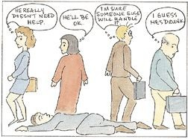
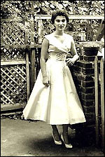
Social Influences on Individuals
Bystander effect (diffusion of responsibility)
  Reluctance to aid a person if an individual thinks others are present and can help
  Kitty Genovese case (1964)
Notes:
Kitty Genovese: Robed, raped and repeatedly stabbed by an assailant. About 38 people heard her screams and please for help. After 35 minutes, the assailant returned and finished off the job. This produced a hug outcry of angst from people all over the world. People in the media initially suggested that the emotions and attitudes of people living in urban environments had gotten so cold that this was able to happen. However, most of the eyewitnesses were actually quite nice and friendly people. The irony is that the crime went unreported because there was so many eyewitnesses.

Slide 64
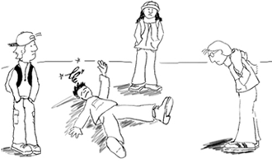
Social Influences on Individuals
Darley and Latané
Latane and Rodin; Darley and Latane find that the presence of others reduces helping behavior by as much as 50%
Often labeled the diffusion of responsibility
Also can be viewed as conforming to the behavior of others who are present.
  Diffusion of responsibility
    “Others will help!”
Notes:
In Darley’s study, the participants were actually sitting in other rooms while engaged in the discussion. Like Asch, there was only 1 real student present.
At one point, one of the other participants pretended to experience a seizure. When the only people in the discussion were the participant and the person experiencing the seizure, nearly all of the participants responded and got help. However, as more people were added to the discussion, the percentage of people helping decreased.
Interestingly, when the participant did not help and the researcher finally entered the room, the participant was often very emotional and asked about the well-being of the person experiencing the seizure. Basically the participant simply failed to act.
What happened is that people experienced a diffusion of responsibility. That is, when they knew that other people were present, they believed that someone else would help and, hence, failed to take any action.
Thus, Diffusion of responsibility is where an individual’s sense of responsibility spreads out when others are around relative to when no one is around.

Slide 65
Why did Germans comply with Hitler’s plans for the Holocaust?

Slide 66
Adolf Eichmann
Adolf Eichmann was captured for war crimes in 1960.
The trial began in 1961.
During the whole trial, Eichmann insisted that he was only "following orders"

Slide 67
Applications of Conformity Research
Obedience to Authority: Stanley Milgram
Key ideas
  Power of the situation- authority figure pressing you on.
  Tendency of observers to commit the fundamental attribution error
  Fundamental Attribution Error: is a theory describing cognitive tendency to predominantly over-value dispositional, or personality-based, explanations. People predominantly presume that the actions of others are indicative of the "kind" of person they are, rather than the kind of situations that compels their behavior.
  Self-serving bias: is a cognitive bias which tends to enhance the ego and self confidence of an individual.

