Slide 1
The
Great
Depression

Slide 2
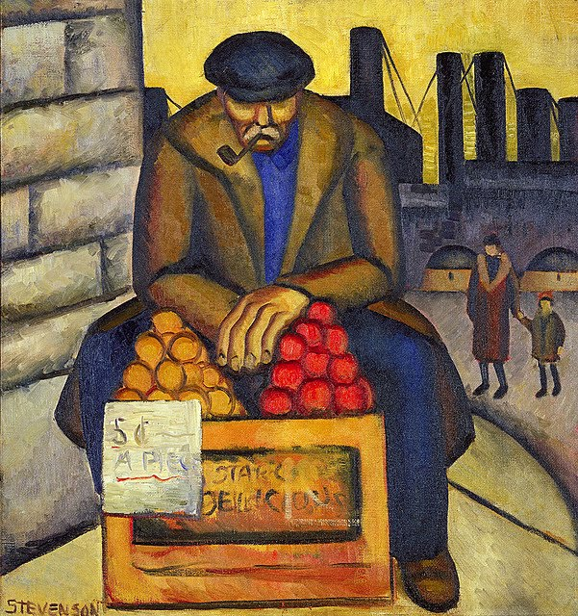
The Great Depression
The Great Depression was a severe worldwide economic depression in the 1930s.
The timing of the Great Depression varied across nations; however, in most countries it started in 1929 and lasted until the late 1930s.
It was the longest, deepest, and most widespread depression of the 20th century.

Slide 3
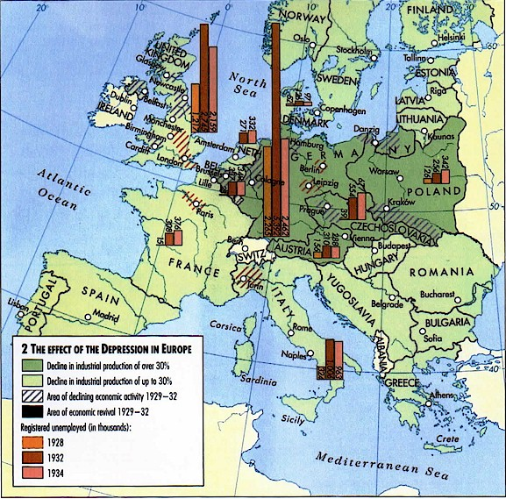
Worldwide Crisis
Shock waves were sent throughout the world when the depression hit.
When the United States could no longer send money to the European countries they too began to suffer.
Many countries in Europe were already on the verge of economic collapse.

Slide 4
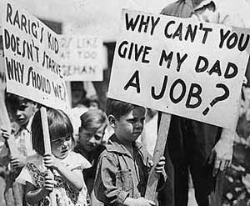
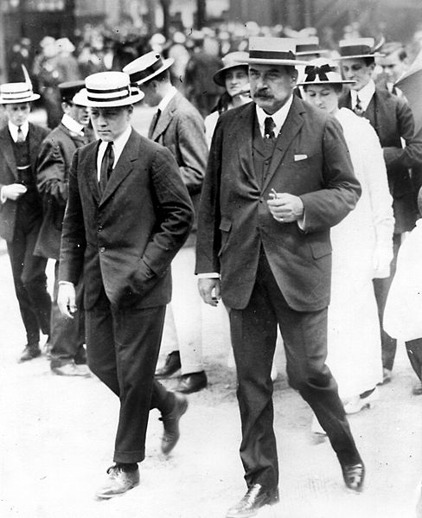
CAUSES OF THE DEPRESSION
A Weak Economy: People bought everything they needed during the 1920’s. goods sat on the shelf.
Stock Market Crash: Stock prices dropped so sharply that investors lost $5 billion in five hours of trade.
Internal Debt: More was being spent than taxed.
International Debt: The United States was owed money by Germany from the war. The U.S. was assisting European countries to recover from the war.
Unbalanced Business System: Greedy investors tried to boost stock prices.
Poor Distribution of Purchasing Power: one of the biggest causes of the depression was over-speculation in the stock market.

Slide 5
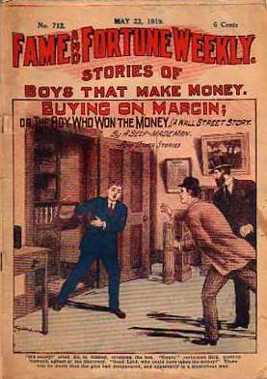
Get Rich Schemes
Margin Buying: investors would give their brokers a fraction of the value of the stock they wanted to purchase. The broker would then borrow the rest to buy the stocks.
Stock Pool: a group of wealthy investors would join together and buy a large amount of stock. They would then trade back and forth with each other to drive up the price and then sell.

Slide 6
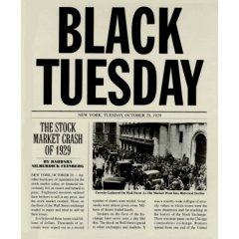
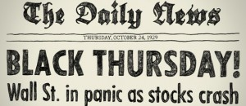
THE CRASH
Thursday, October 24, 1929: stock prices began to plummet. That day became known as Black Thursday.
That afternoon five of the nation's most powerful bankers pledged to restore the market with a quick fix.
The bankers spent millions to try to make the market appear to be on the rebound and restore the confidence of the American people.
Tuesday October 29, 1929: The Stock Market Crashed.
Too many investors were selling their stocks and not enough people were buying.
Prices fell to an unimaginable low.

Slide 7
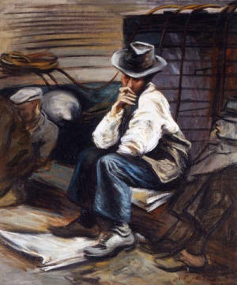
HARD TIMES
Many people who had no relatives to take them in had no where to go.
People resorted to living in shacks with no heat or running water.
The makeshift homes were often constructed of scrap metal, cardboard, or crates.
Several groupings of these shacks started to form around the country to form shantytowns.

Slide 8
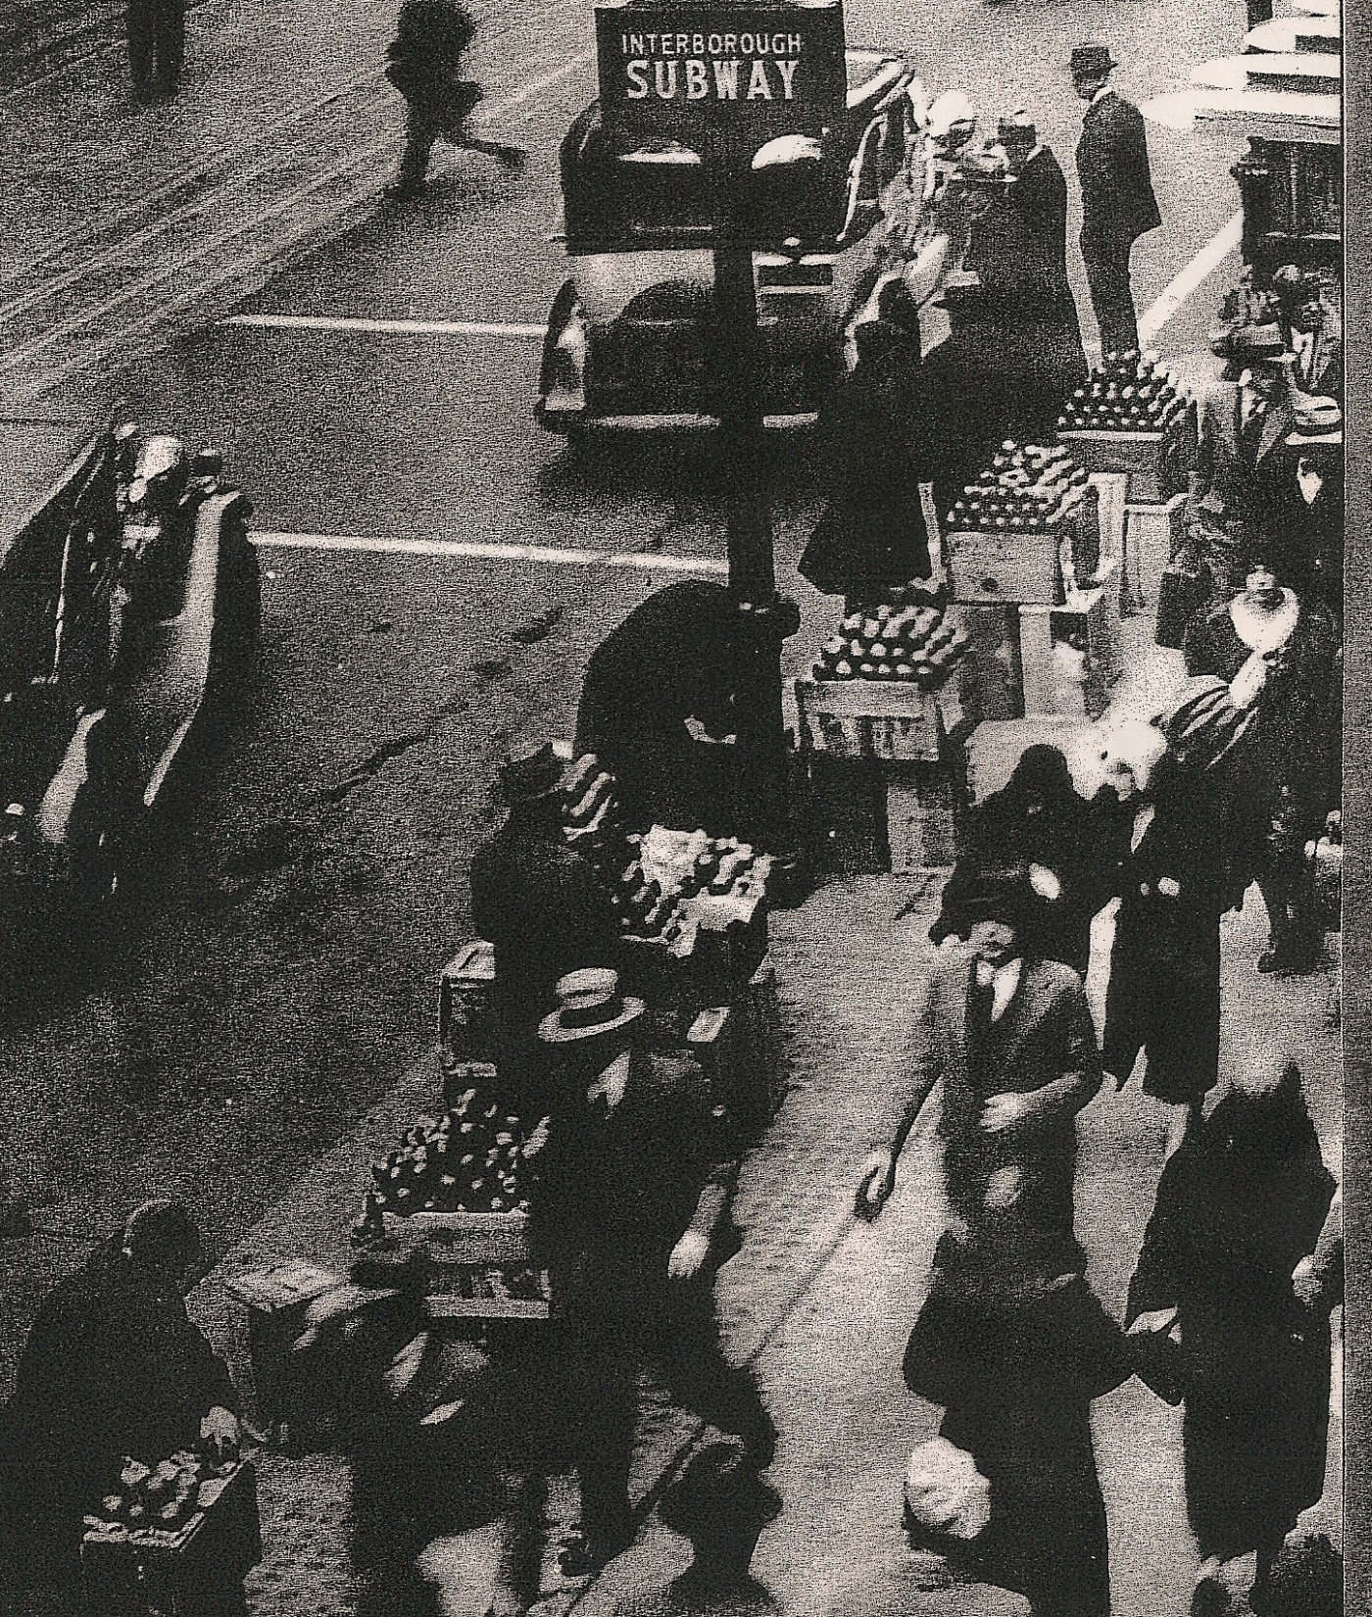
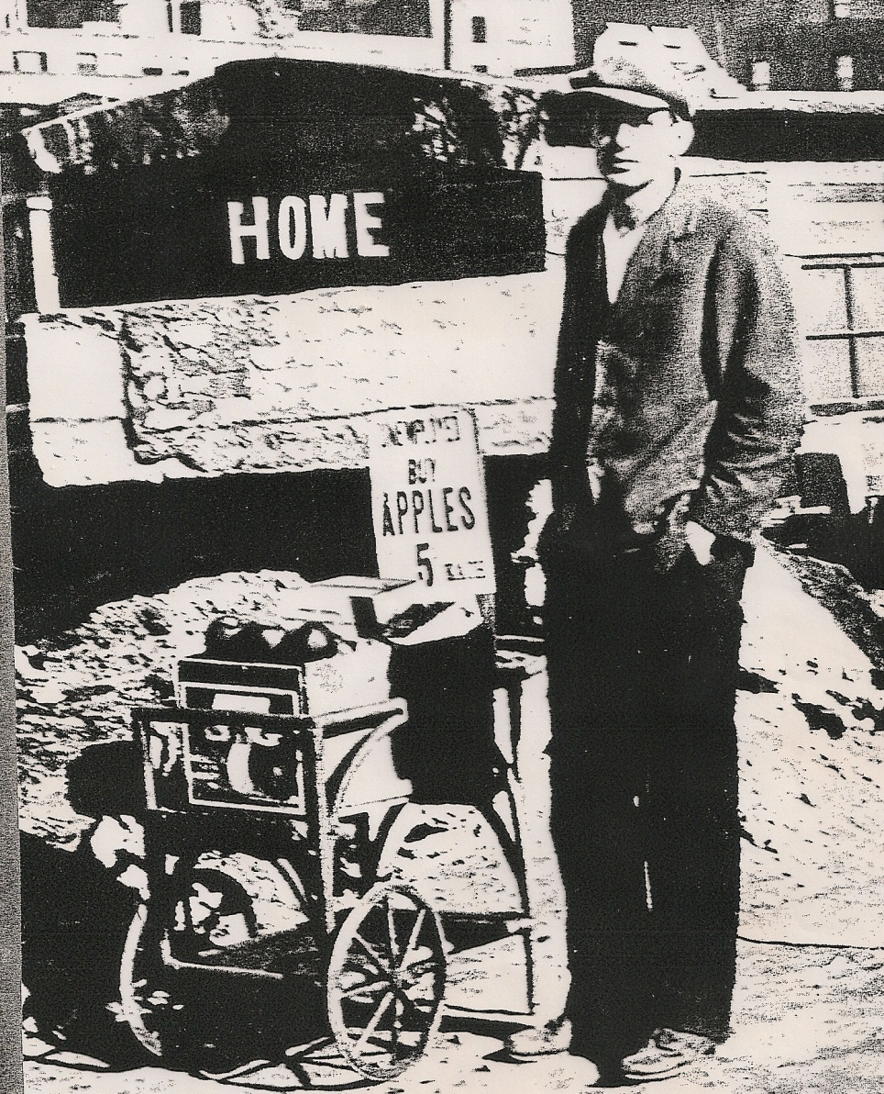
Apple Sellers
At the beginning of the Great Depression, an apple company decided to sell apples to people on credit, who in turn sold the apples. Five cent apple sellers could be found throughout street corners.

Slide 9
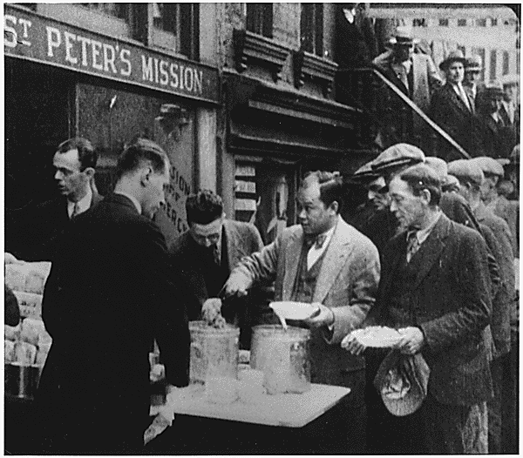
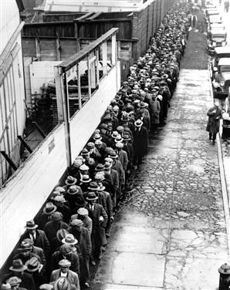
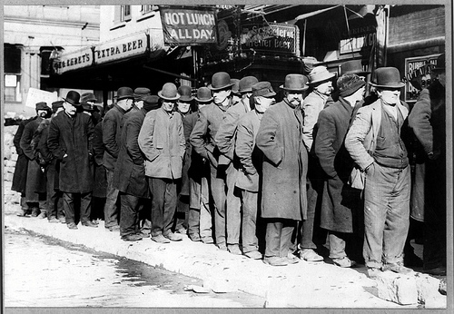
Bread Lines & Soup Kitchens
People would stand in line for hours.

Slide 10
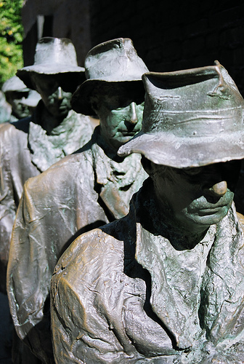
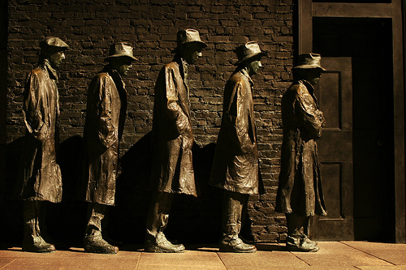
F.D.R. Memorial

Slide 11
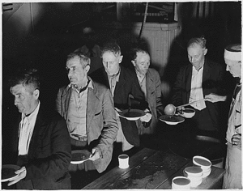
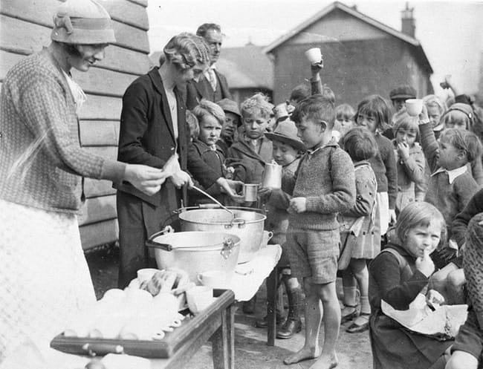
Soup Kitchens
Soup kitchens were opened across the country. In many cases the organizations designed to help the poor ran out of money to operate.

Slide 12
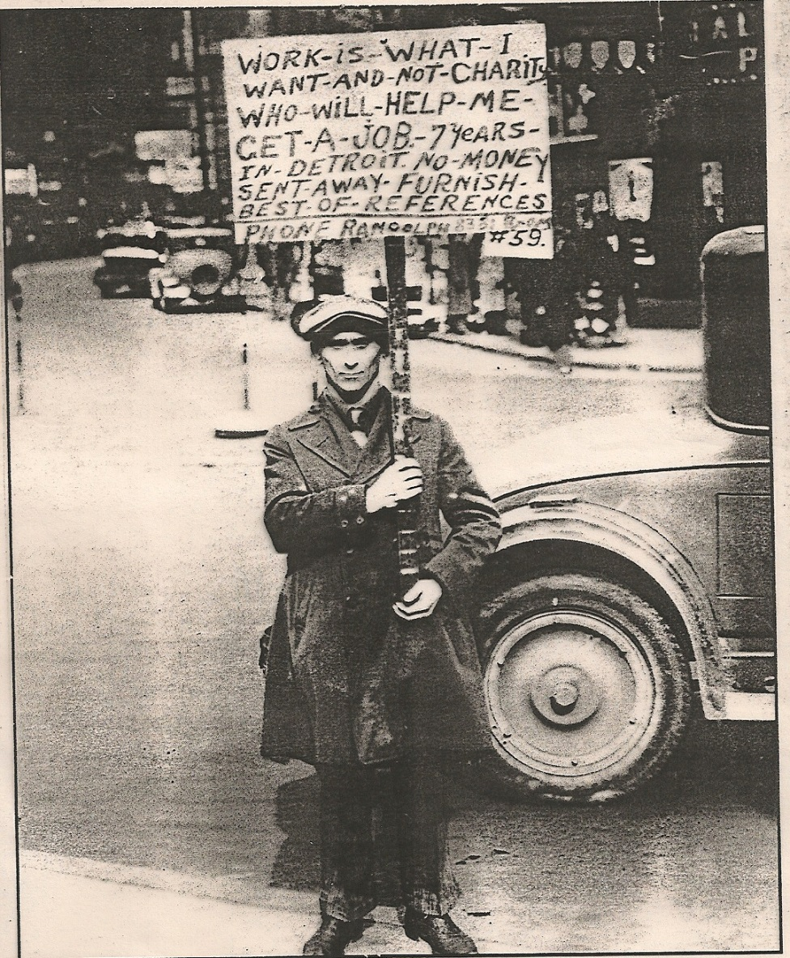
Looking for Work

Slide 13
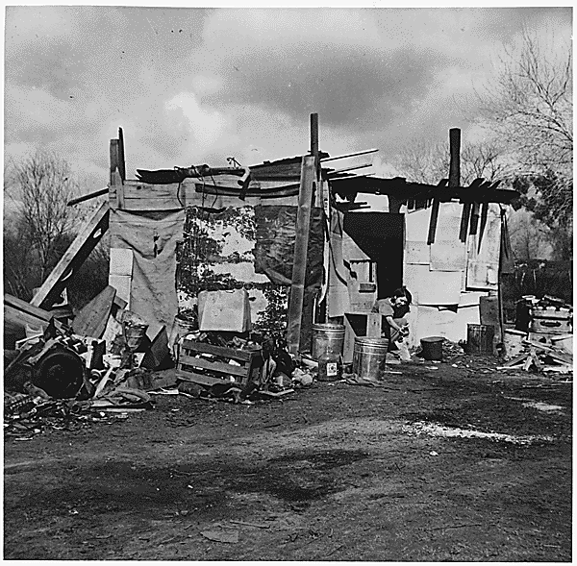
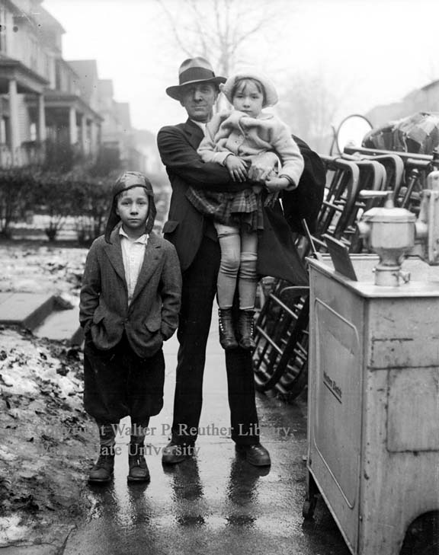
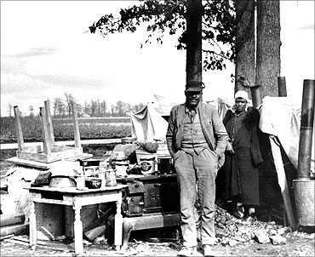

Slide 14
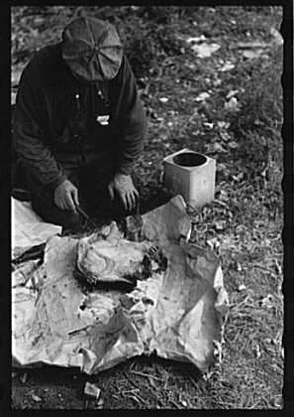
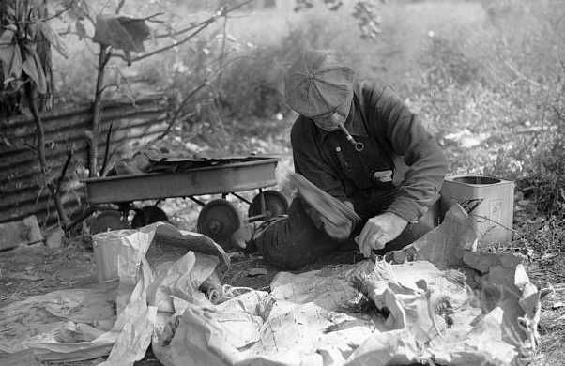
Man killing a turtle to make soup.
People ate rabbits, squirrels, dandelions, and anything they could find that was edible.

Slide 15
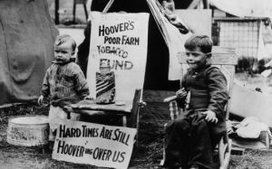
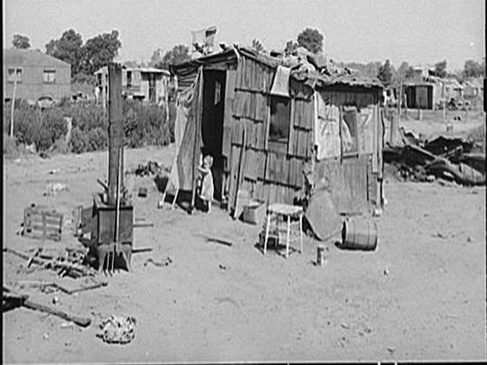

Slide 16
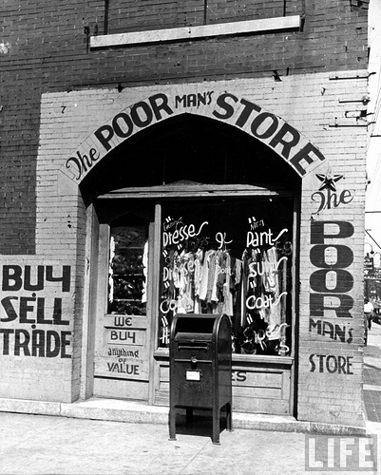

Slide 17
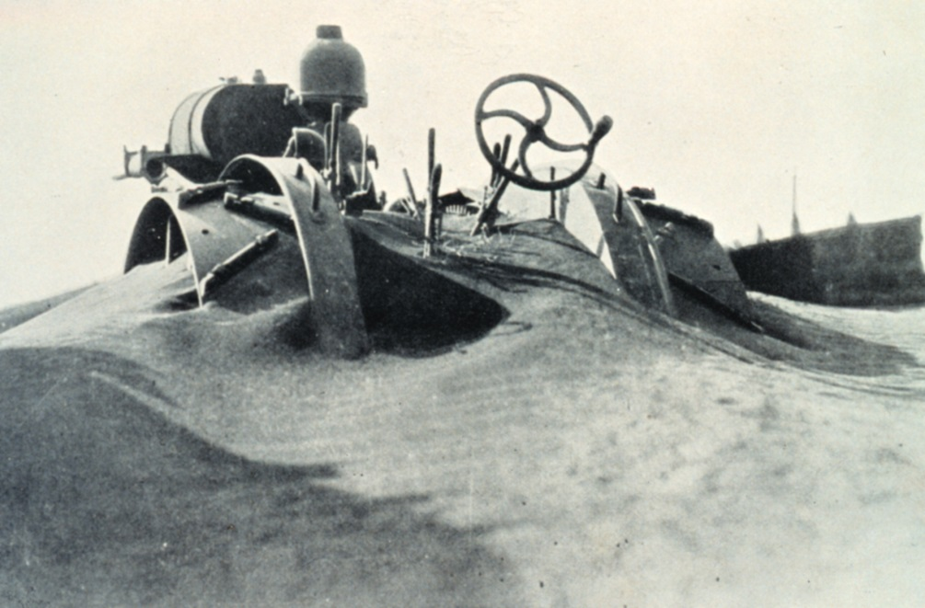
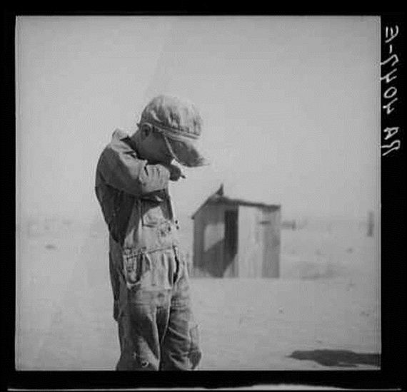

Slide 18
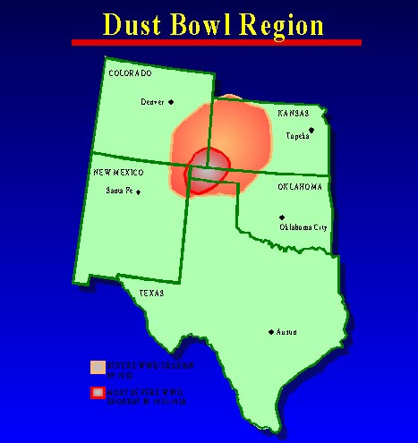
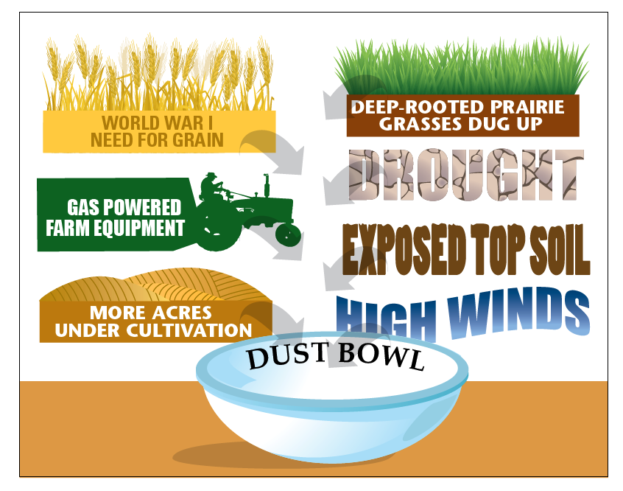
Dust Bowl
Strong winds stirred up the loose soil and created horrible dust storms in the Great Plains.
The Dust Bowl was caused by the following human activities:
1. Farmers plowed up the deep rooted prairie grass.
2. The crops they planted could not take root.
Overgrazing destroyed much of the
grassland.
4. Drought

Slide 19
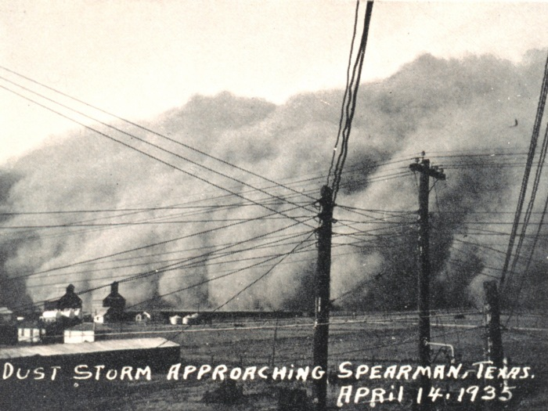

Slide 20
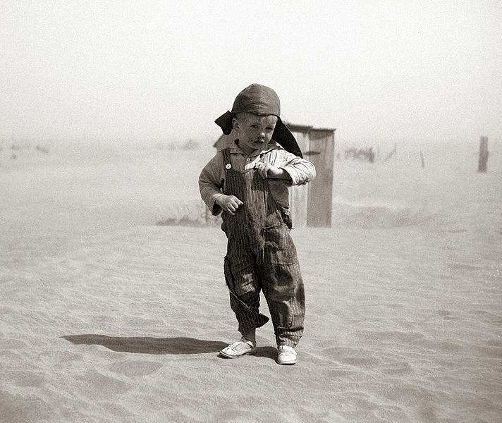
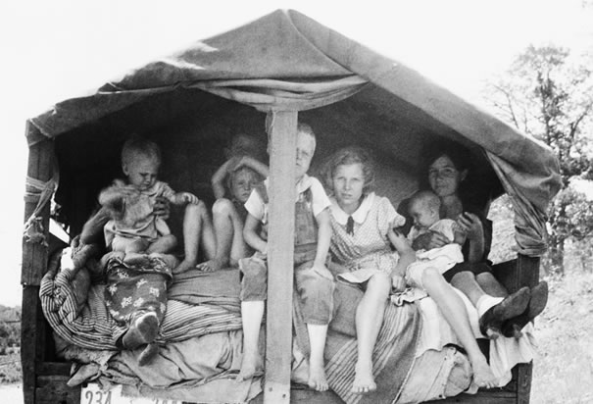
Dust Day
During the Depression, schools across the Plains sent students home because of the dust storms. Some school administrators were worried about what might happen to the students' health.
There had been cases of "dust pneumonia" where dust clogged up the lungs just like the disease.
Other administrators and teachers, especially in the southern Plains, knew that people had gotten lost in dust storms when visibility went to zero

Slide 21
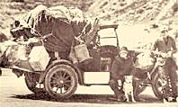
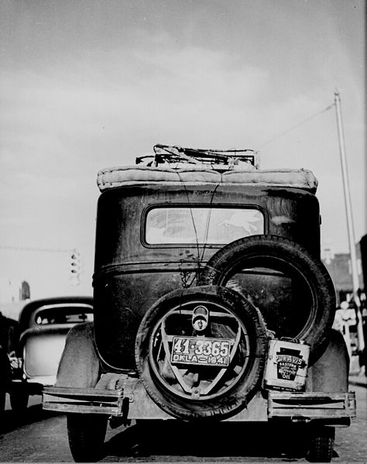
Okies
Many farmers from Oklahoma moved to the west to California hoping to find a better life.
They were given the name Okies. They were driven west by desperation.

Slide 22
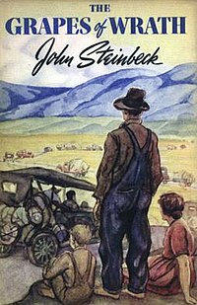
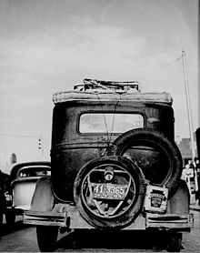
Grapes of Wrath
The Grapes of Wrath is an American realist novel written by John Steinbeck and published in 1939.
The book is about Okies moving West to California for a better life.
The book won the National Book Award and Pulitzer Prize for fiction, and it was cited prominently when Steinbeck was awarded the Nobel Prize in 1962.

Slide 23
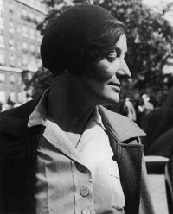
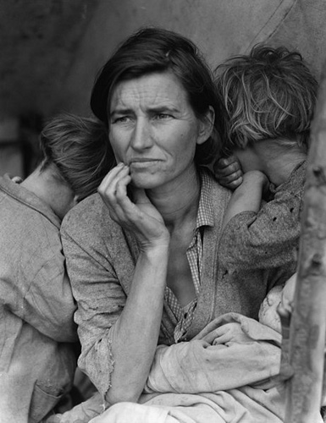
Dorothea Lange
Dorothea Lange was a famous female photographer in the 1930’s.
She took photographs of the suffering people during the Depression.
Lange’s photographs of the rural poor helped raise awareness about the poorest of the poor – sharecroppers and tenant farmers.
In 1937 the federal government finally began to provide help to sharecroppers and tenant farmers.

Slide 24
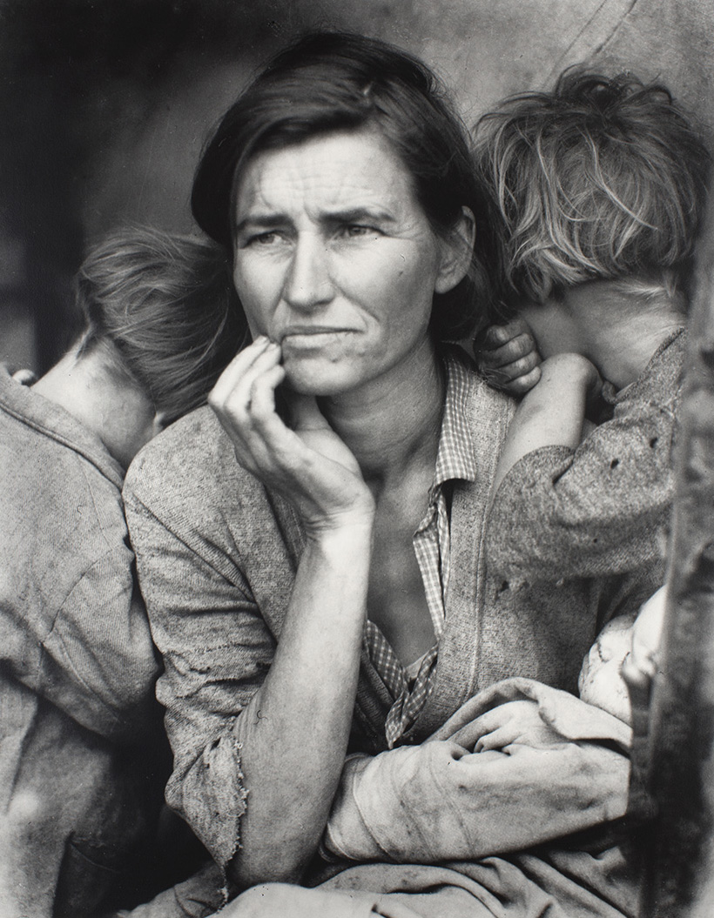
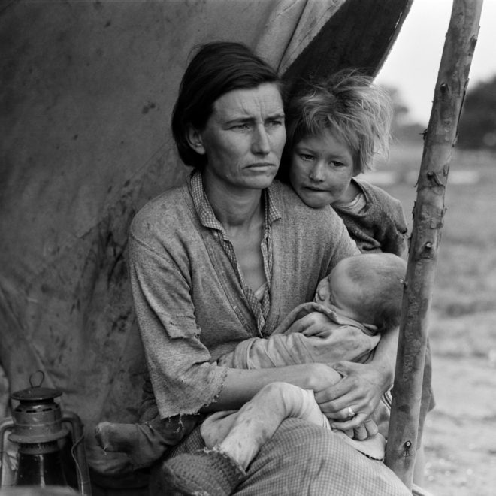
Migrant Mother

Slide 25
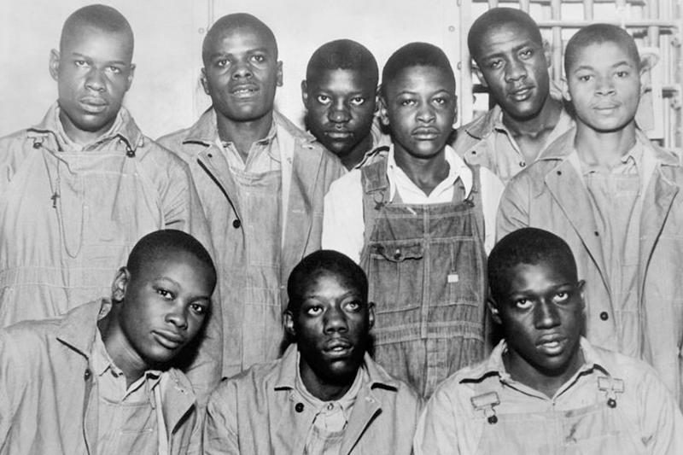
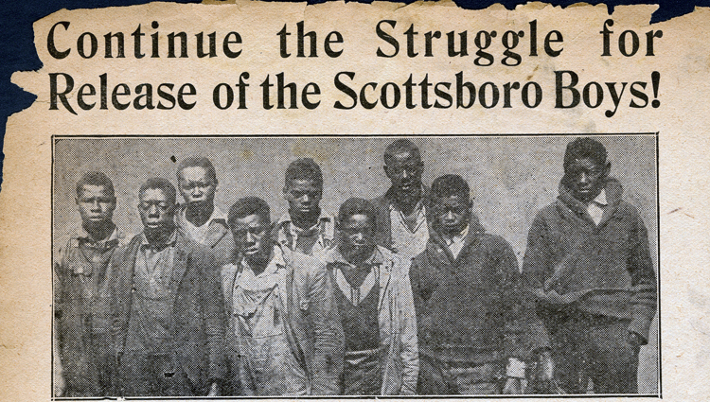
Scottsboro Case
The Scottsboro Boys were nine black teenagers falsely accused of raping two white women aboard a train near Scottsboro, Alabama, in 1931.
The trials and repeated retrials of the Scottsboro Boys sparked an international uproar and produced two landmark U.S. Supreme Court verdicts, even as the defendants were forced to spend years battling the courts and enduring the harsh conditions of the Alabama prison system.
Harper Lee reportedly drew on the boys’ experience when she wrote her classic novel To Kill A Mockingbird, and over the years the case has inspired numerous other books, songs, feature films, documentaries and even a Broadway musical.

Slide 26
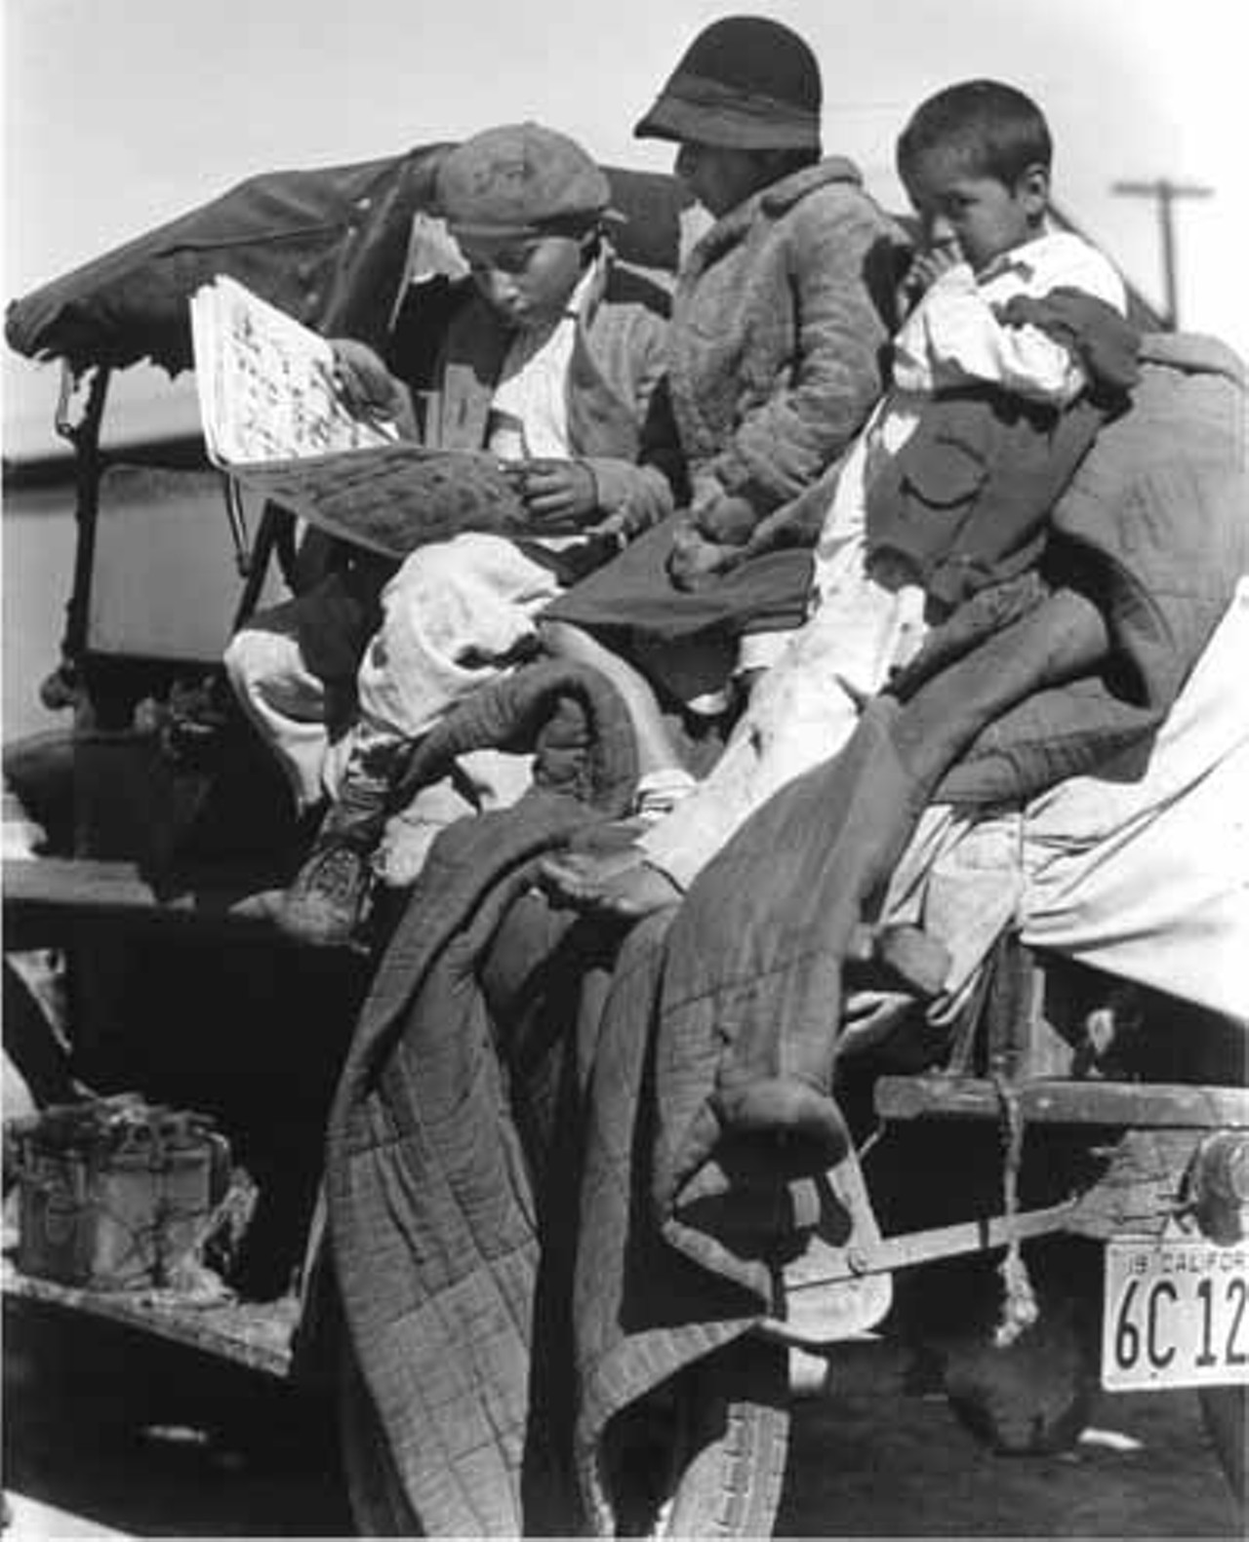
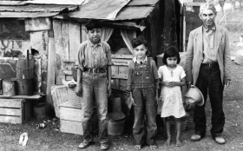
HISPANIC WORKERS TARGETED
Patterns of discrimination confronted many Mexicans and Mexican Americans during the Depression.
The Hispanic population had been growing in California.
They filled the same menial jobs that had been filled by African Americans in other areas of the country.
Unemployed whites demanded jobs held by Hispanics that they had previously considered beneath them.
Mexican unemployment rose quickly to rates far higher than whites.

Slide 27
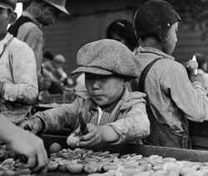
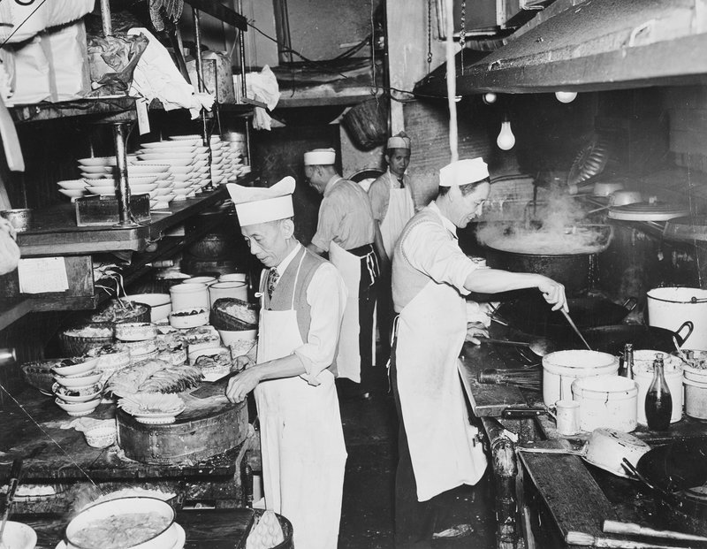
PLIGHT OF ASIAN AMERICANS
The largest Japanese American and Chinese American populations were educated and found it impossible to move into mainstream professions.
Often times they had to resort to working at fruit stands or as farmworkers despite being college graduates with degrees.
Many Chinese worked in family owned laundries and restaurants. Those who moved outside the Asian community could not find work above entry level.

Slide 28
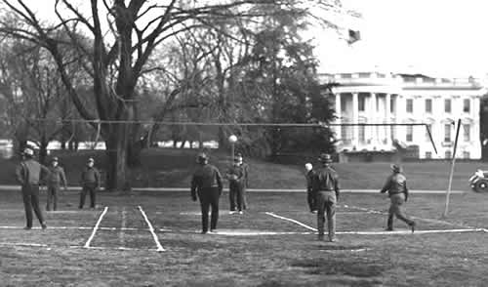
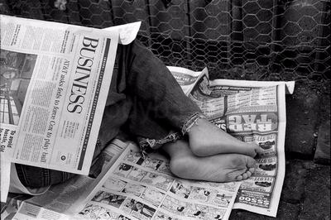
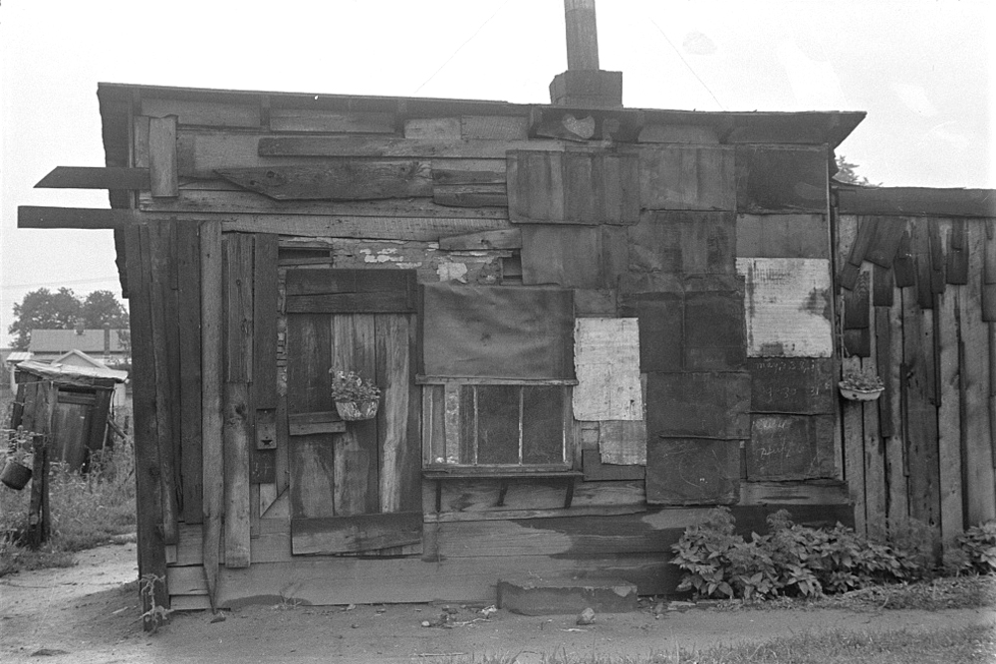
HOOVERISM
Hoover Ball
Hoover Blanket
Hoover Leather
Hoover Flag
Hoover Houses
Hoover Hogs
Hoover Shoes
Hoover Soup
Hoover Heaters
A game Hoover played at the White House.
A newspaper used to cover up.
Cardboard used to mend a hole in your shoe.
Empty pockets turned inside out.
Cardboard boxes
Wild rabbits or game.
Shoes with holes in them.
Ketchup and water.
Campfire

Slide 29
Rugged Individualism
rugged individualism: belief that people should not be put on public funds with unemployed.
Hoover believed that government assistance was not needed to solve the depression. The American public had to wait it out.

Slide 30
AGRICULTURAL MARKETING ACT
The Agricultural Marketing Act of 1929, under the administration of Herbert Hoover, established the Federal Farm Board from the Federal Farm Loan Board established by the Federal Farm Loan Act of 1916 with a revolving fund of half a billion dollars.
The original act was sponsored by Hoover in an attempt to stop the downward spiral of crop prices by seeking to buy, sell and store agricultural surpluses or by generously lending money to farm organizations.

Slide 31
Smoot-Hawley Tariff
The Smoot-Hawley Tariff: high tariff rates that were enacted by Congress in 1930.
Congress did not realize that raising the tariffs only made the situation worse.
European nations retaliated by raising their own tariffs.
In 1931 Europe suffered an economic crisis and Hoover
had to sponsor a moratorium on the payment of war debts.

Slide 32
Hoovervilles
These were makeshift
tent cities for the homeless.

Slide 33
RFC- Reconstruction Finance Corporation
The Reconstruction Finance Corporation (RFC) was a government corporation administered by the United States Federal Government between 1932 and 1957 that provided financial support to state and local governments and made loans to banks, railroads, mortgage associations, and other businesses.

Slide 34
The Battle of Washington (The Bonus Army)

Slide 35
Bonus Army
In 1924, Congress approved of bonus payments to all World War I veterans to be paid in 1945.
When the country fell on hard times the veterans demanded that they be paid early.
In June 1932 about 15,000 marched in Washington.

Slide 36
Veterans brought their families and lived in shacks around the city.
Hoover called on the policed to clear the city.
Two veterans were killed and then Hoover called in the army with tanks, rifles, and tear gas.

Slide 37
Election of 1932
The Republican Party nominated Herbert Hoover who had no opponent within the party. It was a common practice that the current president would be nominated.
The Republicans knew there was very little chance that Hoover would be re-elected.

Slide 38
Franklin Roosevelt
Franklin Roosevelt was born into a wealthy and well-known family in New York. He studied law at Harvard.
In 1921 Roosevelt became ill with polio, a crippling disease that often was deadly. For some time he was completely without the use of his arms and legs.
He never was able to regain the complete use of his legs. He always needed the assistance of braces and crutches.

Slide 39
Hiding the Disability

Slide 42
KEYNESIAN ECONOMICS
Keynesian economics are the various macroeconomic theories about how in the short run – and especially during recessions – economic output is strongly influenced by aggregate demand.
Keynesian economics developed during and after the Great Depression, from the ideas presented by John Maynard Keynes in his 1936 book, The General Theory of Employment, Interest and Money. Keynes contrasted his approach to the aggregate supply-focused classical economics that preceded his book.
Aggregate: total supply of goods and services.

Slide 43
The New Deal
“The only thing we have to fear is, fear itself.”

Slide 44
NEW DEAL
At the Democratic National Convention Roosevelt promised “A New Deal” for the American people.
New Deal: name given to Roosevelt’s domestic programs aimed at solving the Depression.

Slide 45
The Bank Holiday
Temporarily closed all the nation’s banks to stop panic and large-scale withdrawals
Attempt to stop people from hoarding money.

Slide 46
Fireside Chats
FDR gave 30 radio speeches to the nation, which became known as fireside chats. These speeches were clear and directed at all Americans no matter the level of education.
FDR’s first fireside chat on the bank crisis. (March 12, 1933)

Slide 47
Hundred Days
Critical period of government activity in the first 100 days in office.
Roosevelt pushed Congress to put most of his New Deal into practice.
The New Deal promised the three R’s: relief, recovery and reforms.

Slide 48
Relief for the unemployed. Direct aid.
Plans for Recovery of the economy.
Put people back to work.
The New Deal had three major goals:
Reforms to prevent any future economic depressions.

Slide 49
RELIEF PROGRAMS
Millions of Americans enjoyed some form of help.
Direct relief or jobs that provided a steady paycheck.
Soup kitchens and shelters were set up to help the people who were suffering the most.

Slide 50
RECOVERY PROGRAMS
Unemployment remained high.
These programs set out to put people back to work.
Work projects were created.
New Deal left thousands of roadways, bridges, dams, public buildings, and works of art.

Slide 51
REFORM PROGRAMS
Reform programs were designed to provide long term protection in a variety of economic areas.
The purpose of reform was so that there would not be another Great Depression.
There are several reform
programs from the New Deal
That still exist today.

Slide 52
Alphabet Soup Agencies
NEW DEAL AGENCIES
1933 - EBA - Emergency Banking Act 1933 - CCC - Civilian Conservation Corps 1933 - TVA - Tennessee Valley Authority 1933 - AAA - Agricultural Adjustment Administration 1933 - FERA - Federal Emergency Relief Administration 1933 - NRA - National Recovery Administration 1933 - FDIC - Federal Deposit Insurance Corporation 1933 - PWA - Public Works Administration 1933 - CWA - Civil Works Administration 1933 - FAA - Federal Aviation Administration 1933 - HOLC - Home Owners Loan Corporation 1934 - FCC - Farm Credit Administration 1934 - FHA - Federal Housing Administration 1934 - NLRB - National Labor Relations Board (Wagner Act) 1934 - SEC - Securities Exchange Commission 1935 - NYA - National Youth Administration 1935 - SSA - Social Security Administration 1935 - FSA - Farm Security Administration 1935 - DRS - Drought Relief Service 1935 - RA - Resettlement Administration 1935 - REA - Rural Electrification Administration 1938 - USHA - United States Housing Authority 1939 - FWA - Federal Works Agency
There were so many agencies with abbreviations that they became known as the alphabet soup agencies.

Slide 53
A.A.A.- Agricultural Adjustment Act
Helped farmers by paying them not to grow crops.
This agency told farmers how much food to produce so there wouldn’t be a surplus of farm goods.

Slide 54
Agricultural Adjustment Administration
Farmers receiving checks, St. Augstine, Texas (1939)

Slide 55
FDIC: Federal Deposit Insurance Corporation
The Federal Deposit Insurance Corporation (FDIC) is a United States government corporation operating as an independent agency created by the Banking Act of 1933.
As of January 2013, it provides deposit insurance guaranteeing the safety of a depositor's accounts in member banks up to $250,000 for each deposit ownership category in each insured bank

Slide 56
SEC: Securities and Exchange Commission
The U.S. Securities and Exchange Commission (SEC) is an agency of the United States federal government.
It regulates the Stock Exchange and makes sure rules and policies are enforced.
The SEC has a three-part mission: to protect investors; maintain fair, orderly, and efficient markets; and facilitate capital formation.

Slide 57
National Recovery Administration
The goal was to eliminate "cut-throat competition" by bringing industry, labor, and government together to create codes of "fair practices" and set prices.
In 1935, the U.S. Supreme Court unanimously declared that the NRA law was unconstitutional, ruling that it infringed the separation of powers under the United States Constitution.

Slide 58
The Philadelphia Eagles were named after this New Deal program.

Slide 59
T.V.A.- Tennessee Valley Authority
Helped build dams and other projects along the Tennessee River and its tributaries.
This program build energy sources that span seven states are in use still today.

Slide 60
C.C.C.- Civilian Conservation Corps
Helped unemployed young men 18 to 25 years old.
Set up camps for young people to work at and sent their wages back to their families.

Slide 61
Public Works Administration
New York City’s Tri-Borough Bridge

Slide 62
Rural Electrification Administration (REA)
Linemen on utility poles.

Slide 63
Lights for the Barnyard (TN)

Slide 64
Mortgage Relief
*The Federal Housing Administration (FHA) aimed to improve the housing market by encouraging banks to make housing loans.
*The FHA was an answer to critics who wanted every American to be able to buy a home.
Low down payments and the spreading out of payments made it possible for more people to afford a home.

Slide 65
CRITICS OF ROOSEVELT
Areas of Criticism
New Deal costs too much money.
Court Packing Scheme
Refusal to sign Anti-Lynching Bill
Japanese Relocation

Slide 66
DEFICIT SPENDING
Deficit spending is when you spend more than you earn. Government leaders use it to boost growth and stay in office.
The New Deal cost $41.7 billion at the time, according to a 2015 study by economists Price Fishback and Valentina Kachanovskaya.
That figure translates to $653 billion in 2009 dollars.

Slide 67
American Liberty League
The American Liberty League was an American political organization formed in 1934, primarily of wealthy business elites and prominent political figures, who were conservatives opposed to the New Deal of President Franklin D. Roosevelt.
Its principles emphasized private property and individual liberties.

Slide 68
Townsend Plan
Frances E. Townsend, a physician from California, was concerned about the plight of the elderly.
Under his plan the government would pay every person over 60 a pension of $200 a month.
The money had to be spent before another check would be issued.

Slide 69
Father Coughlin
This powerful radio priest, Father Charles Coughlin, was another of Roosevelt’s strongest critics. Coughlin too was an early supporter of Roosevelt.
Although his political views had no direction, Coughlin was able to gain a large following.
He was openly prejudiced against Jews and claimed that Roosevelt and others in his administration had Jewish backgrounds.
CBS dropped his program when it became too controversial.

Slide 70
Huey Long
Long was initially one of Roosevelt’s supporters.
He now became one of his biggest critics.
He was a senator from Louisiana that was very popular with the poor because he built schools and paved roads in the poorer community.
It has been said that the poor blacks and whites of Louisiana worshipped the ground that he walked on.

Slide 71
Share Our Wealth Program
In 1934 Long proposed this program to confiscate all incomes that were over $1 million and redistribute the money to the poor.
This would guarantee $5000 home and a $2000 income to every American.
There was a popular jingle to attract people to the scheme.
The opening sentence was “Every man a king.”

Slide 72
The Second New Deal
A new wave of government initiatives starting in 1935 resulted in some strong successes and stunning defeats for President Roosevelt.
Despite the criticism from people like Huey Long and Father Coughlin, the majority of people were still behind Roosevelt.
Roosevelt wanted to extend the New Deal. He wanted to protect that American people from hardship in the future.

Slide 73
Social Security
In August of 1935 the Social Security Act was passed. This act was created to help protect Americans who were unable to support themselves.
Upon retirement, workers would receive monthly payments for the rest of their lives. The money would be collected from the people who were currently working.
The system is facing a serious drain with the Baby Boomers.

Slide 74
UNIONS
The emergence of powerful trade unions in the 1930’s occurred in response to government efforts to enhance the power of unions.
There was increased militancy amongst workers.
Business leaders and industrialists lost the ability to control government policies.
Sit Down Strikes: A sit-down strike is a labor strike and a form of civil disobedience in which an organized group of workers, usually employed at factories or other centralized locations, take unauthorized or illegal possession of the workplace by "sitting down" at their stations.

Slide 75
FRANCES PERKINS
Frances Perkins was an American sociologist and workers-rights advocate who served as the U.S. Secretary of Labor from 1933 to 1945, the longest serving in that position, and the first woman appointed to the U.S. Cabinet.
During her term as Secretary of Labor, Perkins executed many aspects of the New Deal, including the Civilian Conservation Corps, the Public Works Administration and its successor the Federal Works Agency, and the labor portion of the National Industrial Recovery Act.

Slide 76
LABOR DISPUTES ACT
Smith-Connally Anti-Strike Act, also called War Labor Disputes Act, (June 25, 1943), measure enacted by the U.S. Congress, over President Franklin D. Roosevelt's veto, giving the president power to seize and operate privately owned war plants when an actual or threatened strike or lockout interfered with war production.
The legislation was hurriedly created after 400,000 coal miners, their wages significantly lowered because of high wartime inflation, struck for a $2-a-day wage increase.

Slide 77
WPA- Works Progress Administration
The Works Progress Administration (WPA; renamed in 1939 as the Work Projects Administration) was an American New Deal agency, employing millions of people (mostly unskilled men) to carry out public works projects, including the construction of public buildings and roads.

Slide 78
1936 Referendum
By the middle of 1936, the economy was visibly reviving, there was little doubt Roosevelt would be re-elected.
The election of 1936 was the greatest landslide in American history to that point.
Roosevelt had 61% of the vote to Landon’s 36%.
The election results will not reflect the difficulties Roosevelt will experience in his second term.

Slide 79
Court Packing Plan
Roosevelt’s Plan
Gave the president power to appoint many new judges and expand the Supreme Court by up to six judges
Roosevelt argued that changes were needed to make the courts more efficient.
Most observers saw plan as effort to “pack” the court with friendly justices.
The Result
Plan did not pass; however, the Supreme Court made some rulings that favored New Deal legislation.
Supreme Court upheld a minimum wage law in Washington state.
Court declared Social Security plan to be constitutional.

Slide 80
The Black Cabinet
Roosevelt’s administration also appointed many African Americans.
William Hastie became the first black federal judge.
A group of African Americans hired to fill government posts were known as the Black Cabinet, and they served as unofficial advisors to the president.
Mary McLeod Bethune- was a member of Roosevelt’s Black Cabinet. She was an educator.

Slide 81
African Americans and the New Deal
Still, African Americans continued to face tremendous hardships during the 1930s.
Severe discrimination
Thousands of African American sharecroppers and tenant farmers were not helped by New Deal programs.
Southern Democrats in Congress opposed efforts to aid African Americans.
Many African American switch from the Republican Party to the Democratic Party during the 1930s.

Slide 82
A Turn Towards Democrats
African Americans were hit harder than any other group during Depression. Thousands found jobs in Roosevelt’s New Deal programs.
Symbolic acts influenced the black vote. Opera singer Marian Anderson was refused permission to sing at Constitution Hall on Easter Sunday. Eleanor Roosevelt invited her to sing at the Lincoln Memorial.

Slide 83
Republican to Democrat
“My friends, go turn Lincoln’s picture to the wall. That debt has been paid in full.”
In 1932 the African American population was slow to support Franklin Roosevelt.
Most African Americans had traditionally been members of the Republican Party.
Abraham Lincoln was a Republican and many African Americans joined the party after being freed from slavery and given the right to vote.
By 1936, Roosevelt had won the respect and vote from African Americans for several reasons:
1. The New Deal programs applied to all Americans.
2. He appointed African Americans to high office in the White House.
3. Eleanor Roosevelt was a known supporter of Civil Rights.

Slide 84
Native Americans
Native Americans received strong government support from the New Deal.
Indian Reorganization Act of 1934.
(Commissioner of Indian Affairs) helped create this act; promoted Native American autonomy by granting ownership of Native American lands to the tribes, building schools within the parameters of the reservations and granting permission to tribes to elect tribal councils that governed reservations.

Slide 85
Impact of the New Deal
The New Deal changed the link between the American people and their government.
Roosevelt believed that government could help businesses and individuals achieve a greater level of economic security.
The New Deal required a much bigger government.
Americans now began to look regularly to government for help.
The New Deal restored Americans faith in the government and democracy.

