Slide 1
IB PSYCHOLOGY SL
Introduction to psychology

Slide 2
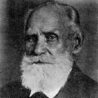
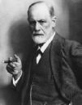
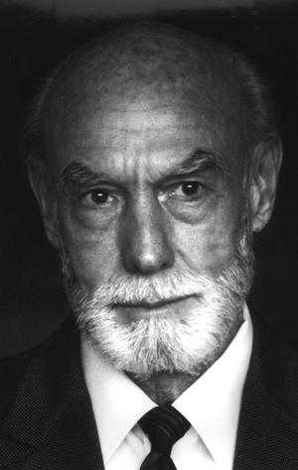
What is Psychology?
Psychology is a broad and diverse area of endeavor, one that has evolved from relatively humble beginnings in the nineteenth century into a science that is now concerned with a great many different aspects of our lives.
Modern psychology is comprised of many specialty areas that are interwoven
PAVLOV
FREUD
SKINNER
SPERRY

Slide 3
What is Psychology?
The term psychology has it’s origins in the Greek words psyche (soul or self) and logos (logic, science).
It is a science that stresses careful observation and experimentation in the quest for objective evidence to back up its claims.
Behavior refers to anything an organism does whether it can be observed directly.

Slide 4
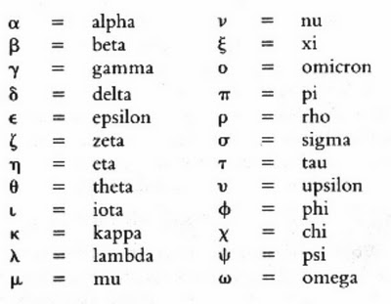
Origin of the Psychology Symbol
Is derived from a letter from the Greek alphabet, psi, which is also the first letter of the Greek word psuche, meaning mind or soul, from which the term psyche arose; which in turn gave us the name of the discipline psychology which is most commonly defined as study of the mind.

Slide 5
Part 1: perspectives
The study of all three of the following perspectives is compulsory. The interaction of these three perspectives substantially influences behavior.
The level of analysis approach reflects a modern trend in psychology towards integration and demonstrates how explanations offered by each of the three levels of analysis (biological, cognitive and sociocultural) complement one another and together provide more complete and satisfactory explanations of behavior.
The Biological Perspective
The Cognitive Perspective
The Socio-Cultural Perspective

Slide 6
BIOLOGICAL PERSPECTIVE
At the most basic level of analysis, human beings are biological systems. Our cognitions, emotions and behaviors are products of the anatomy and physiology of our nervous and endocrine systems. Over the last few centuries, discoveries have shown that:
• the nature of the nervous system is electrical in part (Galvani)
• different areas of the brain carry out different functions (Broca)
• small gaps exist between nerve cells that require the action of chemicals to carry neural transmissions across these gaps
• hormones play an important role in our psychological functioning.

Slide 7
LEARNING OUTCOMES: BIOLOGICAL
General Outcomes:
• Outline principles that define the biological level of analysis (for example, patterns of behavior can be inherited; animal research may inform our understanding of human behavior; cognitions, emotions and behaviors are products of the anatomy and physiology of our nervous and endocrine systems).
• Explain how principles that define the biological level of analysis may be demonstrated in research (that is, theories and/or studies).
• Discuss how and why particular research methods are used at the biological level of analysis (for example, experiments, observations, correlational studies).
• Discuss ethical considerations related to research studies at the biological level of analysis.

Slide 8
Learning outcomes:
Physiology and Behavior
Explain one study related to localization of function in the brain (for example, Wernicke, Broca, Gazzaniga and Sperry).
• Using one or more examples, explain effects of neurotransmission on human behavior (for example, the effect of noradrenaline on depression).
Using one or more examples, explain functions of two hormones in human behavior.
Discuss two effects of the environment on physiological • processes (for example, effects of jet lag on bodily rhythms, effects of deprivation on neuroplasticity, effects of environmental stressors on reproductive mechanisms).
Examine one interaction between cognition and physiology in terms of behavior (for example, agnosia, anosognosia, prosapagnosia, amnesia). Evaluate two relevant studies.
• Discuss the use of brain imaging technologies (for example, CAT, PET, fMRI) in investigating the relationship between biological factors and behavior.

Slide 9
Genetics and behavior
• With reference to relevant research studies, to what extent does genetic inheritance influence behavior?
• Examine one evolutionary explanation of behavior.
• Discuss ethical considerations in research into genetic influences on behavior.

Slide 10
Cognitive perspective
Cognitive psychology represents a vast array of research areas including cognitive psychology, cognitive science, cognitive neuropsychology and cognitive neuroscience.
Topics such as memory, perception, artificial intelligence, amnesia and social cognition are studied.
Cognitive psychologists use traditional research methods (for example, experiments and verbal protocols) but there is an increasing focus on the use of modern technology.

Slide 11
Learning outcomes
General Outcomes
• Outline principles that define the cognitive level of analysis (for example, mental representations guide behavior, mental processes can be scientifically investigated).
• Explain how principles that define the cognitive level of analysis may be demonstrated in research (that is, theories and/or studies).
• Discuss how and why particular research methods are used at the cognitive level of analysis (for example, experiments, observations, interviews).
• Discuss ethical considerations related to research studies at the cognitive level of analysis.

Slide 12
LEARNING OUTCOMES
COGNITIVE PROCESSES
Evaluate schema theory with reference to research studies.
• Evaluate two models or theories of one cognitive process (for example, memory, perception, language, decision‑making) with reference to research studies.
• Explain how biological factors may affect one cognitive process (for example, Alzheimer’s disease, brain damage, sleep deprivation).
• Discuss how social or cultural factors affect one cognitive process (for example, education, carpentered-world hypothesis, effect of video games on attention).
• With reference to relevant research studies, to what extent is one cognitive process reliable (for example, reconstructive memory, perception/visual illusions decision‑making/heuristics)?
• Discuss the use of technology in investigating cognitive processes (for example, MRI (magnetic resonance imaging) scans in memory research, fMRI scans in decision‑making research).

Slide 13
LEARNING OUTCOMES
COGNITION AND EMOTION
To what extent do cognitive and biological factors interact in emotion (for example, two factor theory, arousal theory, Lazarus’ theory of appraisal)?
• Evaluate one theory of how emotion may affect one cognitive process (for example, state-dependent memory, flashbulb memory, affective filters).

Slide 14
Socio-cultural perspective
At the third level of analysis, the biological and cognitive systems that make up the individual are embedded in an even larger system of interrelationships with other individuals.
At its beginning, psychology largely confined itself to the study of the individual acting alone. As the discipline matured, a few psychologists recognized that human behavior could be fully understood only if the social context in which behavior occurred was also taken into account.
This recognition led to many investigations of social influence, that is, how the presence and behavior of one or a few people affect the behavior and attitudes of another individual.

Slide 15
Learning outcomes
General Outcomes:
Outline principles that define the sociocultural • level of analysis (for example, the social and cultural environment influences individual behavior; we want connectedness with, and a sense of belonging to, others; we construct our conceptions of the individual and social self).
Explain how principles that define the sociocultural level of analysis may be demonstrated in research (that is, theories and/or studies).
Discuss how and why particular research methods are used at the sociocultural level of analysis (for example, participant/naturalistic observation, interviews, case studies).
Discuss ethical considerations related to research studies at the sociocultural level of analysis.

Slide 16
Socio-cultural cognition
• Describe the role of situational and dispositional factors in explaining behavior.
• Discuss two errors in attributions (for example, fundamental attribution error, illusory correlation, self‑serving bias).
• Evaluate social identity theory, making reference to relevant studies.
• Explain the formation of stereotypes and their effect on behavior.

Slide 17
Social and Cultural norms
Social norms
• Explain social learning theory, making reference to two relevant studies.
• Discuss the use of compliance techniques (for example, lowballing, foot‑in‑the‑door, reciprocity).
• Evaluate research on conformity to group norms.
• Discuss factors influencing conformity (for example, culture, groupthink, risky shift, minority influence).
Cultural norms
• Define the terms “culture” and “cultural norms”.
• Examine the role of two cultural dimensions on behavior (for example, individualism/collectivism, power distance, uncertainty avoidance, Confucian dynamism, masculinity/femininity).
• Using one or more examples, explain “emic” and “etic” concepts.

Slide 18
Part 2: option
One option from the following list must be studied:
Abnormal Psychology
Developmental Psychology
Health Psychology
Psychology of Human Relationships
Sports Psychology

Slide 19
Abnormal Psychology
Abnormal psychology focuses on diagnosing, explaining and treating humans suffering from psychological disorders. This option begins with a consideration of normal and abnormal behavior. An understanding of issues related to diagnosis provides a framework for the subsequent study of disorders and therapeutic approaches.
Understanding and treatment of dysfunctional behavior.
Anxiety disorders
Schizophrenia
Obsessive compulsive behavior
Serial killers

Slide 20
Developmental Psychology
Developmental psychology is the study of how and why people change over time in the way they behave, think, and relate to others. Developmental psychology focuses on developmental themes such as identity, attachment and adolescence.
Studies the changes in individuals biological, cognitive, social, and emotional behavior.
Focus on childhood development, adolescent development, gender differences, role of identity and stereotypes.

Slide 21
Health Psychology
Promotes the understanding of behavior that leads to a healthier lifestyle.
Health psychology is concerned with how different factors, such as lifestyle and social context, may influence health and illness. One of the goals of health psychology is to promote an understanding of behavior that leads to a healthier lifestyle. The health psychology option focuses on stress, substance abuse, addiction, obesity and health promotion.
Health problems:
Stress
Substance abuse
Eating disorders
Addictive behavior

Slide 22
Sports Psychology
It involves the study of how psychological factors affect performance and how participation in sport and exercise affect psychological and physical factors.
In addition to instruction and training of psychological skills for performance improvement, applied sport psychology may include work with athletes, coaches, and parents regarding injury and rehabilitation, communication, team building, and career transitions.
Emotion and motivation.
Skill and performance development
Problems in Sports

Slide 23
Psychology of Human Relationships
This social psychology option focuses on human relationships; these relationships may be romantic, friendship, familial, or antagonistic. Humans are social animals, but while we depend upon others for our well‑being, conflict with others can threaten our survival individually and as social groups.
Key goals of social psychologists are to understand the complexities of relationships, improve interpersonal relationships, promote social responsibility and reduce violence. Psychologists assume that we may actively change our environment and not simply be manipulated by it.
Study of relationships that may be romantic, friendship, familial, or antagonistic.
Understand the complexities of relationships, improve interpersonal relationships, promote social responsibility, and reduce violence.
Areas of study include: altruism, bystanderism, sociocultural explanations of violence, biological and social origins of attraction.

Slide 24
LEARNING OUTCOMES
General framework (applicable to all topics in the option)
• To what extent do biological, cognitive and sociocultural factors influence human relationships?
• Evaluate psychological research (that is, theories and/or studies) relevant to the study of human
relationships.
Social responsibility
• Distinguish between altruism and prosocial behavior.
• Contrast two theories explaining altruism in humans.
• Using one or more research studies, explain cross‑cultural differences in prosocial behavior.
• Examine factors influencing bystanderism.

Slide 25
LEARNING OUTCOMES
Interpersonal relationships
• Examine biological, psychological and social origins of attraction.
• Discuss the role of communication in maintaining relationships.
• Explain the role that culture plays in the formation and maintenance of relationships.
• Analyze why relationships may change or end.
Violence
• Evaluate sociocultural explanations of the origins of violence.
• Discuss the relative effectiveness of two strategies for reducing violence.
• Discuss the effects of short‑term and long‑term exposure to violence.

Slide 26
Part 3: research methodology
QUALITATIVE RESEARCH
Qualitative research takes place in the real world, as opposed to the laboratory, and deals with how people give meaning to their own experiences.
It involves research of behavior in a natural setting, and is followed by an attempt to interpret the behavior and the meanings that people have given to their experiences.
Qualitative research strategies include the use of observations, interviews and case studies, among others.
These will often involve face‑to‑face interactions between researcher and participant where the researcher needs to be flexible and sensitive to the needs of the social context within which the data is obtained.

Slide 27
LEARNING OUTCOMES
Theory and practice in qualitative research
Distinguish between qualitative and quantitative data.
• Explain strengths and limitations of a qualitative approach to research.
• To what extent can findings be generalized from qualitative studies?
• Discuss ethical considerations in qualitative research.
• Discuss sampling techniques appropriate to qualitative research (for example, purposive sampling, snowball sampling).
• Explain effects of participant expectations and researcher bias in qualitative research.
• Explain the importance of credibility in qualitative research.
• Explain the effect of triangulation on the credibility/trustworthiness of qualitative research.
• Explain reflexivity in qualitative research.

Slide 28
LEARNING OUTCOMES
Interviews
• Evaluate semi‑structured, focus group and narrative interviews.
• Discuss considerations involved before, during and after an interview (for example, sampling method, data recording, traditional versus postmodern transcription, debriefing).
• Explain how researchers use inductive content analysis (thematic analysis) on interview transcripts.

Slide 29
LEARNING OUTCOMES
Observations
• Evaluate participant, non‑participant, naturalistic, overt and covert observations.
• Discuss considerations involved in setting up and carrying out an observation (for example, audience effect, Hawthorne effect, disclosure).
• Discuss how researchers analyze data obtained in observational research.

Slide 30
Learning outcomes
Case studies
• Evaluate the use of case studies in research.
• Explain how a case study could be used to investigate a problem in an organization or group (for example, a football team, a school, a family).
• Discuss the extent to which findings can be generalized from a single case study.

Slide 31
Part 4: simple experimental study
Students are required to plan and undertake a simple experimental study and to produce a report of their study.
A simple experimental study involves the manipulation, by the student, of a single independent variable and the measurement of the effect of this independent variable on a dependent variable, while controlling other variables.
Teachers should prepare students for the simple experimental study and the writing of the report.

Slide 32
RESEARCH METHODS
CASE STUDY: an in depth study of an individual or single instance of something.
SURVEYS: used to gather data from large numbers of people such as questionnaires.
CORRELATION: pairing data. This is widely used in genetic studies about I.Q., mental illness, and can show a link between earlier experiences and behavior.
EXPERIMENT: Manipulation of an independent variable in order to observe changes in the dependent variable. The experiments provide empirical evidence to support a hypothesis.

Slide 33
ETHICAL CONSIDERATIONS
Investigators must consider the ethical implications and psychological consequences for research participants.
Consent
Deception
Debriefing
Withdrawal from the investigation
Confidentiality
Protection from mental and physical harm
Observational Research

Slide 34
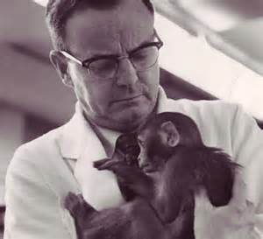
Ethics of Animal Experimentation
This topic has been long debated in many fields.
Animals often times do suffer during experimentation.
Animal rights activists call for an end to the use of animals in experiments.
Scientists argue that advancements in science and medicine that better humankind could not have been made without the use of animals.

Slide 35
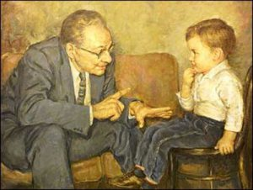
10 MOST UNETHICAL STUDIES IN PSYCHOLOGY
THE MONSTER STUDY (1939)
THE AVERSION PROJECT (1970’S-1980’S)
STANFORD PRISON EXPERIMENT (1971)
THE MONKEY DRUG TRIALS (1969)
LANDIS FACIAL EXPRESSIONS (1924)
LITTLE ALBERT (1920)
LEARNED HELPLESSNESS (1965)
MILGRIM EXPERIMENT (1961)
THE WELL OF DISPAIR (1960)
1. DAVID REIMER (1965-2004)
http://thomasmayers.wordpress.com/2013/04/09/top-10-most-un-ethical-studies-in-psychology/
Notes:
http://thomasmayers.wordpress.com/2013/04/09/top-10-most-un-ethical-studies-in-psychology/

Slide 36
Methodologies- strengths and weaknesses
Case Studies
-gives a unique perspective on an unusual situation, can not be replicated.
Surveys
-works well with a large sample size, subjects may not understand the questions or answer all the questions.
Correlation Studies
- works well in the use of twins as subjects but in most other cases you cannot have such a close comparison. Harder to find subjects.
Experiments
-usually very precise, valuable if it can be replicated, sometimes crosses the line with ethical guidelines, subjects may not behave the same in a scientific setting.

Slide 37
What is holism?
Holism refers to any approach that emphasizes the whole rather than their constituent parts. In other words ‘the whole is greater than the sum of its parts’.
Qualitative methods of the humanistic approach reflect a holistic position. Social psychology also takes a holistic view.
WHAT IS Reductionism?
Reductionism is a mode of explanation (opposite to holism), which attempts to describe and understand human behavior in terms of simple components or units.
Complex phenomena should be explained by the simplest underlying principles possible.

Slide 38
Structuralism
Structuralism was the first school of psychology and focused on breaking down mental processes into the most basic components. Researchers tried to understand the basic elements of consciousness using a method known as introspection.
Strengths of Structuralism
Structuralism is important because it is the first major school of thought in psychology.
Structuralism also strongly influenced experimental psychology.

Slide 39
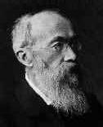
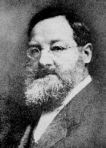
Major Structuralist Thinkers
Wilhelm Wundt: was a German medical doctor, psychologist, physiologist, philosopher, and professor, known today as one of the founding figures of modern psychology. He is widely regarded as the "father of experimental psychology"
Edward B. Titchener: Titchener’s development of structuralism helped establish the very first "school" of psychology, the structuralism did not last long beyond Titchener's death.

Slide 40
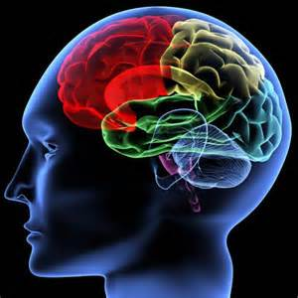
Criticisms of Structuralism
By today’s scientific standards, the experimental methods used to study the structures of the mind were too subjective—the use of introspection led to a lack of reliability in results.
Other critics argue that structuralism was too concerned with internal behavior, which is not directly observable and cannot be accurately measured.

Slide 41
Functionalism
Functionalism was a reaction to structuralism.
Functionalism refers to a general psychological philosophy that considers mental life and behavior in terms of active adaptation to the person's environment.
As such, it provides the general basis for developing psychological theories not readily testable by controlled experiments and for applied psychology.

Slide 42
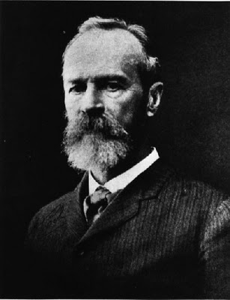
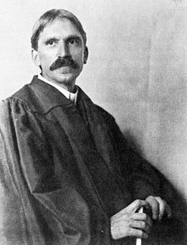
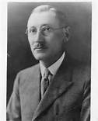
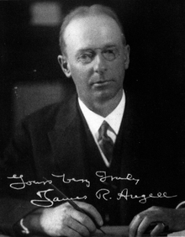
Major Functionalist Thinkers
William James: The first educator to offer a psychology course in the United States
John Dewey: one of the primary figures associated with philosophy of pragmatism and is considered one of the founders of functional psychology. A well-known public intellectual, he was also a major voice of progressive education and liberalism
Harvey Carr: developer of functionalism. Along with John Dewey and James Rowland Angell, he is credited with the development of functionalism as a school of thought.
James Angell: an American psychologist and educator. He served as the president of Yale University between 1921 and 1937.

Slide 43
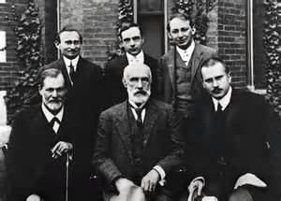
Strengths of Functionalism
Influenced behaviorism and applied psychology.
Influenced the educational system, especially with regards to John Dewey’s belief that children should learn at the level for which they are developmentally prepared.

Slide 44
Freewill
The freewill approach assumes that humans are free to choose their behavior, that they are essentially self-determining.
We think we can freely choose to do many actions, think many thoughts, etc.
Raising my arm
Becoming a philosopher
To kill or not to kill
To exit which door after class

Slide 45
Determinism
Determinism is the name of a broader philosophical view that conjectures that every type of event, including human cognition (behavior, decision, and action) is causally determined by previous events.
In philosophical arguments, the concept of determinism in the domain of human action is often contrasted with free will.
To the Determinist, the universe is like clockwork

Slide 46
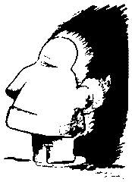
The ability of the student to see one of the images and focus on it even though there are two is considered freewill.

Slide 47
Culture
A program of shared rules, attitudes, values, and beliefs that govern the behavior of the majority of community members communicated from one generation to the next.

Slide 48
Cultural Bias in Psychological Theory
Cultural bias is interpreting and judging phenomena in terms particular to one's own culture.
This is a danger in any field of knowledge that claims objectivity and universality, such as philosophy and the natural sciences.

Slide 49
If we could, at this time, shrink the Earth’s population to a village of precisely 100 people, with all existing human ratios remaining the same, it would look like this: There would be--
14 from the Western Hemisphere (North and South), and
8 Africans.
70 would be non-white.
70 would be non-Christian.
50% of the world’s wealth would be in the hands of only 6 people
All 6 would be citizens of the United States.

Slide 50
70 would be unable to read.
50 would suffer from malnutrition.
80 would live in sub-standard housing.
Only 1 would have a college education.

Slide 51
Race
a group of people distinguished by certain similar and genetically transmitted physical characteristics; antiquated and meaningless
A social category reflecting particular experiences shared by many people belonging to a category called race.
Categories:
white,
black,
Native American,
Asian,
Hispanic/Latino

Slide 52
Ethnicity
Cultural heritage i.e., common ancestral origin, language, traditions, religion, geographic territory
Nation
People who share common geographical origin, history, language, & political entity
Traditional culture
Cultural construct rooted in traditions, rules, symbols, & principles established in past
Non-traditional culture i.e., modern
Based on new principles, ideas, and practices

Slide 53
Collectivism vs. Individualism
Behavior based on
Concern for others
Care for traditions & values
Prefer harmony in conflict resolution
Found in Asian & former communist countries
Behavior based on
Concern for self & one’s primary group
Prefer competitive strategies
Found in Western countries

Slide 54
Theoretical Bias
Cultures differ in many important ways from each other, for example in their values, norms of behavior and social structure.
Since cultural values strongly shape the construction of theories, ethnocentrism becomes a major problem.

Slide 55
Ethnocentrism
The view that supports judgment about other ethnic, national, and cultural groups and events from the onlooker’s cultural outlook i.e., an implication that one’s group of origin is better than others.

Slide 56
Numerous such biases are believed to exist, concerning cultural norms for color, location of body parts, mate selection, concepts of justice, linguistic and logical validity, acceptability of evidence, and taboos.
In brief, any normative belief of a human being seems to be caused by culture, and thus can be reasonably isolated as a cultural bias.

Slide 57
Researcher Bias
There may be bias that exists because there is a lack of researchers from other cultures.
There is bias in the sampling of subjects, the vast majority of the most famous studies down in America used whites only.
In European studies, less than 5% are non-white.

Slide 58
Examples:
People who read English often assume that it is natural to scan a visual field from left to right and from top to bottom.
Also, in the most western countries, a light switch usually turns a light on when up.
Also, in these countries, North is the top of a map, up is usually the larger quantity and better, as well.
As another example, Japanese do not place an X in a check-box to indicate acceptance -- this indicates refusal.

Slide 59
Reducing Cultural Bias
Two possible approaches:
Cross cultural approach – study many different cultures to identify the variations
Trans-cultural approach – study many different cultures to identify the similarities

