Slide 1
Internal assessment
IB PSYCHOLOGY

Slide 2
introduction
The highest markband for this section is 5 to 6 marks. To acquire that score you must include:
The aim to the investigation is stated and its relevance is explained.
The theory or model upon which the student’s investigation is based is described and the link to the student’s investigation is explained.
The independent and dependent variables are stated and operationalized in the null or research hypothesis.

Slide 3
AIm
Choose the wording carefully for the aim.
If you changed something from the original aim be certain to have that reflected in the way you write your aim.
The aims should bring together the IV, DV and the cause and effect relationship between the two.
Example: Loftus and Palmer
The aim of the experiment was to see the effect different post-event information would have on memory in an eye witness situation.
IV: Post-event information
DV: memory

Slide 4
Theory of model
There should be clear description of the background theory or model that the replicated experiment is based on.
Give a description and explanation of the original research experiment including the researchers.
Try to include the following about the original experiment:
Sample
Experimental design
Essential details
Procedure
Controls
Numerical results

Slide 5
State Variables and how they are operationalized
Example: Loftus and Palmer
IV is post-event information: operationalized is the emotional intensity of the verb.
DV is memory: is operationalized as the speed estimate
Make the following points clear in this section:
What research design was used- comparing different groups or comparing the different conditions of the same group.
How the variables are measured.
What is the direction of relationship?
Directional: X will be higher than Y
Non-Directional: X will be different than Y

Slide 6
exploration
The top mark band is 3-4 marks.
It states:
The research design is explained.
The sampling technique is explained.
The choice of participants is explained.
Controlled variables are explained.
The choice of materials is explained.

Slide 7
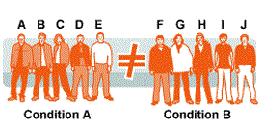
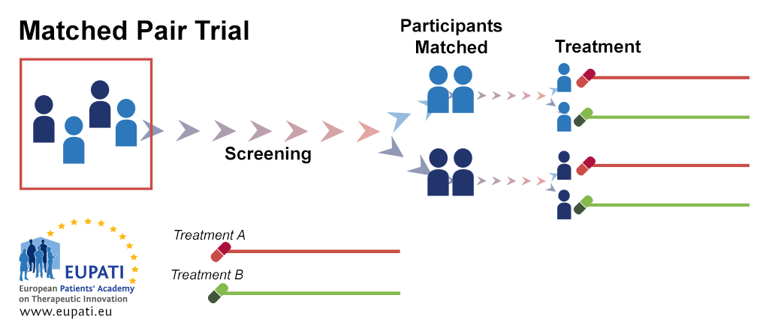
Explaining the research design
There are three types of design:
1. independent measures
2. Repeated measures
3. matched pairs
You need to correctly identify which measures you used and explain it in the context of your experiment.
Independent Measures: allocation to the group is random. Everything is the same for the two groups with the exception of the IV.
Repeated Measures: In this it is comparing the conditions rather than the groups. All of the participants are exposed to both conditions.
Matched Pairs: Similar to independent measures but the researchers use matching. This would be used if random allocation would not work.

Slide 8
Sampling technique
Sampling techniques include random, stratified, self-selected and opportunity.
Identify your target population that you will generalize your findings to.
You can identify your sample as random within the target population of the high school but it may not represent a broader sample so you are also using opportunity sampling.

Slide 9
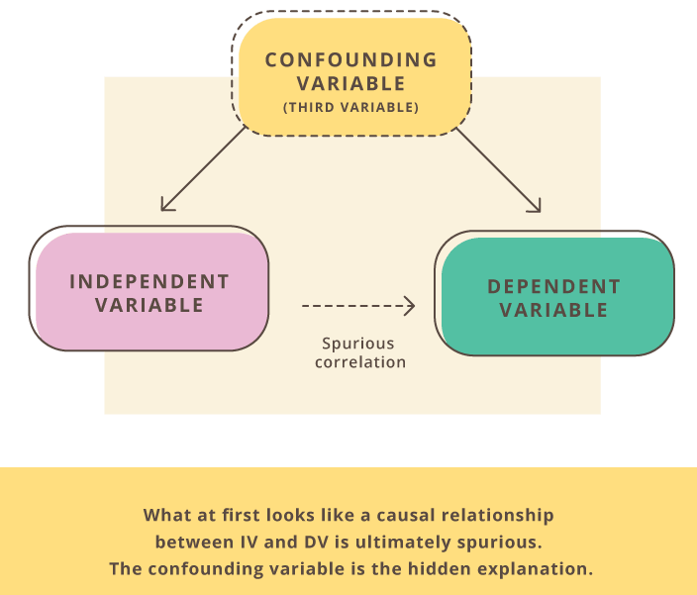
Explain the procedure
You will explain the procedure in regard to the controlled variables.
Come up with a list of factors that could affect the results of your research.
What items can you control? Describe only the most important factors.
For each one consider what are you going to do:
Nothing, and acknowledge they might influence the results.
Use random allocation into groups and expect factors will influence all participants.
Eliminate confounding variables.
Confounding variables are any other variable that also has an effect on your dependent variable. They are like extra independent variables that are having a hidden effect on your dependent variables.

Slide 10
Procedure
Outline step by step your procedure. This can be numbered or in a paragraph. Cite all materials when they are mentioned.
You are expected to give the full text of the standardized instructions in the appendix.
Example:
First we handed out the consent form. (Appendix A)
List and explain materials. Why did you choose to use this list, video, image?

Slide 11
analysis
Descriptive statistics uses the data to provide descriptions of the population, either through numerical calculations or graphs or tables. Inferential statistics makes inferences and predictions about a population based on a sample of data taken from the population in question.
Inferential statistics is one of the two main branches of statistics. Inferential statistics use a random sample of data taken from a population to describe and make inferences about the population.
This section is worth 6 marks. The top mark band is 5-6 marks.
The following is expected to get full marks:
Descriptive and inferential statistics are appropriately applied.
The graph is correctly presented and addresses the hypothesis.
The statistical findings are interpreted with regard to data and linked to the hypothesis.

Slide 12
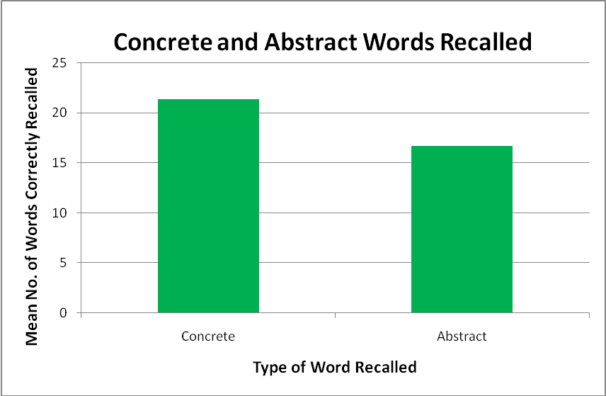
Descriptive Statistics
Descriptive statistics describe the variables. You must do the following:
Determine and explain the level of measurement of the dependent variable.
Describe the normality of its distribution.
Calculate and measure a central tendency (mean, median or mode).
Calculate a measure of dispersion (usually standard deviation).

Slide 13
Levels of measurement
Nominal-level variables: cannot be quantified. For example if people were listing their preference of music genre you can not rank their answers from highest to lowest. Rock, country, jazz, rap, hip hop would all be in their own category. The same would hold true for a yes/no answer to a question.
Ordinal-level variables: this type of results can be ranked from highest to lowest but intervals in between may not be equal.
Interval-level variables: this type of results are ranked from highest to lowest but the intervals in between are presumed to equal.
Ratio-level variables: in this type the 0 is fixed and meaningful meaning that someone could get a 0 as a score.

Slide 14
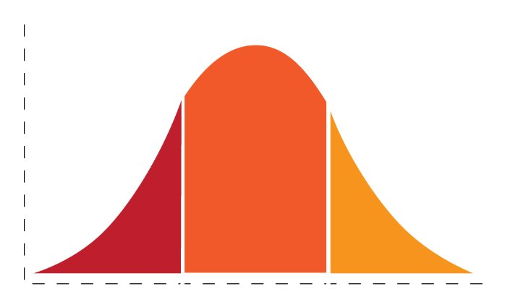
Normality of the dependent variable
This only applies to interval and ratio data.
Distribution is the range of values of a variable according to their frequency.
Example: if participants are given a list the number they recalled from the list could be distributed according to their frequency.
Normal distribution usually is in the form of a bell curve.

Slide 15
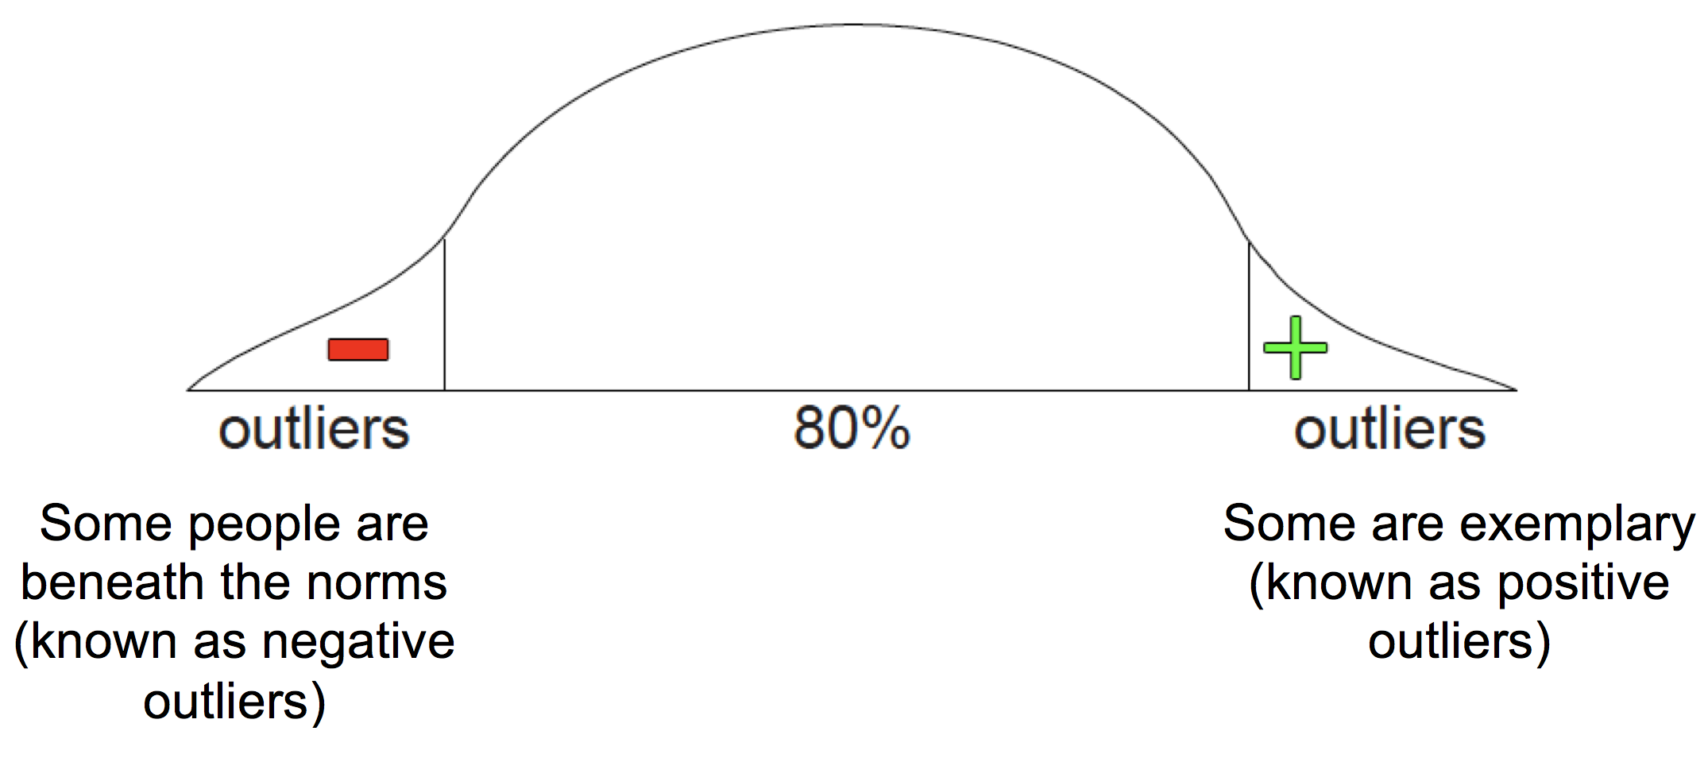
What is normal?
Be sure to include raw data table in your appendix.
Your evaluation of the normality of your results will affect whether you choose to use descriptive statistics or inferential statistics.
Normal distribution of scores typically result in the bell score.
Deviation from the norm is expected to occur.
If the deviation is small then the results can be considered normal.
Look for:
Outliers: these are scores that are extreme compared to the rest of the distribution.

Slide 16
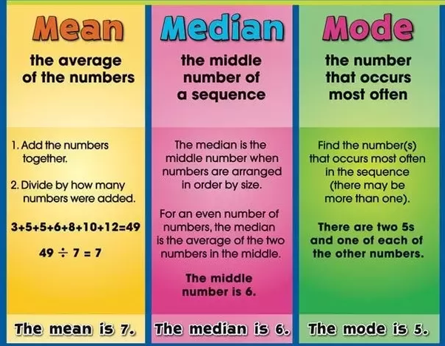
Measures of central tendency
Mean: this is simply the average of all scores. Add all the data points and divide by the number of observations (participants).
Median: the middle score of a sorted list. Use the median when there are strong deviations.
Mode: the value that appears most often. If your measurement is nominal you can only use mode.

Slide 17
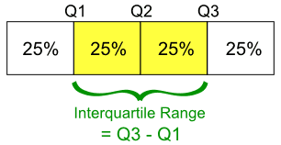
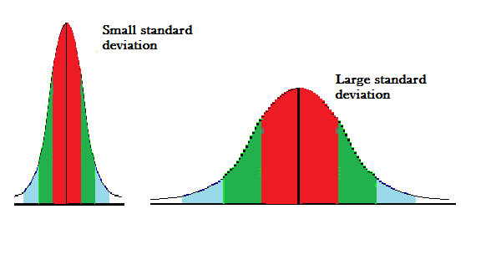
Measures of dispersion
STANDARD DEVIATION
For standard deviation you first calculate the mean of the data.
After this you square the deviation.
You calculate the sum of all squared deviations.
Calculate the square root of that value.
SEMI-INTERQUARTILE RANGE
This measure does not assume normality of distribution and can be used with ordinal level data.
When you sort the list you find the quartiles.

Slide 18
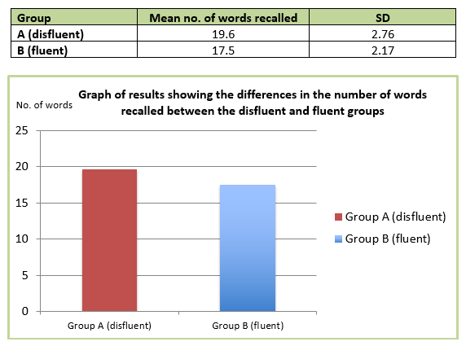
graphing
Sample:
When displaying the analysis of your data you want to clearly represent the two conditions that were present in your experiment.
The graphs should represent the aim of the experiment.
You can use bar charts, circle charts, bell curves and other means to show the data.
Do not include information in the cart that is not directly related to the hypothesis.
Be certain to label the chart with clear labeling that is specific to your conditions.

Slide 19
Inferential statistics
You will choose between a parametric test or a non-parametric test.
a parametric statistical test is one that makes assumptions about the parameters (defining properties) of the population distribution(s) from which one's data are drawn, while a non-parametric test is one that makes no such assumptions.
Descriptive statistics are used to describe the Dependent Variable, inferential statistics are used to test the hypothesis about the relationship the DV has with the IV.
Your choice of inferential test will depend on your:
experimental design
level of measurement
Assumptions about the normality of the distribution.

Slide 20
Parametric or non-parametric
First chart your results on a graph.
If the results have a normal distribution you will use parametric.
If the results have an abnormal distribution you will use non-parametric.
Parametric tests have greater power and are more capable of detecting existing differences.
Non-parametric tests reduce the measurement to ordinal, ignoring the intervals between data points, and therefore loses some power.

Slide 21
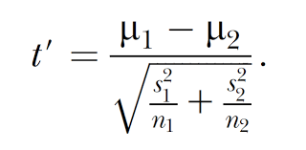
Unrelated t-test independent t-test
The unrelated T-Test is used to test the difference between two independent samples.
Level of measurement should be either interval or ratio.
You have used an independent measure design with two groups of participants.
The DV should be normally distributed for each IV.
There can be some abnormal scores in the form of outliers.
M is the mean
SD is the standard deviation
N is the sample size

Slide 22
Mann-whitney u-Test
Choose this test in the following situations:
Your sample size is sufficient, no fewer than 15.
Groups sizes for the two conditions is approximately equal.
There are no apparent outliers and the distribution does not deviate severely from normality.
Level of measurement is at least ordinal.
You have independent measures design.
In statistics, the Mann–Whitney U test, Wilcoxon rank-sum test, is a nonparametric test of the null hypothesis that it is equally likely that a randomly selected value from one sample will be less than or greater than a randomly selected value from a second sample.
Unlike the t-test it does not require the assumption of normal distributions.
It is nearly as efficient as the t-test on normal distributions.

Slide 23
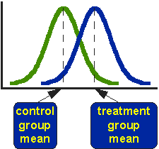
Related T-Test
The related t-test is used to compare two means in to related (dependent) samples.
The level of measurement should be ratio or interval.
Using repeated measures or matched pairs.
The differences in the two related groups should be approximately normal.

Slide 24
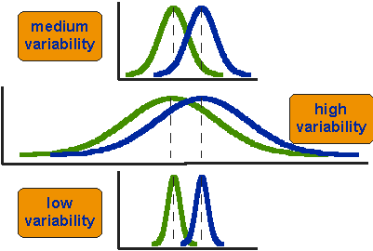

Slide 25
Wilcoxon signed-rank test
This is the non-parametric equivalent to the T-Test.
The level of measurement is at least ordinal.
Use repeated measures or matched pair design.
It deals with differences between pairs of values.

Slide 26
Four steps for wilcoxon
1.

Slide 27
evaluation
The top markband for this section is 5 to 6 marks.
The findings of the student’s investigation are discussed with reference to the background theory or model.
Strengths and limitations of the design, sample, and procedure are stated and explained and relevant to the investigation.
Modifications are explicitly linked to the limitations of the student’s investigation and fully justified.

Slide 28
Information to include:
Did your findings support the background theory or model and why?
Comparison of your findings and the original study.
If you modified the original experiment, how did you and why?
This whole section should be written in the context of whatever theory or model you were replicating in your study.
Focus on strengths and limitations and consider the following:
Construct Validity- were there confounding variables?
Internal validity
External Validity
How constructs were operationalized
How variables were controlled
How sample selected
Were they a target population

