Slide 1
Welcome to Junior Parent Night
Class of 2017

Slide 2
Counseling Team:
Mr. Dan Sandy Seniors (Class of ‘16)
Mr. Rashawn McCraney Juniors (Class of ‘17)
Ms. Bianca Ford Sophomores (Class of ‘18)
Mrs. Caitlin Castle Freshmen (Class of ‘19)

Slide 3
AKRON PUBLIC SCHOOLS GRADUATION REQUIREMENTS
21 credits:
English | 4 Credits
Mathematics | 4 Credits
Science | 3 Credits
Social Studies | 3 Credits
Health | .5 Credit
P.E. I & II | .5 Credit (APS P.E. CLASSES ARE WORTH .25 CREDITS INDIVIDUALLY)
Electives | 6 Credits: Including 1 full credit of Fine Art or Career Ed. program

Slide 4
AKRON PUBLIC SCHOOLS GRADUATION REQUIREMENTS
In addition to earning 21 credits, students must also pass all five parts of the OGT exam:
Citizenship
Math
Reading
Science
Writing
Proficient score of 3 or above on OST exams can count towards corresponding OGT sections. (example: 3 or above on Government OST counts towards Citizenship section of OGT). A remediation Free Score on ACT or SAT will also count towards some parts of the OGT. For full description of OGT alternatives please visit the Ohio Department of Education website using this link:
http://education.ohio.gov/Topics/Ohio-Graduation-Requirements/Graduation-Requirements-2014-2017/New-Testing-Options-for-Students-Required

Slide 5
Recovering Credits
Night School
Summer School
OGT’s – Fall, Spring, Summer
Credit Recovery
Akron Alternative Academy

Slide 6
Credit Flexibility
Application due Feb 12th to counselor
Physical Education I & II
Test – Saturday, April 16th for P.E. I
P.E.II Test- TBD
SENIORS CAN ONLY TEST DURING FALL OF SENIOR YEAR

Slide 7
P.E. Waiver
Waives required .5 credit of P.E. for graduation
Must complete P.E. waiver form
Must complete 2 seasons of sports in one academic year (example: soccer & track during 2015-2016 school year).
Completion is verified by student being on both team’s rosters at the conclusion of both seasons.

Slide 8
P.E. Waiver... Continued
Must make up .5 credit void with another class
Must complete waiver process before the end of 1st semester of senior year
Waiver is “all or nothing”: Students can’t use the waiver if they currently have any credit for P.E.

Slide 9
Honors Diploma State of Ohio Any 7 of 8 required
4 Credits of English
4 Credits of Math including Algebra I, II and Geometry
4 Credits of Science including Physics & Chemistry
4 Credits of Social Studies
3 Credits of ONE Foreign Language or 2 Units of TWO Languages
1 Credit of Fine Arts
Minimum of a 3.5 GPA through grade 12
1800>SAT (1210) OR 27>ACT

Slide 10
College Prep Curriculum
4 English: 4 years of college prep English are required. This will give you the skills you’ll need to understand literature and write effectively.
4 Math: 4 years will give you the best possible preparation. Students who take math in each year of high school are far more successful in college than students taking only three years.
3 Science: 3 years of lab sciences are recommended, even in you don’t plan to pursue a science related field.
3 Social Studies: 3 years will give you the ability to understand and contribute to the community you live in.
3 Foreign Language: 3 years of the same language are recommended. Many universities require their students to study a foreign language. Strong preparation in high school will let you go further, faster in college.
1 Art: 1 year of a visual or performing art is required. This includes courses in which you study, create, or perform art, music, theatre or dance.

Slide 11
College Credit Plus (CCP)
Formerly known as Postsecondary
Available to students in grades 7-12
Earn credit towards high school graduation
Grades, Credits, & GPA will be posted on both transcripts (Any Ohio Public Institution. Private School Discretion)
Free College Education (Fees Assessed when failing/withdraw)
Many Options for Using CCP (On Campus, At FHS, Online)

Slide 12
College Credit Plus
Plan to Participate?
Pick-up a ‘Plan to Participate’ form in Attendance Office and return to your School Counselor by April 1
Meeting with School Counselor to discuss College Credit Plus details
Apply to College
University of Akron application by April 15

Slide 13
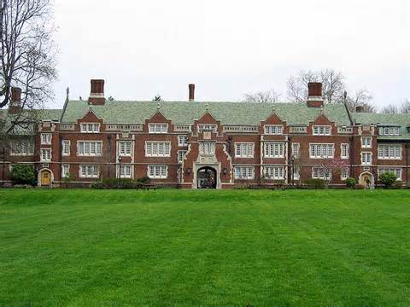
College Credit Plus
The University Of Akron
GPA: 3.0
ACT: 21 Comp.
18 English
Kent State
Review each application for GPA, ACT/SAT scores, and strength of academic preparation.

Slide 14
ACT/SAT

Slide 15
ACT SAT
Questions easier to understand
Has Science Section
Sends only best scores to schools
Answer every question. Nothing to lose.
Emphasizes Vocabulary
Essay no longer required as of March 2016
Sends all scores to schools
Penalty for wrong answers is gone March 2016
ACCORDING TO THE PRINCETON REVIEW
INDICATE UP TO FOUR SCHOOLS TO SEND SCORES TO FOR FREE

Slide 16
Sending ACT Scores
Indicate 4 schools at the time of the test
Some schools accept scores on transcript
Otherwise must send through the www.actstudent.org website for small fee.

Slide 17
ACT Test Dates
Test Date | Registration Deadline | (Late Fee Required)
April 9, 2016 | March 4, 2016 | March 5–18, 2016
June 11, 2016 | May 6, 2016 | May 7–20, 2016
September 10, 2016 | Early August
October 22, 2016 | Early September
December 10, 2016 | Early November
Test Date
April 19, 2016 | APS Funded. Free for All Juniors

Slide 18
ACT Benchmark Scores
College Course | ACT Subject Area Test | ACT Explore® Benchmark Grade 8 | ACT Explore® Benchmark Grade 9 | ACT Plan® Benchmark | The ACT® Benchmark
English Comp. | English | 13 | 14 | 15 | 18
College Algebra | Math | 17 | 18 | 19 | 22
Social Sciences | Reading | 16 | 17 | 18 | 22
Biology | Science | 18 | 19 | 20 | 23

Slide 19
SAT www.collegeboard.com
Register online
Print admission ticket
View and send your scores
Test Date | Deadline | Late Reg. Deadline (Requires Fee)
March 5, 2016 | Feb. 5, 2016 | Feb. 23, 2016
May 7, 2016 | April 8, 2016 | April 26, 2016
June 4, 2016 | May 5, 2016 | May 25, 2016
October 1, 2016 | Late Aug/Early Sept
November 5, 2016 | Late Sept/Early Oct

Slide 20
SAT/ACT Equivalent
1600 - 36 1090 - 24
1540 - 35 1050 - 23
1490 - 34 1020 - 22
1440 - 33 980 - 21
1400 - 32 940 - 20
1360 - 31 900 - 19
1330 - 30 860 - 18
1290 - 29 820 - 17
1250 - 28 770 - 16
1210 - 27 720 - 15
1170 - 26 670 - 14
1130 - 25 620 - 13

Slide 21
ACT/SAT Test Prep Website
www.akronschools.com/testing
- Student ID without 000 is password and username
http://www.princetonreview.com/college/free-actpactice-tst.asp
- Attendance Office Practice Books
- Find Local Test Prep Courses/Resources
- ZAPS
http://www.actstudent.org/testprep/
https://www.khanacademy.org/sat
Ohio Means Jobs k-12- click “plan it” and then “assessments”

Slide 22
Why go to college?
Every bit of education you get after high school increases the chances you'll earn good pay. Most college graduates earn a lot more money during their working years than people who stop their education at high school.
The more education you get the more likely it is you will always have a job. According to one estimate, by the year 2028 there will be 19 million more jobs for educated workers than there are qualified people to fill them.
Continuing education after high school is much more important for your generation than it was for your parents' generation. Today most good jobs require more than a high school diploma. Businesses want to hire people who know how to think and solve problems.
Education beyond high school gives you a lot of other benefits, including meeting new people, taking part in new opportunities to explore your interests, and experiencing success.

Slide 23
Why go to college?
Expected lifetime earnings
Professional degree $4.4 million
Doctoral degree $3.4 million
Master's degree $2.5 million
Bachelor's degree $2.1 million
Associate's degree $1.6 million
Some college $1.5 million
High school graduate $1.2 million
Non-high school graduate $1 million
Source: U.S. Census Bureau

Slide 24
Searching…

Slide 25
Choosing your college: The basics
Geography
Setting
Size
Type
Cost
www.firestonefalcons.org
Notes:
Show websites-how to narrow down

Slide 26
2-Year versus 4-year College
2-year
4-year
High Acceptance Rate
OSU Regional Campus
After 1 year (30 sem. Hours) & min. of 2.0 GPA, student will automatically be accepted into main OSU-Columbus campus
Financial
More Career Specific Training
Transferability (TAG/OTM)
Wide Range of Majors
Wide Range of Classes
On-off Campus Opportunities
Intramurals
Study Abroad
Clubs

Slide 27
Career Tech:
Learning a Trade/Skill
automotive technician, computer technician, hairstylist, medical assistant, truck driver, and many other fields
Usually shorter length.
Earn a certificate, license, etc.

Slide 28
Things to Consider:
Majors
Rugg’s Book
Requirements
Selectivity
SAT or ACT scores
GPA
Special programs and services
Reputation of the program
www.firestonefalcons.org
**Apply to 4 Schools**
Notes:
Majors: take Ruggs book
Requirements: Firestone Falcons Page

Slide 29
Applying to Colleges

Slide 30
Applications:
Tips:
On-line Applications
University Website
Common Application
Applications
Essay
Extracurricular activities
Volunteering
Letter of Recommendation
Transcript
Give yourself time
Calendar of deadlines
Go on College Visits
Allow up to 3 for excused absence
Keep notes on each campus visit.
Students on an IEP, visit disability office on campus.
Look at each college’s admissions criteria
Median ACT?
Median GPA?
www.firestonefalcons.org
To check schools profiles
Notes:
Don’t take it easy your senior year
Take rigorous courses!

Slide 31
Factors of Importance for Acceptance

Slide 32
Writing Your College Essay
Explore topics and stories that show who you really are
Keep working at it
Make it your own
Does it speak to people?
Edit, edit, edit!!!!
Have someone proof read!
www.inlikeme.com
Notes:
Speak/write about any struggle, but how you overcame.
Tell a story
www.inlikeme.com-student aid resources

Slide 33
Choosing

Slide 34
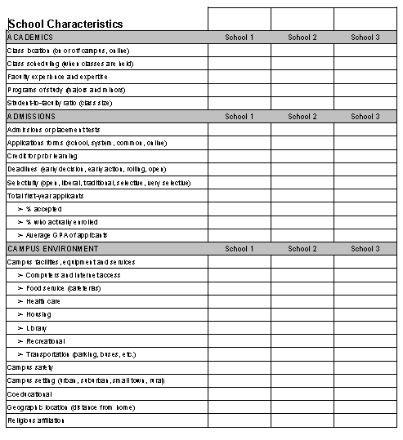
Comparison Sheet:

Slide 35
Cost of Attendance
The University of Akron
Tuition and fees
 | Semester | Academic year
Ohio resident | $5,473 | $10,946
Nonresident surcharge | $4,350 * | $8,700 *
Transportation | $175 | $350
Books and supplies | $450 | $900

Slide 36
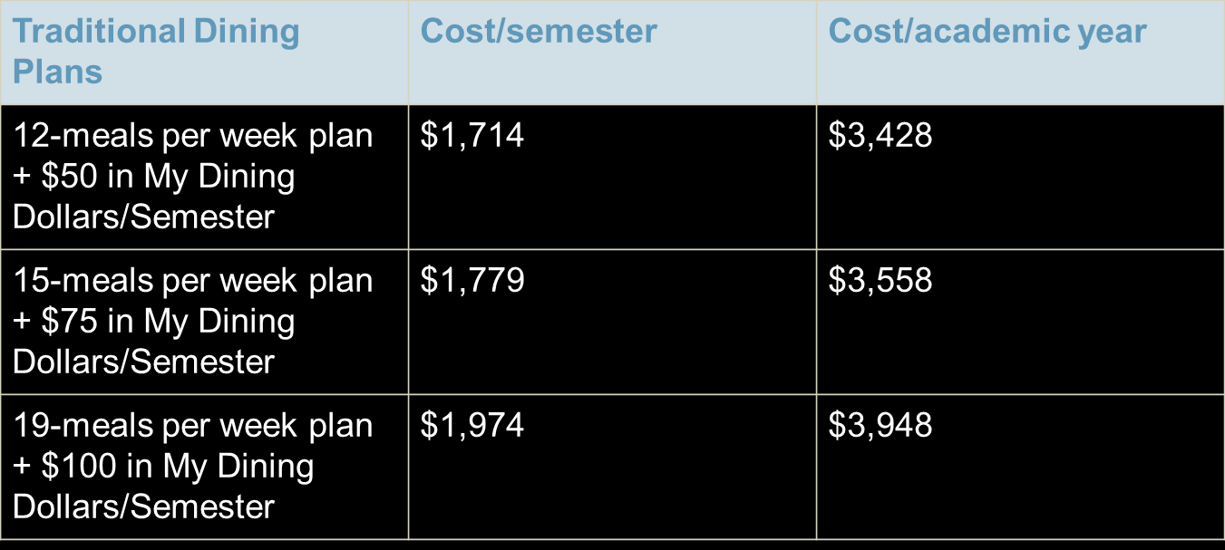
Meal Plan
Cost of Attendance Con’t

Slide 37
Cost of Attendance Con’t
The University of Akron
Housing
Hall | Type | Cost for year
Bulger | Suite | $7,374
Exchange Street | Shared Single occupancy | $9,442
 | Apartment | $9,866
Honors Complex | Shared Single occupancy | $9,442
 | Double occupancy | $7,858
Orr | Double occupancy | $7,020

Slide 38
Cost of Attendance
Stark State
College/University | Annual tuition 30 credits per year | Savings per year | % Savings per year
Stark State College* | $ 4,608
Average of Ohio Public Two-Year Colleges* | $ 5,039 | $ 530 | 12%
Brown Mackie | $ 16,450 | $ 11,941 | 265%
National College | $ 15,216 | $ 10,707 | 237%
Herzing University - Akron Campus* | $ 11,250 | $ 6,840 | 55%

Slide 39
Funding Your Education
Scholarships
Grants
Loans
Work study
EFC (estimated family contribution)
Notes:
Work study = job on campus, earn $$$ (need based)
Complete FAFSA January of your senior year. We will have a financial aid night!

Slide 40
Getting Starting…

Slide 41
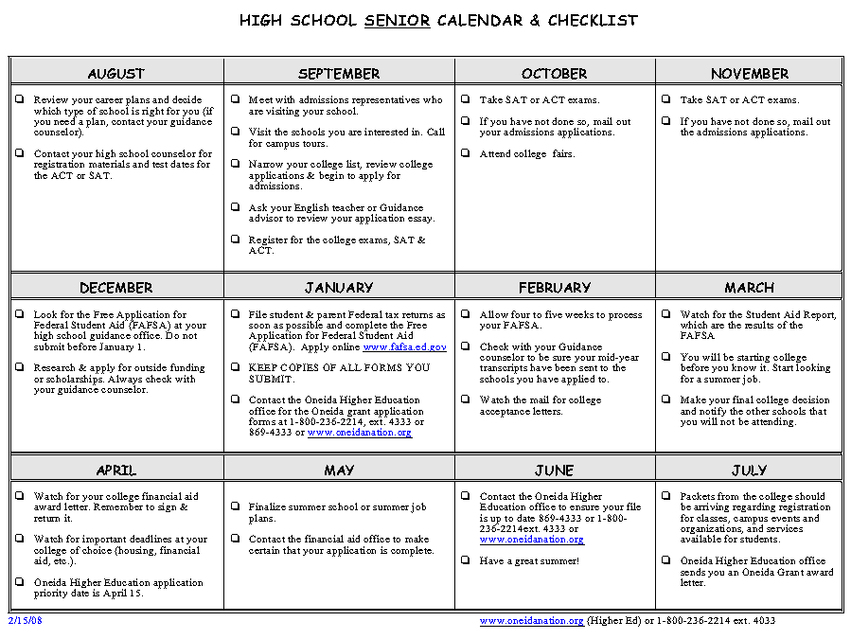

Slide 42
Junior Year
Spring:
Take ACT/SAT
Attend College Fairs
Do research on what majors interest you
Summer:
Visit Colleges
Narrow list of colleges to those you wish to apply
*** Attend Senior Parent Night for Senior year information ***

Slide 43
Counselor Tips:
Follow prompt guidelines/deadlines!
Throughout high school, keep an organized folder-with volunteer records, awards, achievements, experiences (traveling abroad), letters of recommendation, etc.
Now when is comes time your senior year to write essays, fill out autobiographies (for recommendations), you will have an easier time remembering!
Volunteer
Have a good rapport/reputation with your teachers.

Slide 44
Parent Tips:
Ask them monthly, What applications are you working on? How are the applications going? What are you working on and what scholarships have you applied for?"
Sit down with your student and prepare a list of what he/she is looking for in a college and then help him/her sort through the information they receive from the different institutions to decide which ones offer what's on the list.
In January or February, you will need to help your student complete the FAFSA. Your PIN will help speed up the process. Attend FHS Financial Aid Night.
In March, the award notices will start coming in. Look at the financing carefully and contact the schools with any questions. Make comparisons!
Go on trips with your student to as many of his or her top school choices as possible. A visit to the campus is invaluable to making a decision.
Hug them, send them on their way, BUT don't change the locks - they'll be back!

Slide 45
NCAA Requirements
NCAA requirements
www.ncaa.org
www.ncaaclearinghouse.net
***See your counselor for more information
Notes:
All Drawing and Design I and II students have to register with clearinghouse after junior year
Top 10 core classes will be locked in

Slide 46
Career Exploration Tools
Armed Service Vocational Aptitude Battery (ASVAB)
Timed test that measures developed abilities and helps predict future academic and occupational success, specifically military related.
Administered in the fall each year
Ohio Means Jobs
Located at 1040 E. Tallmadge Avenue Akron, OH 44310
https://jobseeker.k-12.ohiomeansjobs.monster.com/seeker.aspx

Slide 47
One-Stop Resource
www.firestonefalcons.org

Slide 48
Thank You!!
If you have any further questions, feel free to contact your counselor.
We appreciate your time and interest in your child’s success.
Sincerely,
FHS Counselors

