Slide 1

OHIO STATE TEST
Social Studies

Slide 2
Notebook Order:
Historical Events
Primary and Secondary Sources
Thesis, Support and Refute
Cause and Effect
Post Cold War- 9/11
Western Expansion
Industrial Revolution
Labor Unions
Amendments
Progressive Movement
Social Movements
Immigration
World War I
14. Federal Reserve
15. 1950’s
16. Civil Rights/1960’s
The Cold War
Korea and Vietnam
End of Cold War
NOW
United Farm Workers
Declaration of Independence
Enlightenment
Constitution
Northwest Ordinance
Federalists/Anti-Federalists
Bill of Rights

Slide 3
What’s on the test?
Historical Thinking and Skills
Historical Documents
Industrialization and Progressivism
Foreign Affairs from Imperialism to Post-World War I
Prosperity, Depression and the New Deal
From Isolation to World War II
The Cold War
Social Transformation in the United States (1945–1994)
United States and the Post-Cold War World (1991–Present)

Slide 4


#1
HISTORICAL EVENTS

Slide 5


CONTENT STATEMENT 1:
Historical events provide opportunities to examine alternative courses of action.
(Not tested)
EXPECTATIONS FOR LEARNING:
Analyze a historical decision and predict the possible consequences of alternative courses of action.

Slide 6
CONTENT STATEMENT 1:
What if Democratic Party officeholders had not been restored to power in the South after Reconstruction?
What if the U.S. had joined the League of Nations?
What if Truman had not ordered atomic bombs dropped on Japan?

Slide 7
#2
PRIMARY AND SECONDARY
SOURCES

Slide 8
CONTENT STATEMENT 2:
The use of primary and secondary sources of information includes an examination of the credibility of each source.
Question:
Analyze and evaluate the credibility of primary and secondary sources.

Slide 9
Content Standard: 2
Primary Source: In the study of history as an academic discipline, a primary source is an artifact, a document, a recording, or other source of information that was created at the time under study.
Secondary Source: is a document or recording that relates or discusses information originally presented elsewhere.
Credibility: refers to the objective and subjective components of the believability of a source or message.
Bias: a perspective, preference, or inclination that inhibits impartial judgment.

Slide 10
How it will be assessed:
What is credibility?
What are the qualifications and reputation of the author?
Is it in agreement with other sources?
How do you determine if a source is credible?
What is bias? What is the perspective of the author?
How do you determine bias in a source?
Can you compare credibility in two or more sources?

Slide 11
CONTENT STATEMENT
#3
THESIS, SUPPORT,
AND REFUTE

Slide 12
Expectations for Learning:
Question:
Develop a thesis and use evidence to support or refute a position.

Slide 13
How it will be assessed:
Matching evidence that supports a thesis.
Find evidence that supports a thesis.
Construct a thesis and provide evidence to support it.
Be able to refute a thesis.

Slide 14
Content Standard: 3
Thesis: a proposition that is supported by an argument.
Evidence: used to support an idea.
Support: to argue in favor of an idea or point.
Refute: to argue against an idea or point.

Slide 15
CONTENT STATEMENT
#4
CAUSE AND EFFECT

Slide 16
Question:
Identify examples of multiple causation and long- and short-term causal relationships with respect to historical events.
Analyze the relationship between historical events, taking into consideration cause, effect, sequence, and correlation.

Slide 17
How it will be assessed:
Be able to explain how an event may have been caused.
Examples:
World War I
Great Depression
World War II
Cold War
See entries for these topics later in book.

Slide 18
CAUSES OF WORLD WAR I
MILITARISM: Europe was going through a period of military
build up which led to the requirement of men to sign up for
military service.
ALLIANCES: the countries of Europe began to make friendships
and agreements with one another for protection and to gain
power.
IMPERIALISM: the policy of stronger countries in taking economic, political, and social control over weaker nations.
NATIONALISM: the belief in the traditions and ideas of one’s
nation and that there should be unity within that nation.

Slide 19
CAUSES OF THE GREAT DEPRESSION
A Weak Economy: People bought everything they needed during the 1920’s. goods sat on the shelf.
Stock Market Crash: Stock prices dropped so sharply that investors lost $5 billion in five hours of trade.
Internal Debt: More was being spent than taxed
International Debt: The United States was owed money by Germany from the war. The U.S. was assisting European countries to recover from the war.
Overproduction: in manufacturing and farming.

Slide 20
CAUSES OF WORLD WAR II
The Terms of the Versailles Treaty
  War Guilt Clause - Germany should accept the blame for starting World War One
  Reparations - Germany had to pay 6,600 million pounds for the damage caused by the war
  Disarmament – Reduction of their military.
  Territorial Clauses - Land was taken away from Germany and given to other countries.
The policy of appeasement by Great Britain and France towards Germany.
The invasion of Poland.
The bombing of Pearl Harbor by Japan.

Slide 21
#5
POST- COLD WAR TO
9/11

Slide 22
COMPOSITION BOOK
Table of Contents:
#5 -September 11th
EXPECTATIONS FOR LEARNING:
Describe political, national security and economic challenges the United States faced in the post-Cold War period and following the attacks on September 11, 2001.

Slide 23

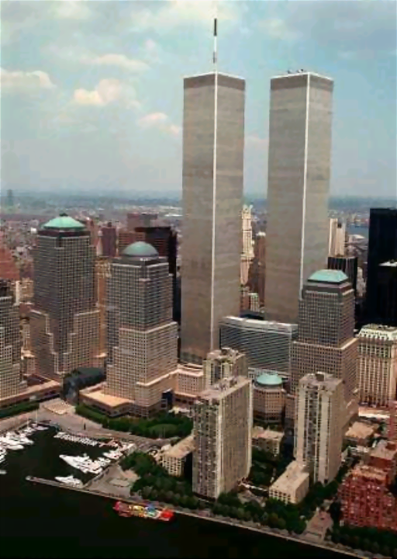
The terrorist attacks on the World Trade Center in New York and the Pentagon in Washington on September 11th, 2001 were calculated moves to test the standing and political and economic positions of the world's sole superpower.
They were aimed at delivering a blow that could carry several messages around the world at once.
The intention was to attack the system of Capitalism in which the U.S. economy is based.

Slide 24

Patriot Act
In October 2001, Congress—just one vote short of unanimous bipartisan support—passed the USA Patriot Act.
The measure gave law enforcement officials sweeping new powers to conduct searches without warrants, monitor financial transactions and eavesdrop, and detain and deport, in secret, individuals suspected of committing terrorist acts.

Slide 25
Department of Homeland Security
By far the most far-reaching and significant measure enacted after September 11 was the Department of Homeland Security Act of 2002, which established the Cabinet-level Department of Homeland Security (DHS) and created the position of Secretary of Homeland Security.
Former Pennsylvania governor Tom Ridge was the first to serve in the position.

Slide 26
WESTERN EXPANSION
#6

Slide 27
COMPOSITION BOOK
Table of Contents:
#6 WESTERN EXPANSION
Question:
What factors contributed to Western Expansion? Explain the government’s policy toward Native Americans. Give examples of how the policy was enforced.

Slide 28
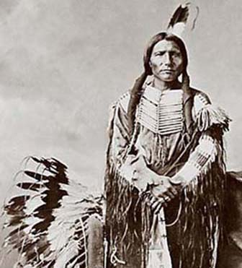
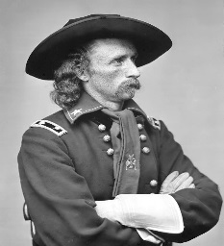
Reasons for Expansion:
Manifest Destiny (bound to control land from coast to coast)
Gold Discovered in California (1848 – Sutter’s Creek)
Homestead Act of 1862-cheap land for settlers.
Transcontinental Railroad
Government Policy:
Removal – move natives further and further West placing them on federal reservations.
Assimilation – many children were required to attend US sponsored boarding schools in which they were forced to adopt “mainstream” customs.
Elimination – go to war and slaughter the buffalo that were vital to plains tribes’ existence.
Examples:
Trail of Tears- forced movement of Native Americans by Jackson Administration.
Dawes Act- required movement of Native people to reservations.
Battle of Little Big Horn- most successful battle waged by Native Americans. General Custer’s Last Stand
Battle of Wounded Knee- last armed conflict between U.S. Military and Native Americans.

Slide 29
INDUSTRIALIZATION
#7

Slide 30
COMPOSITION BOOK
#7
Industrial Revolution
Question:
Analyze how the rise of corporations, heavy industry, mechanized farming, and technological innovations transformed the American economy from an agrarian to an increasingly urban industrial society.

Slide 31
Industrialization
Urban: in the city
Rural: in the country
Agrarian/Agricultural: based on farming
Causes
The use of steam, iron ore, machinery, and advancements in agriculture all led to a growing movement towards industry
Population
Population increased due to immigration. People were leaving Europe in search of a better life and to take factory jobs.
African Americans were leaving the South to escape Jim Crow. The population in the cities increased due to movement from rural areas. Improved technology decreased the number of farming jobs. Displaced workers move to the cities.
Monopoly: when a company has complete control over an industry.
Robber Baron: operates for profit, not concern for workers.
Captain of Industry: takes time and money to help workers and provide some services/benefits.

Slide 32
#8 LABOR UNIONS

Slide 33
#8
LABOR UNIONS
Question:
Explain the major social and economic effects of industrialization and the influence of the growth of organized labor following Reconstruction in the United States.

Slide 34
LABOR UNIONS
Explain the major social and economic effects of industrialization and the influence of the growth of organized labor following Reconstruction in the United States.
The labor movement began to gather strength after the Civil War for many reasons:
A need to bargain effectively with employers
The rapid growth of industry
Millions of new workers such as women and immigrants.
Workers forced out of jobs by new technology.
Poor conditions in the factories, low pay, long hours, unsafe conditions.
Scab: replacement worker for a striking worker.
Government sided with the owners in most cases.
Public sided with the workers most of the time.
Key Terms:
Grievance
Dues
Collective bargaining
Strike
Scab

Slide 35
Management vs. Labor
“Tools” of
Management
“Tools” of
Labor
“scabs”
P. R. campaign
Pinkertons
lockout
blacklisting
yellow-dog contracts
court injunctions
open shop
boycotts
sympathy
demonstrations
picketing
closed shops
organized
strikes
“wildcat” strikes

Slide 36
#9 AMENDMENTS
Be able to identify significant amendments to the Constitution and why they were put into place.

Slide 37
Amendments
12th- electoral college/president and vice
president
13th- abolition of slavery
14th- equal protection under the law
15th- voting rights/African Americans
18th- Prohibition of alcohol
19th- Women’s Voting Rights
21st- End Prohibition
22nd- two terms for President
24th- voting/poll taxes
26th- voting at 18 years old

Slide 38
CONTENT STATEMENT
#10
PROGRESSIVE ERA

Slide 39
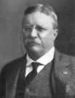
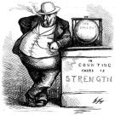
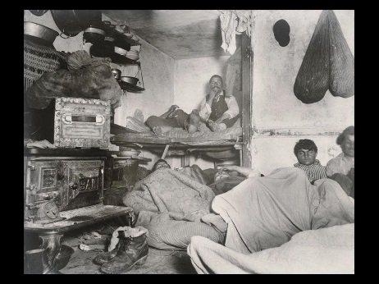
#10
Progressive Movement
Progressive Movement: taking place from around 1900-1914, this movement focused on improving the human condition in many areas.
1. Labor- factories were unsafe, workers poorly paid, long hours- Labor Unions, Safety Laws and Codes
2. Politics- elections were rigged, politicians were corrupt. Government reforms like recall, referendum, petitions.
3. Food- meat and other foods were improperly handled and shipped for human consumption- Pure Food and Drug Act, Meat Inspection Act.
4. Women had no rights: 19th Amendment
5. Alcohol was seen as detrimental to society- Temperance- 18th Amendment Prohibition
Muckraker: person who exposes the ills of society, typically a writer or journalist.
The Progressives:
Teddy Roosevelt- Food/Drug Act
Frances Perkins- Labor
Muckrakers
Upton Sinclair- The Jungle
Ida Tarbell- Standard Oil
Lincoln Steffens- Shame of Cities
Jacob Riis- How the Other Half Lives

Slide 40
CONTENT STATEMENT
#11
POST-RECONSTRUCTION
Social Movements

Slide 41
Social Movements
Reconstruction
Question:
Analyze the post-Reconstruction political and social developments that led to institutionalized racism in the United States. Describe institutionalized racist practices in post-Reconstruction America.

Slide 42
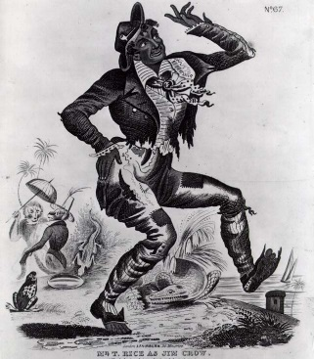
Social Movements
Movements:
Abolition: the movement to ban slavery in the United States.
Key People: Frederick Douglass, William Lloyd Garrison
Women’s Suffrage: movement to obtain voting rights for women.
Key People: Susan B. Anthony, Elizabeth Cady Stanton
Temperance: movement to ban alcohol use as a means to better society.
Key People: Carrie Nation, most of the suffrage movement people.
Institutionalized Racism:
Plessy v. Ferguson- Separate But Equal ruling.
Ku Klux Klan: growth of the KKK lead to intimidation and suppression.
Jim Crow Laws: these laws were set up to segregate society. They called for legal segregation of every part of life.
Examples:
Restrooms, waiting areas, theaters, water fountains, restaurants.

Slide 43
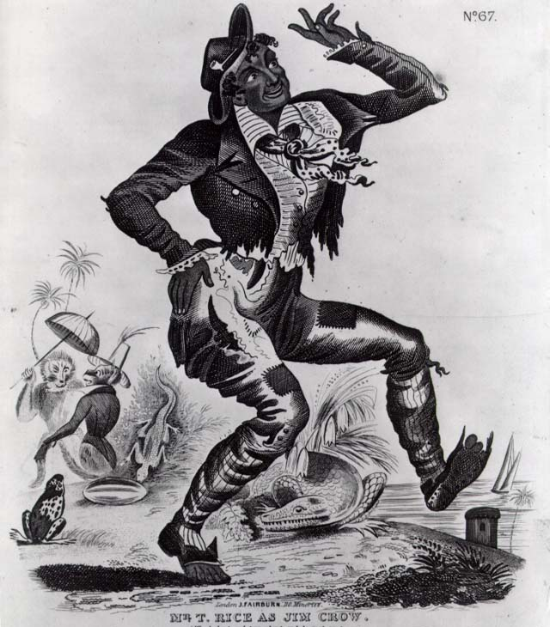
Jim Crow
Jim Crow Laws: these laws were set up to segregate society. They called for legal segregation of every part of life.
Examples:
Restrooms, waiting areas, theaters, water fountains, restaurants.
Jim Crow was named after a character in a minstrel show.

Slide 44
#12
IMMIGRATION

Slide 45
Immigration
CONTENT STATEMENT 12:
Immigration, internal migration and urbanization transformed American life.
Question:
Analyze and evaluate how immigration, internal migration and urbanization transformed American life.

Slide 46
Two Phases of Immigration:
OLD IMMIGRANTS | NEW IMMIGRANTS
1. Lasted until 1880. 2. Mostly Protestants 3. Northern and Western Europe 4. Most were farmers leaving behind poverty, overcrowding, and famine. | 1. Began in the 1880’s 2. Mostly Catholic and Jewish 3. Southern and Eastern Europe 4. They left for many reasons.

Slide 47
African American Voting Rights
13th Amendment- Ended Slavery
14th Amendment- Equal Protection Under the Law
15th Amendment- Voting Rights to all male citizens.
After Reconstruction ended, Southern governments began to restrict the rights of African Americans.
One way to weaken African Americans political power was to restrict their voting rights.
Southerners passed laws that restricted voting rights with literacy tests.
Tests were unfair. They were very difficult, sometimes written in Latin.

Slide 48
The Progressive Era was an effort to address the ills of American society stemming from industrial capitalism, urbanization and political corruption.
Question:
Analyze and evaluate the success of progressive reforms during the late 19th and early 20th centuries in addressing problems associated with industrial capitalism, urbanization and political corruption.

Slide 49
CONTENT STATEMENT
#13
IMPERIALISM/WWI

Slide 50
CONTENT STATEMENT 13:
As a result of overseas expansion, the Spanish–American War and World War I, the United States emerged as a world power.
Question:
Analyze the circumstances that enabled the United States to emerge as a world power in the early 1900s.

Slide 51
What is the definition of imperialism? Give two reasons why the United States had imperialistic ideas.
Question:
Imperialism: the policy of stronger countries in taking economic, political, and social control of weaker countries.
Reasons:
1. Competition in the marketplace with Europe.
2. Expand territory
3. Increase power
4. Keep the French and British out of South America.

Slide 52
What were the causes and consequences of the Spanish American War?
Question:
Causes:
The U.S. business owners in Cuba were concerned that their businesses would be impacted by the violence between Cubans and the Spanish.
Word that Spain was oppressive towards the Cubans makes U.S. citizens call for action.
The sinking of the U.S.S. Maine further ignites anger amongst Americans to clamor for war.
Effects:
The U.S. gained territory such as Puerto Rico, Guam, and the Philippines.

Slide 53
Isolationism: policy of not getting involved in foreign affairs.
Selective Service: raise troops for the war.
Main Causes: militarism, alliances, imperialism, nationalism
U.S. Causes: (1917)submarines, Zimmerman Note, Lusitania, Sussex
End of the War:
The 14 Points: this was Wilson’s plan for peace. It addressed key issues concerning the causes:
End to secret alliances: alliances
Reduction of armies and navies: militarism
League of Nations: association of nations to settle territorial disputes: imperialism
The U.S. did not join the League of Nations or sign off on the Versailles Treaty because we didn’t want drawn into foreign conflicts.

Slide 54
Composition Book
Versailles Treaty
Question: What was the Versailles Treaty? What were some of the terms?
Versailles Treaty: treaty signed at the end of World War I that blamed Germany for being the aggressor during the war. This treaty held Germany solely responsible for WWI.
*They were forced to pay reparations totaling 132,000,000,000 in gold. They lost 1/8 of all its land, all of its colonies, all overseas financial assets, a new map of Europe was carved out of Germany, and The German military was basically non-existent.
*The treaty devastated Germany politically and economically which made the country unstable and subject to rule by dictatorship.
The U.S. will refuse to ratify the Versailles Treaty in order to avoid future conflicts.

Slide 55
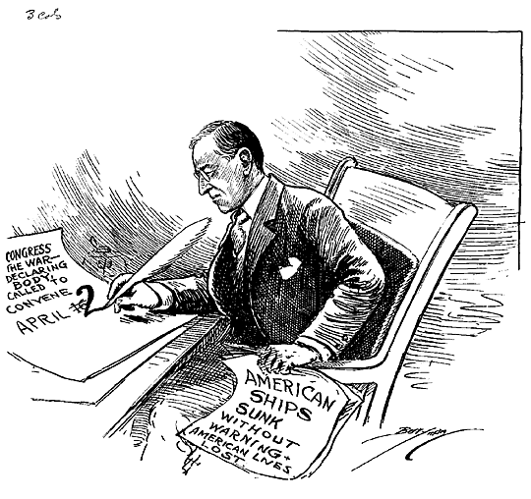
Fourteen Points
Wilson’s plan for peace was called the Fourteen Points.
This plan called for an end of secret treaties, freedom of the seas, reduced armies/navy and a general association of nations.
2. Absolute freedom of navigation upon the seas, outside territorial waters, alike in peace and in war, except as the seas may be closed in whole or in part by international action for the enforcement of international covenants.
4. Adequate guarantees given and taken that national armaments will be reduced to the lowest point consistent with domestic safety.

Slide 56
CONTENT STATEMENT
#14
Federal Reserve

Slide 57
Question: Explain how the Federal Reserve System, by adjusting the interest rate, attempts to prevent the worst consequences of periods of high inflation and economic recessions.
All national banks were required to become members.
All Federal Reserve Banks are supervised by a Reserve Board.
Each regional bank allowed member banks to borrow money to meet short term demands. This would help to prevent bank failures and economic panic.
The Federal Reserve created reserve notes that will become that national currency. This will allow the reserve to expand or contract the amount of money in circulation according to business needs.
The Federal Reserve Bank can decrease the interest rate in times of inflation or economic recession in order to put more money in the hands of the public.

Slide 58
1950’s
From Decade Days
#15

Slide 59
CIVIL RIGHTS MOVEMENT
#16

Slide 60
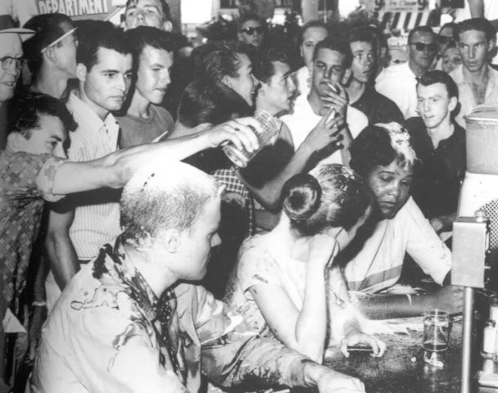
OGT Question: What is civil disobedience? Give an example.
Civil Disobedience is the active refusal to obey certain laws, demands and commands of a government, or of an occupying international power, using no form of violence.
It is one of the primary methods of nonviolent resistance
Examples:
Gandhi’s independence movement in India.
Civil Rights Movement:
-sit ins
-freedom rides
Is a boycott civil disobedience?
Is a march civil disobedience?

Slide 61
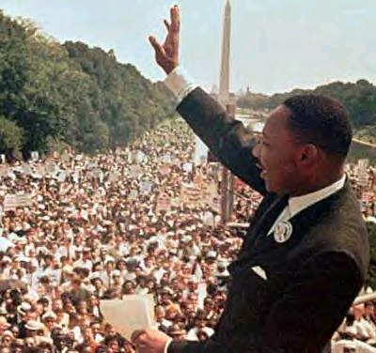
Summarize the struggle for racial and gender equality and the extension of civil rights that occurred in the United States in the postwar period.
Question:
Jim Crow
Brown v. the Board
Emmett Till
Montgomery Bus Boycott
Little Rock
Sit ins
Freedom Rides
March on Washington
Mississippi
Birmingham
Freedom Summer
Selma
Malcolm X
Black Separatism
Black Power
Black Panthers
Watts Riots
Notes:
I have the students write these down and then we discuss them. They need to write explanations for some of them so they have examples for a short answer on the state test.

Slide 62
Jim Crow: laws that segregated the South after the Civil War.
Brown v. the Board: Court case that overturned the Plessy v. Ferguson case that created “Separate but Equal”.
Emmett Till: young man from Chicago who went to the South and was lynched.
Montgomery Bus Boycott: started with Rosa Parks, sparked the whole movement, introduced Dr. King.
Little Rock: first major test of the Brown v. Board ruling to desegregate the schools.
Sit ins: to protest the segregated lunch counters, organized by young people.
Freedom Rides: to desegregate the interstate busing system.
Selma: march for voting rights, march broken up with violence.

Slide 63
Malcolm X: black separatist, seen as a radical, visited Mecca, assassinated.
Black Separatism: whites will never view blacks as equal, set up a separate society.
Black Power: viewed more as a radical part of the movement.
Black Panthers: political group trying to keep the peace in LA and watch for police brutality.
Watts Riots: broke out after a police related death.

Slide 64
THE COLD WAR
#17

Slide 65
EXPECTATIONS FOR LEARNING:
Understand the causes of the Cold War. Analyze the policy of containment the United States followed during the Cold War in response to the spread of communism.

Slide 66
THE COLD WAR-
CAUSES:
The use of atomic weapons
Race to build more weapons
Soviet’s refusal to leave Eastern Europe after WWII,
Race to Space
Differing economic ideologies: command economy/market economy
Significance: Use of containment to stop the spread of Communism will start other wars, the arms race, spending.
Outcome: Korean War, Vietnam War, uneasy relationship between Democracies and Communist nations. Fall of the Soviet Union, national debt.

Slide 67
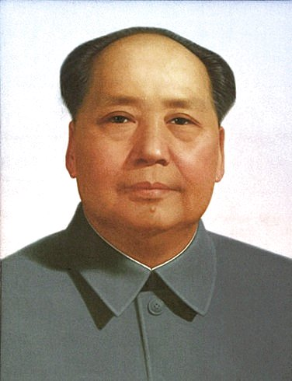
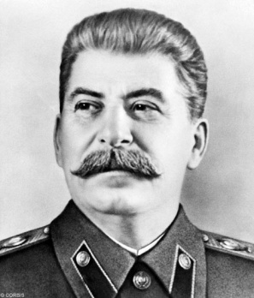
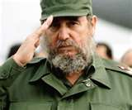
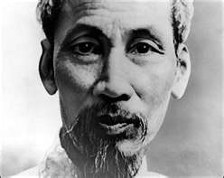
THE COLD WAR- Terms
Appeasement: give in to lesser demands hoping for peace.
Containment: stop the spread of Communism
Domino Theory: one country falls to Communism they all will.
Korea and Vietnam are examples of containment.

Slide 68
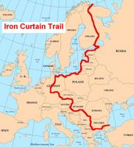
Events of the Cold War
Dropping of Atomic Bomb
Reasons
-End the war.
-Power
-Stop Russia from entering the
war.
-What will it do?
Iron Curtain: line that divided Europe.
Marshall Plan: economic aid to European
countries after WWII
Joseph McCarthy and McCarthyism- using fear of Communism to get elected to political office.
Berlin and Berlin Wall

Slide 69
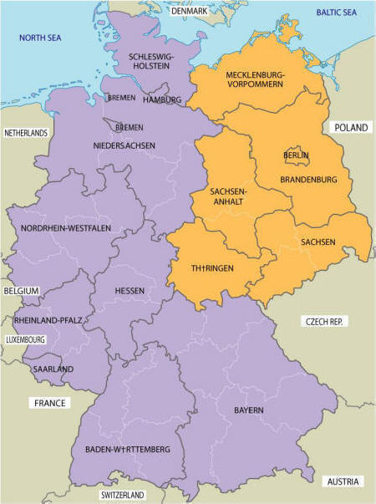
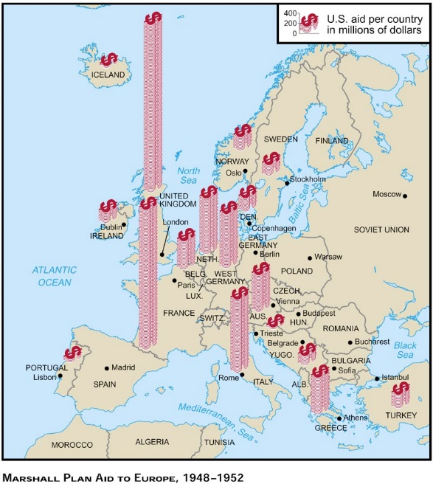

Slide 70
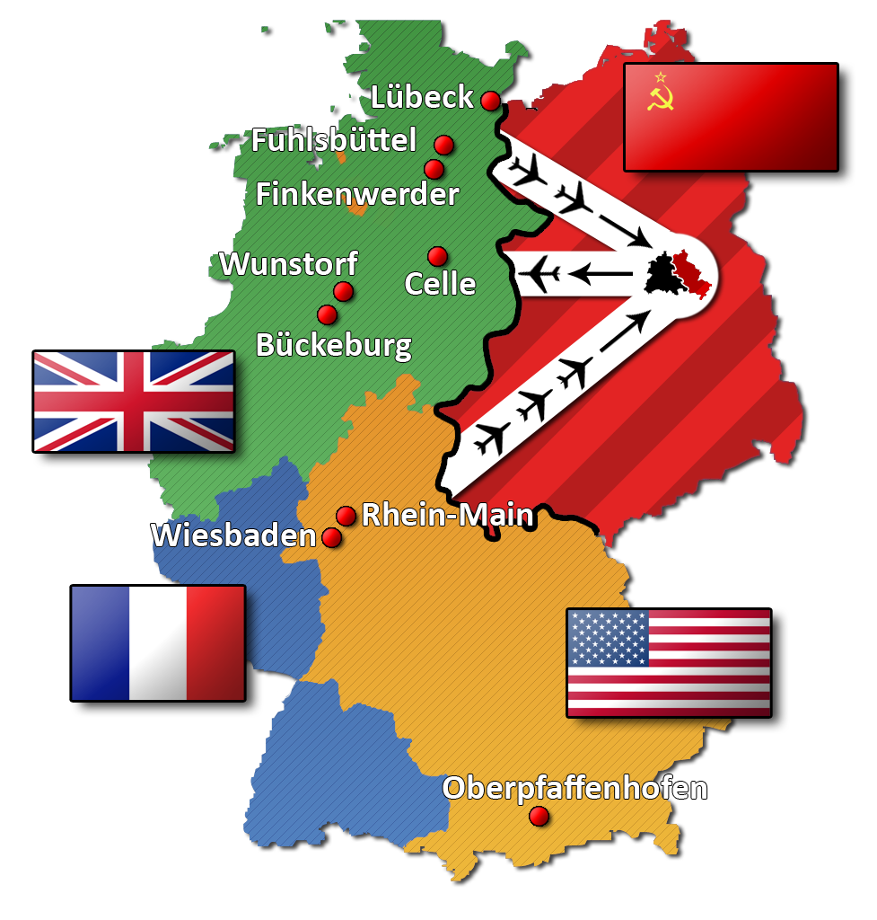
BERLIN
In 1948, Stalin made an effort to take all of Berlin for the Soviet Union. He sealed off all railways, rivers, and highways to block all supplies.
This became known as the Berlin Blockade. The U.S. and its allies began a massive airlift to West Berlin.
Food and supplies were flown in by plane for almost a year. A plane would land in Berlin every three minutes bringing supplies.
The Soviet Union could not halt the air traffic without starting a war. Eventually the blockade failed.

Slide 71
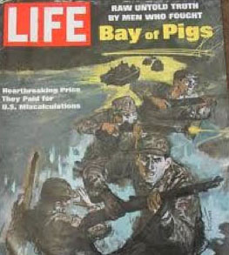
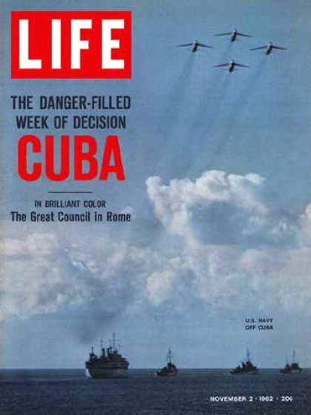
Cuba:
1. Castro- came to power in 1959, became friendly with the Soviet Union, turned Cuba Communist.
2. Bay of Pigs- failed attempt to overthrow Castro by the U.S. government.
3. Cuban Missile Crisis- Closest the U.S. and Soviet Union came to war. Soviet Union installed missiles in Cuba pointed at the U.S.

Slide 72
KOREA AND VIETNAM
#18

Slide 73
VIETNAM
Question:
Analyze how the Cold War and conflicts in Korea and Vietnam influenced domestic and international politics between the end of World War II and 1992.

Slide 74
Both the Korean and Vietnam wars were undeclared. Korea was referred to as a “Police Action”. In both cases they were attempts to contain Communism.
In Vietnam the war was long and drawn out and many Americans turned against the war effort. The American people wanted out of the war yet the war continued.
Gulf of Tonkin Resolution: gave the president the authority to take all necessary measures to repel any armed attack against the United States. Johnson could send forces without a declaration of war.
War Powers Act: The aim of the act was to prevent future wars from starting without congressional support. The President had to inform Congress within two days of any military troops used in a foreign country.

Slide 75
END OF THE COLD WAR
#19

Slide 76
What is NOW? Describe two ways in which the Organization improved the lives of women?
#20
NOW stands for National Organization for Women.
The main goal of NOW was to take action to bring American women into full participation in the mainstream of American society.
It fought for equal pay and equal job opportunities. It attacked the false image of women in the media, such as advertising that used sexist slogans or photographs.
The movement tried to get the Equal Rights Amendment passed but failed.
Additional Note
AIM- American Indian Movement- The American Indian Movement focused on the problems of Native Americans.
They fought for legal rights and autonomy, or self government. They also sought the restoration of land that they believed was illegally taken from them. AIM used a militant approach much like the Black Panthers.

Slide 77
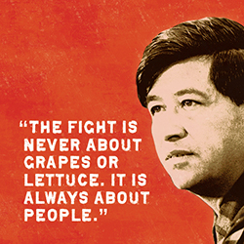
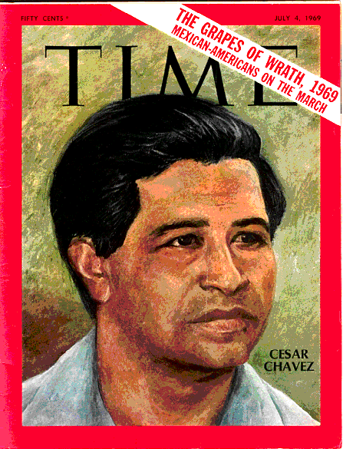
Who was Cesar Chavez and what did he do?
#21
Chavez was an American farm worker, labor leader, and civil rights activist.
He cofounded the United Farm Workers which is a labor union for people who work in the farm industry.
Many of the workers that were targeted for membership were Hispanic and worked in the grape industry out West.
The UFW was committed to restricting immigration because it exploited migrant workers and growers could use cheap immigrant labor to get around the union.

Slide 78
DECLARATION OF
INDEPENDENCE
#22

Slide 79
COMPOSITION BOOK
Question:
Explain a grievance listed in the Declaration of Independence in terms of its relationship to Enlightenment ideas of natural rights and the social contract.

Slide 80

DECLARATION OF
INDEPENDENCE
Some documents in American history have considerable importance for the development of the nation.
Students use historical thinking to examine key documents which form the basis for the United States of America.
The Declaration of Independence reflects an application of Enlightenment ideas to the grievances of British subjects in the American colonies.

Slide 81
Declaration of Independence
A committee was appointed to draft a Declaration of Independence.
The group chose Thomas Jefferson to compose the Declaration for three reasons:
He was an excellent writer.
He was from Virginia.
He was the youngest and would not be able to back out.

Slide 82
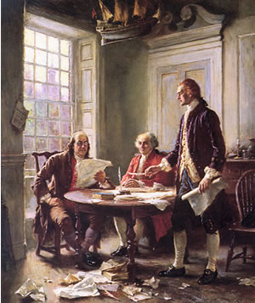
Contents of the Declaration
Preamble
Explanation of political principles and underlying rights of the people.
List of 27 unfair acts of the king.
Colonial acts to redress the problems.
Actual declaration of independence from Britain.

Slide 83
Declaration of Independence
27 GRIEVANCES:
He has forbidden his Governors to pass Laws of immediate and pressing importance.
He has obstructed the Administration of Justice by refusing his Assent to Laws for establishing Judiciary Powers.
He has dissolved Representative Houses repeatedly, for opposing with manly firmness his invasions on the rights of the people.
He has kept among us, in times of peace, Standing Armies without the Consent of our legislatures.
For quartering large bodies of armed troops among us:
For cutting off our Trade with all parts of the world:
For imposing Taxes on us without our Consent:
For depriving us in many cases, of the benefit of Trial by Jury:
For transporting us beyond Seas to be tried for pretended offences:

Slide 84
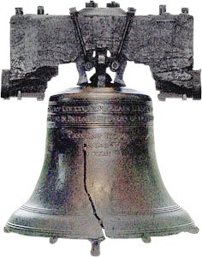
Enlightenment
#23
Question
How do the thinkers of the Enlightenment relate to the American Revolution?

Slide 85
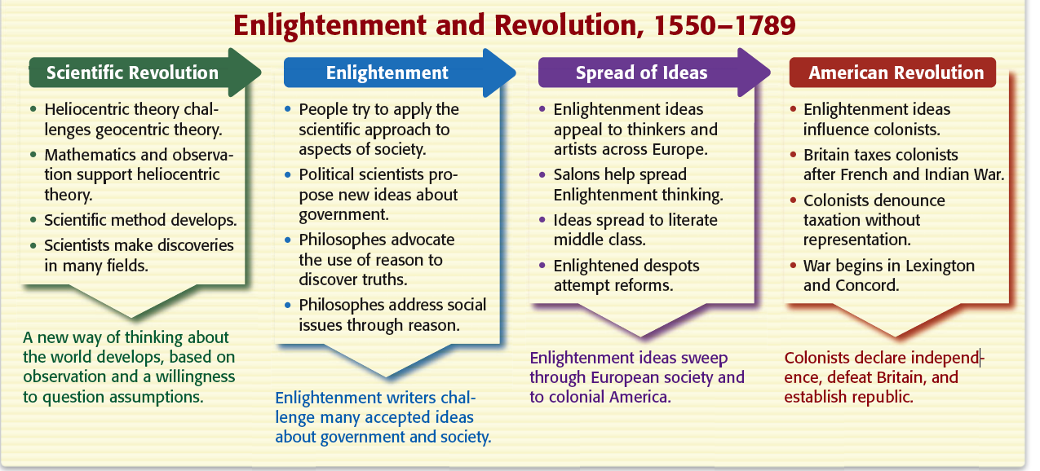
The Enlightenment and the American Revolution

Slide 86
Describe the Enlightenment and some of the key figures.
Adam Smith- believed in free enterprise, in which every person could go into business and operate for profit.
Jean-Jacques Rousseau- believed in popular sovereignty,
that the government should operate based on the will of the people
John Locke- believed in the social contract theory. All people are equal and independent.
Montesquieu- best known for his views on Separation of Powers.

Slide 87
THE CONSTITUTION
#24

Slide 88
COMPOSITION BOOK
Question
Develop an argument that a particular provision of the Constitution of the United States would help in addressing a problem facing the United States in the 1780s.
Explain a provision of the Constitution of the United States in terms of how it reflects Enlightenment thinking.
.
.

Slide 89
Make a Chart
ENLIGHTENMENT | CONSTITUTION

Slide 90
Enlightenment/Constitution
ENLIGHTENMENT | CONSTITUTION
Rousseau, who argued for a society based upon reason rather than faith and Catholic doctrine, for a new civil order based on natural law. | Freedom of religion is found in the First Amendment in the Bill of Rights.
The political philosopher Montesquieu introduced the idea of a separation of powers in a government | Separation of Powers-Divide Government into Legislative, Judicial, and Executive
Voltaire advocated for freedom of religion, freedom of expression, and separation of church and state. | First Amendment in the Bill of Rights.
John Locke believed in separation of church and state. His arguments concerning liberty and the social contract later influenced the written works of Alexander Hamilton, James Madison, Thomas Jefferson, and other founding fathers. | First Amendment Separation of Church and State Popular Sovereignty or the Will of the People.

Slide 91
NORTHWEST ORDINANCE
#25

Slide 92
Composition Book
Question
Show how the Northwest Ordinance, in providing government for the Northwest Territory, established a precedent for governing the United States.

Slide 93
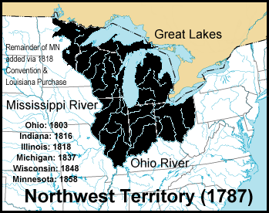
NORTHWEST ORDINANCE
Three Stage Model:
1. Must have a governor, secretary, and three judges to rule.
2. An elected assembly and one nonvoting delegate to Congress to be elected when the population of the territory reached 5,000 free males.
3. A state constitution should be drafted and membership to the Union to be requested in the when the population reached 60,000.

Slide 94
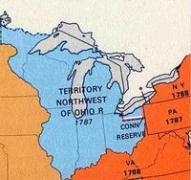
NORTHWEST ORDINANCE
(3) A bill of rights protecting religious freedom, the right to a writ of habeas corpus, the benefit of trial by jury, and other individual rights. In addition the ordinance encouraged education and forbade slavery.

Slide 95
FEDERALISTS/
ANTI-FEDERALISTS
#26

Slide 96
Composition Book
Table of Contents:
#10- Federalists/Anti-Federalists
Question
Compare the arguments of the Federalists and Anti-Federalists on a common topic related to the ratification of the Constitution of the United States, and hypothesize about why the winning argument was more persuasive.

Slide 97
Make a Chart in your notebook.
FEDERALISTS | ANTI-FEDERALISTS

Slide 98
FEDERALIST PAPERS
Federalists
Anti-Federalists
The federalists believe that it is best for the country to gather most of the authoritative and political power in one central government.
They believed that the rights of citizen were assumed in Constitution and did not need written in.
Nation should be protected by a National Army.
The anti-federalists have suspicions in solely placing utmost power in a central, federal government.
The anti-federalists were the first to raise the concern for the lack of citizens rights.
They are concerned about the rights of the states.
To appease the anti-Federalists the Bill of Rights will be added to the Constitution.

Slide 99
BILL OF RIGHTS
#27

Slide 100
Composition Book
Question:
Cite evidence for historical precedents to the rights incorporated in the Bill of Rights.

Slide 101
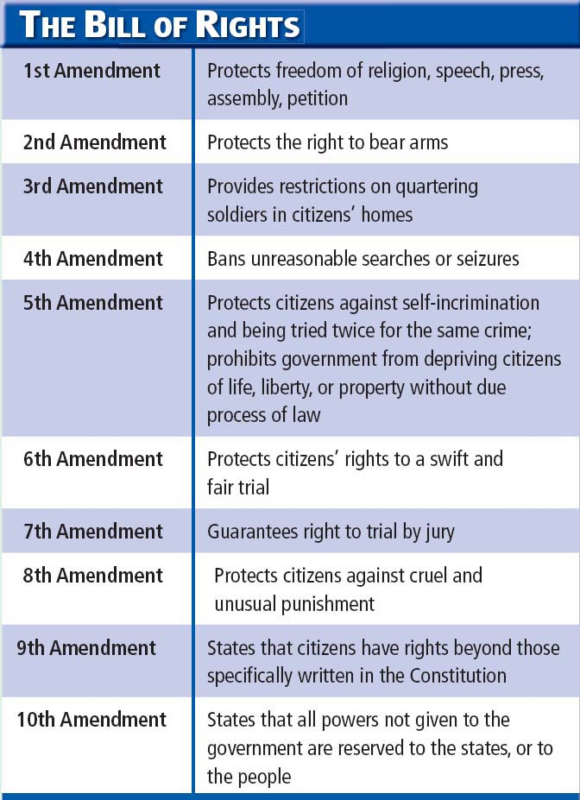
Bill
of
Rights
The Bill of Rights is derived from English law, ideas of the Enlightenment, the experiences of the American colonists, early experiences of self-government, and the national debate over the ratification of the Constitution of the United States.

Slide 102
POPULATION CHANGES
1960’S
#28

Slide 103
Question:
Analyze the social and political effects of the continuing population flow from cities to suburbs, the internal migrations from the Rust Belt to the Sun Belt, and the increase in immigration resulting from passage of the 1965 Immigration Act.

Slide 104

What is the Immigration Act of 1965?
Immigration Act of 1965: The 1965 act marked a radical break from the immigration policies of the past. The law as it stood then excluded Asians and Africans and preferred northern and western Europeans over southern and eastern ones
Immigration changed America's demographics, opening the doors to immigrants from Asia, Africa, and the Middle East. The Latin American population has also dramatically increased since 1965
Rust Belt: The Rust Belt is a term for the region from the Great Lakes to the upper Midwest States, referring to economic decline, population loss, and urban decay due to the shrinking of its once-powerful industrial sector.
Sun Belt: this region has seen substantial population growth since the 1960s from an influx of people seeking a warm and sunny climate, a surge in retiring baby boomers, and growing economic opportunities.

Slide 105
Rust Belt to Sun Belt
With the loss of economic opportunities in the Rust Belt, it's no surprise that people started moving - and in large numbers.
From the 1950s-1970s, Americans migrated in droves out of the Rust Belt. But where did they go?
Middle-class, generally white Americans moved to new housing developments called suburbs.
African American populations, still facing intense racial discrimination across the country, tended to move to new urban centers.

Slide 106
COMPOSITION NOTEBOOK
#29
TECHNOLOGY

Slide 107
COMPOSITION NOTEBOOK #23:
An improved standard of living for many, combined with technological innovations in communication, transportation and industry resulted in social and cultural changes and tensions.
Question:
Describe how an improved standard of living for many, combined with technological innovations in communication, transportation and industry resulted in social and cultural changes and tensions.

Slide 108
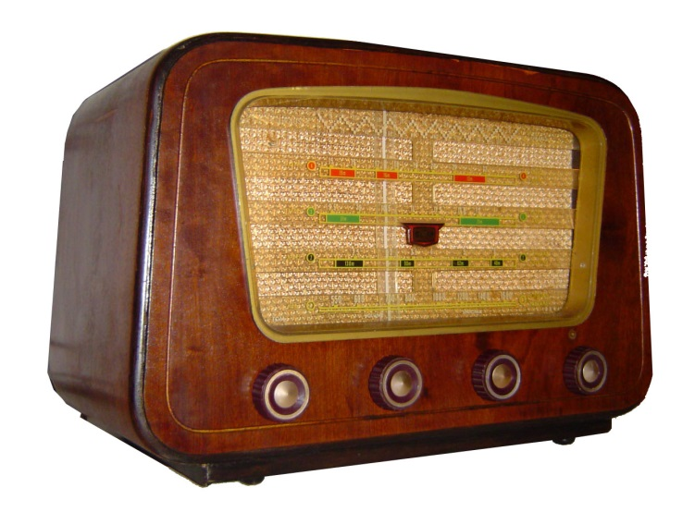
Technology
1920 the first radio broadcast was made. By the end of the decade more than one million families in America had radios. The radio will create a common identity and culture amongst Americans.
Automobiles were more affordable for everyone which increased the mobility of America.
Assembly Line: able to produce goods quickly and at a lesser cost. This brings down the cost to the consumer.

Slide 109
COMPOSITION NOTEBOOK
#30
1920’s Social Change

Slide 110
COMPOSITION NOTEBOOK #24:
Movements such as the Harlem Renaissance, African-American migration, women’s suffrage, and Prohibition all contributed to social change
Question:
Describe social changes that came from the Harlem Renaissance, African-American migration, women’s suffrage and Prohibition.

Slide 111
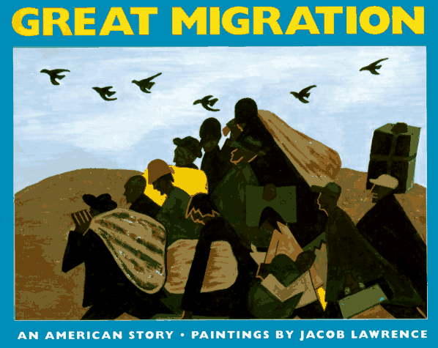
African American Migration
Why people migrated:
To escape Jim Crow and the
segregated South.
To find jobs in the Northern cities.
To find decent housing.
Results:
More competition for jobs in the North.
More competition for housing in the North.
The growth of the NAACP and other Civil Rights groups.
Less competition for jobs in the South.
Other Movements
The Harlem Renaissance establishes a venue for African Americans and their art.
Women obtain the right to vote. 19th Amendment
Alcohol is prohibited to improve society. 18th Amendment

Slide 112
GLOBALIZATION
#31

Slide 113
Question:
What is globalization? Give examples of how the world has become more connected.

Slide 114
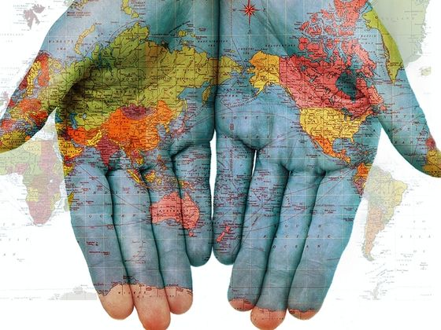
Globalization: the act, process, or policy of making something worldwide in scope or application.
1. The Internet: people from all parts of the world can communicate quickly and efficiently.
2. Airplanes: travel is quicker by plane than by ship today which makes overseas travel more appealing for business.
3. Satellites: television news can transmit information over long distances instantaneously.
4. Cell Phones: people can maintain contact with others from any location.
Global Economy: the interconnections
of the market that go beyond the
national boundaries.

Slide 115
THE ONES WE
DIDN’T ENTER INTO THE BOOK
BUT WE DID COVER IN CLASS

Slide 116
COMPOSITION NOTEBOOK
#22
THE RED SCARE

Slide 117
COMPOSITION BOOK #22
Racial intolerance, anti-immigrant attitudes and the Red Scare contributed to social unrest after World War I.
Question:
Describe how racial intolerance, anti-immigrant attitudes and the Red Scare contributed to social unrest after World War I.

Slide 118
Red Scare
Red Scare was an intense fear of communism and other extreme ideas. The fear included the idea that there was a threat to takeover the government of the United States.
The color red has come to symbolize the idea of communism.
People were quick to take action against anything or anyone who they thought was Anti-American.
People called for Communists in the country to be jailed or driven out of the country.
Examples: Palmer Raids and Sacco and Vanzetti

Slide 119
COMPOSTION BOOK
#25
GREAT DEPRESSION/NEW DEAL

Slide 120
The Great Depression was caused, in part, by the federal government’s monetary policies, stock market speculation and increasing consumer debt. The role of the federal government expanded as a result of the Great Depression.
Question:
Describe how the federal government’s monetary policies, stock market speculation and increasing consumer debt led to the Great Depression. Explain how the efforts to combat the Great Depression led to an expanded role for the federal government.

Slide 121
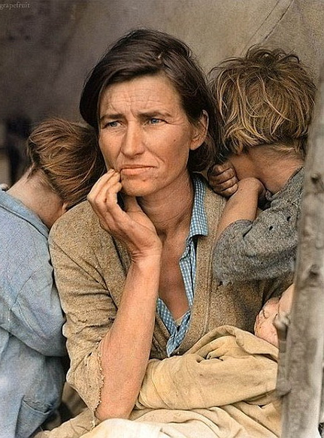
Causes of the Depression
Farm Crisis
A Weak Economy
Stock Market Crash
Internal Debt:
International Debt
Overproduction
The New Deal: the New Deal was a series of programs put into place by F.D.R. to resolve the issues of the Great Depression. New Deal programs were broken into three categories: Relief, Recovery, Reform (Three R’s)
Many programs were put into place to resolve the depression and they were very expensive to run.
Social Security: publicly run system that provides regular payments to people who cannot support themselves. Ex. Retirement
FDIC: set up to federally insure the safety of a person’s money in the bank. Ease the fears of people from the numerous bank closings during the Depression.
*1932 Election a turning point in how people view
the responsibility of the government to help the
people.
*Deficit Spending/Very expensive.
*Restored faith in democracy.

Slide 122
The New Deal: the New Deal was a series of programs put into place by F.D.R. to resolve the issues of the Great Depression. New Deal programs were broken into three categories: Relief, Recovery, Reform
Many programs were put into place to resolve the depression and they were very expensive to run.
Social Security: publicly run system that provides regular payments to people who cannot support themselves. Ex. Retirement
FDIC: set up to federally insure the safety of a person’s money in the bank. Ease the fears of people from the numerous bank closings during the Depression.

Slide 123
#26
BEFORE WORLD WAR II

Slide 124
During the 1930s, the U.S. government attempted to distance the country from earlier interventionist policies in the Western Hemisphere as well as retain an isolationist approach to events in Europe and Asia until the beginning of World War II.
Composition Book #26
Question:
Analyze the reasons for American isolationist sentiment in the interwar period.

Slide 125
ISOLATIONISM
During the 1930s, the combination of the Great Depression and the memory of tragic losses in World War I contributed to pushing American public opinion and policy toward isolationism.
Isolationists advocated non-involvement in European and Asian conflicts and non-entanglement in international politics.
What was the Arsenal of Democracy?
Lend Lease Act:
Roosevelt wanted desperately to help the British fend off Germany.
Due to American neutrality laws he could not sell weapons to only the British.
To get around the law, Roosevelt had Congress pass the Lend Lease Act.
This allowed the U.S. to lend or lease materials to the British. (not sell)

Slide 126
QUESTION #27
WORLD WAR II

Slide 127
The United States’ mobilization of its economic and military resources during World War II brought significant changes to American society.
#27
EXPECTATIONS FOR LEARNING:
Identify and explain changes American society experienced with the mobilization of its economic and military resources during World War II.

Slide 128
WORLD WAR II
The time just after the Great Depression and in the New Deal era when people were searching for work the war provided many opportunities for defense production jobs.
Many people who ordinarily could not find work such as women, African Americans, and Hispanics could now find work due to the large number of men who went off to war.
Selective Service Act: mobilized troops before the war broke out by recruiting young men into the military.
The draft was re-instated in 1940.
Troops were being mobilized to be trained for future deployment.

Slide 129
QUESTION #28
END OF WORLD WAR II

Slide 130
Use of atomic weapons changed the nature of war, altered the balance of power and began the nuclear age.
#28
EXPECTATIONS FOR LEARNING:
Summarize how atomic weapons have changed the nature of war, altered the balance of power and started the nuclear age.

Slide 131
Why We Dropped the Bomb
1. End the war quickly with minimal casualties.
2. End the war before Stalin and Soviets got involved.
3. Show of power to the rest of the world.
To see what it can do.
The dropping of the bomb shifted the balance of power to the United States immediately after World War II and set off an arms race between us and the Soviet Union that would last 50 years.

Slide 132
CONTENT STATEMENT
#25
COLD WAR AT HOME

Slide 133
CONTENT STATEMENT 25:
The second Red Scare and McCarthyism reflected Cold War fears in American society.
Content Statement 25
EXPECTATIONS FOR LEARNING:
Explain how the second Red Scare and McCarthyism reflected Cold War fears in American society.

Slide 134
POST WAR AMERICA

Slide 135
The postwar economic boom, greatly affected by advances in science, produced epic changes in American life.
Question:
Describe how American life in the postwar period was impacted by the postwar economic boom and by advances in science.

Slide 136
POST WAR ECONOMY
As World War II drew to a close, many Americans worried about the domestic economy.
Moreover, millions of veterans would soon return home in search of jobs that might not be there anymore.
Truman and Congress took steps to address the economic downturn. In 1946, for instance, Congress passed the Employment Act, which created the Council of Economic Advisors to help Truman maximize national employment.
Perhaps the most important measure taken in combating the recession was the Montgomery G.I. Bill, which Congress had passed in 1944 to help the 15 million returning U.S. veterans reenter the job market.
Republicans in Congress passed the Taft-Hartley Act in 1947, over Truman’s veto, to restrict the influence of unions. The act outlawed all-union workplaces, made unions liable for damages incurred during inter-union disputes, and required labor organizers to denounce Communism and take oaths of loyalty.

Slide 137
ROLE OF THE GOVERNMENT
1945-1994

Slide 138
Political debates focused on the extent of the role of government in the economy, environmental protection, social welfare, and national security.
EXPECTATIONS FOR LEARNING:
Explain why the government’s role in the economy, environmental protection, social welfare, and national security became the topic of political debates between 1945 and 1994.
.

Slide 139
The United States emerged from World War II as the world's richest and most militarily powerful country, and its leaders soon determined to follow a long-term policy of global military engagement in pursuit of perceived "national security."
In 1947 President Harry S Truman declared what would become known as the Truman Doctrine, an open ended pledge to assist virtually any government threatened by communists, whether from within or without.
U.S. government devised the Marshall Plan and entered into the North Atlantic Treaty, the first formal U.S. alliance since the one with France during the American Revolution.

Slide 140

THE END

