Slide 1
ONE-PAGER

Slide 2
What is a One Pager?
A one-pager is a single response to the reading of your textbook or given unit of study. It is a way of making your own creative and experimental pattern of understanding of what you have read. It is a valuable way to condense the information in a way that organized by you.

Slide 3
DIRECTIONS:
Directions:
Use one sheet white unlined printed paper, writing your name, period, and chapter assigned in the upper left hand corner.
Feel free to use colored pencils, pens, crayons, markers etc. to display your own style. The more visually appealing, the better you will retain the information in your memory.

Slide 4
INCLUDE THE FOLLOWING
1 Visual and 2 sentences summarizing 5 of the 6 following items
-Geographic emphasis/influence/change
-Religious beliefs/goals/change or events
-Achievements in education/the arts/music/technology
-Political changes/events of the time.
-Economic changes/ideas of the time
-Social Changes in regard to women/races/ethnic groups

Slide 5
5 Terms that are vital to the time period, given and defined.
5 people that are vital to the time period, given and described.
5 dates and events listed in chronological order, with a short explanation as to the importance of the events.

Slide 9
RUBRIC
_____ 5 Points/Appearance
____ 25 Points/Visual
____ 10 Points/Terms
____ 10 Points/People
____ 10 Points/Dates
____ 60 Points/Total

Slide 10
Bill of Rights
_____ _____ 1st A. Power of the States and People
_____ _____ 2nd B. Search and Seizure
_____ _____ 3rd C. Trial by Jury in Civil Cases
_____ _____ 4th D. Religious and Political Freedoms
_____ _____ 5th E. Quartering of Troops
_____ _____ 6th F. Limits of Fines and Punishments
_____ _____ 7th G. Right to Bear Arms
_____ _____ 8th H. Rights of People
_____ _____ 9th I. Rights of the Accused
_____ _____ 10th J. Right to a Speedy and Public Trial

Slide 11
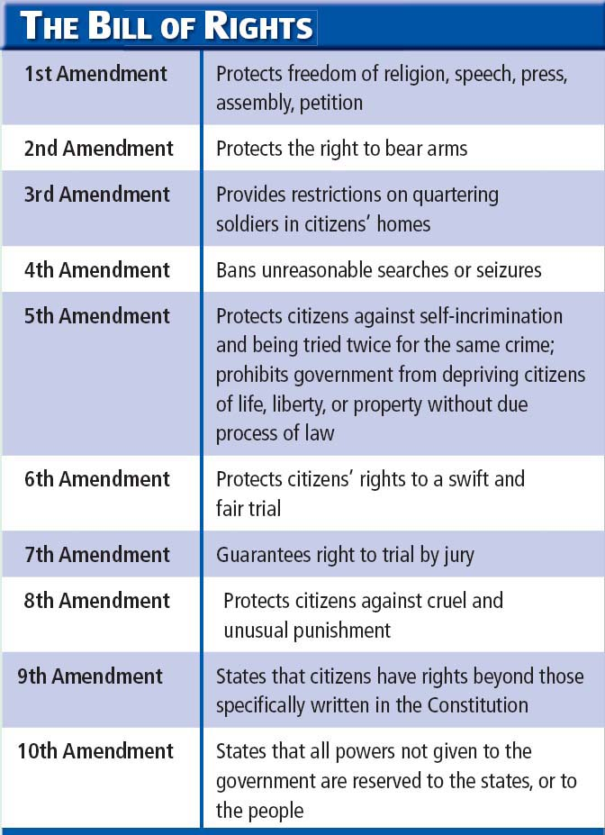
Bill of Rights

