Slide 1
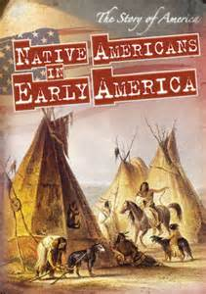
APUS
PERIOD 1
1491-1607
Pre Columbian Native Life
European Interactions (Columbian Exchange)
Consequences of European Contact (Columbian Exchange)

Slide 2
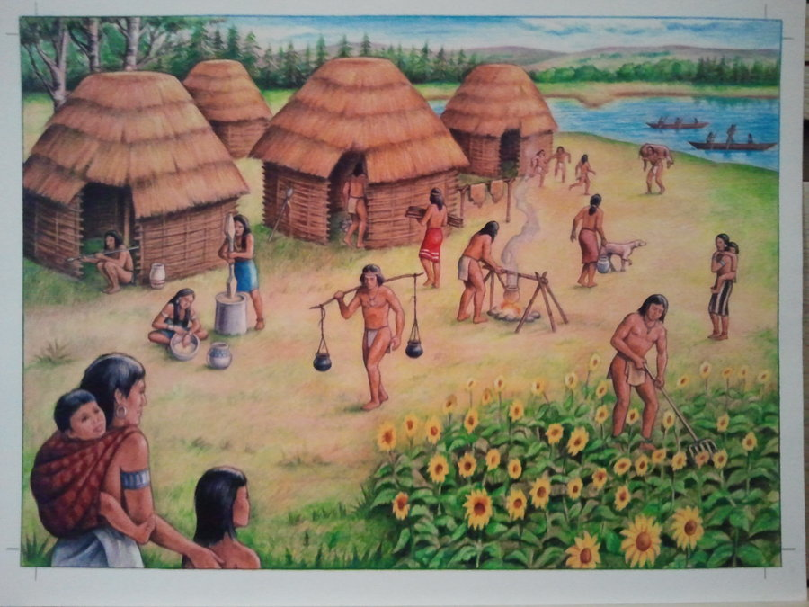
Key Concept 1.1:
Before the arrival of Europeans, native populations in North America developed a wide variety of social, political, and economic structures based in part on interactions with the environment and each other.

Slide 3
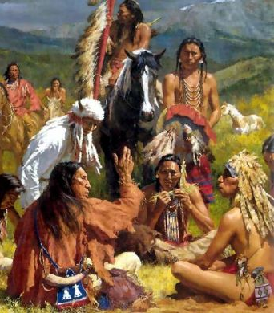
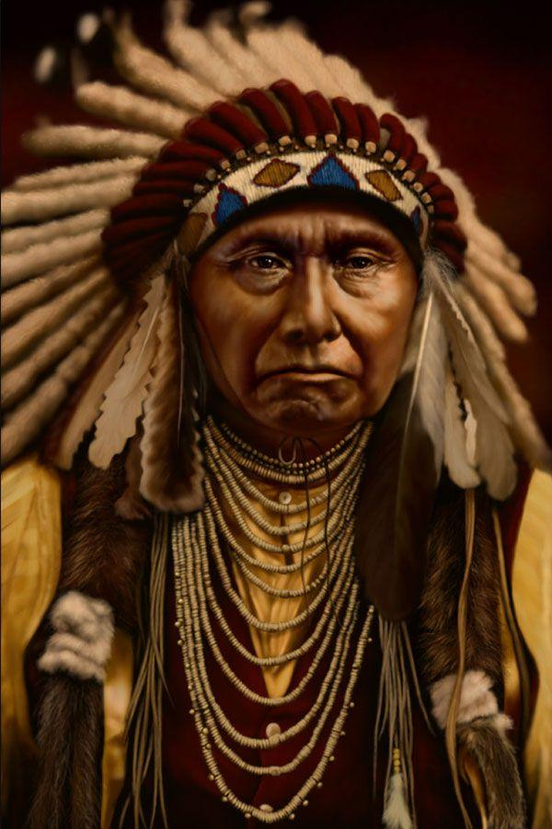
How did natives adapt to their environment?
“Different native societies adapted to and transformed their environments through innovations in agriculture, resource use, and social structure.”
Impact of maize cultivation:
Very popular in the southwest
Societies developed vast irrigation systems (Pueblos in Rio Grande)
How did maize transform societies?
Less emphasis on hunting and gathering
Increase in population
Establishment of permanent villages with socially diverse societies

Slide 4
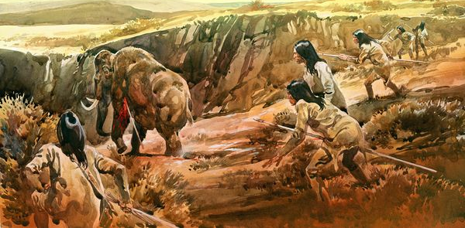
Most natives lived off of hunting and gathering
Lack of natural resources
Large, flat area that was arid (dry) – Basin
Grassland- Plains
With the introduction of the horse, life on the Great Plains was drastically altered
Bison hunting became much easier
Natives with horses became stronger militarily

Slide 5
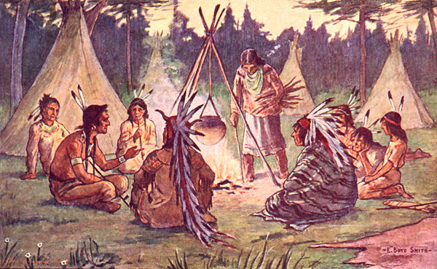
Natives in the Great Basin hunted bison and sheep
Like natives on the Great Plains, horses helped natives become more powerful
Many societies were a mix of hunting and gathering, and agriculture and developed permanent villages
Iroquois:
Adapted to their environment:
Burned forests to hunt and grow crops
Villages were built around maize

Slide 6
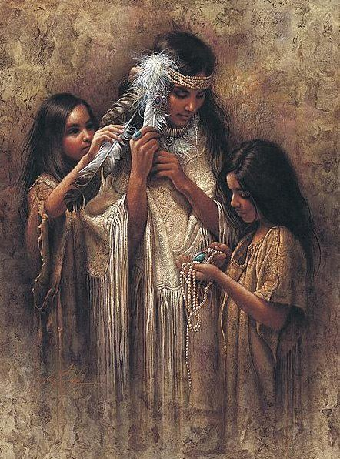
Iroquois were a matriarchal society:
Power was based on female authority
Women were instrumental in councils and decision-making
Women would tend to crops and oversaw community affairs while men hunted

Slide 7
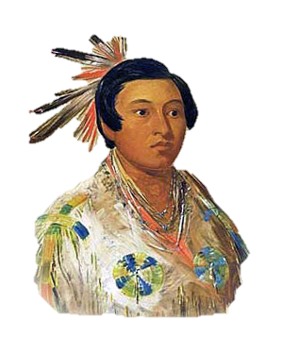
Cahokia Indians – near present-day St. Louis (around 30,000 people in 1200)
Built giant mounds
Largest settled community until NY and Philadelphia in 1800
Roughly 300,000 natives lived in California prior to the arrival of Europeans
Most of these societies were based on hunting, gathering, and foraging
Gather nuts, fish, and hunted
Societies tended to be ruled by wealthy families
Chinooks
Advocated warrior traditions
Used advanced fighting techniques
Lived in longhouses which could house many families

Slide 8
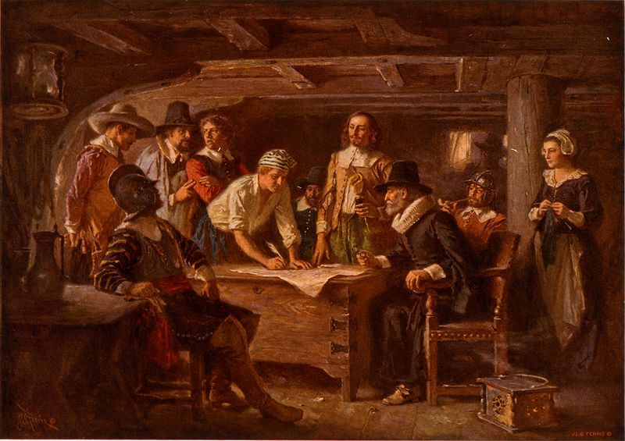
Key Concept 1.2:
“Contact among Europeans, Native Americans, and Africans resulted in the Columbian Exchange and significant social, cultural, and political changes on both sides of the Atlantic Ocean.”

Slide 9
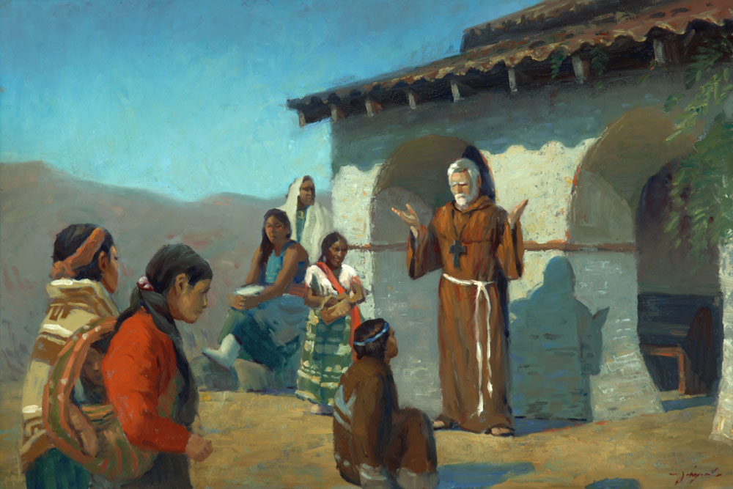
What were reasons that led to European exploration?
Countries sought new sources of wealth – gold and silver
Economic and military competition – glory (defeat of the Spanish Armada by the English)
Spread Christianity – Spain

Slide 10
The Spanish often tried to convert Natives to Christianity
Spanish Mission System:
Outposts throughout the Americas to help convert Natives
Outposts were often military bases as well

Slide 11
The Columbian Exchange revolutionized life in the Americas, Europe, and Africa.
Big Ideas:
What were positives and negatives of the Columbian Exchange on both hemispheres?
Columbian Exchange and its impacts
What was it?
The exchange of plants, animals, culture, humans, diseases, etc. between the Americas, Europe, and Africa
Examples of goods:
Americas to Europe and Africa: potatoes, maize (corn), tomatoes
Europe to the Americas: wheat, rice, horses, chickens, oxen

Slide 12
Impact of exchange?
In Europe and Asia: massive population growth due to new food; increase in wealth; decrease in feudalism and a rise of capitalism
In Africa: Spanish and Portuguese used Africans from West Africa to be used as slaves in the Americas
In the Americas: spread of diseases (smallpox and measles), social classes (Mestizos), horse transformed Native life (made hunting easier), Encomienda system

Slide 13
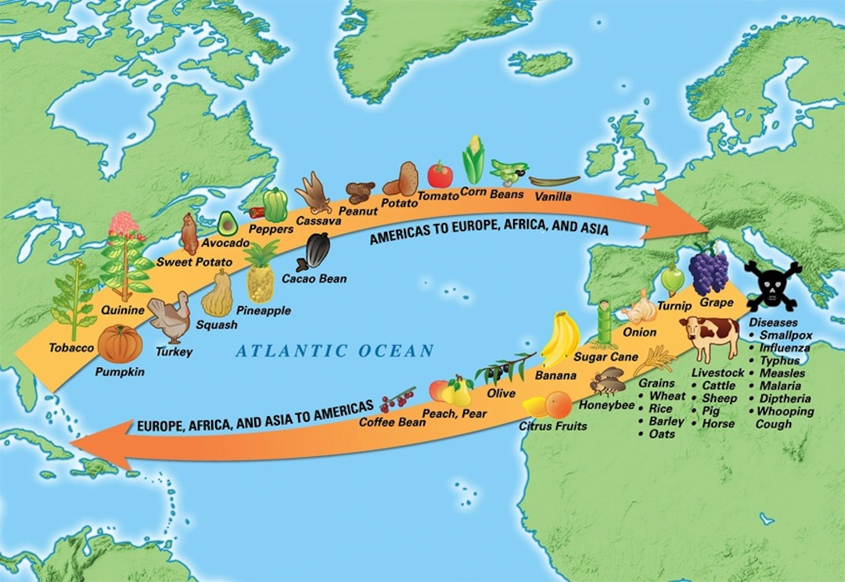

Slide 14
Technology and trade
New technology aided exploration:
Sextant – could be used to find exact position on earth – more precise sailing
Caravel, compass, and quadrant improved sailing efficiency
Economic improvements:
Joint-stock companies – used to raise $ for explorations
Used in Jamestown (1607)

Slide 15
B) Encomienda System (Check out video in the description)
Native American labor was marshaled (arranged, assembled) on plantations
The goal was to use labor for agriculture and gain precious metal
Eventually, the encomienda system was replaced by African Slave Labor
New Laws of 1542 outlawed the encomienda system
C) Spanish and Portuguese traders acquired slaves from some West African groups
Slaves were used by the Spanish on plantations and mines
D) Spanish Caste System:
Incorporated Europeans, Africans, Natives
Europeans were at the top (peninsulares and creoles)
Mestizo and mulatos (mixed European and Native, European and African ancestry)

Slide 16
Key Concept 1.2, II: “In their interactions, Europeans and Native Americans asserted divergent worldviews regarding issues such as religion, gender roles, family, land use, and power.”
A) Misunderstandings between each group
Gender – many Natives societies were matrilineal
Land – Natives did not own individual land
Religion – Natives believed in animism, polytheistic; shamans held power
Some useful aspects of each other’s cultures were eventually adapted:
Natives adapted technology
Europeans adapted agriculture techniques

Slide 17
B) Native resistance to European encroachment and labor:
Natives sought to preserve political, economic, and religious autonomy (independence, self-rule)
Diplomatically and/or militarily
C) Debates over how non-Europeans should be treated:
Many Europeans saw Natives and Africans as “savages”
Juan de Sepulveda:
Advocated harsh treatment of Natives
Claimed slavery for Natives was justified under Christianity
Bartolome de Las Casas:
Argued that Natives deserved the same treatment as all other men
Played an instrumental role in the ending of the encomienda system
Contributed to the “Black Legend”
Arguments used to subjugate Africans and Natives?
Racism, religious - spread of Christianity, Natives and Africans were seen as “barbaric”

Slide 18
A) Impact of Spanish exploration:
Deadly diseases:
Smallpox, malaria
Killed as many as 90% of Natives in some areas – not immune to European diseases
Introduction of new animals and crops:
Horse – transformed Native life on the Great Plains
Crops – wheat, rice, and sugar

Slide 19
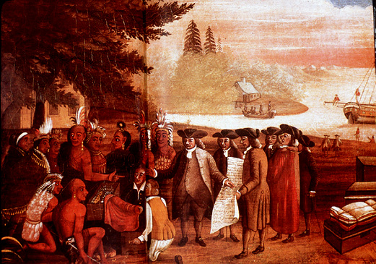
Key Concept 1.3:
Contacts among American Indians, Africans, and Europeans challenged the worldviews of each group.

Slide 20
Many Spanish and Portuguese did not understand Natives and their cultures
Natives were viewed as “Savages” by many Europeans
Juan de Sepulveda:
Advocated harsh treatment of Natives
Claimed slavery for Natives was justified under Christianity
Bartolome de Las Casas:
Argued that Natives deserved the same treatment as all other men
Played an instrumental role in the ending of the encomienda system
Europeans began to develop a belief in white superiority to justify the treatment of Africans and Natives

Slide 21
Europeans began to develop a belief in white superiority to justify the treatment of Africans and Natives
The Spanish often tried to convert Natives to Christianity
Spanish Mission System:
Outposts throughout the Americas to help convert Natives
Outposts were often military bases as well
Don Juan de Onate defeated the Pueblos
Spanish established Santa Fe in 1610
Spanish priests and government suppressed Native practices that were inconsistent with Christianity
Spanish demanded tribute and labor from Natives

