Slide 1
Industrialization immigration progressive movement
Period 6

Slide 2
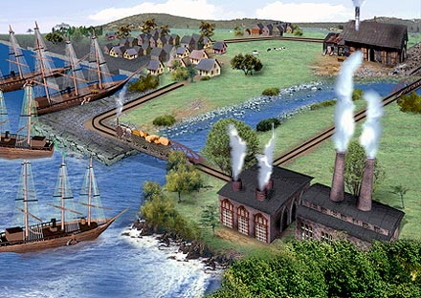
Industrial Revolution
The rise of corporations, heavy industry, mechanized farming, and technological innovations transformed the American economy from an agrarian to an increasingly urban industrial society.

Slide 3
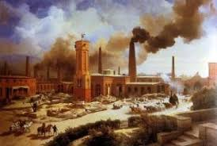
Several Factors That Contributed to the Industrial Revolution:
1. Plentiful Natural Resources
2. Improved Transportation
3. Growing Population
4. High Immigration
5. New Inventions
6. Investment Capital

Slide 4

Who do you think are the 5 wealthiest Americans of all time?

Slide 5
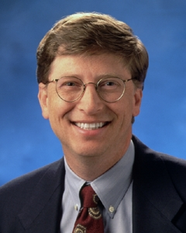
6. BILL GATES- Computers
Bill Gates (1955 - )
$54 billion
Even if Bill Gates’ currently estimated $58 billion fortune is down from its heady peak nearly a decade ago, the Harvard dropout and Microsoft leader is hardly hurting. After the proposed merger with Yahoo fizzled out and shares dropped in the dominant company he cofounded, he’s probably not losing sleep.
He is no doubt looking forward to stepping back from his current role at Microsoft and devoting more time to the bill and Melinda Gates Foundation, currently $38.7 billion strong.

Slide 6

Microsoft Anti-Trust Case
In 1999, a federal judge declared that Microsoft had violated the Sherman Anti-Trust Act by gaining a monopoly over the industry.
The government demanded that the company be broken into two. One would sell windows, and the other could sell everything else.

Slide 7
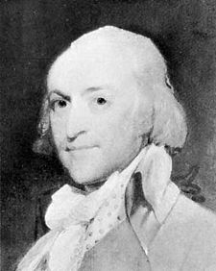
5. JOHN JACOB ASTOR-Fur Trade
John Jacob Astor (1763 - 1848)
$116.6 billion
if john Jacob Astor were alive to hear industry critics’ “fur kills” cries, he might partially agree. He did, after all, make a killing in fur and it made him the first millionaire in America.
Upon overhearing a man discussing fur trading, Astor decided to pursue it himself and realized great success. Along the way, he diversified and dabbled in selling opium -- again, he was successful. Decades later, he got out of the fur business and segued into New York City real estate.

Slide 8
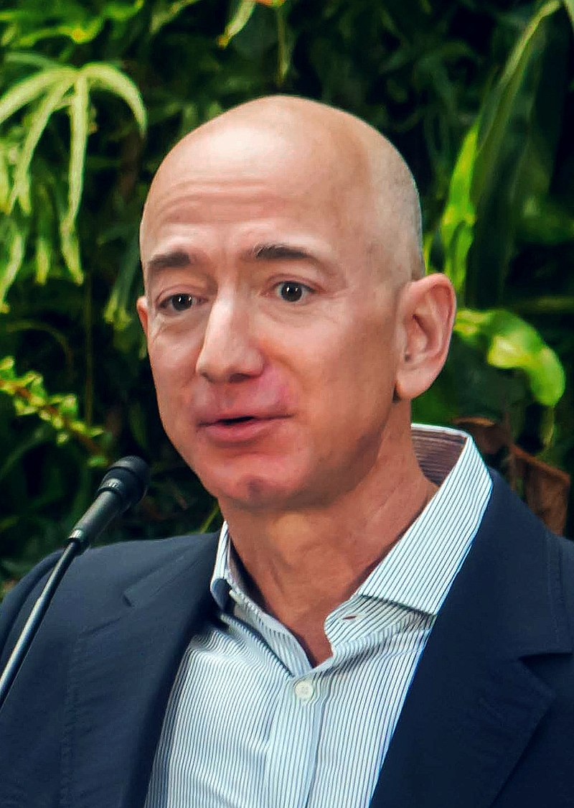
4. Jeff bezos- amazon
$150 Billion
Bezos was born in Albuquerque, New Mexico and raised in Houston, Texas. He graduated from Princeton University in 1986 with degrees in electrical engineering and computer science.
He worked on Wall Street in a variety of related fields from 1986 to early 1994. He founded Amazon in late 1994 on a cross-country road trip from New York City to Seattle.
The company began as an online bookstore and has expanded to a variety of products and services, including video and audio streaming. It is currently the world's largest online sales company, as well as the world's largest provider of cloud infrastructure services via its Amazon Web Services arm.

Slide 9
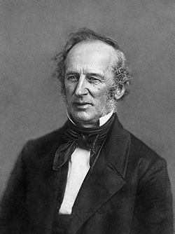
3. CORNELIUS VANDERBILT- Railroads
Cornelius Vanderbilt (1794 - 1877)
$178.4 billion
You can’t necessarily get rich by playing nice, and Cornelius Vanderbilt apparently took that to heart. If some point to Sam Walton as the one who unfairly undercut prices, they should look a little further back to Vanderbilt.
In his early years in the steamboat business, he would undercut competitors to the point of his own unprofitability, just to make a point. That ruthless competitive nature typified Vanderbilt through his years, especially in the way he ran his railroad empire. He may not have always played nice, but without exception, he played to win.

Slide 10
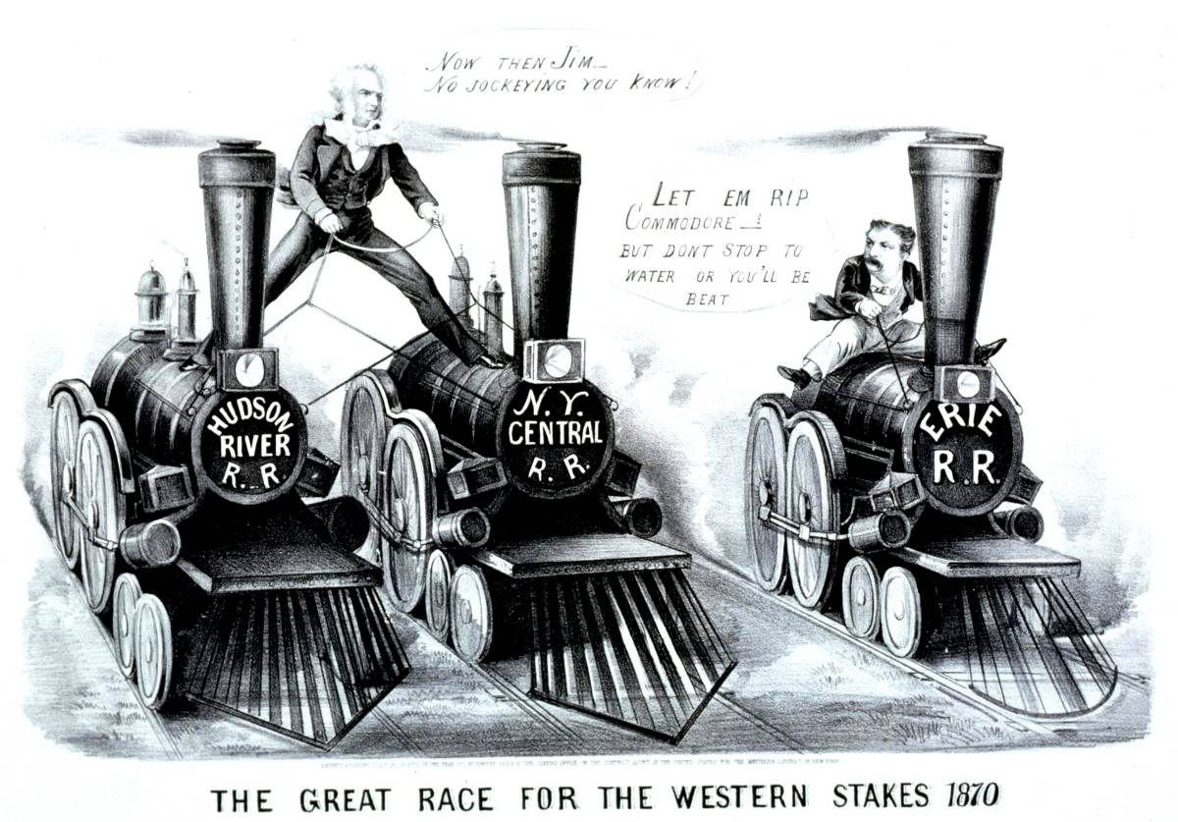
Cornelius Vanderbilt

Slide 11
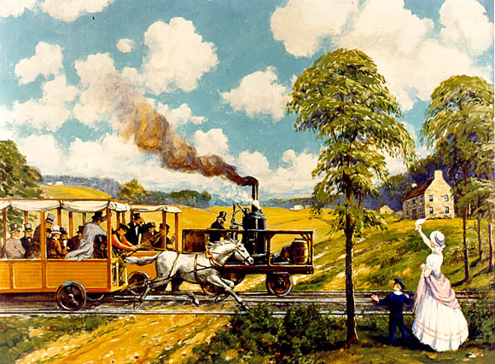
The “Iron Horse” Wins! (1830)

Slide 12
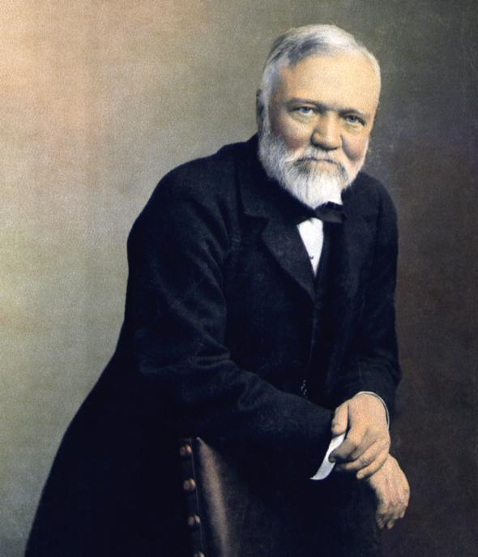
2. ANDREW CARNEGIE-Steel
Andrew Carnegie (1835 - 1919)
$297.8 billion
Steel wasn’t a bad business pursuit in the late 1800s. It paid off for Andrew Carnegie and continued to pay handsomely through philanthropy long after his death. A self-made man from humble beginnings, Carnegie worked hard from childhood.
Even if today’s wealth seekers don’t necessarily follow Carnegie’s principles for philanthropy, they do still highly regard his formulas for acquiring the means.

Slide 13
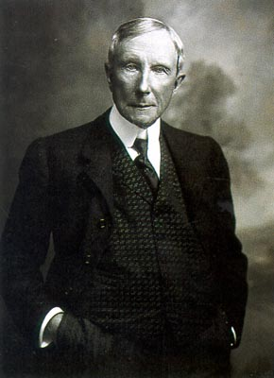
1. JOHN D. ROCKEFELLER-Oil
John D. Rockefeller (1839 - 1937)
$323.4 billion
You have to wonder how John D. Rockefeller would fare as a major player in big oil today. After all, he founded standard oil in 1870, and it wasn’t long before he dominated the industry. Naturally, some didn’t take kindly to that and the company was eventually found to have monopolized.
Yet, for all Rockefeller’s detractors, the U.S.’s first billionaire was a serious philanthropist to education, medicine and science. From a legacy standpoint, however, he’s best remembered for his unfathomable wealth. Even today, the name connotes “money.”

Slide 14
Wealthiest Americans
1 Jeff Bezos $150 billion, amazon
2 Bill Gates $66 B 55 Medina, WA Microsoft
3 Warren Buffett $46 B 80 Omaha, NE Berkshire Hathaway
4 Larry Ellison $41 B 66 Woodside, CA Oracle
5 Charles Koch $31.5 B 75 Wichita, KS, manufacturing, energy
5 David Koch $31.5 B 70 New York , NY manufacturing, energy
6 Christy Walton $27 B 55 Jackson, WY Walmart
7. Jim Walton $26.1 B 62 Bentonville, AR Walmart
8 Alice Walton $26 B 61 Fort Worth, TX Walmart
9 S. Robson Walton $25.7 B 66 Bentonville, AR Walmart
10 Michael Bloomberg $25 B 68 New York , NY Bloom

Slide 15
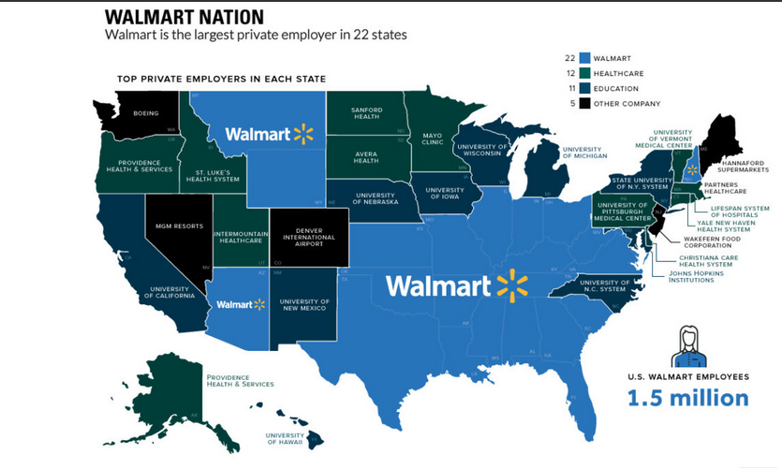

Slide 16

Iron and steel
Steel making was largely a development of the 19th century, with the invention of melting processes; the Bessemer (1855), the open hearth, usually fired by producer gas (1864); and the electric furnace (1900). Since the middle of the 20th century, oxygen conversion, has made it possible to manufacture high quality steel with relatively low production costs.

Slide 17
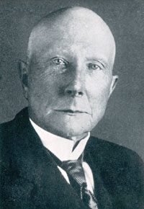
JOHN D. ROCKEFELLER
Standard Oil Company
In 1863, John D. Rockefeller built an oil refinery near Cleveland, Ohio.
He persuaded railroads to give him a deal on transporting his oil.
He lowered his cost to consumers and bought out his competition.

Slide 18
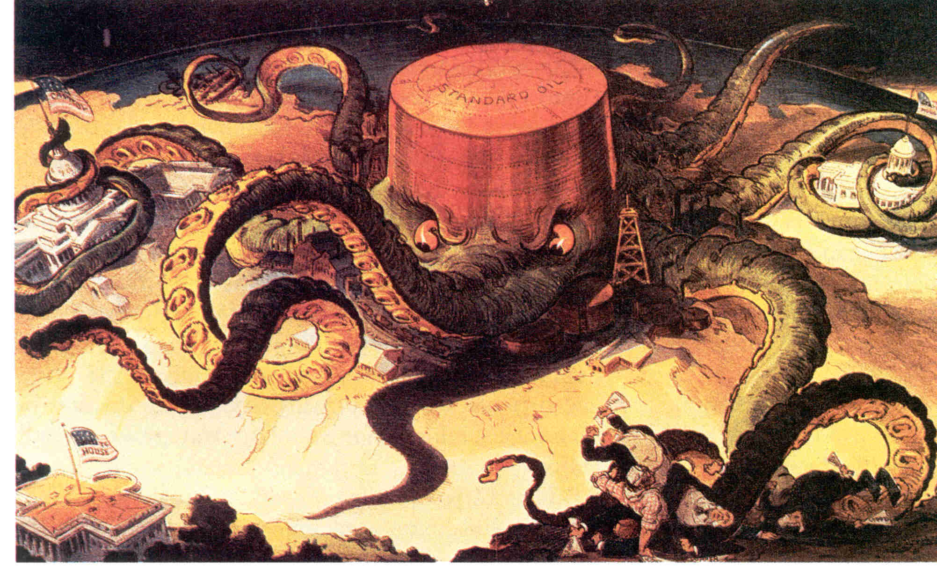
Standard Oil CoMPANY

Slide 19
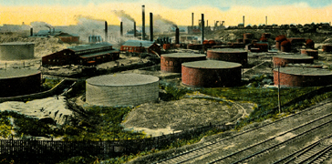
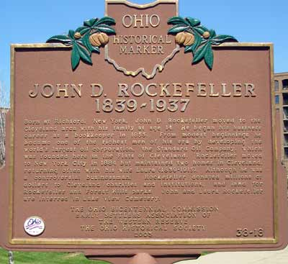
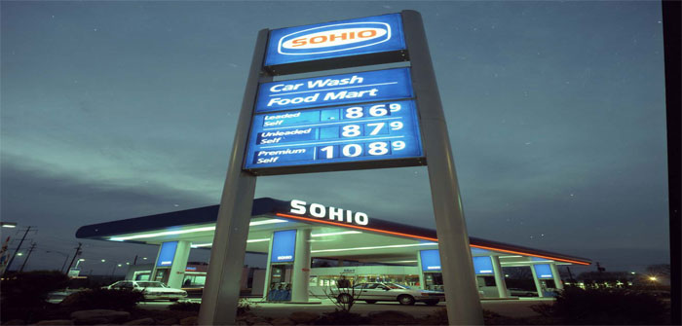
Standard Oil Company

Slide 20
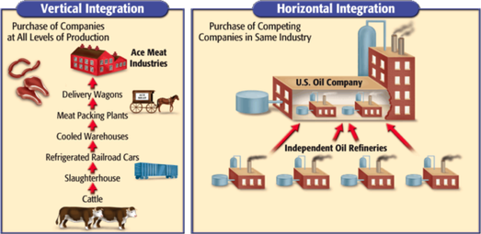
Horizontal Consolidation
This involves bringing together many of the firms in the same business.
Rockefeller bought out and combined various oil companies to create his monopoly on the industry.

Slide 21
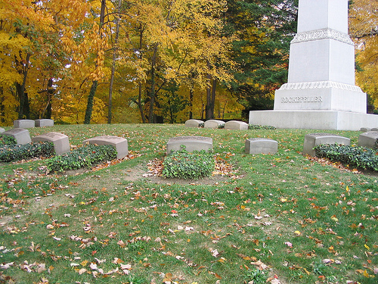
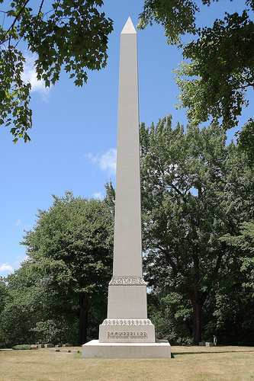
Rockefeller Grave
Rockefeller is buried in Cleveland at Lake View Cemetery.

Slide 22
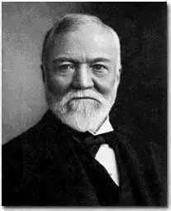
Carnegie Steel
Andrew Carnegie was born in Scotland and immigrated to the United States in 1848.
In began Carnegie Steel in 1873. By 1900 he owned one quarter of all steel production in the U.S.
Carnegie believed in the “Gospel of Wealth”.

Slide 23
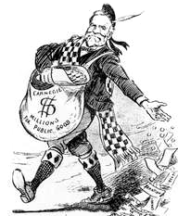
Gospel of Wealth
Carnegie believed that the wealthy had a duty to give back to the community.
During his lifetime he donated over $350 million to many organizations.
He is most known for establishing the library system that we still use today.
He constructed 2,800 libraries during his lifetime.

Slide 24
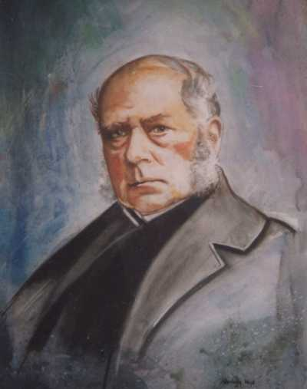
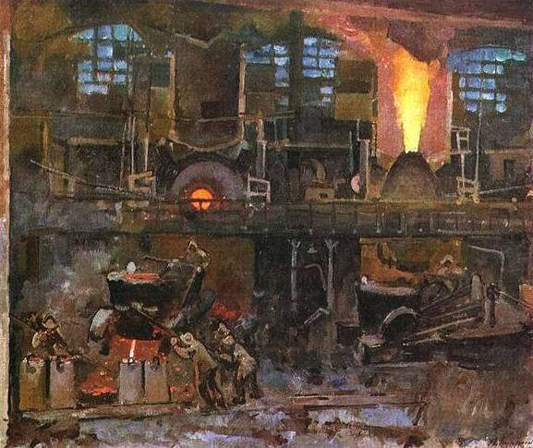
Bessemer Process
This process clarified the quality of the steel and made it quicker and cheaper to produce.

Slide 25
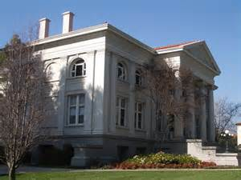
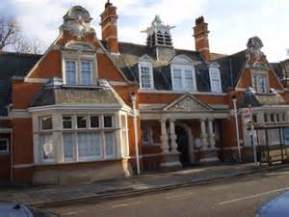
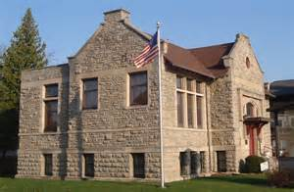
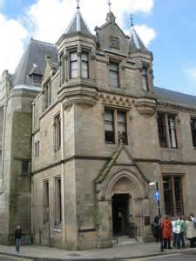
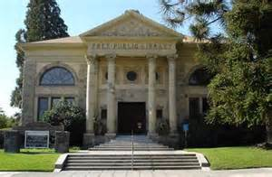
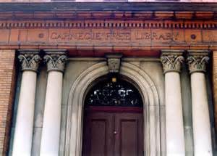
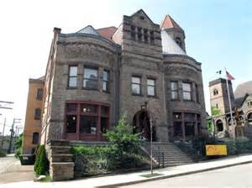
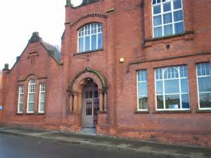
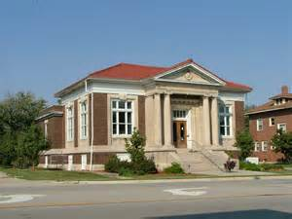

Slide 26
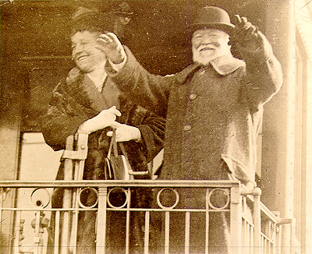
Vertical Consolidation
This involves buying out and consolidating all the related industries that have to do with your business.
Carnegie purchased steel, rail, and coal companies to have control of all of his industries needs.

Slide 27

philanthropist
A philanthropist is someone who engages in philanthropy; that is, someone who donates his or her time, money, and/or reputation to charitable causes.
The term may apply to any volunteer or to anyone who makes a donation, but the label is most often applied to those who donate large sums of money or who make a major impact through their volunteering, such as a trustee who manages a philanthropic organization.

Slide 28
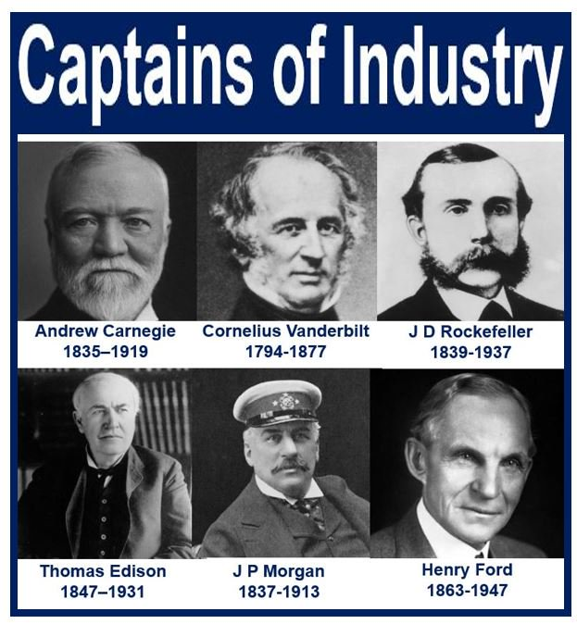
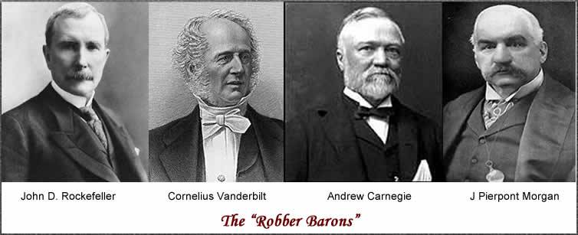
Captain of Industry: is a philanthropist, gives large quantities of their wealth to charities or to better the community.
Robber Baron: reaped huge profits by paying the employees extremely low wages, drove competitors out of business and then raised the cost of the product.

Slide 29
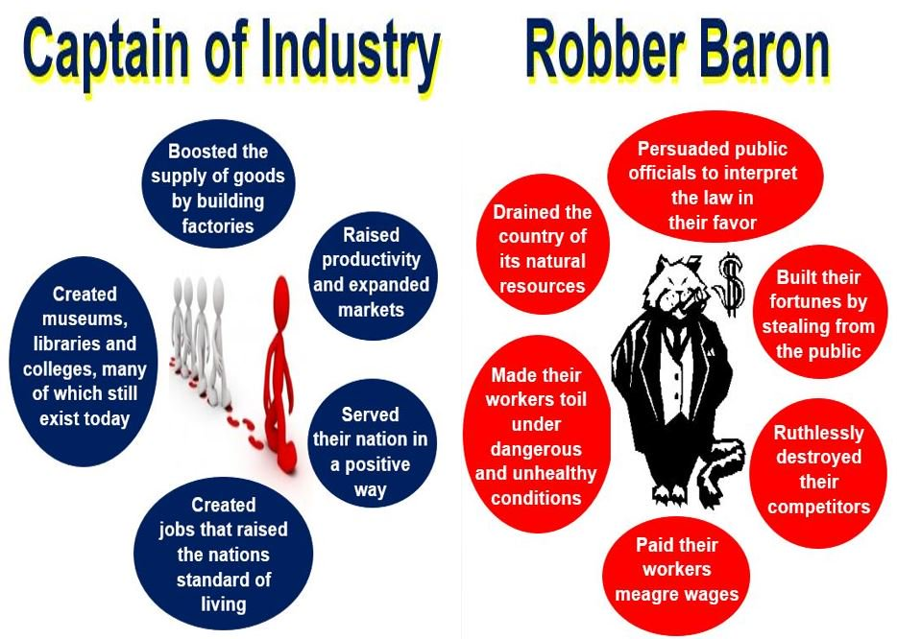

Slide 30
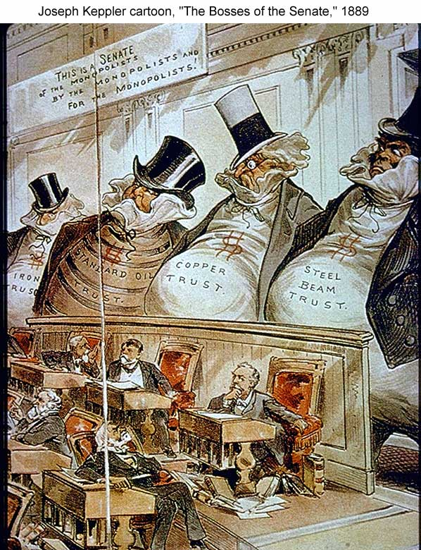

Slide 31
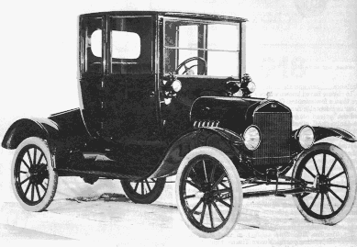
Automobile
Ford was able to build cars cheaply, so everyone could own one.
During the 1920’s his company produced 60% of the nation’s automobiles.
He also standardized the parts, so anyone could buy them in any of the thousands of garages he expected to spring up around the country.
In 1927 a Model T was $295.00.

Slide 32
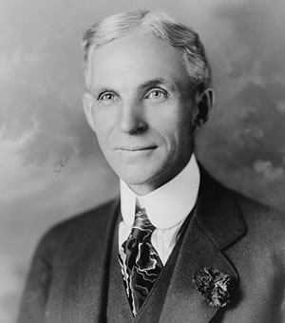
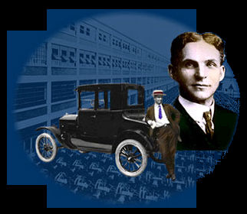
ford
The rapid adoption of industrial mass production in America in the 1920’s arose from the need to produce a vast quantity of products to meet the nation’s material needs.
He wanted to increase production and speed, perfect the idea of interchangeable parts, and divide labor among workers.

Slide 33
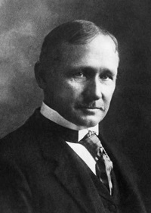
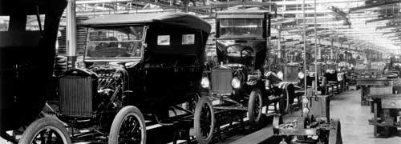
taylorism
A man named Winslow Taylor actually came up with the principles of the assembly line. Ford was the first to use it in his factories.
Assembly Line: each worker does one specialized task in the construction of the final product.

Slide 34
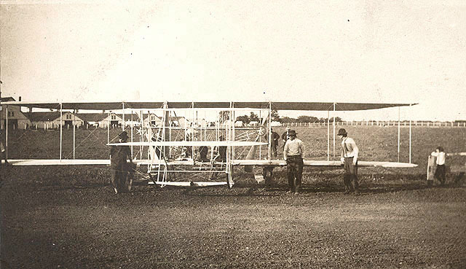
airplane
On December 17, 1903, Wilbur and Orville wright made four brief flights at Kitty Hawk with their first powered aircraft. The Wright Brothers had invented the first successful airplane.

Slide 35
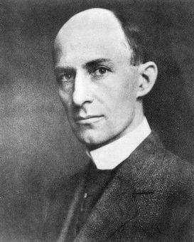
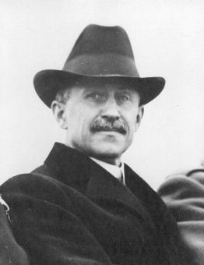
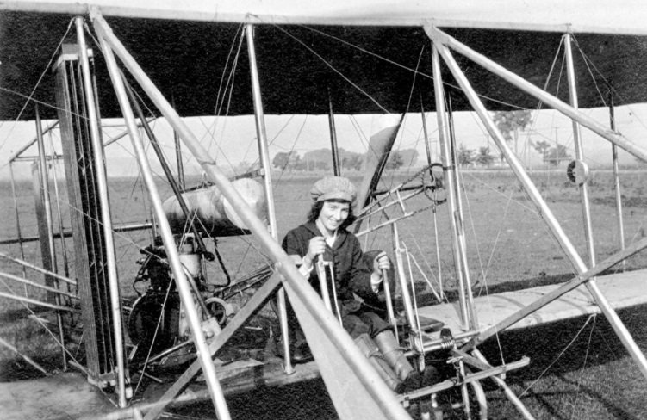
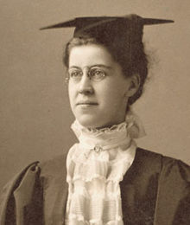
The wright brothers and sister.
Kitty Hawk, NC – December 7, 1903
Wilbur Wright Orville Wright
Katherine Wright

Slide 36
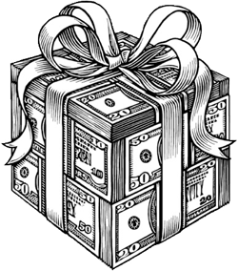
Growth of Big Business
If the government does not interfere the stronger businesses will survive.
Businesses did not mind interference if it was to their benefit.
Businesses willing to accept subsidies.
Subsidy: a payment by the government to encourage the development of key industries.

Slide 37
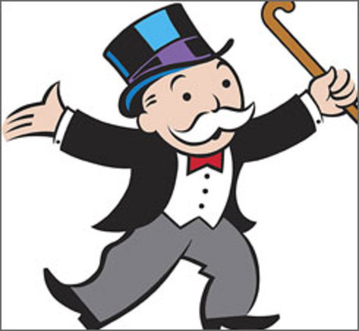
What is the purpose of the game of Monopoly?

Slide 38
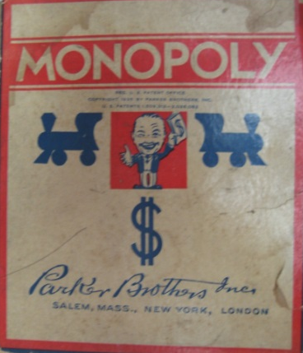
A Brief History of Monopoly
The history of the board game Monopoly can be traced back to the early 20th century. The earliest known version of monopoly, known as the Landlord's Game, was designed by an American, Elizabeth Magie, and first patented in 1904 but existed as early as 1902.
A series of board games were developed from 1906 through the 1930s that involved the buying and selling of land and the development of that land. By 1933, a board game had been created much like the version of Monopoly sold by Parker Brothers.

Slide 39

New Type of Business Entities
1. Monopoly: when a company gains complete control over an industry. A monopoly can buy out it’s competitors.
2. Trust : several companies would join together and turn over their assets to a board of trustees.

Slide 40


Sherman anti-trust
Introduced by Ohio Senator John Sherman.
The Sherman Act broadly prohibits
(1) anticompetitive agreements
(2) unilateral conduct that monopolizes or attempts to monopolize the relevant market.
The law attempts to prevent the artificial raising of prices by restriction of trade or supply.

Slide 41

Laissez Faire → the ideology of the Industrial Age.
Individuals should compete freely in the marketplace.
The market was not man-made or invented.
No room for government in the market!

Slide 42


Gilded Age
The Gilded Age was an era of rapid economic growth, especially in the north and west.
As American wages were much higher than those in Europe, especially for skilled workers, the period saw an influx of millions of European immigrants.
The rapid expansion of industrialization led to real wage growth of 60% between 1860 and 1890, spread across the ever-increasing labor force.

Slide 43

American socialist party
In the first decades of the 20th century, it drew significant support from many different groups, including trade unionists, progressive social reformers, populist farmers and immigrants.
However, it refused to form coalitions with other parties, or even to allow its members to vote for other parties. Eugene V. Debs twice won over 900,000 votes in presidential elections.

Slide 44


Social Darwinism
British economist.
Advocate of laissez-faire.
Adapted Darwin’s ideas from the “Origin of Species” to humans.
Notion of “Survival of the Fittest.”
If a company is more fit to be successful it will survive. Or a person who works the hardest will have the most success.
Herbert Spencer

Slide 45
Great wealth helped to maintain an economic inequality in society.
Many Americans believed they could rise up into the middle class even though they were trapped in poverty.
Rich
Rich
Poor
Poor
Population
Wealth

Slide 46

Johnstown Flood

Slide 47


The situation at Johnstown became symbolic of what was wrong with the distribution of wealth in the United States.
In Pennsylvania, Johnstown was a small working class community.
High above the town on the top of a hill was the South Fork Fishing and Hunting Club.

Slide 48

The Rich Rain Down on the Poor
When the wealthy people like the Carnegies and Mellons, the Rockefellers and the Vanderbilts wanted to get away from it all, they would visit South Fork.
The lake was artificial. The Little Conemaugh River had been dammed by the members of the club to create a lake for fishing.

Slide 49

How it Happened:
The Johnstown Flood disaster (or Great Flood of 1889 as it became known locally) occurred on May 31, 1889.
It was the result of the failure of the South Fork dam situated 14 miles upstream of the town.
The dam's failure unleashed a torrent of 20 million tons of water.
The flood killed over 2,200 people and caused us$17 million of damage.

Slide 50

As the wall of water came down on the town people had no where to go.
Gas lines were broken and fire and explosions took place at the same time as the flood.

Slide 51






Slide 52




Slide 53



THE AMERICAN RED CROSS
It was the first major disaster relief effort handled by the new American Red Cross, led by Clara Barton.
Support for victims came from all over the United States and 18 foreign countries.
CLARA BARTON

Slide 54


The Casualties
99 entire families died in the Johnstown deluge, including 396 children.
124 women and 198 men were left without their spouses,
98 children lost both parents.
777 victims (1 of every 3 bodies found) were never identified and rest in the Plot of the Unknown in Grandview Cemetery in Southmont.

Slide 55

Working in the Factories

Slide 56

Factory Work
There were two types of work:
Skilled work: a job that required a person have a specific trade or skill that they had to be trained or educated to do.
Unskilled work: a job that required a person works performing a task or series of tasks that can be quickly taught to them when they are hired.
Piecework: paying employees by how many pieces or products they could produce.

Slide 57

Sweatshops
A sweatshop is a working environment with conditions that are considered by many people of industrialized nations to be difficult or dangerous, usually where the workers have few opportunities to address their situation.
This can include exposure to harmful materials, hazardous situations, extreme temperatures, or abuse from employers.
Sweatshop workers often work long hours for little pay, regardless of any laws mandating overtime pay or a minimum wage.
Child labor laws may also be violated.

Slide 58

Factory Accidents
During the 1880’s the average number of deaths per year from accidents ranged from 35,000-40,000.
Today the average number of work related deaths is around 5,500 to 6,500.
What is OSHA?
Occupational safety and health administration

Slide 59

muckrakers
The term muckraker was used in the Progressive Era to characterize reform-minded American journalists who attacked established institutions and leaders as corrupt. They typically had large audiences in some popular magazines. In the US, the modern term is investigative journalism.

Slide 60



The Jungle
Upton Sinclair was a muckraker who exposed the conditions of workers in his novel “The Jungle”.
The story takes place in the Chicago stockyards in the meatpacking industry.
He is also well known for his book “Oil” . this book is about corruption and monopolies.

Slide 61

The Triangle
Shirtwaist
Factory Fire,
March 25, 1911

Slide 62


A HISTORY OF PROBLEMS
In 1909, there was an uprising at the company when the workers spontaneously walked out.
20,000 protested in the streets.
Public Fear of Unions/Anarchists

Slide 63


Triangle Shirtwaist Factory
Asch Building, 8th and 10th Floors
The Triangle Shirtwaist Factory fire in New York City was a major industrial disaster.
The company employed 500 workers, most of the them were females working on sewing machines.

Slide 64

Conditions in the Factory
On the afternoon of March 25, 1911, a fire began on the 8th floor.
The workers on the 10th floor were alerted and most of those two floors were evacuated.
Word of the fire did not reach the 9th floor in time.
The conditions in this factory were typical for the time period.
Flammable textiles were stored throughout the factory.
Smoking was common.
Illumination was by gas lighting.
There were no fire extinguishers.

Slide 65


The Fire Department
The department was not very quick to respond.
People did not initially believe there were people inside the building because it was Sunday.
The ladders could only reach to the 6th floor.

Slide 66



EXITS ARE BLOCKED
One stairwell was already filling with smoke.
The other door was locked by the owners to prevent the workers from taking breaks.
26 girls died on the fire escape.

Slide 67




No Way Out!
Realizing there was no way out, some of the women broke the windows and jumped nine floors to their deaths.
Others pried open the elevator shafts and fell to their deaths.
One women was found floating in water that had collected in the elevator shaft after the fire.
She survived.

Slide 68





Inside the Building After the Fire
Scene at the Morgue
Relatives Review the Bodies

Slide 69



Out of the Ashes
NYC created a Bureau of Fire
Prevention.
New strict building codes were passed.
Tougher fire inspection of
sweatshops.
Growing momentum of support for women’s suffrage.

Slide 70



Francis Perkins
Frances Perkins was a social worker and reformer who had a lasting impact on the Progressive Movement.
Perkins witnessed the Triangle Fire and made it her life’s work to improve the condition of workers in the factories.
She later served as the Secretary of Labor under F.D.R.

Slide 71

Collinwood Fire

Slide 72



Slide 73

On ash Wednesday, March 4, 1908, Collinwood's Lake View elementary school became the site of the country's worst school tragedy.
Shortly after 9:00 a.M., And while school was in session, overheated steam pipes ignited nearby wood joists, resulting in a raging fire.

Slide 74


The fire caused a large panic, and roughly half of the students were unable to escape, crowded in the doorways. In the end, 172 children, 2 teachers and 1 rescuer perished in the fire.

Slide 75


Slide 76


Slide 77


Slide 78


Slide 79

The bodies of 19 students could not be identified. The city of Collinwood purchased a common grave for the unclaimed children, who were buried in a row, in individual white caskets. In a second row in front of the unidentified children (and closest to the monument) are 10 additional graves of victims who were identified, but whose families chose to bury next to the other children.

Slide 80


Memorial at Lakeview Cemetery

Slide 81




Other Muckrakers:
Ida Tarbell: The History of Standard Oil
Lincoln Steffens: The Shame of the Cities

Slide 82


Knights of Labor
The Knights of Labor were founded by Uriah Stephens in 1869 as a secret society.
The Knights of Labor hoped to organize all working men and women, skilled and unskilled, into one union.
Membership remained small until Terence Powderly took over in 1879.
The union actively recruited farmers and factory workers and 60,000 African Americans.
Terence V. Powderly
“An injury to one is the concern of all!”

Slide 83


Goal of the Knights of Labor
Eight-hour workday.
Workers’ cooperatives.
Worker-owned factories.
Abolition of child and prison labor.
Increased circulation of greenbacks.
Equal pay for men and women.
Safety codes in the workplace.
Prohibition of contract foreign labor.
Abolition of the National Bank.

Slide 84


The American Federation
of Labor: 1886
The American Federation of Labor followed the leadership of Samuel Gompers.
The AFL sought to organize only skilled workers in smaller unions, devoted to specific craft.
The AFL had very few African American members, women were not permitted to join.
Gompers was against women joining the union because he felt their presence drove down wages.
Samuel Gompers

Slide 85


How the AF of L
Would Help the Workers
Catered to the skilled worker.
Represented workers in matters of national legislation.
Maintained a national strike fund.
Evangelized the cause of unionism.
Prevented disputes among the many craft unions.
Mediated disputes between management and labor.
Pushed for closed shops.
.

Slide 86



Yellow dog contract: a promise that the person agrees to upon being hired that they will not join a union.
Closed shop: the employer agrees to only hire union workers.
Collective bargaining: direct talks between organized workers and their employer.

Slide 87


THE STRIKES

Slide 88

STRIKES
Strike: to stop work, protest, walk off the job.
Many business leaders were opposed to unions because they believed it would violated their rights to free enterprise.
The labor unrest and strikes the followed would often leave people fearful of anarchy.
Strikes would shut down major industries that affected the entire nation.

Slide 89



Scab: a negative term used to describe a worker that comes in to replace a striking worker.

Slide 90

“Tools” of
Labor
Management vs. Labor
“Tools” of
Management
boycotts
sympathy
demonstrations
picketing
closed shops
organized
strikes
“wildcat” strikes
“scabs”
P. R. campaign
Pinkertons
lockout
blacklisting
yellow-dog contracts
court injunctions
open shop

Slide 91

Employers took several measures to stop the unions:
They forbade union meetings.
They fired union organizers.
They forced new workers to sign “yellow dog” contracts.
They refused to bargain when strikes occurred.
They refused to recognize union leaders as representatives of the workers.

Slide 92


The Railroad Strike of 1877
The strike began when the Baltimore and Ohio railroad company announced that it was going to cut wages by 10%.
Railroad workers reacted with violence.
Rioting spread from Pittsburgh to Chicago to St. Louis and several other cities.
Workers names were put on blacklists.

Slide 93

The Great Railroad Strike of 1877

Slide 94



Federal troops were called in to restore order.
Troops fired upon the strikers killing some and wounding many.
The strikes were crushed but bitterness lingered on all sides.
After the great railroad strike of 1877, union organizers planned for their next battles while politicians and business leaders took steps to ensure that such chaos could not reoccur.
For workers and employers alike, the strikes had shown the power of workers in combination to challenge the status quo.
What does status quo mean?

Slide 95

Haymarket Riot (1886)

Slide 96


Haymarket Strike of 1886
On May 1, 1886, groups of workers mounted a demonstration for an eight hour workday. Strikes erupted in a number of cities.
These strikes were supported by the Knights of Labor.
On May 3rd, police broke up fights between workers and scabs at a reaper factory in Chicago.
A couple of strikers were killed by the police.
The original flyer sounded threatening so it was changed.

Slide 97

The Rally
Union leaders called for a rally on May 4th to protest.
During the rally a bomb was thrown into a police formation killing seven officers.
The bombing was blamed on anarchists.
Anarchist: person who believes there should be no government, anti-government.

Slide 98


The prosecutor could not prove that any of the men threw the bomb.
All eight were convicted for conspiracy to kill a police officer.
4 were hanged, one committed suicide, and the other three went to prison.

Slide 99

Homestead Steel Strike (1892)

Slide 100


Homestead Strike of 1892
During the summer of 1892 while Andrew Carnegie was in Europe his business partner Henry Frick tried to cut wages at Carnegie Steel.
The union at the Homestead plant called for a strike. Frick planned to break the union at any cost.

Slide 101


The Pinkertons
Frick called in a private police security force called the Pinkertons.
The agency would soon become a major force against the young labor movement developing in the United States.

Slide 102



The Pinkerton Agents Arrive
The Pinkertons moved in near the steel company under the cover of darkness.
Shooting broke out when they arrived near the plant.
At first Americans sympathized with the strikers.
The effort against labor tarnished the image of the Pinkertons for years.

Slide 103

The Carnegie Steel Works. Showing the shield used by the strikers when firing the cannon and watching the Pinkerton men.

Slide 104



Attempted Assassination!
On July 23rd, an anarchist named Alexander Berkman tried to assassinate Frick.
Americans quickly changed their sympathies and sided with the Frick and the company.
The union eventually admitted defeat.
Carnegie out of a guilty conscience built one of the largest libraries at Homestead.
Henry Clay Frick
Alexander Berkman

Slide 105


International Workers of the World (“Wobblies”)
The IWW was founded in Chicago in June 1905 at a convention of two hundred socialists, anarchists, and radical trade unionists from all over the United States who were opposed to the policies of the American Federation of Labor.

Slide 106


The Pullman Strike of 1894

Slide 107


A “Company Town”:
Pullman, IL
Sleeping car maker George Pullman considered himself a caring industrialist.
The town included a school, bank, water and gas systems, and comfortable homes.

Slide 108

The Pullman Strike of 1894
Conditions worsened in the town during the Depression of 1893.
Pullman planned to cut jobs and wages at the plant.
A delegation of workers went to Pullman to protest.

Slide 109


Eugene V. Debs
As a member of the American railway union, Debs was involved and later imprisoned for his part in the famed Pullman Strike, when workers struck the Pullman palace car company over a pay cut.
The effects of the strike resulted in president Grover Cleveland calling members of the United States Army into Chicago, Illinois, which led to Debs' arrest and imprisonment.

Slide 110


Striking workers began to sabotage the trains by unhooking the Pullman cars from the rest of the train.
Railroad owners turned to the federal government for help.
The Pullman cars were typically at the end of the train.
Mail cars were situated in the middle of the train.
Workers re-ordered the train putting the mail cars at the end and making a quick end to the strike.

Slide 111


Coal Strike 1902
The industry involved in the strike was the United Mine Workers of America (UMWA) in Pennsylvania.
The union tried a meeting with several of the miners of strike, but they would not negotiate with the union.
Roosevelt attempted to resolve the conflict by listening to each side.
Roosevelt threatened to take over the mines if they did not come to an agreement.

Slide 112



Slide 113


Brotherhood of Sleeping Car Porters
The brotherhood of sleeping car porters (BSCP) was a labor union in the United States organized by the predominantly African-American Pullman porters.
Organized in 1925, it struggled for twelve years before winning its first collective bargaining agreement with the Pullman company.

Slide 114


Slide 115




Slide 116

Newsboys Strike
The newsboys strike was a
General strike of newsboys
In cities throughout New
England.
The strike took place from
July through august of 1899.

Slide 117


Cause of the strike
In 1898, the Spanish-American War increased newspaper sales. Several publishers raised the cost of a newsboy bundle of 100 newspapers from 50¢ to 60¢.
After the war, many papers reduced the cost back to previous levels, with the exceptions of the New York World and the New York Morning Journal.
Published by
Joseph Pulitzer
The strike lasted two weeks, causing Pulitzer's New York World to reduce its circulation from 360,000 to 125,000.

Slide 118

The End of the Strike
At the end of the strike, the newspapers did not lower their prices
They compromised by agreeing to buy back the newsboys' unsold newspapers. After that the union disbanded.

Slide 119

The west
The Far West was a composite of many lands. The land varied from arid to wet and lush, plains, and mountains.
The West also contained many different peoples.
By the mid-1840’s many white American migrants had settled in the West. Farmers, ranchers, and miners found opportunity.

Slide 120


Homestead act
The Homestead Acts were several laws in the United States by which an applicant could acquire ownership of government land or the public domain, typically called a “Homestead.”
In all, more than 270 million acres of public land, or nearly 10% of the total area of the U.S., Was given away free to 1.6 million homesteaders; most of the homesteads were west of the Mississippi River.

Slide 121

miners
The first economic boom in the Far West will be the result of miners.
The California Gold Rush will bring many who were seeking fortune into the area in 1849.
Gold and Silver mining will spur stampedes in to different areas.
The less glamorous mining of copper, lead, tin, quartz, and zinc will have significant success.

Slide 122


Comstock lode
The Comstock lode is a lode of silver ore located under the eastern slope of Mount Davidson, a peak in the Virginia range in Nevada (then western Utah territory). It was the first major discovery of silver ore in the United States, and named after American miner Henry Comstock.

Slide 123

Gender disparity
Men greatly outnumbered women in the Western Territory.
Younger men in particular had difficulty finding women their age.
Because of this gender disparity there was a market for prostitutes.
Pearl Hart- one of the only female
stagecoach robbers.

Slide 124

Cattle kingdom
Cattle Ranching was based on an industry that was founded by people in Mexico and Texas.
Mexican ranchers developed the techniques and equipment that the cattle ranchers will later use.
The challenge for ranchers was getting the cattle from the ranches to the railroad centers. These journeys were long drives and could result in heavy losses.

Slide 125

Range wars
A series of “range wars” between sheep men, cattlemen, ranchers, and farmers erupted over competition on the land.
Farmers put fences around their claims which blocked trails on the open range.
In the end there was not enough grass to support the amount of cattle and the long drives so the Open-Range Industry began to decline.

Slide 126


Rocky mountain school
The Rocky Mountain School was a group of painters who celebrated the West with grandiose canvases. The paintings and photography of the west will later inspire tourism. The two most well known painters were Albert Bierstadt and Thomas Moran.

Slide 127


cowboys
The rugged, free spirited lifestyle that many Americans associated with the West was appealing.
Many Americans idealized the figure of the cowboy. Western novels and later Western movies and television shows would glorify the frontier.
Buffalo soldiers were all black regiments formed post Civil War to serve in the west as soldiers and park rangers.

Slide 128


Mark Matthews
The oldest living Buffalo Solider, Mark Matthews, died in 2005 at the age of 111.

Slide 129


Mark twain
Mark Twain will become the voice of the romantic vision of the frontier.
His series of novels The Adventures of Tom Sawyer and the Adventures of Huckleberry Finn produced characters that escaped the ordinary world and live in the natural world.

Slide 130

White tribal policies
The traditional policy of the federal government was to regard tribes simultaneously as independent nations.
The U.S. would negotiate treaties and treat the tribes as wards of the president.
The concentration policy was a new reservation policy that assigned each tribe to a defined reservation.

Slide 131

Buffalo herds
After the Civil War, professional hunters, amateurs, and even casual visitors who would shoot from passing trains, contributed to the decline of the buffalo.
Native American tribes depended on the herds for food and supplies and the decline of the herds make it difficult to resist white advancements.

Slide 132

Dawes act
The Dawes Act of 1887 (also known as the general allotment act or the Dawes severalty act of 1887), authorized the President of the United States to survey Native American tribal land and divide it into allotments for individual Native Americans.

Slide 133

Life in the City

Slide 134

Causes of the Growth of Cities
Industrialization: people moving to the cities for jobs.
Western settlement: free land in the west had been claimed.
Heavy immigration: immigrants would reside in big cities.

Slide 135

inventions

Slide 136


Elisha Otis
He was forty, and when he started to clean up the factory, he wondered how he could get all the old debris up to the upper levels of the factory.
He heard of hoisting platforms, but they often broke, and he didn't want to take any chances. He and his sons, who were also tinkerers, designed their own "safety elevator" and tested it successfully.

Slide 137



John A. Roebling:
The Brooklyn Bridge, 1883

Slide 138






Thomas Alva Edison

Slide 139


Samuel F. B. Morse
1840 – Telegraph

Slide 140


Alexander Graham Bell
Bell was a Scottish immigrant who taught deaf students in Boston.
In the evenings Bell and his assistant Watson worked on a way to transmit human speech.
His telephone was first shown at the Centennial Exhibition in 1876.
Telephone (1876)

Slide 141


The Metal Detector
In 1881 Bell was asked to put his metal detector to use.

Slide 142

U. S. Patents Granted
Thomas Edison accumulated 1500-plus patents worldwide for his inventions.
1790s → 276 patents issued.
1990s → 1,119,220 patents issued.

Slide 143

skyscrapers
The invention of the Bessemer Process and the elevator increased the ability to produce large buildings.
Skyscrapers became more common place at the end of the 1800’s into the early 1900’s.

Slide 144

Tenements
Housing was a problem for many Americans. For two reasons working class families had a hard time finding decent housing:
Prosperity made property values rise.
The steady stream of poor people into the city make a strong market for low income housing.
Landlords tried to cram as many people as possible into apartment buildings.

Slide 145



Slide 146



Slide 147

Dumbbell Tenements
The new design was to allow fresh air into the buildings.
The air shafts actually allowed the smell of garbage from the alleys below to enter the building.
They also allowed fire to spread more rapidly.
More than ten thousand of these tenements were built in New York City.

Slide 148

Dumbbell Tenement Plan
Tenement House Act of 1879, NYC

Slide 149

Problems in the City:
Growing population placed many demands on the city other than housing and transportation.
What is meant by the term city services?
City dwellers needed safer water, a waste disposal system, protection from fire and crime, more hospitals, schools, and parks.

Slide 150



Fire:
The fire departments were transformed from volunteer to paid departments.
Hydrants were installed throughout the city streets.
Hand pump fire engines were replaced by steam engines.

Slide 151


Horse Drawn Fire Engines

Slide 152

Chicago Fire
In 1871 a fire destroyed nearly 2000 acres in the heart of the city of Chicago.

Slide 153


Effect of the Chicago Fire
Chicago became the center for innovation.
The city had to rebuild and architects soon began to build 10 story buildings.

Slide 154

This painting was originally printed in Harper’s Weekly of people fleeing the fire.

Slide 155



Crime:
Improved street lighting led to a decrease in the crime rate.
Police forces were increased in size and were provided better training.

Slide 156


dreiser
Theodore Dreiser wrote the novel, Sister Carrie, which exposed one troubling part of urban life, the single woman.
The single woman found themselves without any support like the woman in the novel. Carrie had to find a job and then drifted into a life of sin.
The book was very controversial.

Slide 157
Public health
Short Lifespan:
Health care at the turn of the century was dismal.
One way to measure health care is average lifespan.
In America in 1900, men lived to be an average of 46 and women to 48.
There are several reasons for the era’s short lifespan.
Poor sanitation and pollution
Many people only bathed once a week.
Inadequate public bathrooms
Public spitting was common
Malnutrition
Hard labor in unsafe conditions
Rampant germs and bacteria
Lack of knowledge about anti-biotics

Slide 158



Slide 159


SAN FRANCISCO EARTHQUAKE

Slide 160

San Francisco was the financial and cultural center of the West.
The area was occasionally shook by earthquakes because of the San Andreas fault.
In 1906, the earthquake that shook the area was the first to shake a major California city.

Slide 161

The Quake
The quake began at 5:12 a.m. And lasted for 45-60 seconds.
Buildings collapsed, roads buckled, gas lines broke.
3,000 people died in the quake and resulting fires.
The population was 400,000 and 225,000 were left homeless.
28,000 buildings collapsed.
$400 million in damage.

Slide 162


Slide 163


Many viewed the disaster as a way to correct old problems and beautify the city.
The new city codes emphasized the use of fire resistant walls because much of the city was destroyed by fire.

Slide 164

Then
and
Now

Slide 165




Slide 166

Central park
The park was established in 1857 on 778 acres of land acquired by the city. In 1858, landscape architect Frederick Law Olmsted and architect/landscape designer won a design competition to improve and expand the park with a plan they titled the “Greensward Plan".
Construction began the same year, and the park's first area was opened to the public in the winter of 1858. Construction north of the park continued during the Civil War in the 1860s, and the park was expanded to its current size in 1873.

Slide 167


City beautiful movement
The City Beautiful Movement was a reform philosophy of north American architecture and urban planning that flourished during the 1890s and 1900s with the intent of introducing beautification and monumental grandeur in cities.

Slide 168

Back bay
Back Bay is an officially recognized neighborhood of Boston, Massachusetts.
It is most famous for its rows of Victorian brownstone homes—considered one of the best preserved examples of 19th-century urban design in the United States—as well as numerous architecturally significant individual buildings, and cultural institutions such as the Boston Public Library.

Slide 169

IMMIGRANTS

Slide 170

migrations
More than 10 million immigrants poured into the United States during the 1800’s seeking new opportunity and freedom.
Between 1870 and 1900 the population of the United States almost doubled from 39 million to 76 million.

Slide 171


Slide 172

Two Phases of Immigration:
Old immigration
1. Lasted until 1880.
2. Mostly protestants
3. Northern and Western Europe
4. Most were farmers leaving behind poverty, overcrowding, and famine.

Slide 173


New Immigration
New immigration:
1. Began in the 1880’s
2. Mostly Catholic and Jewish
3. Southern and Eastern Europe
4. They left for many reasons.

Slide 174

Reasons the New Immigrants Left:
Emigration laws were relaxed.
Steamship service became cheaper.
Many learned of a better life in the U.S.
Many were fleeing religious persecution or even genocide.

Slide 175


Immigrant Experience
They left the familiar to come to a place they did not know.
The trip over was very uncomfortable.
1. Overcrowded
2. Seasickness
3. Disease
Many were quarantined after they arrived.
Quarantine: separated from the group.
Most traveled in steerage.
Steerage: the lowest level of the ship.
.

Slide 176






Slide 177



Ethnic Villages
People formed ethnic villages to help ease the transition to American ways of life.
Examples:
Chinatown
Slavic Village
German Town
Little Italy

Slide 178

Ethnic Tension
The influx of new immigrants in 1880 led to ethnic tension.
The Irish, Germans, and Scandinavians were well established by 1900.
Newer immigrants, mostly Italians, Slavs, Greeks, and Poles were not established.
The new immigrant families often outnumbered the established immigrants.

Slide 179



Ethnic Tension
New arrivals spoke little or no English, lived under harsh conditions, and worked at low paying jobs.
The difference between “old” and “new” immigrants often led to tension.

Slide 180

assimilation
What does assimilation mean?
Assimilation: to blend in and adopt the culture of another people.

Slide 181

Railroad Workforce
The central pacific was in desperate need of workers so they began to look towards immigrants.
Chinese immigrants were paid to come over by the company. They were expected to work off their debt.
10,000 Chinese workers were brought over.

Slide 182

Standard Time
The railroads changed many aspects of American life including the time.
Up until the late 1800’s the railroads chose their own standard times.
There was Chicago time, New York time, Philadelphia time. The standard time proposal set a standard time for all of the country with set time zones to correspond with the time that the sun went down.

Slide 183


Slide 184

Chinese Immigration
The Chinese came over in large numbers during the building of the railroad. Nearly ¼ of a million arrived at this time.
American born workers complained that the Chinese workers were taking their jobs for less pay.
Hostility grew and unions began to press Congress to ban Chinese immigration to the United States.

Slide 185

coolies
The word coolie, meaning a laborer, has a variety of other implications and is sometimes regarded as offensive or a pejorative, depending upon the historical and geographical context.
It is similar, in many respects, to the Spanish term peon, although both terms are used in some countries, with slightly differing implications.
During the 19th and early 20th centuries, coolie was usually a term implying an indentured laborer from South Asia, South East Asia or China.

Slide 186

Chinese Exclusion Act
In 1882 Congress responded to the demand of labor unions by passing legislation that banned Chinese laborers from entering the country.
The act was renewed every ten years and was not repealed until 1943.
This is the only time in U.S. history that immigration by a particular group was banned.

Slide 187

The irish
At this time, when famine was raging in Ireland, Irish immigration to America came from two directions: by transatlantic voyage to the east coast ports (primarily Boston and New York) or by land or sea from Canada, then called British North America.
Ireland was also part of Britain, and fares to Canada were cheaper than fares to the USA, especially after 1847.
Those that survived the journey often had just one thought on their minds: to be free of British oppression.

Slide 188


Molly maguires
The Molly Maguires was an Irish 19th-century secret society active in Ireland, Liverpool and parts of the Eastern United States, best known for their activism among Irish-American and Irish immigrant coal miners in Pennsylvania.

Slide 189

JANE ADDAMS AND
THE HULL HOUSE

Slide 190

Jane Addams
Jane Addams grew up in middle class comfort, the daughter of a banker.
She devoted her life to helping poor immigrants by founding the hull house in Chicago.
She became the first American woman to win the Nobel Peace Prize.

Slide 191

HULL HOUSE
Settlement houses helped people by offering them food, medical care, and other social services.
At hull house, Germans, Italians, Russians, and people from all over could learn to speak English, to read and write, and to understand the customs and laws of the United States.

Slide 192


CLEVELAND HULL HOUSE

Slide 193


POVERTY IN THE CITIES

Slide 194



Jacob Riis'
How the Other
Half Lives (1890)

Slide 195



Slide 196



Slide 197


Slide 198

Political Machines

Slide 199

Political machines
Political machines were organized groups that controlled a political party of a city.
Machines were often controlled by a political boss who provided services to immigrants in return for votes.

Slide 200



Political Boss
They do not necessarily hold public office themselves. In fact, most historical bosses did not.

Slide 201

“My constituents don’t know how to read, but they can’t help seeing those damned pictures.” Boss Tweed

Slide 202

Nast’s series of cartoons helped overthrow the Tweed Ring.
Tweed stole millions from the New York Treasury.

Slide 203

Corruption in Elections
Many machines formed in cities to serve immigrants to the U.S. in the late 19th century who viewed machines as a vehicle for political enfranchisement.
Additionally, many immigrants unfamiliar with the sense of civic duty that was part of American Republicanism traded votes

Slide 204

Corrupt Activities:
Rigging elections
Blackmail
Money laundering
Embezzlement
"You have the liberty of voting for any one you please; but we have
the liberty of counting in any one we please."
"Do your duty as citizens, and leave the rest to take its course."

Slide 205



Thomas Nast
Thomas Nast was a German-born American caricaturist and editorial cartoonist who is considered to be the “Father of the American Cartoon.

Slide 206


Taking Down Boss Tweed
The ring Tweed was associated with was also known as the Tammany Ring.
Tammany was the name of city hall.
Nast often depicted Tweed as a vulture preying on the money of the people of New York City.

Slide 207


Tammany Ring
Nast used a tiger to represent Tammany Hall in many of his cartoons.
Most of the members of the ring avoided punishment but Tweed went to jail.
He tried to escape to Spain but was arrested after someone recognized him from the cartoons.

Slide 208



Elephant and Donkey

Slide 209

Santa
Nast is also known for his drawings of Santa Claus. His depictions were later used by Coca-Cola.

Slide 210

The Populist Movement
Populism:
-in rural areas
-lead by farmers
-less educated
-seen as radical changes
-a failure
Reforms were called for by people in the cities but a new movement will emerge in the country.
Farmers began to call for reforms to ease some of their hardships.
Farmers were borrowing large sums of money to pay for new equipment, and more land so they could grow more crops.

Slide 211

The silver Issue
In order to create a better situation for farmers financially, the Farmer’s Alliance wanted to expand the money supply.
Farmers wanted the money to be backed by both gold and silver.
In 1873, Congress voted to adopt the gold standard.
Gold Standard: all paper money backed by gold.

Slide 212

money
The increase in the number of crops resulted in an oversupply of farm products.
Indebted farmers had to lower their prices in order to make any money.
As they ran out of money the banks began to foreclose on their property and seize it. Typically the banks would auction off the property.
At the same time the railroads were increasing their fees.

Slide 213


Slide 214

Grover cleveland
Grover Cleveland was a politician and lawyer who was the 22nd and 24th President of the United States, the only president in American History to serve two non-consecutive terms in office.

Slide 215

The National Grange
Farmers began to organize themselves just as the unions had in the cities.
The Grange started as a social group but grew into an emergency relief group to help struggling farmers.
As the success of the Grange became clear other groups began to form such as the Farmer’s Alliance.

Slide 216

Farmer’s alliance
The farmers alliance was an organized agrarian connected in the west economic movement among American farmers that developed and flourished ca. 1875.
One of the goals of the organization was to end the adverse effects of the crop-lien system on farmers in the period following the Civil War.

Slide 217

Coxey’s army
Coxey's Army was a protest march by unemployed workers from the United States, led by Ohio businessman Jacob Coxey.
They marched on Washington D.C. In 1894, the second year of a four-year economic depression that was the worst in United States history to that time.

Slide 218

Cross of gold
The Cross of Gold speech was delivered by William Jennings Bryan, a former United States representative from Nebraska, at the Democratic National Convention in Chicago on July 9, 1896. In the address, Bryan supported bimetallism or "free silver", which he believed would bring the nation prosperity.

Slide 219


The environment
He created the United States Forest Service
Established 150 national forests
51 federal bird reserves
4 national game preserves
5 national parks
18 national monuments by enabling the 1906 American Antiquities Act.
During his presidency, Theodore Roosevelt protected approximately 230 million acres of public land.
Theodore Roosevelt is often considered the "conservationist president."
Conservation increasingly became one of Roosevelt's main concerns.
After becoming president in 1901, Roosevelt used his authority to protect wildlife and public lands.

Slide 220


Slide 221



The sierra club
The Sierra Club is an environmental organization in the United States.
It was founded on May 28, 1892, in San Francisco, California, by the Scottish-American preservationist John Muir, who became its first president.

Slide 222

Benjamin harrison
Benjamin Harrison was an American politician and lawyer who served as the 23rd president of the United States from 1889 to 1893. He was a grandson of the ninth president, William Henry Harrison, creating the only grandfather–grandson duo to have held the office

Slide 223

Grover cleveland
Grover Cleveland’s illegitimate child.
The boy was born on September 14, 1874, in a hospital for unwed mothers in Buffalo.
He was named Oscar Folsom Cleveland, after Cleveland's best friend (Cleveland would later marry Folsom's daughter despite a 27-year difference in age, and she became America's youngest first lady. But that's another story.)

Slide 224


Slide 225

mugwumps
The Mugwumps were Republican political activists who bolted from the United States Republican party by supporting Democratic candidate Grover Cleveland in the United States Presidential election of 1884.

Slide 226

tariffs
A contentious financial issue at the time was the protective tariff.
While it had not been a central point in his campaign, Cleveland's opinion on the tariff was that of most Democrats: that the tariff ought to be reduced. Republicans generally favored a high tariff to protect American industries.
American tariffs had been high since the Civil War, and by the 1880s the tariff brought in so much revenue that the government was running a surplus.

Slide 227

Panic of 1893
The Panic of 1893 was a serious economic depression in the United States that began in 1893 and ended in 1897.
It deeply affected every sector of the economy, and produced political upheaval that led to the realigning election of 1896 and the presidency of William McKinley.

Slide 228






Slide 229

Populism vs. Progressivism
Populism:
-In rural areas
-Lead by farmers
-Less educated
-Seen as radical changes
-A failure
Progressivism:
-In the cities
-Lead by unions and workers
-More educated
-Broken in by the populists
-Successful

Slide 230

Robert lafollette
Robert La Follette developed his fierce opposition to corporate power and political corruption as a young man.
Affiliated with the Republican Party for almost his entire career, La Follette embarked on a political path that would take him to Congress, the governorship of Wisconsin, and the U.S. Senate.
His support for progressive reforms, rousing oratory, and frequent clashes with party leaders earned him the nickname “Fighting Bob."

Slide 231

Government Reforms
Reforms to the government gave voters a larger role in the lawmaking process.
Initiative: gave voters the power to propose a bill and present it to legislature for a vote.
Referendum: the public would vote on a bill presented by the legislature.

Slide 232

More Reforms:
Recall: allowed voters to remove an official from office
Primary system: gives party members the chance to choose their own candidates for political office. This process is addressed in the 17th amendment.
Petition: signed proposal for the government.
.

Slide 233


Spoils System
In 1880, James A. Garfield was elected.
As many public officials of the time, Garfield made many promises to his supporters during the election.
This practice allowed for corruption and incompetence in the government.

Slide 234




Assassination
On July 2, 1881, Garfield was shot by a man who was angry that Garfield did not give him a job in the government.
The entire nation was shocked.
On September 19, 1881, the president died from his wounds.

Slide 235


James A. Garfield Memorial

Slide 236



Slide 237



Slide 238




Slide 239




Slide 240



Memorial to Garfield in Washington D.C.

Slide 241

Arthur and the Stalwarts
They were a large faction within the Republican Party's political machine who strongly supported the patronage system in the US government during the post Civil War period.
Stalwarts wanted to keep the Spoils System in place.
Arthur was a Stalwart.
When president Garfield was assassinated in 1881 by a disgruntled office seeker, change was seen as essential.

Slide 242


Civil Service Act
In 1883, the Civil Service Act was passed.
(Also known as the Pendleton Act)
This required that all people who were going to take jobs with the government pass an exam for entry to their position.
Chester a. Arthur, Garfield’s Vice President, is the one who pushed for the reforms.

Slide 243

Middle class
The middle class is a description given to individuals and households who fall between the working class and the upper class within a societal hierarchy.
The middle class emerged out of and contributed to a complex, uneven, and contradictory process of political, economic, and social change.
Although the middle class owed much to a revolutionary legacy that attacked rank and privilege, it also contributed decisively to the hierarchies that came to mark the antebellum United States.

Slide 244

Progressivism
for the
Consumer

Slide 245

consumerism
Consumerism is a social and economic order that encourages the acquisition of goods and services in ever-increasing amounts.

Slide 246

Department Stores
Stores began to buy products in large quantities which allowed them to charge lower prices.
The low prices attracted new customers which allowed the company to open new stores.
One of the first department stores to open was Montgomery Ward.
Ward took retail one step further by offering a mail order catalog.
Sears Roebuck Company had one of the largest mail order catalogs in the business.

Slide 247

Advertising
Advertising became a necessity. Soon the supply of consumer items outnumbered the demand.
Companies had to design ways to tell the public about their product.
The companies strove to get consumers to identify the company name with the product.

Slide 248






Examples
Tissue
Bandage Strip
Cotton Swab
Bleach
Petroleum Jelly
Lip Balm
Kleenix
Band Aid
Q-Tip
Clorox
Vaseline
Chapstick

Slide 249
Entertainment
Affordable and reliable transport in the form of railways allowed urban workers to travel on their days off, with the first package holidays to seaside resorts appearing in the 1870s, a trend which spread to industrial nations in Europe and north America.
As workers channeled their wages into leisure activities, the modern entertainment industry (beginning with the film industry) emerged in industrialized nations, catering to entertain workers on their days off.
This Victorian concept—the weekend—heralded the beginning of leisure time as it is known today.

Slide 250

Vaudeville
Vaudeville was a theatrical genre of variety entertainment in the United States and Canada from the early 1880s until the early 1930s.
Each performance was made up of a series of separate, unrelated acts grouped together on a common bill.
Types of acts included:
Popular and classical musicians,
Dancers, comedians,
Trained animals, magicians,
Female and male impersonators,
Acrobats,
Jugglers, one-act plays
Or scenes from plays,
Minstrels, and movies.

Slide 251




Sarah Bernhardt
Al Jolson, blackface, minstrel

Slide 252

RAGTIME

Slide 253



Scott Joplin
The story of Scott Joplin is one of aspirations achieved and hopes dashed.
He was a black artist trying to find acceptance and recognition in white society.
The music he created is called “Ragtime” which means ragged time.

Slide 254


He began to attract attention for his style of music when he was age 7.
In 1893, he performed at the world’s fair.
He died at age 49 in 1917 but his music lives on in show tunes, jazz, and other forms of American music.
Two of the most well known tunes are:
Maple leaf rag and the Entertainer

Slide 255


RINGLING BROTHERS
The Ringling brothers were seven siblings who transformed their small touring company of performers into one of America's largest circuses in the late 19th and early 20th centuries.

Slide 256






Slide 257


P.T. Barnum
Phineas Taylor Barnum (July 5, 1810 – April 7, 1891) was an American showman, businessman, and entertainer, remembered for promoting celebrated hoaxes and for founding the circus that became the Ringling Bros. and Barnum & Bailey Circus

Slide 258



CEDAR POINT
In the 1860s, during the American Civil War, housing for a battery of four field artillery pieces was constructed at the tip of the peninsula to guard access to the confederate prisoner of war camp on nearby Johnson's island.
When the war ended, Cedar Point resumed its role as a summer picnic area, and the initial park was constructed in 1870.

Slide 259


Cedar Downs 1920’s

Slide 260


THE HISTORY OF BASEBALL

Slide 261

History of Baseball
In the early days there were several versions of the game known as “Rounders”.
There was no set of official rules. Variations included the number of players, number of bases, formation, and other rules.
It was believed to be invented in 1845 by alexander cartwright.
He was looking for recreation activities for a group of his friends.

Slide 262

Baseball
The Knickerbocker club of New York and the New York Nine were two of the first organized baseball teams.
They would have a formal dinner after each game.
The first professional team was the established in 1869, the Cincinnati Red Stockings.
The first world series was in 1903.

Slide 263





Slide 264




FOOTBALL
American football resulted from several major divergences from rugby, most notably the rule changes instituted by Walter Camp, considered the “Father of American football".
The popularity of collegiate football grew as it became the dominant version of the sport in the united states for the first half of the 20th century

Slide 265


From its earliest days as a mob game, football was a violent sport.
The 1894 Harvard-Yale game, known as the “Hampden Park Blood Bath", resulted in crippling injuries for four players; the contest was suspended until 1897.
The annual army-navy game was suspended from 1894–1898 for similar reasons.
The situation came to a head in 1905 when there were 19 fatalities nationwide. President Theodore Roosevelt threatened to shut down the game if drastic changes were not made.

Slide 266



Professional Football
THE TEAMS
The Akron Pros
Buffalo All-Americans
Canton Bulldogs
Chicago Tigers
Cleveland Indians
Columbus Panhandles
Dayton Triangles
Decatur Staleys
Detroit Heralds
Hammond Pros
Muncie Flyers
Racine Cardinals
Rochester Jeffersons
Rock Island Independents
In 1920, the American Professional Football Association, was founded, in a meeting at a Hupmobile car dealership in Canton, Ohio. Jim Thorpe was elected the league's first president.
After several more meetings, the league's membership was formalized. The original teams were:

Slide 267

AKRON WINS THE LEAGUE
The 1920 season saw several teams drop out and fail to play through their schedule.
Only four teams: Akron, Buffalo, Canton, and Decatur, finished the schedule.
Akron claimed the first league champion, with the only undefeated record among the remaining teams.

Slide 268


The Football
Charles Goodyear designed and manufactured spherical footballs; these were made entirely of vulcanized rubber.
The football was a rugby ball that was later redesigned so that it was easier to grip.

Slide 269



BASKETBALL
In early December 1891, Dr. James Naismith, a Canadian-born physical education professor and instructor at the international Young Men's Christian Association (YMCA) training school was trying to keep his gym class active on a rainy day.
After rejecting other ideas as either too rough or poorly suited to walled-in gymnasiums, he wrote the basic rules and nailed a peach basket onto a 10-foot elevated track.

Slide 270

Art and culture
Artists at the turn of the century were turning away from the traditional academic style of art.
Members of the Ashcan School produced work known for it’s naturalism and portrayal of social realities.
This artwork was captured at the Armory Show in New York City.
George Bellows: Stag at Sharkeys

Slide 271


Horatio alger
Was an American writer, best known for his many young adult novels about impoverished boys and their rise from humble backgrounds to lives of middle-class security and comfort through hard work, determination, courage, and honesty.
His writings were characterized by the "rags-to-riches" narrative, which had a formative effect on America during the Gilded Age.

Slide 272


Louisa may alcott
Alcott was an American novelist and poet best known as the author of the novel Little Women (1868) and its sequels Little Men (1871) and Jo's Boys (1886).

Slide 273

Henry George
Henry George was an American political economist and journalist. His writing was immensely popular in the 19th century, and sparked several reform movements of the Progressive Era.

Slide 274

Edward bellamy
Bellamy was an American author and Socialist, most famous for his utopian novel, Looking Backward, a tale set in the distant future of the year 2000.
Bellamy's vision of a harmonious future world inspired the formation of at least 165 "nationalist clubs" dedicated to the propagation of Bellamy's political ideas and working to make them a practical reality.

Slide 275


Universal schooling

Slide 276

Child Labor
Child labor began to decline as the labor and reform movements grew and labor standards in general began improving.
Union organizing and child labor reform were often intertwined, and common initiatives were conducted by organizations led by working women and middle class consumers.

Slide 277


Public school
The Progressive Era in education was part of a larger progressive movement, extending from the 1890s to the 1930s. The era was notable for a dramatic expansion in the number of schools and students served, especially in the fast-growing metropolitan cities. After 1910, smaller cities also began building high schools.
By 1940, 50% of young adults had earned a high school diploma.

Slide 278

TRUANCY LAWS
The first compulsory attendance law was enacted in Massachusetts in 1853 and in New York one year later. The idea of compulsory attendance was not firmly established until the turn of the century, by which time thirty-two states had enacted such laws.
Literacy: the ability to read and write.
Public Education:
Everyone in the United States has a right to a free public education.

Slide 279

Morrill land grant
Each state used federal funding from the Morrill Land-grant colleges acts of 1862 and 1890 to set up "land grant colleges" that specialized in agriculture and engineering.
The 1890 act required states that had segregation also to provide all-black land grant colleges, which were dedicated primarily to teacher training.
These colleges contributed to rural development, including the establishment of a traveling school program by Tuskegee Institute in 1906.

Slide 280

science
Doctors during this time period were now beginning to accept there were underlying causes to particular symptoms.
G.W. Crile invented the blood transfusion. Loss of blood during surgery was a common cause of death.
Germ Theory begins to be more accepted and the awareness of infection and spread of disease cause doctors to more often sterilize their instruments.
This will result in a declining mortality rate.

Slide 281


The Social Role of Women
Most men during this time period believed that women should remain outside of public life.
Women in the 1800’s enjoyed very few legal rights.

Slide 282


Women Could not…
Vote
Sit on Juries
Hold Public Office
Drink in public
Smoke in public
Own and control property
Control their own finances

Slide 283


Susan B. Anthony
Susan B. Anthony was a skilled organizer who worked the temperance movement and the anti-slavery movement.
The one cause that drove Anthony was to get the right to vote for women.
In 1979, a coin was issued to honor Susan B. Anthony’s accomplishments.
The average lifespan of a $1 bill is 18 months. The lifespan of a coin is 30 years. The government thought this would save money.

Slide 284

Higher Education
Throughout the early 1800’s women had very limited opportunities for higher education.
Property Rights
Men controlled all the land and earnings.
Single women enjoyed some freedoms such as managing their own property.
Single women were treated in some cases as outcasts because it was outside the social norm to not be married.

Slide 285



Women and Abolition
Women were some of the strongest abolitionists during the 1840’s through the end of the civil war.
In 1840 an anti-slavery convention was held and women were not allowed to attend.
They were told to sit on the other side of a heavy curtain and must remain silent.

Slide 286


Abolition meets Women’s Rights
A prominent abolitionist, William Lloyd Garrison, was opposed to the treatment of women.
He went on the other side of the curtain and sat with them.
Mott and Stanton held the Seneca Falls convention in 1848 after seeing the success of abolition conventions.
At their convention they declared that all men and women were created equal.
SENECA FALLS CONVENTION
GARRISON
DOUGLASS

Slide 287

Women’s Declaration of Sentiments and Resolutions was read at the Seneca Falls Convention.

Slide 288


Suffrage
Suffrage: the right to vote.
Some women feared that the public would laugh at the idea of women having the right to vote.
The women’s rights movement was ridiculed by the press.

Slide 289


Men opposing to equal rights
Here, men gather to promote the banning of equal rights amongst women.

Slide 290

Women Promoting Convention

Slide 291

Women Promoting Equal Rights

Slide 292


Sojourner Truth
In May, she attended the Ohio Women's Rights Convention in Akron, Ohio where she delivered her famous speech later known as "Ain't I a Woman."

Slide 293
"Ain't I A Woman?" is the name given to a speech, delivered extemporaneously, by Sojourner Truth
Dat man ober dar say dat womin needs to be helped into carriages, and lifted ober ditches, and to hab de best place everywhar. Nobody eber helps me into carriages, or ober mud-puddles, or gibs me any best place!"
And raising herself to her full height, and her voice to a pitch like rolling thunder, she asked. 'And ain't I a woman? Look at me! Look at my arm! (and she bared her right arm to the shoulder, showing her tremendous muscular power). I have ploughed, and planted, and gathered into barns, and no man could head me!
And ain't I a woman? I could work as much and eat as much as a man--when I could get it--and bear de lash as well! And ain't I a woman? I have borne thirteen chilern, and seen 'em mos' all sold off to slavery, and when I cried out with my mother's grief, none but Jesus heard me! And ain't I a woman?

Slide 294


Margaret Sanger
Margaret Sanger was an American birth control activist, sex educator, writer, and nurse.
Sanger popularized the term "birth control", opened the first birth control clinic in the United States, and established organizations that evolved into the Planned Parenthood Federation of America.

Slide 295


19th Amendment
The 19th amendment granted women the right to vote.
It passed in late 1919. Women were able to vote in the presidential election of 1920.
Warren G. Harding was elected president.

Slide 296


Women and the Workplace
Traditional jobs for women in the 1800’s included teaching and nursing.
Many women began to enter the workforce as secretaries, bookkeepers, and typists.
Women without a strong educational background flooded the garment industry.

Slide 297

Blue Laws
The laws were set up to guide moral behavior based on religious observances.
Examples:
-No drinking on Sundays
-No dancing
-No gambling
-No smoking on Sundays

Slide 298

Temperance Movement

Slide 299

Temperance
The Temperance Movement was the movement to ban the drinking of alcohol.
The two main groups opposed the alcohol consumption were:
Women
Factory owners

Slide 300

The Beginnings:
The American Temperance Society was formed in 1826 and benefited from a renewed interest in religion and morality. Within 12 years it claimed more than 8,000 local groups and over 1,500,000 members.
By 1839, 18 Temperance journals were being published.
Simultaneously, many protestant churches were beginning to promote temperance

Slide 301
Reasons why women wanted to ban alcohol:
Reason why factory owners wanted to ban alcohol:
Their husbands would come home drunk.
Their husbands spent their paycheck on booze.
Their husbands would cheat on them while drunk.
Their husbands would become abusive.
1. Workers were less productive when hung over.
2. Workers would be late or call off if sick after a night of drinking.
3. The number of accidents increased due to tired and hung over workers.

Slide 302



CARRIE NATION

Slide 303



CARRIE NATION
Carrie nation was the head of the WCTU.
Women’s Christian Temperance Union.
This group campaigned for the enforcement of a ban on the sale of liquor.
Nation was notorious for attacking saloons with a hatchet in hand.
She was 6ft tall and 175 pounds.
She claimed “divine ordination” drove her to commit these acts.

Slide 304


The Anti-Saloon League
The Anti-Saloon League was the leading organization lobbying for prohibition in the United States in the early 20th century.
Founded as a state society in Oberlin, Ohio in 1893, its influence spread rapidly. In 1895 it became a national organization and quickly rose to become the most powerful prohibition lobby in America

Slide 305

What does the passing of the 18th Amendment have to do with WWI?

Slide 306

WILLIAM MCKINLEY
McKinley was well like by the American people.
He helped the U.S. to gain victory over Spain in the Spanish American War.
Theodore Roosevelt was selected as his vice president by the Republicans to keep him in a back seat position in the government.

Slide 307


President McKinley’s House in Canton
After winning the nomination for President, McKinley went home and conducted his famous "front porch campaign."

Slide 308

McKinley Goes to New York
McKinley arriving at the Pan-American Exhibition in Buffalo, New York on September 4, 1901.
He was to give a speech on Sept. 6th.

Slide 309

McKinley’s Last Speech

Slide 310

The Assassination
After the president’s speech he stood in the entrance of a building to greet people and shake their hands.
People filed in two by two and narrowed down single file when they reached the president.
A man in a plain gray suit approached the president. Noticing that the man had his right hand wrapped McKinley reached out to shake his left.

Slide 311

Assassination
The man sprang forward and fired two shots
A group of men began to beat the gunman severely.
McKinley called out “Don’t hurt him”.

Slide 312

Leon Czolgosz
As McKinley laid dying he told his security people to be careful how the told his wife.
The gunman was a proclaimed “anarchist”.
Since 1894, anarchists had taken responsibility for killing the leaders of France, Italy, and Austria. Five months before McKinley’s assassination Britain’s Prince of Wales narrowly escaped an anarchist’s bullet.

Slide 313

McKinley Memorial in Canton, Ohio

Slide 314



THEODORE ROOSEVELT
The youngest American to become President of the United States.

Slide 315


Trustbuster
Theodore Roosevelt was a known trustbuster. He went after large corporations and broke up monopolies.

Slide 316

Roosevelt at Lincoln’s Funeral

Slide 317

SQUARE DEAL
The Square Deal was president Theodore Roosevelt's domestic program formed upon three basic ideas: conservation of natural resources, control of corporations, and consumer protection.
These three demands are often referred to as the “Three C's" of Roosevelt's Square Deal.

Slide 318

SQUARE DEAL FOR WORKERS
Roosevelt believed that in order to ensure continued national prosperity, both property owners and the laboring classes must share in the wealth produced.
To maintain this balance, labor and capital must remain on an equal footing and subject to the same laws.

Slide 319

The Jungle: Upton Sinclair
Muckraker: journalist who digs up the dirt on a topic and brings it to everyone’s attention.
Nothing brought more attention to the problems of consumers than the book “the jungle”.
When Theodore Roosevelt read the book he was outraged and pledged to do something about it.
He appointed a commission to investigate the plants and later recommended federal regulations.

Slide 320

Pure Food and Drug Act- 1906
This federal law provided federal inspection of meat products, and forbade the manufacture, sale, or transportation, of adulterated food products or poisonous patent medicines.
The law made sure products were labeled correctly.
Products could contain anything as long as it was labeled correctly.

Slide 321



Slide 322

William Taft
Taft was less likely to speak critically of big business than Roosevelt.
Nevertheless, his rule-of-law orientation resulted in the filing of 90 antitrust suits during his administration, compared to 54 such suits by Roosevelt's two-term justice department.
Taft's efforts included one suit against the country's largest corporation, U.S. Steel.

Slide 323


Taft’s Bathtub

Slide 324

Woodrow Wilson
Americans sought progressive change with Wilson.
Wilson, an educator and the son of a Presbyterian minister, recognized this and embarked on a program to continue progressive reform called the “New Freedom."

Slide 325

Creation of the Federal Reserve
Federal Reserve Banks in 12 districts would print and coin money as well as set interest rates. In this way the "fed," as it was called, could control the money supply and effect the value of currency.
The more money in circulation the lower the value and inflation went up.
The less money in circulation the greater the value and this would lower inflation.

Slide 326

Progressivism ends with wwi

