Slide 1
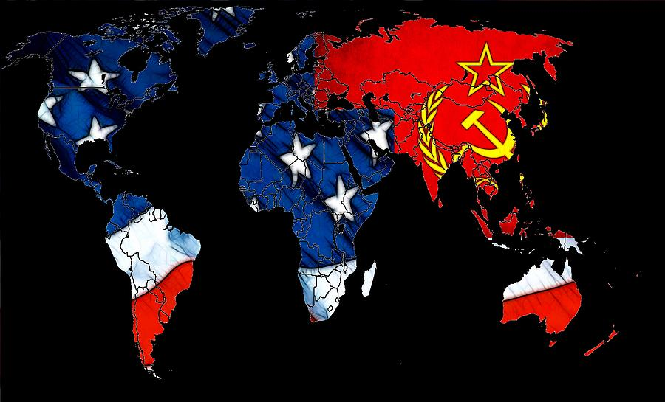
Period 8: 1945-1980
Redefining Democracy in the Era of the Cold War and Liberal Ascendency

Slide 2
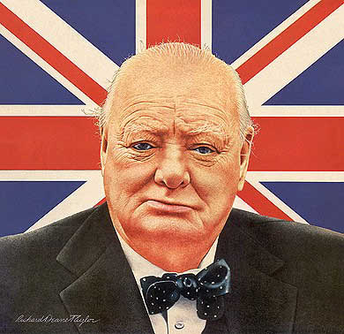
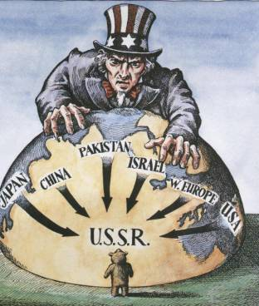
Containment
Winston Churchill warned that Soviet aggression was tightening its grip on Europe.
He stated that an iron curtain had descended across Europe.
Churchill and Truman shared the same political views on the Soviet Union.
containment: policy of the United States to halt any further expansion of Communism.

Slide 3
Origins of the Cold War
The use of the atomic bomb at the end a World War II sent a strong message to the rest of the world. This new weapon would give the United States the title of superpower.
After the war the relationship between the United States and the Soviet Union will become strained.
The two countries will compete around the world for
resources, markets, prestige, and political strength for
nearly 50 years.

Slide 4
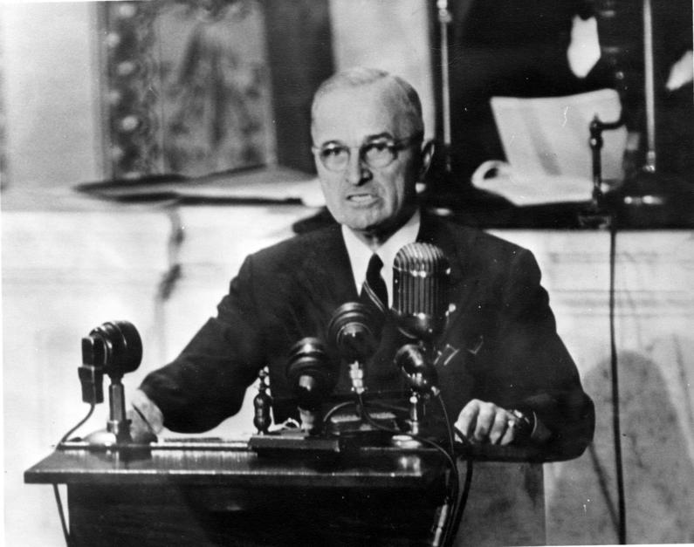
Truman Doctrine
The U. S. should support free peoples throughout the world who were resisting takeovers by armed minorities or outside pressures…
“We must assist free peoples to work out their own destinies in their own way.”- Truman

Slide 5
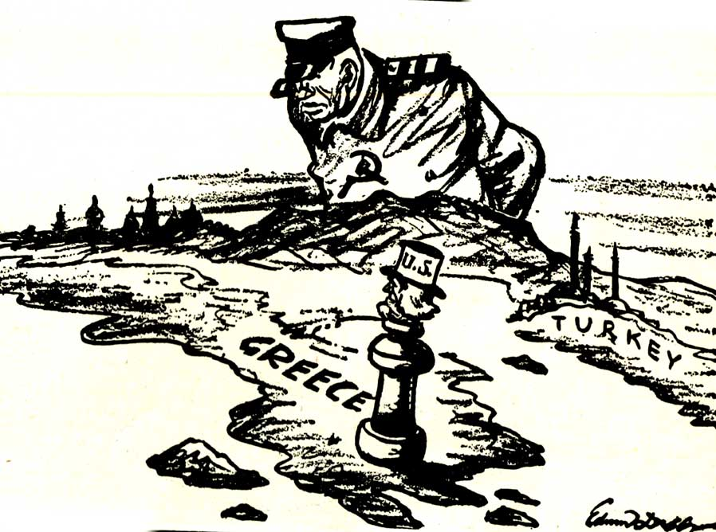
Greece and Turkey
In February 1947, the British Embassy announced to the United States that they could no longer provide financial and economic aid to Greece and Turkey.
To prevent a Communist take-over, the U.S. assumed the “responsibility” of supporting the two countries.
As stated in President Truman’s doctrine, the United States supplied Greece and Turkey with 400 million dollars for “economic and military assistance.”

Slide 6
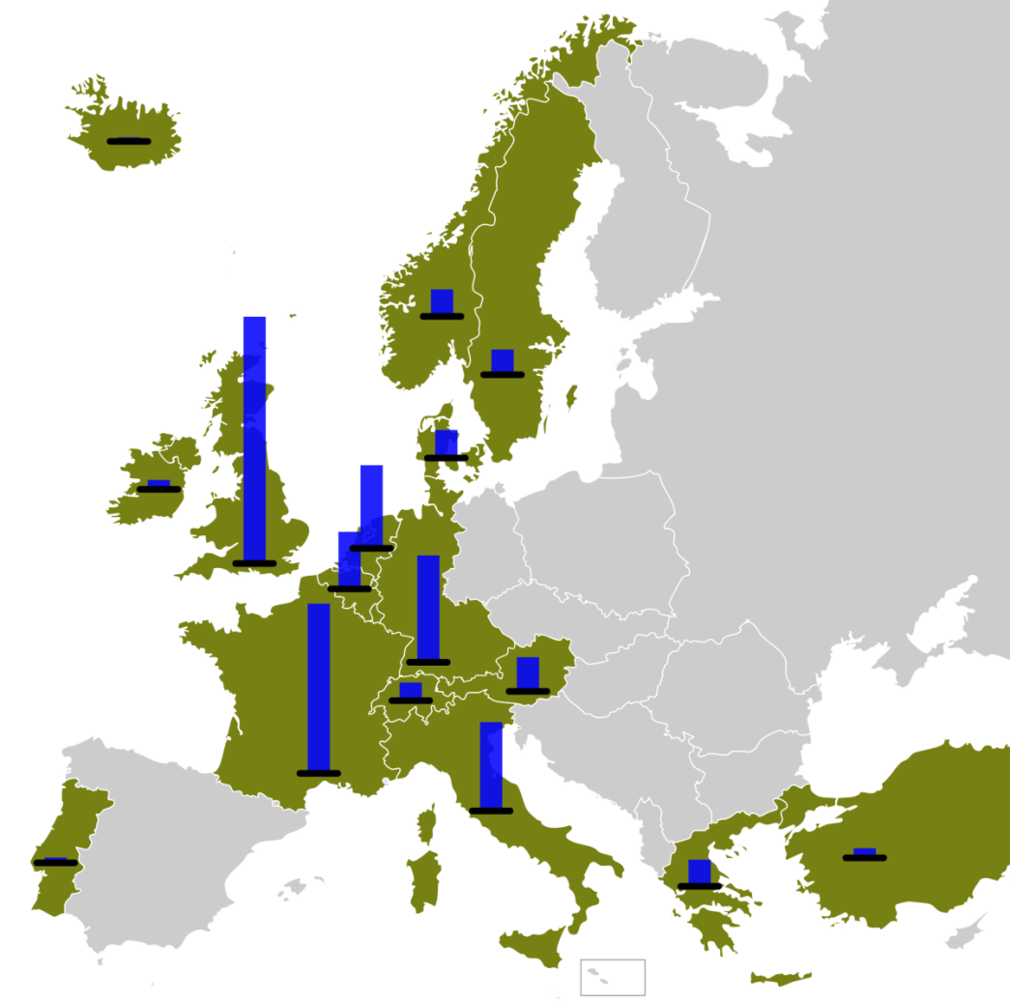
Marshall Plan
The Marshall Plan proposed a program of massive economic aid to Europe.
Most European nations had been destroyed by World
War II. The people of these nations were left hungry and in poverty.
It was widely believed that economic despair led to support of communism.
During a three year period $12 billion was sent to
16 nations throughout Western Europe.

Slide 7
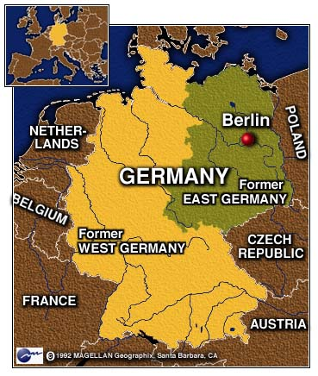
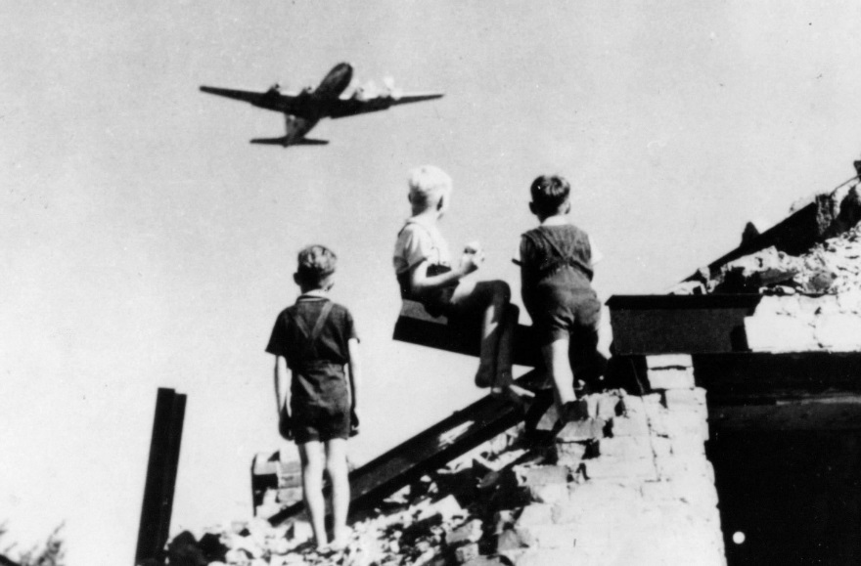
Berlin Blockade and Berlin Airlift
At the end of the war Germany was partitioned into four zones.
The Soviet Union occupied Eastern Germany and the United States, France, and Great Britain occupied Western Germany.
Berlin had also been divided. The city of Berlin is located in Eastern Germany which was controlled by the Soviet Union.

Slide 8
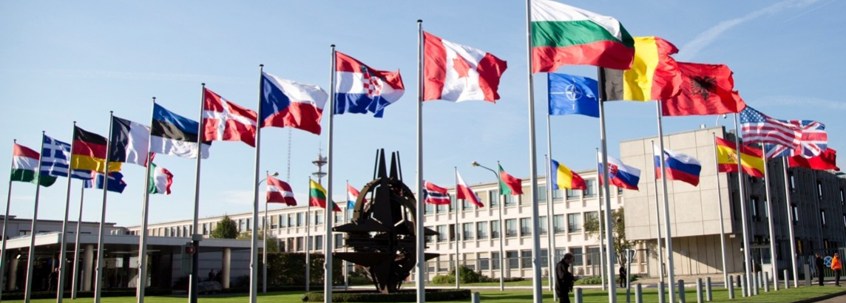
NATO
NATO (North Atlantic Treaty Organization)
The United States, Canada, Iceland, and nine European countries entered an agreement that they would defend each other in the event of an attack.
*The U.S. involvement in NATO would take some of the pressure of the Cold War off of the United States.
*Congress feared that NATO would allow the President to sent troops into battle without officially declaring war.
*Congress also feared that it would provoke an arms race with the Soviet Union.

Slide 9
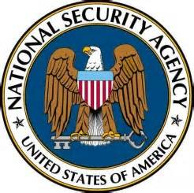
NSC-68
National Security Council Report 68 (NSC-68) was a 58-page top secret policy paper by the United States National Security Council presented to President Harry S. Truman on April 14, 1950.
It was one of the most important statements of American policy that launched the Cold War.
NSC-68 "provided the blueprint for the militarization of the Cold War from 1950 to the collapse of the Soviet Union at the beginning of the 1990s

Slide 10
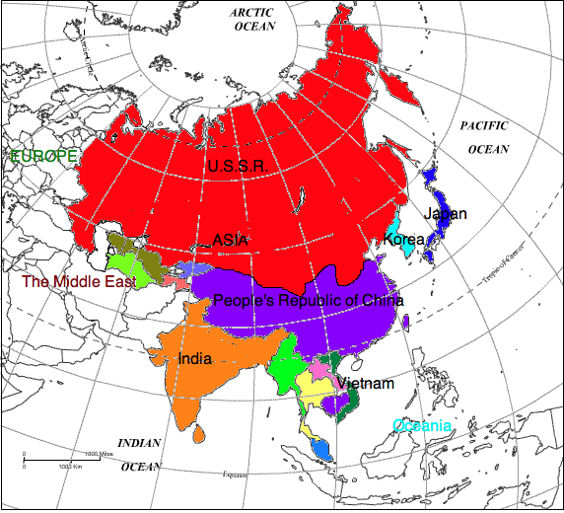
Cold War in Asia

Slide 11
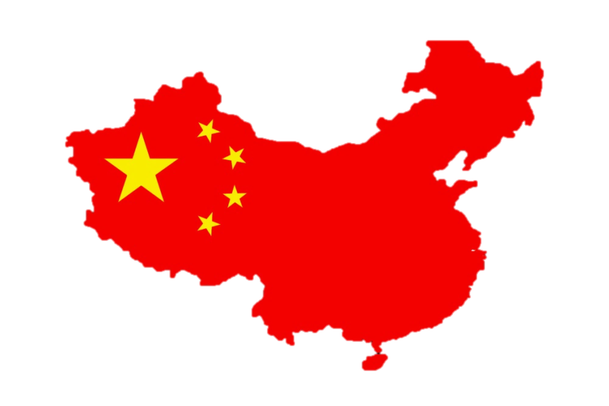
China
For two decades the Chinese Communists struggled against the Nationalist government of Chiang Kai-Shek.
Between 1945 and 1949 China received $3 billion in aid from the United States. Despite this effort the Communist movement continued to gain strength in China.
In 1949 the Communist took over led by Mao Zedong.
Chiang Kai-Shek was forced to flee to the island of
Formosa.

Slide 12
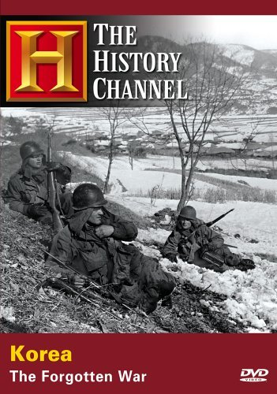
Korean War
After World War II the United States remained a strong influence in the Pacific. The U.S. had gained the right to shape the future of Japan after its defeat in the war.
Limited War: a war in which nations limit their objectives or resources.
It was decided that Korea would be divided at the 38th parallel. The Soviet Union would occupy the North and the U.S. would occupy the South.

Slide 13
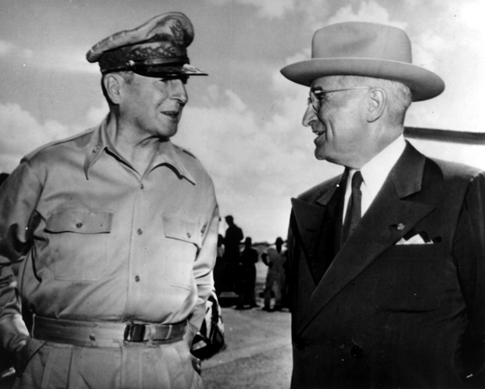
MacArthur
MacArthur insisted to Truman that the mainland of China be bombed. Truman refused. Truman called for a limited goal.
General MacArthur proceeded to heavily criticism Truman for the decision. Truman ordered that he halt his statements.
MacArthur refused and Truman fired him.

Slide 14
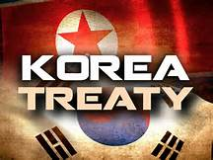
Armistice
When Eisenhower arrived in Korea he found that the war was at a stalemate.Truce talks began in 1951 but did not make much progress. There was a deadlock over the issue of prisoners of war.
*Eisenhower in an attempt to end the deadlock increased bombing raids over North Korea. He also sent a secret message to China that the United States might use a nuclear weapon.

Slide 15
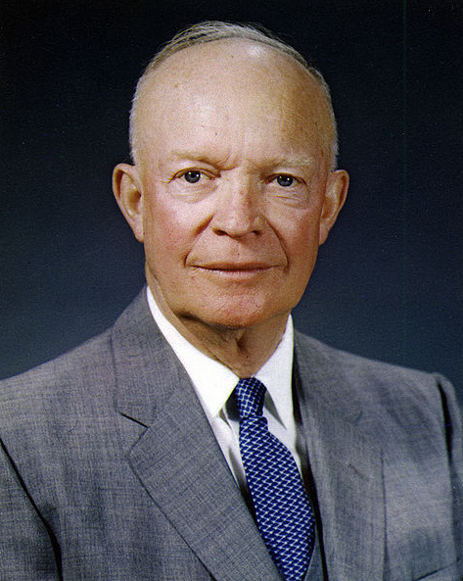
New Look
The New Look was the name given to the national security policy of the United States during the administration of President Dwight D. Eisenhower.
It reflected Eisenhower's concern for balancing the Cold War military commitments of the United States with the nation's financial resources.
The policy emphasized reliance on strategic nuclear weapons to deter potential threats, both conventional and nuclear, from the Eastern Bloc of nations headed by the Soviet Union.

Slide 16
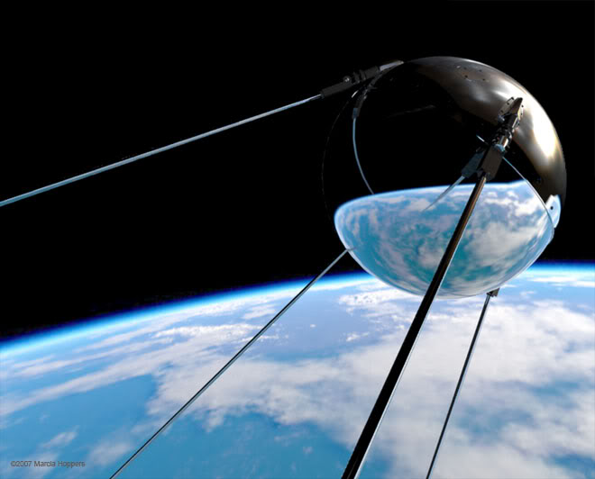
Sputnik
The Soviet Space Program was seen as more successful than the United States.
In 1957, the Soviets launched a successful satellite called Sputnik.
Sputnik was a basketball sized object.
The American people were shocked that the Soviets were able to get to space first.
National Defense Education Act

Slide 17
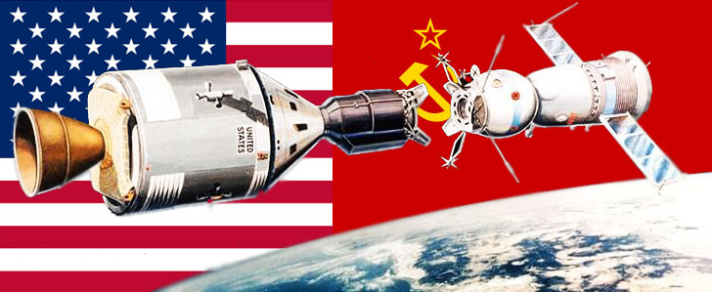
The Space Race
The Space Race was a 20th-century competition between two Cold War rivals, the Soviet Union (USSR) and the United States (US), for supremacy in spaceflight capability. It had its origins in the missile-based nuclear arms race between the two nations that occurred following World War II.

Slide 18
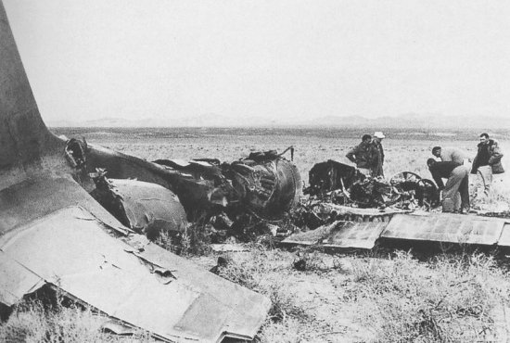
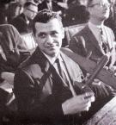
U2 Incident
In 1960 the hopes for a summit between the U.S. and Soviet Union were dashed.
Krushchev announced that an American spy plane had been shot down over Soviet territory. The U.S. had routinely flown U-2’s over the Soviet Union.
The planes would photography military movement and missile sites.
The pilot safely parachuted to the ground and was captured by the Soviets.
Krushchev angrily called off the summit conference and withdrew an earlier invitation to Eisenhower to visit the Soviet Union.

Slide 19
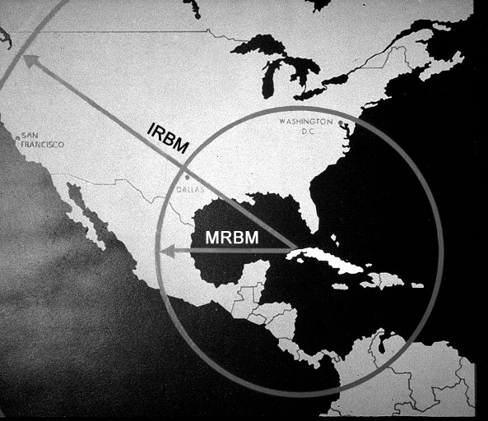
Cuban Missile Crisis
The Cuban Missile Crisis of October 1962 was a direct and dangerous confrontation between the United States and the Soviet Union during the Cold War and was the moment when the two superpowers came closest to nuclear conflict.
The Cuban missile crisis stands as a singular event during the Cold War and strengthened Kennedy’s image domestically and internationally. It also may have helped mitigate negative world opinion regarding the failed Bay of Pigs invasion.

Slide 20
War in Vietnam
The war in Vietnam resulted from the occupation of Vietnam after World War II.
The Vietnamese hoped to become an independent nation after the war but were reoccupied by the French.
After the French Indochina War Vietnam was divided into the North and South at the 17th parallel.

Slide 21
The Domino Theory
If one country falls to Communism, all the one’s around it will fall.

Slide 22
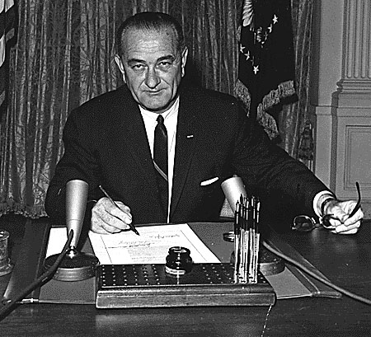
Gulf of Tonkin
Gulf of Tonkin Resolution: gave the president the authority to take all necessary measures to repel any armed attack against the United States. Johnson could send forces without a declaration of war.

Slide 23
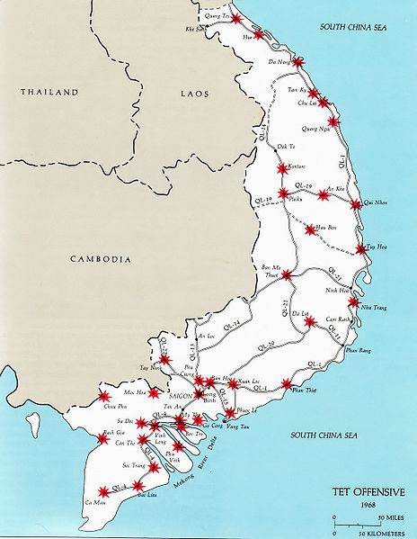
Tet Offensive
On January 31, 1968 the Vietcong invaded the U.S. embassy in Saigon.
The operation was called the Tet Offensive. Tet is the traditional Vietnamese New Year.
Despite the fact that there was a holiday ceasefire the Communists used this day to launch a major offensive.
The Communist hoped the assault would spark a popular revolt against the American-backed government.

Slide 24
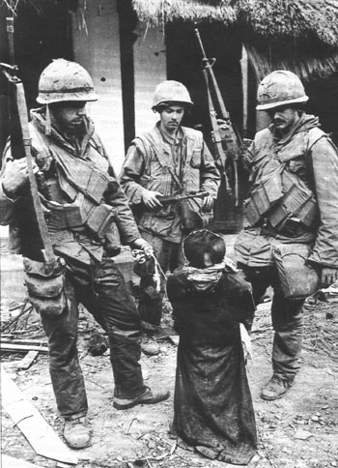
My Lai
In November 1969, journalists learned of a massacre where U.S. soldiers had killed hundreds of unarmed civilians.
The massacre was covered up.
There was no battle. U.S. troops went in looking for Vietcong.
The soldiers had recently suffered many attacks by booby traps, snipers, and land mines. They attacked the village out of the spirit of revenge.
Soldiers opened fire for several hours killing 350 innocent civilians.

Slide 25
Vietnamization
This policy involved replacing U.S. forces with South Vietnamese forces in order to begin a gradual withdrawal from the war.
The U.S. pulled out of Vietnam in 1973 and North Vietnam took over in 1975.

Slide 26
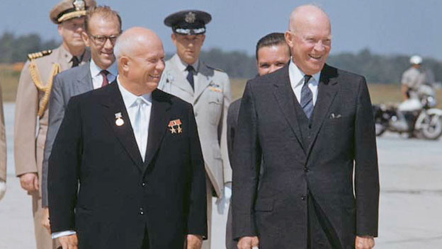
EISENHOWER
Eisenhower hoped for a warming of relations with Khrushchev and a reduction of the threat of nuclear war.
They met at Geneva and V.P. Nixon met in 1959 with the famous “kitchen debate”.
Plans were made for a summit in Paris but they were foiled by the U2 Spy plane being shot down over the Soviet Union.

Slide 27
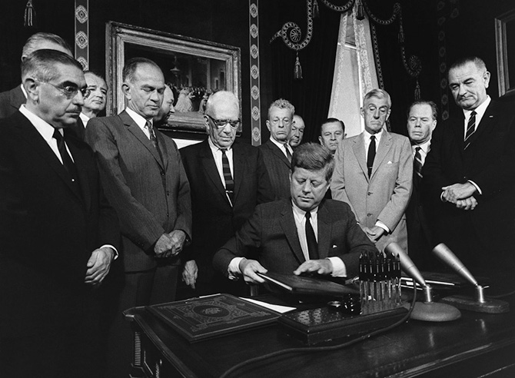
KENNEDY
Kennedy made attempts to ease tensions between the Soviet Union and U.S.
A Partial Test Ban Treaty was signed in 1963 which banned certain types of nuclear tests.

Slide 28
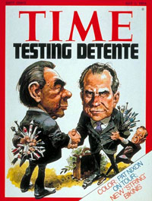
DETENTE
The term is most often used in reference to a period of general easing of the geo-political tensions between the Soviet Union and the United States which began in 1969, as a foreign policy of U.S. presidents Richard Nixon and Gerald Ford called détente; a "thawing out" or "un-freezing" at a period roughly in the middle of the Cold War.

Slide 29
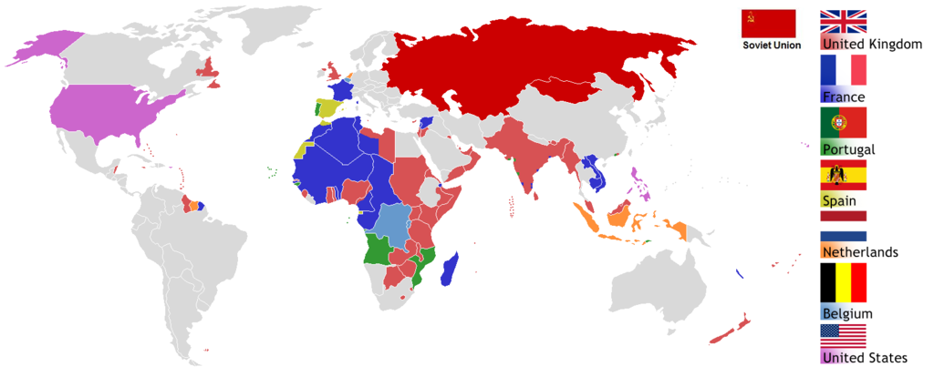
DECOLONIZATION, NATIONALISM, AND ALLEGIANCES
In the post WWII period nationalist movements developed in many colonized areas setting off a wave of decolonization efforts
Both the U.S. and Soviet Union will compete to gain the allegiance of these countries from Africa, South America, and Asia.

Slide 30
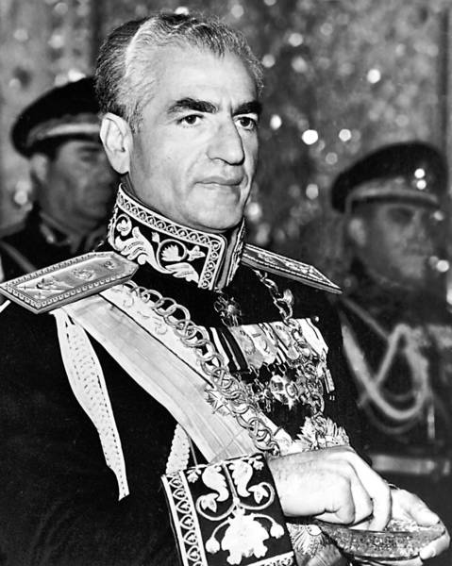
IRAN AND THE CIA
During the Cold War the U.S. was involved in a number of covert operations where they attempted to remove regimes.
In 1953, the U.S. helped to restore power to the Shah in Iran to protect oil interests.
These events came back to haunt the U.S. in 1979.

Slide 31
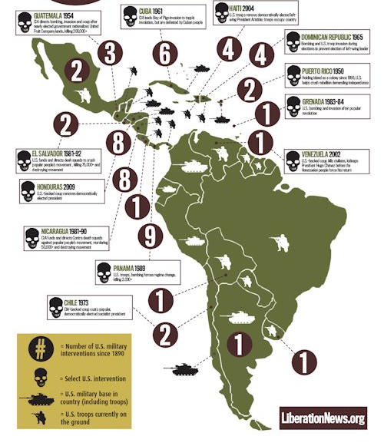
LATIN AMERICA
During the Cold War the U.S. sought to protect countries in Latin America from Communism by re-instating the Monroe Doctrine and trying to keep up with their policy of containment.

Slide 32
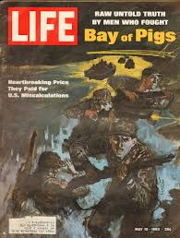
CUBA
Cuba became a hotspot in 1959 when Fidel Castro took power.
In 1961, the failed attempt at an overthrow of Cast took place with the Bay of Pigs invasion.

Slide 33
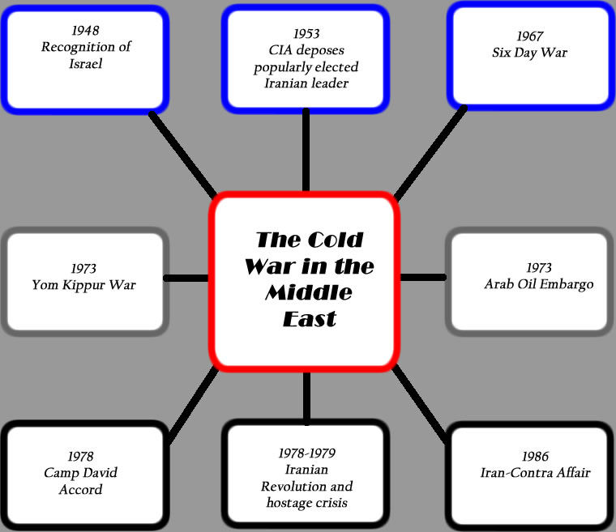
THE MIDDLE EAST
The U.S. policy in the Middle East was driven by political ideology and economics because of the trade of oil.

Slide 34
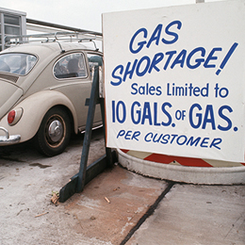
THE ENERGY CRISIS
The 1973 oil crisis began in October 1973 when the members of the Organization of Arab Petroleum Exporting Countries proclaimed an oil embargo.
The embargo occurred in response to United States' support for Israel during the Yom Kippur War. By the end of the embargo in March 1974, the price of oil had risen from US$3 per barrel to nearly $12 globally; US prices were significantly higher.
The embargo caused an oil crisis, or "shock", with many short- and long-term effects on global politics and the global economy. It was later called the "first oil shock", followed by the 1979 oil crisis, termed the "second oil shock."

Slide 35
NATIONAL ENERGY POLICY
In 1977, President Carter created the Department of Energy as a Cabinet level position.
This department encouraged conservation habits like turning down thermostats, turning off lights, and carpooling.
Looking into solar power and alternative energy was encouraged.

Slide 36
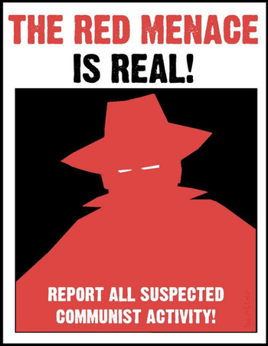
CONTAINMENT/RED SCARE
Americans began to debate the increasingly aggressive methods of the federal and state governments in terms of identifying and applying sanctions to suspected Communists.

Slide 37
TAFT-HARTLEY ACT
This is a United States federal law that restricts the activities and power of labor unions.
The act, still effective, was sponsored by Senator Robert A. Taft and Representative Fred A. Hartley, Jr., and became law by overcoming U.S. President Harry S. Truman's veto.

Slide 38
MCCARRAN SECURITY ACT
The Immigration and Nationality Act of 1952, also known as the McCarran–Walter Act, restricted immigration into the U.S. and is codified under.
The Act governs primarily immigration to and citizenship in the United States.
The Act abolished racial restrictions found in United States immigration and naturalization statutes going back to the Naturalization Act of 1790. The 1952 Act retained a quota system for nationalities and regions. Eventually, the Act established a preference system which determined which ethnic groups were desirable immigrants and placed great importance on labor qualifications.

Slide 39
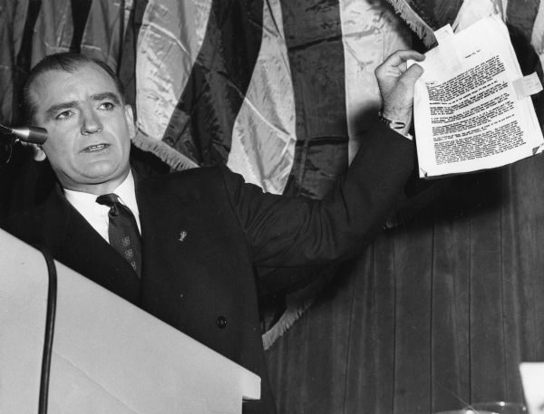
JOSESPH MCCARTHY
McCarthy became the most visible public face of a period in which Cold War tensions fueled fears of widespread Communist subversion.
He was noted for alleging large numbers of Communists and Soviet spies and sympathizers inside the federal government and elsewhere. Ultimately, the controversy he generated led him to be censured by the U.S. Senate.
The term "McCarthyism", coined in 1950 in reference to McCarthy's practices

Slide 40
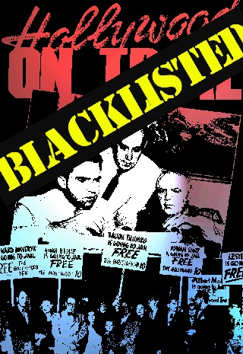
HOLLYWOOD
The Hollywood blacklist—as the broader entertainment industry blacklist is generally known—was the practice of denying employment to screenwriters, actors, directors, musicians, and other American entertainment professionals during the mid-20th century because they were accused of having Communist ties or sympathies

Slide 41
NUCLEAR WAR
Both the U.S. and Soviet Union invested large sums of money in the building of weapons.
The arms race resulted in a never ending threat of nuclear war.

Slide 42
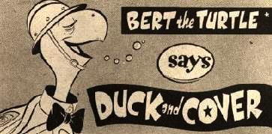
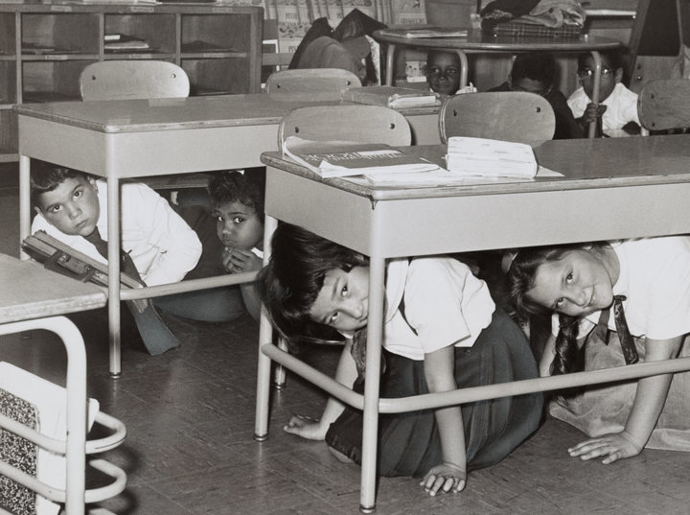
Duck and Cover
"Duck and cover" is a method of personal protection against the effects of a nuclear explosion. Ducking and covering is useful at conferring a degree of protection to personnel situated outside the radius of the nuclear fireball but still within sufficient range of the nuclear explosion.

Slide 43
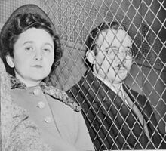
Rosenbergs
Julius and Ethel Rosenberg were United States citizens who were executed for conspiracy to commit espionage for the Soviet Union.
They were instrumental in the transmission of information about top-secret military technology and prototypes of mechanisms related to the atomic bomb, which were of value to the Soviet nuclear weapons program and also provided top-secret radar, sonar, and jet propulsion engines to the Soviet Union.

Slide 44
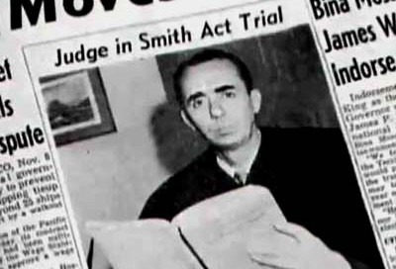
The Smith Act
The Alien Registration Act of 1940 (Smith Act), 76th United States Congress, enacted June 29, 1940, that set criminal penalties for advocating the overthrow of the U.S. government and required all non-citizen adult residents to register with the government.
Approximately 215 people were indicted under the legislation, including alleged communists, anarchists, and fascists.
Prosecutions under the Smith Act continued until a series of United States Supreme Court decisions in 1957 reversed a number of convictions under the Act as unconstitutional. The statute has been amended several times.

Slide 45
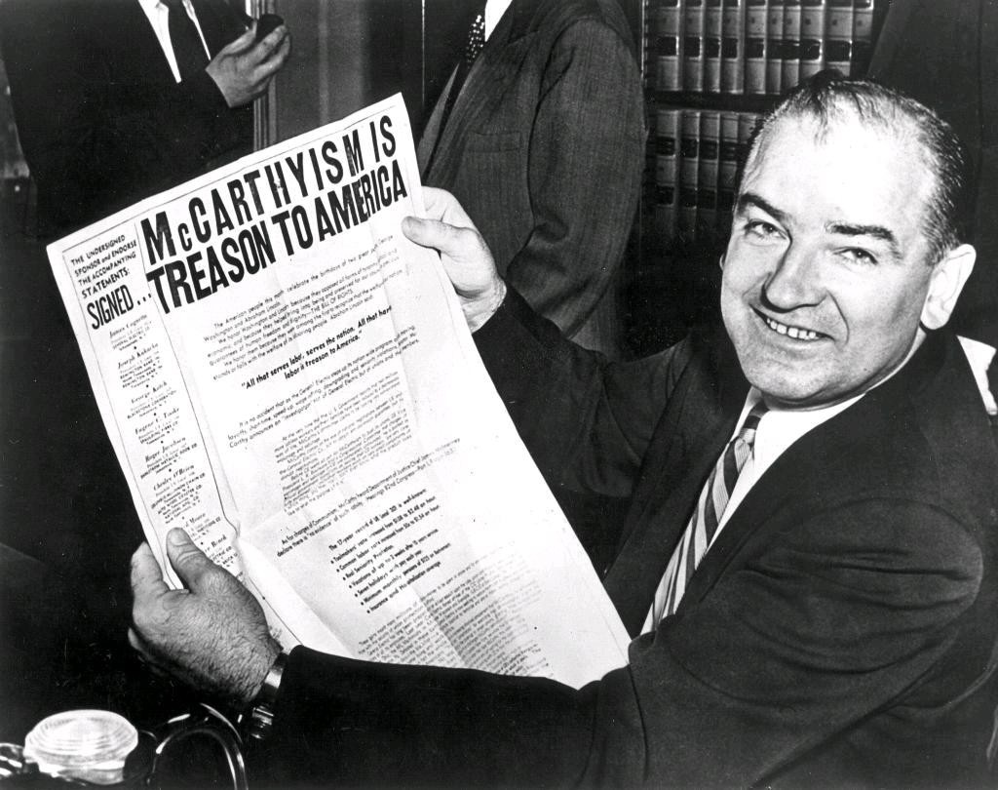
Fall of McCarthyism
McCarthyism is the practice of making accusations of subversion or treason without proper regard for evidence.
In the mid- and late 1950s, the attitudes and institutions of McCarthyism slowly weakened. Changing public sentiments heavily contributed to the decline of McCarthyism.
Its decline may also be charted through a series of court decisions.

Slide 46
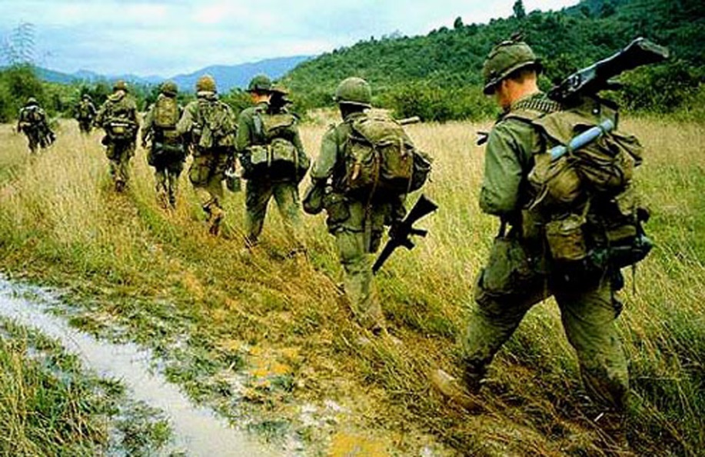
Vietnam
During the 1950’s the U.S. sent advisors to Vietnam to keep an eye on the weakening democracy in the South.
By 1964 we were sending combat troops and becoming involved in a quagmire.
Quagmire: unwinnable war.

Slide 47
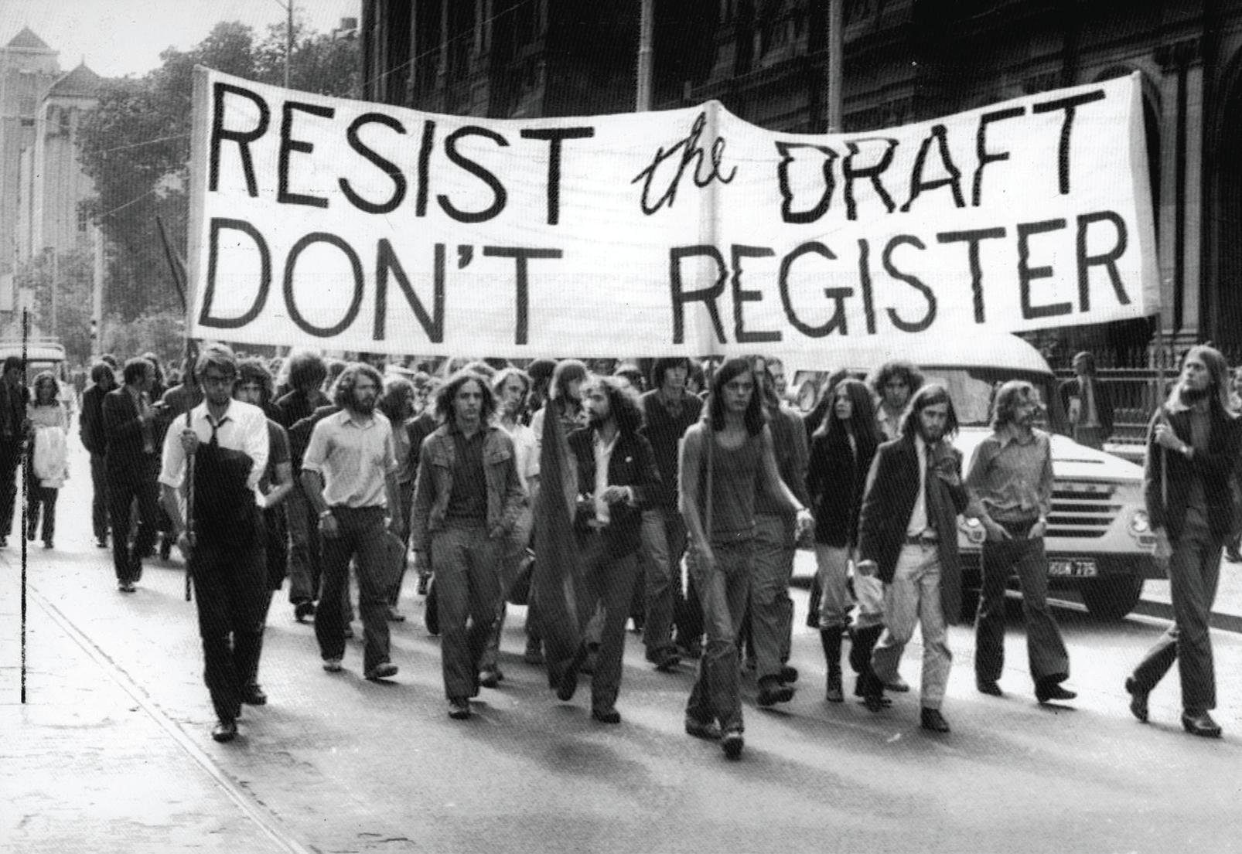
The Draft
In 1964 the Selective Service started to draft young men to serve in the armed forces.
The draft resulted in many people participating in the anti-war movement.

Slide 48
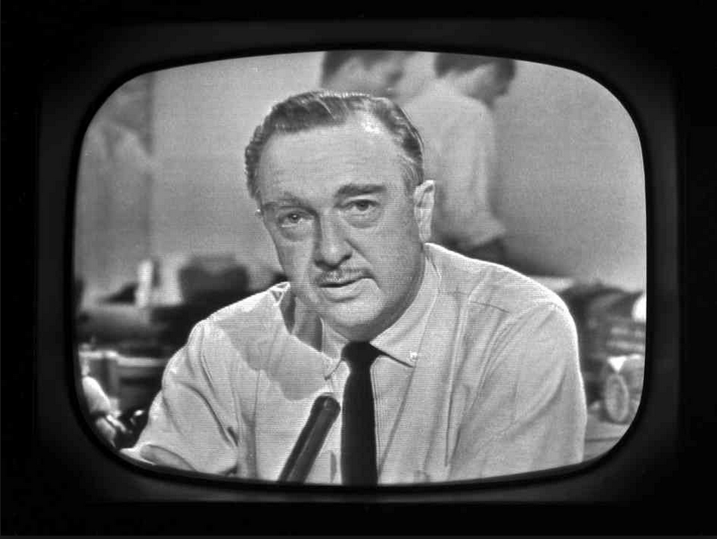
Living Room War
This was the first war in which the vast majority of Americans owned a television.
People could see daily updates and coverage of the war on a daily basis in their living room.
This influx of information led to more opposition of the war.

Slide 49
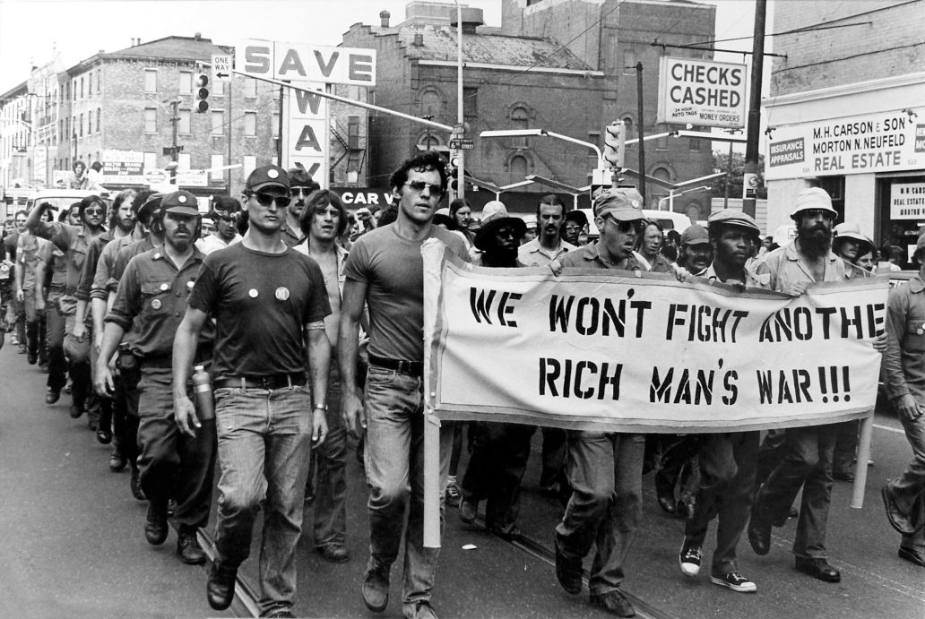
Working-Class War
The Vietnam War was considered a working class war because 80% of the troops were working class and poor.
The Middle Class often obtained deferments because of college or had connections to avoid the draft.

Slide 50
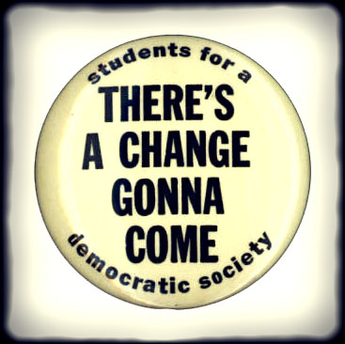
Anti-War Movement
The anti-war movement grew as peace groups questions the purpose of the war.
Students for a Democratic Society or SDS was formed to protest the war. Protests were common on college campuses.

Slide 51
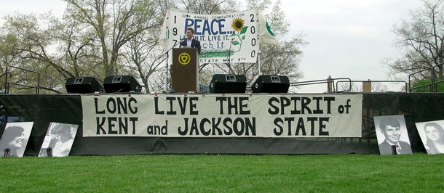
Kent State and Jackson State
Shootings took place at both Kent State University and Jackson State in response to anti-war protests.
National guardsmen shot and killed four on the campus of Kent State and two African American students were killed two weeks later on the campus of Jackson State.

Slide 52
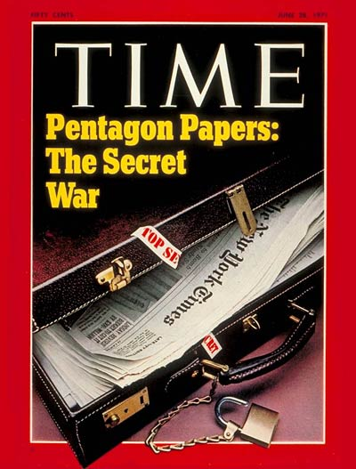
Pentagon Papers
he Pentagon Papers, officially titled "Report of the Office of the Secretary of Defense Vietnam Task Force", was commissioned by Secretary of Defense Robert McNamara in 1967. In June of 1971, small portions of the report were leaked to the press and widely distributed.

Slide 53
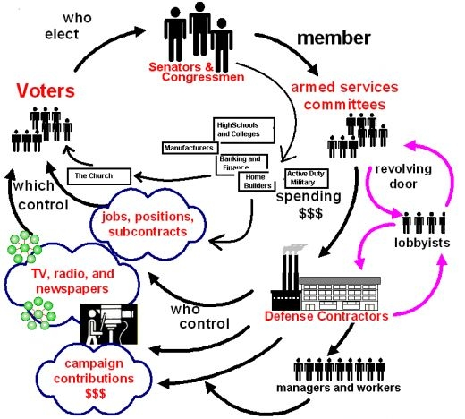
Military Industrial Complex
The Military Industrial Complex was a phrase used by outgoing President Dwight Eisenhower when warning of a close relationship between the government and its defense industry.

Slide 54
Challenging the Nuclear Policy

Slide 55
Civil Rights Movement

