Slide 1
Period 9: Political and Foreign Policy Adjustments in a Globalized World

Slide 2
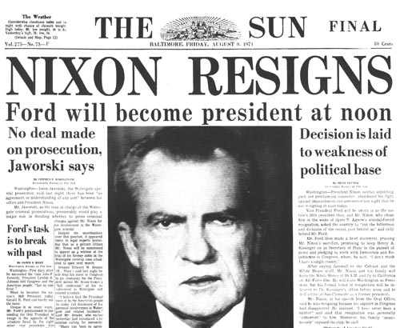
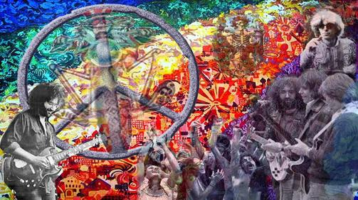
There was a decline in public trust which led to a rise in Christian conservatism. This was brought on by economic decline, political scandals, and a sense of moral decay.

Slide 3
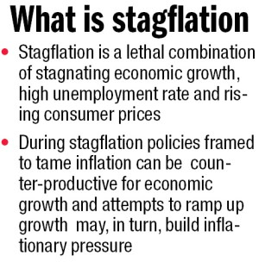
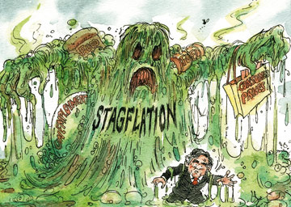
WIN: Whip Inflation Now was a program initiated by Ford to convince the American people to be more fiscally responsible.

Slide 4
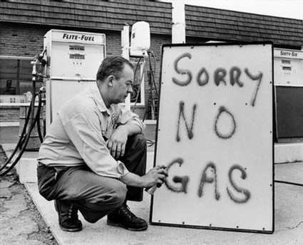
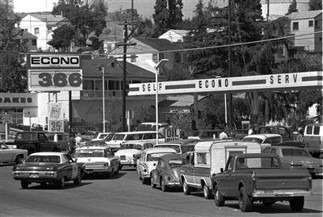
OPEC: Organization of the Petroleum Exporting Countries.
In the 1970’s fuel prices increased drastically in combination with shortages at the pumps.
There were long lines at the pumps and Americans realized there was not an infinite supply of oil.

Slide 5
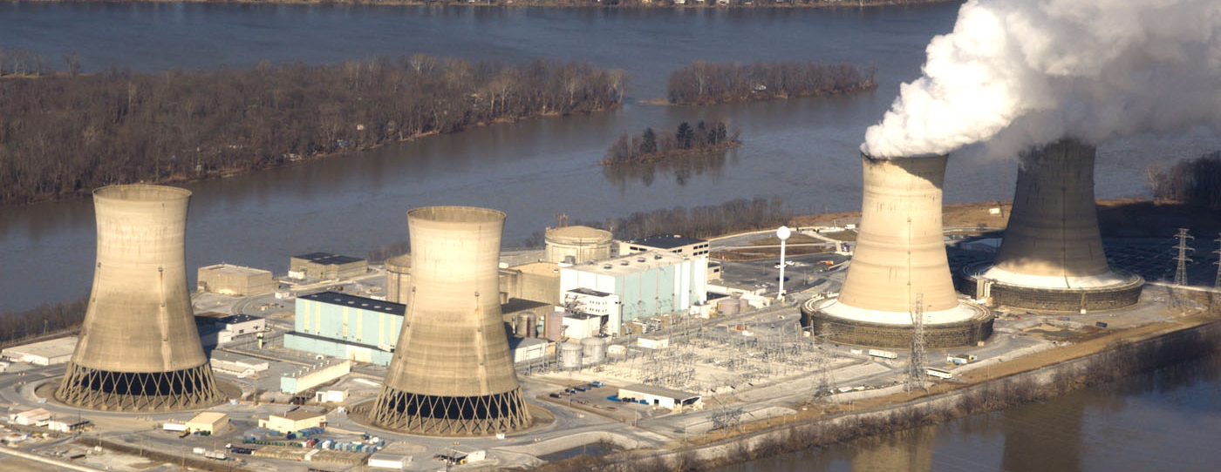
Three Mile Island
The Three Mile Island accident was a partial nuclear meltdown that occurred on March 28, 1979. The worst nuclear accident took place at Chernobyl in the Soviet Union in 1986.
These accidents raised concerns about nuclear safety and the environment.

Slide 6
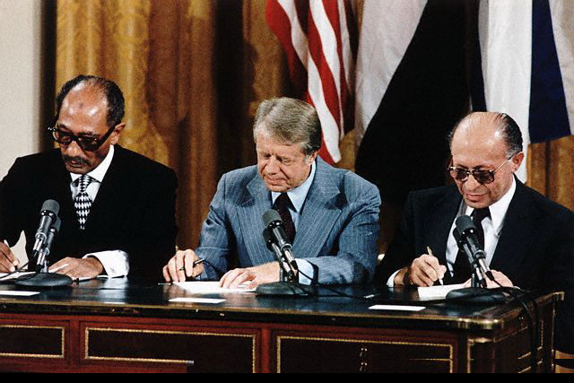
Camp David Accords
The Camp David Accords were signed by Egyptian President Anwar El Sadat and Israeli Prime Minister Menachem Begin in September 1978, following twelve days of secret negotiations at Camp David.
The two framework agreements were signed at the White House, and were witnessed by United States President Jimmy Carter. The second of these frameworks led directly to the 1979 Egypt-Israel Peace Treaty.

Slide 7
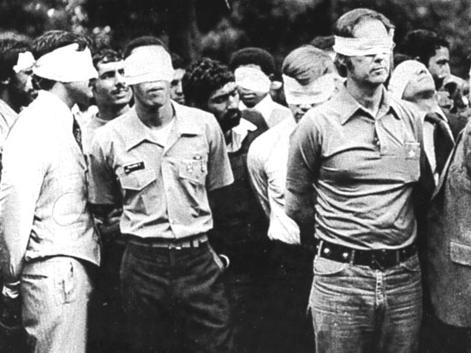
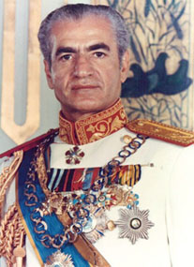
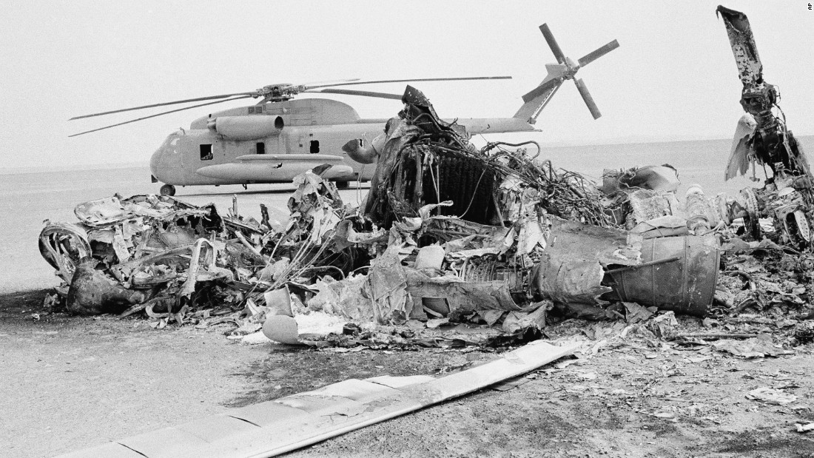
Iranian Hostage Crisis

Slide 8
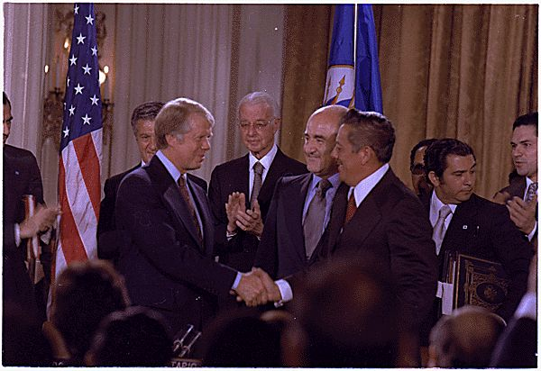
Panama 1977
Carter signed two treaties with Panama. One called for the U.S. to turn over control of the canal to Panama.
The other asserted that the canal would remain neutral.

Slide 9
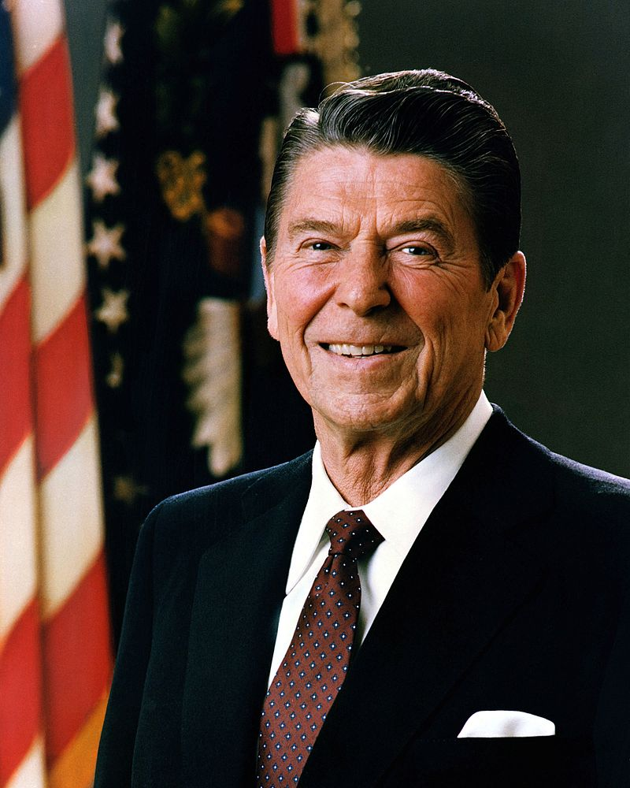
The New Right
The second New Right formed a policy approach and electoral apparatus that brought Ronald Reagan into the White House in the 1980 presidential election. The New Right was organized in the American Enterprise Institute and The Heritage Foundation to counter the liberal establishment.

Slide 10
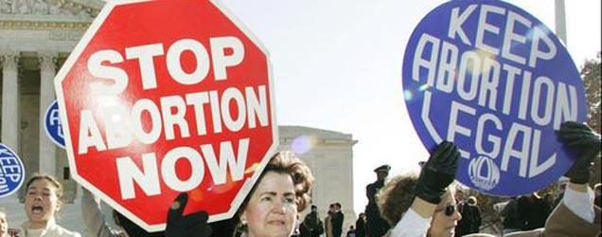
Roe v. Wade
The issue the propelled cultural conservatives was abortion. The 1973 decision united conservatives and they found their voice.

Slide 11
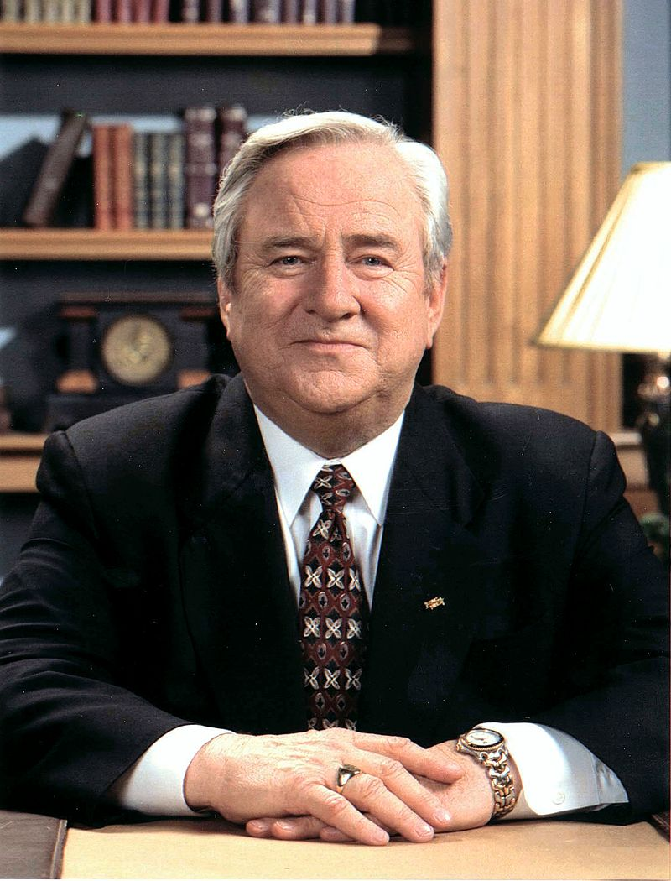
The Moral Majority
The Moral Majority was a prominent American political organization associated with the Christian right and Republican Party. It was founded in 1979 by Baptist minister Jerry Falwell and associates, and dissolved in the late 1980s.
It played a key role in the mobilization of conservative Christians as a political force and particularly in Republican presidential victories throughout the 1980s.

Slide 12
Election of Ronald Reagan
There were skeptics upon the election of Ronald Reagan due to his lack of experience and past as an actor in B movies such as “Bedtime for Bonzo”.
After becoming President of the Screen Actors Guild in the 1940’s he became increasingly interested in politics.
He was Governor of California.

Slide 13
Reaganomics
Reaganomics refers to the economic policies promoted by U.S. President Ronald Reagan during the 1980s.
These policies are commonly associated with supply-side economics, referred to as trickle-down economics or voodoo economics by political opponents, and free-market economics by political advocates.
Supply side economics is a style that argues economic growth can be most effectively created by investing in capital and by lowering barriers on the production of goods and services.

Slide 14
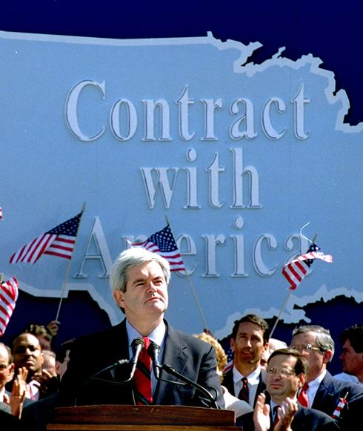
Contract with America
The Contract had promised to bring to floor debate and votes 10 bills that would implement major reform of the federal government.

Slide 15
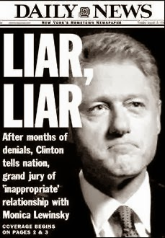
Impeachment Proceedings
The impeachment of Bill Clinton was initiated by the House of Representatives on December 19, 1998, against Bill Clinton, on two charges, one of perjury and one of obstruction of justice.
These charges stemmed from Clinton's extramarital affair with former White House Intern Monica Lewinsky and his testimony about the affair during a sexual harassment lawsuit filed against him by Paula Jones.
Clinton was subsequently acquitted of these charges by the Senate on February 12, 1999. Two other impeachment articles – a second perjury charge and a charge of abuse of power – failed in the House.

Slide 16
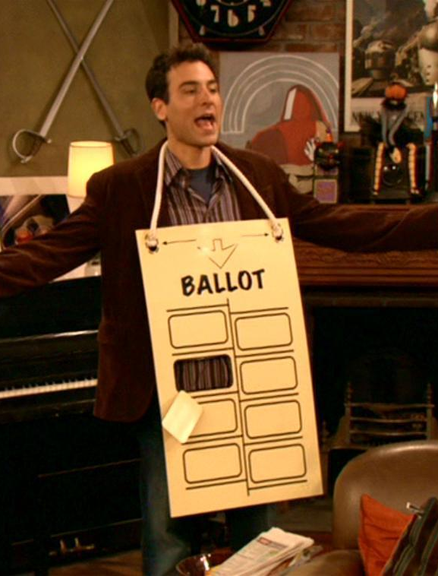
Election of 2000
This was the closest presidential election in the nation's history, with a .009% margin, 537 votes, separating the two candidates in the decisive state, Florida.
The narrow margin there triggered a mandatory machine recount the next day, after which Gore requested recounts in four counties, including populous South Florida, as permitted by law.
Litigation ensued in numerous counties in both state and federal courts, ultimately reaching the Florida Supreme Court and the United States Supreme Court.

Slide 17
No Child Left Behind
This was a U.S. Act of Congress that reauthorized the Elementary and Secondary Education Act; it included Title I provisions applying to disadvantaged students.
It supported standards-based education reform based on the premise that setting high standards and establishing measurable goals could improve individual outcomes in education.
The Act required states to develop assessments in basic skills. To receive federal school funding, states had to give these assessments to all students at select grade levels.

Slide 18
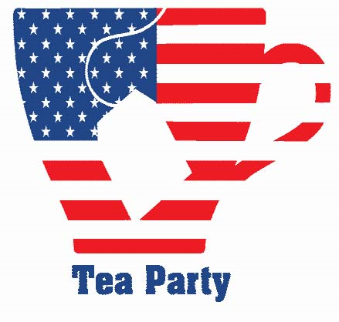
The Tea Party Movement
The Tea Party movement is an American political movement known for its conservative positions and its role in the Republican Party.
Members of the movement have called for a reduction of the U.S. national debt and federal budget deficit by reducing government spending, and for lower taxes.
The movement opposes government-sponsored universal healthcare and has been described as a mixture of libertarian, populist, and conservative activism.

Slide 19
Expansion of Medicare and Medicaid
Both Medicare and Medicaid have expanded since they were created by Lyndon Johnson during his “Great Society”.
Reagan lead an effort to protect Social Security despite his promise to end “Big Government”.
All of these programs are very expensive to operate.

Slide 20
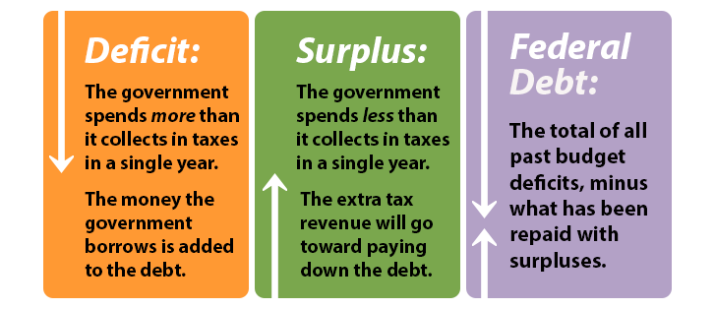
The Federal Deficit
During the Reagan Administration the combination of increased military spending with decreased taxes revenue from taxes on corporations and wealthy individuals lead to a drastic increase in the deficit.

Slide 21
Increased Military Spending
During the Reagan Administration there was a drastic increase in military spending to challenge “the evil empire”. This included the Strategic Defense Initiative that goes by the nickname “Star Wars”.

Slide 22
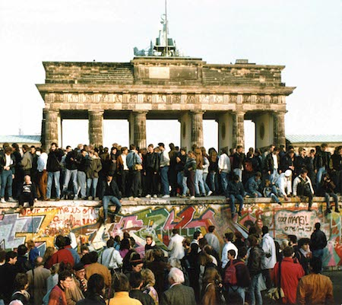
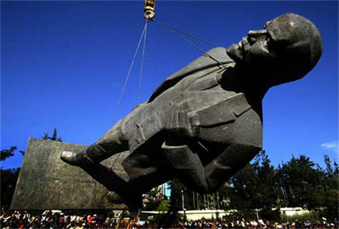
Fall of Communism
One of the most symbolic ends to the Cold War was the taking down of the Berlin Wall in 1989.
By 1991, the Soviet Union had collapsed. This collapse was brought on by too much spending on defense and shortages of food and other materials for the population.

Slide 23
The Reagan Doctrine

Slide 24
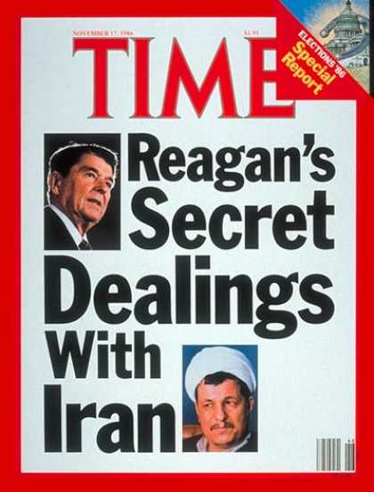
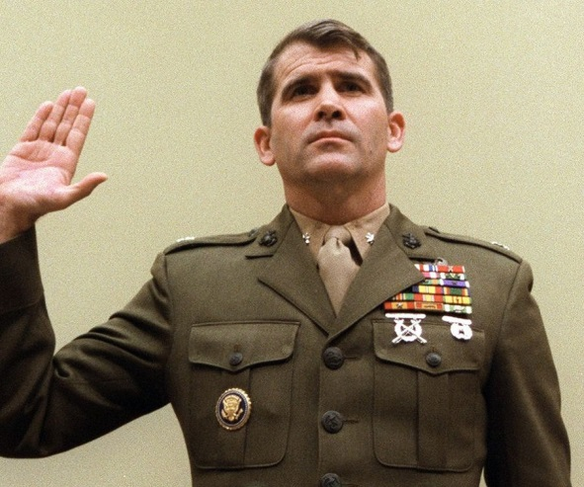
Iran Contra-Scandal
This was a political scandal in the United States that occurred during the second term of the Reagan Administration.
Senior administration officials secretly facilitated the sale of arms to Iran, which was the subject of an arms embargo.
They hoped, thereby, to fund the Contras in Nicaragua while at the same time negotiating the release of several U.S. hostages. Under the Boland Amendment, further funding of the Contras by the government had been prohibited by Congress.

Slide 25
Persian Gulf War
The Gulf War (2 August 1990 – 28 February 1991), codenamed Operation Desert Shield (2 August 1990 – 17 January 1991) for operations leading to the buildup of troops and defense of Saudi Arabia and Operation Desert Storm (17 January 1991 – 28 February 1991) in its combat phase, was a war waged by coalition forces from 35 nations led by the United States against Iraq in response to Iraq's invasion and annexation of Kuwait.

Slide 26
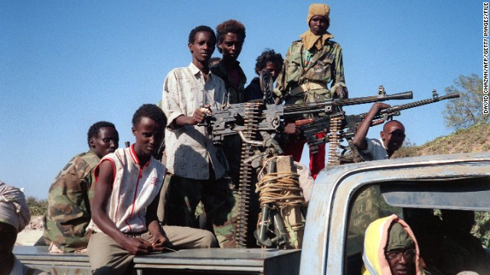
Somalia
The Battle of Mogadishu, was part of Operation Gothic Serpent and was fought from 3–4 October 1993, in Mogadishu, Somalia, between forces of the United States—supported by UNOSOM II—and Somali militiamen loyal to the self-proclaimed president-to-be Mohamed Farrah Aidid, who had support from armed civilian fighters. The battle is also referred to as the First Battle of Mogadishu, to distinguish it amongst the nine major Battles of Mogadishu during the decades long Somali Civil War.

Slide 27
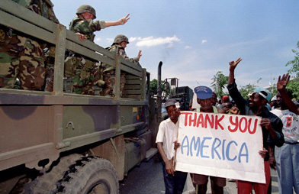
Haiti
In 2004, a revolt began in northern Haiti. The rebellion eventually reached the capital, and Aristide was forced into exile, after that the United Nations stationed peacekeepers in Haiti. Some including Aristide and his bodyguard, Franz Gabriel, stated that he was the victim of a "new coup d'état or modern kidnapping" by U.S. forces. Mrs. Aristide stated that the kidnappers wore US Special Forces uniforms, but changed into civilian clothes upon boarding the aircraft that was used to remove Aristide from Haiti

Slide 28
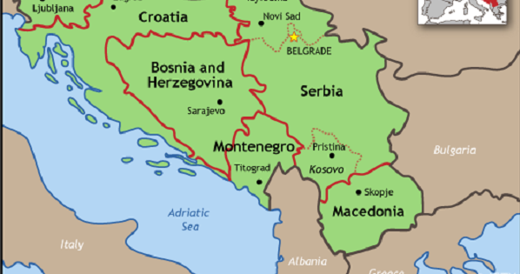
Yugoslavia
There was increasing violence in Yugoslavia under the Communist government.
Ethnic cleansing of parts of the civilian population resulted in U.S. involvement.
Refugees from Serbia were brought to the U.S.
The Dayton Peace agreement was signed in 1995 that resulted in NATO troops being sent to the area.

Slide 29
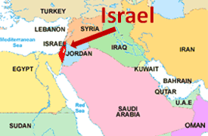
The Middle East
There were four wars between Israel and the surrounding countries between 1948 and 1973 that revolved around Israel’s right to exist.
In 2000, the growth of Israeli settlements on the West Bank led to increased tension. Clinton arranged a meeting of Arafat and Barak at Camp David to come to a resolution.
It was not resolved.

Slide 30
The Bush Doctrine
President Bush shifted American foreign policy away from it’s traditional reliance on deterrence and containment.
His policy called for preemptive strikes against nations perceived as a threat to the U.S.
The Axis of Evil consisted of Iraq, Iran, and North Korea.

Slide 31
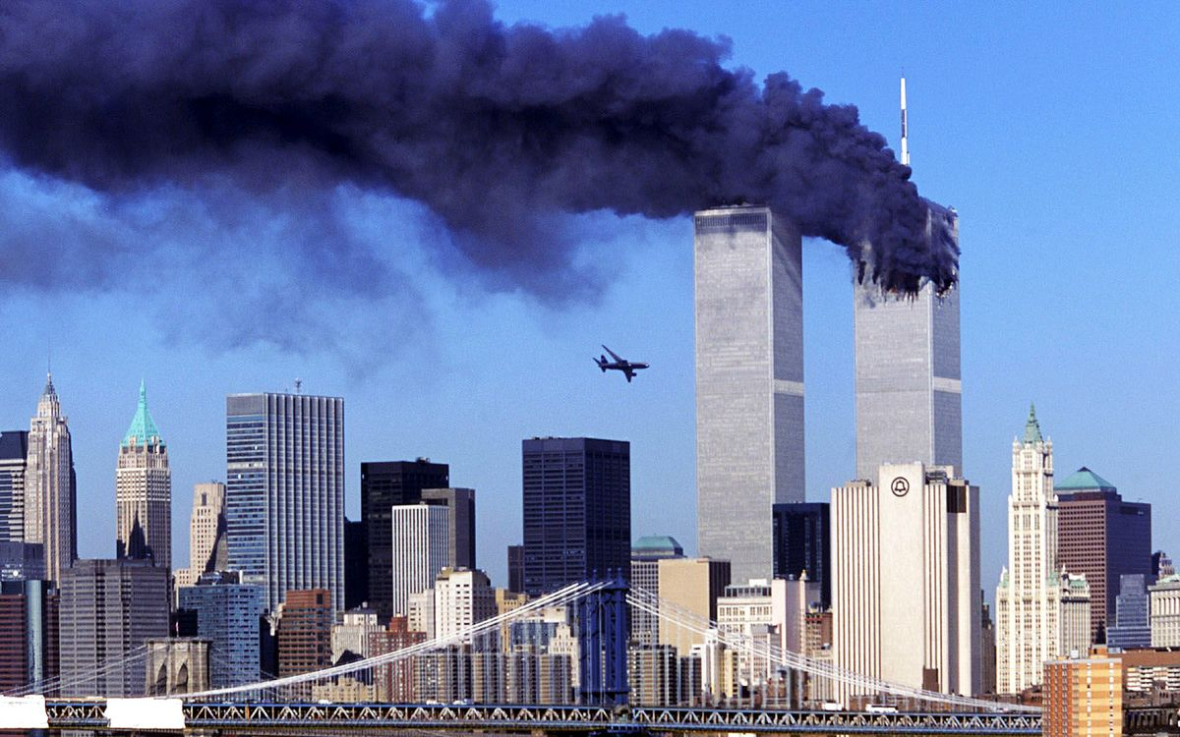
9/11
On 9/11 four planes were used as guided missiles to execute a coordinated attack on Washington and New York City.
The World Trade Center and Pentagon were hit. A fourth plane crashed in Pennsylvania.

Slide 32
The Patriot Act
Passed 45 days after 9/11 in the name of national security, the Patriot Act was the first of many changes to surveillance laws that made it easier for the government to spy on ordinary Americans by expanding the authority to monitor phone and email communications, collect bank and credit reporting records, and track the activity of innocent Americans on the Internet.
While most Americans think it was created to catch terrorists, the Patriot Act actually turns regular citizens into suspects.

Slide 33
War with Iraq
George W. Bush initiated a two front military action in Iraq and Afghanistan.
Operation Iraqi Freedom had the goal of removing Saddam Hussein from power and searching for weapons of mass destruction.
The operation in Afghanistan was to take down the Taliban led government and find Osama Bin Laden.

Slide 34
Department of Homeland Security
The creation of the Department of Homeland Security is directly related to the attacks on 9/11.
It is a cabinet level department that is responsible for protecting the U.S. from terrorists attacks and disasters.

Slide 35
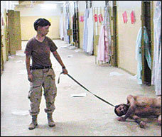
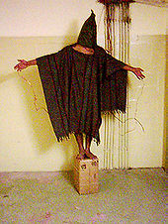
Tactic in the War on Terror
The use of “enhanced interrogation” and “waterboarding” became controversial after it was revealed that these tactics were being used on prisoners at the Abu Ghraib prison camp by U.S. Troops.
The policy of holding prisoners indefinitely without due process became a Supreme Court issue and was struck down due to violations of the Geneva Accords.

Slide 36
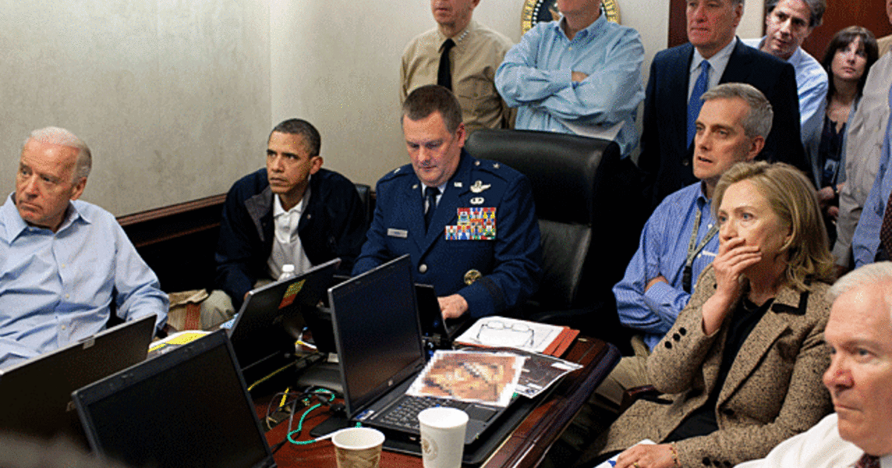
Obama and the Muslim World
Obama made a major speech in Cairo, Egypt, pledging to mend relations with the Muslim world.
He also, committed forces to finding and killing Osama Bin Laden.
He committed U.S. forces to working with Europe to oust Libyan leader Muhammar Qadaffi. Qadaffi was killed in 2011.

Slide 37
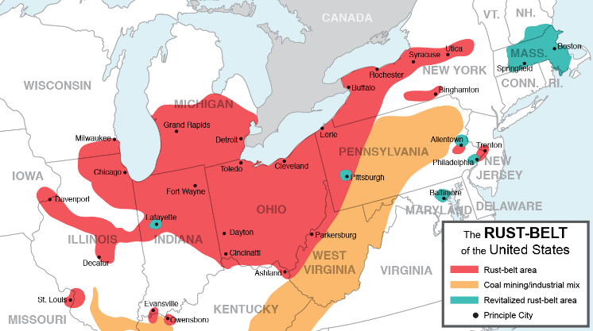
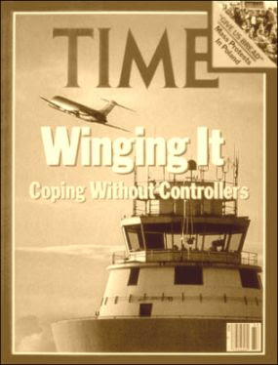
Deindustrization and Labor Unions
Deindustrization refers to large factories closing down in industrial areas such as Cleveland, Detroit, and Pittsburgh leading to the nickname “the Rust Belt”.
The decline in manufacturing jobs led to a decline in Union membership.
A turning point in the government policy towards unions occurred during the Air Traffic Controller Strike in 1981.

Slide 38
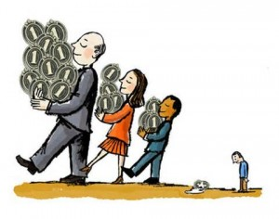
The Income Gap
Since the 1970’s the gap between the income of the very wealthy and the middle class has grown significantly.
This has resulted in an increase in debt in the middle class and poor.

Slide 39
NAFTA- North American Free Trade Agreement
NAFTA is an agreement signed by Canada, Mexico, and the United States, creating a trilateral trade bloc in North America. The agreement came into force on January 1, 1994.
Free trade supporters promised global prosperity as more nations participated in a global economy.
Opponents worried about environmental regulations and workers rights.

Slide 40
GATT

Slide 41
The Welfare System
A major change in how the welfare system works took place when Clinton shifted control over welfare from the federal level to the state level.
Workfare- a stipulation in the new reform that requires people to find work within two years.

Slide 42
Healthcare Reform
President Obama chose Health Care Reform as his first domestic initiative.
The plan had been supported for years by Ted Kennedy and Hillary Clinton.
Republicans likened the program to “socialism”.
The Affordable Care Act was challenged in several court cases.
It is in the process of being dismantled by the current administration.

Slide 43
Social Security Reform
Since the Baby Boom the concern over the collapse of Social Security has been debated by lawmakers.
The increased population collecting from the program could cause a drain on the funds causing it to collapse.
Democrats and Republicans have been arguing about how to fix it for years.

Slide 44
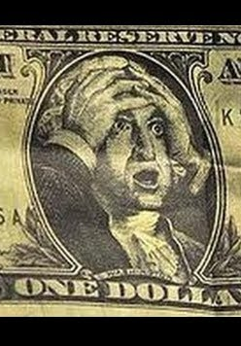
The Bailout
During the 1980’s the near collapse of the savings and loan industry caused concern. This near collapse was a result of risky investments and a downturn in the housing market.
The conditions worsened to the point that during the term of George W. Bush a massive bailout was needed by the government.
This cost the taxpayers $120 billion.

Slide 45
The Climate and Energy Policy
After the Oil Embargo in 1973, lawmakers were searching for ways to reduce America’s dependency on oil.
Since the 1980’s scientists have noted a trend towards warmer temperatures and were convinced this was from greenhouse gasses that are trapped in the atmosphere.
Much debate on the topic has existed in the U.S. over what should been done through regulation of industry.

Slide 46
Rust Belt to Sun Belt
Demographics have shifted in the U.S. from the Rust Belt to the Sun Belt.
The Sun Belt is the lower part of the U.S. where the temperatures are warmer. People are a part of the Baby Boom generation have migrated there in large numbers to enjoy their retirement.

Slide 47
Identity
In the late 20th Century and early 21st Century there has been a debate about gays and lesbians and gender roles.
The redefining of family structures and recognition of the non-traditional families has divided liberals and conservatives.

Slide 48
The Aids Crisis
AIDS was first clinically observed in 1981 in the United States. The initial cases were a cluster of injecting drug users and homosexual men with no known cause of impaired immunity who showed symptoms of Pneumocystis carinii pneumonia (PCP), a rare opportunistic infection that was known to occur in people with very compromised immune systems.
Aids epidemics swept through gay communities in New York City, San Francisco, Los Angeles and elsewhere.

Slide 49
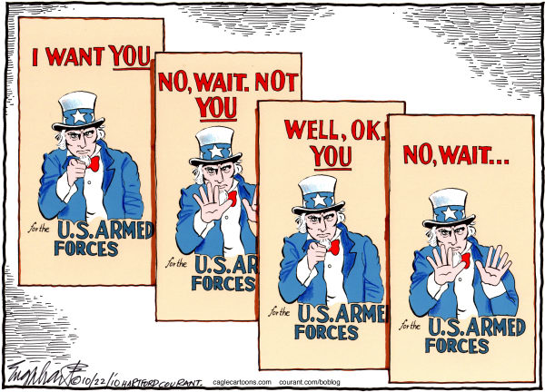
Don’t Ask Don’t Tell
The armed forces have historically discriminated against gays serving in the military.
In 1994, the military initiated a new policy that allowed gays and lesbians to serve as long as they remained closeted.
The policy was repealed by Obama in 2011.

