Slide 1
ONE-PAGER

Slide 2
What is a One Pager?
A one-pager is a single response to the reading of your textbook or given unit of study.
It is a way of making your own creative and experimental pattern of understanding of what you have read.
It is a valuable way to condense the information in a way that organized by you.

Slide 3
Directions:
Use one sheet white unlined printed paper, writing your name, period, and chapter assigned in the upper left hand corner.
Feel free to use colored pencils, pens, crayons, markers etc. to display your own style.
The more visually appealing, the better you will retain the information in your memory.
It has to be colored!!!

Slide 4
Format
1 Visual and 2 sentences summarizing 5 of the 6 following items
-Geographic emphasis/influence/change
-Religious beliefs/goals/change or events
-Achievements in education/the arts/music/technology
-Political changes/events of the time.
-Economic changes/ideas of the time
-Social Changes in regard to women/races/ethnic groups

Slide 5
5 Terms that are vital to the time period, given and defined.
5 people that are vital to the time period, given and described.
5 dates and events listed in chronological order, with a short explanation as to the importance of the events.

Slide 6
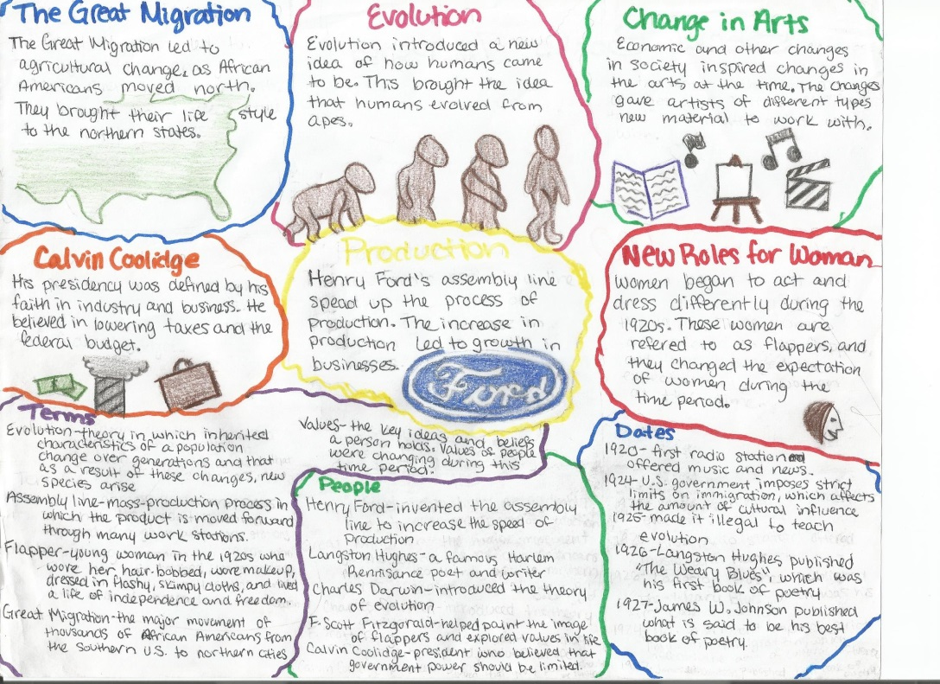

Slide 7
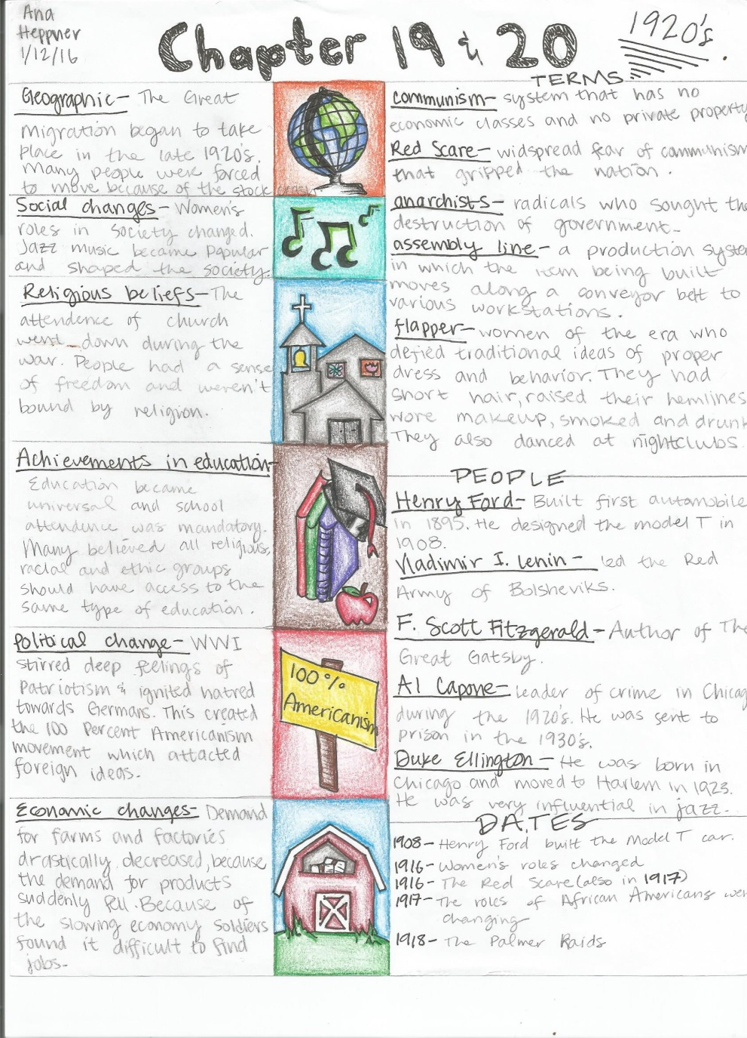

Slide 8
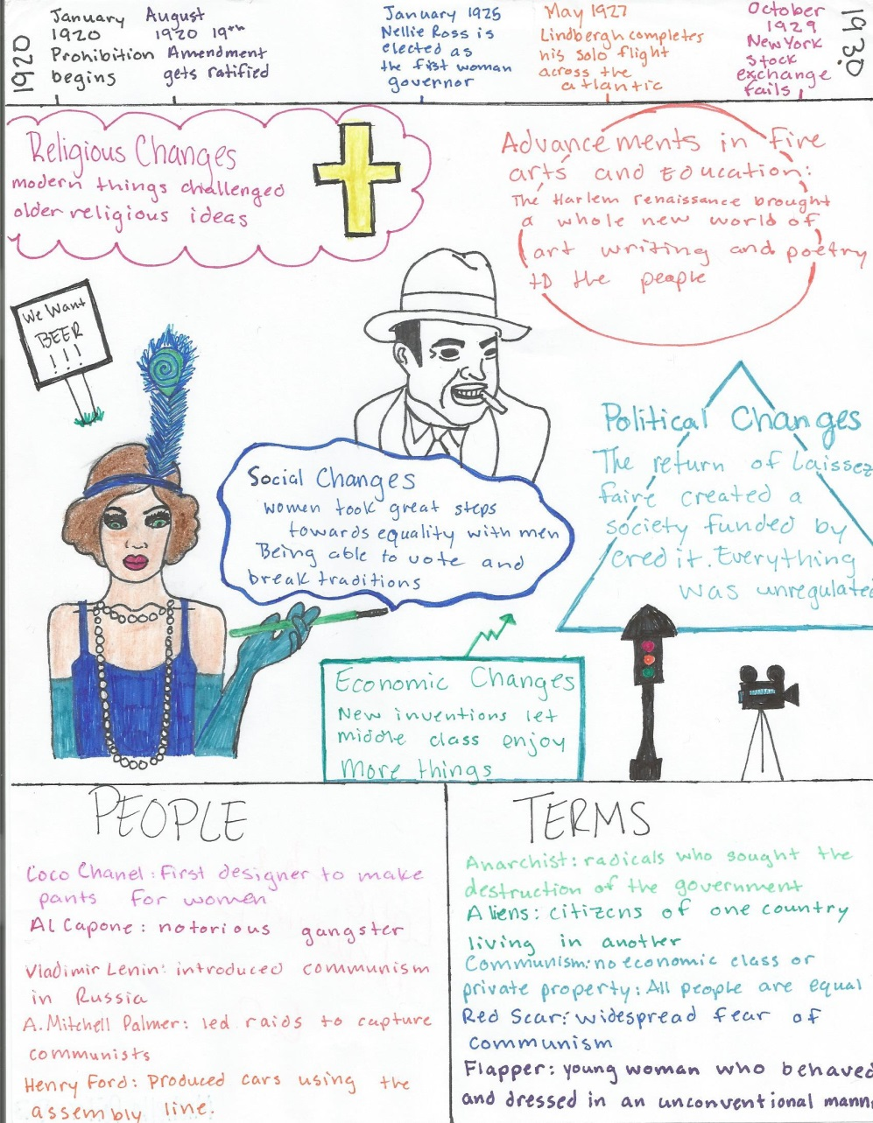

Slide 10
RUBRIC
_____ 5 Points/Appearance
____ 25 Points/Visual
____ 10 Points/Terms
____ 10 Points/People
____ 10 Points/Dates
____ 60 Points/Total

Slide 11
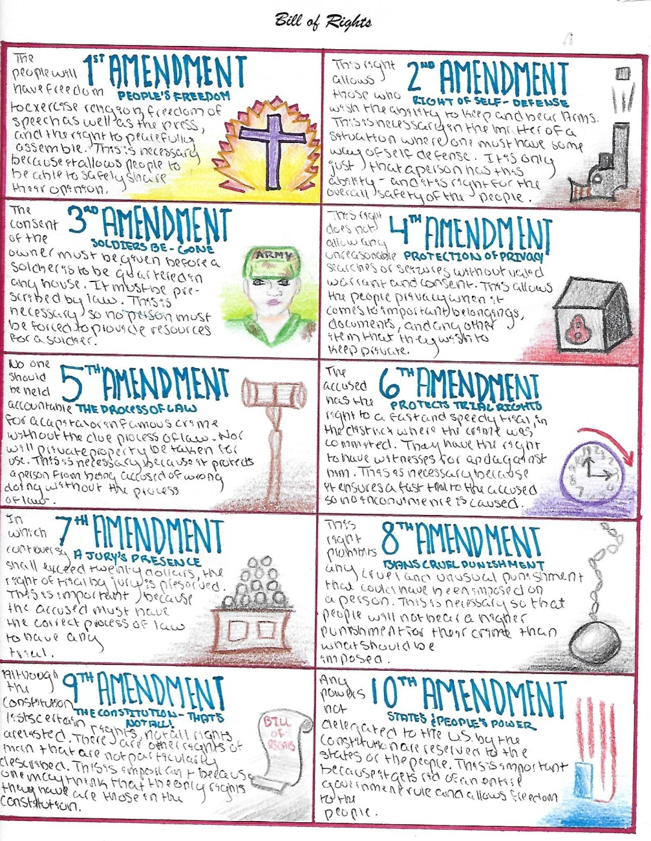
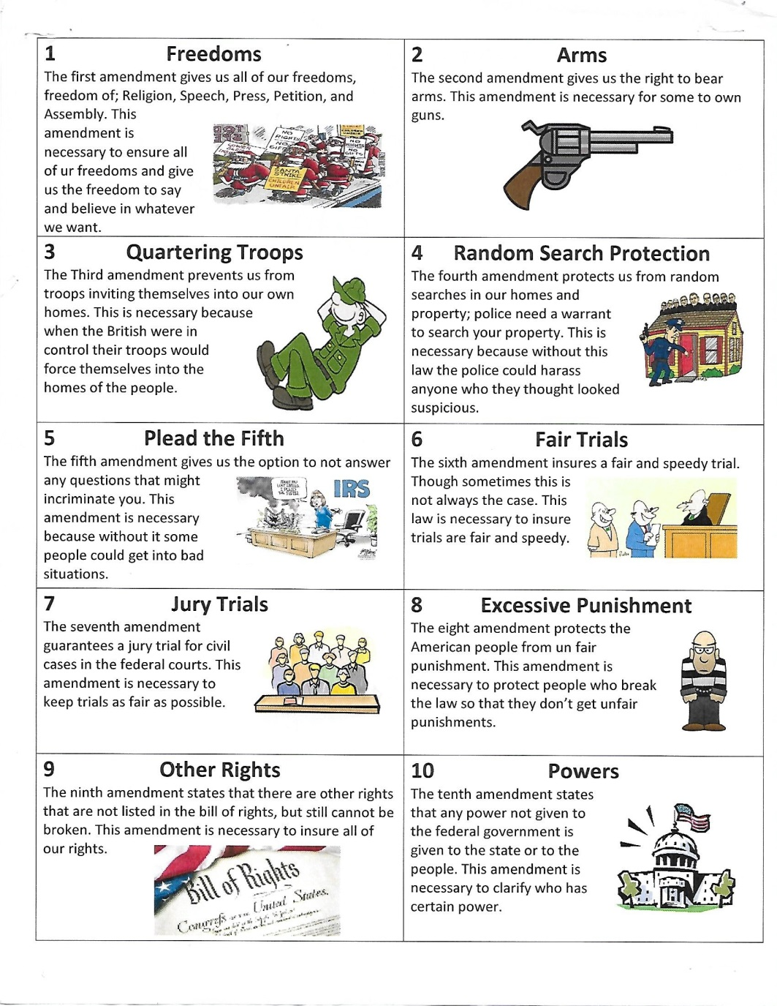
Bill of Rights- One Pager

