Slide 1
Student Financial Aid
Presented by ?? Kent State University
103 Schwartz Center
www.kent.edu/financialaid
330-672-2972

Slide 2
Critical Questions?
How do I apply for federal aid?
Am I eligible for federal aid?
Am I eligible to receive scholarships?
What will I pay?
What do I need to know about borrowing loans?
Notes:
Some critical questions you may have are…
We will answer these questions from this presentation

Slide 3
Overview
Philosophy
Application Process
Awarding Process
Types of Financial Aid
Figuring Out Your Cost
Financial Wellness
Notes:
The overview flows with the critical questions

Slide 4
Philosophy of Financial Aid
Available to all families regardless of family income or college cost.
Primary responsibility of the family to pay the educational costs to the extent that they are able.

Slide 5
APPLICATION PROCESS

Slide 6
Federal Student Aid ID
Apply for FSA ID
Both student and parent of dependent student
Password needs to be updated every 18 months
Used to sign the FAFSA electronically
fsaid.ed.gov
Notes:
Make sure it’s easy to remember. Student should be the one to create ID in case it’s forgotten can answer security questions and check emails for security code validation.

Slide 7
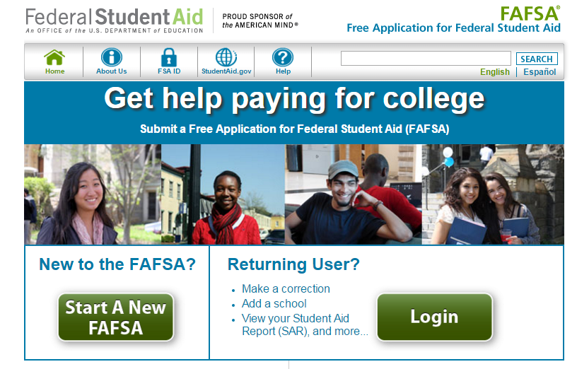
Free Application for Federal Student Aid
www.FAFSA.gov
Notes:
Free Online Federal Application to apply for federal grants, state grants and federal loans. It’s FREE. Beware of websites that ask you to pay. Must be completed to received federal aid at an institution. Must be completed online.

Slide 8
FAFSA Guidelines
Submit the FAFSA beginning January 1st
Complete the FAFSA every year
The 2016-2017 FAFSA will use 2015 federal tax information
Use IRS DATA Retrieval Tool
OK to use estimated income information
Check priority deadlines at every school you are considering. March 1 is the common date.
Notes:
Explain importance of IRS DATA Retrieval tool. Later slides will explain criteria. There will be new dates for 2017-2018 and forward

Slide 9
FAFSA Guidelines
Information Needed to Apply
Student and Parent social security numbers
Federal tax information or tax returns including W-2 information
Records of untaxed income such as:
Child support received
Interest income
Information on cash: savings and checking account balances, investments and business/farm assets
Notes:
Explain Parent info only needed if student is dependent.

Slide 10
FAFSA Worksheet
Complete as a “pre-application” to the FAFSA
Presents questions in similar order as FAFSA on the Web
DO NOT MAIL – not the actual FAFSA application
Studentaid.gov
Notes:
You can also complete the FAFSA Worksheet as a “pre-application”. The worksheet is used to help give you an insight on the questions that are on actually on the FAFSA on the Web application. Please DO NOT MAIL in the worksheet.

Slide 11
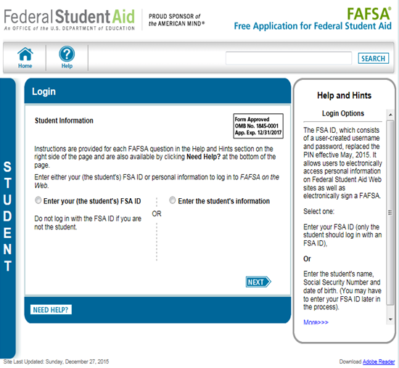
FAFSA on the Web
Must log in with student info to begin new application
“Help and Hints” box
FAFSA on the Web has 6 sections of questions
www.FAFSA.gov
Notes:
Must complete an application for each child entering college. Helps and Hints box will appear for each question.

Slide 12
FAFSA on the Web 6 Sections
Notes:
Student demo – basic information
School selection – institutions you want to receive your FAFSA
Depend. Stat – determines if stud is depend (need parent info) or independ, special circumstances – depen. Appeals.
Parent demo – basic info
Financial Info – for parent and student – income and asset information
Signing – FSA ID info submitted

Slide 13
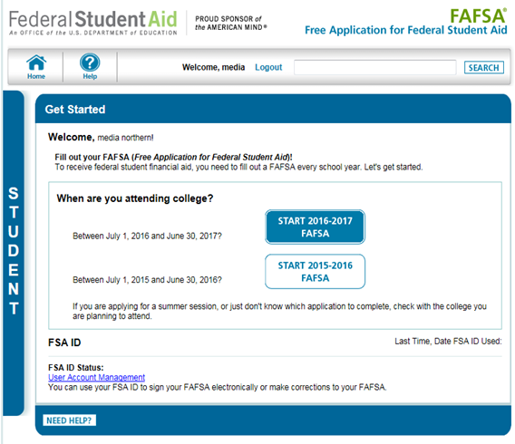
FAFSA on the Web
Select appropriate year
Notes:
Can also apply for a FSA ID at this point. The 16-17 Application will be available on January 1st.

Slide 14
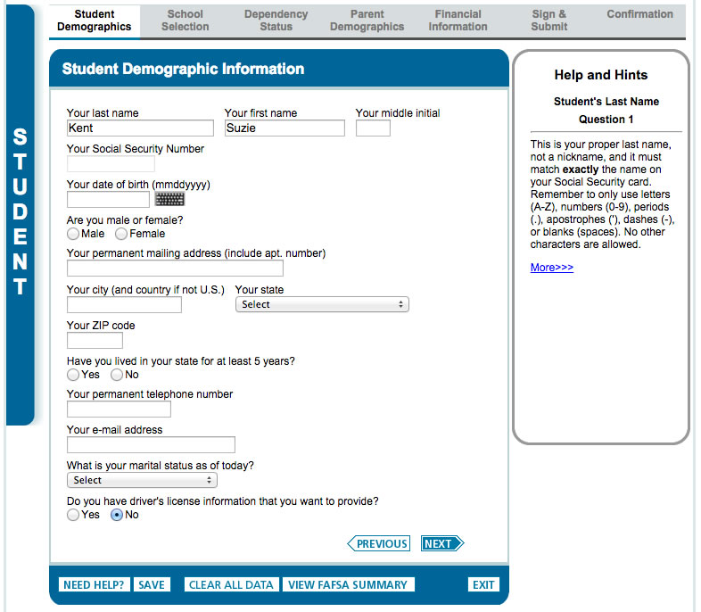
Student Demographics
Notes:
First section is Student Demographics. There are three parts to the student demographics section. This will be the same for the parent sections as well. You are required to provide your name. The Department of Education matches each name and Social Security number (SSN) with the Social Security Administration (SSA). Therefore, the name provided for this question should match exactly the name on your Social Security card. If you use a name (such as a nickname) other than the name on your Social Security card, you will be asked to correct the inconsistency, and there might be a delay in the awarding of your aid.
Martial status of student; You are required to provide your marital status as of the date the application is signed.

Slide 15
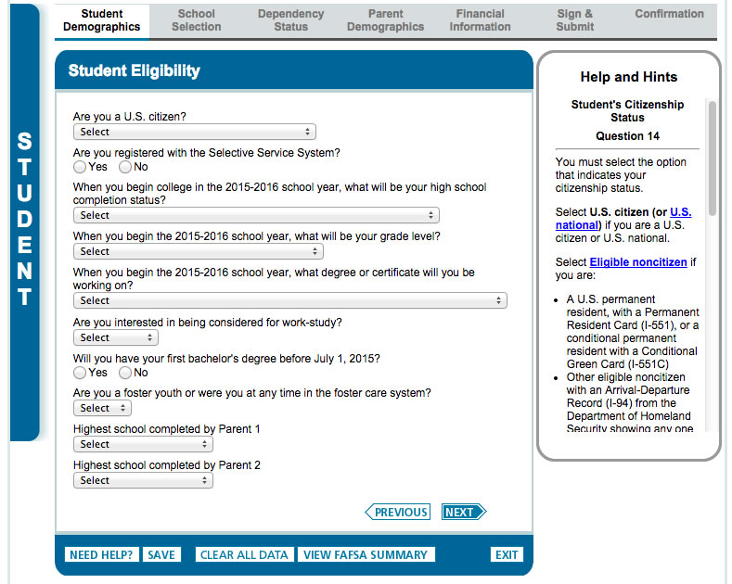
Student Demographics
Notes:
Here is part two of the Student Demographic section . Citizenship status. You are required to indicate your citizenship status. Only U.S. citizens and eligible noncitizens are eligible to receive federal student aid. For financial aid purposes, an eligible noncitizen is one of the following:
• A U.S. permanent resident who has a Permanent Resident Card (I-551 or I-151) (also known as a green card)
• A conditional permanent resident (I-551C)
• A student also may qualify as an eligible noncitizen if he or she holds a T-visa or if his or her parent holds a T-1 visa.
Selective Service registration. Males, age 18 through 25 must be registered with Selective Service to be eligible for federal student aid.
If you have not registered with Selective Service, you can answer ―Register me‖ and Selective Service will register you. You can also register on the Web at www.sss.gov.
Status when you begin college – University’s use this information to determine financial aid eligibility (i.e. loan levels)
Father’s/mother’s highest school level. Indicate your father‘s/mother‘s highest level of schooling. ―Father and ―mother in these questions mean your birth parents. Used for statistical purposes and some state and institutional programs use the information provided here to offer aid to first-generation college students.

Slide 16
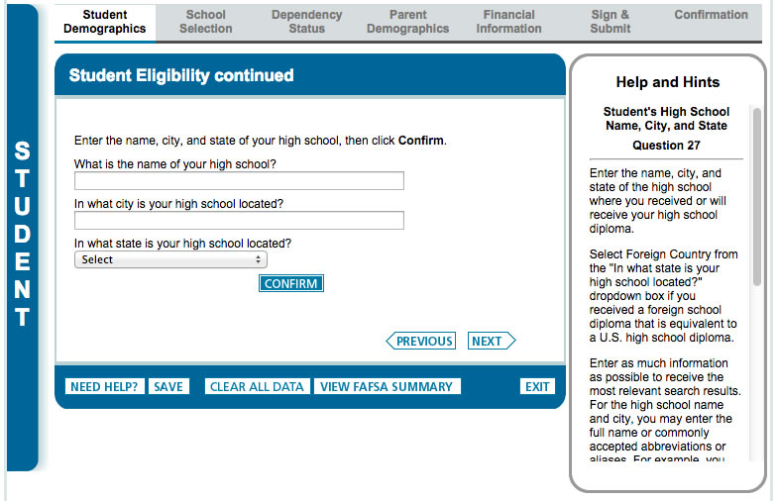
Student Demographics
High School Information
High school name, city and state must be entered if applicant indicates he/she has or will receive a high school diploma, regardless of grade level
Notes:
If left blank, will delay processing of FAFSA and awarding of aid.

Slide 17
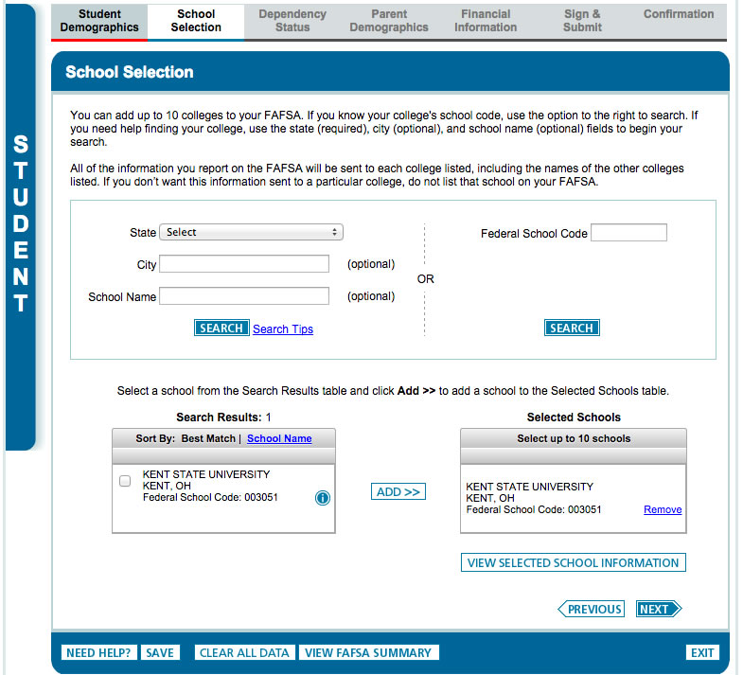
School Selection
Selected schools will receive FAFSA
Can add up to 10 schools
Can search for school codes
Notes:
2nd Section is School Selection. You will also be asked to select your housing status (living on/off campus or with parent). Your FAFSA will be electronically submitted by the Dept. of Education to every school you select.

Slide 18
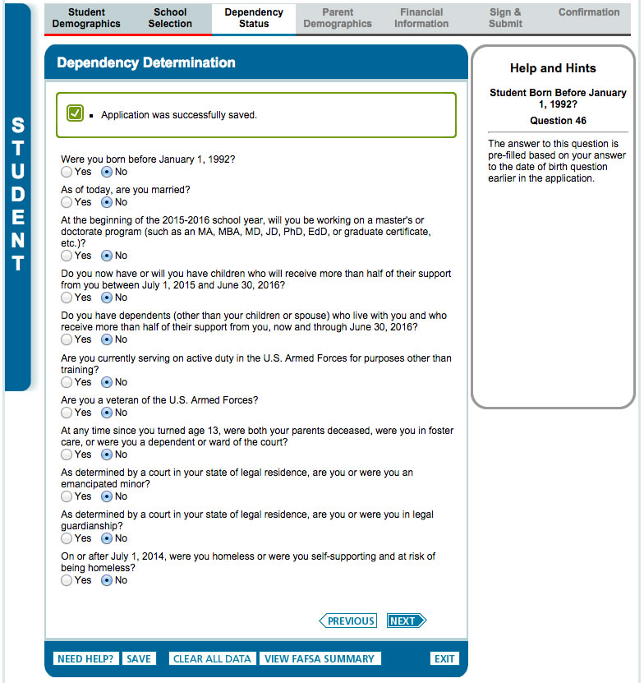
Dependency Status
Dependent vs. Independent
Dependent = “No” to all listed questions
Independent = “Yes” to one listed question
Notes:
3rd Section is Dependency Status. Explain the different between the two and that the Dept. of Ed only looks at this section to make the decision.

Slide 19
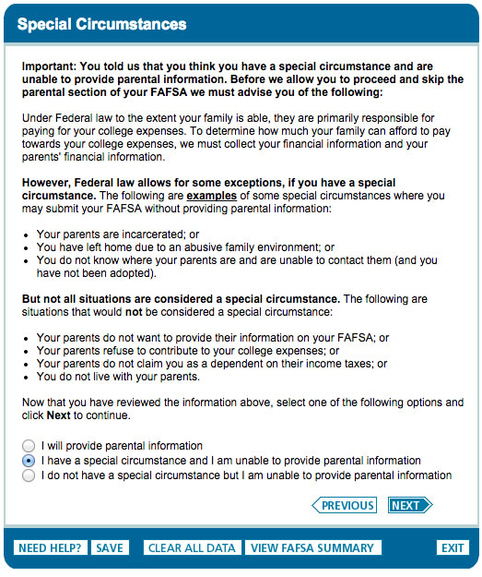
Dependency Status
Special circumstances with obtaining parental information
Must follow up with a financial aid administrator at the school you plan to attend
Notes:
This an example of a student with special circumstances.
May want to talk about Dependency Appeal option that may be available at the different schools and give different examples of extenuating circumstances. Also explain what doesn’t warrant a dependency override – self-sufficiency, parent not willing to give info, parents claimed student on taxes.
If FAFSA is submitted without parental information – will most likely be contacted by school. This will unfortunately delay FAFSA processing.

Slide 20
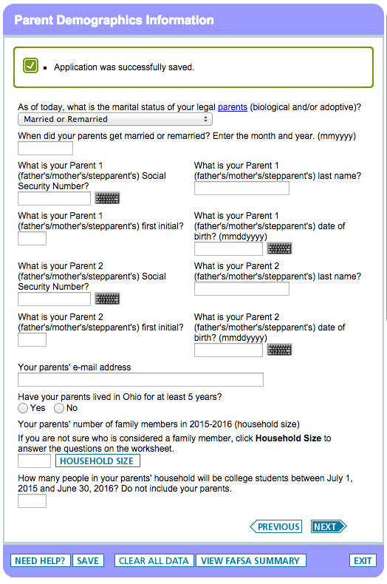
Parent Demographic
Biographical and Household information
Help and Hints box will assist you in figuring out what information to include in this section
Notes:
4th section is Parent Demographics. The term ―parent is not restricted to biological parents. Think in term of your household. Who does your student live with. An adoptive parent is treated in the same manner as a biological parent on the FAFSA.
If the student lives with both biological/adopt parents answer the following questions about them.
If biological/adopt. parents aren’t married but live together then answer the following questions about them both.
If the student lives with Parent 1 and stepparent answer the following questions about them.
If the student lives with Parent 2 and stepparent answer the following questions about them.
If biological/adopt parents are divorced or separated and the student lives with one parent answer the following questions about that one parent.
If there is a student living with grandparents or persons other than biological parents because of extenuating circumstances please see me after the presentation or contact a financial aid administrator at the selected schools.

Slide 21
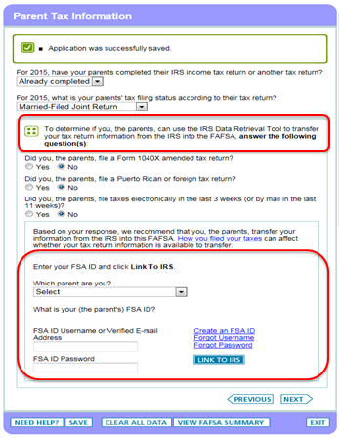
Financial Information (for Parent)
IRS Data Retrieval Tool
Available early Feb 2016
May not qualify due to: Filing status, country and date
Notes:
5th section is Financial Information – it will include questions for both parent and student. Have you completed your 2015 tax return? Those of you who indicate that they have filed their federal tax returns prior to completing their FAFSA and who are otherwise eligible will be directed to use the FAFSA-IRS Data Retrieval process to complete their FAFSA more easily and accurately. If you are completing the FAFSA prior to Feb. it’s okay to use estimated numbers. Will need to put in actual numbers when taxes are completed.

Slide 22
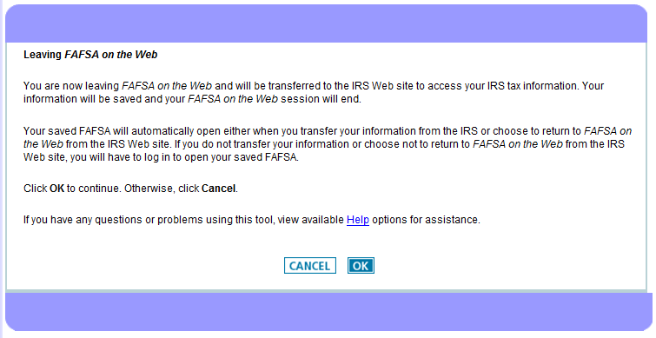
IRS Data Retrieval Tool
Notes:
This allows the FAFSA to pull in your 2015 income information right from the IRS database. Taxes will need to be filed 2 to 3 weeks prior to using the IRS Data Retrieval Tool

Slide 23
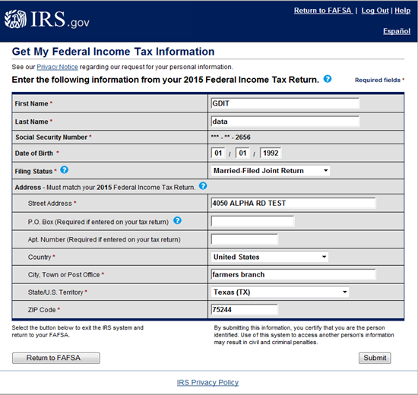
IRS Data Retrieval Tool
Notes:
The IRS pages are the same for the student and parent. If the parent and/or student are eligible to use the IRS DRT, they will follow the same process outlined in this slide. You must submit the information exactly as it is on your Federal Tax Return otherwise, the tool will not be able to link your information.

Slide 24
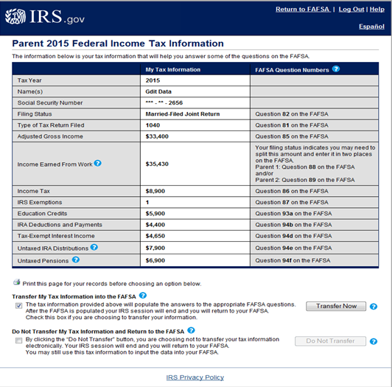
IRS Data Retrieval Tool
Notes:
It will give you the option to transfer or not to transfer.

Slide 25
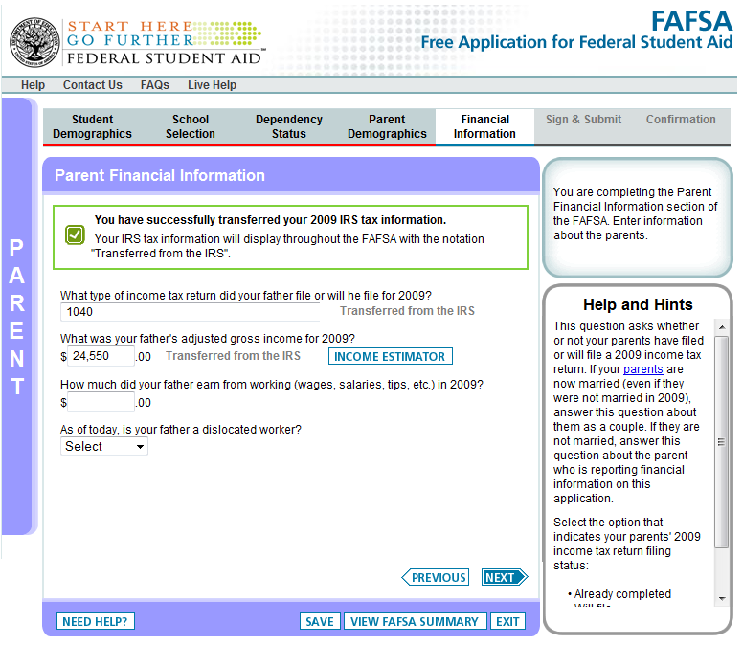
Financial Information
(for Parent)
If not eligible to use IRS Data Retrieval Tool, will have to input income information manually
Notes:
Will see “Tax income information was successfully transferred” if you choose to transfer.
Can use Help and Hints box to assist with manually entering info correctly.

Slide 26
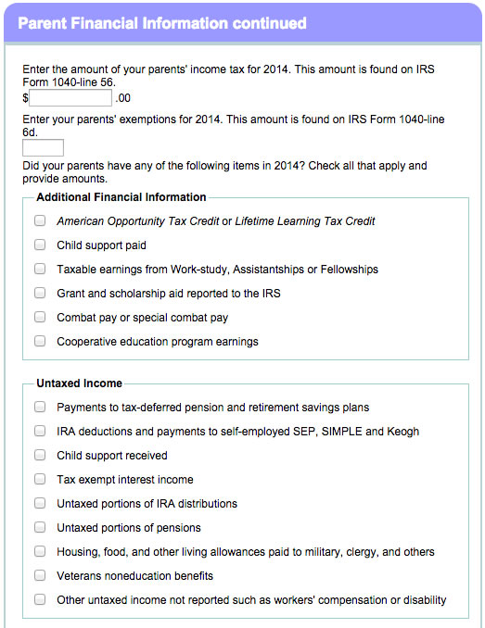
Financial Information (for Parent)
Additional Financial Information, Untaxed Income & Assets
Notes:
This sections is asking about additional financial info, untaxed income information and assets. The Help and Hints box is really helpful for this section.

Slide 27
What are assets?
Cash, savings, and checking accounts
Other real estate, installment and land contracts
Mutual funds, money market funds, CDs
Stocks and stock options
Bonds, commodities and precious metals
UTMA and UGMA accounts

Slide 28
What are NOT assets?
Retirement accounts (IRAs - non-education, 401K, 403B)
The home you live in
Cash value of life insurance policies
Family farm
Family owned and controlled small businesses (100 or fewer fulltime employees)

Slide 29
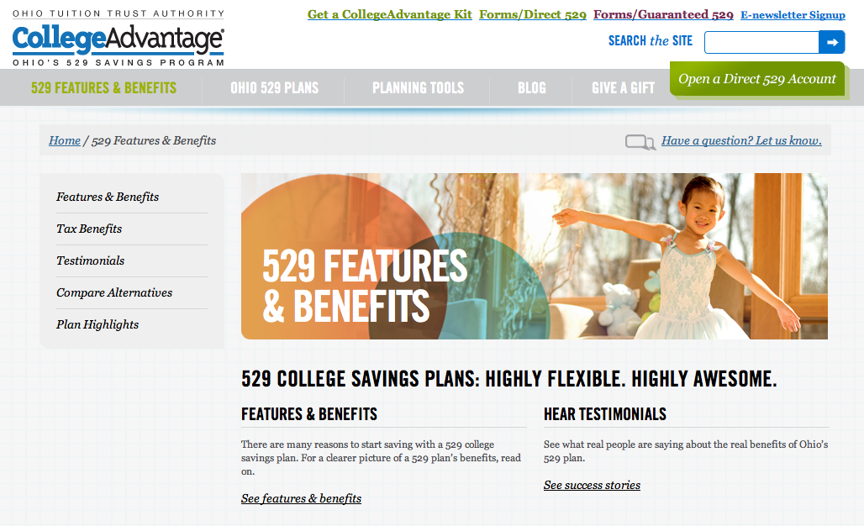
529 College Savings Plans
and Prepaid Tuition Plans
Treated same as mutual funds, CD’s and other investments
For financial aid purposes, if the student is dependent then the 529 plan is a parent asset
Notes:
In most cases, this plan is set up through the 529 administrator and the institutions billing office.

Slide 30
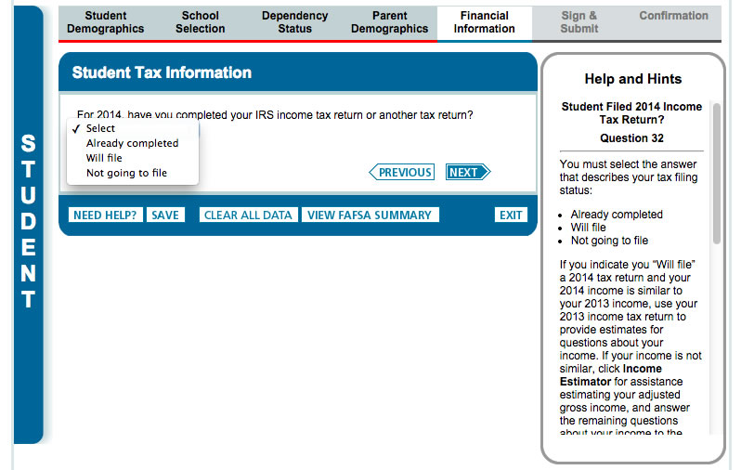
Financial Information (for Student)
Same questions as the parent section
Can also use the IRS Data Retrieval Tool
Notes:
After you complete the Parent Financial Information, you will start to complete the same information for the student.

Slide 31
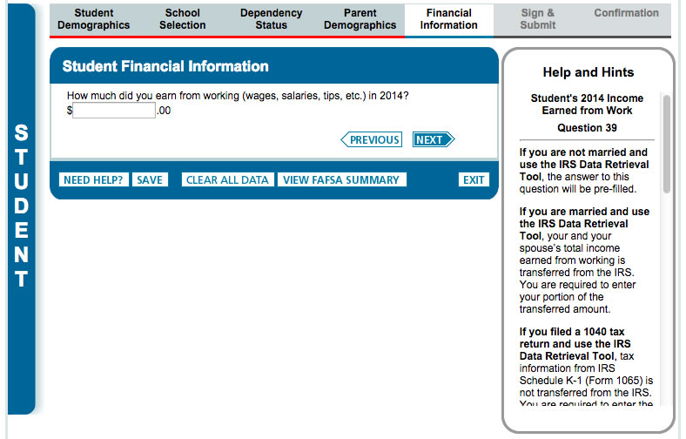
Financial Information (for Student)
If student will not file 2015 taxes but worked, they will still need to submit wages using their W2
Notes:
The Dept. of Ed counts both the student and parents income to calculate the EFC which we will talk about in a few slides.

Slide 32
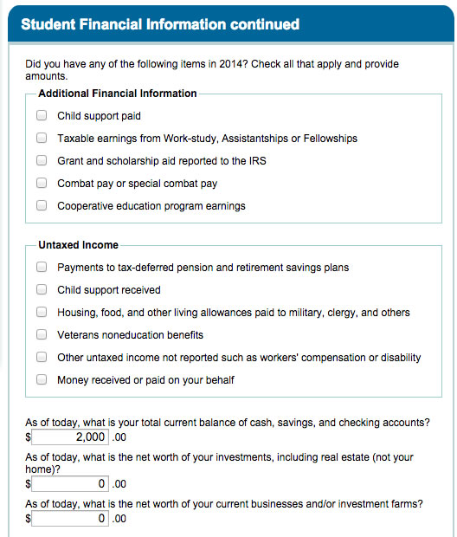
Financial Information (for Student)
Notes:
Students will be asked the same additional financial info, untaxed income and asset information questions.

Slide 33
Avoid Errors!!
Read instructions and complete all sections carefully
Use the “Help and Hints” box
Errors on the FAFSA or supplemental forms may delay application processing and result in loss of financial aid funds
Highly recommended to utilize IRS Data Retrieval Tool
Pulls income information directly from IRS.
Notes:
IRS DRT is available early Feb and you must have filed head of household or married filing jointly. Taxes have to be filed for 2 to 3 weeks.

Slide 34
Frequent FAFSA Errors
Social security number
Date of birth
Divorced/remarried parental information
Income earned by parents/stepparents
US income taxes paid
Household size

Slide 35
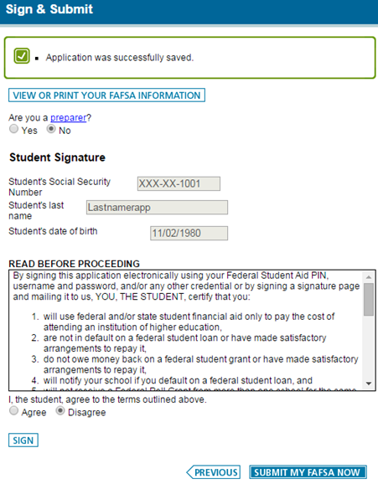
Sign & Submit
(for Student)
Student will use their FSA ID to sign
Be careful to submit the correct information
Notes:
This is the 6th section for the electronic signatures.

Slide 36
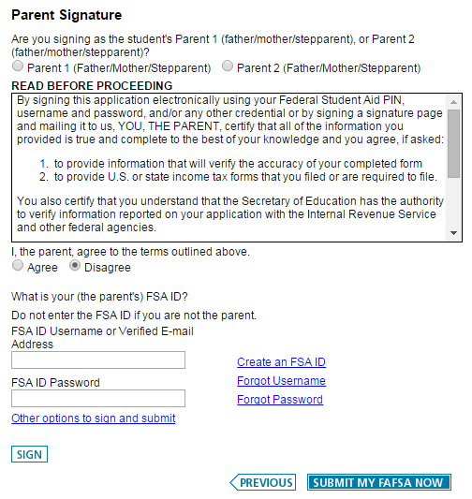
Sign & Submit
(for Parent)
Parent will use their own FSA ID to sign as well
Can view summary of FAFSA information at this point
Notes:
Viewing the summary will allow you to see and if there are any corrections you want to make.

Slide 37
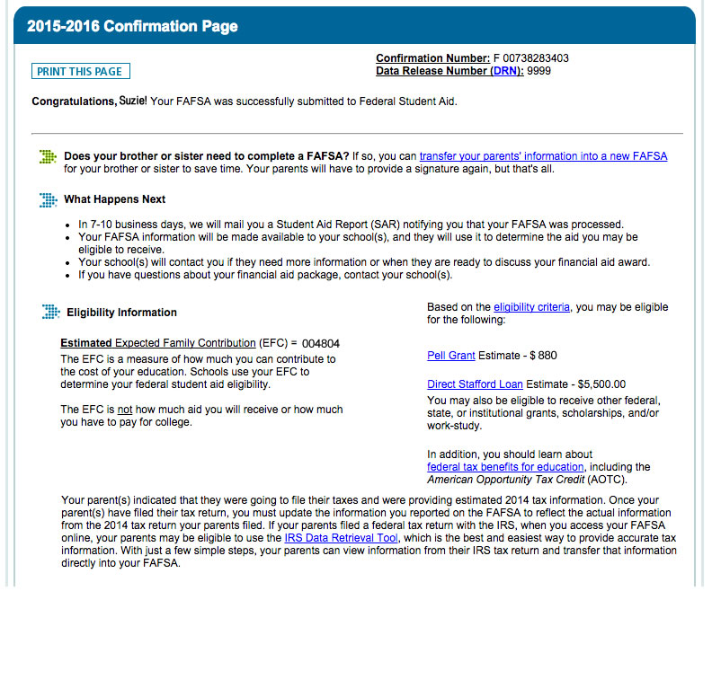
Confirmation Page
3 important sections to review:
What Happens Next
Expected Family Contribution (EFC)
Pell Grant and Direct Loan eligibility
Notes:
Can also post to Facebook and tweeter from this page. In the next section we will talk about next steps and the EFC.

Slide 38
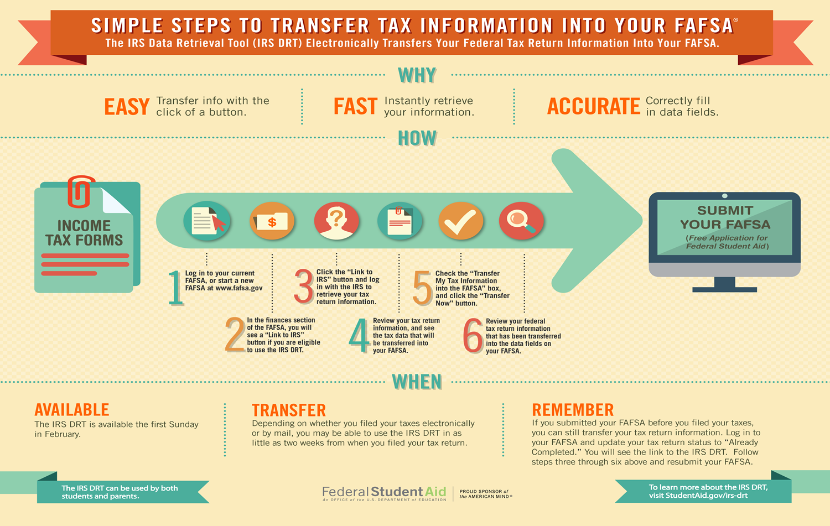
FAFSA Resources
The FAFSA Process
IRS Data Retrieval Process
Who’s My Parent
Studentaid.gov
Notes:
This will help you prepare and gather all the information and documents required to help you complete the application. It will also explain the IRS Data Retrieval Tool.

Slide 39
AWARDING PROCESS

Slide 40
Dept. of Education
FAFSA on the Web
College receives electronic copy of FAFSA
Student receives eSAR

Slide 41
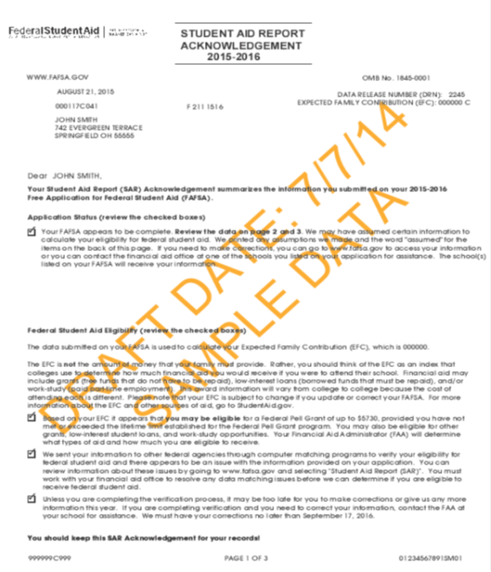
Student Aid Report
Summarizes the information submitted on your 2016- 2017 FAFSA
List Expected Family Contribution (EFC)
List federal student aid eligibility
Provides checklist of next steps
Notes:
Will be emailed by the Department of Education as a link

Slide 42
What is the EFC?
Calculated by the Department of Education
Is an index number and not a dollar amount
Stays the same regardless of school
Determines if a student is eligible for federal or state grants
State grant amounts may differ based on type of university (public vs. private)
Does not affect ability to receive federal student loan eligibility
Helps determine a students financial need

Slide 43
Cost of Attendance (Budget)
Direct costs
Tuition, room and board
Indirect costs
Books, transportation and miscellaneous
Varies widely from college to college
Notes:
The other factor of financial need is cost of attendance. This is a budget assigned to students. It’s not the actual amount expected. It consist of direct or indirect cost.

Slide 44
Cost of Attendance (Budget)
 | Four Year Public | Commuter 4 Year Public | Out of State Public | Regional Campus
Tuition | 10,012 | 10,012 | 18,212 | 5,664
Room and Board | 10,334 | 3,360 | 10,334 | 3,360
Books | 1,290 | 1,290 | 1,290 | 1,290
Transportation | 1,752 | 2,850 | 1,752 | 2,468
Miscellaneous & Personal | 2,144 | 2,144 | 2,144 | 1,750
Loan fees | 118 | 118 | 118 | 118
Total | $25,650 | $19,774 | $33,850 | $14,650
Notes:
This is KSU COA for 15 – 16. Private institutions will have higher cost.

Slide 45
Determination of Financial Need
Cost of Attendance (COA)
Expected Family Contribution (EFC)
= Financial Need

Slide 46
College processes FAFSA information
College receives electronic copy of FAFSA
College emails or mail the initial award letter to student

Slide 47
TYPES OF FINANCIAL AID

Slide 48
Two Types of Aid
Gift Aid
Scholarships
Grants
Self Help Aid
Work Programs
Loans

Slide 49
Scholarships
When to Start Searching?
Start Early
Make a Search Plan
Talk to your guidance counselor
Ask every financial aid office
Ask every major
Look online
Be aware of deadlines
RIGHT NOW!

Slide 50
Scholarships
Other Resources
Volunteer opportunities may lead to service-oriented scholarships
Parent and student employers
Scholarship opportunities listed in Local or Community sections of newspapers
Local organizations may run an art or poetry contest to win a scholarship
Bulletin boards at the library

Slide 51
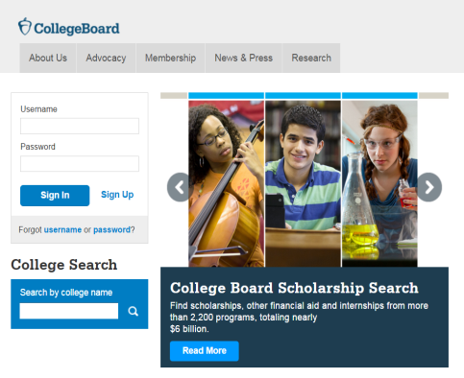
Scholarships
Searching Online
Set up an account
Don’t sign up for too many
Take your time
Don’t pay anyone
fastweb.com
collegeboard.org
scholarships.com

Slide 52
Federal Grants
Pell Grant
Supplemental Educational Opportunity Grant (SEOG)
Teacher Education Assistance for College and Higher Education Grant (TEACH)
Studentaid.gov
Notes:
Amounts and criteria are listed in the publications handed to you or you can visit studentaid.ed.gov.
TEACH grants are not available at all schools with eligible programs. Schools must choose to participate.

Slide 53
The Ohio Board of Regents (OBR) is now the Ohio Department of Higher Education:
www.ohiohighered.org
Notes:
OBR administers all the state grant and scholarship programs and has a new name.

Slide 54
Ohio Aid Programs 2015-2016
Ohio College Opportunity Grant (OCOG)
(File FAFSA by Oct. 1 deadline)
Nurse Education Assistance Loan Program (NEALP)
Ohio Education Training & Voucher (foster care)
Ohio Safety Officers Memorial Scholarship
Ohio War Orphans Scholarship
Ohio National Guard Scholarship
Choose Ohio First (STEMM)
Notes:
All programs under ODHE.

Slide 55
Work Programs
Federal Work Study
Student can work part time while enrolled in school
University Funded Work
May be available to students not awarded work study
Studentaid.gov
Notes:
Now going to talk about Self-Help aid. May want to check with your institutions Career Services Center.

Slide 56
Federal Student Loans
Federal Direct Loans
Subsidized
Unsubsidized
Federal Nursing Loan
For nursing majors only
Studentaid.gov
Notes:
Amounts and interest rates are listed in the handouts provided or you can visit studentaid.gov. No more Perkins. Maximum amount for freshmen is $5500. Current interest rate for DL is 4.66 It’s 5% for NL. The picture is a publication available on the provided website.

Slide 57
Other Loan Options
Federal Direct PLUS
Only parents can apply
Credit based
Other options available if credit is denied
Alternative Loans
Non federal
Student loan through a bank, credit union, state agency or school
Studentaid.gov
Notes:
Can talk about PLUS criteria

Slide 58
Figuring Out Your Cost

Slide 59
Figuring Out Your Cost
Three Main Costs
Visit university's Billing office website (commonly known as Bursar)
Tuition
Visit university’s Residence Services website
Housing and meal plan
Notes:
Housing & meal plan if student is living on campus. Amounts will vary based on the institution.

Slide 60
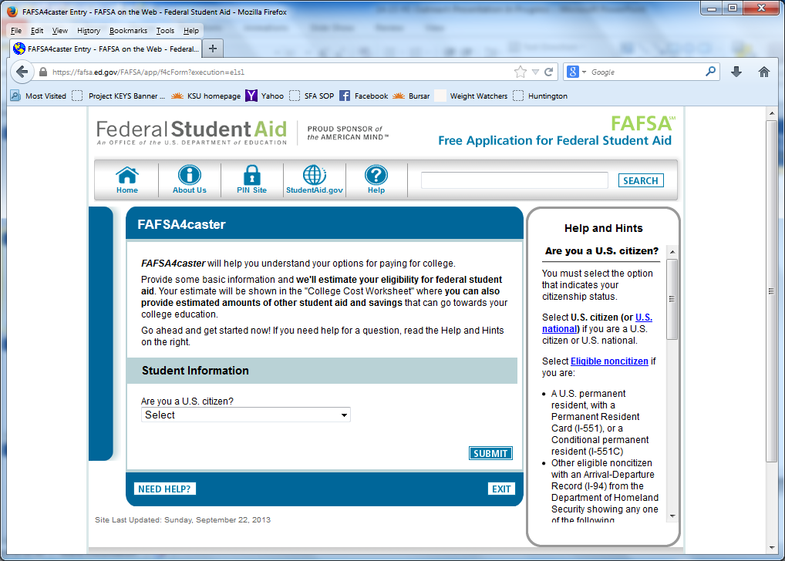
FAFSA4CASTER
Under the Thinking About College section of the homepage.
FOTW questions duplicated
Estimates eligibility for federal student aid at selected school
Estimates cost at selected school
www.FAFSA.gov
Notes:
The 4caster no longer has it’s own website. It’s now on the FAFSA website. Students will be asked to input their parents and their income information.

Slide 61
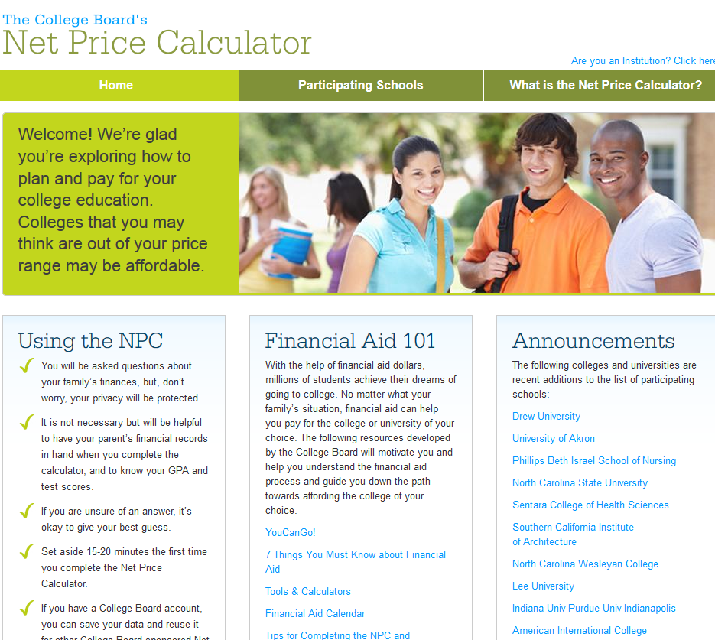
Net Price Calculator
Helps you understand options for paying for college
Estimates eligibility for Federal Student Aid
www.collegeboard.org
Notes:
The NPC is very similar to the FAFSA4caster.

Slide 62
Shopping Sheet
Information for prospective students regarding their cost and financial aid
Not provided by every institution
Available when institution has awarded student
Viewed through their student online portal
www.collegecost.ed.gov
Notes:
A consumer tool designed to simplify information for prospective students regarding their cost and financial aid. Also provides information regarding graduation rates and loan default rates

Slide 63
FINANCIAL WELLNESS

Slide 64
What is Financial Wellness?
The possession of knowledge and understanding of financial matters and money management.
Notes:
This can be related to your personal life and financial aid.

Slide 65
Financial Wellness in Financial Aid
Helpful Information & Resources:
CashCourse.org
Studentloans.gov
Financial Aid Awareness Counseling
Managing your student loans
Entrance Counseling
National Student Loan Data System (NSLDS)
Notes:
We will talk about each briefly

Slide 66
CashCourse.org
A free online resource
Learn how to:
Budget
Manage your money and spend wisely
Deal with credit cards
Manage your financial aid
Smart borrowing
Notes:
Videos, Interactive spreadsheets, Articles, Printable documents

Slide 67
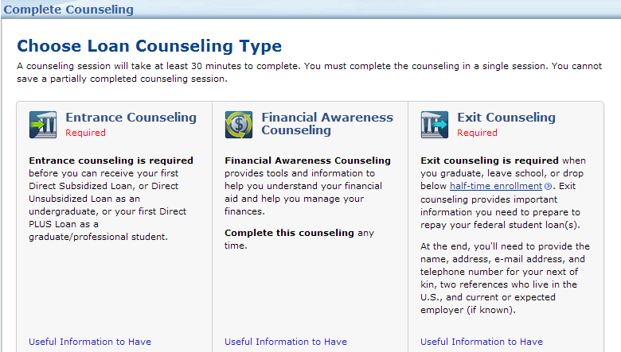
Studentloans.gov
Financial Aid Awareness Counseling Tool

Slide 68
Managing Your Student Loans
Entrance Counseling for Federal Student Loans
Quiz on topics related to loans
Mandatory
Completed online at studentloans.gov
Review the National Student Loan Data System (NSLDS)
www.nslds.ed.gov
List of all federal loans borrowed and lenders
Notes:
Entrance counseling mandatory before you can borrow

Slide 69
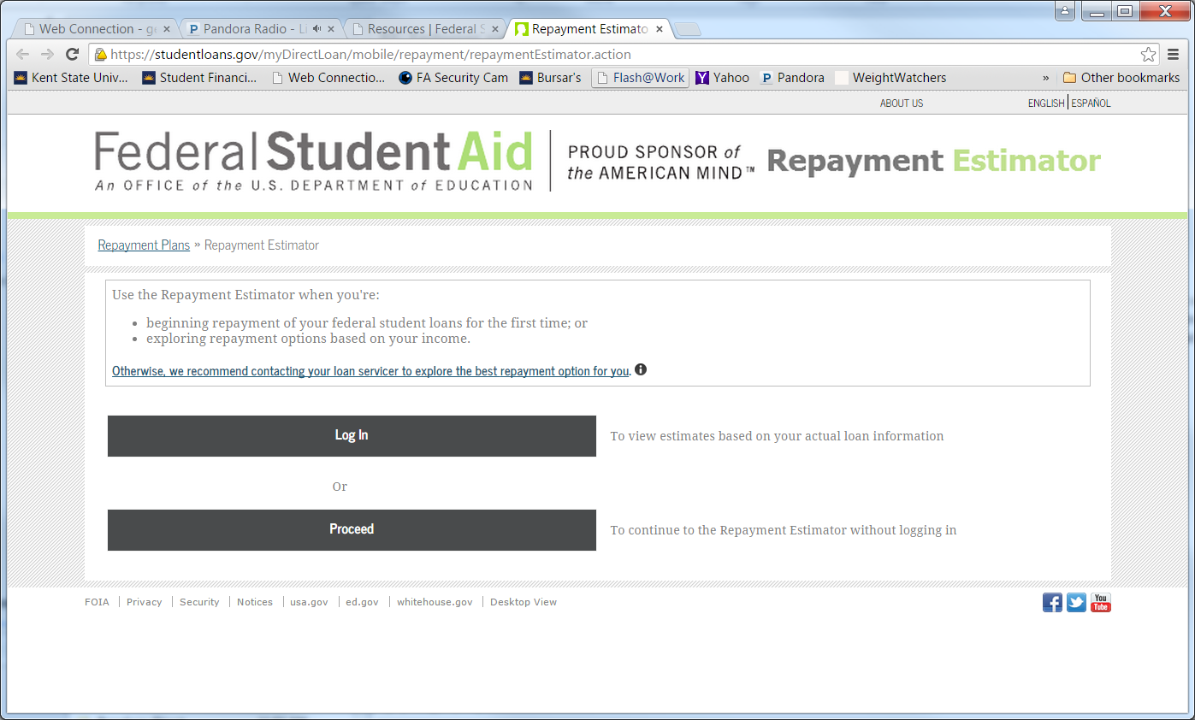
Managing Your Student Loans
Repayment Timeline
Repayment Estimator
Studentaid.gov
Notes:
Publications on studentaid.gov

Slide 70
YouTube Videos
Studentaid.gov
Notes:
Related to financial literacy. All can be found on studentaid.gov under resources.

Slide 71
RESOURCES

Slide 72
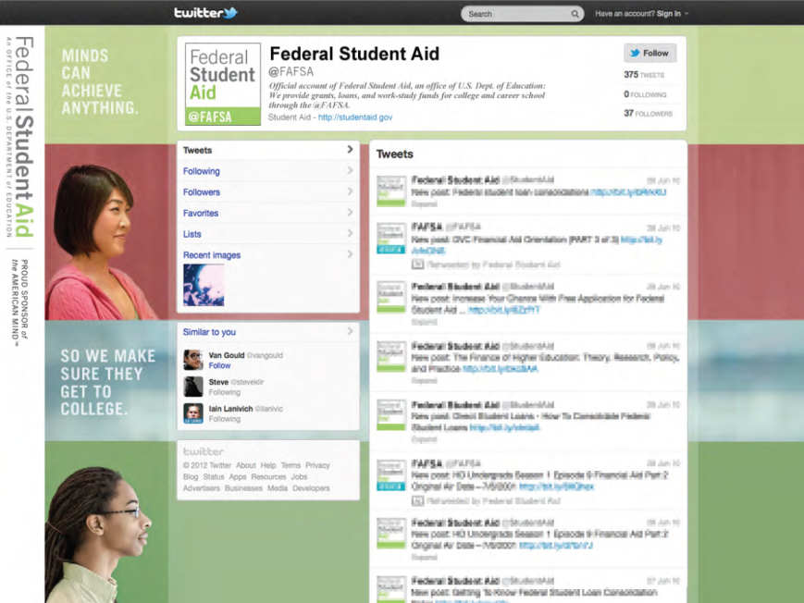
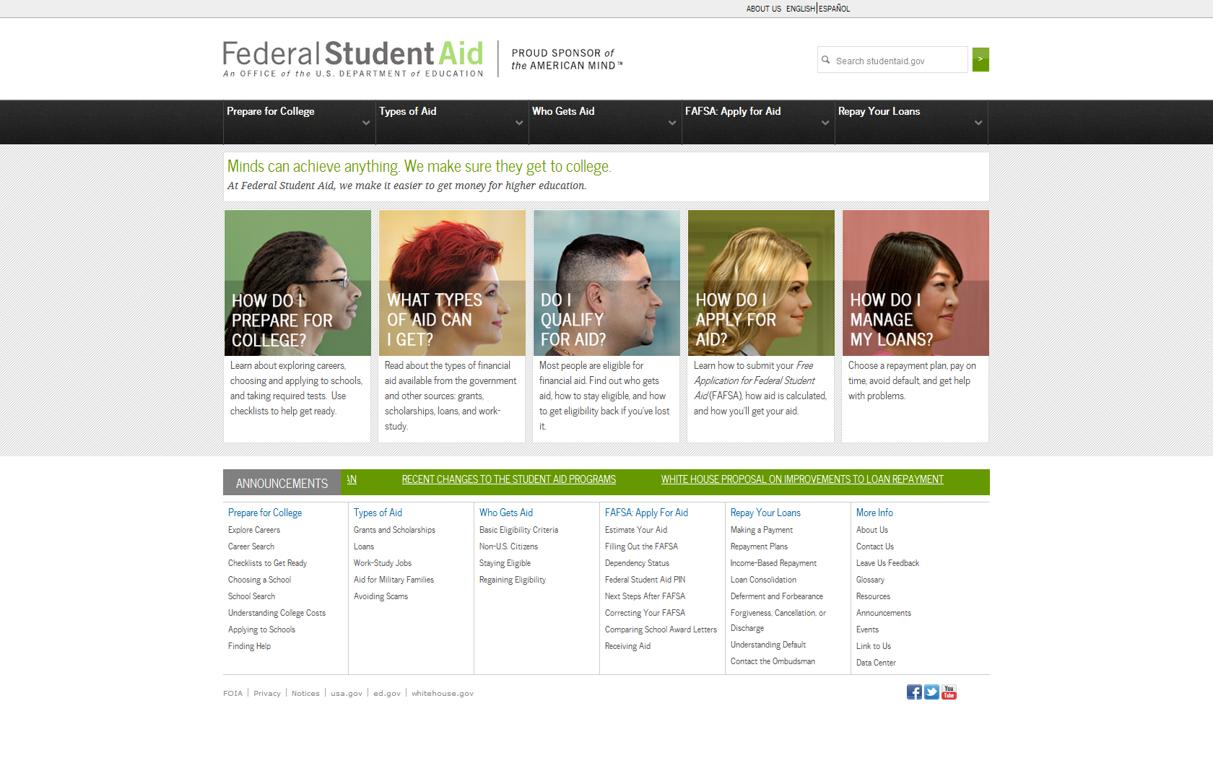
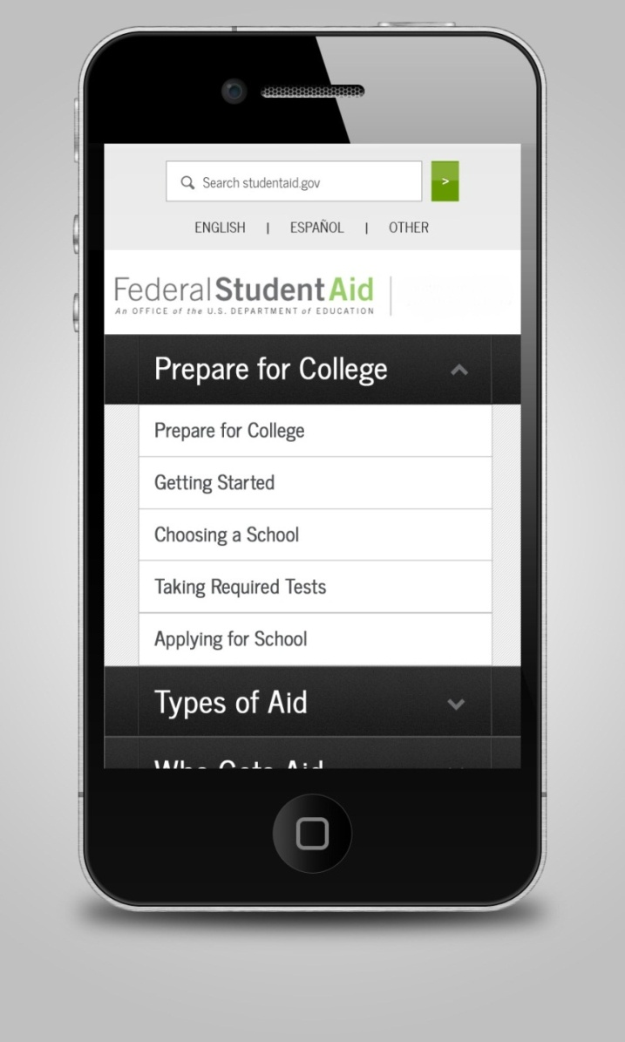
Studentaid.gov website, videos, mobile, Facebook, Twitter
Notes:
Comprehensive information on federal student aid – from awareness, to application, to repayment. Includes repayment calculators, videos, and images/infographics.
Approach and design based on focus groups and online surveys.
Serves audiences from middle school students and parents to adults, applicants, and borrowers.
Available in English and Spanish
FSA’s first mobile-optimized site to display on all devices include tablets and smart phones.
Links to FSA’s other key sites
Continuous enhancements and improvements including customer usability testing

Slide 73
Recommended Publications for High School Students
Studentaid.gov
Notes:
“The FAFSA Process”, HS Checklist for all grades and parents, Funding Your Education (overview of available aid).

Slide 74
Social Media Websites
Facebook
www.facebook.com/FederalStudentAid
Twitter
www.twitter.com/FAFSA
YouTube
www.youtube.com/FederalStudentAid
Notes:
You can like their page on Facebook, follow them on twitter and watch them on YouTube. Obtain great information from the Dept. of Ed regarding financial aid.

Slide 75
Financial Aid Helpful Websites
Studentaid.gov
Provides general information and overall process for financial aid
Provides checklists for students and parents
www.collegecost.ed.gov/scorecard
Financial and demographic snapshot of institutions
www.ed.gov/parents
Information to assist parents with financial aid process
www.edpubs.gov
Can order FAFSA worksheet and application

Slide 76
College Goal Sunday
Free
February 14th, 2016
Complete FOTW with Financial Aid Staff
Multiple locations
www.ohiocollegegoalsunday.org
Notes:
The website to register at CGS is provided. You will find a list of other locations as well.

Slide 77
Review of Information
Complete Admissions application
Apply for FSA ID
Complete the FAFSA beginning January 1st
Search for external scholarships
Figure out your cost (FAFSA4caster and NPC)
Sign up for freshmen orientation
Visit us online at www.kent.edu/financialaid

Slide 78
Please complete your evaluation form!
Thank You!

Slide 79
Contact Information
Kent State University
Student Financial Aid Office
103 Schwartz Center
330-672-2972
www.kent.edu/financialaid

