Slide 1
Sociocultural perspective
Ib psychology

Slide 2
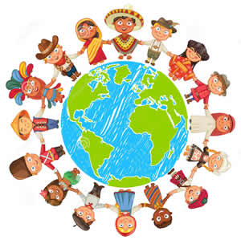
Big ideas
Cultural influences on individual attitudes, identities and behavior- culture and cultural norms.
Cultural origins of behavior and cognition- cultural dimensions.
Becoming oneself-socialization and social cognition.
Us and them- how we understand others.

Slide 3
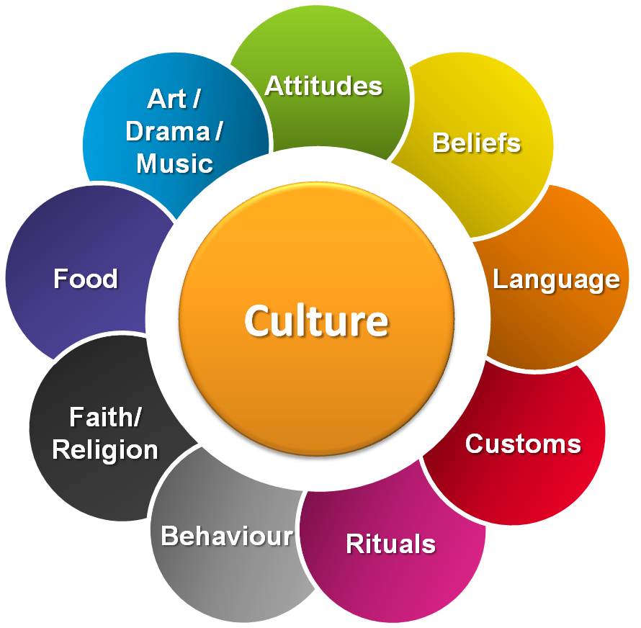
Cultural influences
Culture: the set of shared attitudes, values, goals, and practices that characterizes an institution or organization.
The origin of language, understood as the human capacity of complex symbolic communication, and the origin of complex culture are often thought to stem from the same evolutionary process in early man.
Language and culture both emerged as a means of using symbols to construct social identity and maintain coherence within a social group too large to rely exclusively on the pre-human ways of building community (for example, grooming)

Slide 4
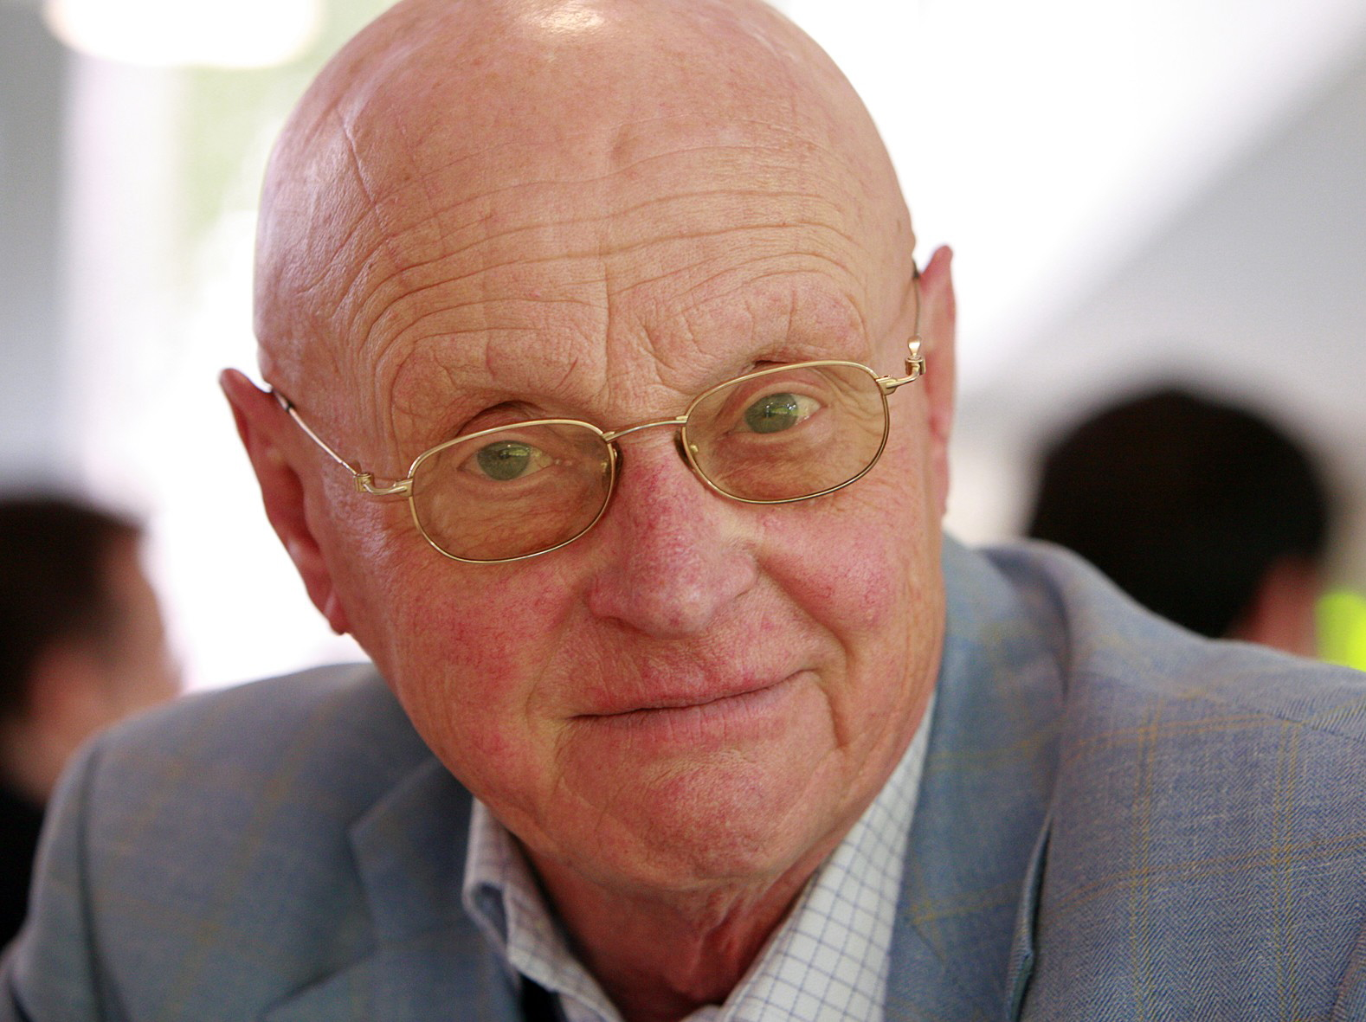
Cross cultural psychologists:
Hofstede
  Defines culture as “the collective programming of the mind distinguishing the members of one group or category from another”.
Matsumoto
  Culture is a unique meaning and information system, shared by a group and transmitted across generations, that allows the group to:
    Meet basic needs of survival.
    Coordinate socially to achieve a viable existence.
    Transmit social behavior
    Pursue happiness and well being.
    Derive meaning from life.

Slide 5

Cultural norms
Cultural norms are the unique set of attitudes, beliefs, and behaviors specific to particular culture.
Enculturation is the process by which people learn their culture.
Cultural Transmission is how culture is transferred from one generation to the next.

Slide 6
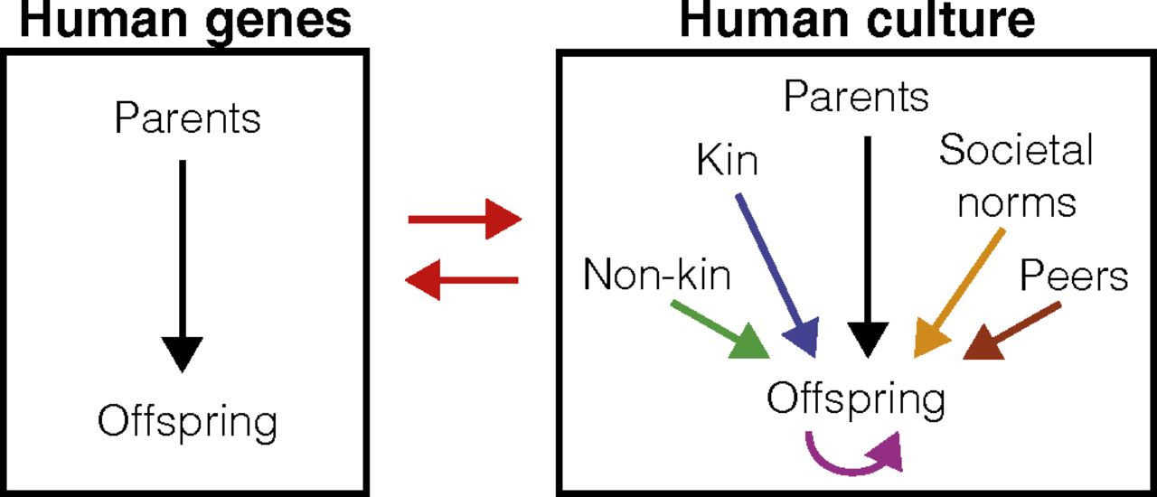
Cultural transmission
Cultural transmission is a theory of learning where individuals acquire a significant amount of information simply by interacting with their culture.
Culture and cultural norms are in a bidirectional relationship with the individuals who make up the cultural group.
Bidirectional: culture and norms grow out of the behavior of the individuals within the culture. Sometimes cultural norms change over time.

Slide 7

Culture of honor
Culture of honor is when individuals (usually men), place a high value on strength and social reputation.
An insult to one’s reputation, property, or family results in violence.
Brown, Osterman, Barnes
Their hypothesis was that culture of honor would be uniquely predictive of school-violence indicators.
They found that culture-of honor states had more than twice as many school shootings per capita as non-culture-of-honor states.
The data revealed important differences between school violence and general patterns of homicide and are consistent with the view that many acts of school violence reflect retaliatory aggression springing from intensely experienced social-identity threats.

Slide 8
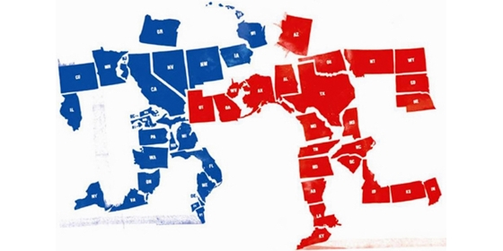
Honor cultures
Laboratory research has demonstrated that men in honor cultures perceive interpersonal threats more readily than do men in other cultures, including increases in cortisol and testosterone levels following insults.
A 2016 study suggests that honor culture increases the risk of war.
The study found that international conflicts under Southern presidents are "twice as likely to involve uses of force, last on average twice as long, and are three times more likely to end in victory for the United States than disputes under non-Southern presidents.
Other characteristics of Southern presidencies do not seem able to account for this pattern of results

Slide 9

Cohen and nisbett
Cohen and Nisbett (1995): College students from the southern and northern part of the United States were insulted by a confederate.
Students who had grown up in the southern United States were more upset (had a higher rise in cortisol levels) and were more likely to engage in aggressive and dominant behavior.

Slide 10
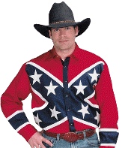
SOCIO-CULTURAL ASPECTS
Homicide rates for White southern males are substantially higher than for White northern males (especially in rural areas)
  However, they do not endorse violence in general, only as a tool for protection of property and in response to insults: “Culture of honor” based upon history as herding society
Nisbett research on southerners reaction to being bumped and cursed at
  More upset, primed for aggression (testosterone increase), more likely to engage in aggression after the incident.

Slide 11
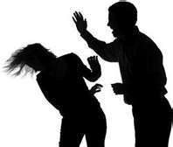
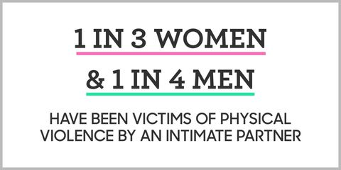
CULTURAL NORMS- VIOLENCE
What is the norm of violence in domestic situations?
-What would you do?

Slide 12


Slide 13
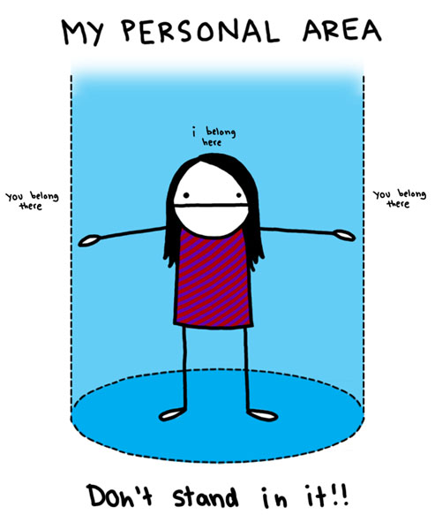
PERSONAL SPACE

Slide 14
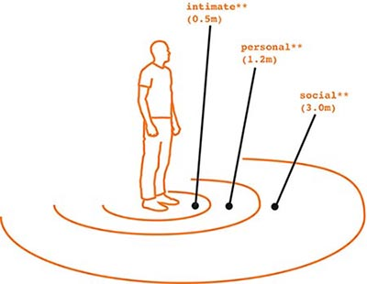
Personal Space
One of the issues that defines how people in different cultures greet each other is how touchy they are. Here is a scale of touch don’t touch:
Don’t Touch Middle Ground Touch
←------------------------------------------------------------------------→
Japan France Middle East
United States China Latin Countries
Canada Ireland Italy
England India Greece
Northern European Spain
Australia Portugal
Estonia Russia

Slide 15
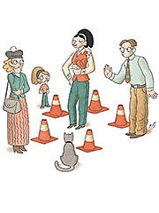
Personal Bubble
Your personal space is like an invisible bubble that surrounds you. If people move inside this bubble when they are talking to you, it may make you feel uncomfortable.
Everyone's personal space is different. How close you normally stand to someone else when you are talking to them will depend on who it is you are talking to, and under what circumstances.

Slide 16
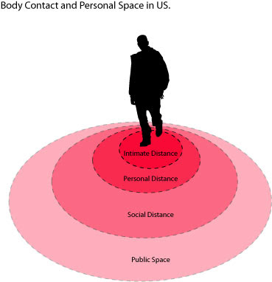
Facts about the personal bubble:
The bubble is larger if you are talking to a stranger.
The better you know the person you're talking to, the smaller the bubble may be.
The bubble is usually larger for two men than for two women.
The bubble may be very small for a man and a woman if they are in a relationship.
The bubble may be larger than normal for a man and a woman who are strangers to each other.
The bubble size may differ for different cultures.

Slide 17
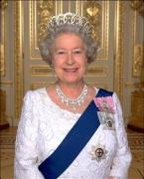
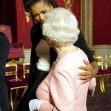
Disregarding the customs of touching might cause an international incident. On one occasion the queen was visiting Canada when the Provincial Transportation Minister touched the Queen while escorting her.
Headlines read:
“Hands Off Our Queen!”
In England there is an unwritten rule that nobody touches the Queen. Even when shaking hands she must shake first.

Slide 18
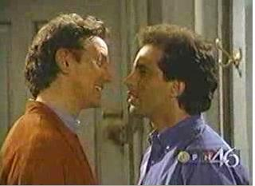
Seinfeld and the Close Talker
But what makes you feel hostile toward “close talkers,” as the show “Seinfeld” dubbed people who get within necking distance of you when they speak? Or toward strangers who stand very near to you on line? Or toward people who take the bathroom stall next to yours when every other one is available?

Slide 19

Southeast Asia
In 1988 in Los Angeles, an entertainer from Thailand was convicted of second-degree murder. A patron of the Thai cabaret put his foot on a chair with the sole facing the singer.
When the cabaret closed the singer followed the patron and shot him.
Why?
In Southeast Asia showing the sole of a shoe is a grievous insult.

Slide 20
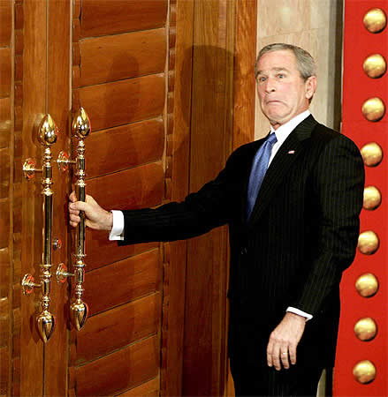
China
-The Chinese do not touch a drink at dinner without proposing a toast to others.
-The Chinese are very sensitive to problems of precedence at doorways. Failure to yield right of way could be interpreted as arrogance.
Japan
-To signal respect and attention to a person who is speaking the audience should close their eyes and slightly nod their heads.

Slide 21

Cultural dimensions
#35 How are other cultures studied by psychologists?
Etic: studying culture from an outside perspective.
  Compares psychological theories across cultures.
  Looking for universal behaviors.
  Emphasizes similarities and differences between culture.
  Brings outside perspective.
Emic: trying to understand a culture from within that culture.
  Focuses on one culture and looks for culturally specific behavior.
  Emphasizes uniqueness of cultures.
  Seeks inside perspective.

Slide 22
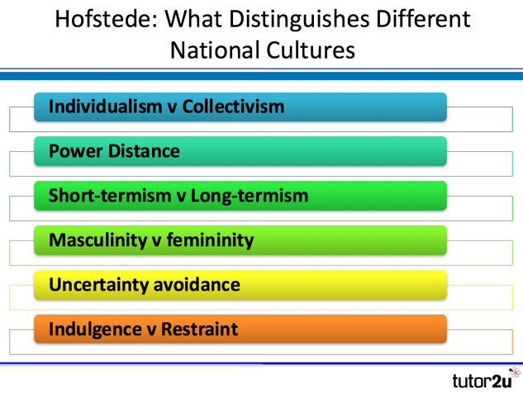
#32 What are cultural dimensions?
Know one or more of the following: individualism/collectivism, uncertainty/avoidance, power/distance, Masculinity/femininity, long term/short term, time orientation, indulgence/restraint.

Slide 23
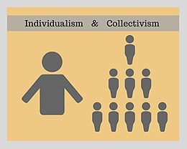
Individualism vs. collectivism
The high side of this dimension, called Individualism, can be defined as a preference for a loosely-knit social framework in which individuals are expected to take care of only themselves and their immediate families.
Its opposite, Collectivism, represents a preference for a tightly-knit framework in society in which individuals can expect their relatives or members of a particular in-group to look after them in exchange for unquestioning loyalty. A society’s position on this dimension is reflected in whether people’s self-image is defined in terms of “I” or “we.”

Slide 24
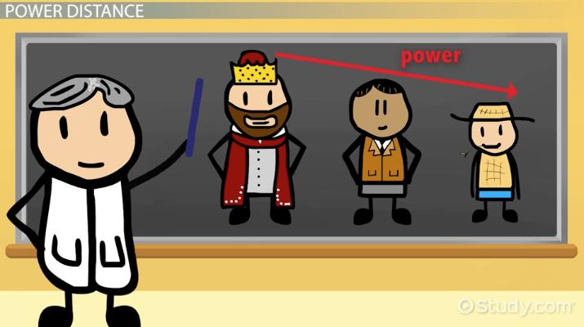
Power distance
This dimension expresses the degree to which the less powerful members of a society accept and expect that power is distributed unequally.
The fundamental issue here is how a society handles inequalities among people.
People in societies exhibiting a large degree of Power Distance accept a hierarchical order in which everybody has a place and which needs no further justification.
In societies with low Power Distance, people strive to equalize the distribution of power and demand justification for inequalities of power.

Slide 25

Masculinity vs. femininity
The Masculinity side of this dimension represents a preference in society for achievement, heroism, assertiveness, and material rewards for success.
Society at large is more competitive. Its opposite, Femininity, stands for a preference for cooperation, modesty, caring for the weak and quality of life.
Society at large is more consensus-oriented.
In the business context Masculinity versus Femininity is sometimes also related to as “tough versus tender” cultures.

Slide 26

Uncertainty avoidance dimension
The Uncertainty Avoidance dimension expresses the degree to which the members of a society feel uncomfortable with uncertainty and ambiguity.
The fundamental issue here is how a society deals with the fact that the future can never be known: should we try to control the future or just let it happen?
Countries exhibiting strong UAI maintain rigid codes of belief and behavior, and are intolerant of unorthodox behavior and ideas.
Weak UAI societies maintain a more relaxed attitude in which practice counts more than principles.

Slide 27
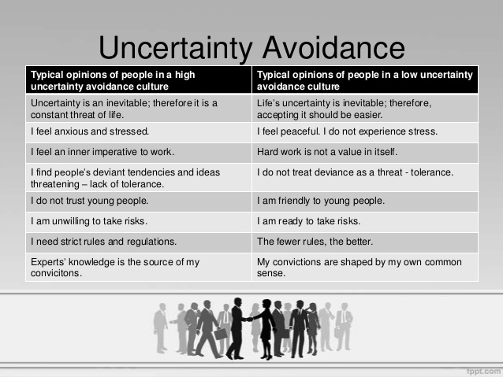

Slide 28
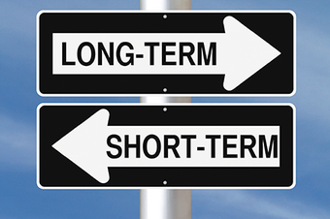
Long term vs. short term orientation
Every society has to maintain some links with its own past while dealing with the challenges of the present and the future.
Societies prioritize these two existential goals differently.
Societies who score low on this dimension, for example, prefer to maintain time-honored traditions and norms while viewing societal change with suspicion.
Those with a culture which scores high, on the other hand, take a more pragmatic approach: they encourage thrift and efforts in modern education as a way to prepare for the future.

Slide 29
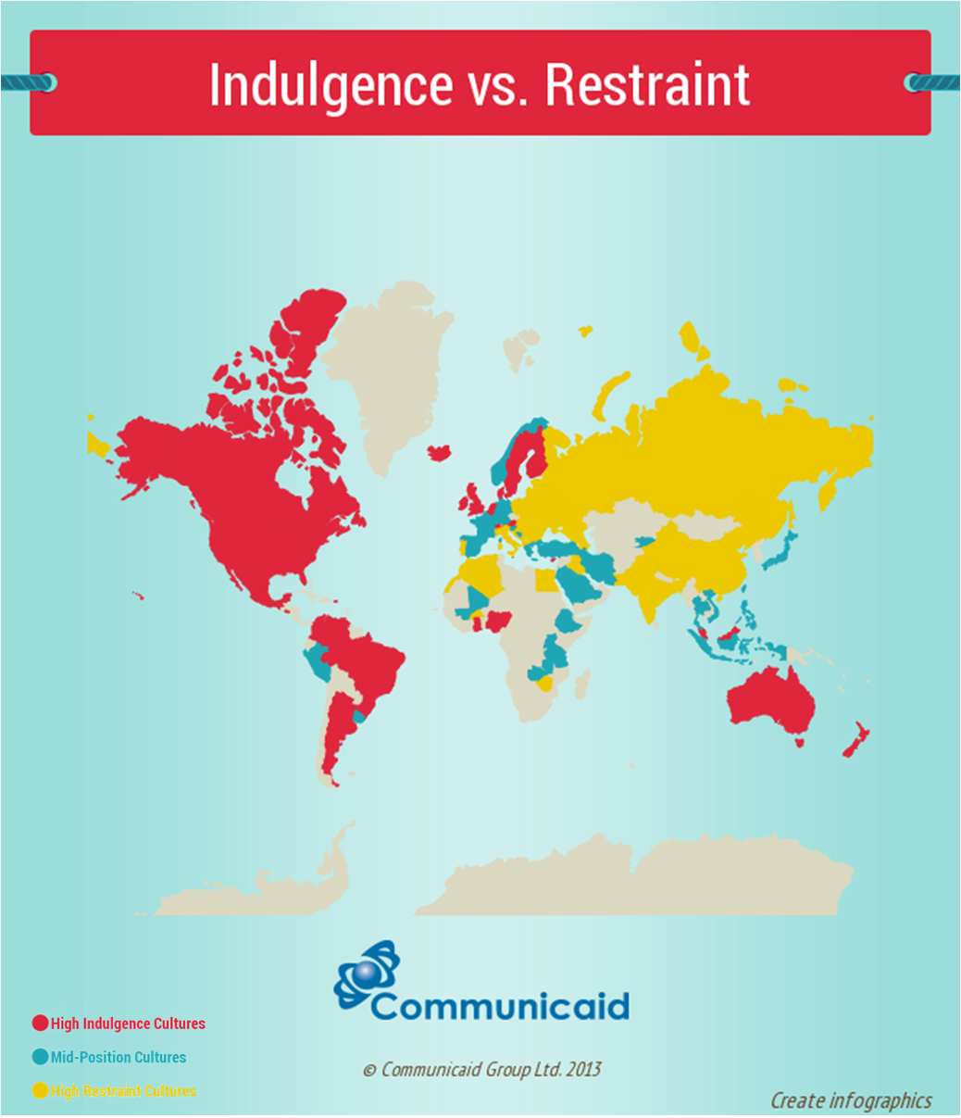
Indulgence vs. restraint
Indulgence stands for a society that allows relatively free gratification of basic and natural human drives related to enjoying life and having fun.
Restraint stands for a society that suppresses gratification of needs and regulates it by means of strict social norms.

Slide 30

triandis
Triandis identified four categories of individualism vs. collectivism.
  Horizontal individualism: members are unique and the same status.
  Vertical Individualism: members are unique but it is possible to distinguish yourself and enjoy a higher status in a social hierarchy.
  Horizontal collectivism: members merge themselves with the in-group and enjoy largely the same status.
  Vertical collectivism: members merge themselves with the in-group and submit themselves to an authority in that in-group.

Slide 31
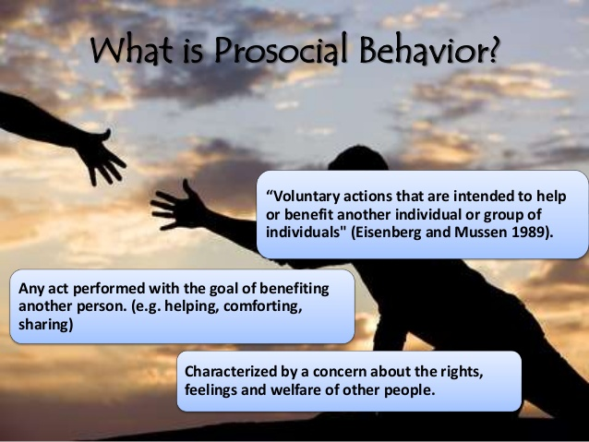

Slide 32

Kemmelmeier, jambor, letner
They sought to examine the relationship between individualism and voluntary, pro-social behavior. The reasons for stranger on stranger giving.
Data was collected by telephone in 40 U.S. states with 2,553 participants.
Researchers found that individualistic societies were active in voluntary pro-social behavior.
  Causes:
    Self-Determination
    Self-Promotion
    Self-Actualization

Slide 33

Cultural dimensions and acculturation
HSU and BARKER
This study examined the cultural values promoted in television advertisements targeting younger and older audiences in China and the US, respectively, testing the hypothesis that ads in China would reflect a value shift caused by the open-door policy implemented in 1979.
A content analysis of 566 television ads was conducted, rating the degree of individualism and collectivism, as well as the prominence of modern and traditional themes.

Slide 34

results
As predicted, ads targeting younger Chinese scored higher in individualism than collectivism.
Compared to ads targeting the older demographic, ads targeting younger Chinese scored higher in individualism, with no significant differences in the other three dimensions.
As expected, mean scores for individualism and modernity were higher in the American ads, while mean scores for collectivism and tradition were lower.
The results revealed no differences in the scores between younger and older audiences in the US.

Slide 35

How does pdi influence behavior?
MEEUWESEN, VAN DEN BRINK-MUINEN, HOFSTEDE
This study investigated at a country level how cross-national differences in medical communication can be understood from the first four of Hofstede's cultural dimensions, i.e.
power distance
uncertainty avoidance,
individualism/collectivism
masculinity/femininity
together with national wealth.

Slide 36
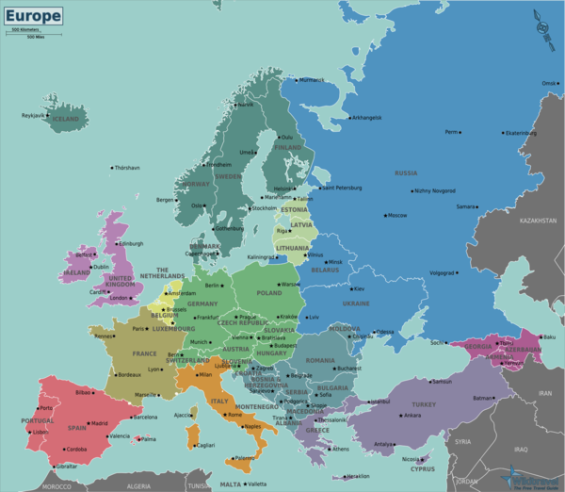
method
They collected date from 10 diverse European countries.
Medical communication was videotaped and assessed using Roter's interaction analysis system (RIAS).
Additional context information of physicians (gender, job satisfaction, risk-taking and belief of psychological influence on diseases) and patients (gender, health condition, diagnosis and medical encounter expectations) was gathered by using questionnaires.
Countries differ considerably form each other in terms of culture dimensions.
A total of 307 general practitioners (GPs) and 5820 patients from Belgium, Estonia, Germany, Great Britain, the Netherlands, Poland, Romania, Spain, Sweden and Switzerland participated in the study.

Slide 37

results
The higher the PDI score the less information was shared and a shorter consultation.
The lower the PDI score the consultations lasted longer.
The understanding of these cross-national differences is a precondition for the prevention of intercultural miscommunication.
Improved understanding may occur at micro-level in the medical encounter, as well as on macro-level in pursuing more effective cooperation and integration of European health care policies.

Slide 38

The larger a nation's power distance, the less room there is for unexpected information exchange and the shorter the consultations are.
Roles are clearly described and fixed.
The higher the level of uncertainty avoidance, the less attention is given to rapport building, e.g. less eye contact.
In wealthy countries, more attention is given to psychosocial communication.
The four culture dimensions, together with countries' wealth, contribute importantly to the understanding of differences in European countries' styles of medical communication.

Slide 39

Eylon and Au
They researched power distance and empowerment in the workplace and found that the amount of supervision and management required to maximize work performance is culturally dependent.
There were 135 participants who were MBA students from a Canadian University.
They evaluated empowerment in relation to work satisfaction and performance.

Slide 40
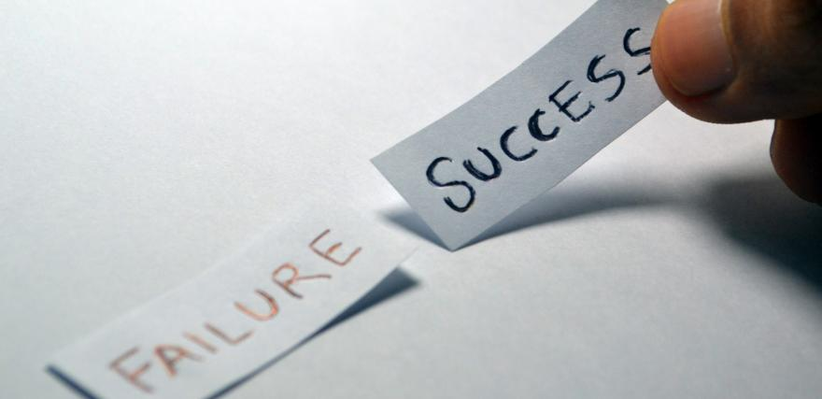
Method results
Participants were divided into high power distance and low power distance groups.
They were then put through three conditions.
Conditions:
  Empowered
  Disempowered
  Control
  Results showed that all participants were more satisfied when empowered than not empowered, regardless of the PDI score.
  The differences were seen in work performance.
  Worker performance in the low power distance did not change.
  Worker performance in the high power distance became significantly less well.

Slide 41

Malcolm Gladwell- cockpit culture theory
Gladwell says that, though plane crashes are often portrayed in movies as the results of a single catastrophic event, in reality they occur because of the accumulation of many small problems.
Bad weather, tired pilots, new or unfamiliar airports, crew members who have only recently started to work together—it often takes all of these things to add up to disaster.
“The typical accident involves seven consecutive human errors.”
In Korea between 1970 and 1999 there were 16 aircraft disasters which is a unusually high rate.
Gladwell focused on the high PDI score in Korea and communication problems between flight crews.

Slide 42

Power distance: Crash rate
In 17 of 19 cultures, flight crews had a significantly higher PDI score than Hofstede’s original research.
The conclusion was that flight crews had and exaggerated PDI score.
This may be due to the fact that many airlines hire ex-military pilots.
The military, by nature, is strictly hierarchical with extreme power distance scores.
Earl Weener who designed the 747 says the cockpit is designed for two equals working in cooperation.
To reduce crashes in Korean airlines they looked at the connection between power distance and cockpit culture.
They lowered the power distance and
reduced the crash rate.

Slide 43
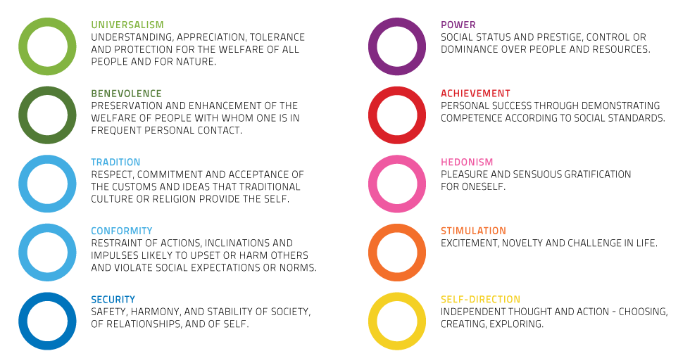
Schwartz theory of basic values
Schwartz has offered a theory that is considered an extension of Hofstede’s Dimensions.

Slide 44
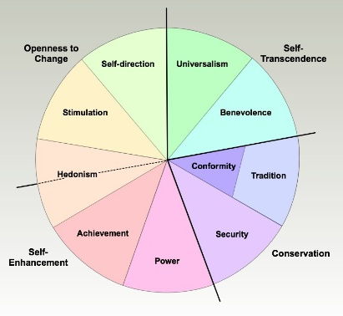
schwartz
Schwartz’s theory of basic values not only claims to describe the basic values of all cultures but explains how they influence and interact with each other.
In an effort to show this visually Schwartz created a circular chart that shows the relationship of the basic values.
The Schwartz Value Survey measures 10 basic principles on a scale of importance from -1 to 7

Slide 45
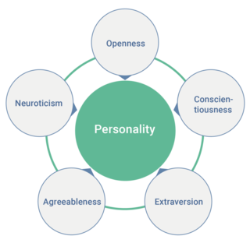
Personality traits and cultural dimensions
Hofstede and Schwartz do not claim to be describing the personalities within cultures but the characteristics of culture overall.
When comparing personalities you must compare individuals. To compare cultures you must compare societies.
Ecological Fallacy: inferring information about individuals using information from a group to which they belong.
Using dimensions to compare individuals within a culture leads to stereotyping.

Slide 46
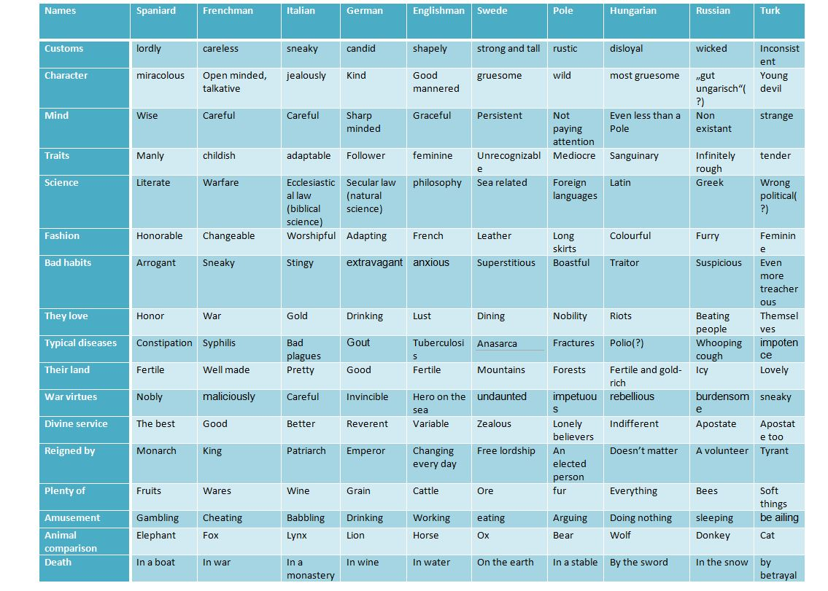
Volkertafel’s stereotypes of the 17th Century

Slide 47
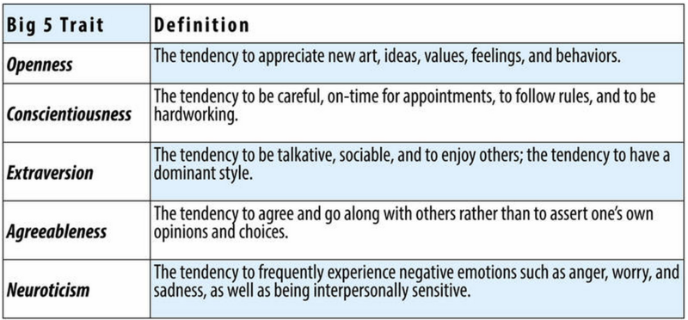
HoFstede and mccrae
A popular measure for personality is the 5 Factor Model of Personality.
The model consists of the following factors:

Slide 48
Hofstede and McCrae found that:
  Individualism correlated with extraversion.
  Uncertainty avoidance correlated with neuroticism and tended to score higher on open to experience.
  High power distance correlated with conscientiousness and extraversion.
  Masculinity correlated with neuroticism and cultures rating high in masculinity tended to rate themselves more open to experience than feminine cultures.

Slide 49
The individual and the group
#29 What is social cognitive theory? (Conformity/Compliance, Norms, Rules)
Socialization: the process of becoming a member of a group.
Primary Socialization: when a child learns the basic norms of living in his or her group. This would be from immediate family and close friends.
Gender Socialization: children learn attitudes and behaviors that are appropriate for their gender.
Cultural socialization: children are taught about their racial, cultural or ethnic heritage.

Slide 50
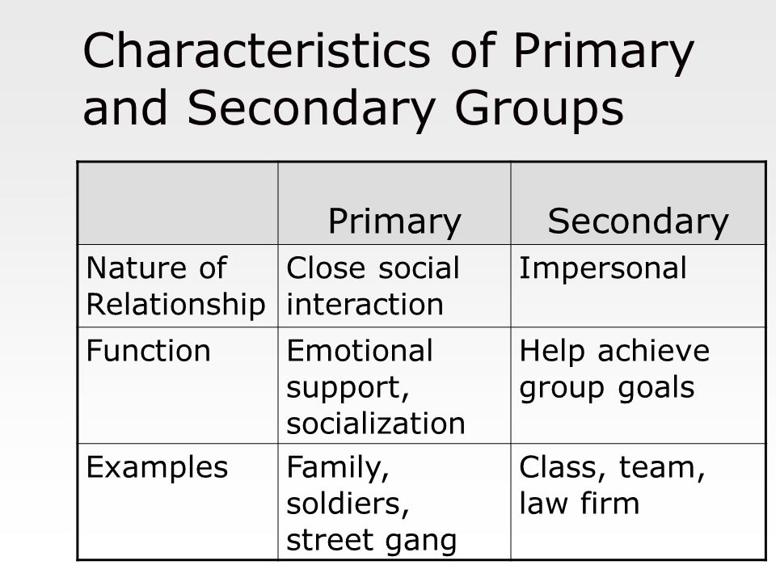
Secondary socialization
Secondary socialization includes extended family, the community, the media.
Secondary socialization refers to the process of learning what is the appropriate behavior as a member of a smaller group within the larger society.
Basically, it is the behavioral patterns reinforced by socializing agents of society.
Secondary socialization takes place outside the home.
Group Socialization: it’s the individual’s peer group, the not person’s parental figures, that influences personality and behavior.

Slide 51
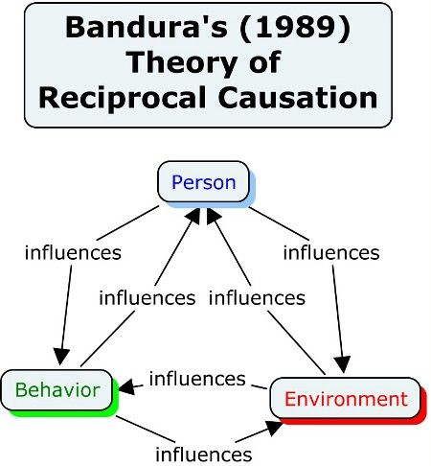
Social cognitive theory
Social Cognitive Theory was developed by Albert Bandura and is used to explain how norms, behaviors, attitudes, and identities are transmitted between group members.
Direct: learning can be done by performing the action ourselves and then experiencing the consequences.
Indirect: learning can be done by observing the consequences of another person’s actions.

Slide 52
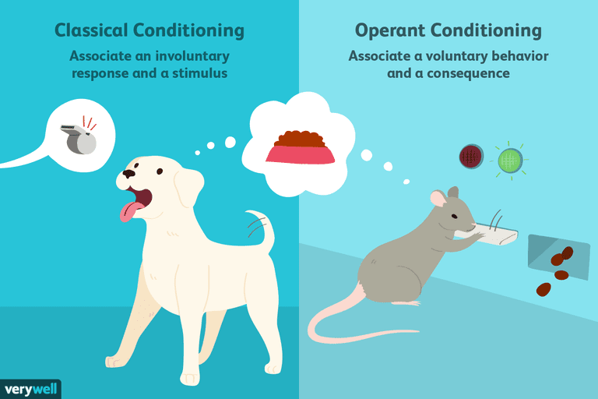
Classical and operant conditioning
Social Learning Theory is based on a behaviorist approach.
Classical or operant conditioning are used to describe how social learning occurs.
The behaviorist approach to learning places and emphasis on observable behavior as opposed to cognition.
In order to learn something, individuals must observe it and then try it.
Bandura states that trial and error is how people learn language, customs, educational, religious, and political practices.

Slide 53
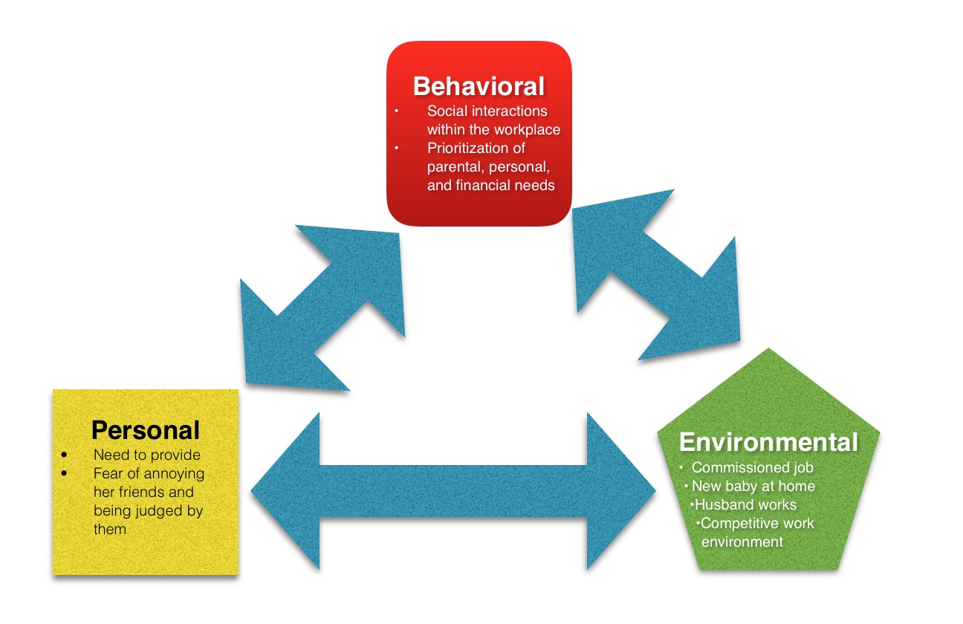
Reciprocal determinism triadic reciprocal determinism
Reciprocal determinism is the theory set forth by psychologist Albert Bandura which states that a person's behavior both influences and is influenced by personal factors and the social environment.
Bandura accepts the possibility that an individual's behavior may be conditioned through the use of consequences

Slide 54
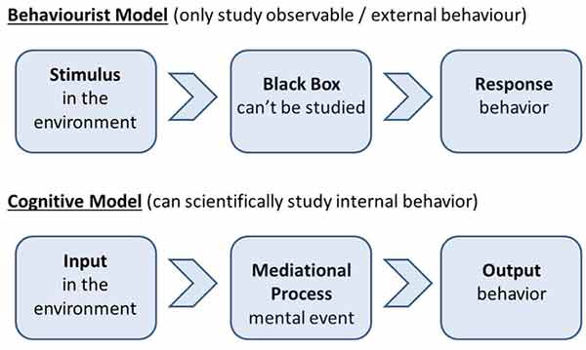
Bandura adopted the assumption that the mind could be studied scientifically and therefore tried to shed light on the black box of the mind.
Instead of simply stimulus-behavior, Bandura’s theory encourages researchers to examine the complex thought processes that occur between observation and behavior.

Slide 55
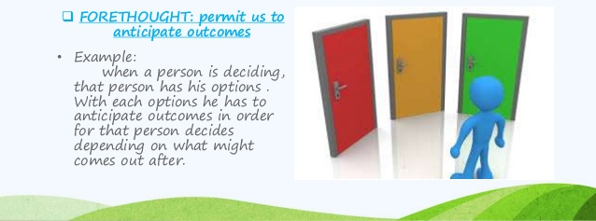
Agentic approach
Bandura believed researched should look at stimulus-cognition-behavior. He called this the agentic approach.
To be an agent means:
  To have control over behavior.
  To develop intentions and forethought-to be able to visualize future behaviors.
  To regulate behavior- do things that give satisfaction and reward while avoiding things that result in negative outcomes.

Slide 56
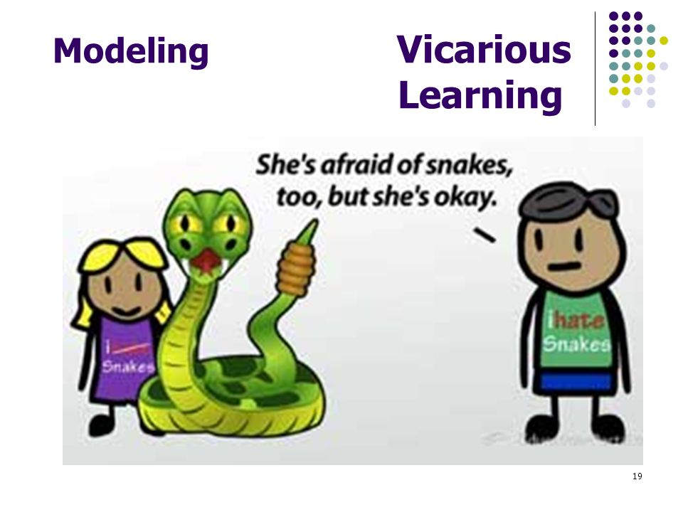
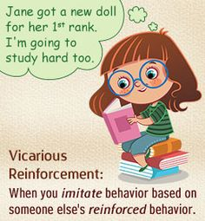
bandura
Vicarious learning: learning from the success and mistakes of others.
Vicarious Reinforcement: learning from reinforcements learned by others.
Bandura believed that reinforcement is not essential for learning to occur but the expectation of reinforcement affects performance of what has been learned.

Slide 57
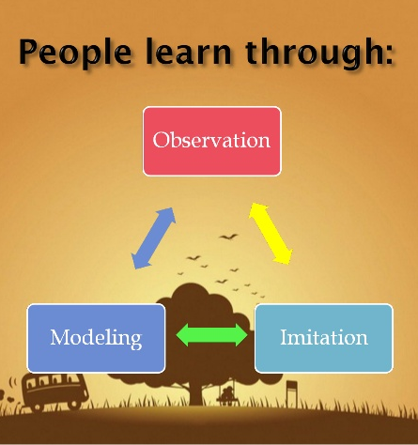
attention
Bandura argues that instead of learning by trial and error, people learn by their ways of thinking and behaving and by paying attention to how others think and behave.
He calls this observational learning.
Bandura is most known for his experiments carried out with Ross and Ross in 1961 with the Bobo Doll.

Slide 58
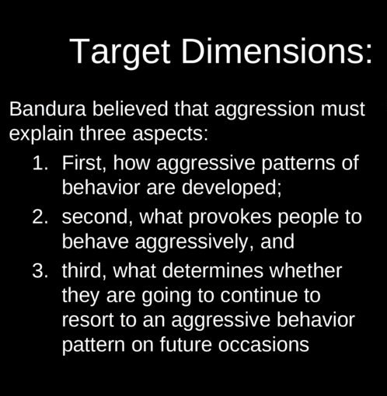


Slide 59
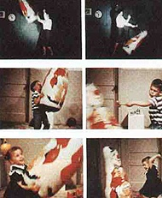
The Bobo Doll Experiment
The Bobo doll experiment was conducted by Albert Bandura in 1961.
In this work, Bandura found that children exposed to aggressive adult model acted more aggressively than those who were exposed to a nonaggressive adult model.

Slide 60
Design of the Bobo Doll Experiment
Sample / Subjects / Participants
36 boys and 36 girls, from Stanford Nursery, mean age 4 years 4 months
Independent Variable-Exposure to aggressive model or non-aggressive model
Dependent variable-Imitation / behavior after the exposure
Imitation of physical aggression: […] striking the Bobo doll with the mallet, sitting on the doll and punching it in the nose, kicking the doll, and tossing it in the air.
Imitative verbal aggression: Subject repeats the phrases, "Sock him," "Hit him down," "Kick him," "Throw him in the air," or "Pow"
Imitative nonaggressive verbal responses: Subject repeats, "He keeps coming back for more," or "He sure is a tough fella."
Mallet aggression: Subject strikes objects other than the Bobo doll aggressively with the mallet.
Sits on Bobo doll: Subject lays the Bobo doll on its side and sits on it, but does not aggress toward it.

Slide 61
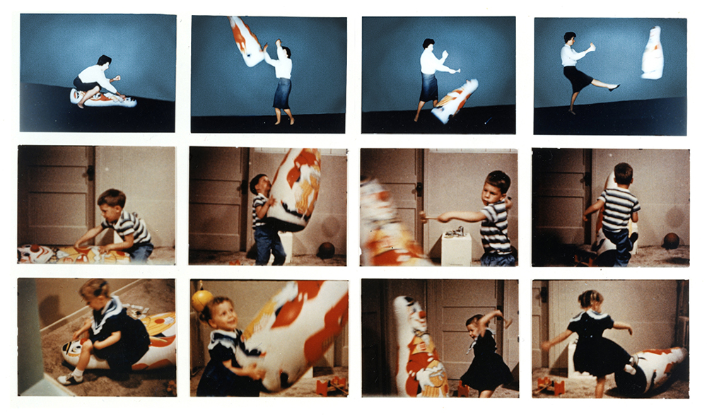

Slide 62
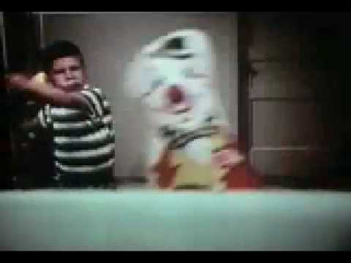
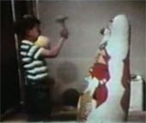
Method
The control group was composed of 24 children. The first experimental group comprised 24 children exposed to aggressive model behavior.
The second experimental group comprised 24 children exposed to nonaggressive model behavior.

Slide 63

Method
To avoid skewed results due to the fact that some children were already predisposed to being more aggressive, the experimenter and the teacher (both knew the children well) rated each child based on physical aggression, verbal aggression, and object aggression prior to the experiment.
This allowed Bandura to group the children based on average aggression level.

Slide 64
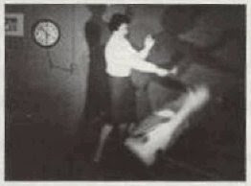

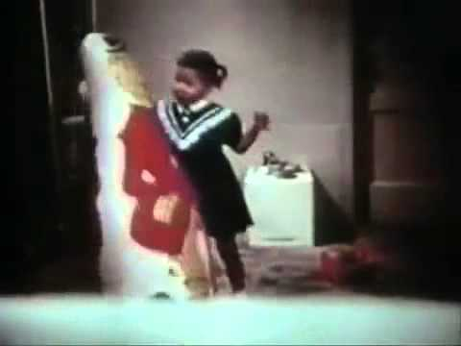
Results
Bandura found that the children exposed to the aggressive model were more likely to act in physically aggressive ways than those who were not exposed to the aggressive model.
This experiment is important to psychology because it was a precedent that sparked many more studies about the effects of viewing violence on children.

Slide 65
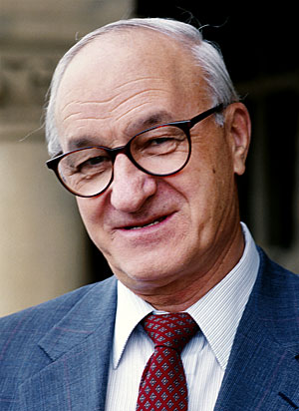
Conclusions
Aggression is a learned behaviour, not an in-built instinct
Learning can take place in absence of any reinforcement, only via observation and modeling
Modeling is a powerful and fast way of learning

Slide 66
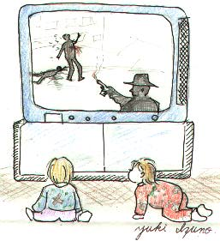
Bandura’s further research
Bandura, Ross & Ross (1963): children watched films with either an aggressive or non-aggressive model.
Filmed model produced even more aggression than live model.
Model rewarded or punished for aggression.
Children imitated the rewarded aggresive model the most.
Bandura’s research as the ‘first generation’ of scientific research on the effects of media violence on children.

Slide 67

Self-efficacy
Self-efficacy is an individual's belief in their innate ability to achieve goals.
Albert Bandura defines it as a personal judgment of "how well one can execute courses of action required to deal with prospective situations".
Expectations of self-efficacy determine whether an individual will be able to exhibit coping behavior and how long effort will be sustained in the face of obstacles.
Individuals who have high self-efficacy will exert sufficient effort that, if well executed, leads to successful outcomes, whereas those with low self-efficacy are likely to cease effort early and fail.

Slide 68
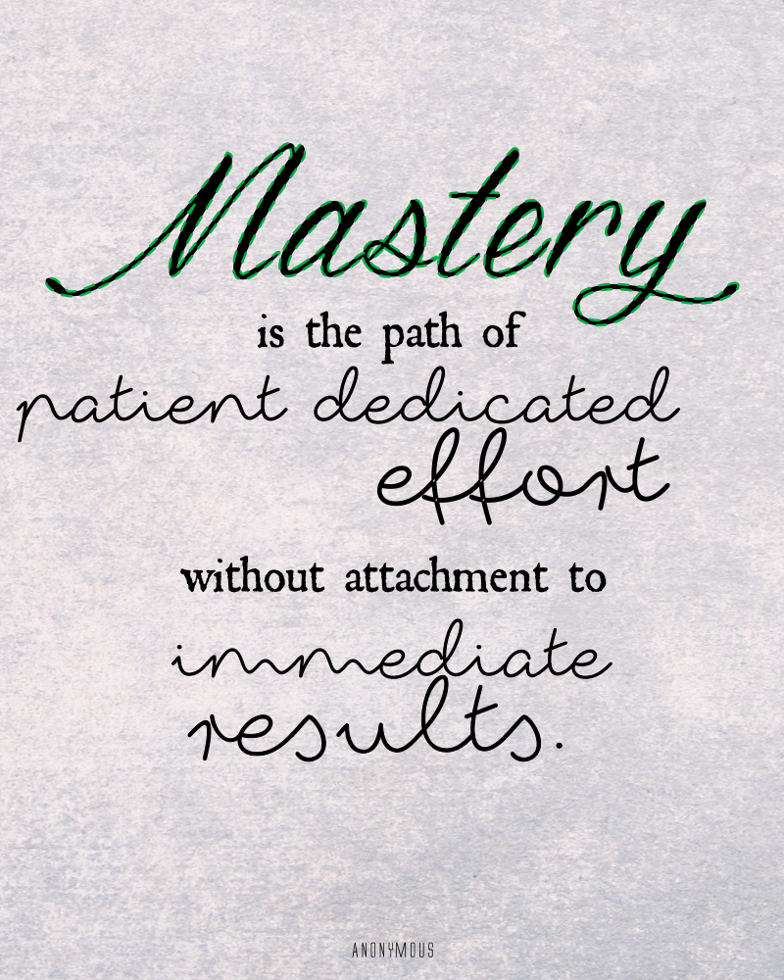
Mastery experiences
Is experiencing the results of self-efficacy first hand.
The key to mastery is approaching life with dedicated efforts and experimenting with realistic but challenging goals.
Essential to mastery is also acknowledging the satisfaction of goals that are achieved.
Easy success with little effort can lead to us to expect rapid results which can in turn make us easily discouraged by failure (Bandura, 2008).
Experiencing failure is important so that we can build resilience to it.
This is done by treating every failure as a learning opportunity and a chance to reach competence with a different approach.

Slide 69
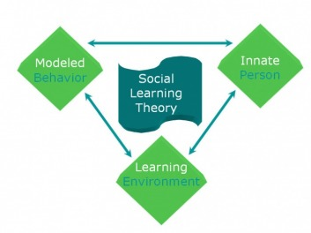
Social modeling
This means choosing role-models that can demonstrate their self-efficacy.
Observing those who employ this in their lives and have reached their goals despite adversity can provide great motivation.
Bandura notes that due to modern technology, it is not necessary to draw role-models from one’s own social surroundings.
The internet and other digital resources can provide windows into the lives of many inspiring models.

Slide 70

Social persuasion
This is about ‘finding the right mentor’.
While social modeling refers to the observation of a role model, social persuasion is about having others directly influence one’s self-efficacy by providing opportunities for mastery experiences in a safe and purposeful manner.
Due to the specific nature of self-efficacy strengthening experiences (avoiding easy successes and overwhelming failures) it essential to
have a mentor that is “knowledgeable and practice[s]
what they preach” (Bandura, 2008).

Slide 71

States of physiology
Our emotions, moods, and physical state can influence our interpretation of self-efficacy.
It is easy to judge oneself with bias based on the state one in when a failure occurs.
To feel ‘tension, anxiety, and weariness’ is normal, but society has negative perspectives on such states, leading to a stronger sense of failure in the wake of these feelings.
Positive and negative emotions act as magnets to further influence one’s sense of self-efficacy, especially in the case of a depressed mood when control can feel out of reach.

Slide 72

cognitive
Thinking in self-enhancing (optimistic) or self-debilitating (pessimistic) ways can greatly influence functioning.
To believe that one’s actions have an impact on their experience and environment allows for a self-sustaining optimistic view of life-that no matter what the circumstance something can be done to effect the ultimate outcome.
Without this belief, a more pessimistic thought process often takes predominance where events are thought of as ‘out-of-my-hands’ and the individual is simply a passenger in the ride that is life.

Slide 73

motivational
Based on how opportunities and obstacles are interpreted, it is easy to become victim to believing effort is futile in the face of obstacles, finally giving up altogether.
The alternative is seeing obstacles as something to be overcome, if the right skills and motivation were developed and employed.
Self-efficacy means believing in the value of motivation to influence an outcome. Feeling secure in this belief leads to self-determined motivation—therefore it is not a question of ‘can I reach my goal?’ but rather ‘what is required for me to reach my goal?’

Slide 74
Emotional decisional
Revisiting the idea of how states of physiology (our moods and feelings) influence self-efficacy, it works in reverse as well.
A strong sense of self-efficacy means recognizing that it is normal and human to feel discouraged in the face of failure. However believing in one’s ability to ‘bounce back’ can influence the outcome of an experience.
When we learn that we are not at the mercy of our physiological states, we become less susceptible to emotional reactions.
Self-efficacy means that there is a choice when it comes how we choose to experience our situation.
By employing self-efficacy one can choose which environments are best suited for their growth and development.
This is essentially addressing the idea of destiny vs agency where people develop their own destinies and create the opportunities they desire through thoughtful choices.

Slide 75

Mihalic and elliot
Social Cognitive Theory has been used to explain marital violence.
Violence is a learned behavior and has been accepted as being an intergenerational transmission.
Michalic and Elliot found that males and females who endured more physical violence as children had higher rates of marital violence as adults.
As children they observed the model of their parents and how they behave in a relationship.
They learn what is “appropriate” for these relationships.

Slide 76

Social cognition #29
Social Cognition is the study of how people understand their social world.
In order to make sense of the world we are required to engage in three cognitive processes according to Baron and Byrne.
1. Interpret information we receive about other people by examining it within its social context and giving it meaning.
2. Analyze the initial appraisal and modify it accordingly. First impression may not be accurate.
Be able to recall previous knowledge and experiences at the appropriate time.

Slide 77


Attribution Theory
Attribution Theory: suggests that how we explain someone’s behavior- by crediting either the situation or the person’s disposition.
The theory is concerned with the ways in which people explain (or attribute) the behavior of others or themselves (self-attribution) with something else.
It explores how individuals "attribute" causes to events and how this cognitive perception affects their usefulness in an organization.

Slide 78

Two Types
"External" or "situational" attribution assigns causality to an outside factor, such as the weather.
"Internal" or "dispositional" attribution assigns causality to factors within the person, such as their own level of intelligence or other variables that make the individual responsible for the event.

Slide 79

heider
Heider (1958) believed that people are naive psychologists trying to make sense of the social world.
People tend to see cause and effect relationships, even where there is none!
Heider didn’t so much develop a theory himself as emphasize certain themes that others took up.
There were two main ideas that he put forward that became influential: dispositional (internal cause) vs situational (external cause) attributions.

Slide 80

Jones and davis
Jones and Davis (1965) thought that people pay particular attention to intentional behavior (as opposed to accidental or unthinking behavior).
Jones and Davis’ theory helps us understand the process of making an internal attribution.
They say that we tend to do this when we see a correspondence between motive and behavior.
For example, when we see a correspondence between someone behaving in a friendly way and being a friendly person.

Slide 81

Dispositional (i.e., internal) attributions provide us with information from which we can make predictions about a person’s future behavior.
The correspondent inference theory describes the conditions under which we make dispositional attributes to the behavior we perceive as intentional.
Davis used the term correspondent inference to refer to an occasion when an observer infers that a person’s behavior matches or corresponds with their personality. It is an alternative term to dispositional attribution.
So what leads us to make a correspondent inference?
Jones and Davis say we draw on five sources of information:

Slide 82

Sources of information
Choice: If a behavior is freely chosen it is believed to be due to internal (dispositional) factors.
Accidental vs. Intentional Behavior: Behavior that is intentional is likely to be attributed to the person’s personality, and behavior which is accidental is likely to be attributed to situation / external causes.
Social Desirability: Behaviors low in sociable desirability (non conforming) lead us to make (internal) dispositional inferences more than socially undesirable behaviors.
Hedonistic Relevance: If the other person’s behavior appears to be directly intended to benefit or harm us.
Personalism: If the other person’s behavior appears to be intended to have an impact on us, we assume that it is “personal”, and not just a by-product of the situation we are both in.

Slide 83

Social Cognition & Attributions
Harold Kelley’s Theory of Attribution
  Situation/disposition attributions influenced by:
  (1) Consistency of a Behavior
    Does the individual behave this way always?
  (2) Distinctiveness of a Behavior
    Does the individual behave differently in different situations?
  (3) Consensus of a Behavior
    Do others behave similarly in this and other situations?
  All in all, why do you think humans prefer making dispositional attributions?
Notes:
Kelley suggested that whether we attribute other’s behaviors to situational or dispositional factors depends on three type of information: Consensus; Distinctiveness and Consistency.
Consensus - The extent to which we have personally observed a behavior to be common to several other people in a given situation. That is, during lecture, do you see all people taking notes or only one person? When our consensus is high, we generally attribute the behavior of others to situational causes. If consensus is low, we attribute behavior to dispositional factors.
Consistency - is whether a person’s behavior occurs reliably over time in the same situation, or if their behavior only occurs occasionally. If a person’s behavior is consistent in the a particular situation, then it is not likely that the behavior is due to situational factors. If the person’s behavior is inconsistent in that situation and/or is seen on other situations as well, then the behavior is likely due to dispositional factors.
Distinctiveness - is the extent to which a person performs a particular behavior only during one particular event, other person or thing. That is, how often does a person’s particular type of behavior exhibit itself: frequently, or rarely? If a behavior is very distinct and seen infrequently, then the behavior is likely to be attributed to the situation. If the behavior is seen to occur frequently and in many situations, then the behavior is likely dispositions.

Slide 84

Kelly: covariation model
Kelley’s (1967) covariation model is the best-known attribution theory.
He developed a logical model for judging whether a particular action should be attributed to some characteristic (dispositional) of the person or the environment (situational).
The term covariation simply means that a person has information from multiple observations, at different times and situations, and can perceive the covariation of an observed effect and its causes.
He argues that in trying to discover the causes of behavior people act like scientists.
More specifically they take into account three kinds of evidence.

Slide 85

Three types of evidence- Example
Consensus: the extent to which other people behave in the same way in a similar situation. E.g., Alison smokes a cigarette when she goes out for a meal with her friend. If her friend smokes, her behavior is high in consensus. If only Alison smokes, it is low.
Distinctiveness: the extent to which the person behaves in the same way in similar situations. If Alison only smokes when she is out with friends, her behavior is high in distinctiveness. If she smokes at any time or place, distinctiveness is low.
Consistency: the extent to which the person behaves like this every time the situation occurs. If Alison only smokes when she is out with friends, consistency is high. If she only smokes on one special occasion, consistency is low.

Slide 86

Example:
Now, if everybody laughs at this comedian, if they don’t laugh at the comedian who follows and if this comedian always raises a laugh, then we would make an external attribution, i.e., we assume that Tom is laughing because the comedian is very funny.
On the other hand, if Tom is the only person who laughs at this comedian, if Tom laughs at all comedians and if Tom always laughs at the comedian then we would make an internal attribution, i.e., we assume that Tom is laughing because he is the kind of person who laughs a lot.
So what we’ve got here is people attributing causality on the basis of correlation. That is to say,; we see that two things go together and we, therefore, assume that one causes the other.

Slide 87
According to Kelley we fall back on past experience and look for either
1) Multiple necessary causes.
  For example, we see an athlete win a marathon, and we reason that she must be very fit, highly motivated, have trained hard etc., and that she must have all of these to win
2) Multiple sufficient causes.
  For example, we see an athlete fail a drug test, and we reason that she may be trying to cheat, or have taken a banned substance by accident or been tricked into taking it by her coach. Any one reason would be sufficient.
One problem, however, is that we may not have enough information to make that kind of judgment.
For example, if we don’t know Tom that well, we wouldn’t necessarily have the information to know if his behavior is consistent over time.
So what do we do then?
According to Kelley we fall back on past experience and look for either:

Slide 88


Attribution Bias
In psychology, an attributional bias is a cognitive bias that affects the way we determine who or what was responsible for an event or action (attribution).
Attributional biases typically take the form of actor/observer differences: people involved in an action (actors) view things differently from people not involved (observers).

Slide 89

BIAS IN SOCIAL INFORMATION PROCESSING
Correspondence Bias- the tendency to assume that people’s behavior corresponds to their internal states rather than the external situation.
Example: Road Rage
We make assumptions about people we do not know based on how they drive.

Slide 90

Examples: Internal/External
Maria’s car breaks down on the highway. If she believes that the car broke because of her lack of knowledge about cars then she is making and internal attribution.
If she believes that car broke because it is old then she is making an external attribution.

Slide 91
Stable/Unstable
Attribution
Example: Stable/Unstable
Researchers distinguish between stable and unstable attributions.
Stable: the person infers that an event or behavior is due to stable, unchanging factors.
Unstable: the person infers that the event or behavior is due to unstable or temporary factors.
Lee gets a D on his sociology term paper. If he attributes the bad grade to his bad luck, he is making a stable attribution.
If Lee is attributing the bad grade to the fact he didn’t have enough time to work on it he is making an unstable attribution.

Slide 92

Self-FuLfilling Prophecy
What is this?
People will rise to the expectations they are given.
Students will perform better if they are expected to do well than if they are expected to do poorly.
  Schemas can cause people to behave in an “expected” manner

Slide 93
When people make an attribution, they are guessing about the causes of events or behaviors.
These guesses are often wrong.
People have systematic biases, which lead them to make incorrect attributions.
This includes:
-fundamental attribution bias
-self-serving bias
-just world hypothesis

Slide 94

Fundamental Attribution Error
The fundamental attribution error is the tendency for people to over-emphasize dispositional, or personality-based, explanations for behaviors observed in others while under-emphasizing situational explanations.
In other words, people have an unjustified tendency to assume that a person's actions depend on what "kind" of person that person is rather than on the social and environmental forces influencing the person.

Slide 95

Example:
Alexis falls asleep in class.
Sean attributes her behavior to laziness.
When Sean fell asleep in class he attributed it to his pulling an all-nighter to finish his term paper.

Slide 96

Self-Serving Bias
The tendency to attribute successes to internal factors and failures to situational factors.
This tendency tends to increase the more time has passed after the event.
Example: Chad wins the poetry contest but fails to get his poem published in a magazine that he sent it to. His success in the contest was due to his talent, the failure with the magazine is because he has bad luck.

Slide 97

Positivity/Negativity Effect
The positivity effect is the tendency of people, when evaluating the causes of the behaviors of a person they like or prefer, to attribute positive behaviors to the person's inherent disposition and negative behaviors to situations surrounding the behaviors.
The negativity effect is the tendency of people, when evaluating the causes of the behaviors of a person they dislike, to attribute positive behaviors to the situations surrounding the behaviors and negative behaviors to the person's inherent disposition.

Slide 98
Example: Positive/Negative
He is a good kid, he only behaved that way because the rest of the class is bad.
She is a troublemaker, the only reason she is good in this class is because Mrs. Smith is such a great teacher.

Slide 99

conformity
A change in behavior or belief as a result of real or imagined social norms.
Refers to both acting as if you accept the group, and actually accepting the group attitudes.

Slide 100
Conformity
Why do we conform?
We look to the group for information!
Factors that predict conformity:
Cohesiveness: wanting to fit with the group
  Refers to group status and unanimity
Norms for behavior
  Normative Influence: We want to be liked
  Informational Influence: We want to do the right thing, which is what others are doing.

Slide 101

Groups Encourage
conformity
  Behave according to group expectations
  Adjust attitudes in accordance with the group
  Conformity can be good
  Is too much conformity bad?

Slide 102

Social Influences on Individuals
Social norms
  Unwritten laws for behaving in social situations
  But, there are many rules and “laws” that are informal and unwritten. These rules are usually part of the closest group that you belong to, for example, your group of friends. Following these informal rules, called social norms
Notes:
Many laws and rules in a society or in a group are formally written down and must be legally followed. For example, in the US, you cannot go out and beat up someone.
But, there are many rules and “laws” that are informal and unwritten. These rules are usually part of the closest group that you belong to, for example, your group of friends. Following these informal rules, called social norms, is not a matter of legality; rather, is a matter of how you are expected to act and think in certain situations. That is, social norms are a set of guidelines that groups use to persuade members of the group in ways that they should think and act.
Sherif had participants sit, individually in a room and watch a beam of light projected on to a screen. All participants experienced the autokinetic effect, that is, the light appeared to move though it was static. The individual estimates of how far the light moved were highly variable. Sherif then placed the participants into groups of three to try to come up with group estimates of how far the light had moved (while watching it again). Finally, he re-tested the individuals without the aid of their groups. What happened, was that, after the group-testing was completed, participants’ estimates of the distance that the light had moved were very close to the estimates that the group had made together. Thus, the group participation had created a frame of reference that the individuals used in making their own judgments later.
Group polarization occurs when the initial decision or position of a group becomes more extreme over time and over more discussion. For example, if a group decided on a risky decision, later on, the final decision will be even riskier. Or, if the initial position is conservative, the final position and decision will be even more conservative.
For example, a group that is racially prejudiced will become more prejudiced after discussion of the topic. The reason for this seems to be constant reinforcement of the position of the group through repeated discussion.
Groupthink is the desire to avoid dissent from the group’s position so as to maintain a consensus of the group. Generally, groupthink occurs when a very important decision is made in a stressful situation and when the stakes are potentially very high. An example of this is the Iraq war. There was little to no dissent in the Bush administration (that we are aware of), the situation was stressful (for US citizens, not the administration) and the stakes were potentially high (for oil companies). This desire by a few to go to war caused everyone in the administration to conform to the group consensus.

Slide 103

Group Polarization
Group polarization occurs when the initial decision or position of a group becomes more extreme over time and over more discussion.
Example:

Slide 104

GROUPTHINK CAN BECOME DANGEROUS:
Deindividuation: loss of self-awareness and self restraint occurring in group situations that foster arousal and anonymity.

Slide 105
Groupthink
Not all conformity is good though
Countless examples where conformity is disastrous
  The Holocaust
  Watergate Scandal
  Space Shuttle Challenger

Slide 106

Groupthink
Groupthink is the desire to avoid dissent from the group’s position so as to maintain a consensus of the group.
Generally, groupthink occurs when a very important decision is made in a stressful situation and when the stakes are potentially very high.

Slide 107

Groupthink, continued…
Irving Janis coined the term groupthink
When concurrence seeking overrides realistic appraisal
Factors that lead to groupthink
  Self-censorship
  Illusion of unanimity
  Direct pressure on dissenters
  Illusion of invulnerability
  Illusion of morality
  Stereotype and dismiss competitors

Slide 108

Acting Like Lemmings

Slide 109


Behavior is Contagious
One person laughs, yawns, or coughs and others in the group will do the same.
A cluster of people gaze upwards, passersby do likewise.
Bartenders and musicians “seed” their tip bar to look as if others have given.
Chameleon Effect
Chartrand and Bargh
We naturally copy the behavior of others.
People mimic out of empathy and to fit into the group.
Copycat Behavior: when people copy the behavior of others.
What causes suicide clusters?

Slide 110

Social Identity Theory
Henri Tajfel was a Polish social psychologist, best known for his pioneering work on the cognitive aspects of prejudice and social identity theory, as well as being one of the founders of the European Association of Experimental Social Psychology.
Social Categorization: Social Identity Theory is based on the cognitive process of social categorization. The theory is used to explain:
Ethnocentrism
In-group Favoritism
Stereotyping
Conformity to In-Group Norms

Slide 111

In Group and Out Group
In-group: “us” people whom share a common identity.
People tend to hold positive attitudes towards members of their own groups, a phenomenon known as in-group bias.
Outgroup: “them” those who are perceived as different or apart from one’s in-group.
an outgroup is a social group towards which an individual feels contempt, opposition, or a desire to compete

Slide 112

Examples of In-group/Outgroup
Most students think that their school is better than the other schools in town.
Most graduating classes believe their class was the best.
High school students form cliques- such as jocks, goths, gangs, geeks, preps, and other groups.

Slide 113

Responses to Social Influence
Compliance: purely motivated by desire to gain reward or avoid punishment (Power)
Identification: adopt a behavior to be like those we find attractive. A greater level of belief adoption than in compliance (Attractiveness)
Internalization: becomes part of our belief system. Intrinsically driven by the desire to be correct. Most enduring (Credibility)
Asch study is an example of compliance.

Slide 114

Conformity and Solomon Asch
Solomon Asch conducted an experiment to investigate the extent to which social pressure from a majority group could affect a person to conform.
Definition: change in a person’s behavior or opinions as a result of real or imagined pressure from a person or group of people.
Asch: completed two studies that demonstrate how easily conformity occurs.

Slide 115

Using a line judgment task, Asch put a naive participant in a room with seven confederates/stooges.
The confederates had agreed in advance what their responses would be when presented with the line task.
The real participant did not know this and was led to believe that the other seven confederates/stooges were also real participants like themselves.
Each person in the room had to state aloud which comparison line (A, B or C) was most like the target line.
The answer was always obvious. The real participant sat at the end of the row and gave his or her answer last.
There were 18 trials in total, and the confederates gave the wrong answer on 12 trails (called the critical trials).
Asch was interested to see if the real participant would conform to the majority view.
Asch's experiment also had a control condition where there were no confederates, only a "real participant."

Slide 116
Asch experiment
6 people in the experiment (actually, 5 confederates)
Which line matches the test line?

Slide 117

Asch: Other Variables
Size of group: as group size increases to 3 others, conformity increases. After that, little change
Presence of one dissenter decreases conformity immensely
The more wrong the majority was, the less influence.
The greater the privacy, the less conformity

Slide 118

RESULTS
Asch measured the number of times each participant conformed to the majority view.
On average, about one third (32%) of the participants who were placed in this situation went along and conformed with the clearly incorrect majority on the critical trials.
Over the 12 critical trials, about 75% of participants conformed at least once, and 25% of participant never conformed.
In the control group, with no pressure to conform to confederates, less than 1% of participants gave the wrong answer.

Slide 119

Milgram Experiment

Slide 120

Why did Germans comply with Hitler’s plans for the Holocaust?

Slide 121

Adolf eichmann
Adolf Eichmann was captured for war crimes in 1960.
The trial began in 1961.
During the whole trial, Eichmann insisted that he was only "following orders“.

Slide 122
Applications of Conformity Research
Obedience to Authority: Stanley Milgram
Key ideas
  Power of the situation- authority figure pressing you on.
  Tendency of observers to commit the fundamental attribution error
  Fundamental Attribution Error: is a theory describing cognitive tendency to predominantly over-value dispositional, or personality-based, explanations. People predominantly presume that the actions of others are indicative of the "kind" of person they are, rather than the kind of situations that compels their behavior.
  Self-serving bias: is a cognitive bias which tends to enhance the ego and self confidence of an individual.

Slide 123

Stanley Milgram’s “Obedience Study”
  Subjects were “teachers” in a “memory study”
  “Learner” was in another room
  “Teacher” shocked “learner” for mistakes
  How long would the “teacher” give the shocks?
Notes:
Obedience is, loosely defined, as the situation where a person behaves or thinks in accordance with the desires and orders of a superior, even when they do not think that what they are doing is justified or OK. That is, people comply with the request of superiors and are persuaded by the arguments made by people in authority. (The Iraq war is a good example.)
An example of obedience is the behavior of the Nazi concentration camp workers during WWII. In this case
It was not actually a memory experiment, but was actually an experiment on obedience.
The “learner” was not actually a participant, but was a paid actor.
The “teachers” were told that they were to teach the learner a series of words to learn and that the learner would repeat the words. Anytime that the “learner” was incorrect” they should give him a shock and then increase the voltage.
The device that was used to deliver the shocks is shown here. It had a range of voltage from 15-450 volts with different labels under some of the voltages; from “Slight Shock” to Danger: Severe Shock” to the ominous “XXX”.
The “learner” was not shocked, but acted out different levels of pain to each shock.
The researcher made sure that the “teacher”: increased the shock severity after each mistake.
At the 300-Volt level the “learner” pounded the wall and stopped responding to all questions. At this point, the researcher told the “teacher” that ‘no-answer’ was an incorrect answer and to increase the voltage to 315-Volts and shock again. If the teacher complied, the “learner” continued to pound the wall again, but made no verbal response.
If the “teachers” did not want to continue, The researcher said: “Please go on.” “The experiment requires that you continue.” It is absolutely essential that you continue.” You have no other choice, you must go on.”

Slide 124

Shock labels:
15 - slight shock
75 - moderate
150 - strong
225 - very strong
300 - intense
345 - severe
375 - Danger: severe shock
435 - XXX
450 - XXX

Slide 125


Experiment involved “teaching through negative reinforcement”

Slide 126


Why did so many obey?
experimenter said he was responsible (diffusion)
commands were gradual in nature
participants had little time for reflection
experimenter was perceived as an authority figure
  People believed he had the power to influence/control their behavior

Slide 127

Obedience
Obedience- change behavior in response to direct orders from authority (most direct form)
Milgram’s Obedience Study
  Participants told to deliver increasing levels of shock to a “learner” each time he made an error on a simple learning task
Why did so many people obey? What was wrong with them?
Notes:
12
11
4

Slide 128
Social Influences on Individuals
Milgram (1963) Results:
  Majority of subjects gave the lethal shock!
Notes:
What is even more interesting is that, in a later experiment, Milgram found that 37.5% of participants would still give lethal shocks even when the learner was in the same room and could personally see the man struggling and in pain.
What is even more amazing, is that 30% would hold the man’s hand against a metal plate so that he would still be shocked when he tried to move his hand.

Slide 129

results

Slide 130

Social Influences on Individuals
What is even more interesting is that, in a later experiment, Milgram found that 37.5% of participants would still give lethal shocks even when the learner was in the same room and could personally see the man struggling and in pain.
What is even more amazing, is that 30% would hold the man’s hand against a metal plate so that he would still be shocked when he tried to move his hand.
Notes:
What is even more interesting is that, in a later experiment, Milgram found that 37.5% of participants would still give lethal shocks even when the learner was in the same room and could personally see the man struggling and in pain.
What is even more amazing, is that 30% would hold the man’s hand against a metal plate so that he would still be shocked when he tried to move his hand.

Slide 131

What reduces compliance?
  Two experimenters disagree about continuing.
  Two “fellow participants” refuse to continue.
  Experimenter was in different room than participant.
  Participant has to physically hold victim’s hand to shock plate.
  Victim claiming he had a heart condition
  The experiment was done for a market research company
  The victim extracting an explicit demand to stop on demand.

Slide 132

Social Influences on Individuals
Impact of Milgram’s results?
  People follow authority
  Explains actions of Nazis
  guards and Abu Ghraib MPs
  Example of the fundamental attribution error.
    Underestimate situational factors on behavior
    Overestimate dispositional factors on behavior
Ethical considerations of Milgram study?
  Participants had negative self-perceptions
  Should deception be used?
Abu Ghraib Prison
Notes:
In Milgram’s experiments, the authority figure was the researcher, who prodded the participants to keep shocking the man. These studies seem to explain some of the behavior of Nazi death camp soldiers that killed people, that is, they were following orders. (This defense did not work at Nuremburg!)
What is interesting is that Milgram’s results represent the fundamental attribution error. Remember, this is where people underestimate the effectiveness of situational factors and overestimate the effect of dispositional factors, in the control of human behavior. In this case, the situational factors was the authority figure and the orders given and the dispositional factors was the person’s desire not to harm people.
Many people have questioned whether Milgram should have done his study in this way.
Although the participants were very stressed, Milgram did practice this experiment before implementing it and was very careful to provide assistance and counseling to the participants if they needed it (which they did).
It should be noted that in a follow-up questionnaire, 84% of the participants reported that they were glad to have taken part in the study whereas only 1.3% were angered and not happy.

Slide 133

We Do What We're Told
In 1986, musician Peter Gabriel wrote a song called We do what we're told (Milgram's 37), referring to the number of fully obedient participants in Milgram's Experiment 18: A Peer Administers Shocks.
In this one, 37 out of 40 participants administered the full range of shocks up to 450 volts, the highest obedience rate Milgram found in his whole series.

Slide 134

JUST WORLD PHENOMENON
The Just-World Phenomenon is the tendency to believe that the world is just and that people get what they deserve.
Because people want to believe that the world is fair, they will look for ways to explain or rationalize away injustice, often blaming the person in a situation who is actually the victim.

Slide 135

stereotypes
The term stereotype was first used in a psychological sense by Lippmann in 1922, who defined stereotypes as “little pictures in our heads that help us interpret what we see”.
Aronson claims that when we stereotype we allow these pictures to take over our thinking, causing us to assign identical characteristics to any person in a group.

Slide 136

Piaget-Childhood development of schemas
Theorist Jean Piaget introduced the term schema, and its use was popularized through his work.
According to his theory of cognitive development, children go through a series of stages of intellectual growth.
In Piaget's theory, a schema is both the category of knowledge as well as the process of acquiring that knowledge.
He believed that people are constantly adapting to the environment as they take in new information and learn new things.
As experiences happen and new information is presented, new schemas are developed and old schemas are changed or modified.

Slide 137

Types of schemas
Person schemas are focused on specific individuals. For example, your schema for your friend might include information about her appearance, her behaviors, her personality, and her preferences.
Social schemas include general knowledge about how people behave in certain social situations.
Self-schemas are focused on your knowledge about yourself. This can include both what you know about your current self as well as ideas about your idealized or future self.
Event schemas are focused on patterns of behavior that should be followed for certain events. This acts much like a script informing you of what you should do, how you should act, and what you should say in a particular situation.

Slide 138

Grain of truth hypothesis
Grain of Truth Hypothesis asserts that there is some truth to most stereotypes we have about others.
Can be negative, positive, or neutral.
Holding stereotypes about others is problematic in 3 ways:
1. We accentuate differences between groups (focus on differences rather than similarities)
2. They cause us to underestimate differences within other groups.
3. Cause us to engage in selective perception (occurs outside of awareness. Ex: confederate flag we notice it more in the south)

Slide 139

Illusory correlations
It is common for people to see two variables as related when they are not. This is known as illusory correlation.
Common examples
  A student believing Asians are good at math because they sit next to an Asian who is good at math.
  Believing pit bulls are dangerous because of reading an article about an aggressive pit bull.
  A soccer player putting on this left shoe before his right because he believes that the last game he scored a goal because of this.
Illusory correlations are relevant to stereotypes because perceived correlations between the group and the trait.
They are illusory because they are falsely being understood as actual correlations.

Slide 140

Hamilton and Gifford
Aim –
To investigate illusory correlation as an explanation for stereotype formation
Method –
Researchers asked participants to read about two groups.
Group A (26 participants)
Group B (13 participants) The description based on positive and negative behaviors.
Group A had 18 positive and 8 negative behaviors.
Group B had 9 positive and 4 negative behaviors.
Participants answered question about behaviors of the groups.
Results –
Participants found that there were more undesirable behaviors for Group B than for Group A
Conclusion –
Distinctive information draws attention. Because group B was smaller it was more distinct than group .
Because of this Group B negative behaviors stand out more.
This causes illusory correlations.

Slide 141

Rosenthal and jacobson
Rosenthal’s most famous study was conducted with Lenore Jacobson in 1963 at an elementary school just south of San Francisco, California (Spiegel, 2012).
His purpose was to figure out what would ensue if teachers would react differently towards certain students if told that a select number of students were expected to learn more information and more quickly than the pupils in their class.
To test this, Rosenthal issued a Test of General Ability to the students in the beginning of the year.

Slide 142

method
After the students had completed this IQ test, some were chosen at random to be the students that were expected to academic bloomers; however, the results of the test did not influence which students of the class were chosen (Bruns et al., 2000).
He continued to observe the interactions between teachers and students and decided to issue another IQ test at the end of the study to see how IQ has improved in students that were to be academic bloomers versus the control group.

Slide 143

results
Rosenthal’s and Jacobson’s results had reinforced their hypothesis that the IQs of the “academic bloomers” would in fact be higher than those of the control group even though these academic bloomers were chosen at random.
Especially in younger children like those in grades 1 and 2, there was a remarkable difference in the increases of IQ between the students chosen to be academic bloomers and those that were not.
A reason for this is because younger children may be able to be influenced more greatly by their teachers, who are respected authorities.

Slide 144

conclusions
The conclusions demonstrated by the study greatly illustrate the Pygmalion effect, or Rosenthal effect, which is the phenomenon that explains better performances by people when greater expectations are put on them (Bruns et al., 2000).
For example, the teachers in the study, may have unnoticeably given the supposed academic bloomers more personal interactions, highly extensive feedback, more approval, and kind gestures, such as nods and smiling (Spiegel, 2012).
On the other hand, teachers would generally pay less attention to low-expectancy students, seat them farther away from teachers in the classroom, and offer less reading and learning material (Bruns et al., 2000).

Slide 145

Stereotype threat
Stereotype threat occurs when people are at risk for living up to a negative stereotype about their group.
Stereotype threat is a term that was created by social scientists Claude Steele and Joshua Aronson.
They completed an important early study in 1995 which defined stereotype threat as “being at risk of confirming, as self-characteristic, a negative stereotype about one’s group."

Slide 146

Steele and aronson
Steele and Aronson observed the performance of Black and White students on academic tests.
Steele and Aronson created the study in response to a negative stereotype about Black students which pervades culture .
– Black students are portrayed as less intelligent and less competent than white students.
Because of this stereotype, Steele and Aronson wondered if Black students would “protectively dis-identify with achievement in school and related intellectual domains."
This desire to disengage from intellectual pursuits could possible lead Black students to live up to their negative stereotype.

Slide 147

results
The results of the study confirmed the researcher’s suspicion.
When test instructors emphasized the role of race before the test, Black students performed worse than White students. When instructors did not emphasize race, Black and White students performed equally well.
In essence, stereotype threat occurs when people fear that they will live up to a negative stereotype about their group.
In response to their fear, they participate in disengaging and self-defeating behaviors that ironically cause them to live up to the feared stereotype.

Slide 148
Stereotype threat has been shown to impact peoples’ behavior in the following ways.
Reduced effort – People who fear they might live up to a stereotype sometimes reduce their effort so they can have an excuse if they fall into that stereotype. For example, people may not prepare for a test so they have an excuse when they do poorly.
Disengaging – People who are stereotypically not good at something (such as woman in mathematics) will often disengage from that field or area. Changing aspirations and career goals – Some people go as far as to change their life aspirations and career goals in response to stereotype threat.

Slide 149
Reducing stereotype threat
Providing role models. People who observe role models from their group engaging in certain fields and activities are more likely to think they can do the same thing. One study showed that woman who read about other woman who had succeeded in fields of architecture, law, medicine, and intervention performed better on a mathematics test than those who didn’t.
Encouraging self-affirmation – One study showed that having African students engage in a self-affirming journal exercise before the start of a semester closed the racial achievement gap by 40%.
Emphasizing motivation and effort – African American students who were taught that intelligence is “a malleable rather than fixed capacity" that can be increased through motivation and effort received better grades than those who were not taught this.

Slide 150

Social identity theory
Henri Tajfel's greatest contribution to psychology was social identity theory.
Social identity is a person’s sense of who they are based on their group membership(s).
Tajfel (1979) proposed that the groups (e.g. social class, family, football team etc.) which people belonged to were an important source of pride and self-esteem. Groups give us a sense of social identity: a sense of belonging to the social world.

Slide 151

The central hypothesis of social identity theory is that group members of an in-group will seek to find negative aspects of an out-group, thus enhancing their self-image.
Prejudiced views between cultures may result in racism; in its extreme forms, racism may result in genocide, such as occurred in Germany with the Jews, in Rwanda between the Hutus and Tutsis and, more recently, in the former Yugoslavia between the Bosnians and Serbs.
Henri Tajfel proposed that stereotyping (i.e. putting people into groups and categories) is based on a normal cognitive process: the tendency to group things together.
In doing so we tend to exaggerate:
1. the differences between groups
2. the similarities of things in the same group.

Slide 152

Examples of In-groups – Out-groups
o Northern Ireland: Catholics – Protestants
o Rwanda: Hutus and Tutsis
o Yugoslavia: the Bosnians and Serbs
o Germany: Jews and the Nazis
o Politics: Labor and the Conservatives
o Football: Browns and the Steelers
o Gender: Males and Females
o Social Class: Middle and Working Classes

Slide 153
Tajfel and Turner (1979) proposed that there are three mental processes involved in evaluating others as “us” or “them” (i.e. “in-group” and “out-group”. These take place in a particular order.
The first is categorization. We categorize objects in order to understand them and identify them.
In a very similar way we categorize people (including ourselves) in order to understand the social environment.
We use social categories like black, white, Australian, Christian, Muslim, student, and bus driver because they are useful.
In the second stage, social identification, we adopt the identity of the group we have categorized ourselves as belonging to.
If for example you have categorized yourself as a student, the chances are you will adopt the identity of a student and begin to act in the ways you believe students act (and conform to the norms of the group).

Slide 154
The final stage is social comparison. Once we have categorized ourselves as part of a group and have identified with that group we then tend to compare that group with other groups.
If our self-esteem is to be maintained our group needs to compare favorably with other groups.
This is critical to understanding prejudice, because once two groups identify themselves as rivals, they are forced to compete in order for the members to maintain their self-esteem.
Competition and hostility between groups is thus not only a matter of competing for resources like jobs but also the result of competing identities.

Slide 155
Tajfel 1971
The aim of the studies was to assess the effects of social categorization on intergroup behavior when, in the intergroup situation, neither calculations of individual interest nor previously existing attitudes of hostility could have been said to have determined discriminative behavior against an outgroup.
These conditions were satisfied in the experimental design. In the first series of experiments, it was found that the subjects favored their own group in the distribution of real rewards and penalties in a situation in which nothing but the variable of fairly irrelevant classification distinguished between the in-group and the outgroup.

Slide 156
Maximum Joint Profit: boys could allocate the largest amount to both boys in the matrix.
Maximum In-group profit: boys could allocate the largest amount to their in-group.
Maximum Difference: this decision maximized the amount given to the boys in their in-group and minimized the amount given to members of the outgroup.

Slide 157
Second series of experiments
In the second series of experiments it was found that:
1) maximum joint profit independent of group membership did not affect significantly the manner in which the subjects divided real pecuniary rewards;
2) maximum profit for own group did affect the distribution of rewards;
3) the clearest effect on the distribution of rewards was due to the subjects' attempt to achieve a maximum difference between the in-group and the outgroup even at the price of sacrificing other ‘objective’ advantages.

Slide 158
Can schemas be changed?
The processes through which schemas are adjusted or changed are known as assimilation and accommodation.
In assimilation, new information is incorporated into pre-existing schemas.
﻿In accommodation, existing schemas might be altered or new schemas might be formed as a person learns new information and has new experiences.

Slide 159

acculturation
Acculturation is the process of psychological and cultural change as a result of contact and interaction between cultures.
This can result in change for both cultures, not just the dominant culture.
Accelerating globalization is driving acculturation.
Resistance cultures are those who try to maintain they cultural identity.

Slide 160


Resisting cultures
The Sentinelese, an aboriginal tribe of hunter-gatherers who have lived isolated from the outside world for almost 60,000 years.
The North Sentinel Island -- home to the Sentinelese tribe -- is out of bounds for visitors.
Since the 1960s, there have been a handful of efforts to reach out to the Sentinelese tribe who live in the North Sentinel Island, off Adaman and Nicobar, but all have largely failed.

Slide 161

berry
Individuals can adopt four strategies for cultural change:
  1. Assimilation: when individuals are open to change and are unconcerned about any loss of their original culture.
  2. Integration: when individuals want to hold onto traditional values and beliefs but at the same time desire daily interactions with other cultures.
  3. Separation: when individuals value their original culture and are adverse to losing touch with values and traditions of their past.
  4. Marginalization: when individuals have little interest in maintaining their original culture but at the same time little interest in opening relations with other cultures.

Slide 162

Health behavior of migrants
The health behavior of migrants has been extensively studied.
Two main effects have been noticed.
Healthy Migrant Effect: the concept that recent migrants tend be healthier than their native born counterparts.
Negative Acculturation Effect: the apparent diminishing differences between migrants and their native born counterparts.

Slide 163

shah
Approximately 65% of the United Arab Emirates (UAE) population are economic migrants from the low- and middle-income countries of South Asia.
Emerging evidence suggests that expatriate populations from low or middle-income countries that migrate to high-income countries acculturate their lifestyle with the obesogenic behaviors of the host country.
Previous research has focused on migrant populations in the United States.
The objective of this study was to assess the prevalence of obesity and explore the relationship between years of residency (surrogate measure for acculturation) and obesity among South Asian (from India, Pakistan and Bangladesh) male immigrants residing in the UAE.

Slide 164
A random sample of 1375 males was recruited from a mandatory residency visa health screening centre in Abu Dhabi (UAE).
Employing a cross-sectional design, participants completed an interviewer-led adapted version of the World Health Organization STEPS questionnaire, and anthropometric and blood pressure measurements were collected. Glycated haemoglobin (HbA1c) was measured in a random sub-sample (n = 100).
Logistic regression was used to determine risk factors for being classified as obese, and to assess the relationship between years of residency and adiposity.

Slide 165
conclusions
Our study revealed a high prevalence of overweight, central obesity and hypertension amongst a young South Asian male migrant population in the UAE.
Study findings suggest a diminished ‘Healthy Migrant Effect’ with increased years of residency possibly due to greater acculturation and a transition in lifestyle behaviors.
Health initiatives targeting the maintenance of a healthy body size, coupled with regular assessments of glucose control and blood pressure are urgently required in this population.

Slide 166
Delavario
The objective of this study is to systematically review the evidence on the relationship between acculturation - as measured with a standardized acculturation scale - and overweight/obesity among adult migrants from low/middle countries to high income countries.
A systematic review of relevant studies was undertaken using six EBSCOhost databases and following the Centre for Reviews and Dissemination’s Guidance for Undertaking Reviews in Health Care.

Slide 167
results
The initial search identified 1135 potentially relevant publications, of which only nine studies met the selection criteria.
All of the studies were from the US with migrant populations from eight different countries.
Six studies employed bi-directional acculturation scales and three used uni-directional scales.
Six studies indicated positive general associations between higher acculturation and body mass index (BMI), and three studies reported that higher acculturation was associated with lower BMI, as mainly among women.

Slide 168

Acculturative stress
Moving from one country to another is interesting to people who love to experience and explore new things.
Nevertheless, it is a pain to other people because the strange land means a new life linked with worries and pressure brought by cultural clashes.
People who experience acculturative stress often consider it tough and confusing to adjust in the new environment with a wide range of strange things such as language, climate, customs, and food.

Slide 169

Culture shock
Another alternative term for acculturative stress is culture shock.
There are times that immigrants are not confident or comfortable with the country.
Only after two months do they find it easy to breathe and live again.
There are no more sad thoughts or more tears in the next few months as compared to the first previous months.
They are more likely to experience depressive symptoms that attribute to this higher degree of stress, brought by the process and status of immigration.

Slide 170
conclusions
Despite the small number of studies, a number of potential explanatory hypotheses were developed for these emerging patterns.
The ‘Healthy Migrant Effect’ may diminish with greater acculturation as the host culture potentially promotes more unhealthy weight gain than heritage cultures.
This appears particularly so for men and a rapid form of nutrition transition represents a likely contributor.
The inconsistent results observed for women may be due to the interplay of cultural influences on body image, food choices and physical activity.
That is, the Western ideal of a slim female body and higher values placed on physical activity and fitness may counteract the obesogenic food environment for female migrants.

