Slide 1
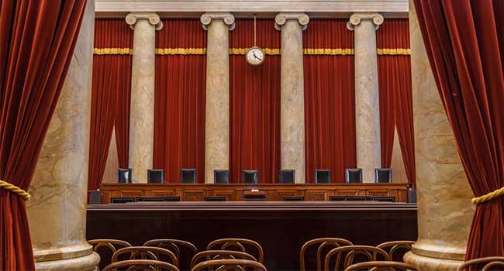
U.S. SUPREME COURT CASES

Slide 2
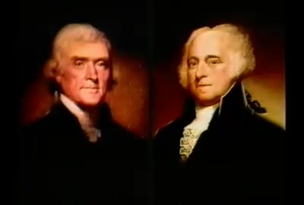
MARBURY V. MADISON
Year:
1803
Why It’s Important:
This case established the Supreme Court’s power of judicial review—the power to determine whether or not a law or other government action is constitutional. This power has become part of the “unwritten Constitution” and one of the Supreme Court’s most important roles.

Slide 3
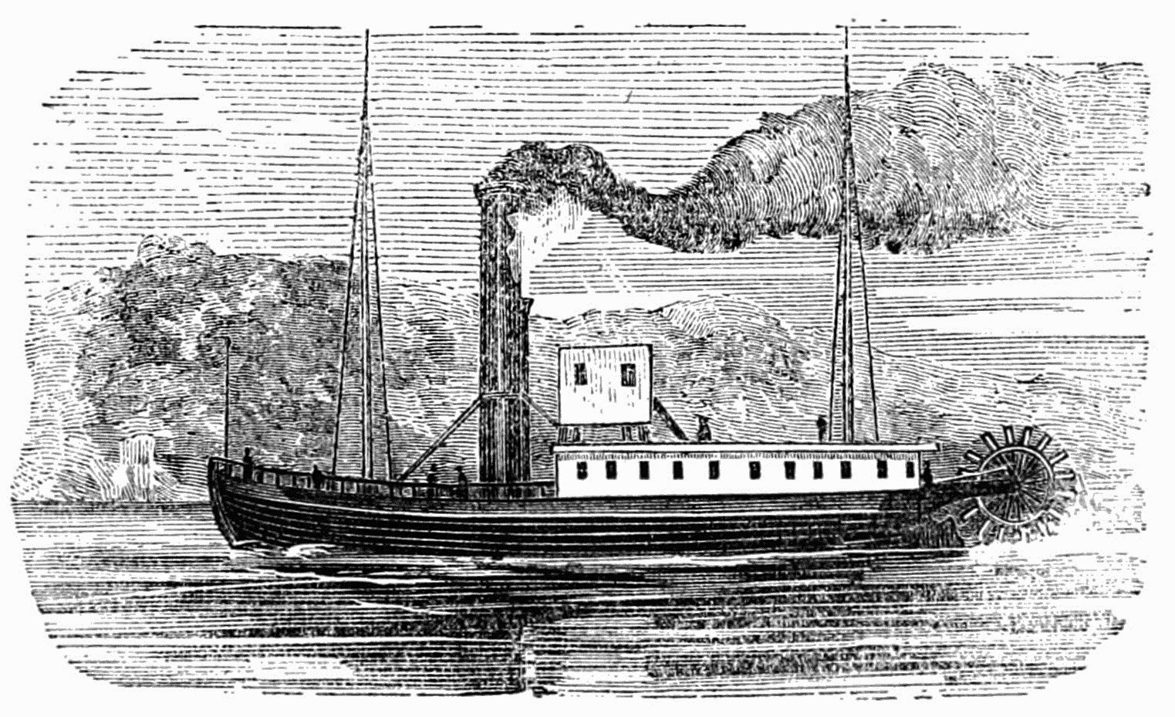
GIBBONS V. OGDEN
Year:
1824
Why It’s Important:
The court decided that the federal government only (not the states) had the right to control interstate commerce.

Slide 4
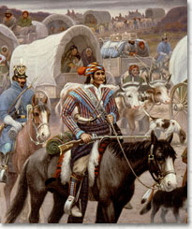
CHEROKEE V. GEORGIA
Year
1823
Why was this case important?
"The conditions of the Indians in relation to the United States is perhaps unlike that of any two people in existence," Chief Justice John Marshall wrote, "their relation to the United States resembles that of a ward to his guardian. . .(they were a) domestic dependent nation." Established a "trust relationship" with the tribes directly under federal authority.

Slide 5
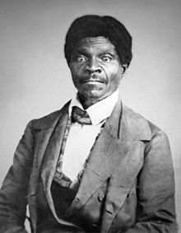
DRED SCOTT V. SANDFORD
Year:
1857
Why It’s Important:
Dred Scott was a slave who sued for his freedom after his master moved him into a free territory. The Supreme Court ruled against Scott. The ruling had these three major points:
Slaves were not U.S. citizens, so they had no right to sue.
Slaves are property and the government cannot take away a man’s property (or prevent him from moving with it). Therefore, Congress cannot ban slavery in the territories. This made the Missouri Compromise of 1820 null and void.
The federal government does not have the right to free slaves brought into the territories.

Slide 6
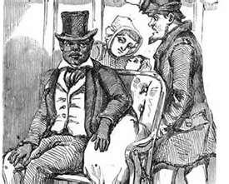
PLESSY V. FERGUSON
Year:
1896
Why It’s Important:
This case gave the legal green light to “separate but equal” public facilities for blacks and whites. It legitimized the Jim Crow segregation laws that would characterize racial policy for the next half-century.

Slide 7
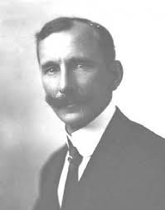
SCHENCK V. THE U.S.
Year:
1919
Why is it important?
Charles Schenck was protesting the war and using his First Amendment rights to free speech. Due to the war and heightened fears, the Supreme Court ruled against him and declared him “A Clear and Present Danger”.

Slide 8
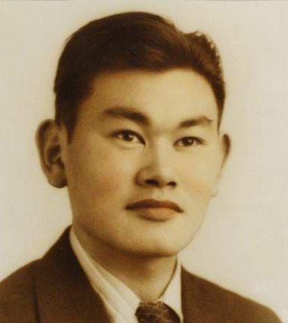
KOREMATSU V. THE U.S.
Year:
1944
Why It’s Important:
The Supreme Court ruled that interning Japanese-Americans during World War II, even those who were citizens born in the U.S., was legal.

Slide 9
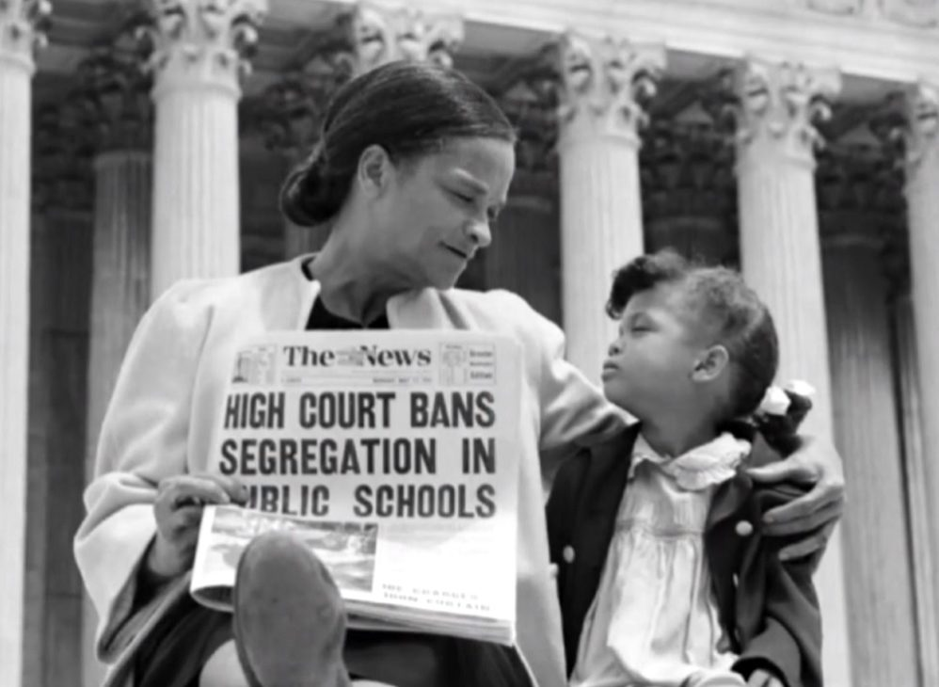
BROWN V. THE BOARD
Year:
1954
Why It’s Important:
Essentially undoing Plessy v. Ferguson, the Supreme Court ruled this time that “separate but equal” facilities for blacks and whites were “inherently unequal.” This case outlawed racial segregation of public schools and paved the way for the integration of other areas as well.

Slide 10
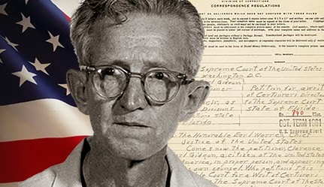
GIDEON V. WAINWRIGHT
Year:
1963
Why It’s Important:
This decision expanded the guarantees of the Bill of Rights by ruling that the 6th Amendment right to an attorney regardless of ability to pay applies to state cases as well as federal ones.

Slide 11
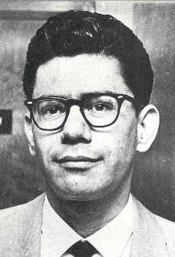
MIRANDA V. ARIZONA
Year:
1966
Why It’s Important:
This case is designed to make sure that those accused of a crime know their rights before they are interrogated by police. You’ve probably seen tons of movies and tv shows where someone is being arrested and the officer tells them, “You have the right to remain silent. Anything you say can and will be used against you in a court of law. You have the right to an attorney. If you cannot afford an attorney, one will be provided for you.” This is known as the “Miranda Warning” or “Miranda Rights” and it is required now thanks to this case.

Slide 12
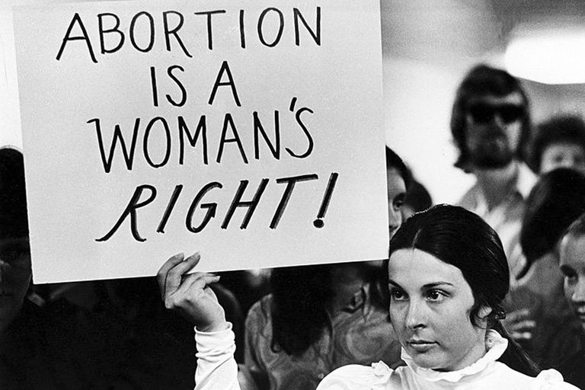
ROE V. WADE
Year:
1973
Why It’s Important:
The Supreme Court used the 4th Amendment as the basis to legalize first trimester abortion. The court ruled that states cannot outlaw abortions during that period. This is one of the most controversial rulings still on the books.

Slide 13
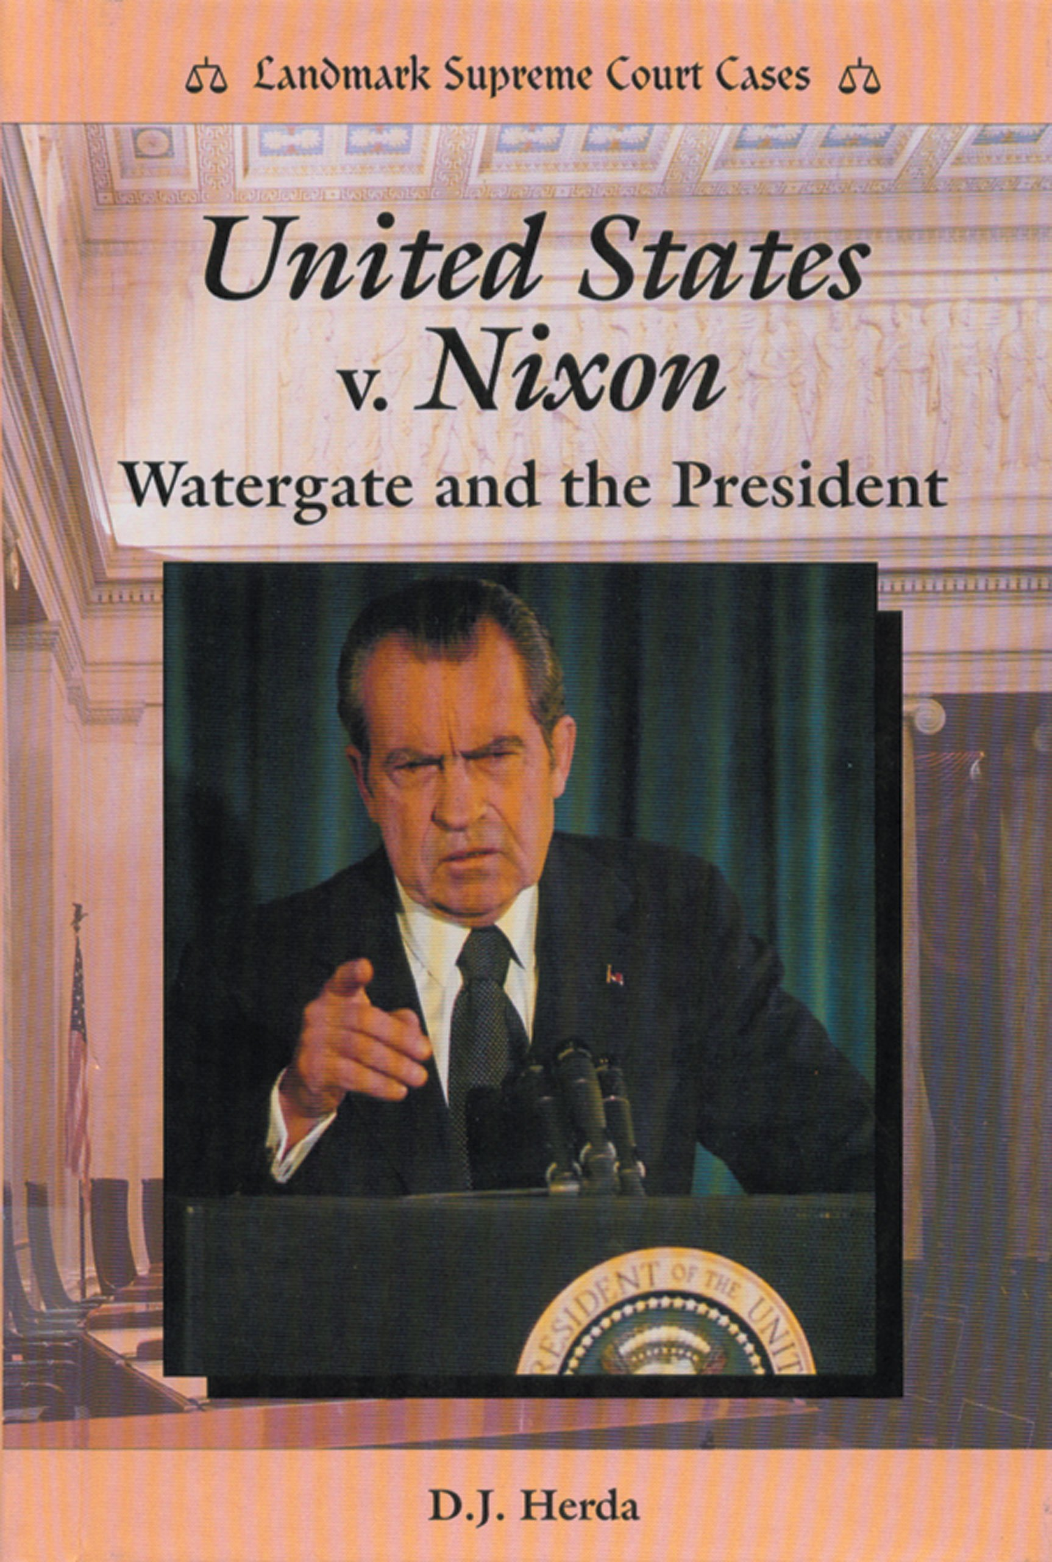
U.S. V. NIXON
Year:
1976
Why It’s Important:
During the Watergate scandal, President Richard Nixon tried to assert that his “executive privilege” made him immune from subpoena’s requesting the release of White House audio recordings. The court ruled that Nixon had no such privilege. This case had the lasting impact of asserting that even the president is not above the law.

Slide 14
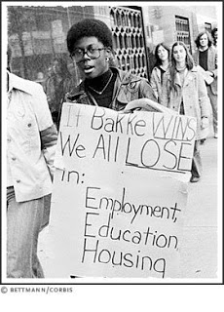
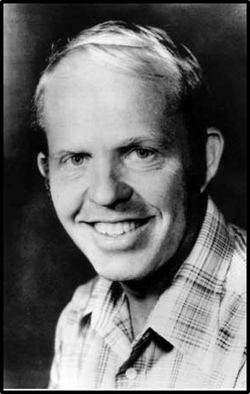
BAKKE V. CALIFORNIA
Year
1978
Why was this case important?
Ambiguous ruling by a badly divided court that dealt with affirmative action programs that used race as a basis of selecting participants. The court general upheld affirmative action, but with a 4/4/1 split, it was a very weak decision.

Slide 15
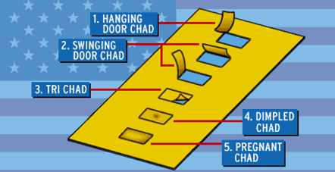
Bush v. Gore
Year:
2000
Why was this case important?
The court ruled that manual recounts of presidential ballots in the Nov. 2000 election could not proceed because inconsistent evaluation standards in different counties violated the equal protection clause. In effect, the ruling meant Bush would win the election.

Slide 16
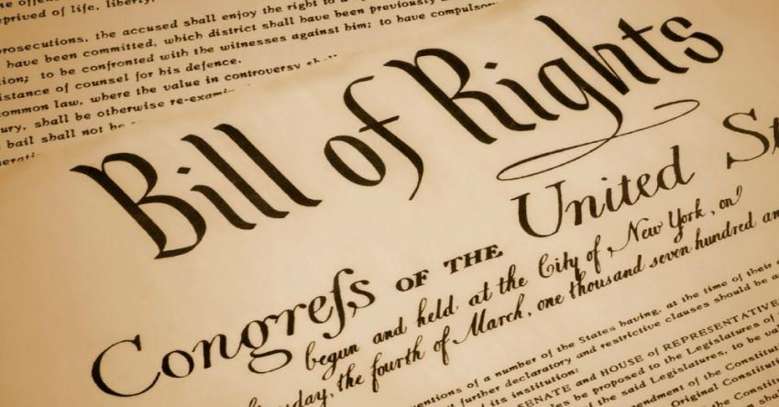
Amendment Review 1-27
First 10 Amendments make-up the Bill of Rights.
Anti-federalist would not approve the Constitution until a Bill of Rights was added.

Slide 17
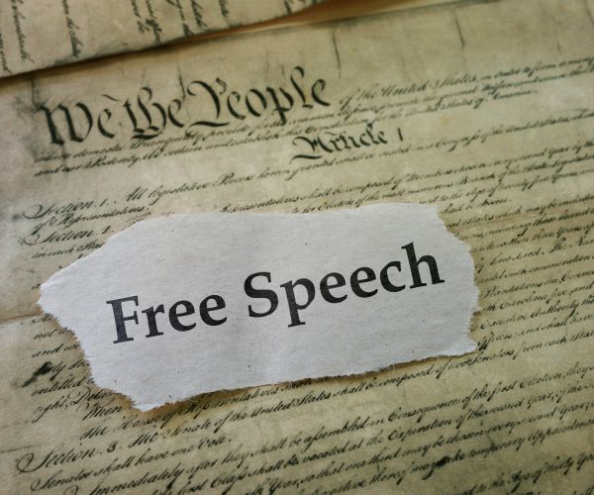
First Amendment: RAPPS
5 Basic Freedoms
R: Religion
A: Assembly
P: Press
P: Petition
S: Speech

Slide 18
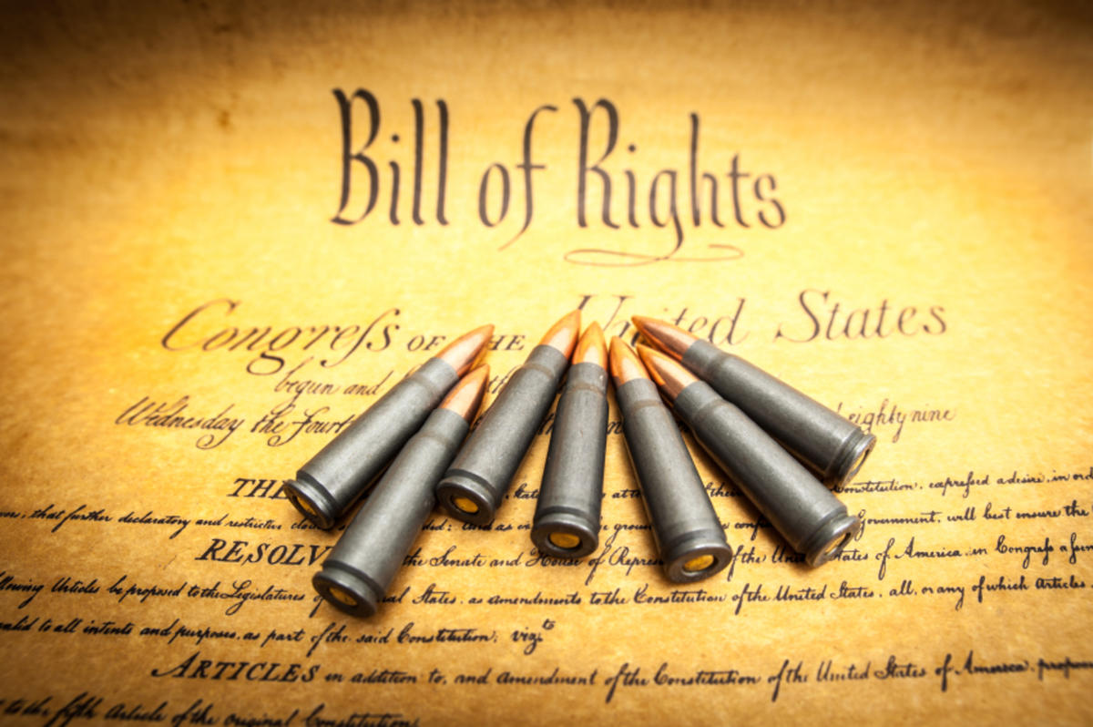

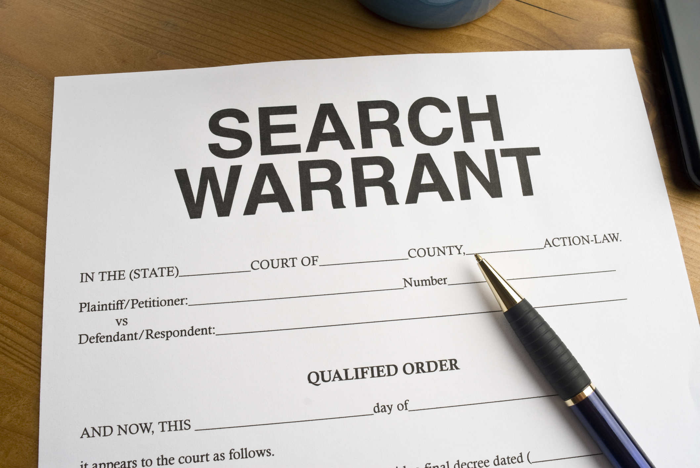
2nd Amendment:
  right to bear arms (weapons)
3rd Amendment:
  forbids quartering of soldiers
4th Amendment:
  limits searches and seizures

Slide 19
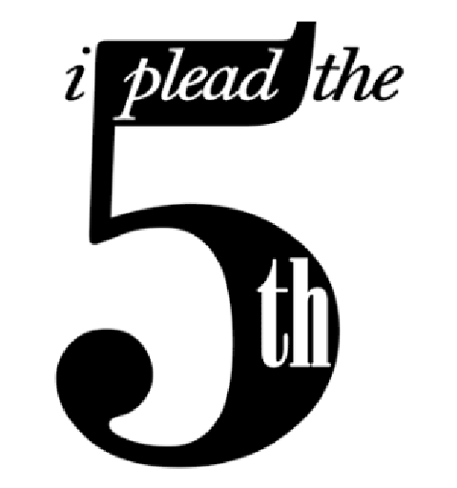
5th Amendment:
  due process of law
  protection against self-incrimination
    I plead the 5th!
  double jeopardy
    cannot be tried for the same crime twice

Slide 20
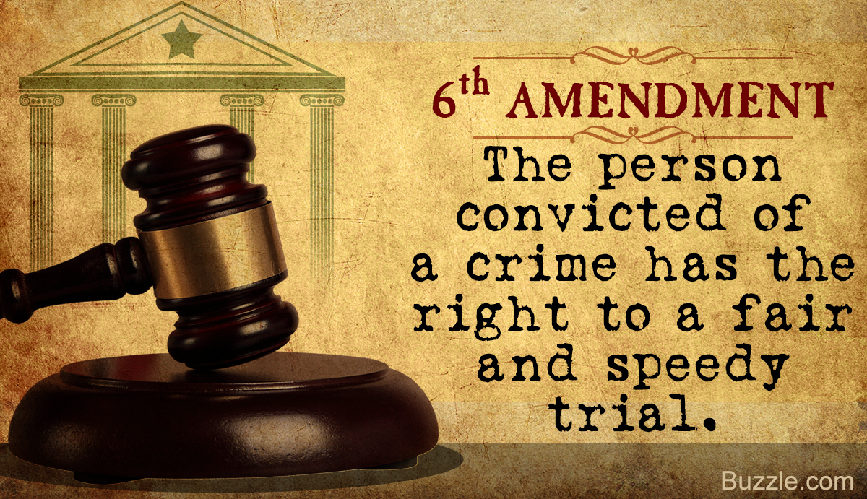
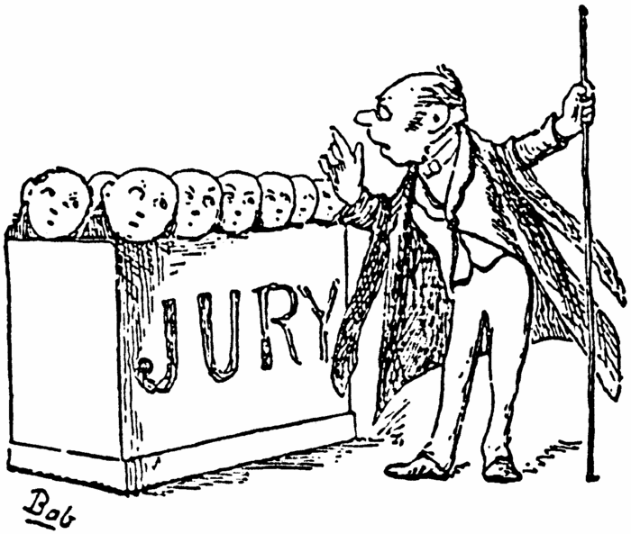
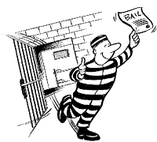
6th Amendment:
  right to a lawyer
  right to a speedy & public trial in criminal cases
7th Amendment:
  right to a jury trial in civil cases
8th Amendment:
  forbids “cruel and unusual punishment”
  forbids excessive bails & fines

Slide 21

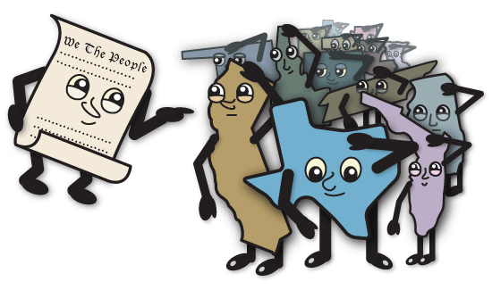
9th Amendment:
  entitles you to rights not listed in the Constitution
10th Amendment
  powers not given to the U.S. government are reserved to the states (reserved powers)

Slide 22
11th Amendment:
  places limits on an individual’s right to sue states
12th Amendment:
  separate ballots for president and vice president

Slide 23
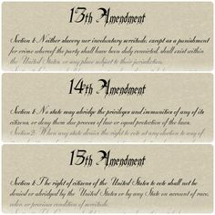
Civil War Amendments
13th Amendment:
  abolished slavery
14th Amendment:
  guarantees rights of citizenship, due process and equal protection under the law
15th Amendment:
  voting rights for former slaves (African American men)

Slide 24
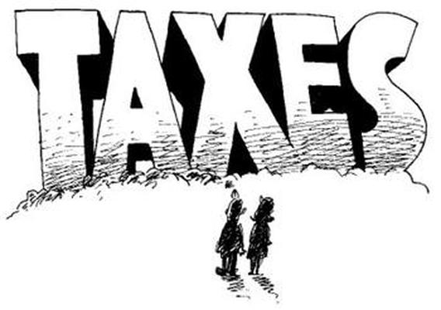
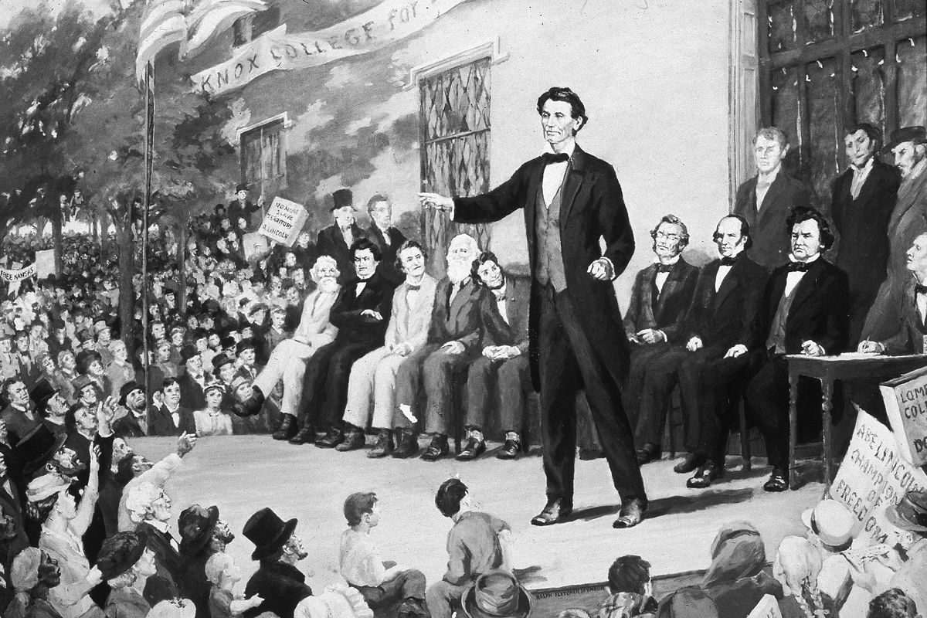
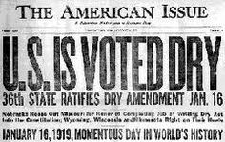
16th Amendment:
  created a federal income tax
17th Amendment:
  U.S. Senators are elected directly by the people rather than by state legislatures
18th Amendment:
  prohibition-made the manufacture, sale, and transport of alcoholic beverages illegal

Slide 25
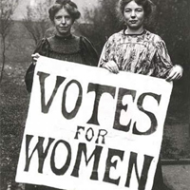
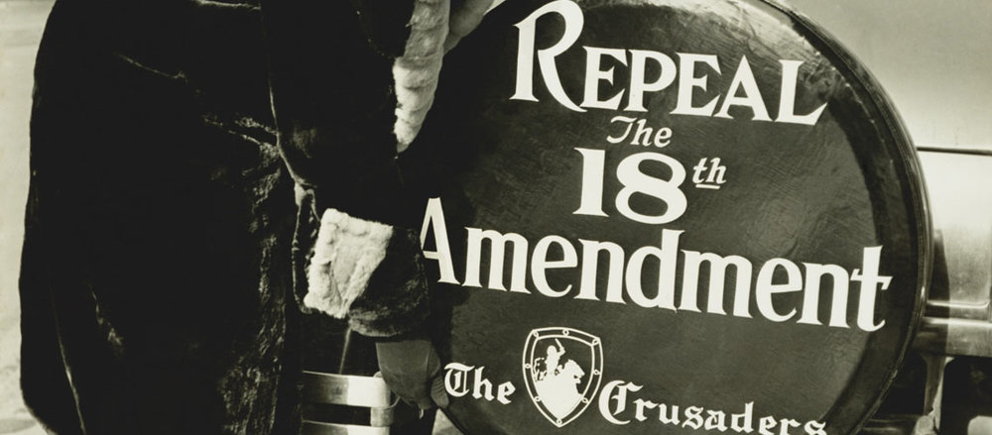
19th Amendment:
  gives women the right to vote (suffrage)
20th Amendment:
  sets the dates of presidential and congressional terms
21st Amendment:
  repealed (ended) prohibition-alcohol becomes legal again

Slide 26
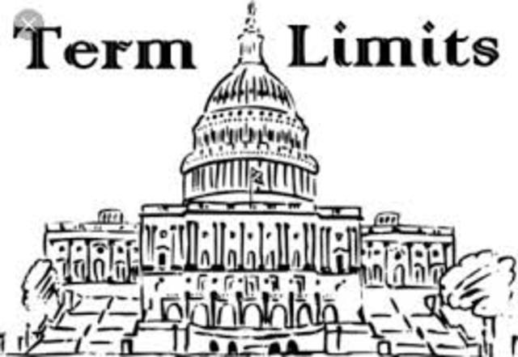

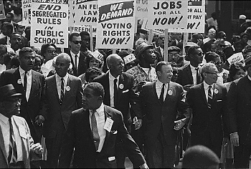
22nd Amendment:
  limits the president to two terms
23rd Amendment:
  gives people in D.C. the right to vote for the president; D.C. received three electors
24th Amendment:
  bans poll taxes (forbids having to pay a tax to vote)

Slide 27
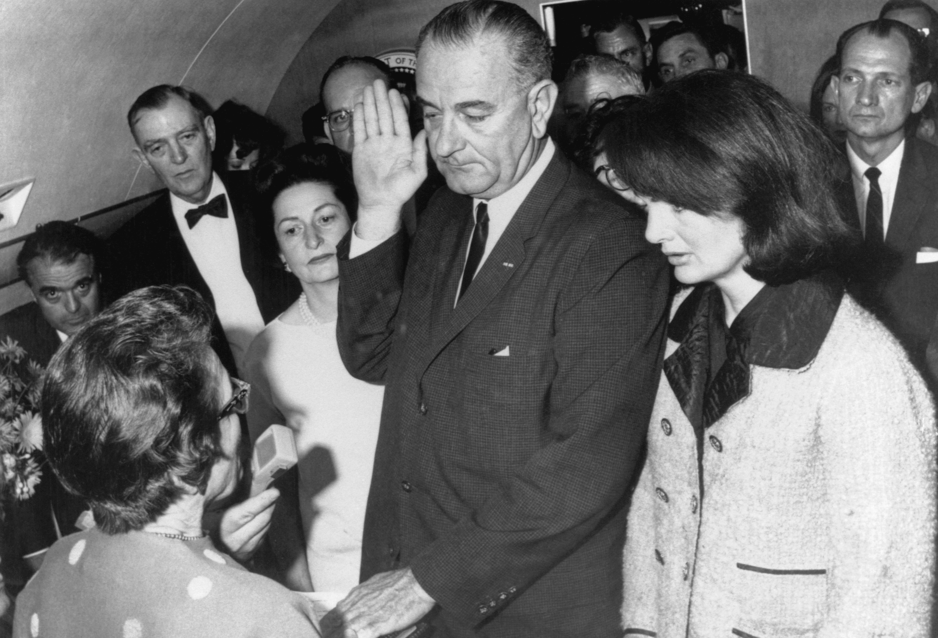
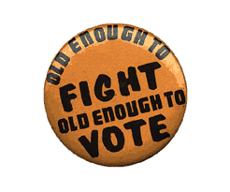
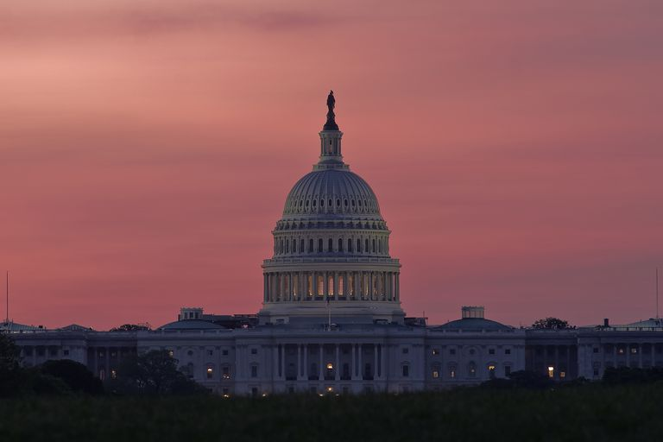
25th Amendment:
  establishes presidential succession
26th Amendment:
  lowers the voting age to 18
    Passed in response to Vietnam War.
27th Amendment:
  regulates the salaries of members of Congress (rules for creating pay raises)

