Slide 1
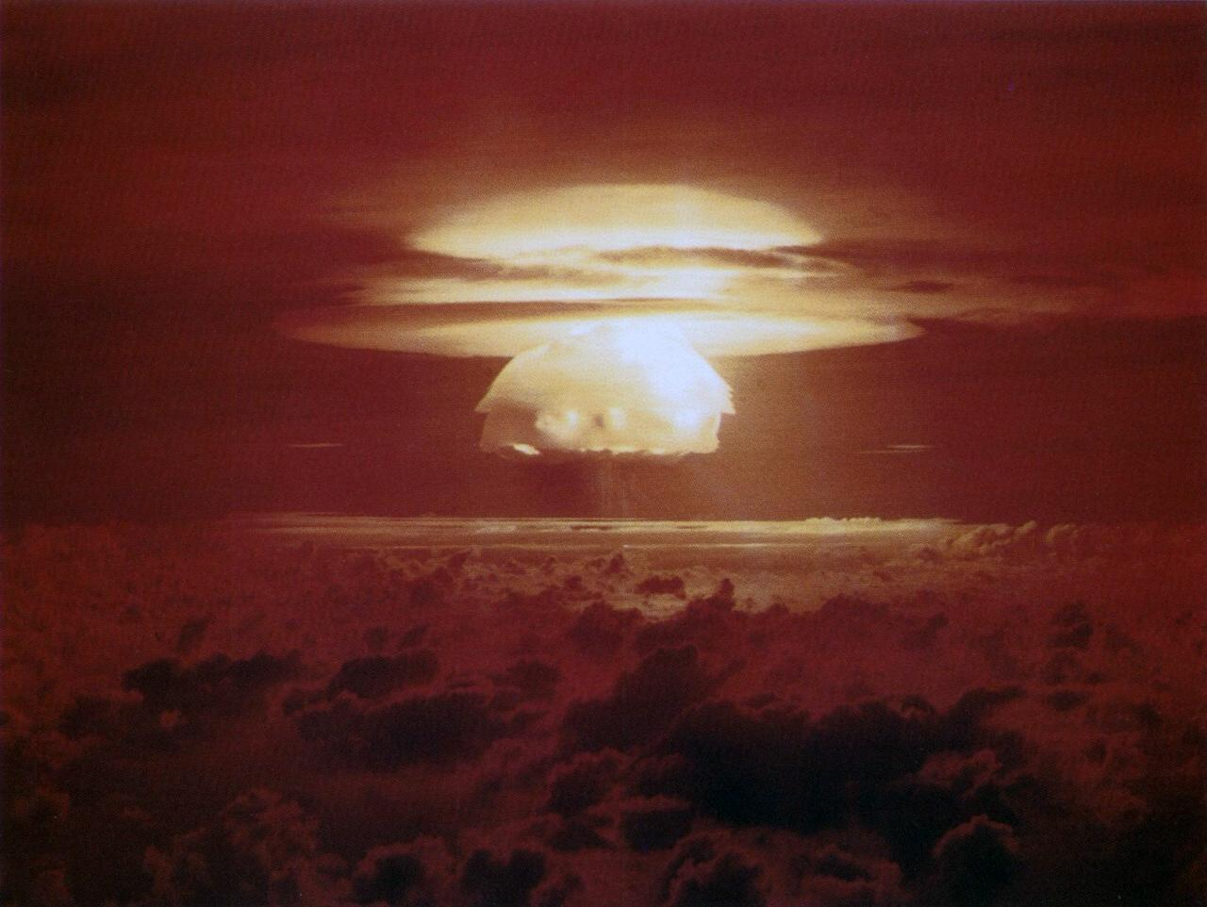
THE COLD WAR
1945-1989

Slide 2
THE COLD WAR
The use of the atomic bomb at the end a World War II sent a strong message to the rest of the world. This new weapon would give the United States the title of superpower.
After the war the relationship between the United States and the Soviet Union will become strained.
The two countries will compete around the world for
resources, markets, prestige, and political strength for
nearly 50 years.

Slide 3
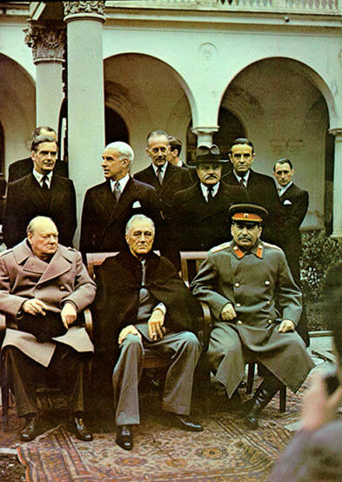
Yalta Conference
At the Yalta Conference, Stalin promised that he would allow free elections in Eastern Europe.
The Soviet Union began to consolidate power by eliminating dissent.

Slide 4
Three Types of War
Hot War : this is actual warfare. All talks have failed and the armies are fighting.
Warm War : this is where talks are still going on and there would always be a chance of a peaceful outcome but armies, navies etc. are being fully mobilized and war plans are being put into operation ready for the command to fight.
Cold War : this term is used to describe the relationship between the U.S. and the Soviet Union 1945 to 1980. Neither side ever fought the other - the consequences would be too appalling - but they did ‘fight’ for their beliefs using client states who fought for their beliefs on their behalf. For example: Korea and Vietnam.

Slide 5

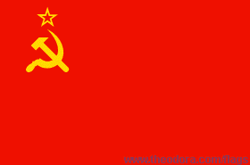
Differences Between Two Superpowers
America Soviet Union
Free elections No elections or fixed
Democratic Autocratic / Dictatorship
Capitalist Communist
‘Survival of the fittest’ Everybody helps everybody
Richest world power Poor economic base
Personal freedom Society controlled by the secret police
Freedom of the media Total censorship

Slide 6
Demobilization and Eastern Europe
Demobilization is the gradual decrease of U.S. troops in Europe.
There were over 10 million U.S. troops serving overseas during the war.
Troops will remain in Europe to:
Rebuild
Maintain Order
Help Holocaust Survivors

Slide 7
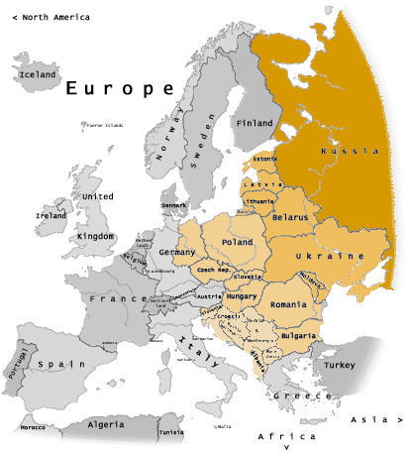
Satellite Nations
In Soviet controlled Eastern Europe there was no freedom of speech, assembly, or petition.
satellites: a nation that is officially independent but controlled by an outside power.
*By 1948, seven Eastern European countries had become satellites.

Slide 8
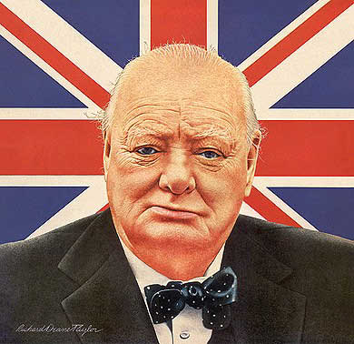
Iron Curtain and Containment
Winston Churchill warned that Soviet aggression was tightening its grip on Europe.
He stated that an iron curtain had descended across Europe.
Churchill and Truman shared the same political views on the Soviet Union.
containment: policy of the United States to halt any further expansion of Communism.

Slide 9
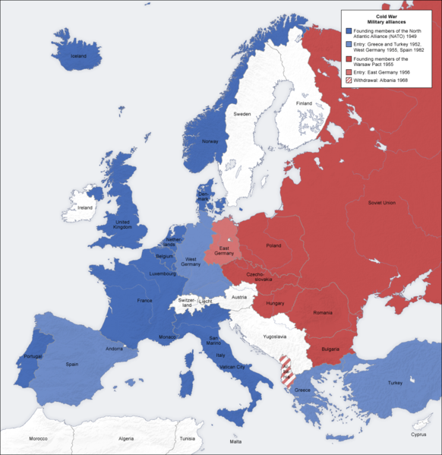
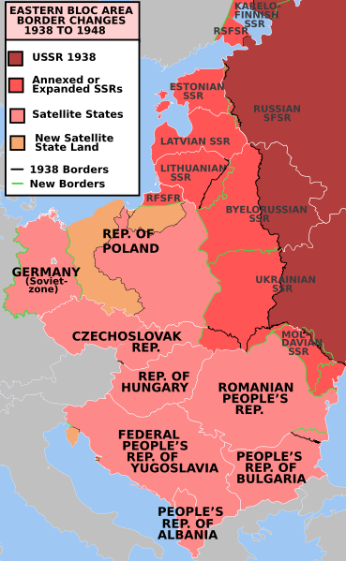

Slide 10
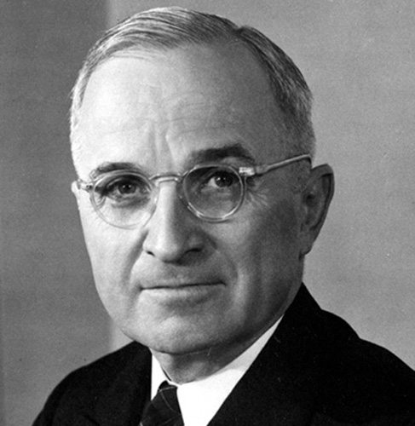
Truman Doctrine
The U. S. should support free peoples throughout the world who were resisting takeovers by armed minorities or outside pressures…
“We must assist free peoples to work out their own destinies in their own way.”- Truman

Slide 11
The Marshall Plan
The Marshall Plan proposed a program of massive economic aid to Europe.
Most European nations had been destroyed by World
War II. The people of these nations were left hungry and in poverty.
It was widely believed that economic despair led to support of communism.
During a three year period $12 billion was sent to
16 nations throughout Western Europe.

Slide 12
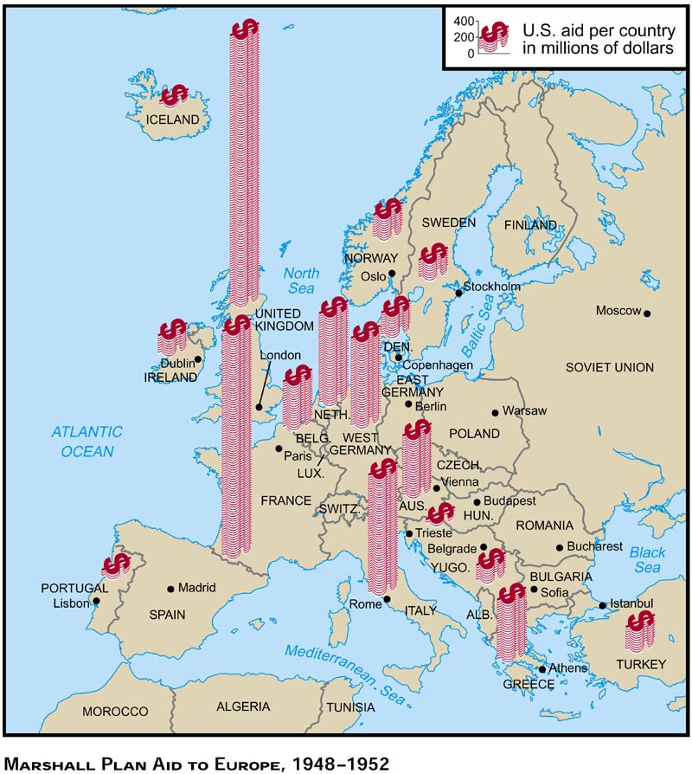

Slide 13
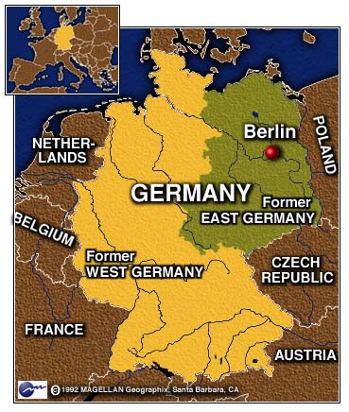
BERLIN
At the end of the war Germany was partitioned into four zones.
The Soviet Union occupied Eastern Germany and the United States, France, and Great Britain occupied Western Germany.
Berlin had also been divided. The city of Berlin is located in Eastern Germany which was controlled by the Soviet Union.

Slide 14
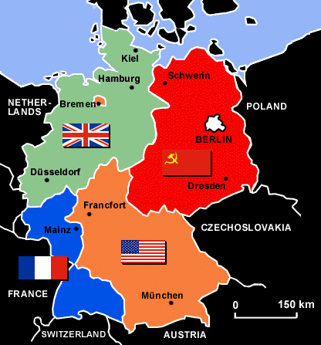

Slide 15
BERLIN BLOCKADE
In 1948, Stalin made an effort to take all of Berlin for the Soviet Union. He sealed off all railways, rivers, and highways to block all supplies.
This became known as the Berlin Blockade. The U.S. and its allies began a massive airlift to West Berlin.

Slide 16
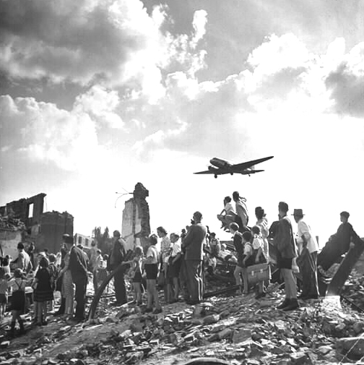
Berlin Airlift
Food and supplies were flown in by plane for almost a year. A plane would land in Berlin every three minutes bringing supplies.
The Soviet Union could not halt the air traffic without starting a war. Eventually the blockade failed.

Slide 17
COLLECTIVE SECURITY
NATO
NATO (North Atlantic Treaty Organization)
The United States, Canada, Iceland, and nine European countries entered an agreement that they would defend each other in the event of an attack.
*The U.S. involvement in NATO would take some of the pressure of the Cold War off of the United States.
*Congress feared that NATO would allow the President to sent troops into battle without officially declaring war.
*Congress also feared that it would provoke an arms race with the Soviet Union.

Slide 18
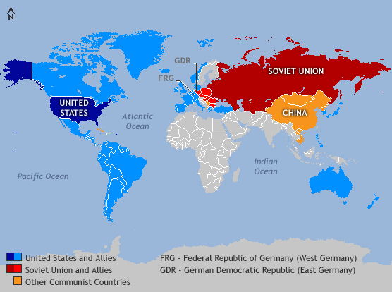
The Warsaw Pact
The Soviets responded by creating their own alliance.
The Warsaw Pact included the Soviet Union and the seven satellite nations in Eastern Europe.

Slide 19
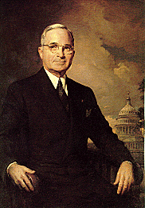
Election of 1948
The Republicans felt that their candidate, New York Governor, Thomas Dewey, could easily defeat Truman.
Truman had lost support from some Democrats because of his civil rights platforms.
Dixiecrats: Southern Democrats who voted Republican to avoid voting for Truman.
Truman traveled all over the country giving speeches and trying to gain support.
A few weeks before the election many polls and surveys suggested that Dewey would win.

Slide 20
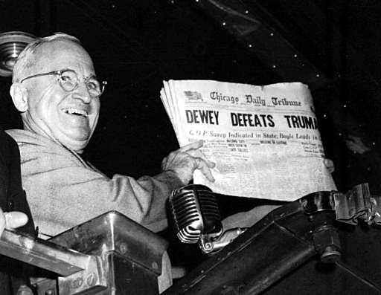
On election day Truman won one of the largest political
upsets in the century. He won by gaining 49.5% of
the vote.
Newspaper editors were certain Dewey would win. The
Chicago Daily Tribune went to the press before the
returns were in. The headline read:
“DEWEY DEFEATS TRUMAN”

Slide 21
The Fair Deal and Taft Hartley Act
The Fair Deal
Truman’s domestic program that called for the creation
of jobs, more public housing, and an end to job
discrimination for African Americans.
Taft-Hartley Act
This bill outlawed closed shops and allowed union shops.
Workers had to join a union. Sympathy strikes were
also banned.

Slide 22
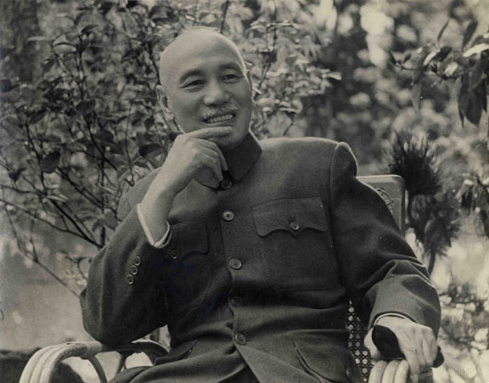
China
For two decades the Chinese Communists struggled against the Nationalist government of Chiang Kai-Shek.
Between 1945 and 1949 China received $3 billion in aid from the United States. Despite this effort the Communist movement continued to gain strength in China.
In 1949 the Communist took over led by Mao Zedong.
Chiang Kai-Shek was forced to flee to the island of
Formosa.

Slide 23
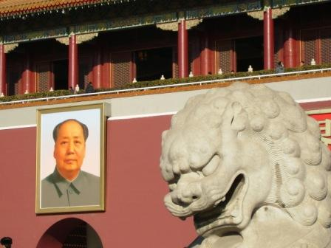
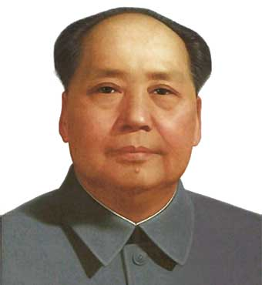
Losing China
Truman was blamed for “losing China”. Many people believed that with China becoming a communist nation it was further proof the communists were trying to control the world.

Slide 24
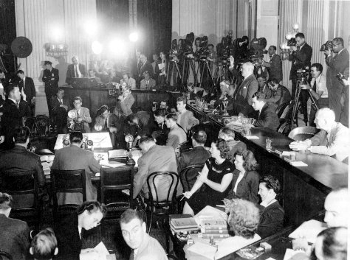
LOYALTY AT HOME
The government responded to the fear of communism by creating the Loyalty Review Board. Federal employees could be fired for belonging to a group that the Board saw as subversive.
HUAC
*The House Committee on Un-American Activities began
to investigate the use of Communist propaganda in
Hollywood.
Witnesses were called to testify and asked:
“Are you now, or have you ever been,
a member of the Communist Party?”

Slide 25
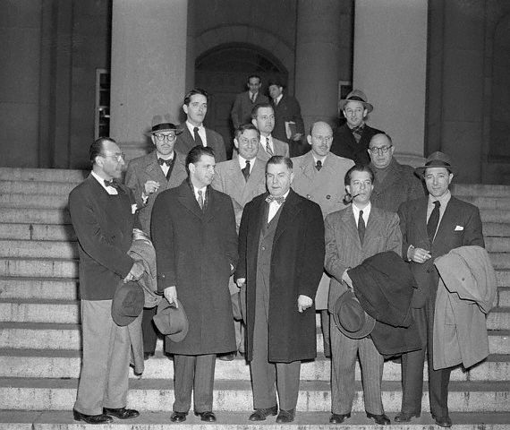
Hollywood Ten
In September and October of 1947, HUAC called a number of Hollywood writers, directors, actors, and producers to testify.
They were an important group who had been responsible for some of the best pictures in Hollywood.
Facing the committee the celebrities who had radical political associations had little chance to defend themselves.
The Hollywood Ten
Alvah Bessie, screenwriter
Herbert Biberman, screenwriter and director
Lester Cole, screenwriter
Edward Dmytryk, director
Ring Lardner Jr., screenwriter
John Howard Lawson, screenwriter
Albert Maltz, screenwriter
Samuel Ornitz, screenwriter
Adrian Scott, producer and screenwriter
Dalton Trumbo, screenwriter

Slide 26

McCarran-Walter Act
Senator McCarran had become convinced that most of the disloyal Americans were immigrants from Communist dominated parts of the world.
At his urging Congress passed the McCarran Walter Act which established a quota system for each country.
This would discriminate against potential immigrants from Asia and Eastern Europe.
President Truman vetoed the bill saying:
“This is one of the most un-American acts I’ve ever seen.”
Congress overturned the veto and the bill passed.

Slide 27
Spy Cases Inflame the Nation
People were on edge in the United States. Who was a Communist? Was it your neighbor, your friend, your
congressman?
The fear that Communist spies were revealing information to the Soviets was overwhelming.
Two famous spy cases emerged from this hysteria:
1. Alger Hiss- a high ranking state department official.
2. Julius and Ethel Rosenberg- a married couple.

Slide 28
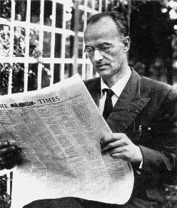
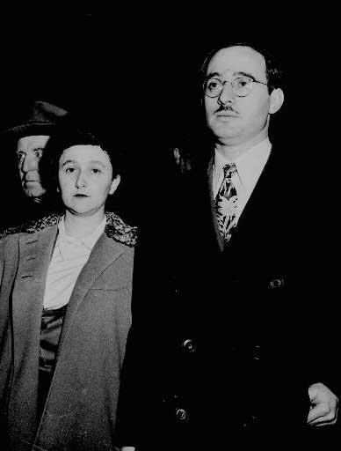
The Rosenbergs
In 1950 a man by the name of Klaus Fuchs was arrested
and charged with espionage. He admitted to passing
information to the Soviets since the Manhattan project.
The FBI were desperate to discover the names of spies
who had worked with Klaus Fuchs while he had been in
America.
In 1945 the FBI was given 80 names of people suspected
of being involved with Fuchs and the Communist Party.
Julius and Ethel Rosenberg were accused of participating
in this spy ring. The claim was that Julius passed on
information about the atomic bomb to a man named
Harry Gold who was now a convicted spy.

Slide 29
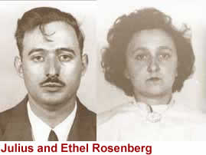
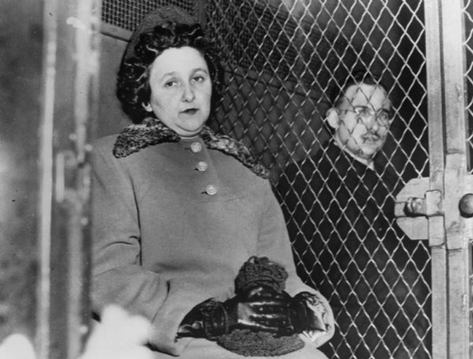
Rosenbergs Executed
The Rosenbergs remained on death row for twenty six months.
*They both refused to confess and provide evidence against others.
*They were executed on June 19, 1953.

Slide 30
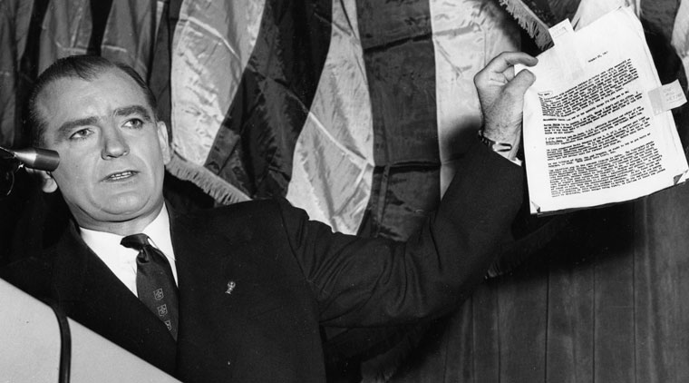
Joseph McCarthy
Joseph McCarthy was an unknown Republican senator from Wisconsin. In his campaign for reelection he wanted a good issue to gain support from the public.
McCarthy was urged by his friends to use the issue of anti-Communism in his campaign.
At a speech he gave in Wheeling, West Virginia, McCarthy said he had the names of 205 suspected Communists in the State Department.

Slide 31
Senate Investigation of McCarthy
The Senate subcommittee looked into the matter and stated that it was “a hoax and a fraud”.
Most of McCarthy’s targets were Democrats and he was a
Republican. For four years McCarthy was able to remain in the spotlight making accusations and stirring up fear.
The term McCarthyism became known as the practice of trying to advance one’s career by making unproven accusations.

Slide 32
Army-McCarthy Hearings
When Eisenhower became president many people felt that McCarthy would ease up on his accusations. He got worse.
Eventually he made accusations about the military and was made out to be a fraud on national television.
The Army-McCarthy Hearings made the public see him for what he was.

Slide 33
Army McCarthy Hearings: McCarthy launched an investigation of the army that was broadcast on television.
The American public now had a good view of McCarthy in action and they didn’t like what they saw.
In 1954 McCarthy was condemned by Congress with a censure.
Censure: the most severe way of condemning the behavior of another member of Congress.

Slide 34
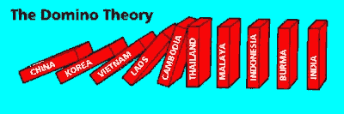
Domino Theory
Domino Theory: this is the belief that if one country is allowed to fall to Communism that all of the countries surrounding it will fall too.

Slide 35
The Three Worlds
During the Cold War the worlds leaders began to think of the world as if it were divided into three parts or worlds.
The First World:
-The first world included Western Democracies such as
the United States, Britain, and France.
The Second World:
-The second world would include the Soviet Union, China,
and the Communist nations of Eastern Europe.

Slide 36
The Third World
The Third World:
The third world consisted of all other nations. Most of
the third world countries at the following in common:
1. Illiteracy 3. Agricultural way of life
2. Poverty 4. A history of colonial rule
Many third world countries desired independence which clashed with the first and second worlds. Both the first and second worlds wanted to maintain influence on the third world countries.
The third world became a prime battleground for the Cold War.

Slide 37
Korean War
After World War II the United States remained a strong
influence in the Pacific. The U.S. had gained the right
to shape the future of Japan after its defeat in the war.
General MacCarthur ruled Japan for seven years after
the war. The U.S. and Japan became strong Allies after
the U.S. helped Japan recover from its defeat.
Limited War: a war in which nations limit their objectives or resources.

Slide 38
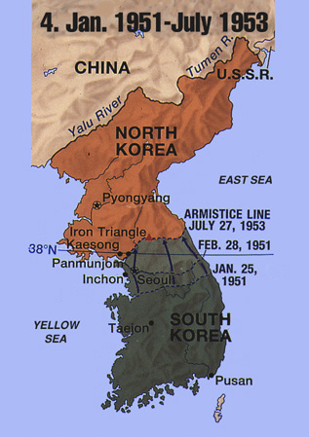
Korea Divided
Japan ruled Korea from 1910 to 1945. The U.S. and Soviet Union moved into Korea in 1945 to accept the Japanese surrender.
When the war was over neither the U.S. or Soviet Union wanted to remove its troops.
It was decided that Korea would be divided at the 38th parallel. The Soviet Union would occupy the North and the U.S. would occupy the South.
Both the U.S. and Soviet Union left Korea in 1949 leaving it a deeply divided region.
The North was ruled by Kim Il-Sung. The South was ruled by and American educated Korean named Syngman Rhee.

Slide 39
Trouble in Korea
Kim Il-Sung and Syngman Rhee wanted to unify Korea as one nation. Each side started skirmishes on the border.
Rhee threatened a full-scale invasion of North Korea, but he never followed through on his threats.
In 1950 there was evidence of a massive military build up along the 38th parallel. On June 25th the North Koreans invaded the South with force.
When the fighting broke out the United States quickly agreed to intervene.

Slide 40
Truman Responds
Truman had been accused of “losing” China to Communism and now he had his chance to take a stand to save South Korea.
Truman Responds
Truman ordered air strikes against North Korea. He soon ordered ground troops to South Korea calling the move a “police action”.

Slide 41
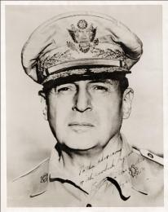
McCarthur
When American troops bombed the bridges at the Yalu River China threatened to enter the war.
China’s entry to the war resulted in UN troops being pushed South.
MacArthur insisted to Truman that the mainland of China be bombed. Truman refused. Truman called for a limited goal.
General MacArthur proceeded to heavily criticism Truman for the decision. Truman ordered that he halt his statements.
MacArthur refused and Truman fired him.

Slide 42
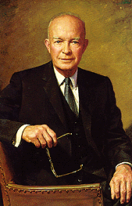
Eisenhower
Truman lost popularity during the end of his presidency as a result of the Korean War and the firing of General MacArthur.
The Republican campaign promised peace and stability.
Dwight Eisenhower was easy to like by the American public. He served as a hero from World War II, he was friendly, and held the same values of many Americans.
The choice for Vice President was Richard M. Nixon who was mostly known as an anti-communist.

Slide 43
Korean Settlement
When Eisenhower arrived in Korea he found that the war was at a stalemate.
*Rhee believed that another invasion of North Korea would be successful.
*Eisenhower did share those feelings and decided the best option was to negotiate.
*Truce talks began in 1951 but did not make much progress. There was a deadlock over the issue of prisoners of war.
*Eisenhower in an attempt to end the deadlock increased bombing raids over North Korea. He also sent a secret message to China that the United States might use a nuclear weapon.

Slide 44
The Arms Race
Throughout the 1950’s the United States and the Soviet Union would wage an increasingly intense struggle for power.
Arms race: the struggle to gain superiority with weapons.
Whenever one side would appear to be gaining power the other would respond with new programs and policies.
Nowhere was this competition more dangerous than with the arms race. In 1949 the Soviet Union tested its own atomic bomb.

Slide 45
The Arms Race
During the 1950’s American scientists developed a nuclear bomb that was 150 times stronger than the one’s that were dropped on Hiroshima and Nagasaki.
H-bomb: this new weapon was called the H-bomb or hydrogen bomb.
The first nuclear weapons were called “A-bombs”. They were developed from splitting uranium atoms.
Hydrogen bombs worked by the uniting of hydrogen atoms.
Scientists who worked on the “A-bomb” asked the government to stop research on the “H-bomb” because they feared that if a number of them exploded it could destroy the earth.

Slide 46
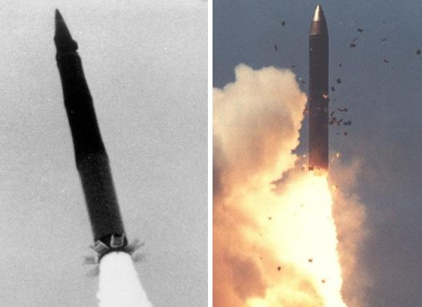
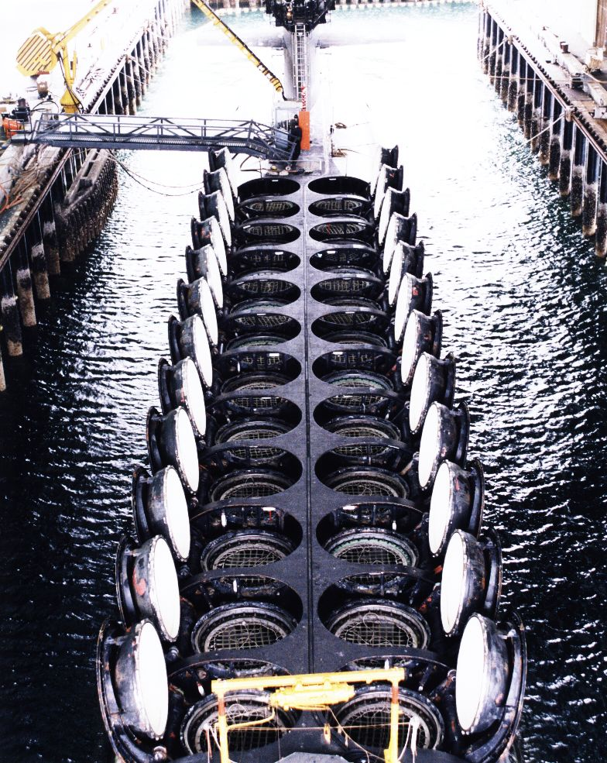
Brinkmanship and ICBM’s
Brinkmanship: The policy of risking war in order to protect one’s interests.
The Soviets focused on the building of ICBM’s.
ICBM’s: intercontinental ballistic missiles.

Slide 47
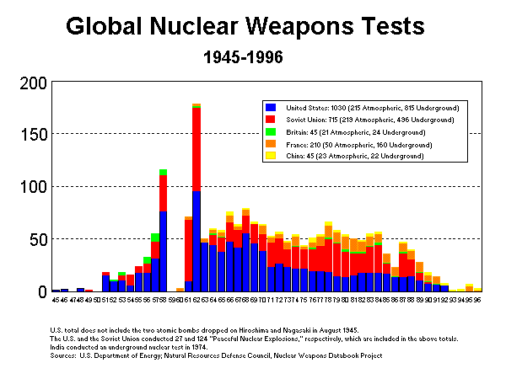

Slide 48
Massive Retaliation
John Foster Dulles
Dulles was the Secretary of State for Eisenhower. To Dulles the Cold War was a moral crusade. He called for the rollback of communism to its pre-World War II boundaries.
Eisenhower and Dulles feared that the Korean War would be the first of many limited wars fought around the globe.
massive retaliation: the U.S. would not be drawn into a long drawn out conflict, it would punish the Soviet Union with an all out nuclear attack.

Slide 49
Hungarian Uprising
rollback: to liberate nations who were already under Communist control. As fighting continued in the Middle East, a revolt was breaking out in Hungary.
The Soviet dominated Hungarians rose up in 1956 to call for a withdrawal of Soviet troops and for a democratic government.
*The Soviets response was swift and brutal. Eisenhower gave some thought to helping the Hungarians but they were deep in Soviet territory.
*Eisenhower said they were “inaccessible”, America made no response.
*The lack of response by the United States made it clear that rollback was a slogan, not a policy.

Slide 50
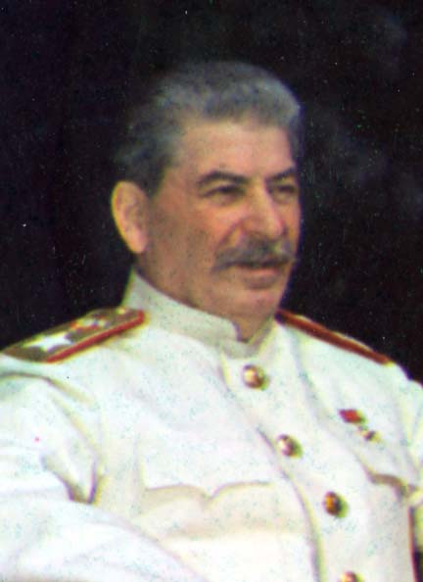
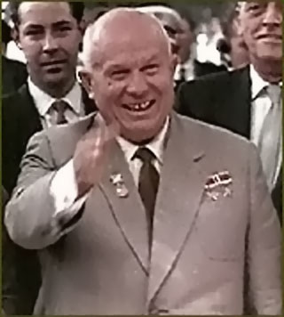
Superpower Negotiations
During the 1950’s, relations between the United States and the Soviet Union remained strained.
The two superpowers were locked in a thermonuclear arms race.
Stalin died in 1953, with his death was the hope that new Soviet leadership might be more moderate.
Nikita Krushchev publicly denounced Stalin for his murderous policies.
De-Stalinization

Slide 51

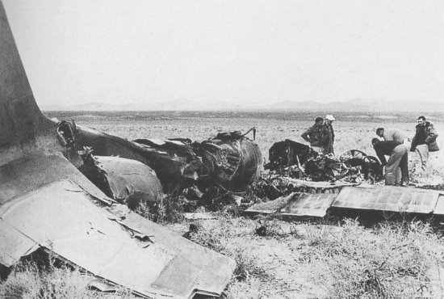
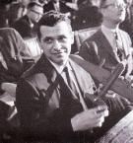
U-2 INCIDENT
In 1960 the hopes for a summit between the U.S. and Soviet Union were dashed.
Krushchev announced that an American spy plane had been shot down over Soviet territory. The U.S. had routinely flown U-2’s over the Soviet Union.
The planes would photography military movement and missile sites.
The pilot safely parachuted to the ground and was captured by the Soviets.
Krushchev angrily called off the summit conference and withdrew an earlier invitation to Eisenhower to visit the Soviet Union.

Slide 52

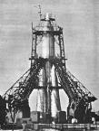
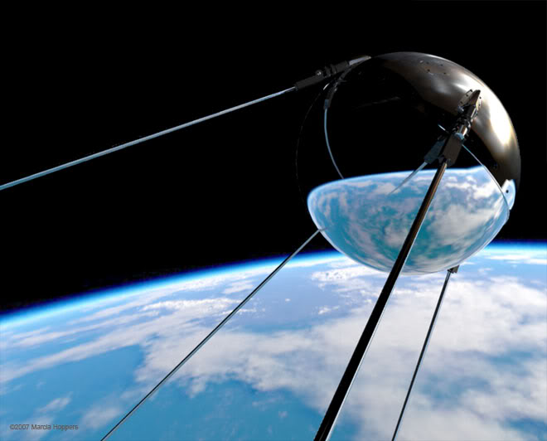
Sputnik
The Soviet Space Program was seen as more successful than the United States.
In 1957, the Soviets launched a successful satellite called Sputnik.
Sputnik was a basketball sized object.
The American people were shocked that the Soviets were able to get to space first.
National Defense Education Act: this legislations was passed giving over 1 billion dollars towards improving science, math, and foreign languages in the schools.

Slide 53
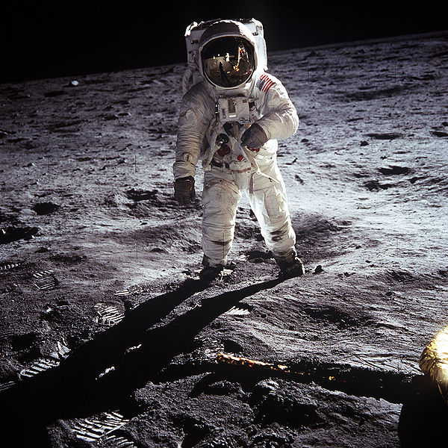
More about the Space Program in the Kennedy Chapter.

Slide 54
We Didn’t Start the Fire
1949: Harry Truman, Doris Day, Red China, Johnny Ray, South Pacific, Walter Winchell, Joe DiMaggio
1950: Joe McCarthy, Richard Nixon, Studebaker, Television, North Korea, South Korea, Marilyn Monroe
1951: Rosenbergs, H-Bomb, Sugar Ray, Panmunjom, Brando, The King and I, and the Catcher in the Rye
1952: Eisenhower, Vaccine, England’s Got a New Queen, Marciano, Liberace, Santayana Good Bye
1953: Joseph Stalin, Malenkov, Nasser, and Prokofiev, Rockefeller, Campanella, Communist Bloc
1954: Roy Cohn, Juan Peron, Tosconini, Dacron, Dien Bien Phu Falls, Rock Around the Clock
1955: Einstein, James Dean, Brooklyn’s Got a Winning Team, Davy Crockett, Peter Pan, Elvis Presley Disneyland

Slide 55
1956: Bardot, Budapest, Alabama, Khrushchev, Princess Grace, Peyton Place, Trouble in the Suez
1957: Little Rock, Pasternak, Mickey Mantle, Kerouac, Sputnik, Chou En Lai, Bridge on the River Kwai
1958: Lebanon, Charles DeGaulle, California Baseball, Starkweather Homicide, Children of Thalidomide
1959: Buddy Holly, Ben Hur, Space Monkey, Mafia, Hula Hoops, Castro, Edsel is a No Go
1960: U-2, Syngman Rhee, Payola, and Kennedy, Chubby Checker, Psycho, Belgians in the Congo
1961: Hemmingway, Eichmann, Stranger in a Strange Land, Dylan, Berlin, Bay of Pigs Invasion
1962: Lawrence of Arabia, British Beatle Mania, Ole Miss, John Glenn, Liston beats Patterson
1963: Pope Paul, Malcolm X, British Politician Sex, JFK Blown Away, What else more do I have to say.

Slide 56
1964: Birth Control, Ho Chi Minh, Richard Nixon back again, Moonshot, Woodstock, Watergate, Punk Rock, Begin, Reagan, Palestine, Terror on the Airlines, Ayatollahs in Iran, Russians in Afghanistan, Wheel of Fortune, Sally Ride, Heavy Metal, Suicide, Foreign Debts, Homeless Vets, Aids, Crack, Bernie Goetz, Hypodermics on the Shore, China’s under Martial Law, Rock and Roller, Cola Wars, I can’t take it anymore.
CHORUS
We Didn’t Start the Fire
It was always burning,
Since the world’s been turning.
We didn’t light it,
But we tried to fight it.
But when we are gone
It will still burn on and on and on and on….

