Slide 1
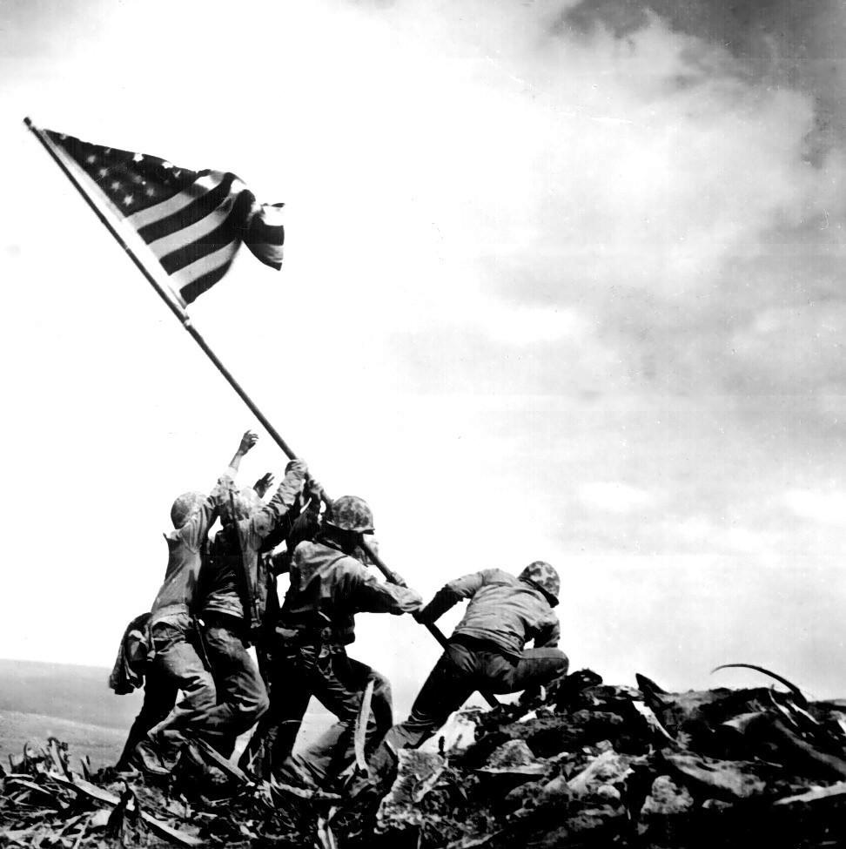
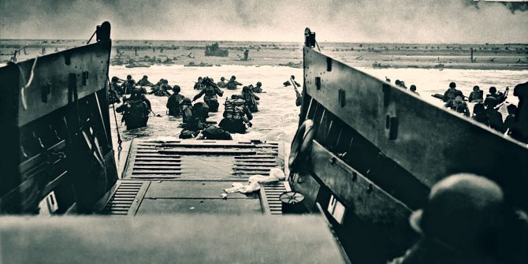
World war ii

Slide 2
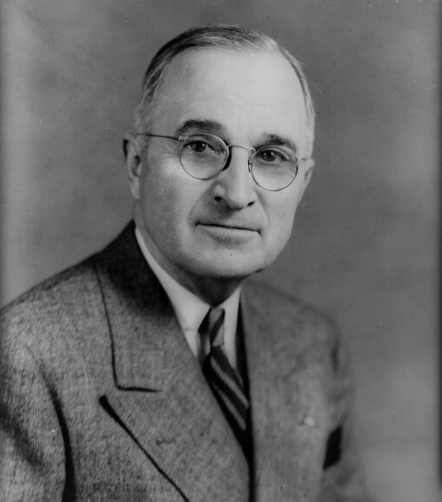
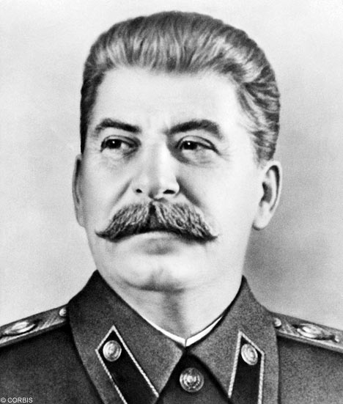
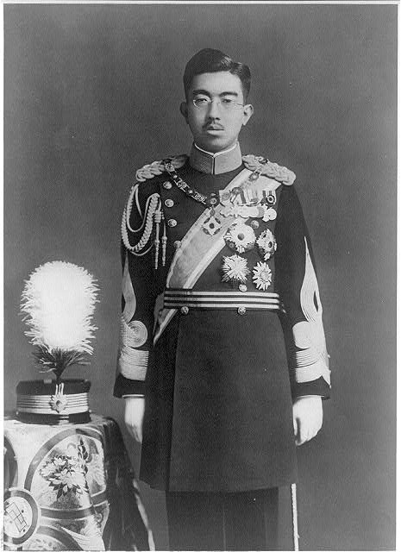
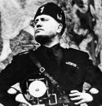
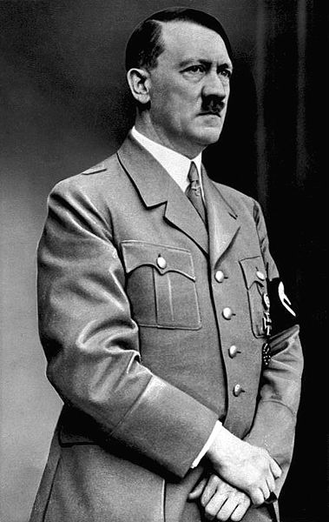
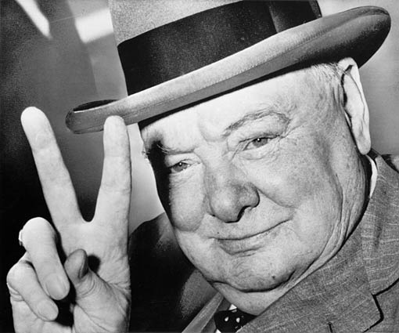
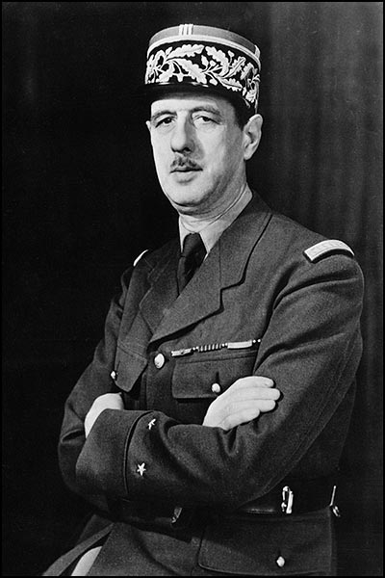
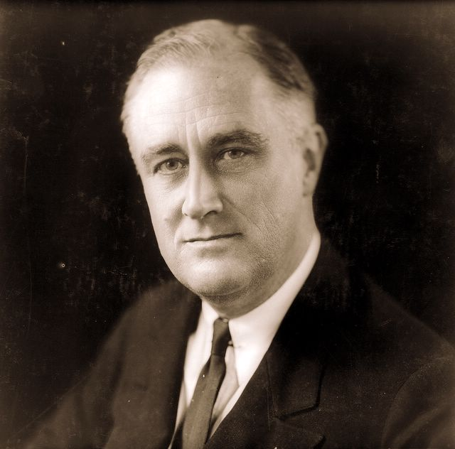
Who’s Who?
4
1
2
3
5
7
6
8

Slide 3
Who’s Who?
3
4
1
2
STALIN
MUSSOLINI
TRUMAN
5
HIROHITO
HITLER
6
7
CHURCHILL
8
DE GAULLE
ROOSEVELT

Slide 4
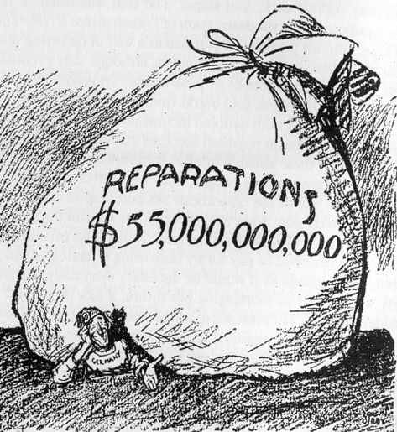
DAWES PLAN
The Dawes Plan was a plan that was in 1924 to resolve the World War I reparations that Germany had to pay, that had strained diplomacy following World War I and the Treaty of Versailles.

Slide 5
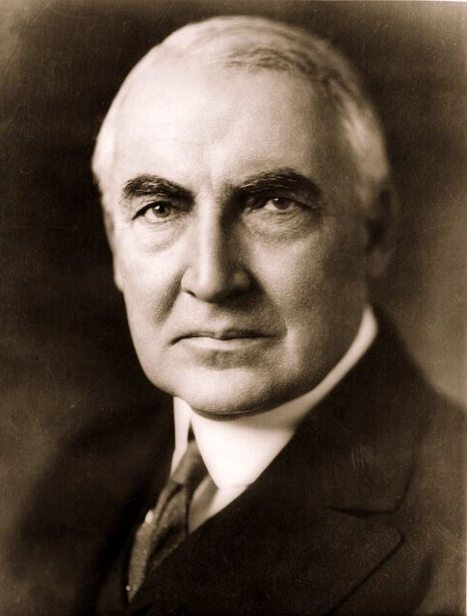
Washington conference
Warren G. Harding invited delegates from Japan and Europe because the U.S. was on the verge of an arms race with Japan and Great Britain.
At the conference they discussed:
-a ban on building new battleships.
-a limit on total navy tonnage.
-a fixed ratio of ships.
-an agreement not to attack each other’s possessions in the Pacific.

Slide 6
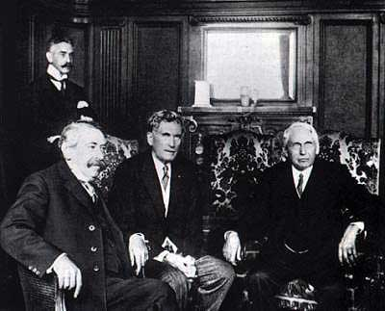
Kellogg-briand pact
In 1928, fifteen nations signed a pact pledging to renounce war was an instrument of national policy.
The main problems with the pact were that they did not discuss how the pact would be enforced and the pact did not forbid war as a result of self defense.

Slide 7
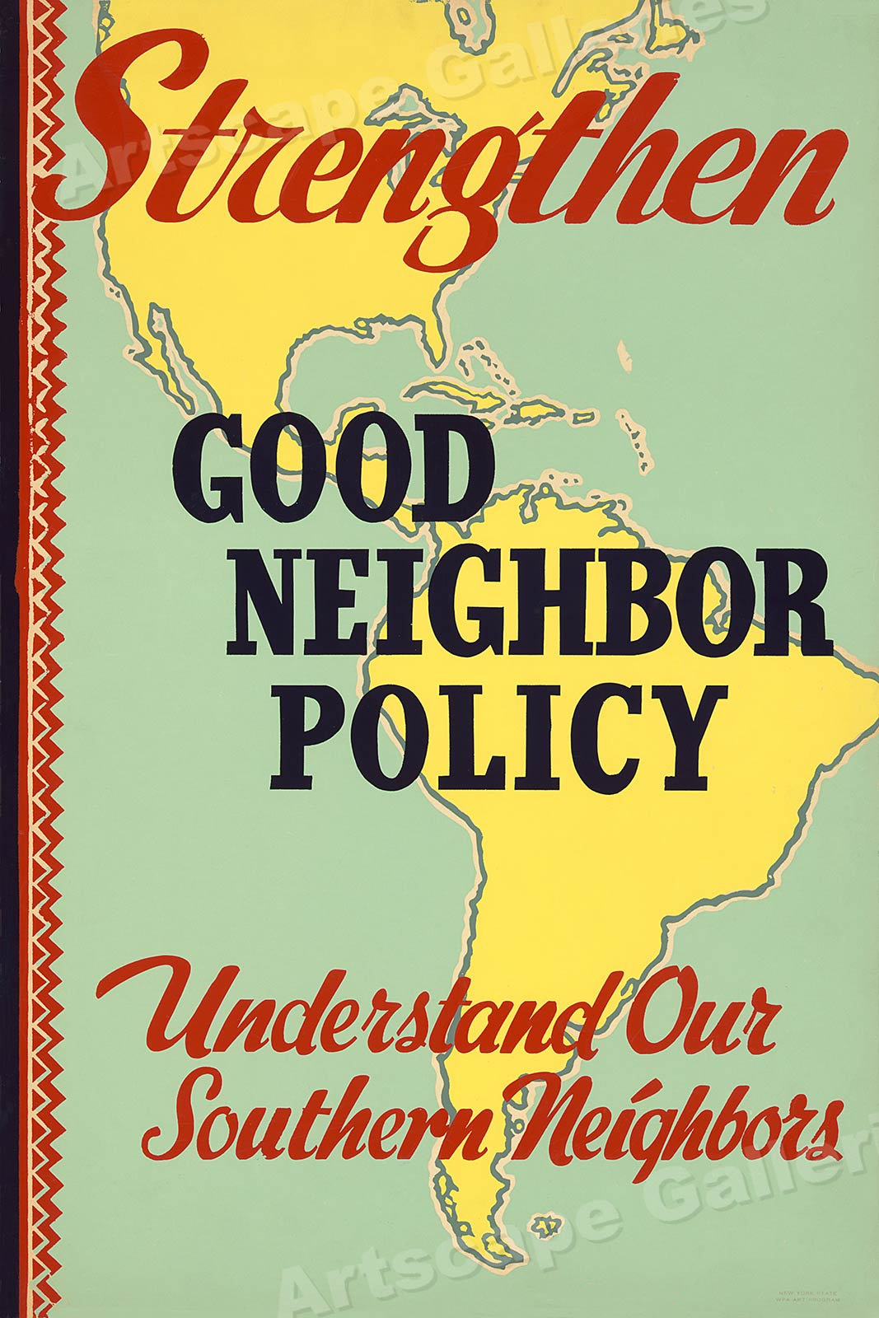
GOOD NEIGHBOR POLICY
The Good Neighbor policy was the foreign policy of the administration of United States President Franklin Roosevelt towards Latin America.
The policy's main principle was that of non-intervention and non-interference in the domestic affairs of Latin America. It also reinforced the idea that the United States would be a "good neighbor" and engage in reciprocal exchanges with Latin American countries.

Slide 8
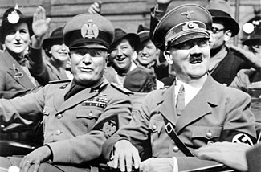
FASCISM
Fascism: is a form of radical, right-wing, authoritarian ultra-nationalism, characterized by dictatorial power, forcible suppression of opposition, and strong regimentation of society and of the economy.

Slide 9
Hitler Violates Versailles Treaty
First he built up the German military.
Then he sent troops into the Rhineland.
This was a direct violation of the Treaty of Versailles, which said in 1919 that Rhineland was a demilitarized zone.
Hitler wanted to conquer whoever he felt was inferior to the Germans or Aryans. He wanted “living space” for the Germans in Eastern Europe.

Slide 10
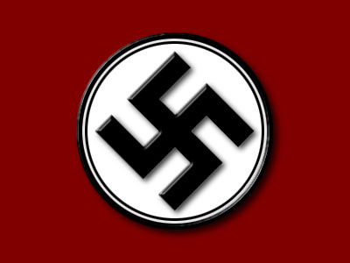
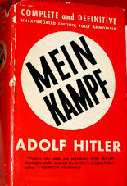
Hitler’s Rise to Power
Adolf Hitler entered German politics because he was angry over the Treaty of Versailles.
Joined a small political party called the National Socialists, or Nazis
Tried to seize power in Germany by force in 1923; revolt failed and he was sent to prison
From prison, wrote Mein Kampf—a book that outlined his political ideas
Believed in the racial superiority of the German people.

Slide 11
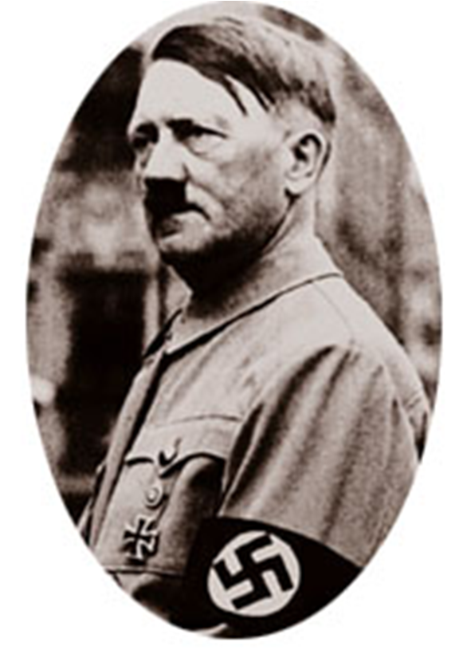
Hitler in power
Began campaign against Jews soon after becoming chancellor.
Established a series of anti-Semitic laws intended to drive Jews from Germany.
Laws stripped Jews of their citizenship and took away most civil and economic rights.

Slide 12
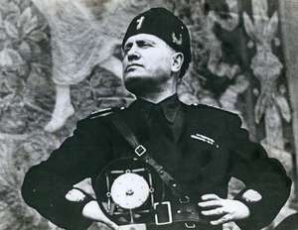
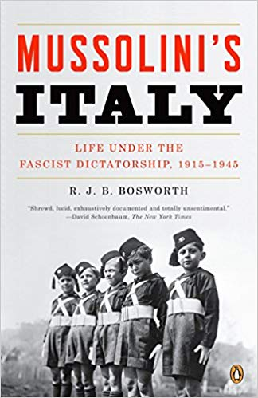
MUSSOLINI
Italian Fascism was rooted in Italian nationalism and revolutionary nationalism and the desire to restore and expand Italian territories, which Italian Fascists deemed necessary for a nation to assert its superiority and strength and to avoid succumbing to decay.
Italian Fascists also claimed that modern Italy is the heir to ancient Rome and its legacy and historically supported the creation of an Italian Empire to provide spazio vitale "living space”.

Slide 13
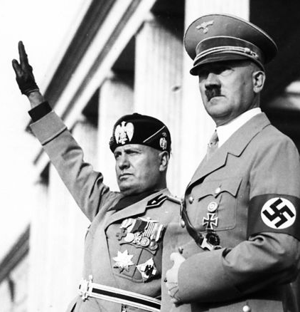
Benito Mussolini
He encouraged the use of violence against Socialists and Communists, whom many Italians blamed for the chaos of postwar Italy.
Angry over the Treaty of Versailles, he founded the National Fascist Party.
Fascism stressed the glory of the state—the rights and concerns of individuals were of little importance.
Established a dictatorship that allowed no other political parties
Had total control over daily life in a totalitarian regime

Slide 14
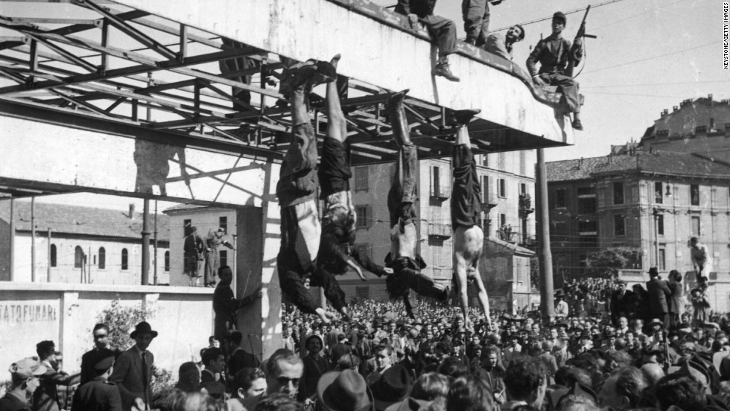
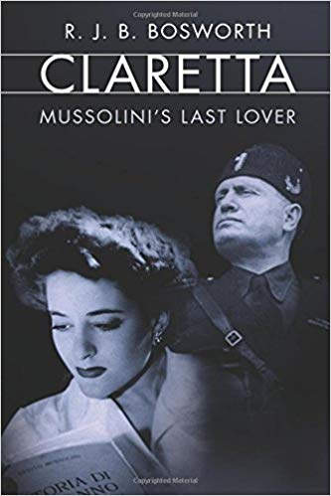
The death of Benito Mussolini, the deposed Italian fascist dictator, occurred on 28 April 1945, in the final days of World War II in Europe, when he was summarily executed by Italian partisans in the small village of Giulino di Mezzegra in northern Italy.

Slide 15
Things to know
We will have a decade day
on Fridays –
3/29- 1950’s
4/5- 1960’s
4/12- 1970’s
5/10- 1980’s
5/17- 1990’s
APUS REVIEWS
3/26- Art History
3/28- Court Cases

Slide 16
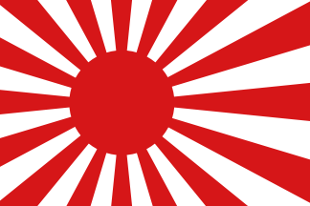
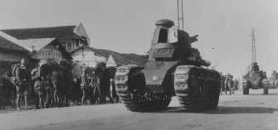
JAPANESE MILITARISM
Japan had a severe lack of natural resources.
Nearby Manchuria had plenty of coal, plus industries and ports.
China had already been carved up by the Western powers.
1910 Japan moved into Korea.
The goal was to control the entire
Pacific Rim.

Slide 17
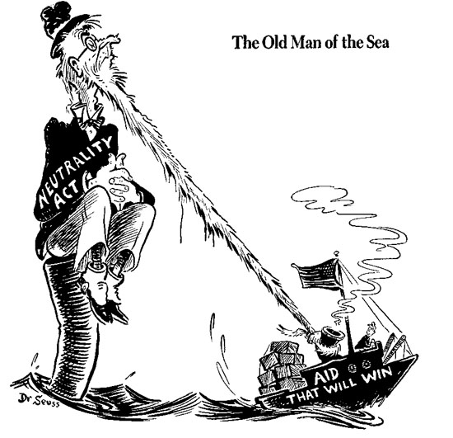
isolationism
After World War I, the United States was returning to a policy of avoiding foreign conflicts.
Isolationists discouraged the growth of the military, even though many believed the U.S. economy depended on World Peace.
In order to encourage peace and stability the U.S. took part in several international peace conferences.
Neutrality Acts: were laws passed in 1935, 1936, 1937, and 1939 to limit U.S. involvement in future wars.
They were based on the widespread disillusionment with World War I in the early 1930s and the belief that the United States had been drawn into the war through loans and trade with the Allies.

Slide 18
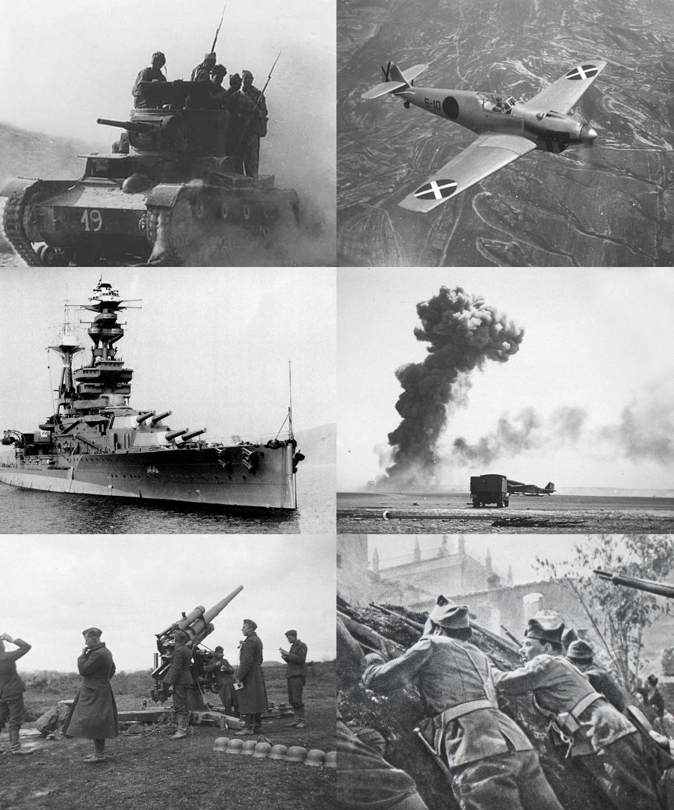
Spanish Civil War
Spanish Civil War, (1936–39), military revolt against the Republican government of Spain, supported by conservative elements within the country.
When an initial military coup failed to win control of the entire country, a bloody civil war ensued, fought with great ferocity on both sides.
The Nationalists, as the rebels were called, received aid from Fascist Italy and Nazi Germany.
The Republicans received aid from the Soviet Union, as well as from International Brigades, composed of volunteers from Europe and the United States.

Slide 19
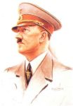
THE 1936 OLYMPIC GAMES
In 1936 the Olympic Games were held in Berlin, Germany where Hitler’s Nazi Regime had firm power.
The games were Hitler’s chance to show off his Aryan race to the world.

Slide 20
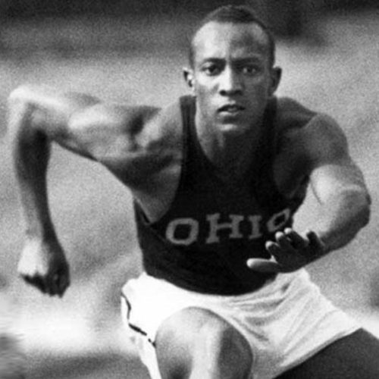
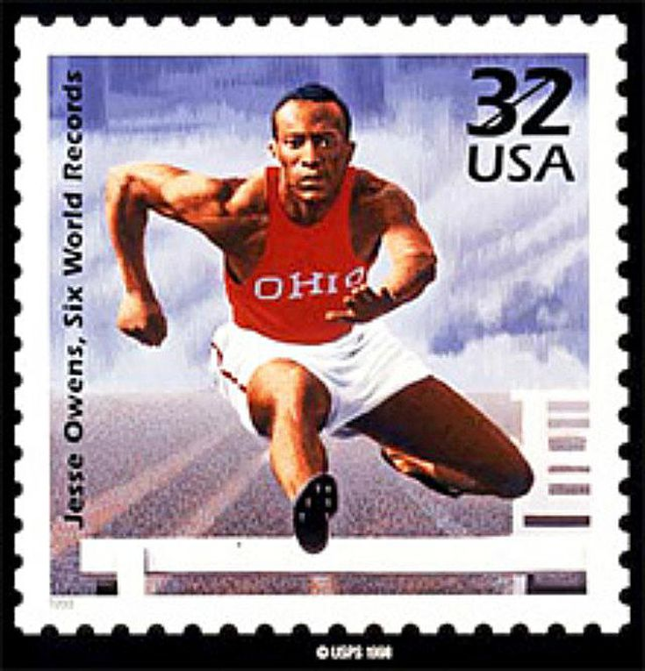
Jesse Owens
Owens grew up in the Cleveland area where he ran attended West Technical High School. He later was accepted at Ohio State University.
In May 1935, Jesse Owens had the greatest day in track and field history. He broke three world records and tied another in just one hour.

Slide 21
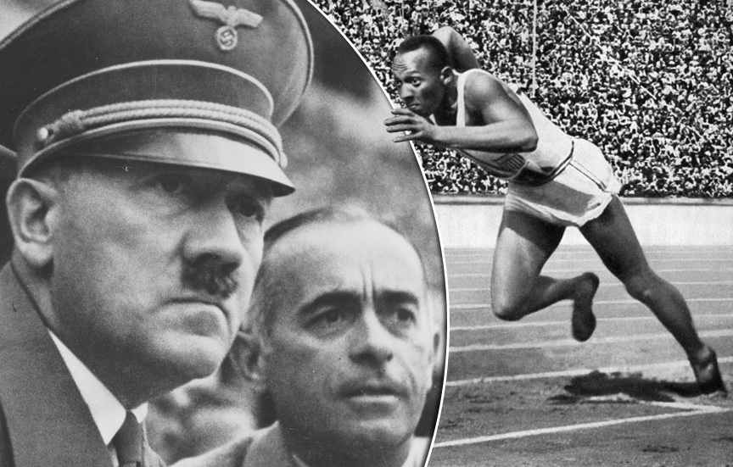
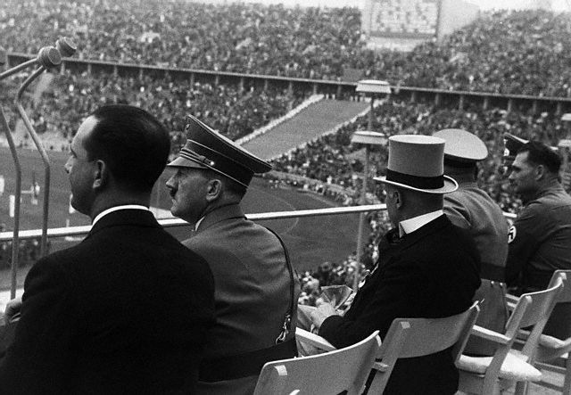
Owens in 1936
Although Owens was a favorite of the Americans and even German fans, he did not have the respect of the German officials.
The presence of Owens and his extreme athletic ability was a threat to Hitler’s ideas of Aryan supremacy.
In the first event, Owens tied the Olympic record. Hitler made no move to congratulate him as he had done with other athletes.

Slide 22
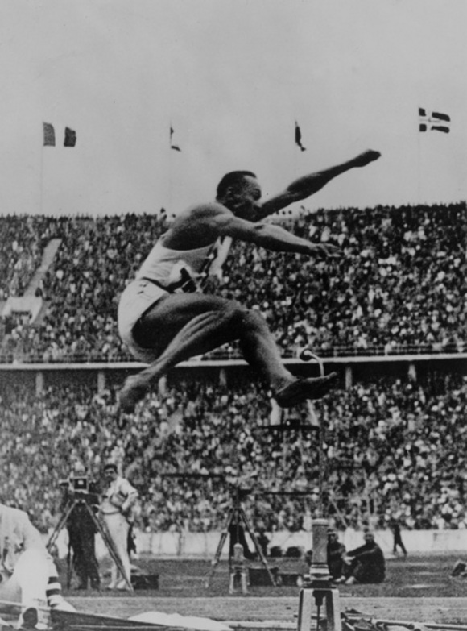
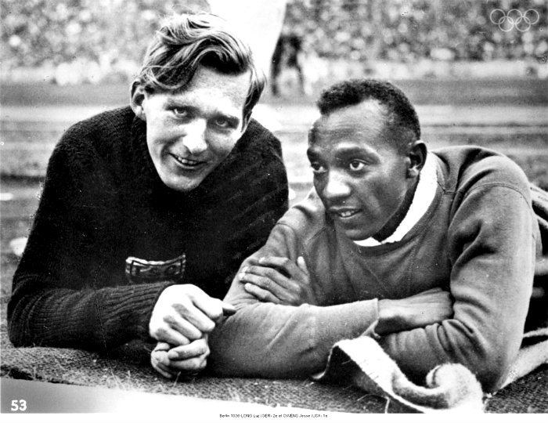
The Long Jump
The next event was the long jump. Owens had difficulty in his first two attempts and had to qualify in his third for the final round.
His opponent, Luz Long, gave him some pointers just before the jump. It was a courageous move by Long to speak to Owens in open view of Hitler and other Nazi officials.
Owens qualified and won his second gold medal with an Olympic record of 26 feet, 5 1/2 inches. A record that was not broken until Bob Beamon in 1968.

Slide 23
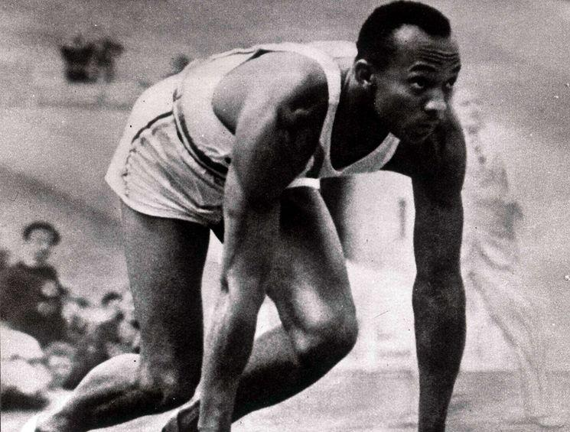
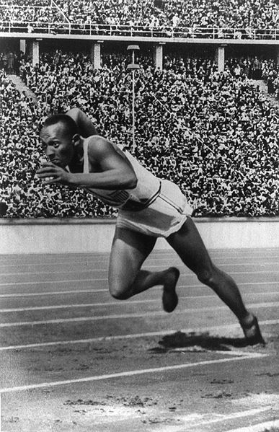
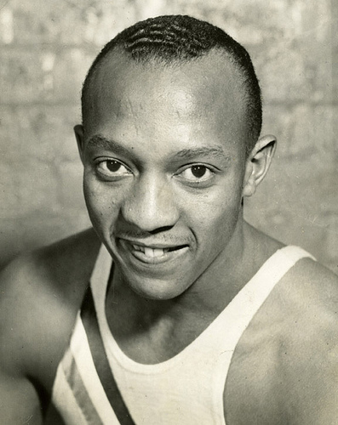

Slide 24
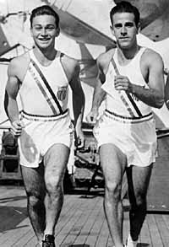
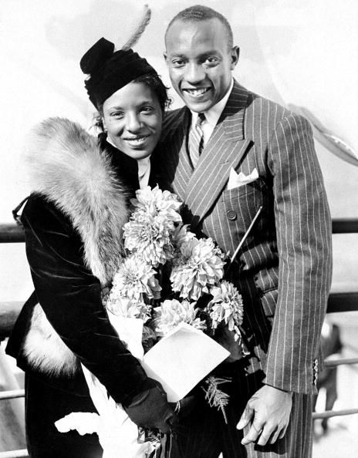
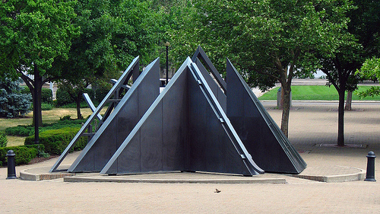
On the third day of competition, Owens won his third gold medal and another Olympic record. He won his fourth and final medal in the 4 x 100 relay.
In the 1950’s Owens was voted the greatest track and star of the first half of the century.
In 1990 he received the highest U.S. honor when President Bush awarded him with the Congressional Medal of Honor for
“his unrivaled athletic triumph, but more than that, a
triumph for all humanity.”
Marty Glickman
and
Sam Stoller

Slide 25
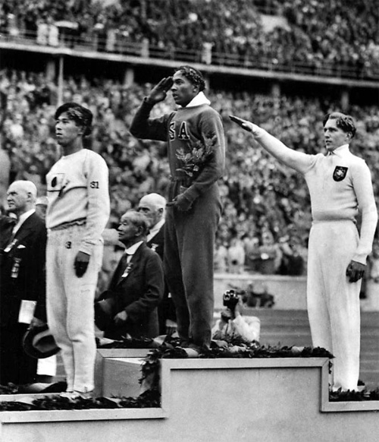
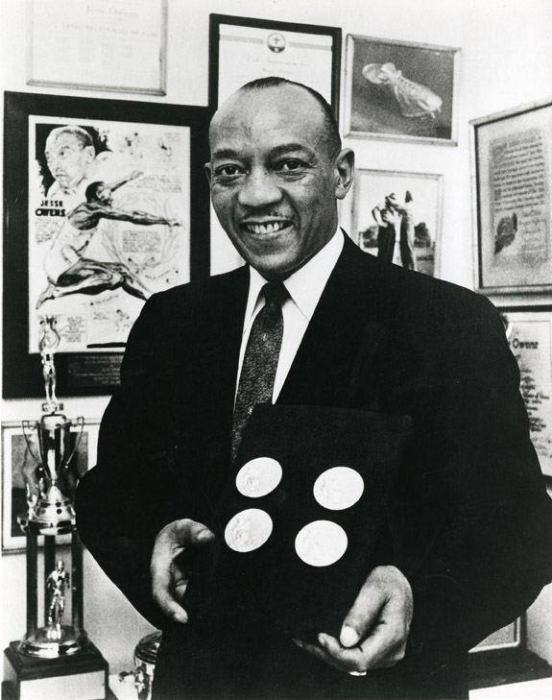
Olympic Gold

Slide 26
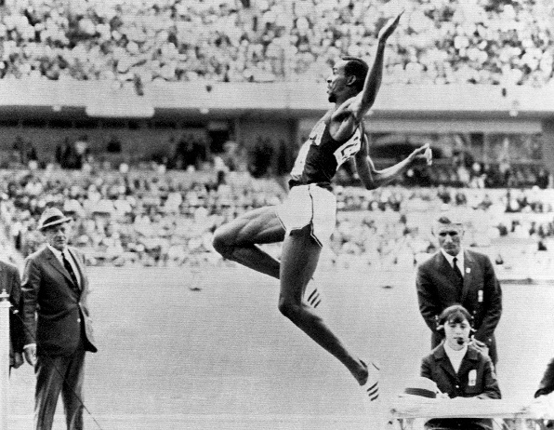
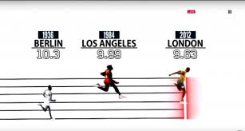
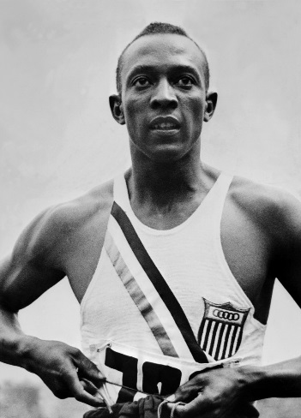
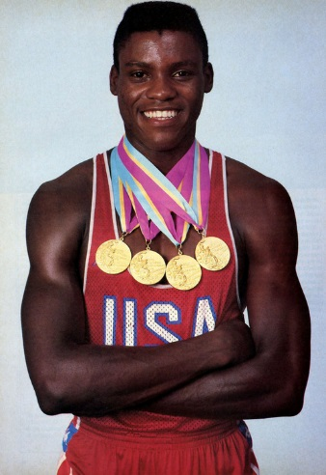
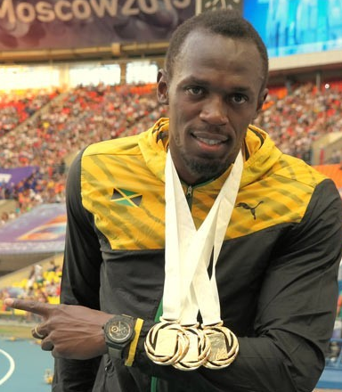
World Records
Michael Powell 1991 LJ 29ft 4 ½ inches
Bob Beamon 1968 LJ 29ft 4 ¼ inches
Jesse Owens 1936 LJ 26ft 5 ½ inches
Usain Bolt 2014 100 m 9.58 seconds
Usain Bolt 2012 100m 9.63 seconds
Carl Lewis 1984 100m 9.99
Jesse Owens 1936 100 m 10.3 seconds

Slide 27
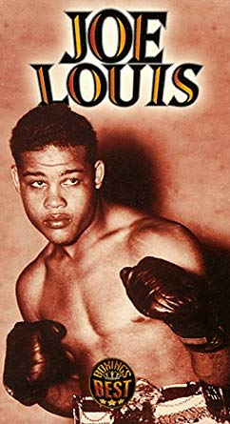
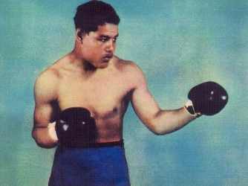
Joe Louis vs. Hitler
In 1936 Joe Louis was 22 years old and carried a perfect record of 27 wins, 0 losses, and 23 knockouts in the ring.
He reigned as the world heavyweight champion from 1937 to 1949, and is considered to be one of the greatest heavyweight boxers of all time.

Slide 28
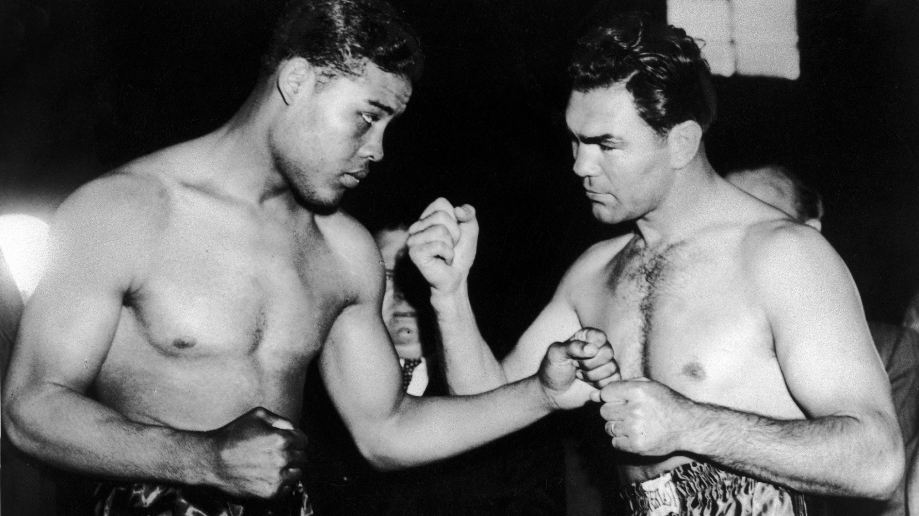
Louis vs. Schmeling
In 1936 in another attempt to prove racial superiority the Germans sent their boxer Max Schmeling to go up against Louis.
Schmeling was age 30 when the two met in Yankee Stadium.
The unthinkable happened when Schmeling beat the unbeatable Joe Louis.

Slide 29
Joe Louis
In a 1938 rematch, Louis knocked out Schmeling in the first round of the fight.
Louis went on to serve in World War II.
He is buried in Arlington National Cemetery.

Slide 30
Nazi attacks on jews
Anti-Semitism: against the Jewish religion and people.
Nuremberg Laws: took away citizenship and rights.
Discrimination and violent attacks against Jews continued. Wearing of the Star of David, Krystallnacht, public humiliation.

Slide 31
Scapegoating
Blamed the Jews for many of Germany’s problems
Hitler became Germany’s chancellor in 1933.
Set up a totalitarian dictatorship
Secretly began to build up the German military.

Slide 32
Munich Conference
In 1938 the British Prime Minister, Chamberlain, flew to Munich, Germany to talk with Hitler.
At the conference Chamberlain and the French Premier Daladier wanted to discuss Czechoslovakia.
They agreed to allow Germany to take control of the Sudetenland, a German speaking part of Czechoslovakia.
In return Hitler promised to make no more territorial advances in Europe.
Hitler’s word was worthless.

Slide 33
Why the French and British Did Not Respond:
1. The Memory of World War I: Both countries were exhausted by the first war. No one wanted to become engaged in another bloody conflict.
2. Fear of Soviet Communism: Some conservatives believed that a strong Germany would counteract the Soviets.
3. Unease With the Versailles Treaty: People felt that Germany had valid objections to the treaty.
4. Hope for Compromise with Germany: Hitler’s demands sounded reasonable and he convinced Europeans that he had limited ambitions.
Appeasement
The policy of avoiding war with Germany by giving in to some of Hitler’s demands.
When Hitler invaded Czechoslovakia Great Britain and France did not respond.

Slide 34
Stalin
Joseph Stalin was the absolute ruler of the Soviet Union for more than a quarter of a century.
During World War I, Russia suffered more casualties than any other warring nation. Food shortages developed in the cities and the country was war weary.
The Russian people turned toward Lenin and the Bolsheviks to save them from their despair. The Bolsheviks promised a quick end to the war.

Slide 35
Non-Aggression Pact
Non-Aggression Pact: agreement between Hitler and Stalin to both invade Poland and to not attack each other.
Hitler broke his nonaggression pact with Stalin and invaded the Soviet Union in 1941.
The Soviets then joined the Allies as enemies of the Axis Powers.

Slide 36
How long will the honeymoon last?
This political cartoon is about the non-aggression pact.

Slide 37
Invasion of Poland
On September 1, 1939 Germany invaded Poland without a declaration of war. This starts World War II.
Britain and France declared war on Germany on
September 3, 1939.
Italy declared war on France and Britain on June 10, 1940.
Soviet Tanks invading Poland in 1939

Slide 38
blitzkrieg
In German blitzkrieg means “lightning war”.
Hitler used blitzkrieg during his invasion of Poland.
Blitzkrieg included surprise attacks, rapid advances into enemy territory, and massive air attacks that struck and shocked the enemy.
Germany achieved most of its victories in World War II with the Blitzkrieg tactic.

Slide 39
THE DRAFT
Before the attack on Pearl Harbor there were about 1.5 million Americans serving in the armed forces.
At the end of the war there were 12 million soldiers in the U.S. military.
After Pearl Harbor many volunteered for service and as the war dragged on the Selective Service- draft will be put in place.

Slide 40
ATLANTIC CHARTER
The Atlantic Charter was a joint declaration released by U.S. President Franklin D. Roosevelt and British Prime Minister Winston Churchill on August 14, 1941 following a meeting of the two heads of state in Newfoundland.
The Atlantic Charter provided a broad statement of U.S. and British war aims.
The Charter they drafted included eight “common principles” that the United States and Great Britain would be committed to supporting in the postwar world. Both countries agreed not to seek territorial expansion.

Slide 41
BIG THREE
In World War II, the three great Allied powers—Great Britain, the United States, and the Soviet Union—formed a Grand Alliance that was the key to victory.
But the alliance partners did not share common political aims, and did not always agree on how the war should be fought.
Roosevelt, Churchill, Stalin

Slide 42
Hitler’s Aggression
Hitler will begin his plan to reunite the German speaking people’s of Europe under one Empire.
He will invade Austria without opposition. He then sets his sights on Czechoslovakia to reunite more than 3 million Germans who were living there.
The Czechs resisted Hitler’s invasion. They had a defense treaty with France, however France did not want to risk war with Germany.

Slide 43
The World at War
World War II will be fought in Europe, Asia and North Africa.

Slide 44
The World At War
The U.S. declared war on Japan, Germany declared war on the U.S.
Axis Powers: Germany, Italy, and Japan
Allies: Great Britain, Soviet Union, and the United States
*The Allies agreed that Germany posed a greater threat
than Japan so they decided on a “Europe first” policy.
*In 1941 Hitler’s army invaded the Soviet Union. German
forces swept rapidly eastward with success at first.
.

Slide 45
Japan: Invasion of China
The Japanese army gradually crept Southward, through China, fighting all the way.
By 1938 There were 1 million Japanese troops in China.
Japan could occupy only key areas and cities.
They adopted The ‘Three All Campaign’ (‘Kill all, burn all, destroy all’)
Many Chinese cities lay in ruins.

Slide 46
A baby caught up in the bombing of a Shanghai railway station

Slide 47
Lend Lease Program
Roosevelt wanted desperately to help the British fend off Germany.
Due to American neutrality laws he could not sell weapons to only the British.
To get around the law, Roosevelt had Congress pass the Lend Lease Act.
This allowed the U.S. to lend or lease materials to the British. (not sell)
The term “ARSENAL OF DEMOCRACY”
was coined to describe the roll the U.S.
played as the supplier of weapons and materials.

Slide 49
Road to pearl harbor
U.S. freezes Japanese assets and starts embargo
U.S. cuts off sale of airplane fuel to Japan and cuts back on other natural resources.
Great Britain and the Dutch East Indies also participate in the embargo.
Japan cut off from its major source of oil
66.4 percent of imports came from Anglo-Americans
Over 80 percent of its oil came from U.S.
Japanese Navy’s oil reserves (2 years)
Planned for war after August 1, 1941
The longer Japan waited the worse its economic and military situation would become.

Slide 50
Emperor Hirohito Hideki tojo
He had complete control over, and commanded complete loyalty from his subjects.
Prime Minister of Japan and primary military leader was Hideki Tojo.

Slide 51
PEARL HARBOR

Slide 52
The plan
Japanese military leaders recognized American naval strength as the chief deterrent to war with the United States.
Early in 1941, Admiral Yamamoto, Commander of the Japanese Combined Fleet, had initiated planning for a surprise attack on the United States Pacific Fleet at the beginning of any hostilities that the Japanese might undertake.

Slide 53
PEARL HARBOR
The assumption was that before the United States could recover from a surprise blow, the Japanese would be able to seize all their objectives in the Far East, and could then hold out indefinitely.
17 Ships were damaged, 14 were returned to service.
Battleships:
Arizona: hit by four armor-piercing bombs, exploded; total loss. 1,177 dead.
Oklahoma: hit by five torpedoes, capsized; total loss. 429 dead.
West Virginia: hit by two bombs, seven torpedoes, sunk; returned to service July 1944. 106 dead.
California: hit by two bombs, two torpedoes, sunk; returned to service January 1944. 100 dead.
Nevada: hit by six bombs, one torpedo, beached; returned to service October 1942. 60 dead.
Pennsylvania hit by one bomb and debris from USS Cassin; remained in service. 9 dead.
Tennessee: hit by two bombs; returned to service February 1942. 5 dead.
Maryland: hit by two bombs; returned to service February 1942. 4 dead

Slide 56
Ariel View of Pearl Harbor

Slide 57
Pearl harbor
All together the Japanese sank or severely damaged 18 ships, including the 8 battleships, three light cruisers, and three destroyers.
On the airfields the Japanese destroyed 161 American planes (Army 74, Navy 87) and seriously damaged 102 (Army 71, Navy 31).

Slide 58
A date which will live in infamy
On December 8, 1941, within less than an hour after a stirring, six-minute address by President Franklin D. Roosevelt.
Congress voted, with only one member dissenting, that a state of war existed between the United States and Japan, and empowered the President to wage war with all the resources of the country.

Slide 59
“There they will live in centers encircled with barbed wire and watch towers. Guards are instructed to shoot anyone who tries to leave. All of this is taking place despite the fact that there have been no criminal charges.”

Slide 60
Japanese Relocation
Executive Order 9066: the internment or imprisonment of Japanese Americans into camps.
In February 1942 politicians and army officials urged Roosevelt to sign the order due to post Pearl Harbor hysteria.

Slide 61
Quotes from the Military:
“The Japanese are an enemy race and while many second and third generation Japanese were born on American soil, possess United States citizenship, and have become “Americanized”, the racial strains are undiluted.”
“The very fact that no sabotage has taken place to date is a disturbing and confirming indication that such action will be taken.”
-U.S. Army

Slide 62
The Relocation:
The War Relocation Authority was responsible for the relocation of anyone with as little as 1/16th Japanese ancestry.
People were given 10 days to sell their property, close their businesses and bring what they could carry.

Slide 63
Trains to the Camps

Slide 64
Most Camps were in the West:
The majority of Japanese population was already in the West.
The camps were far away from major cities.
The camps were away from Washington D.C.
In remote areas where Americans would not see what was going on in the camps.

Slide 65
Camps were crowded with very little privacy.
Often times whole families were living in one small room.

Slide 66
Many innocent people lost their property and businesses during the internment.

Slide 68
Some were in internment camps: but others served in the armed forces
The 442nd Army Regiment was one of the most decorated of WW II
Its members fought in many capacities: front line combat, translating, nursing, etc.

Slide 69
Korematsu v. u.s.
Question: Did the President and Congress go beyond their war powers by implementing exclusion and restricting the rights of Americans of Japanese descent?
Over 100,000 Issei and Nisei were placed in the camps. 2/3rds of them were naturalized or native born citizens.
The ruling in the case was that the Supreme Court upheld the evacuation as constitutional. They were unable to win any substantial compensation for their imprisonment until the 1980’s.
President Bill Clinton awarded the Presidential Medal of Freedom, the highest civilian honor in the United States, to Korematsu in 1998, saying:
"In the long history of our country's constant search for justice, some names of ordinary citizens stand for millions of souls: Plessy, Brown, Parks ... to that distinguished list, today we add the name of Fred Korematsu."

Slide 70
Manzanar Relocation Camp
Camps were located far from the West Coast
For 4 years 112,000 Japanese Americans were interned in camps like this with no trial and no right of appeal.
The US government formally apologized and offered small reparation payments to interned citizens in 1987.

Slide 71
guadalcanal
The Guadalcanal Campaign, also known as the Battle of Guadalcanal and codenamed Operation Watchtower by American forces, was a military campaign fought between 7 August 1942 and 9 February 1943 on and around the island of Guadalcanal in the Pacific theater of World War II.
It was the first major offensive by Allied forces against the Empire of Japan.

Slide 72
Europe first
The Big Three went with a Europe First policy. It was deemed that Hitler was a bigger threat than Japan.
Roosevelt, Churchill, and Stalin met for the first time in 1943.
Roosevelt wanted to cross the English Channel and finish off the Germans.
Churchill wanted to attack Southeastern Europe first. He feared that if the Soviet army arrived from the West first the British would lose their influence.

Slide 73
General eisenhower
During World War II, he was a five-star general in the United States Army and served as supreme commander of the Allied Expeditionary Forces in Europe.

Slide 74
stalingrad
The Battle of Stalingrad was a brutal military campaign between Russian forces and those of Nazi Germany and the Axis powers during World War II.
The battle is infamous as one of the largest, longest and bloodiest engagements in modern warfare:
From August 1942 through February 1943, more than two million troops fought in close quarters – and nearly two million people were killed or injured in the fighting, including tens of thousands of Russian civilians.
But the Battle of Stalingrad (one of Russia’s important industrial cities) ultimately turned the tide of World War II in favor of the Allied forces.

Slide 75
Opa- office of price administration
The Office of Price Administration (OPA) was established within the Office for Emergency Management of the United States government by Executive Order 8875 on August 28, 1941.
The functions of the OPA were originally to control money (price controls) and rents after the outbreak of World War II.

Slide 76
A. Philip Randolph
A. Philip Randolph organizes a “March on Washington.”
Roosevelt issues executive order 8802 requiring equal pay in war industries

Slide 77
Double V Campaign
James Thompson of PA wrote to the newspapers about being drafted.
He suggested a Double V Campaign. The symbol stood for victory at war over enemies 'from without,' and victory at home against the enemy of prejudice 'from within.

Slide 78
Race riots
With many African Americans moving from the South to the North to find war industry jobs, racial tension increased in the cities.
1943 Detroit race riot. The 1943 Detroit race riot took place inDetroit, Michigan, of the United States, from the evening of June 20 through the early morning of June 22. The race riot was ultimately suppressed by the use of 6,000 federal troops.

Slide 79
Congress on racial equality
The Congress on Racial Equality organized in 1942 to challenge segregation.
Several young African Americans like James Farmer, who helped found the organization helped organize the sit-ins and freedom rides in the 1960’s.
Pressure grew for change in the military.
The armed services maintained their traditional practice of only allowing African Americans to serve doing menial jobs and in segregated troops.

Slide 80
Native americans
As many as 25,000 Native Americans actively fought in World War II: 21,767 in the Army, 1,910 in the Navy, 874 in the Marines, 121 in the Coast Guard, and several hundred Native American women as nurses.
The name code talkers is strongly associated with bilingual Navajo speakers specially recruited during World War II by the US Marine Corps to serve in their standard communications units of the Pacific theater.
Code talking, however, was pioneered by the Cherokee and Choctaw peoples during World War I.

Slide 81
Mexican americans
Hispanic Americans, also referred to as Latinos, served in all elements of the American armed forces in the war. They fought in every major American battle in the war.
They were not kept in statistics as separate from whites, as African Americans and Asian Americans were.
Many Hispanic women also served the country by working in the factories and belonging to WWII women’s groups like the WAACS and WAVES.

Slide 82
Zoot suit riots
During the 1930s and 40s, many Latino youths in the Southwestern U.S. developed their own sub-culture, which included distinctive fashions, music, and slang.
These youths, rebelling both against Anglo culture and even against elements of their own culture, called themselves Pachucos.
To the white community, Pachuco culture soon became synonymous with gang culture, and social tensions threatened to erupt in several urban areas.
On the night of June 3, 1943, eleven U.S. Navy sailors on shore leave in Los Angeles claimed they were attacked by a “group of Mexican kids.”

Slide 83
Chinese americans
It has been estimated that between 12,000 and 20,000 Chinese-American men, representing up to 22 percent of the men in their portion of the U.S. population, served during World War II.
Of those serving about 40 percent were not citizens, and unlike Japanese and Filipino Americans, 75 percent served in non-segregated units.
Chinese Americans distinguished themselves from Japanese Americans, and suffered less discrimination.

Slide 84
Wartime Industry
Factories that made cars now made tanks or planes.
The Ford Plant opened a factory specifically for wartime production of bombers.
When the factory was running smoothly they could produce 340 planes in one month.
Factories that made shirts now made mosquito netting or uniforms.

Slide 85
Wartime Workforce
The wartime employment ended the problems of the Great Depression.
Two weeks after the bombing of Pearl Harbor labor and business leaders agreed to stop all strikes and labor lockouts.
Even with the agreement the number of strikes rose sharply between 1942-1943
Lockout: employer keeps all the employees out of the workplace in order to avoid meeting their demands.

Slide 86
WAR PRODUCTION BOARD
The country will put all of its resources toward the war effort.
The government will take control of the wartime economy and all citizens will be asked to help.
Roosevelt will create the War Production Board.
As the war continued, industries in the United States made the shift from peacetime to wartime production.
This board will decide what needs to be made and how it will be distributed.

Slide 87
Wildcat Strike
Wildcat strikes are strikes that are organized by the workers not the labor unions.
The federal courts have held that wildcat strikes are illegal and that employers may fire workers participating in them.

Slide 88
Liberty Ships
Henry J. Kaiser perfected mass production of ships.
Liberty Ships: these vessels made Kaiser famous.

Slide 89
Financing the War
Wartime production was so vital that the United States was willing to pay whatever was necessary.
Federal spending increased from 8.9 billion to 95.2 billion.
In order to pay for the high cost of the war people were encouraged to purchase war bonds.
War Bond: government savings bonds that helped to finance the war.

Slide 90
Deficit Spending
The government was spending borrowed money during the Great Depression.
The borrowing skyrocketed during World War II.
Deficit spending is when you spend more than what you are taking in.

Slide 91
Every scrap of metal and rubber is needed for our weapons
RATIONING
Children collect all kinds of metal to recycle: tin cans, old garden tools, even old cooking pots
Rubber boots, hoses, old tires, even rubber bands are saved
Paper can be recycled too!

Slide 92
Victory Gardens: If we grow for our homes, farmers can grow for our armed forces.

Slide 93
Office of War Information
The Office of War Information (OWI) was one of the numerous government bureaucracies created by the total mobilization effort of the Victory Program.
OWI was to undertake campaigns to enhance public understanding of the war at home and abroad; to coordinate government information activities; and to handle liaison with the press, radio, and motion pictures.

Slide 94
Hollywood goes to war
There was deep disagreement within the film-making community as to the stance towards the war that should be taken by one of America's most lucrative industries.
Hollywood Goes to War reveals the powerful role played by President Franklin D. Roosevelt's Office of War Information—staffed by some of America's most famous intellectuals in shaping the films that were released during the war years.
Efforts were made to promote the war in a positive light and keep Americans in support of the war effort.
Celluloid War: the sanitized version of the war offered by Hollywood.

Slide 95
Books and Movies
Films like Casablanca genuinely attempted to inform the movie going audience of the causes of and reasons for the war.
Paperback books were popularized by Robert De Graf.

Slide 96
The uso
The United Service Organizations Inc. is a nonprofit-charitable corporation that provides live entertainment, such as comedians, actors and musicians, social facilities, and other programs to members of the United States Armed Forces and their families.
Bob Hope
The Andrew’s Sisters

Slide 97
Wartime Music
Big Band music was very popular during this time period.
Any music that focused on the topic of the military or patriotism was also popular.
The Andrew’s Sisters and Glenn Miller were popular.
The Andrews Sisters

Slide 98
WOMEN AND THE WAR
With the outbreak of war, many jobs that were once filled by men were now left open.
Women were needed to replace the vacant positions.

Slide 99
The symbol of the strength, determination and courage of all these women is called “Rosie the Riveter.”
Rosie the Riveter came to symbolize working women across the country.
Rosie was used in propaganda.

Slide 100
Problems for Working Women
Women often times would face hostile reactions from male workers.
Managers would create strict rules about male and female workers.
Daycare centers were scarce.
Women earned much less than men did doing the same jobs.

Slide 101
waacs
waves
The Women's Army Corps was the women's branch of the United States Army. It was created as an auxiliary unit, the Women's Army Auxiliary Corps on 15 May 1942 by Public Law 554, and converted to an active duty status in the Army of the United States as the WAC on 1 July 1943.
The United States Naval Reserve, better known as the WAVES, was the women's branch of the United States Naval Reserve during World War II. It was established on July 21, 1942 by the U.S. Congress and signed into law by President Franklin D. Roosevelt on July 30.

Slide 102
Wartime conservatism
Through 1942 and 1943 America was becoming increasingly politically conservative on the home front. In times of war and faced with uncertainty, people are often less open to accepting new political or social ideas.
The focus is on winning the war and protecting closely held traditional social beliefs.
Opposed to federal planning, spending, and social programs, the conservative Congress went to work cutting back the smaller and more vulnerable New Deal programs that still existed from the previous decade.

Slide 103
How will we pay for all the weapons, ammunition and men?
Taxes will go up.
People at home will loan their money to the government to finance the war
These loans are called “liberty bonds.”

Slide 105
Wartime Sports
In 1943, The United States was in full force fighting in World War II.
P.K. Wrigley received word from President Franklin Delano Roosevelt that the 1943 Major League baseball season might be suspended due to manpower shortage.
He wanted Wrigley to do something to keep the baseball game going until the men got home from service.

Slide 106
League of Their Own
Women have been playing professional baseball since the 1940's, yet it wasn't really a well know fact until the 1992 Penny Marshall movie, "A League of Their Own", starring Tom Hanks, that put these women in the public eye.

Slide 107
Women’s Baseball featured in the Hall of Fame
The league lasted from 1943 - 1954. In 1948, the league drew a record 910,000 fans for the 10 team league.
The All American Girls Professional Baseball League memorabilia was enshrined in the Cooperstown, New York Hall of Fame on November 5, 1988.
Over 550 names are on a plaque in the exhibit named "WOMEN IN BASEBALL".

Slide 108
The invasion of France was the largest seaborne invasion in history.
June 6, 1944, 160,000 Allied troops landed along a 50-mile stretch of heavily-fortified French coastline to fight Nazi Germany on the beaches of Normandy, France.

Slide 109
Operation Overlord
The Big Three finally agreed on an invasion of France.
The invasion took the code name “Operation Overlord”.
As the date approached nearly 3 million soldiers, sailors, and airmen crowed the Southern tip of England.

Slide 110
The Allies could not keep it a secret that an invasion was planned.
They could keep the Germans guessing when and where they would invade.
Through false radio transmissions the Germans believed that the Allies would cross into Norway or at the closest point on the English Channel.

Slide 112
Soldier travelled across the English Channel in Higgins boats.
The D-Day cost was high -more than 9,000 Allied Soldiers were killed or wounded -- but more than 100,000 Soldiers began the march across Europe to defeat Hitler.

Slide 113
At dawn, 11,000 planes provided air cover as the first wave of Allied troops stormed the shore.
The Allies landed more than 300,000 men in the first week alone. Within one month there were over 1 million Allied Forces in France.

Slide 115
German Fortification

Slide 116
Battle of the Bulge
By the winter of 1944 the Allies were closing in on Hitler from both sides. The British and Americans from the West and the Soviets from the East.
Germany made one last ditch effort to plan a counter attack.
A huge bulge was created in the front lines. The Allies were able to regroup and drive the Germans back

Slide 117
V.E. Day!
On April 25, 1945 American and Soviet troops met near the Elbe River, 60 miles south of Berlin. A few days later Hitler committed suicide.
On May 7th the Germans signed a unconditional surrender. People around the world celebrated V-E Day. Victory in Europe Day.

Slide 118
New York City on May 8th.

Slide 119
Yalta Conference
In February of 1945, Roosevelt, Churchill, and Stalin met at Yalta, a Soviet resort to discuss plans for the future.
*Roosevelt’s top priority was to create a new international body to help solve world disputes without war.
The League of Nations had failed because it lacked support from all of the world’s major powers.

Slide 120
A Secret Deal with Stalin
Roosevelt also worked out a secret pledge from Stalin that the Soviet Union would declare war on Japan after Germany surrendered.
This agreement was important to the United States in case it was necessary to invade the Japanese mainland.
It is widely believed that if there was to be a invasion of Japan there would be an estimated 1 million deaths on the Allied side.

Slide 121
Death of Roosevelt
At the Yalta Conference it was evident that Roosevelt’s health had deteriorated.
On April 12, 1945 Roosevelt died of a stroke. The death of the President was mourned all over the nation. Many had not known any other leader.

Slide 122
The American people were devastated by the death of the president. He served for 12 ½ years.

Slide 123
Roosevelt Memorial

Slide 126
Japanese Balloon Bombs

Slide 127
On to Japan...

Slide 128
War against japan
When the United States had to surrender the Philippine
Islands it seemed that Japan was unbeatable.
The Japanese navy had three times as many ships as the United States. They were poised to invade Australia and even possibly the United States.

Slide 129
Bataan death march
In the early part of the war Japan had success in their attack on Pearl Harbor and other offensives against the United States and Great Britain throughout the Pacific.
The Japanese seized Manila, the capital of the Philippines from the United States.
American and Filipino troops had to withdraw to Bataan Peninsula and Corrigidor Island.

Slide 130
Battle of midway
In 1942, a Japanese armada of more than 100 ships attacked an American navel base on Midway Island.
Midway was a steppingstone on the way to the Hawaiian Islands.
The fleet led by Yamamoto had five aircraft carriers that were loaded with hundreds of warplanes.
The United States was able to intercept and decode messages that allowed them to pinpoint the Japanese fleet.
In a matter of minutes four Japanese carriers were destroyed and the fleet had to retreat.
Winning this battle was viewed as a turning point.

Slide 131
Island hopping
The Allies used a strategy called island-hopping.
Instead of planning to invade every island controlled by the Japanese the Allies only focused on a few strategic ones.

Slide 132
KAMIKAZES
Kamikaze- the word means Divine Wind’.
It became obvious that the US possessed more and better war technology
In desperation Japan ordered her young men to beat the enemy by flying bombs into the enemy (and dying in the process)
These suicide bombers flew planes, or manned suicide torpedoes.

Slide 133
kamikazes
The idea of suicide attacks was not new to the war in 1944 when in an act of desperation, the Minister of the
Japanese Navy gave permission for the first planned Kamikaze attacks.
Japanese pilots had been crashing their planes into Allied ships and aircraft throughout the war.
In the initial attacks were individual acts of pilots with damaged aircraft with no hope of returning to their airbase.

Slide 134
To the Japanese, success and death were the only honorable options.
At first the pilots were volunteers, later pilots were ordered to carry out the mission.

Slide 135
Soldiers, highly skilled in attack, defense, and jungle warfare.
Highly motivated to defend their Emperor and their land to the death.

Slide 136
The pilots were seen as extreme nationalists. Most of them were born between 1912-1926 and had gone through a brainwashing education. They were products of militaristic Japan.
The Kamikaze would leave for his mission with only enough fuel to get there. His goal was to cause as much damage as possible to the enemy ships.

Slide 137
Iwo jima
In February of 1945 the U.S. marines landed on the island of Iwo Jima.
They did not have air cover as they advanced against the well hid Japanese.
As the marines were victorious in the bloody battle they place a flag on the top of Mount Suribachi. The scene was captured in pictures and later became memorial in Washington D.C.

Slide 139
okinawa
Okinawa was the next steppingstone on the way toward Japan.
The battle became the bloodiest in the Pacific with 110,000 Japanese and 12,000 Americans killed.
Once Okinawa was captured it provided the United States with needed air bases close to Japan. This would be useful for air raids if Japan was invaded.
American pilots began systematic fire bombings over Japan.

Slide 140
Firebombing
Firebombing is a bombing technique designed to damage a target, generally an urban area, through the use of fire, caused by incendiary devices, rather than from the blast effect of large bombs.

Slide 141
Tuskegee Airmen
The Tuskegee Airmen prove they can fly fighter jets and earn international respect

Slide 142
Courage in Battle
The Tuskegee Airmen were the first African American military aviators in the United States armed forces. During World War II.
The American military was racially segregated.
The Tuskegee Airmen were subject to racial discrimination, both within and outside the army. Despite these adversities, they flew with distinction. They were particularly successful in their missions as bomber escorts in Europe.
Luftwaffe awarded these airmen the nickname, "Schwarze Vogelmenschen," or "Black Birdmen."

Slide 143
Harry S. Truman
When Truman became President he had only been the vice president for a few short months. Truman had been left out of many of the key decisions of the war.
The Nazi officials believed that the death of Roosevelt was a turning point in the war.

Slide 144
potsdam
The Potsdam Conference was held at sea between Truman, Churchill, and Stalin.
During this conference the Big Three discussed what to do about Japan and plans to rebuild Europe.
At the time of this conference the United States was testing the atomic bomb in the desert.

Slide 145
??? Albert Einstein
Albert Einstein escaped from Germany in the 1930’s.
In 1939, President Roosevelt received a letter from Einstein suggesting that the Germans may be working on a powerful new weapon.

Slide 146
The Manhattan Project
Roosevelt became concerned about the German completion of such a weapon and ordered the secret Manhattan Project to begin.
Several science students from Harvard were given orders to report to a military compound in New Mexico.
The head of the project was Robert Oppenheimer.

Slide 148
Why not drop it on the Germans?
Oppenheimer was uncertain of the power of the bomb and suggested a demonstration be done.

Slide 149
Reasons to drop the bomb
1. End the war quickly with minimal casualties.
2. End the war before Stalin and Soviets got involved.
3. Show of power to the rest of the world.
4. To see what it can do.

Slide 150
The bomb explodes above the center of the city.
Everything at ground zero is swept and instantly incinerated.

Slide 151
Three Effects of the Bomb
Blast or pressure (as from a demolition bomb).
Heat (which is present in other explosions, as the familiar injuries known as "flash burns" on warships illustrate, but ordinarily not at high enough diffused temperatures to burn a man or set fire to combustible objects at any considerable distance from the explosion).
Radiation (similar to X-rays or to that from radium).

Slide 152
Blast Shadows

Slide 153
In this photo on display at the Atomic Testing Museum, heat from an atomic bomb caused the shadow of a man and a ladder to appear on a wooden wall.

Slide 155
Hiroshima Fire Department

Slide 156
Nakamura-San

Slide 157
Japanese Surrender
V.J. Day

Slide 158
Immediate effects
1. The defeat of the Axis Powers
2. The founding of the United Nations
United Nations: The UN was and organization that was
the idea of President Roosevelt to help serve as a police
force for the world.

Slide 159
Long term effects
1. The United States becomes a global power.
2. The Soviet Union dominates Eastern Europe.
3. The Cold War
*The end of World War II left the world with two dominant
powers: The United States and the Soviet Union.
*The Soviet Union had enormous military strength and the
United States had its hands on a new weapon which
confirmed its power.

Slide 160
Eleanor roosevelt

Slide 161
Un commission on human rights

